Slide 1
Pátý týden Czech for Foreign MU Staff: Beginners 1
Fifth week

Slide 2
Jděte! Walk! (on foot) Musíte jít
Jeďte! Go! (by vehicle) Musíte jet
FORMAL „vy“ communication
Jdi! Walk! (on foot) Musíš jít
Jeď! Go! (by vehicle) Musíš jet
INFORMAL „ty“ communication
This is the verb‘s order (imperative) form but is also used for directions. In English imperative has the same form as infinitive.
Uč. str. 16, cv. 11

Slide 3
Something useful ☺
How to say: Do you want to sit down in Czech?
Chcete si sednout? (formal)
CHTÍT = WANT
SEDNOUT SI = SIT DOWN, TAKE A SEAT
How to say: Excuse me in Czech when you want to get off the bus/tram?
S dovolením! = with permission; TO DOVOLENÍ, 7th case

Slide 4
Í konjugace sloves + MÍT (to have) regular and somehow irregular verbs

Slide 5
DĚLAT → DĚLÁM (Á VERBS, infinitiv ends with -at) = TO DO
ROZUMĚT → ROZUMÍM (Í VERBS, infinitiv ends with –et, -it. –ět + jíst, spát, stát) = TO UNDERSTAND
PRACOVAT → PRACUJU (UJ VERBS, infinitiv ends with –ovat) = TO WORK
Infinitiv
type of verb
the stem
the ending for já

Slide 6
Stem + type of verb + ending
Á verbs
Endings for
1., 2., 3. person
Í verbs
Endings for
1., 2., 3. person
UJ verbs
Endings for
1., 2., 3. person

Slide 7
Somehow irregular verbs: jíst (to eat), spát (to sleep), stát (to stand), mít (to have), you have to remember the infinitive and first person.
Infinitive ends with –ít
First person mám →
Á verb + endings

Slide 8
Infinitive ends with –át
First person spím →
Í verb

Slide 9
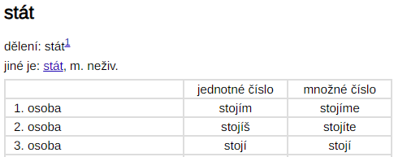
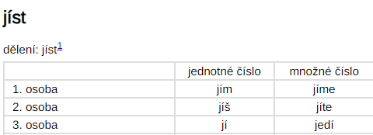
Infinitive ends with –át
First person stojím →
Í verb
Infinitive ends with –ít
First person jím →
Í verb

Slide 10
Uč. str. 17/1 (audio)
Uč. str. 17/2
Uč. str. 17/3
Uč. str. 17/4

Slide 11
Čísla 11–100
Numbers
Uč. str. 18/1 (AUDIO) (AUDIO)

Slide 12
-NÁCT | -CET, -DESÁT | STĚ, STA, SET
11 JEDENÁCT | 20 DVACET | 100 STO | 1000 TISÍC
12 DVANÁCT | 30 TŘICET | 200 DVĚ STĚ
13 TŘINÁCT | 40 ČTYŘICET | 300 TŘI STA
14 ČTRNÁCT |  | 400 ČTYŘI STA
15 PATNÁCT | 50 PADESÁT | 500 PĚT SET
16 ŠESTNÁCT | 60 ŠEDESÁT | 600 ŠEST SET
17 SEDMNÁCT | 70 SEDMDESÁT | 700 SEDM SET
18 OSMNÁCT | 80 OSMDESÁT | 800 OSM SET
19 DEVATENÁCT | 90 DEVADESÁT | 900 DEVĚT SET
41 = ČTYŘICET JEDNA
25 = DVACET PĚT

