Slide 1
RADIO FREE EUROPE RADIO LIBERTY
Zuzana Holubová

Slide 2
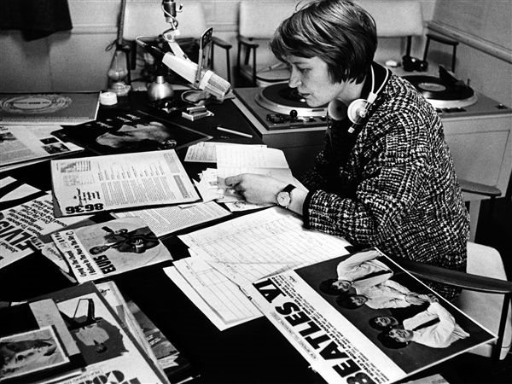
Contents
Data
History
Today

Slide 3
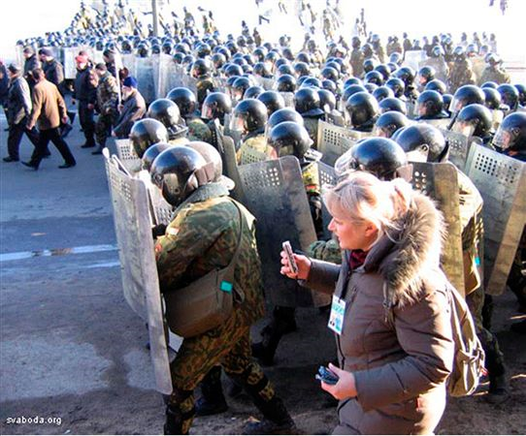
What is Radio Free Europe (RFE)?
one of the most comprehensive media organizations in the world
produce radio, Internet and television programs in countries where a free press is either banned by the government or not fully established
provide uncensored news, responsible discussion, and open debate

Slide 4
Datas
Platforms: Radio, Internet, Television
Audience: 24.6 million/week (radio, web, streaming audio)
Employees: 500 at Prague headquarters and Washington office; 400 full-time journalists and 750 freelancers
Budget: $83,000,000
Countries: 20
Languages: 28

Slide 5
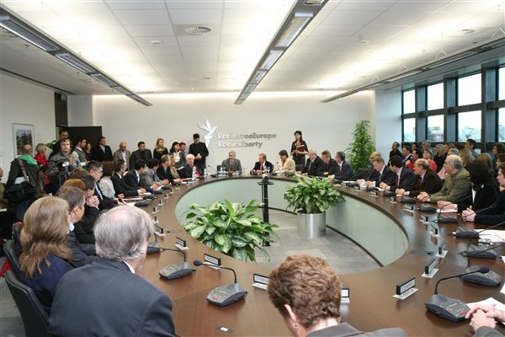
Type of organization
RFE/RL is a private, nonprofit corporation
President: Jeffrey Gedmin named in 2007
funded by the U.S. Congress through the Broadcasting Board of Governors (BBG) (includes Voice
of America,
Radio Free Asia)

Slide 6
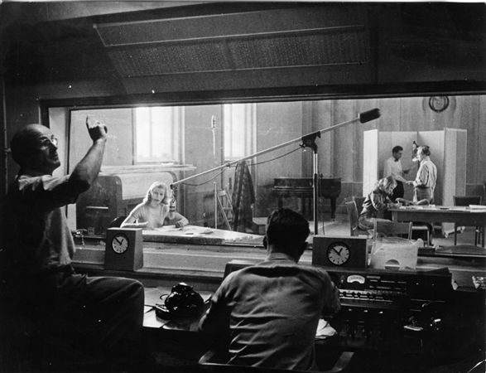
HISTORY
RFE and RL originally
separate organizations
founded in 1950,
broadcast to Bulgaria, Czechoslovakia, Hungary, Poland and Romania
three years later RL began broadcast to the Soviet Union
broadcasts to Estonia, Latvia, and Lithuania in 1976
the two corporations were merged into RFE/RL, Inc. in 1976

Slide 7
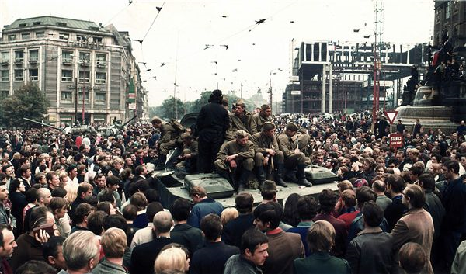
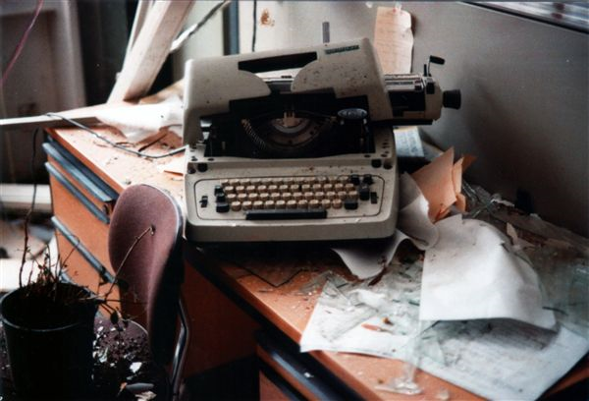
The period of the Iron Curtain
provided an unbiased, professional substitute for the free media
the programs focused on local news not covered in state-controlled domestic media as well as religion, science, sports, Western music and locally banned literature and music
the programs were produced primarily at the radios’ Munich headquarters and broadcast from Germany, Spain, Portugal

Slide 8
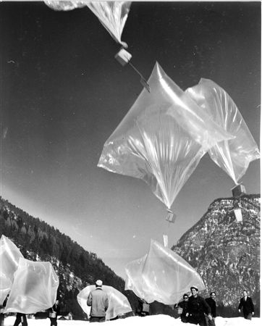
Personalities
Ferdinand Peroutka, Pavel Tigrid, Karel Kryl, Yvonne Přenosilová, Jožka Pejskar, Jaroslav Pecháček (“baloon information“)

Slide 9
After the Velvet revolution
the Hungarian service was closed in 1993
the Polish service in 1997
the Czech broadcasts ended in 2002
broadcasts to Estonia, Latvia, Lithuania, Slovakia, and Bulgaria were closed in 2004
broadcasts to Romania ended in 2008

Slide 10
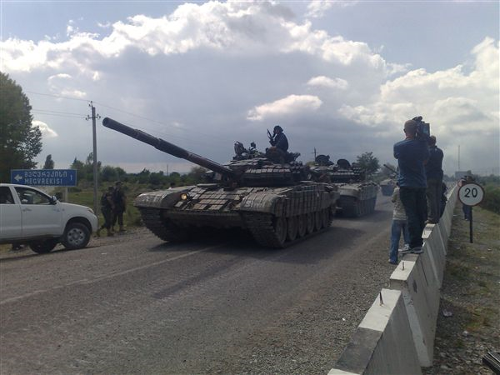
Today
20 states:
Afghanistan, Armenia,
Azerbaijan, Belarus, Bosnia, Georgia, Iran, Iraq, Kazakhstan, Kosovo, Kyrgyzstan, Macedonia, Moldava, Montenegro, Russia, Serbia, Tajikistan, Turkmenistan, Ukraine, Uzbekistan
rebroadcasting to local stations is prohibited in Belarus, Iran, Turkmenistan, Tajikistan, Uzbekistan, and most recently Azerbaijan

Slide 11
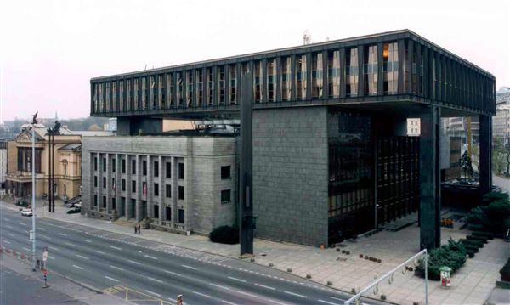
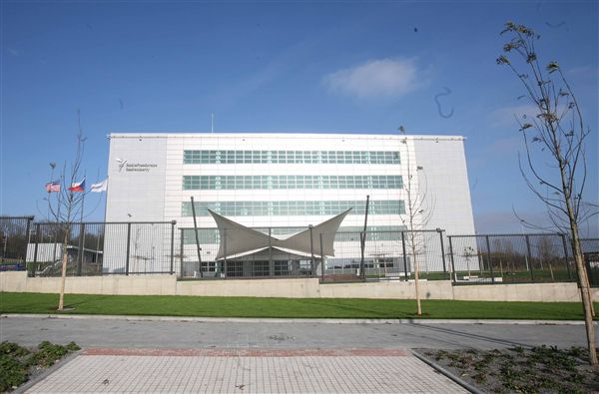
Headquarters
relocated its broadcasting center to the former Czechoslovak parliament building in Prague in 1995
2009 move to a custom built building

Slide 12
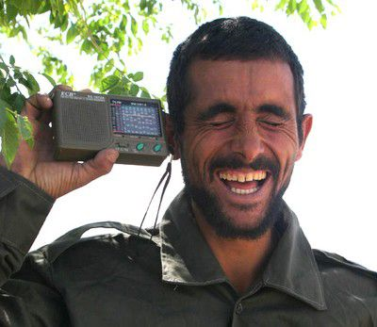
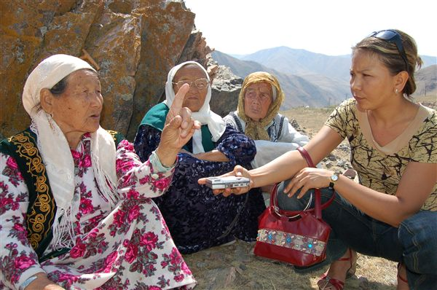
Web page
www.rferl.org

Slide 13
Thank you for your attention!

