Slide 1
Russian
Banking system
Lecturer – Oleg Deev
oleg@mail.muni.cz

Slide 2
The choice of the financial system model
Financial market-based system (US, UK)
  Relies on the capital market and on segmented banking
  High economic and organizational prerequisites for the efficiency
Bank-based system (Europe, Japan)
  Collects short-term deposits
  Handles transfers of funds to business
  Well capitalized to cover ordinary banking risks
  For transition economies
    Universal banking
    Foreign bank entries are preferable

Slide 3
USSR banking system
Gosbank controlled all banks
  Vneshtorgbank - foreign currency, debt, and trade
  Sberbank - the state savings bank
  Stroibank - state enterprise credits
The system channeled funds to state enterprises according to government decisions and, thereby, controlled enterprises, financed government debt, and foreign trade

Slide 4
Banking system at the first phase of economic transition
Two-tier banking system:
  Central Bank of Russia (CBR or Bank of Russia)
  Commercial banks
Emerged without any solid foundation
  Low capital requirements for a license
  Almost no bank supervision
Large quantity of institutions
  Gosbank ⇒ Central Bank of Russia
  Vneshtorgbank ⇒ Vneshekomombank
  Sberbank (the only institution of efficient savings mobilization)
  Stroibank ⇒ specialized banks by industry
  Numerous additional small banks

Slide 5
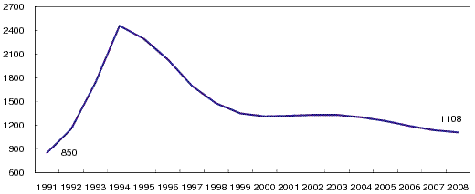
Number of banks
There are still many banks, most of which are very small

Slide 6
Performance of banks – 1992-1995
Inexpensive credits from the Bank of Russia
Large portfolio of non-performing loans – as a result of money lending based on political considerations rather than on credit worthiness
Banks promised depositors extremely high interest rates, hoping to pay from earnings on loans, but paid it from fresh deposit – financial pyramid schemes
Bank earned profits from “current accounts” (with almost no interest rate) of former state enterprises and state agencies
Banks exchanged rubles for dollars, lent dollars to those with licenses to export commodities – these short-termed loans were extremely profitable
Foreign banks were kept out till 1995

Slide 7
Performance of banks – 1995-1998
Inflationary profits disappeared ⇒ banking crisis?
Frightened government chose to subsidize banks
Government bonds are the largest source of income – 40% of all receipts
Interest payment received on loans to the real sector made up about 35% of income
Speculation on foreign currency
Forward obligations to hedge the currency risks
Some regulatory tightening

Slide 8
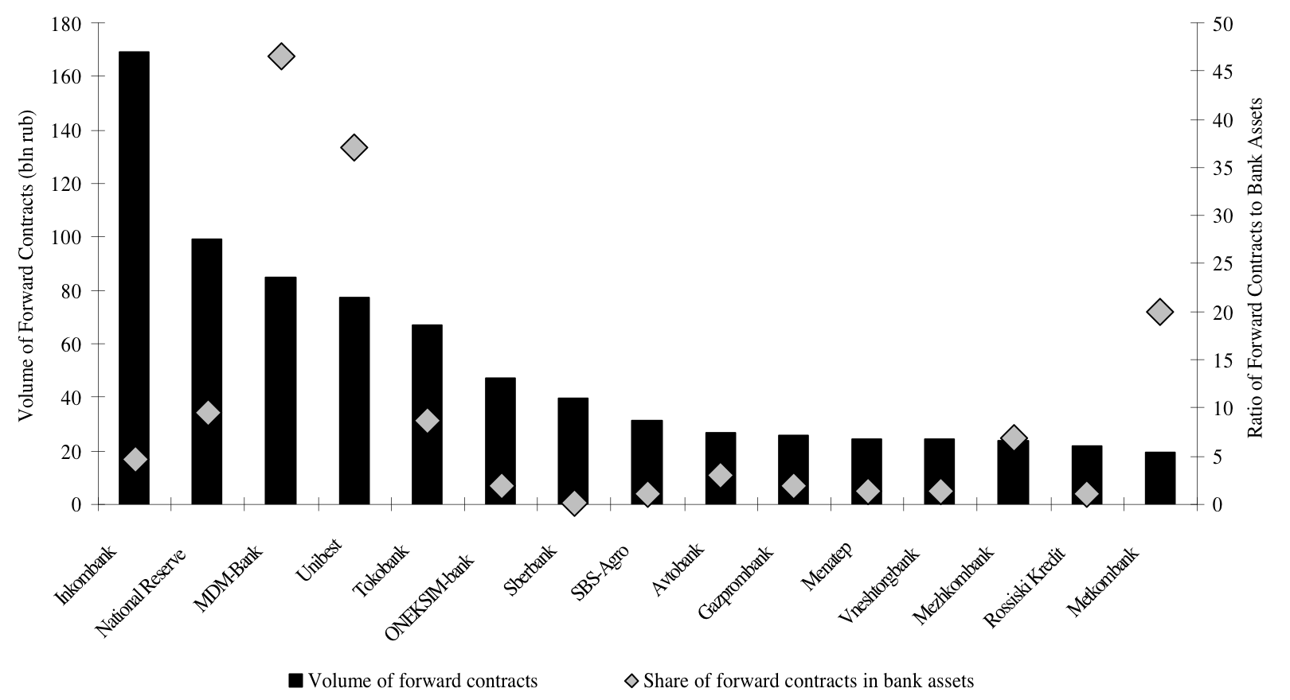
Russian banks with the largest forward positions

Slide 9
The banking crisis - 1988
No huge losses on securities due to insider information - 13% of net charges to capital of banks
Immense losses on loans, many of which have never been returned - $64.3 billion or 34% of net charges to capital of banks
Foreign exchange losses – 28% of net charges to capital of banks

Slide 10
Positive changes after the 1998 crisis
Rebuilding of customer confidence (including private investors)
Restructuring of several large banks
Maintenance of technological and material base for banking business
New shareholders’ acquisitions
Stabilization of banking proceeds
Write off of Non performing loans and formation of loan loss provisions
Formation of five clusters of commercial banks, besides Sberbank

Slide 11
Performance of banks – since 1998
Year | Number of banks | The average volume of assets per bank, mln RUB | The average volume of the own capital per bank, mln RUB | The average volume of the loans per bank, mln RUB
1998 | 1641 | 418 | 76 | 127
1999 | 1476 | 643 | 72 | 203
2000 | 1349 | 1075 | 142 | 336
2001 | 1311 | 1647 | 223 | 590
2002 | 1319 | 2186 | 342 | 909
2003 | 1329 | 2875 | 438 | 1216

Slide 12
Key indicators of the banking system
Year | Assets / GDP, % | Capital / GDP, % | Loans / GDP, % | Deposits / GDP, % | Spread in interest rates, % per annum
1998 | 36,07 | 4,04 | 11,41 | 16,36 | 24,74
1999 | 30,07 | 3,98 | 9,40 | 14,62 | 26,03
2000 | 29,56 | 4,01 | 10,59 | 15,12 | 17,93
2001 | 31,89 | 4,99 | 13,26 | 16,47 | 13,06
2002 | 35,17 | 5,36 | 14,87 | 18,48 | 10,75
2003 | 39,14 | 5,85 | 17,06 | 20,29 | 8,63

Slide 13
Non-performing loans and Reserves for credit risks

Slide 14
Commercial bank clusters
Sberbank
Other state-owned banks
Banks of energy and raw material sectors
Banks of other (non-energy) industry sectors
Foreign banks and joint ventures
Other (small and middle-sized) banks

Slide 15
Performance of banks – 2000s
bln. rubles

Slide 16
The largest banks
Bank’s name | % of total banking assets | Ownership
Sberbank | 23,7 | State
VTB | 8,0 | State
Gazprom | 4,7 | State
Rosselhozbank | 2,9 | State
Bank of Moscow | 2,8 | State
Alfa-Bank | 2,5 | Private domestic
UniCredit Bank | 2,1 | Foreign
Raiffeisenbank | 2,1 | Foreign
VTB-24 | 2,0 | State
Rosbank | 1,7 | Foreign

Slide 17
State-dominated banking sector
Among largest banks only two are private ones, three - foreign-controlled, five - state-controlled (including big three)
During the financial crisis 2008-2009:
  Government’s market share of state-controlled banks has topped ½
  State-controlled banks used as liquidity channel (esp. Sberbank, Rosselkhozbank)
  Private banks faced funding problems, resulted in foreign-controlled banks’ sale
Little possibility to turn back towards the privatization of banks in short-to-medium term

Slide 18
The size of the banking system

Slide 19
Conditions for further development
The external factors
  The oil price levels
  The level of interest rates on capital markets
  The demand on the energy resources
  Russia’s international investment ratings
The internal (domestic) factors
  Macroeconomic stability
  The ruble rate appreciation toward the main world currencies
  Money supply
  The availability of the financial instruments on the national market

