Slide 1
ECONOMIC TRANSITION OF RUSSIA
Lecturer – Oleg Deev
oleg@mail.muni.cz

Slide 2
Results (1991-1998)
Free market
Private business – 70% of GDP
Huge fall in output
High inflation
Income redistribution
Privatization – controversial results
people’s disapproval & emergence of oligarchs
Organized crime and corruption
Capital flight – $20 billion a year
The development of barter economic relations and dollarization
Unemployment and poverty
Deterioration of education system, health care, demographics
Inadequate pension system
Inefficient legal system
Existence of shadow economy

Slide 3
GDP growth rates, %

Slide 4
Russian financial crisis – August 1998

Slide 5
Russian financial crisis – August 1998

Slide 6
Russian financial crisis – August 1998

Slide 7
Russian financial crisis – August 1998
1997 - Inflow of portfolio investment of $46 billion or 10% of GDP
High volatility of exchange rate – ruble/USD (high valuation of ruble)
Extremely high interest rates
1998 – world price for Russia’s oil – 10$ per barrel
The government was not able to refinance it’s debt

Slide 8
Measures – August 1998
Devaluation of the ruble
At the moment the ruble/dollar trading band was expand from 5.3-7.1 RUR/USD to 6.0-9.5 RUR/USD
Later the RUR/USD rate was set to move freely within the wider band
Default on domestic debt
To prevent mass Russian bank default Russia's ruble-denominated debt would be restructured
A moratorium on payment to foreign creditors
A temporary 90-day moratorium was imposed on the payment of some bank obligations, including certain debts and forward currency contracts

Slide 9
Russia's 1998 financial collapse
In a matter of days the exchange rate lost over 60% of its value
more than in all most Latin American and Southeast Asian countries (except for Indonesia)
Prices increased by nearly 50% in only 2 months after the crisis
as compared to less than 6% annual inflation July 1998 to July 1997 before the crisis
Real output fell by about 6% in 1998
after registering a small increase of 0.6% in 1997 for the first time since 1989, it fell in January - September 1998, i.e. mostly before the August 1998 crisis

Slide 10
Why was the drop so drastic?
Some of the standard explanations
Bad institutions
Natural resource dependence
Bad policies
For a medium income level country, Russia is trade wise open
Financial dependence proved important
Short-term debt was concentrated and fast growing
Dependence of financial intermediation on foreign funding
The dual financial system: households and most companies using domestic markets; some big companies and banks dependent on foreign markets

Slide 11
Measures 1998-1999
Budget reform
Expenditures and arrears reduction
Revision of expenditures
Taxation reform
The creation of efficient taxation system
Changes in banking sector
The worst half of the banks was closed
Strengthening the governance of banks
The payment system improvement

Slide 12
So why the talk of a safe haven?
Politicians were not in the business of doom-saying
Shifting blame to where it belonged: global imbalances
Good grounds why a pure financial crisis might handle Russia softly
Small financial sector with limeted role in investment finance
Strong public sector financial position – taxation reform
Households with no financial wealth, little debt: no wealth effect on consumption
Labor markets expected to be very flexible

Slide 13
After the crisis
Boom in industry
After devaluation, domestic producers were taking advantage of new export opportunities and made shift from foreign to Russian made goods
Devaluation of the previously overvalued currency restored the previously lost competitiveness
Output was falling in the beginning of 1998, but started to grow in October (unlike in East Asia, where output fell after the currency crises)

Slide 14
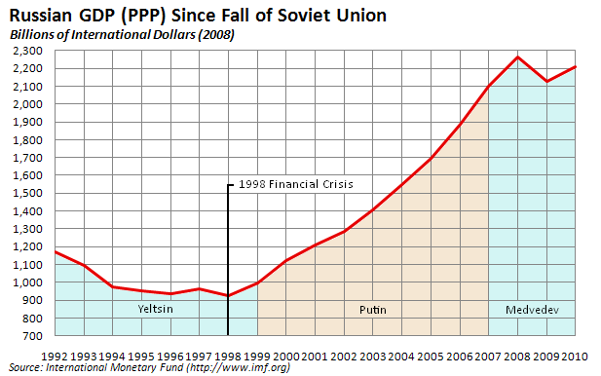
Economic growth – 1999-2008

Slide 15
Output is growing, inflation is under control

Slide 16
Oil price grows, GDP does not accelerate

Slide 17
Russia’s anti-crisis policies – 2008-2009
Basically similar to those in other countries
Package of tax reforms, reducing the tax burden
Emphasis on monotowns, pensions, minimum wages - crisis fighting as a social policy measure
Since 2005 - emphasis on social policy, with view on demography (national priority programs). In practice - expenditure on health, education and housing are stable as share of budget, increasing in line with total expenditure
Since 2007 - decisions to increase pensions, minimum wages, public sector salaries were made
Structure of the banking system left no alternative to ”favoring” state-controlled banks as liquidity channels

Slide 18
Challenges for the future
Unpredictable export revenue
Oil price
Energy efficiency needed for maintaining export volumes
Changes in gas markets
Regaining budget surplus
Re-accumulating reserve funds is a high priority
Expenditure pressure due to recent hikes, long-term needs
Revenue problem due to declining share of energy sector in GDP
Exchange rate policy
Increased flexibility of nominal rate, no pure inflation targeting
Real exchange rate appreciation pressures as financial inflow resumes
Financial system development
Rolling back the state
Need for long-term domestic funding
Pension reform
Increasing dependency ratio
Previous failures to depart from pay-as-you-go
Competitiveness of jobs

