Slide 1
Business Management in the Czech Republic
Ing. Lukas Gottwald
lukas@gottwald.cz
Business Management in the Czech Republic
2011

Slide 2
Business Management in the Czech Republic – Course Info
Specialist Course
  Several Lecturers for different management related topics
Final Test
  Written
  Multiple-choice
    For more info see IS MU or email:castek@econ.muni.cz

Slide 3
Business Management in the Czech Republic
1st Lecture
  Development of E-commerce in the Cyech Republic
    Ing. Lukas Gottwald
    lukas@gottwald.cz
2nd Lecture
  Consumer Rights in the Czech republic
    Ing. Lukas Gottwald

Slide 4
Developement of
E-commerce in the Czech republic
Business Management in the Czech Republic
Lukas Gottwald
lukasgottwald@gmail.com
Department of Business Management

Slide 5
Lecture Structure
1. E-commerce
  Definition, Characteristics, Quotes, Benefits&Riscs
2. E-commerce developement Timeline 1995-1999
  In USA
  In the Czech republic
  Summary 1995 - 1999
3. 2000 Dot Com bubble bust
  Disillusion, more realistic investor expectations in the Western economies
  Comparatively small effect in the Czech republic
4. E-commerce developement in 2001-2009
  In the USA
  In the Czech republic
  Trends & 2009 Outlook
5. Case Study: Opening an e-store as a SMC
  Why and How
    Managerial and marketing considerations

Slide 6
E-commerce
Defintion
  „Refers to commercial transactions occurring over open networks, such as the Internet. Both business-to-business and business-to-consumer transactions are included.“worldbank.org
    Definition 2.: „Electronic Commerce, commonly known as (electronic marketing) e-commerce or eCommerce, consists of the buying and selling of products or services over electronic systems such as the Internet and other computer networks.“ wikipedia.org

Slide 7
E-commerce
Characteristics
  Custumer has to own a „gadget“ connected to a network in order to participate in e-commerce (i.e. PC)
  Merchant has to have a space within the network (i.e. domain name and website)
  Customer obtains information about the product electronically
  Customer confirms his decision to purchase the product electronically (i.e. filling in a form on a website)
  Payment can be made online
    Credit Cards, Paypal, PaySec(Czech), SMS payments
  Distibution
    Electronic - Online ( i.e. songs, books, software, services)
    Physical - Offline ( necessary for physical goods)

Slide 8
E-commerce
Characteristics
  Quote from Rubens Ricuper Secretary-General of the UNCTAD (2000)
    „Electronic commerce is quickly emerging as a particularly visible and spectacular incarnation of globalization. At this stage, it is still too early to say whether electronic commerce will narrow or broaden the gap between rich and poor. However, it is safe to say that the rapid expansion of electronic transactions constitutes a major opportunity for trade and development…“
    However further on in the 2000 UNCTD report
      The United States and Europe will dominate world e-commerce
      The change here will come from Europe’s progressive “catching up” with the United States.
        Most available data show that the United States will retain its global lead in e-commerce well into the next decade (2000-2010)

Slide 9
E-commerce
Characteristics
  Quote from Kofi A. Annan Secretary-General of the UN (2004)
    „Information and communications technologies have considerable potential to promote development and economic growth. They can foster innovation and improve productivity. They can reduce transaction costs and make available, in mere seconds, the rich store of global knowledge. In the hands of developing countries, and especially small- and medium-sized enterprises, the use of ICTs can bring impressive gains in employment, gender equality and standards of living.“

Slide 10
E-commerce
Benefits
  Lower transaction cost
    Merchant side
      Store, inventory, staff, communication
    Customer side
      Time needed to get info and compare prices, communication
  Global market
      Outsource services globaly
      Take advatage of price diffreneces, exchange rates etc…
  Marketing
      Whole AIDA + payment + distribution in one moment
      Both B2B and B2C in one channel
        example: www.hp.com

Slide 11
E-commerce
Riscs & Drawbacks
  Security Issues
    Fraud, both on Merchant and Customer sides
  Virtual relationship
    No face-to-face interaction – may contribute to the trust problem
  Technology & Equipment
    Direct proportion between Internet expansion and E-commerce growth
  Consumer behaviour more „item specific“
    According to Stuchlik, Dvoracek (2002) customers engage mostly in „targeted shopping“ not in „leisure shopping“ in the online environment

Slide 12
E-Commerce Timeline 1995-1999
UNITED STATES
1995
  Jeff Bezos launches Amazon.com
  The first commercial-free 24 hour, internet-only radio stations, Radio HK and NetRadio start broadcasting
  Dell and Cisco begin to aggressively use Internet for commercial transaction
  eBay is founded by computer programmer Pierre Omidyar as AuctionWeb.
CZECH REPUBLIC
1995
  „Czech Telecom“ looses monopol
  It is now possible for other providers to offer Internet connection
  First households connect to internet.

Slide 13
E-Commerce Timeline 1995-1999
UNITED STATES
1996
  Google began in January 1996 as a research project by Larry Page, a Ph.D. student at Stanford, he was soon joined by Sergey Brin
1997
  Business.com sold for 150 000 USD
  Amazon IPO on Nasdaq
  30% US population is online (59 mil. people)
CZECH REPUBLIC
1996
  Seznam.cz, now a major Czech search engine is founded by Ivo Lukacovic
  Vltava.cz and Cybex.cz among first online Stores
1997
  Seznam reachers an yearly turnover of nearly 50 000 USD
    most of the income is from advertising
  Only 27% households have a computer
    out of these only 8% are online (0.216 mil. people)

Slide 14
E-Commerce Timeline 1995-1999
UNITED STATES
1998 & 1999
  Dot Com bubble growing, lot of start ups, some suceed
    Paypal founded 2000)
  In 1999: 3,7 billions USD spent on online advertising
CZECH REPUBLIC
1998 & 1999
  27% of households owns a computer, out of these 33% are online
  In1999: 2,7 millions USD spent on online advertising
    No bubble – too little money involved…
  Paegas Internet Call
    Progresive VoiceOverIP service in Czech rep.

Slide 15
1995 – 1999 Summary
USA
  Golden Era
  113 mil. People online in 1999
  Unrealistic growth expectations
  Online payments available and commonly used
Czech republic
  The concept of e-commerce has been much slower to develop in the Czech Republic than in most of Western Europe.
  Czechs are a relatively well-educated group and computer literate. Yet, there were many difficulties in accessing the Internet. A significant factor was the reletively very high cost of access
  low personal-computer penetration
  slow growth of the financial applications needed to conduct online commerce, mainly those concerning credit cards and more-sophisticated banking methods globaltechforum.eiu.com

Slide 16
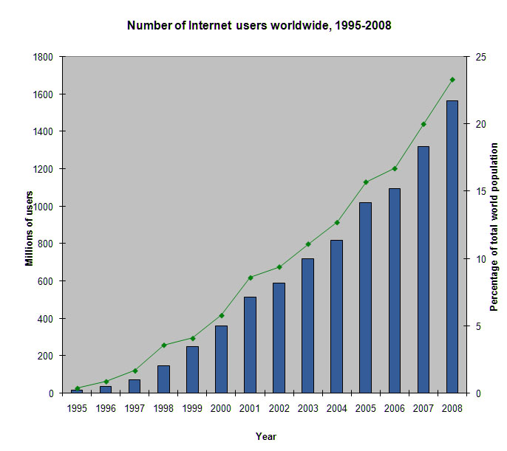
1995 – 1999 Summary
Internet usage growth - worldwide
1995 – 2008

Slide 17
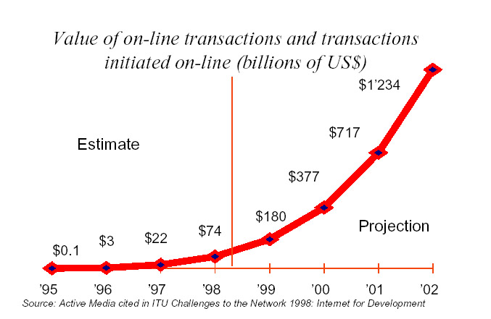
1995 – 1999 Summary
E-commerce transactions growth worldwide
1995 - 2002

Slide 18
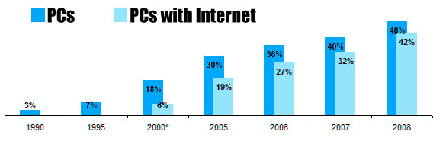
Internet usage growth in Czech rep.

Slide 19
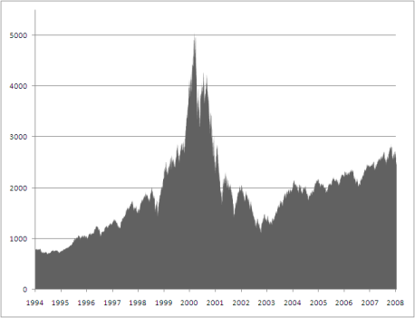
Dot Com Bubble Bust
USA
NASDAQ index peaked 10th March 2000,
followed by a rapid downturn, recovery and another downturn
from 2003 quite steady growth

Slide 20
Dot Com Bubble Bust
Czech republic
  Less money involved, bubble bust indirec effect
  Faster Internet user growth after 2000
    Online ad spending in Czech rep.
      1999: 2.5mil USD
      2000: 4 mil USD
      2001: 6 mil USD
    User base - growth
      3/1999: 1 163 170 people
      2/2001: 1 806 800 people

Slide 21
E-commerce Timeline 2001 – 2009
USA
2002
  eBay acquires PayPal for $1.5 billion
2006
  Google Buys You Tube in 2006 ($1.65 billion USD)
  US e-comm sales 1st time over 100 bil. USD
2007
  Microsoft bought 1.6% share of Facebook for $240 million, giving Facebook a total implied value of around $15 billion
CZECH REPUBLIC
2003
  Ministry of Informatics established
2005
  APEK reports 40% E-Commerce sales growth from 2004, total of 0.5 bil. USD sold in CZ that year
  Mall.cz the becoms the largest e-comm store in CZ, reports sales over 50 mil. USD (1 bil. CZK)
  Important Electronic Communication Bill passed

Slide 22
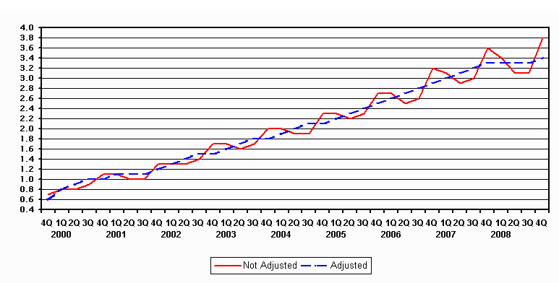
E-commerce Sales 2001 – 2009
USA

Slide 23
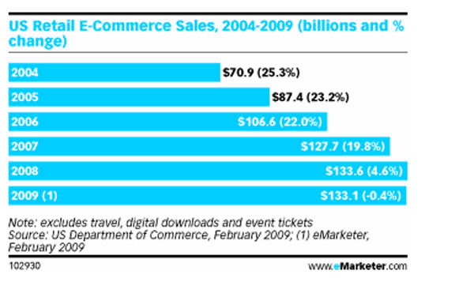
E-commerce Sales 2004 – 2009
USA

Slide 24
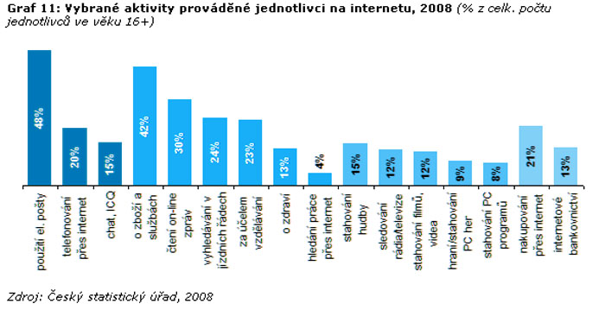
Common Online Activities
Czech republic
21% of Czech population shops online
That is 39%of the internet userbase

Slide 25
E-commerce Timeline 2001 – 2009
Highlights 2005 - 2009
  Rapid growth of social networks & Google
  Facebook becomes huge…
    Czech: 560 000 (5%)
    Slovakia: 361 000 (5%)
    Hungary: 167 000 (1,6%)
    Poland: 320 000 (1%)
    Austria: 538 000 (7%)
    France: 9 000 000 (15%)
    United States: 61 000 000 (20%)
  eBay great success…
    Fasciliate international trade
    Revenue around 9 bil. USD expected for 2008
    370 million registered users around the world.
  Google phenomenon
    In less then 10 years a multi-billion dollar company (2005 a 7 bil. USD stock market value)
Seznam remains no.1 in CZ
    1,5 mil. Users daily

Slide 26
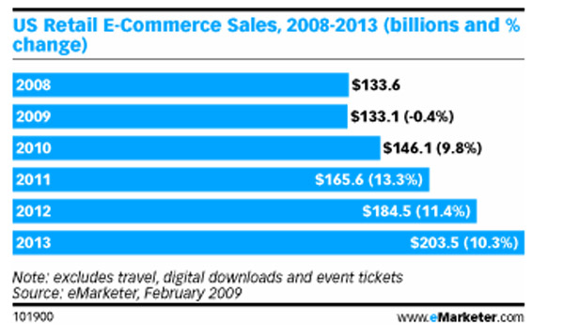
E-commerce Outlook
E-marketer report

Slide 27
E-commerce Outlook 2011
Community shopping online
  Groupon.com
    Co.uk, .at, .de
    Launched November 2008
  Slevomat.cz, Zapakatel.cz
    Czech Groupon clones
    Slevomat od léta 2010
Integration with social media „deal of the day“

Slide 28
Brief Case study: opening an e-store
Considerations from SME Management perspective
  Why?
    Global sales channel at low cost
    Global Networking possibilities
    Typically low transaction cost
    Economies of scale – great possibilities (one store for millions of people)
  Why not?
    Profitability – lot of competition
    Restrictions in human resources (typical for SMEs)

Slide 29
Brief Case study: opening an e-store
Marketing
  Benefits
    Imagine buying software offline and online
      Promotion – AIDA continously, seemlesly - one click…
      Product - Automatization in product customization
      Price – custom price, or auction type interactive price + internet as a payment channel
      Place – Internet as distribution Channel (Software… iTunes…)
    Viral marketing, PR, buzz marketing, WOM
      Give your satisfied customers a platform for sharing their emotions and experiences
      Give your satisfied customers a possibility to endorse ypur products ina easy and entertaining way
  Riscs
    Security + Product lifecycle „Time runs faster online“

Slide 30
Thank you
?UESTIONS
  lukas@gottwald.cz

Slide 31
References
E-commerce definition:
web.worldbank.org/WBSITE/EXTERNAL/TOPICS/EXTINFORMATIONANDCOMMUNICATIONANDTECHNOLOGIES/0,,contentMDK:21035032~menuPK:2888320~pagePK:210058~piPK:210062~theSitePK:282823,00.html
E-commerce on wikipedia http://en.wikipedia.org/wiki/E-commerce
UNTCD 2000 report http://r0.unctad.org/ecommerce/docs/building.pdf
UNTCD 2004 report http://www.unctad.org/en/docs/ecdr2004_en.pdf
STUCHLIK, P.; DVORACEK, M. Reklama na Internetu. Grada Publishing. 2002.226 p.
Internet timeline http://www.webopedia.com/quick_ref/timelne.asp
Amazon History: http://en.wikipedia.org/wiki/Amazon.com#History_and_business_model
US ad spending in 1999 http://www.socialresearchmethods.net/Gallery/Cho2/noname6.htm
Czech e-commerce http://globaltechforum.eiu.com/index.asp?layout=rich_story&doc_id=9933&title=Czech+Republic:+Overview+of+e-commerce&categoryid=29&channelid=4
Dot Comm bubble http://en.wikipedia.org/wiki/Dot-com_bubble
E-comm sales usa: http://www.emarketer.com/Article.aspx?R=1007068
Global internet usage http://www.globalpolicy.org/globaliz/charts/internet.htm
USA internet usage 1995-2006 http://blogs.zdnet.com/ITFacts/?p=10998
Electronic Commerce:Concepts, Methodologies, Tools, and Applications http://www.igi-global.com/downloads/excerpts/reference/ecom.pdf
Czech internet usage statistics http://www.czso.cz/csu/redakce.nsf/i/3_kolik_ceskych_domacnosti_ma_pocitac_a_internet

