Slide 1
Agenda
Credits: Product factory
Key components of Basel II -> impact on business, what is the role of Credits, methods used
Examples: risk / capital ratios of a bank

Slide 2
Ekonomika a řízení bank – ESF MU
CREDITS
Marek Loula, Executive Director Credits ČSOB

Slide 3
What does Credits manage?
Traditionally (and still in many banks), Credits = decision taking
However, CSOB Credits act as full scope embeded product provider (without its own shadow P/L !). What does it mean to be “end-to-end” product factory?
Distribution | Credits | Distr.
Models and Score cards
Design workflow/products for Distribution network
IT applications used in the credit process
Credit request
Individual decision taking
Preparing loan documentation
Book and draw credit lines
Follow-up (ex post monitoring, Credit Review)
Bad debts

Slide 4
Scope of Credits in CSOB Group lending
Amounts in CZK bln | 31/12/2009 | 31/12/2010 | Role of Credits
Group lending | 407.9 | 413.7
Retail/SME segment
Mortgages | 135.6 | 144.9 | Models, process
- Building savings loans | 65.8 | 71.9
- Consumer finance | 17.4 | 18.2 | Applications, some models
- SME loans | 66.9 | 62.9 | End-to-end
Leasing | 29.2 | 23.3 | Decision taking, newly models
Corporate segment
- Corporate loans | 84.2 | 76.5 | End-to-end
Factoring | 3.7 | 3.6 | Decision taking
Head office | 0.5 | 0.5
Other (a.o. Banks) | 4.5 | 11.8 | End-to-end
In the last 5 years, CSOB has grown from mainly a Corporate bank to predominantly RET/SME bank.

Slide 5
Credits: Balancing act
What type of costs/risk Credits manage or have to watch?
Capital costs (agreed framework / policies / risk appetite)
Credit costs
Operational costs
Opportunity costs

Slide 6
Nature of units within Credits
Operations
Modeling
Advice & Underwriting
Management / Support
Management of Products and Processes
Business Architect function (link to ICT) + Application management
Credit Administration
Bad Debts
Credit Review
Split within Credits between CORP and RET/ SME
Shared across Credits

Slide 7
How are Credits organized in CSOB?
Bartel Puelinckx
(CFO, Country Team Member)
Credits
(Marek Loula)
Corporate and Bank Credits
(Ivan Vertenten)
RET/SME Credits
(Jiří Feix)
Transactional Modelling
(Tomáš Magyar)
Business Architect Credits
(Gerry Gallen)
Advice and Underwriting Corporates
(Jiří Suchánek)
Advice and Underwriting RET/SME
(Jiří Střižík)
Application Management
(Michal Platil)
Advice and Underwriting Banks
(Milan Procházka)
Credit Review
(Karel Havlíček)
PURE (part Credits)
Corporate Products & Processes
(Václav Pecka)
SME Credit Architecture
(Tomáš Přibyla)
Projects delivery
Corporate Credit Administration Unit
(Jana Majerová)
SME Credit Administration Unit
(Anna Šafářová)
Corporate Bad Debts
(Tomáš Korbas)
SME Bad Debts
(Jiří Feix)
State Assets Administration
(Antonín Peterský)
RET Credit Architecture
(Petra Novotná)

Slide 8
Difference beween Corporate and SME lending?
Corporate lending
SME lending
Speed
Generally medium importance, but ad-hoc ultra speed required
Important for small SME (use of score cards)
EXAMPLE
Risk / Return
Crucial, also at the level of each client. Sensitive on change of models
EXAMPLE (PD, LGD => RAROC)
Relevant on product groups / level of sub segments
Automated workflow
Nice to have. Only some elements have to be automated.
Critical success factor (expectations, costs, follow up of risk)
EXAMPLE
Need for (high) delegations to business
Important element in KBC / ČSOB environment
(front line responsibility for the risk, reaction time)
Very similar to Corp

Slide 9
Example: Risk / Return
Key elements of Basel II, Impact on business
  Concept of Basel II
  Applied as of 2008, replacing previous Basel I (valid mostly as of 1993)
  In the Czech Republic: Regulation of CNB No. 123/2007
  The idea is to protect bank clients and the bank itself from unexpected events and potential losses
  Basel II enables the shift of the responsibility from the local regulators towards the commercial banks after fulfillment of certain predefined criteria
  Impact on Business
  Counterparty risk assessment and measurement of key risk parameters
  Enables to steer business based on risk drivers
  Infuences approval process and delegation levels
  Enables precise definition of business strategies and “cherry-picking”

Slide 10
Concept of Expected & Unexpected loss
UL = f (PD,Maturity,Size) x LGD x EAD
Unexpected loss (UL) – estimated deviation from expected losses. Should be covered by available capital with high enough certainty (99,9%)
Expected loss (EL) – average loss expected to be realized on the credit portfolio. In theory, it should be close to credit provisions and covered by pricing (margin).
EL = PD x LGD x EAD

Slide 11
Counterparty Risk: Probability of Default (PD)
  The counterparty risk is the risk that a customer will default. The PD is a result of a statistical measurement in which the past history of the portfolio of an institution is translated into the probability that clients out of the healthy portfolio will default in the coming year.
  The counterparty risk is determined by:
    The financial status of a counterpart
      Repayment capacity/ Cash flow
      Wealth/ Balance sheet strength
      Indebtedness/ leverage
      Etc..
    The non financial status of a counterpart
      Retail: marital status, education level, number of phones, fixed address, color of the car, anything…
      Non retail: market position, management quality, succession arrangements, etc…
  It is important to understand that the PD methodology has some drawbacks:
    the PD’s used are so-called “point in time” (PIT). In other words, it describes the probability of default based on past behavior, not taking into account current or future changes in the external or internal environment. Within the group, the need for “forward looking PIT PD’s” and “Through the cycle PD’s” are being investigated. It is likely that we will have more PD’s in the future, used for different purposes.
    the PD’s are based on “outdated” input. In the retail segment, this input is still relatively recent, as PD’s are calculated on a monthly basis, based on behavioral characteristics. However, in COR and SME, the input data (mainly financial) are between 1 and 2 years old.
    In principle, the PD’s should in an ex-post exercise, resemble the provisions (did what we predict come true?). Besides the above mentioned elements, granularity is an additional problem for COR and larger SME’s.
  Despite the drawbacks of the methodology, PD’s are still the best available tool for distinguishing the credit quality of a portfolio in terms of default.

Slide 12
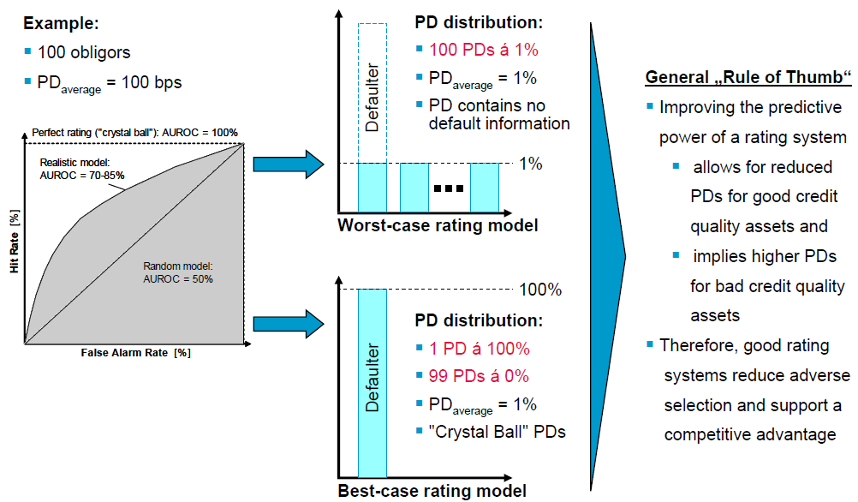
Counterparty Credit risk measurements
Counterparty credit risk measurement – competitive advantage through sophisticated rating systems (illustrative example)
=
=100%
= 0%

Slide 13
Product risk: Exposure at default (EAD)
  Not all products are drawn to the full extent at the moment of default => some are less risky than others
  Product Categories:
    Cash out: ST loans, LT loans
    Off Balance sheet: Guarantees, Promises
    PRF limits: FX, IR instruments (Forwards, swaps, options,…)
  Product nature
    Drawn/ undrawn
    Committed and uncommitted
  All these elements lead to a different “weighing” of the nominal volume of a product. The nominal multiplied with the weighted factor equals the exposure at default. This is a measure of the risk inherent in the product sold. The issue dealt with here is to what amount will a loan be drawn at the moment of default. This depends not only on the behavior of the customer, but also on the behavior of the lender. E.g.: a ST loan limit might be frozen at the level of the outstanding in case of a breach of covenants.
  The exposure at default thus reduces the amount of risk by applying a Credit Conversion Factor (ccf) to the nominal amount. In other words, the EAD is usually smaller than the nominal amount of the loan. For LT investment loans, the CCF will be closed to 1, but for ST loans or guarantees, they are closer to 0.7-05.
  The EAD is prescribed by the regulator under foundation, but dependant on the modeling results (i.e. the historical behavior) under Advanced

Slide 14
Collateral Value: Loss given default (LGD)
  The loss in case of a default (or LGD) is the difference between the exposure at default and the collateral value. It is the inverse ratio of a recovery rate.
  LGD can be calculated based on recovery rates of a specific collateral only or a combination of these recovery rates and other factors. KBC works in general with a “segmentation” approach, i.e. an LGD linked to the traits of the specific collateral only.
  Next to recovery value, also the cost of recovery plays a role.
  In Basel II Foundation and Standard, these values are prescribed by the Regulator. In Advanced, they are the result of historical recovery rates.
  2 types of LGD are generally calculated:
    LGD unsecured: this is the LGD in case an exposure is unsecured. Under Basel II Foundation, this is fixed at 45%.
    LGD secured: this is the LGD that is linked to a particular type of security, and thus differs.
  In order to apply an LGD percentage, a collateral must first be declared “eligible” by the local regulator. If the collateral is deemed to be not eligible, the exposure needs to be treated as unsecured.

Slide 15

Implications towards pricing
Credit Pricing
  Definition of minimal required profitability (RAROC) – transactional as well as relationship
  Composition of RAROC:
What influences RAROC:
  Margin, Fees – the higher the better the transactional RAROC will be
  Ancillary business (other than credit related income – FX, fees from payments etc.) – influences relationship RAROC
  PD of the borrower – the better the PD, the lower the EL and RCap, the better the RAROC
  Collateral – the more collateral provided, the lower the EL, the better the RAROC
  Type of product – the less committed nature of the specific product čím méně závazný produkt, the lower the EL, the better the RAROC
  Maturity – the shorter the deal, the smaller the unexpected loss (= capital function), the better the RAROC
  YORE – income from reinvested capital (ALM)
  RAROC = (Income – OP.costs – EL) * (1-tax%) + YORE
Regulatory capital (RCap)

Slide 16
Implications towards pricing
Impact of PD on regulatory capital
PD 5
PD 6
Relative difference (increase) in Rcap due to one notch downgrade (all other elements being equal) = cca 26%
Relative difference (increase) in EL due to one notch downgrade (all other elements being equal) = cca 90%
RCap is highly sensitive on PD changes in the range of KBC masterscale. On contrary, in the range of very high PD the sensitivity diminishes since the Unexpected loss become to be “expected” (high probabilities)

Slide 17
Implications towards pricing
Impact of LGD on regulatory capital
LGD 45% unsecured
LGD 35% secured (real estate collateral)
Relative difference (decrease) in Rcap due to 10% decrese in LGD (all other elements being equal) = 10%
Relative difference (decrease) in EL due to 10% decrease in LGD (all other elements being equal) = cca 10%
RCap is highly sensitive on LGD changes. X % relative change in the underlying LGD percentages has a linear impact on the Rcap at the amount of X%.

Slide 18
Implications towards pricing
Impact of maturity on regulatory capital
Maturity 1 year
Maturity 5 years
An increase in the maturity of the deal immediately implies an increase in the required regulatory Capital. The maturity effect is visible up to 5 years. The maturity adjustment increases the angular coefficient of the capital function thus leads to higher capital charges while all other parameters remain stable.
Below & Above 20% due to maturity changes
CRO
Distribution
Credits

Slide 19
Thank you
Marek Loula
Executive Director
Ceskoslovenska obchodni banka, a. s.
Credits
Radlicka 333/150
150 57 Praha 5
Phone: +420 224 116 856
Mobile: +420 737 201 869
E-mail: mloula@csob.cz
http://www.csob.cz/

