Slide 1
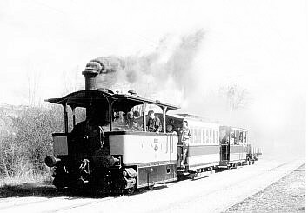
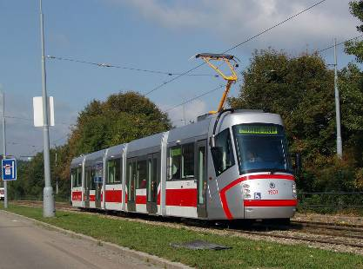
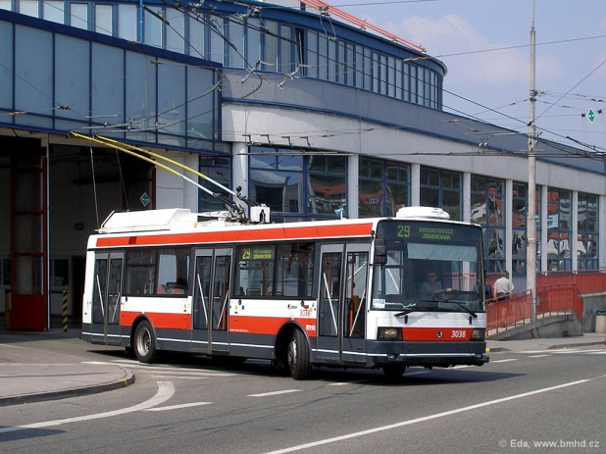
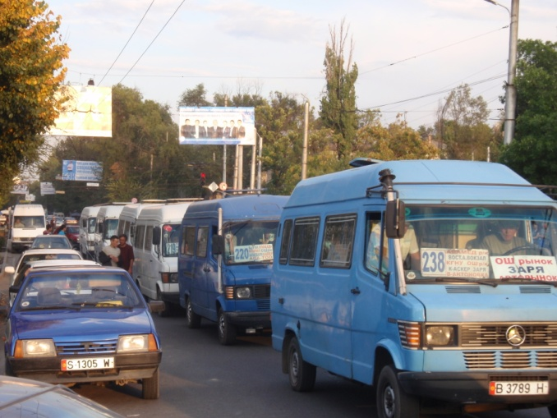
Urban public transport (UPT)
Almaz Kadyraliev
k.almazkeu@ymail.com

Slide 2
Content
History and current state of
Brno public transport (DPMB)
2.1. The period of horse-drawn
tramways (1869-1881)
2.2. Steam Operation (1884-1899)
2.3. Electrical Operation (from 1900)
2.4. From 1918 onwards
2. Integrated public transport system
in South Moravia (IDS JMK)
3. Comparison UPT between Czech and
Kyrgyz republics
4. Conclusion

Slide 3
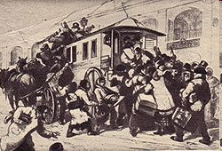

1.1. The period of horse-drawn transport
First mass public transport in the World – Nante 1826, France (Omnibus)
17 August 1869 –
horse-drawn carriage track, Brno
The third in then the Austria-
Monarchy after Vienna and Budapest
First line - from Kiosk
(Moravské náměstí) to Kartouz (Královo Pole, Semilasso)
6 carriages were operating in the interval of 15 minute.
1875-1881 - discontinued

Slide 4
1.2. Steam Operation (1884-1899)
1884 - a joint stock company Brno Steam Tramway
24 May 1884 - steam tramway on the line Pisárky - Královo Pole
1889 - new company:
Brno Local Railway Company

Slide 5
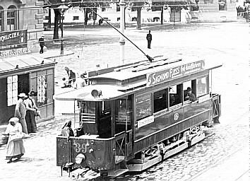
1.3. Electrical Operation (from 1900)
1900 - Austrian “Electricity company union“
Street transport system with electrical drive
1900 – Brno Electrical Street Tramway Company
(predecessor of today's DPMB)
1903-1904 – first vehicles of local production

Slide 6
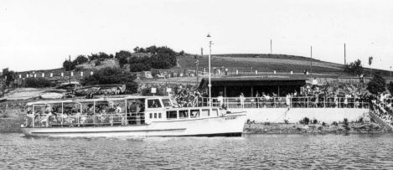
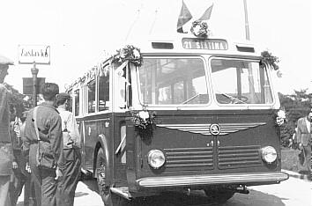
1.4. From 1930 onwards
1930 - bus transport to supplement the operating
tramway system
1946 –
boat transport
1949 - trolley-bus
1951 – DPMB
(Brno City Transport Company

Slide 7
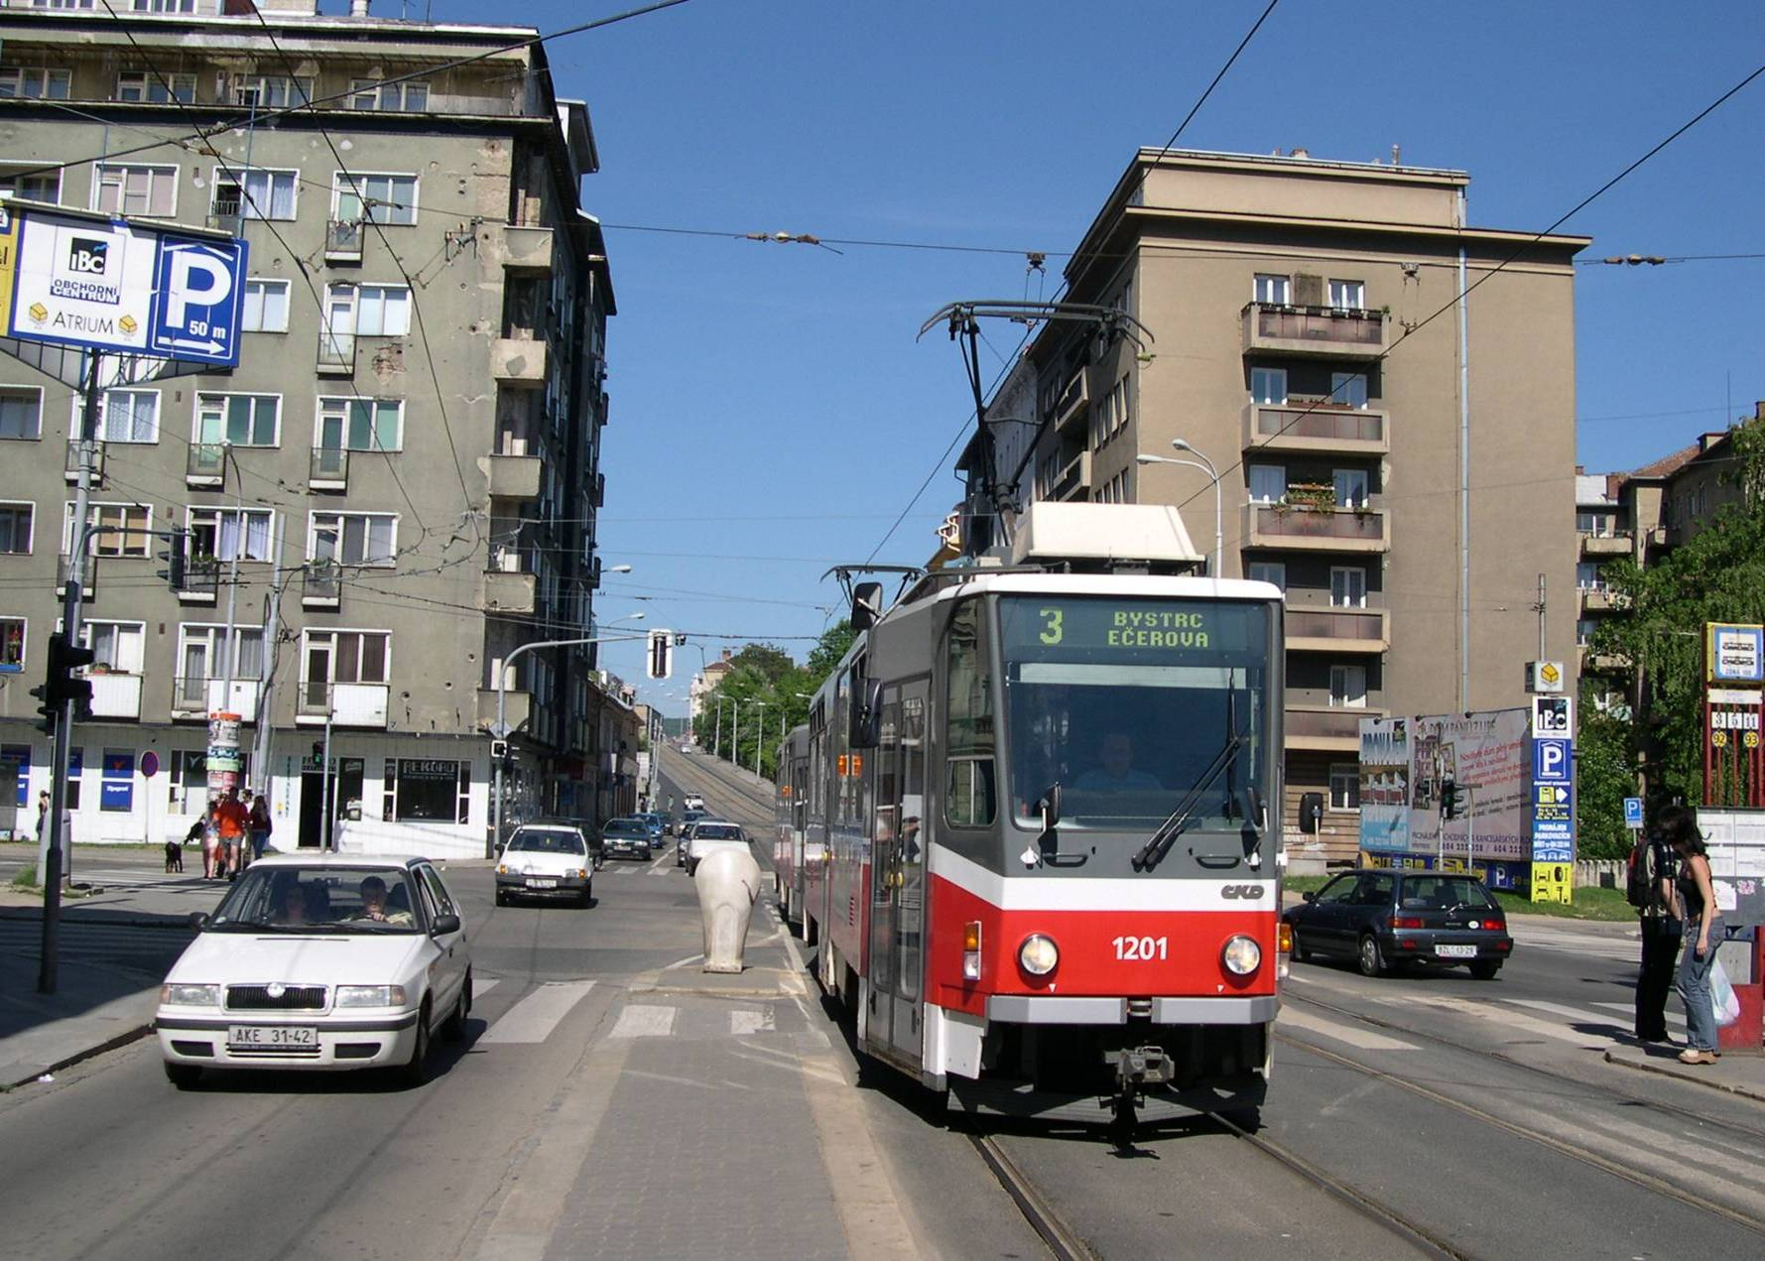
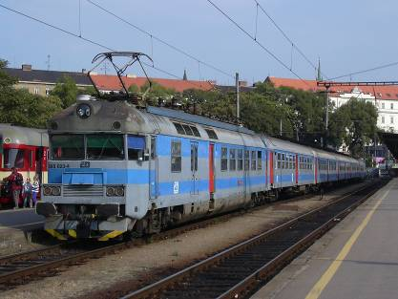
2. SOUTH MORAVIAN INTEGRATED PUBLIC TRANSPORT SYSTEM (IDS JMK)
Passengers:
Population of IDS JMK+Visitors
organizátor IDS:
KORDIS JMK
IDS JMK IS FOUNDED BY:
Brno city
South Moravian region
Municipalities (towns) of JMK
CARRIERS IN IDS JMK:
Brno public transport company DPMB
  tram
  trolleybus
  buses
  boat
Czech Railways
Bus companies (outside DPMB, a.s.)

Slide 8
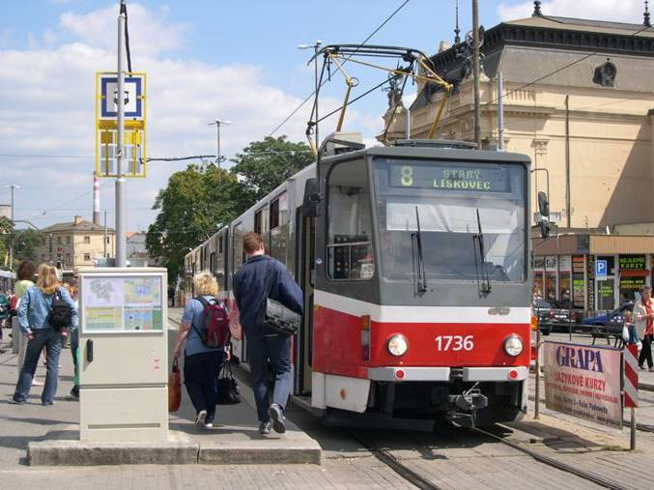
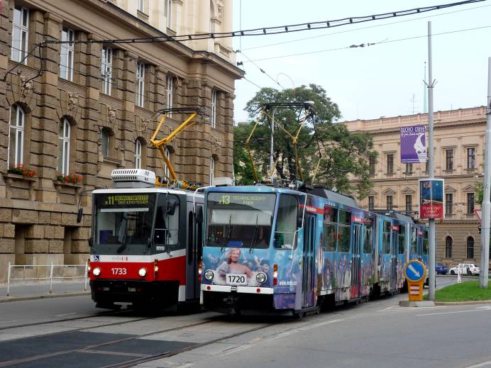
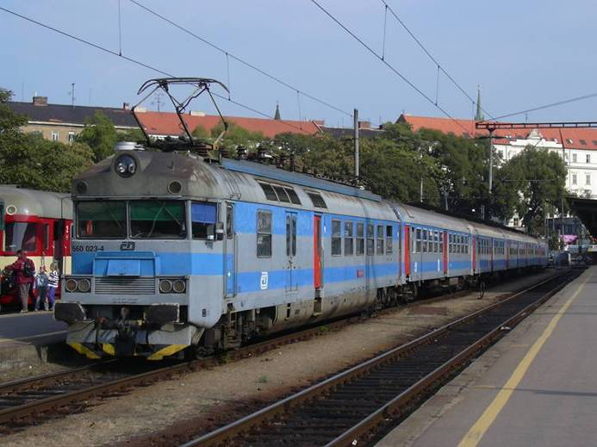
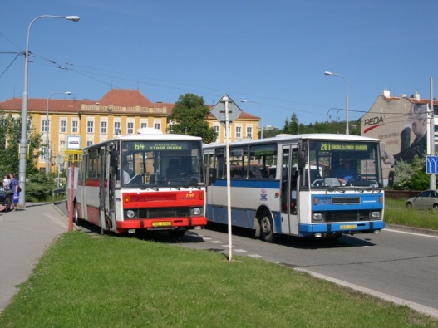
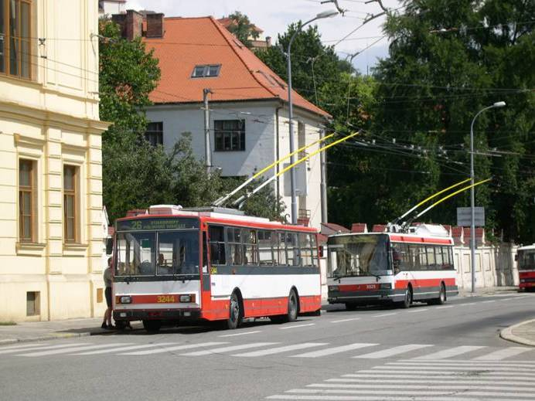
Numbering zones of IDS JMK
Source: Brno municipality

Slide 9
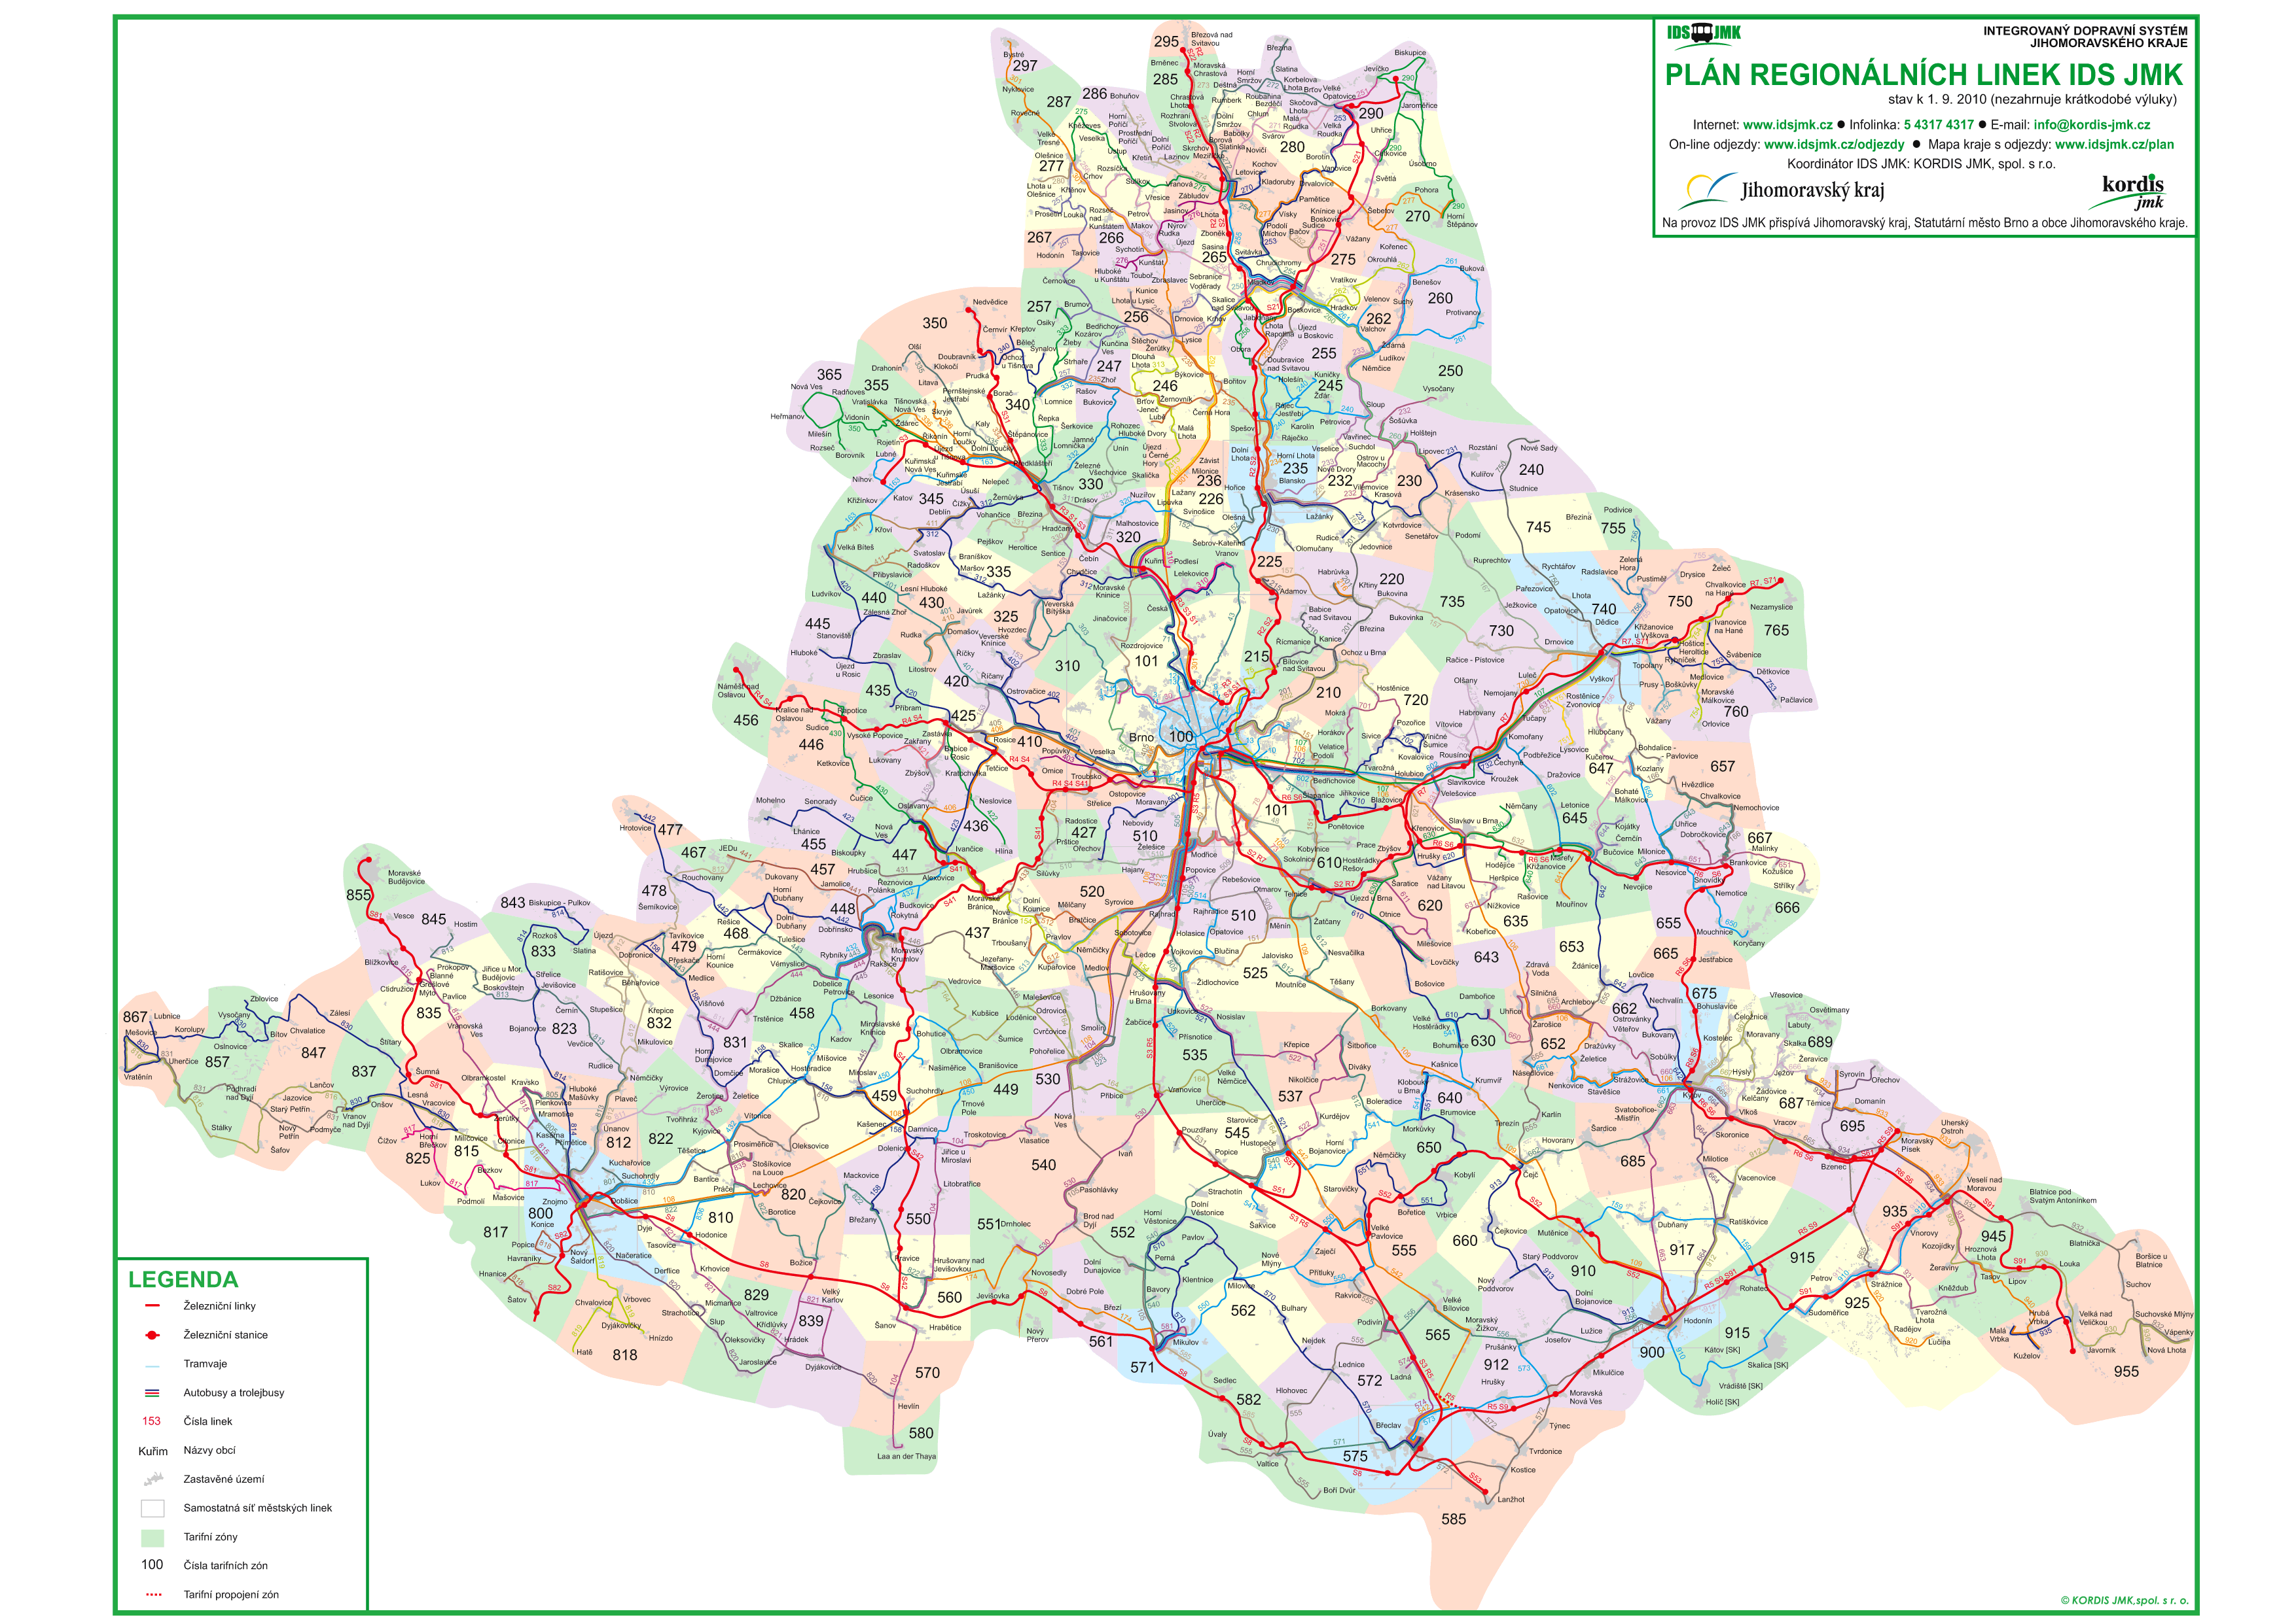
Source: www.idsjmk.cz

Slide 10
Population in IDS JMK 1 212 530
Municipalities in IDS JMK 725
IDS JMK carriers 23
Performance per year (mln. km) >90 mil.
Revenue share of season ticket 59%
JMK subsidy to public transport (mln€/year) 40
Subsidy of Brno city to DPMB (mln. € / yer) 40
Source: Brno municipality
Notes:
10

Slide 11
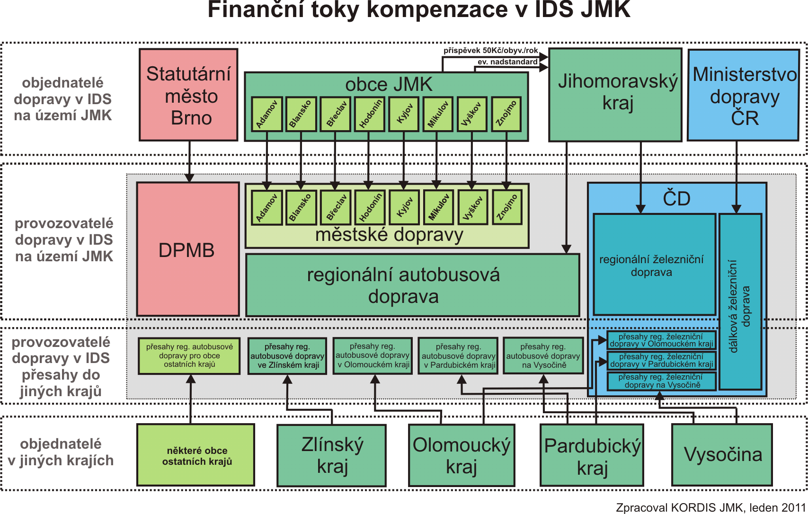
Source: Brno municipality

Slide 12
Odhad kompenzace poskytované DPMB, a.s. městem Brnem
na veřejnou hromadnou dopravu pro rok 2011
vztažená k měrnému přepravnímu výkonu
 |  |  | Tramvajová doprava |  | Trolejbusová doprava |  | Autobusová doprava
 |  |  | na území SMB | mimo území SMB | na území SMB | mimo území SMB | na území SMB | mimo území SMB
Přepravní výkony (v tis.míst.km) |  |  | 2 316 519 | 15 943 | 533 059 | 12 701 | 1 253 042 | 45 208
Náklady | variabilní | Kč/100 místkm | 7,06 | 7,06 | 8,34 | 8,33 | 19,20 | 19,20
 | fixní |  | 48,93 | 48,93 | 66,29 | 66,31 | 48,98 | 48,95
 | celkem |  | 55,99 | 55,99 | 74,63 | 74,64 | 68,18 | 68,15
Kompenzace SMB |  | Kč/100 místkm | 36,59 | 36,59 | 53,93 | 53,93 | 46,76 | 46,76
Source: Brno municipality

Slide 13
3. COMPARATIVE STUDY BETWEEN CITIES
City | Tram | Bus | Trolleybus | Minibus
Bishkek | No | Yes | Yes | Yes (60%)
Brno | Yes | Yes | Yes | Yes (a few)
City | Population (thousand) | Territory | UPT performance/ year (thous) | Number of vehicles in total | Number of seats in vehicles in total
Bishkek | 1,200 | 127 sq.km | 200,0 | 3420 | 40-44 000
Brno | 370 | 230 sq.km | 350,0 | 783 | 35-40 000
Country | GDP per capita
Czech Republic | 18 000 US dollars
Kyrgyz Republic | 980 US dollars

Slide 14
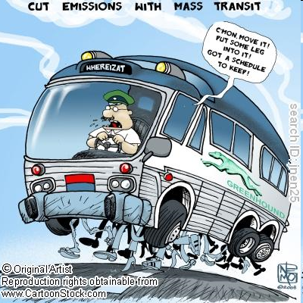
3.1. MODE OF VEHICLES IS AN IMPORTANT INDICATROR
IN THE EFFICIENCYOF UPT
Minibus share in Bishkek 60%
Tram share in Brno UPT 55%

Slide 15
Figure 2: Financial statement of municipal public transport companies
(som/KGS, thousand)

Slide 16
Cost and revenue in UPT
a)
b)
Cost
Revenue
Farebox
Operational cost
Passengers
Passengers

Slide 17
Literatures available at ESF library
1. Schiefelbusch M & Dienel H.L., (eds). Public Transport and its users/The passengers Perspective in Planning and Customer
Care, Ashgate: England, 2009
2. Pavel Dušek, Encyklopedie městské dopravy v Čechách, Na
Moravé a ve Slezsku, Praha 2003
Literatures available at web links:
1. Integrated transport system in South Moravian, www.dpmb.cz, idsjmk.cz
2. Kominek Z., Filling the gap in urban transport: Private sector participation in transition countries, EBRD/Working paper No. 93-2005. Online. http://www.ebrd.com/downloads/research/economics/workingpapers/wp0093.pdf

