Slide 1

2
THE REAL ECONOMY IN THE LONG RUN

Slide 2
2
Production and Growth

Slide 3
Revision
What is GDP?
Gross domestic product (GDP) is the market value of all final goods and services produced within a country in a given period of time.
What does GDP measure?
GDP measures two things at once:
the total income of everyone in the economy
the total expenditure on the economy’s output of goods and services

Slide 4
Revision
How GDP is calculated?
by adding up the total income (wages, rent and profit) paid by firms
by adding up the total expenditure by households
What are the components of GDP in terms of spending?
Y = C + I + G + NX
What distinguishes real GDP from nominal GDP?
Nominal GDP values the production of goods and services at current prices.
Real GDP values the production of goods and services at constant prices.

Slide 5
Revision
How Consumer Price Index (CPI) is constructed?
Step 1 Fix the Basket
Step 2 Find the Prices
Step 3 Compute the Basket’s Cost
Step 4 Choose a Base Year and Compute the Index
Step 5 Compute the inflation rate
What are the differences between CPI and GDP deflator as measures of the overall price level?
  The GDP deflator reflects the prices of all goods and services produced domestically, whereas the consumer price index reflects the prices of all goods and services bought by consumers.
  The consumer price index compares the price of a fixed basket of goods and services whereas the GDP deflator compares the price of all currently produced goods and services.

Slide 6
Production and Growth
There is a great variation in the standard of living across countries at any point in time and within a country across time – e.g. between the UK and India today, and between the UK and the UK of 100 years ago.
The following questions need to be answered:
How much the level and growth of living standards vary around the world?
Why productivity is the key determinant of a country’s standard of living?
Which are the factors that determine a country’s productivity?
How a country’s policies influence its productivity growth?

Slide 7
Economic Growth around the World
Living standards, as measured by real GDP per person, vary significantly among nations.
The poorest countries have average levels of income that have not been seen in the UK for many decades.
Within a country there are large changes in the standard of living over time.
In the UK over the past 130 years, average income as measured by real GDP per person has grown by about 1.35 per cent per year.
  Growth rate – how rapidly real GDP per person grew in the typical year

Slide 8

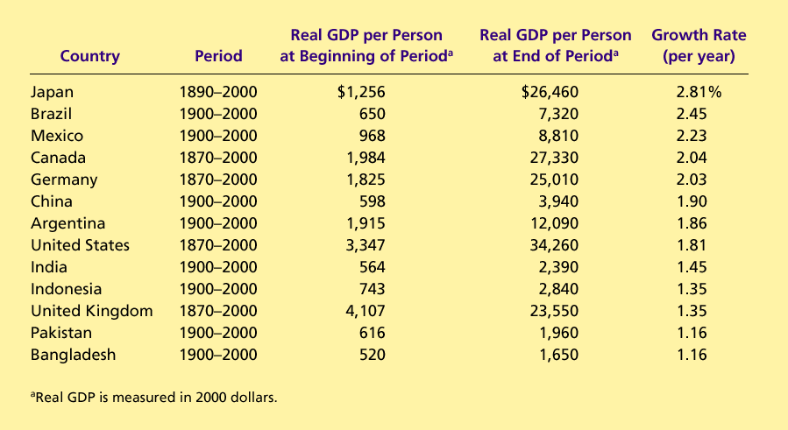
Table 1 The Variety of Growth Experiences
Copyright©2010 South-Western

Slide 9
Economic Growth around the World
  Compounding refers to the accumulation of a growth rate over a period of time.
Annual growth rates that seem small become large when compounded for many years.
  Although 2% growth might seem small, such an average growth rate implies that income doubles every 35 years i.e. 8 times per century.
  “the rule of 70”: if some variable grows at a rate of x percent per year, then that variable doubles in approximately 70/x years.

Slide 10
Why Productivity Is So Important?
Productivity plays a key role in determining living standards for all nations in the world.
  Productivity refers to the amount of goods and services produced for each hour of a worker’s time.
To understand the large differences in living standards across countries, we must focus on the production of goods and services.

Slide 11
How Productivity Is Determined?
The inputs used to produce goods and services are called the factors of production.
The factors of production directly determine productivity.
The Factors of Production
  Physical capital (K)
  Human capital (H)
  Natural resources (N) incl. labor resources (L)
  Technological knowledge (A)

Slide 12
How Productivity Is Determined?
Physical Capital (K)
  is the stock of equipment and structures that are used to produce goods and services.
    Tools used to build or repair automobiles.
    Tools used to build furniture.
    Office buildings, schools, etc.
  is a PRODUCED factor of production.
    It is an input into the production process that in the past was an output from the production process.

Slide 13
How Productivity Is Determined?
Human Capital (H)
  the economist’s term for the knowledge and skills that workers acquire through education, training, and experience
    Like physical capital, though less tangible, human capital is a produced factor of production that raises a nation’s ability to produce goods and services.

Slide 14
How Productivity Is Determined?
Natural Resources (N)
  inputs used in production that are provided by nature, such as land, rivers, and mineral deposits.
    Renewable resources include trees and forests.
    Nonrenewable resources include petroleum and coal.
  can be important (e.g. 19-century U.S., 20-century Kuwait, Saudi Arabia) but are not necessary (e.g. Japan) for an economy to be highly productive in producing goods and services.

Slide 15
How Productivity Is Determined?
Technological Knowledge (A)
  society’s understanding of the best ways to produce goods and services.
  differs from human capital which refers to the resources expended transmitting this understanding to the labor force.
    For example, quality of society’s textbooks is closely related but not the same as the amount of time that population has devoted to reading them.

Slide 16
FYI: The Production Function
Economists often use a production function to describe the relationship between the quantity of inputs used in production and the quantity of output from production.
Y = A F(L, K, H, N)
  Y = quantity of output
  A = available production technology
  L = quantity of labor
  K = quantity of physical capital
  H = quantity of human capital
  N = quantity of natural resources
  F( ) is a function that shows how the inputs are combined.

Slide 17
FYI: The Production Function
A production function has constant returns to scale if, for any positive number x,
xY = A F(xL, xK, xH, xN)
That is, a doubling (x=2) of all inputs causes the amount of output to double as well.

Slide 18
FYI: The Production Function
Production functions with constant returns to scale have an interesting implication.
  Setting x = 1/L,
  Y/ L = A F(1, K/ L, H/ L, N/ L)
    Where:
    Y/L = output per worker
    K/L = physical capital per worker
    H/L = human capital per worker
    N/L = natural resources per worker
The preceding equation says that productivity (Y/L) depends on physical capital per worker (K/L), human capital per worker (H/L), and natural resources per worker (N/L), as well as the state of technology, (A).

Slide 19
Economic Growth and Public Policy
Governments can do many things to raise productivity and living standards:
  Encourage saving and investment.
  Encourage investment from abroad
  Encourage education and training.
  Establish secure property rights and maintain political stability.
  Promote free trade.
  Promote research and development.

Slide 20
The Importance of Saving and Investment
One way to raise future productivity is to invest more current resources in the production of capital.
As the stock of capital rises, the extra output produced from an additional unit of capital falls; this property is called diminishing returns.
Because of diminishing returns, an increase in the saving rate leads to higher growth only for a while.

Slide 21

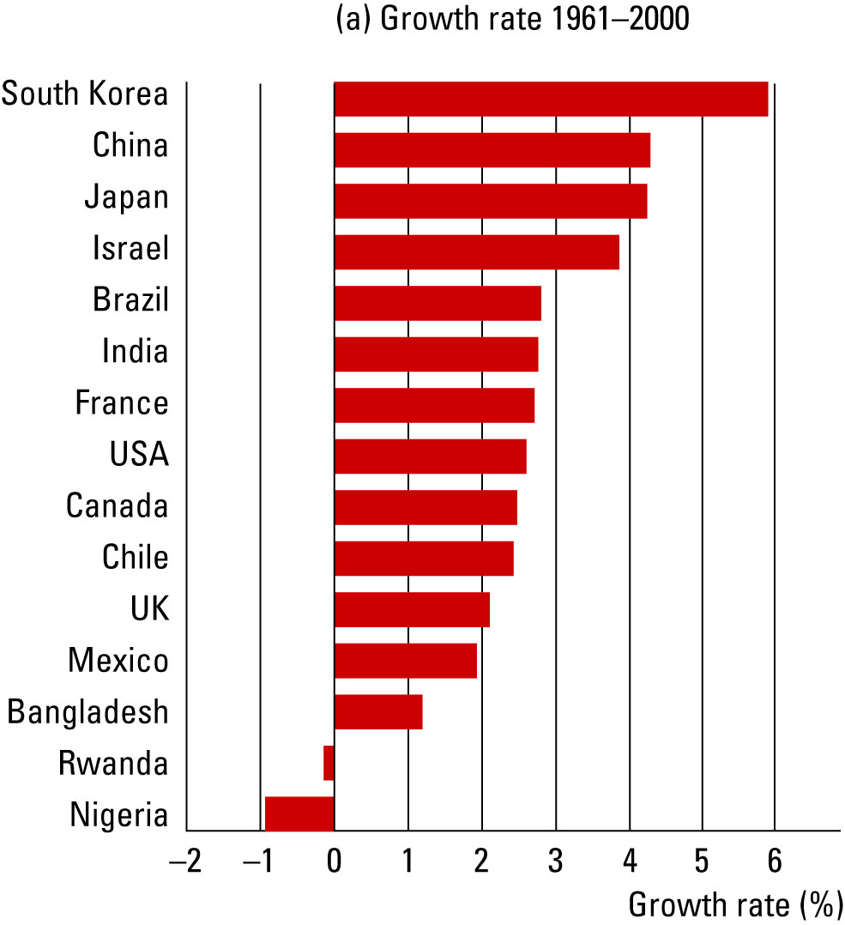
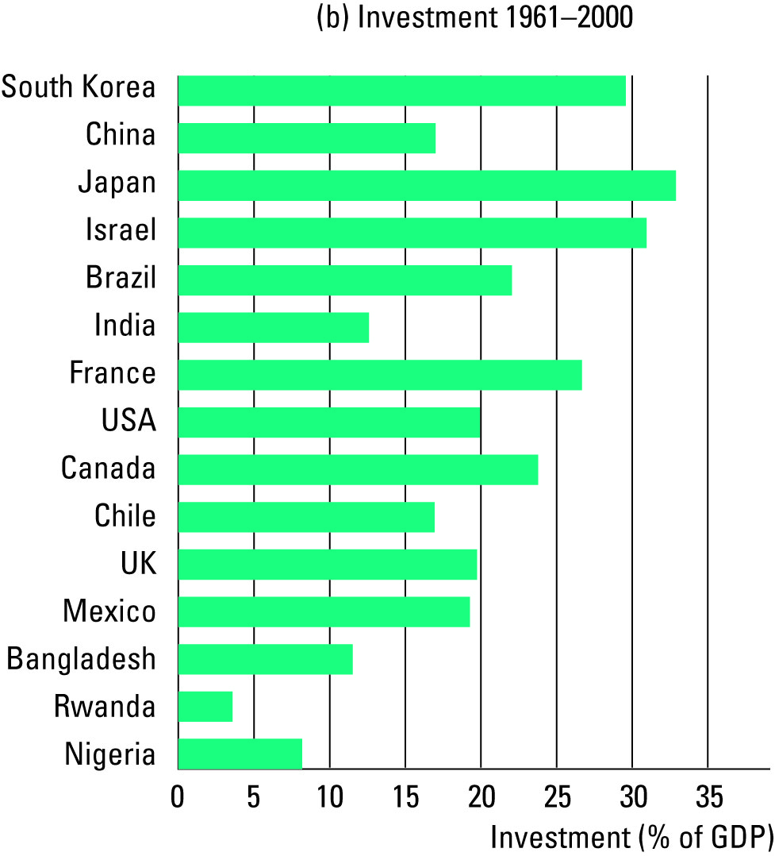
Figure 1 Growth and Investment
Copyright©2010 South-Western

Slide 22
Diminishing Returns and the Catch-Up Effect
In the long run, the higher saving rate leads to a higher level of productivity and income, but not to higher growth in these areas.
The catch-up effect refers to the property whereby countries that start off poor tend to grow more rapidly than countries that start off rich.

Slide 23
Investment from Abroad
Governments can increase capital accumulation and long-term economic growth by encouraging investment from foreign sources.
Investment from abroad takes several forms:
  Foreign Direct Investment (FDI)
    Capital investment owned and operated by a foreign entity.
  Foreign Portfolio Investment (FPI)
    Investments financed with foreign money but operated by domestic residents.

Slide 24
Investment from Abroad
Lesson from the World War II: Economic distress often leads to political turmoil, international tensions, and military conflicts.
World Bank – an international organization that tries to encourage the flow of investment to poor countries, set up together with its sister organization International Monetary Fund (IMF) after the World War II.

Slide 25
Education
For a country’s long-run growth, education is at least as important as investment in physical capital.
  In the developed economies of Western Europe and North America States, each year of schooling raises a person’s wage, on average, by about 10 percent.
  Thus, one way the government can enhance the standard of living is to provide schools and encourage the population to take advantage of them.

Slide 26
Education
On the one hand, investment in human capital has an opportunity cost – the wages students forego while being in school.
On the other hand, however, there is a positive externality of education – when an educated person generates new ideas about how best to produce goods and services, they enter society’s pool of knowledge and provide an external benefit to others. This justifies public investment in education.
One problem facing some poor countries is the brain drain – the emigration of many of the most highly educated workers to rich countries.

Slide 27
Property Rights and Political Stability
Property rights refer to the ability of people to exercise authority over the resources they own.
  An economy-wide respect for property rights is an important prerequisite for the price system to work and division of production among firms to be coordinated efficiently.
  In many less developed countries, the system of justice does not work well – contracts are hard to enforce and theft and fraud often go unpunished. This makes investment in business risky and discourages foreign investors.
  In more extreme cases, the government not only fails to enforce property rights but actually infringes upon them – to do business, firms are expected to bribe government officials. Corruption impedes the coordination power of markets and undermines the efficiency of market economies.

Slide 28
Property Rights and Political Stability
  Another threat to property rights is political instability. If a revolutionary government can confiscate the capital of some businesses, as was often true after communist revolutions, domestic residents have less incentives to save, invest and start new businesses.
A country with an efficient court system, honest government officials, and a stable constitution will enjoy a higher economic standard of living than a country with a poor court system, corrupt officials and frequent revolutions and coups.

Slide 29
Free Trade
Trade is, in some ways, a type of technology. When a country exports wheat and imports steel, the country benefits in the same way as if it has invented a technology for turning wheat into steel.
A country that eliminates trade restrictions will experience the same kind of economic growth that would occur after a major technological advance.

Slide 30
Free Trade
Some countries engage in . . .
  . . . inward-orientated trade policies, avoiding interaction with other countries.
    Policymakers in less-developed countries (esp. former colonies in Africa and Latin America) impose tariffs and other trade restriction following the infant industry argument – domestic firms claim they are too small and vulnerable and need protection from foreign competition in order to survive and grow competitive.
  . . . outward-orientated trade policies, encouraging interaction with other countries.
Landlocked countries find international trade more difficult and tend to have lower level of income than countries with easy access to the world’s waterways.

Slide 31
Research and Development
The advance of technological knowledge has led to higher standards of living.
  Most technological advance comes from private research by firms and individual inventors.
  Government can encourage the development of new technologies through research grants, tax breaks, and the patent system.

Slide 32
Population Growth
Population growth is a key determinant of country’s labor force.
Economists and other social scientists have long debated how population growth affects a society.
On the one hand, countries with large populations tend to produce greater GDP than countries with small populations.
On the other hand, population growth interacts with other factors of production:
  Stretching natural resources
  Diluting the capital stock
  Promoting technological progress

Slide 33
Population Growth
Reducing the rate of population growth is widely thought to be one way less developed countries can try to raise their standards of living.
  Example: China fines couples with more than one child.
Policies that increase awareness of birth control techniques and foster equal treatment of women are another way for less developed economies to reduce the rate of population growth without restricting their citizens’ freedom directly.

Slide 34
Summary
Economic prosperity, as measured by real GDP per person, varies substantially around the world.
The average income of the world’s richest countries is more than ten times that in the world’s poorest countries.
The standard of living in an economy depends on the economy’s ability to produce goods and services.
Productivity depends on the amounts of physical capital, human capital, natural resources, and technological knowledge available to workers.

Slide 35
Summary
Government policies can influence the economy’s growth rate in many different ways.
The accumulation of capital is subject to diminishing returns.
Because of diminishing returns, higher saving leads to a higher growth for a period of time, but growth will eventually slow down.
Also because of diminishing returns, the return to capital is especially high in poor countries.
Another way government can enhance the standard of living is to provide schools and encourage the population to take advantage of them.

Slide 36
Summary
Governments can also increase capital accumulation and long-term economic growth by encouraging investment from foreign sources.
To encourage domestic citizens to save and foreign firms to invest and do business locally, property rights and political stability need to be guaranteed in the country.
  Another way in which government can increase the long-term economic growth is to encourage the development of new technologies through research grants, tax breaks, and the patent system.
  It is widely thought that less developed countries can try to raise their standards of living by reducing the rate of their population growth.

