Slide 1
Global financial system
Lecturer – Oleg Deev
oleg@mail.muni.cz

Slide 2
Contents
Concept of the global financial system
Evolution of the global financial system
International reserve currency
Post-Bretton Woods global financial system
Institutions of global financial system
Financialization
Globalization of finance

Slide 3
What is a global financial system?
The Global Financial System refers to those financial institutions and regulations that act on the international level, as opposed to those that act on a national or regional level
This is the interplay of financial companies, regulators and institutions operating on a supranational level
The global financial system can be divided into regulated entities (international banks and insurance companies), regulators, supervisors and institutions

Slide 4
When the global financial system has emerged?
Birth of the global financial system is directly connected to the growth of international economic relations
International trade in a global scale started in the late 19th century
International trade is complicated by the fact that most nations have their own currency, and that the rules and regulations governing financial transactions vary widely between countries

Slide 5
Evolution of the global financial system (1)
Late 19th – early 20th centuries – little coordination of international finances
Gold standard – financial obligations were settled in currencies redeemable in gold
World War I involved vastly larger international capital flows than ever before
European nations such as Britain and Germany went deeply in debt, borrowing heavily from other nations, especially the United States
The Great Depression of the 1930s resulted partially from sharply declining international trade caused, in part, by high tariffs
World War II disrupted world trade and led to international cooperative arrangements to facilitate economic stability and growth

Slide 6
Evolution of the global financial system (2)
1944 – Bretton Woods Conference
John Maynard Keynes and Harry Dexter White successfully proposed a new international financial order
The International Monetary Fund (IMF) and the International Bank for Reconstruction and Development (World Bank) were created
Dollar was established as a main reserve currency (Keynes had argued against the dollar having such a central role in the monetary system, and suggested an international currency called Bancor used instead)
1947 – General Agreement on Tariffs and Trade (GATT - WTO)
Dramatic reductions in barriers to international trade
Led to the creation of a system of international financial arrangements and deeper economic / financial integration (especially EU, NAFTA)
1971 – Dollar’s convertibility into gold was suspended
1973 – Abandonment of fixed exchange rates

Slide 7
International monetary systems
Date | System | Reserve assets | Leaders
1803 - 1873 | Bimetallism | Gold, silver | France, UK
1873 - 1914 | Gold standard | Gold, pound | UK
1914 - 1924 | Anchored dollar standard | Gold, dollar | USA, UK, France
1924 - 1933 | Gold standard | Gold, dollar, pound | USA, UK, France
1933 - 1971 | Anchored dollar standard | Gold, dollar | US, G-10
1971 - 1973 | Dollar standard | Dollar | US
1973 - 1985 | Flexible exchange rates | Dollar, mark, yen | US, Germany, Japan
1985 - 1999 | Managed exchange rates | Dollar, mark, yen | US, G7, IMF
1999 - ? | Dollar, euro | Dollar, euro | US, Eurozone, IMF
Source: IMF

Slide 8
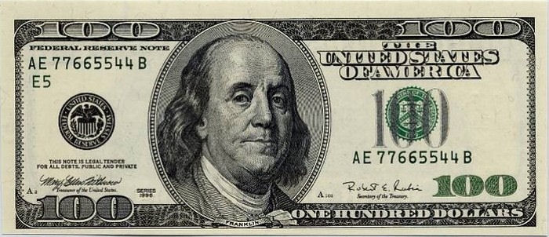
International reserve currency
is a currency used as a reserve or store of wealth, as if it were an asset itself
Source of wealth for whoever has the privilege to issue that currency
Un-cashed cheque at everyone else’s expense
Permits deficit financing (Vietnam and Iraq wars, current US bank bailout)

Slide 9
Historic role of reserve currencies
No reserve currency has ever been permanent
Reserve currencies reflects political power and authority
UK pound sterling is a reserve currency for more than 100 years
The exorbitant privilege refers to the benefit the country has in its currency being the international reserve currency: this country would not face a balance of payments crisis, because it purchased imports in its own currency (concept created by Valerie Giscard d’Estaing)

Slide 10
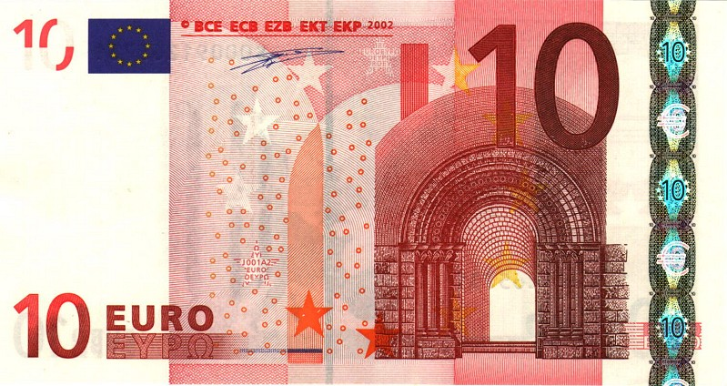
The exorbitant privilege for euro?
Operating reserve currency brings costs
Euro area lacks political will for unity and avoids promoting Euro as reserve
Euro area not de-coupled, but connected, to US crisis
Flight to quality is thus benefiting dollar

Slide 11
Global financial system based on US dollar
China’s dollar dependence (Not just China, but Brazil, India, Russia and oil-exporting Gulf states all similarly attached to US situation)
Reserve accumulation over $1tn
Power to destabilise US financial system but only at huge cost to itself
US domestic economy transformed (like in 19th century in UK) to financial services while neglecting exports, manufacture and jobs
Weaker dollar needed to stimulate US economy but counter-balanced against damage it does to its partners
US lacks surpluses given its economic weakness to sustain strong dollar as reserve

Slide 12
Features of the post-BW system
Volatility drastically increased
Contradicting expectations and orthodox economic predictions
Volatility created need to hedge against fluctuating prices
New markets in volatility-management tools: derivatives
Created marketplace for speculative profits and amplified the use of these tools
Assault on transparency
Vast majority of derivatives ‘OTC’ – over the counter and not traded on exchanges
Created mechanism to avoid supervision or regulatory oversight
New markets in derivatives allowed huge profit opportunities via speculation on price movements that were disconnected from real economic activity

Slide 13
Post-BW global financial system
Financial crises have been more intense and have increased in frequency by about 300%
All financial crises since 1971 have been preceded by large capital inflows into affected regions
Investors have frequently achieved very high rates of return, with salaries and bonuses in the financial sector reaching record levels

Slide 14
Institutions of global financial system
International Institutions
IMF - keep account of international balance of payment of members states, also acts as lender of last resort
World Bank - provide funding, take up credit risk and offer financial favorable terms to development projects in developing countries
WTO - negotiate international trade agreements, settles trade disputes
Bank for International Settlements (BIS)
Institute of International Finance (IIF)
Government institutions
Financial ministries, tax authorities, central banks, securities and exchange commissions, etc.
Private participants
Commercial banks, pension funds, hedge funds, etc.
Regional institutions
Eurozone, NAFTA, CIS, Mercosur

Slide 15
Bank for International Settlements
is an intergovernmental financial organization of central banks which fosters international monetary and financial cooperation and serves as bank for central banks
Regulates capital adequacy
Encourages reserve transparency
Leads the changes of banking regulation and supervision through the Basel Committee on Banking Supervision passing global regulatory standards (Basel II, Basel III)

Slide 16
Institute of International Finance
is the world’s only global association of financial institutions
Providing analysis and research to its members on emerging markets and other central issues in global finance
Developing and advancing representative views and constructive proposals that influence the public debate on particular policy proposals, including those of multilateral agencies, and broad themes of common interest to participants in global financial markets
Coordinating a network for members to exchange views and offer opportunities for effective dialogue among policymakers, regulators, and private sector financial institutions

Slide 17
The era of financialization
Developed countries’ financial systems exploded relative to other parts of economy, particularly the role of banks
Climate of greater general indebtedness and increased gearing (debt to equity ratios)
Financial assets and debts become larger proportion of GDP
Banks strategically became focused upon commissions business and speculative operation

Slide 18
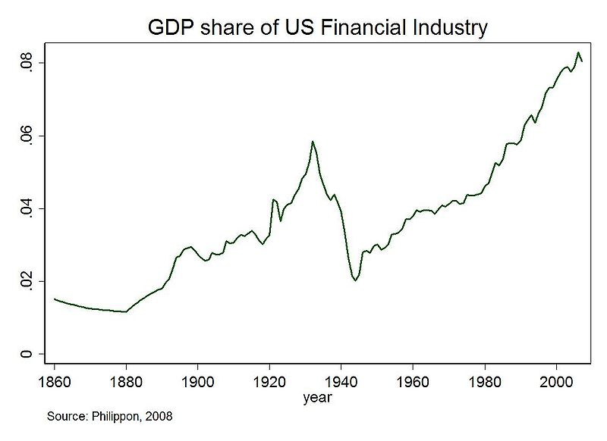
GDP share of US financial industry

Slide 19
Bank assets, $ billions

Slide 20
Financialization
Speculative price bubbles
Debt being used to inflate value of assets against which more debt is raised to re-start the cycle
Financial innovation
Also used to evade legislative oversight, e.g. 1999 Amendment to US Community Reinvestment Act which excluded banks’ mortgage investment in securities from scrutiny – then sub-prime lending doubled from 2001 to 2006
Policy mistakes
Ignored bubbles and stoked consumer spending via indebtedness

Slide 21
CDS contracts outstanding in $ billions

Slide 22
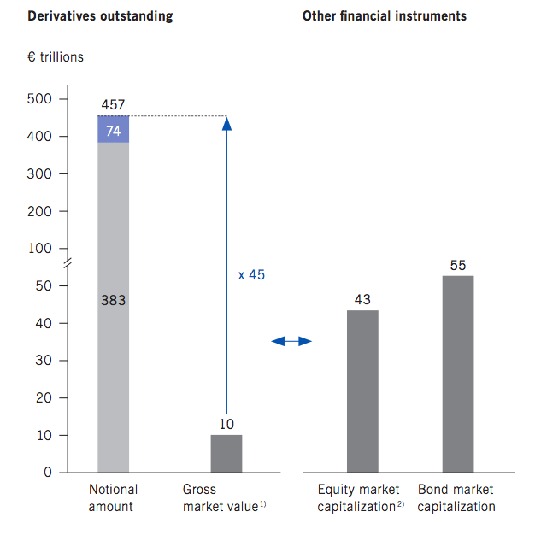
Growth in derivatives

Slide 23
Key features of international financialization
Liberalisation of capital account
Capital flows increasingly taking form of FDI and portfolio investment
Inflation targeting priority over growth, jobs, health or other social outcomes to protect value of investment capital

Slide 24
Globalization of finance
Financial institutions are forced to cultivate strategic partnerships that allow them to be competitive and offer diverse services to customers
Reasons for globalization in financial services:
Economic integration
Deregulation of financial intermediation
Augmentation of domestic savings
Lower cost of capital due to better risk allocation
Transfer of technology
Enhancement of capital inflows by signaling better policies
What are advantages and disadvantages of globalization?

Slide 25
Readings for the next topic
Geisst, C.R. (2009). Globalization and the US Financial System. US Department of State eJournal, vol.14, 5, pp. 13-16.
Levine, R. (2010). An autopsy of the US Financial System: accident, suicide, or negligent homicide. Journal of Financial Economic Policy, vol.2, 3, pp. 196-213.
Trachtman, J.P. (2009). Global Financial Trouble: Causes, Cures, Responses. US Department of State eJournal, vol.14, 5, pp. 23-26.

