Slide 1
China’s economic transition
Lecturer – Oleg Deev
oleg@mail.muni.cz

Slide 2
Contents
Key factors of economic development
Chinese central-planned economy vs. Soviet central-planned economy
Motivation for the economic transformation
Objectives and goals of the transformation
Reformation process
Results
Reasons for success
Challenges for the future

Slide 3
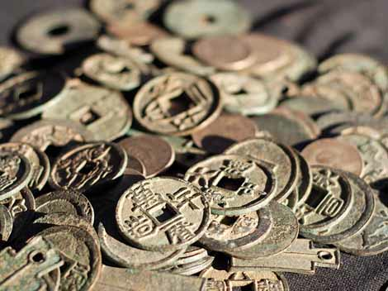
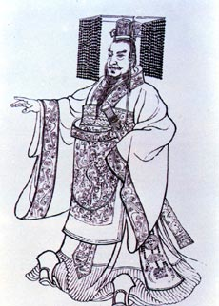
Key factors of economic development
One of the world’s earliest civilization

Slide 4
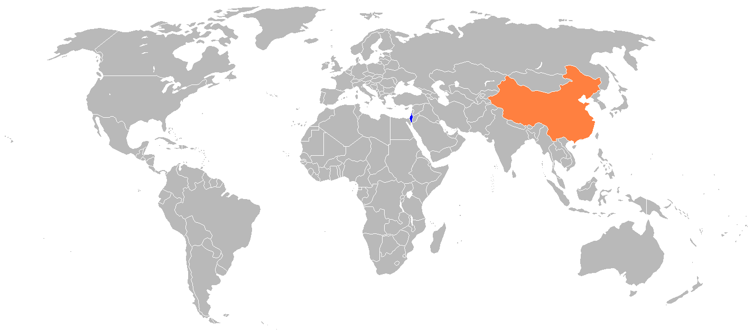
Key factors of economic development
The second largest country in the world by land area - 9,6 billion km²

Slide 5
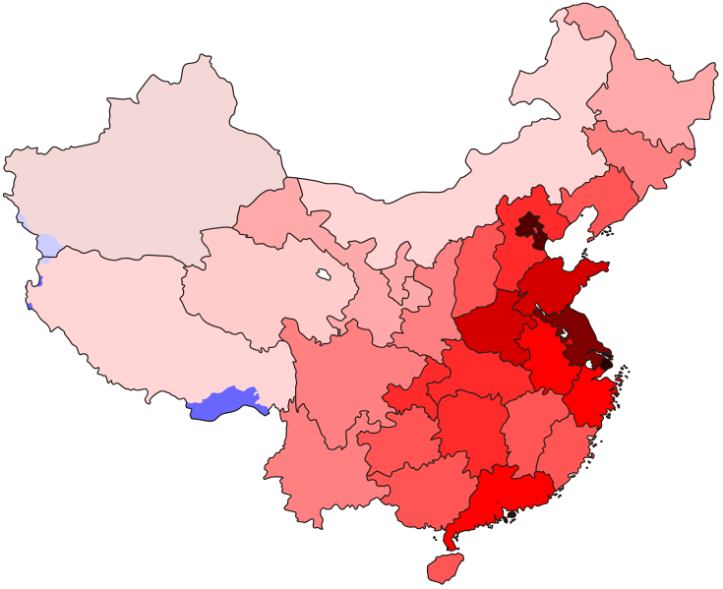
Key factors of economic development
The most populous state in the world - over 1.3 billion people
A population density map
The eastern, coastal provinces are much more densely populated than the western interior.

Slide 6
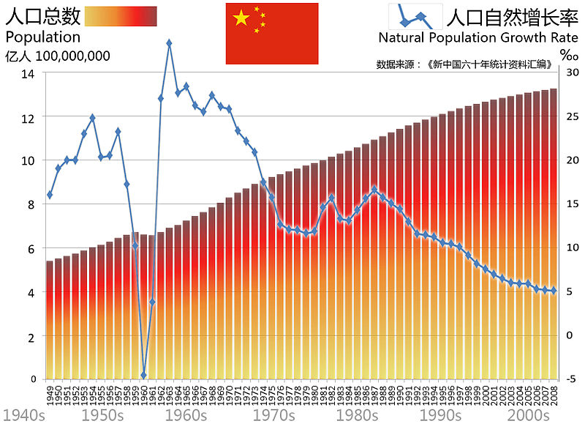

Slide 7
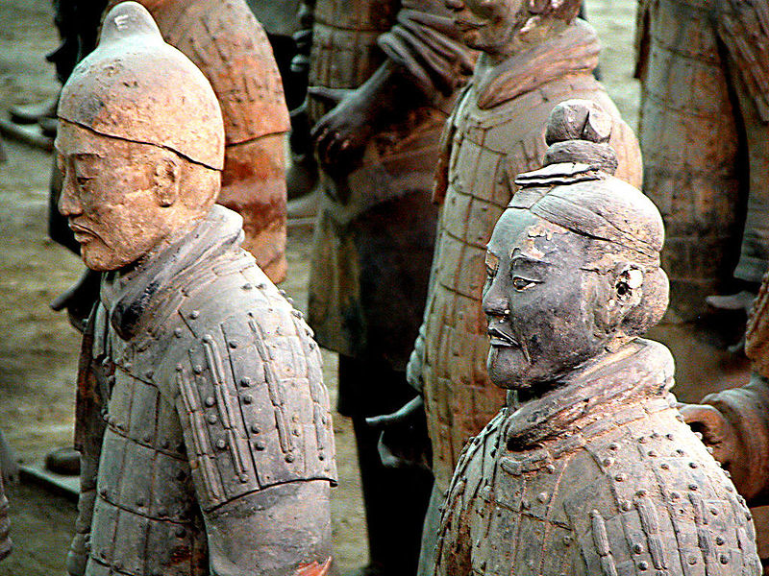
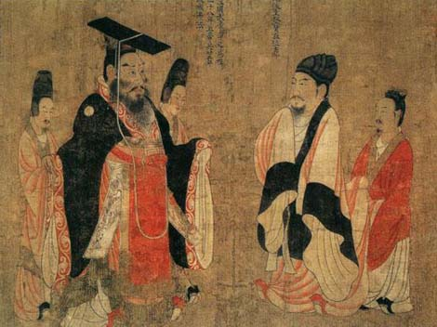
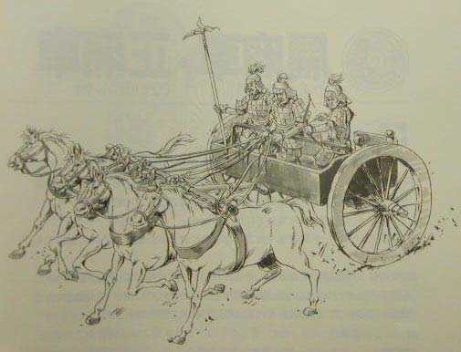
Key factors of economic development
Authoritarian nature of governance to control people and territory

Slide 8
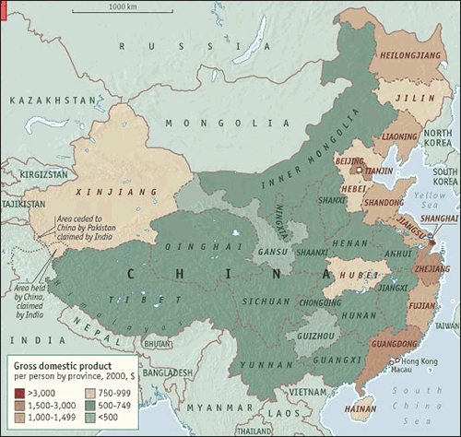
Key factors of economic development
Disparities between coastal and inland provinces
Shanghai
Hong Kong
Beijing
Tianjin
Chongqing

Slide 9
Important Years
1911: End of traditional economy
1937: Wars
1949: Communist party taking control
  Radical change in government
  Rapid and modern economic growth (sometimes turbulent)
    Develop a massive socialist industrial complex through direct government control
    Inward-directed strategy rather than the coastal enclave industrialization
1978: Reform and opening

Slide 10
The “command economy” system
The government directly control all large factories, transportation, communication, land, and farms
Planners assign production targets to firms and allocate resources and goods among different producers
Investments are made by the governments. Fiscal revenues mainly come from state-owned firms’ profits
Prices do not reflect market demand and supply. Government can increase revenue by setting goods’ prices (e.g. prices of labor and raw materials are set low and those of industrial goods are set high)

Slide 11
Difference between the economic systems of China and Soviet Union
The core planning system in China was much less centralized and much less tightly controlled
  Transportation and communication were less developed in China
  The system in China allocates a maximum of 600 varieties of industrial product. The Soviet Union had allocated 60,000 separate commodities by 1970s
  More authority could be exercised by those in the middle, typically local government officials

Slide 12
Why China turned around in 1978
The heavy-industry-and-closed-economy strategy could not let China continue high growth rate
  Agricultural output can not keep pace with industrial growth
Unsatisfied people – not confident in communism as a political system (1979-1992)
  Massive drop in living standards
  Suppressed consumption
  Lack of mobility
  Urban-rural gap
  Destruction of much traditional culture
Death of Mao in 1976

Slide 13
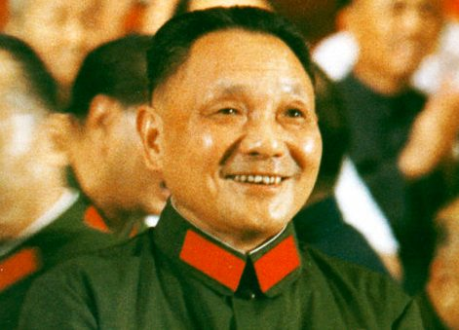
Deng Xiaoping (1985)
The Chinese reform is a great experiment, something that is not described in books

Slide 14
Deng Xiaoping
Identified several policy errors that contributed to the failure of the Soviet Union and its satellites:
  The Soviet economy could not sustain the costs of the Soviet Union’s global military confrontation with the United States during the Cold War
  The liberalization of the political system in Soviet Union and its satellites before economic reforms could produce prosperity allowed dissatisfied electorates to vote the communists out of power

Slide 15
Objectives
To adopt market-oriented economic policies and institutions and open country to international trade and investment
To keep Communist Party of China in power (to redefine communism)
  Program called “Socialism with Chinese characteristics“

Slide 16
Goals
1980s - To introduce economic policy changes gradually
  To conduct experiments in special economic zones
  To revise the results, and only then adopt the new economic policies throughout China
1990s – Export-promotion development strategy
  To liberalize the market for international trade and investment
  To reform the price system
  To correctly align domestic incentives
  To import needed management skills and technology
To establish a macroeconomic-control mechanism to exercise monetary and fiscal policies

Slide 17
Special Economic Zones (SEZs)
Economic activities are primarily driven by market forces
Established in 4 coastal cities and 15 coastal development areas
Encourage Foreign Investment through tax incentives
  Capital Inflows
  Technology
  Knowledge of Rest of World (Chinese Diaspora)
Encourage Production for Export
Contrast with Self-Reliance

Slide 18
Reform in agricultural sector
Initiated locally
Assigning the collective farm land to each farm household
Allowing households to keep all the products in excess of the amount required by the procurement quota
Farmers decide what and how to plant

Slide 19
The agricultural production, tons
Crop | 1949 output | 1978 output | 1999 output
Grain | 113,180,000 | 304,770,000 | 508,390,000
Cotton | 444,000 | 2,167,000 | 3,831,000
Oil-bearing crops | 2,564,000 | 5,218,000 | 26,012,000
Sugarcane | 2,642,000 | 21,116,000 | 74,700,000
Fruit | 1,200,000 | 6,570,000 | 62,376,000
Meat | 2,200,000 | 8,563,000 | 59,609,000

Slide 20
Reform in industrial sector
Early 1980’s – state enterprises were given some autonomy in production, distribution and investment decisions
Middle 1980’s – price and input control were gradually reduced
1987 – the contract responsibility system
  An enterprise was leased to its management and a fixed tax was collected from the enterprise, allowing the enterprise to keep all the remaining profits

Slide 21
Gross Domestic Product

Slide 22
Reform of the banking system
1983 – the People’s Bank was officially changed to a central bank
The conversion of the state specialized banks into commercial banks – 60% of the domestic banking business
  the Industrial and Commercial Bank
  the Agricultural Bank
  the People’s Construction Bank
  the Bank of China
1994 - three types of banks: commercial banks, policy banks and cooperative banks, with an increasing role for private banks

Slide 23
Reform of the banking system
Commercial banks do not function effectively?
  Political interference (banks are under government ownership)
  Lack of trained personnel
  The control for interest rates for loans and deposits
  Insufficient incentives
Banking crisis in China is nearly impossible
  An asset management company is set up for each of the large commercial banks to take over non-performing loans
  Chinese people keep most of their savings as bank deposits (They assume that deposits are guaranteed by the government and are save)

Slide 24
The open-door policy
The volume of foreign trade has increased from just below 10 percent of GDP in 1978 to over 35 percent in 1996
Trade deficits in the 1970s and the 1980’s were changed to trade surpluses in the 1990s
Control of foreign exchanges was gradually relaxed
  successive devaluation of the Chinese currency from 1.7 yuan / US dollar ratio in 1980 to 8.6 in 1994, the exchange rate was made equal to the market rate and the Chinese currency became convertible as far as trade transactions were concerned
The encouragement of foreign investment

Slide 25
Exchange rate (yuan / US dollar)

Slide 26
Direct foreign investment

Slide 27
Development of non-state sectors
Permission for entrepreneurs to start up business
Collectively owned township and village enterprises
  were built by the political and economic resources of the township and village governments to increase revenue
  are subject to market competition
  employ the managerial skill of competitively selected and highly paid managers
  utilize the high-quality labor force available in the countryside
  publicly owned
  are operating without a modern legal framework

Slide 28
GDP growth rate, %

Slide 30
Unemployment rate, %

Slide 31
RESULTS
The world’s second largest economy
The largest trading nation
The largest recipient of FDI in the developing world
Income per capita increased 6 fold
Never before in history have so many millions of people been lifted out of poverty in such a short time

Slide 32
Is China the only country that has been growing so fast?
No. Many other economies have been growing rapidly in the past decades – so poor to begin with
  Other east Asian economies
But China is the one that grow the fastest and for the longest period, in terms of GDP per capita
  China: over 30 years of growth with high growth rates
Possibly growth rate will slow as western income levels would be approached

Slide 33
Why the reforms were successful?
China enjoyed the advantages of backwardness
Planning was less entrenched in China than it has been in other transitional economies
China had always had a strong administrative capacity
Properties of the labor force
  Large labor pool
  Skilled and disciplined
  Lower cost – average $1 per hour and work 58 hours/week
  No organized unions
Exports inexpensive low and medium tech goods
Imports technologies

Slide 34
Challenges for the future
Unfavorable demographics
Corruption, transparency and weak rule of law (guanxi)
Financially distressed state-owned and state-influenced enterprises
Domestic and international imbalances

Slide 36
Rural and urban population share, %

Slide 37
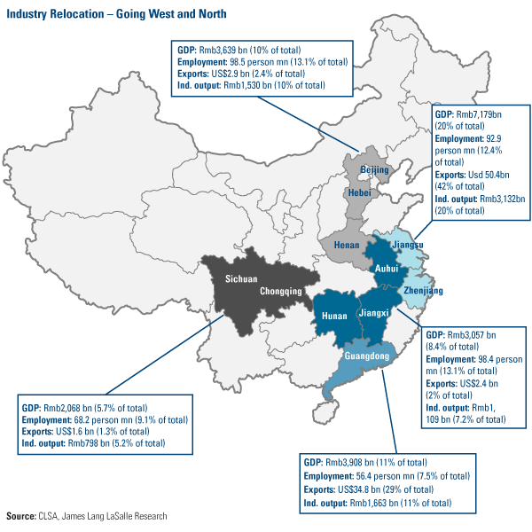

Slide 38
Imbalances in China’s economy
Momentum of economic growth
  Economic growth is driven by investments and exports
Economic distribution
  Income distribution – gaps in living standards (between urban and rural areas, between state employees and workers, etc.)
Financial flow
  Banks overfunded monopolized state-owned enterprises and real estate industry
Use of economic resources
  Most of China’s economic resources are utilized by government (capital, land and cost of labor are all controlled)

Slide 39
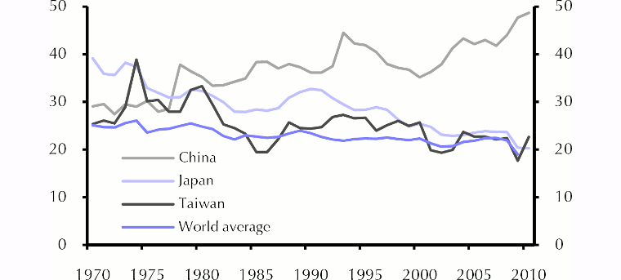
Drivers of economic growth in China
Investment as a proportion of GDP

Slide 40
Additional materials
Australian TV reportage “China’s Ghost Cities” available at: http://www.sbs.com.au/dateline/story/watch/id/601007/n/China-s-Ghost-Cities
Additional web-chapter to McConnell’s book “Transition Economies: Russia and China” (available at the Study Materials)

