Slide 1
MACROECONOMICS I
Class 12. The Labor Market
May 23rd, 2014

Slide 2
Announcements
Final Exam: May 30th, 10:30 – 12:30, S6
Closed-book exam; bring your calculator!!!
Project deadline: May 30th, before exam, hard copy
Project checklist:
Summary of the article (main issue)
Placing the issue in the context of our course
General theory behind the issue
Your opinion about the article and the issue
NO more than 4 pages !

Slide 3
Goals of the Economy
Economic growth
External balance (avoiding trade deficit)
Price-level stability (low inflation)
Low unemployment rate (full employment)
Conflicting goals in the short run

Slide 4
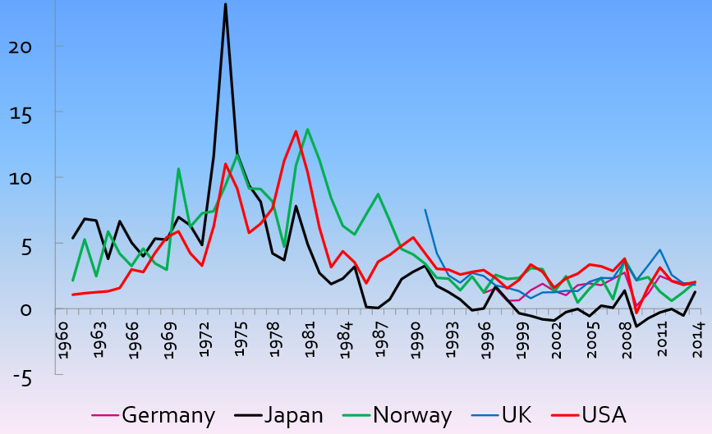
Inflation in Selected Countries
Source: OECD statistical database

Slide 5
Real Exchange Rate
Nominal ER: Amount of national currency you pay for a unit of foreign currency
Real ER: Relative price of foreign goods to domestic goods at the prevailing exchange rate (competitiveness)
A rate at which we can trade goods and services of one country for that of another
Measuring RER
Using a simple representative good
Using the overall price level
w/r to a single country or all trading partners

Slide 6
Real Exchange Rate (Cont.)
TE Price of McDonalds’ hamburger in CR is 35 CZK
Price of McDonalds’ hamburger in Vienna is 1 Euro
Comparing prices of hamburgers: converting into common currency
Nominal exchange rate: 1 euro = 27 CZK
Price of Austrian hamburger (in CZK) = 1 * 27 = 27 CZK
Price of Czech hamburger = 35 CZK
RER = 27/35 = 0.77
=> Hamburgers in Austria are 30 % cheaper than in CR (when expressed in the same currency)

Slide 7
Real Exchange Rate (Cont.)
Measuring RER using a basket of representative goods
Price level in Czech Republic (P)
Price level in Austria (P*)
Nominal exchange rate: 1 euro = 27 CZK
Real ER = Nominal ER ∙ P* / P
P and P* represent CPI or GDP Deflator price indexes
How expensive, on average, foreign goods are relative to domestic
RER = 1.2 => average consumer prices abroad are 20 % higher than at home, relative to a chosen benchmark

Slide 8
Real Exchange Rate (Cont.)
What is the value of RER if the PPP holds?
When RER diverge from PPP, the nominal exchange rate experiences pressure to adjust
Three determinants: P, P* and nominal ER
A real exchange rate appreciation and depreciation
Overvalued currencies (RER<1) => pressure to depreciate
Undervalues currencies (RER>1) => pressure to appreciate

Slide 9
Source: FED statistics

Slide 10
Causes of Inflation
Demand-pull inflation
Cost-push inflation
Increase in M^{S}
Increase in aggregate demand (through inputs market)
Increase in the costs of production independent of demand
M^{S} growth faster than Y
“Inflation is always and everywhere a monetary phenomenon, in the sense that it cannot occur without a more rapid increase in the quantity of money than in output.” M. Freedman

Slide 11
Short Run vs. Long Run
Quantity Theory of Money
In the long run:
Real output (Y) is determined by available L, K, and A
Velocity is constant (empirical fact)
Increase in M^{S} leads only to an increase in P
Money neutrality: changes in M^{S} do not affect REAL variables
Empirical tests: long-run + across countries

Slide 12
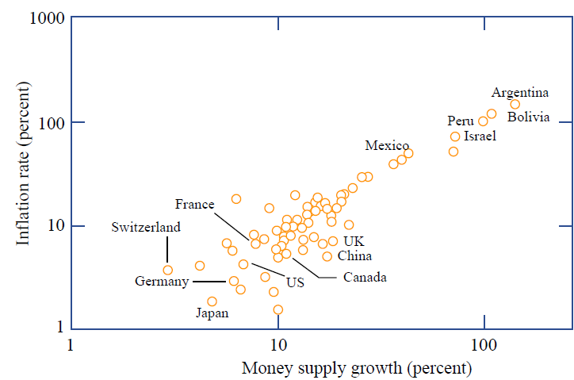
Average Inflation Rates & Money Supply Growth
Source: Mankiw, 2012

Slide 13
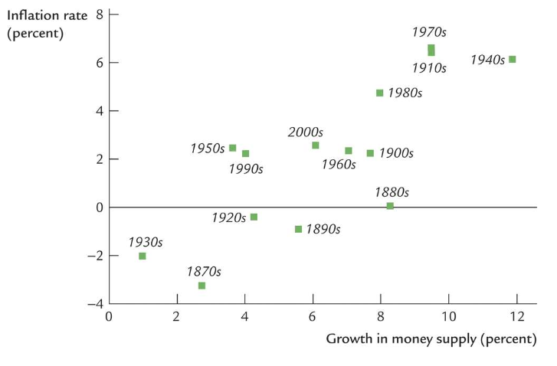
The Quantity Theory in the US Across Time

Slide 14
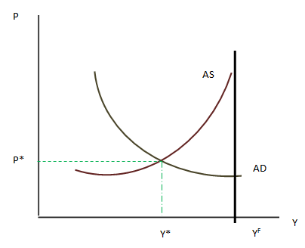
AD-AS Model: The Equilibrium
Equilibrium: Y* and P*

Slide 15
Costs of Inflation
Fall in the real value of savings
Fall in net exports
Fall in investment expenditures
Fall in GDP
Increase in unemployment
Redistribution of real income (decreasing liabilities of debtors and assets of creditors in real terms)
Loss of the purchasing power? => Money neutrality

Slide 16
The Labor Market: Major Players
DEMAND
SUPPLY
Firms
Labor Force
Labor
Wages
Working age 15-65
Employed + Unemployed
Non-institutionalized
Government
Minimum wage
Unemployment insurance
Training programs
Labor unions
Wage bargaining
Protection of rights

Slide 17
Structure of the Labor Force
Working-age population
Labor Force
Out of Labor Force
Retirees
Stay-home mothers
Students
Institutionalized
Military
Discouraged
Employed
Unemployed
Participation rate:
TE Participation rate in Czech Republic in 2012 was 58.8 %
Males: 67.8 %
Females: 50.1 %

Slide 18
Structure of the Labor Force (Cont.)
TE Czech Republic in 2005
Total population: 10.2 mil
Working age population: 70.5 %
Out of labor force: 3.5 mil
Working age population (mil):
Labor force (mil):
Participation rate:

Slide 19
Labor Force: Unemployed Population
A person without a job who puts efforts to find one
Unemployment rate: Percentage of the labor force not working but looking
A summary measure of the health of the labor market
Low unemployment rate => Tight labor market
Can the unemployment rate be equal to 0?
Generally NO

Slide 20
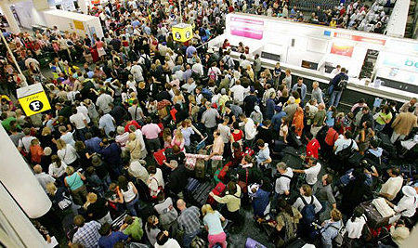
Unemployment Rate (Cont.)
Active or stagnant labor market?
Average duration of unemployment and its type

Slide 21
Unemployment Rate
Limitations
Does not say anything about unemployment duration
Long-term unemployment – more than 1 year
Does not distinguish between full-time and part-time employment
Very difficult to distinguish between unemployed and those out of labor force
Discouraged workers: people who report being out of labor force, but in fact may be willing to work (gave up after unsuccessful search)
Underemployment (skill waste)

Slide 22
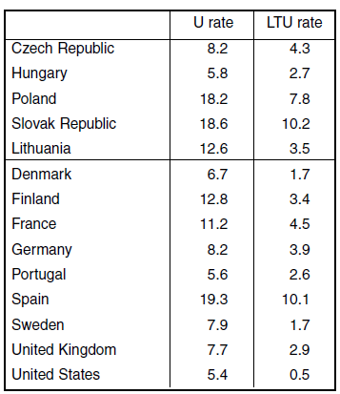
Unemployment and Long-Term Unemployment Rates
Average for the period 1991-2001
Average duration of unemployment in 2012
The US – 5 month (the lowest!)
EU – 27 months
France – 40 month
Czech Republic – 12 months
Slovakia – 26 months
Source: OECD.StatExtracts

Slide 23
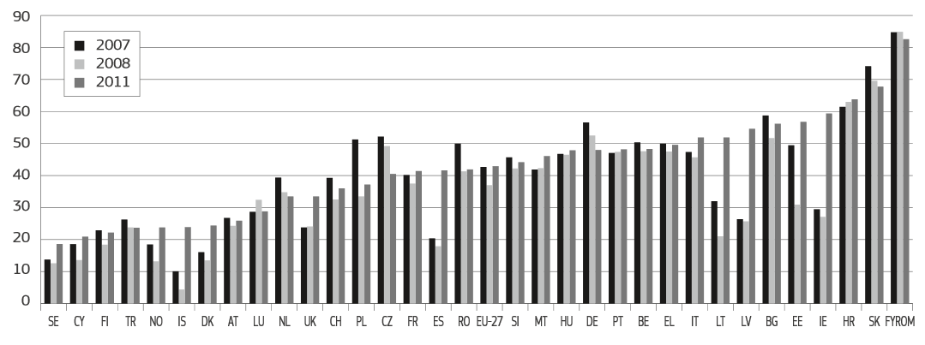
Long-Term Unempl. as a % of the Total Unemployment

Slide 24
Measuring Labor
TE In the US: Bureau of Labor Statistics (BLS)
Current Population Survey (monthly): 60,000 households
People who are working
People who are not working but looking
People who are not working and not looking (out of labor force)
In Czech Republic: National Statistical Office (CZSO)
Quarterly Labor Force Sample Survey: 26,500 households

Slide 25
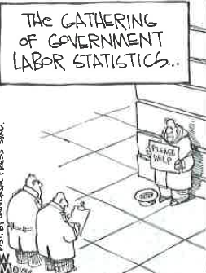
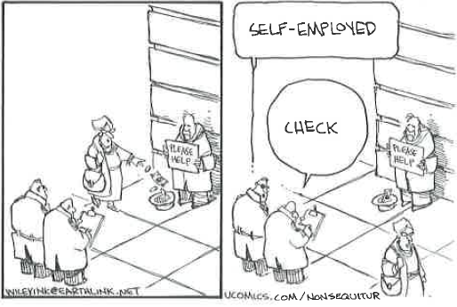

Slide 26
Categories of Unemployment
Why there is unemployment in the economy?
Short term
Frictional Unemployment
Qualified individuals with transferable skills that move between jobs/careers
Outcome of the labor market turnover
A sign of healthy economy
It takes time for workers to find jobs that are best suited for them
Special case: Seasonal unemployment: move b/w jobs that change with seasons
Increases with an increase in unemployment benefits

Slide 27
Unemployment Insurance
Country | Initial phase of unemployment |  | Long-term unemployment
 | Single person | Married with 2 children | Single person | Married with 2 children
Czech Republic | 50 | 54 | 31 | 71
France | 71 | 76 | 41 | 70
Germany | 61 | 78 | 61 | 68
Greece | 46 | 50 | 0 | 3
Italy | 52 | 60 | 0 | 0
Netherlands | 71 | 78 | 58 | 72
Norway | 66 | 73 | 42 | 64
Slovak Republic | 62 | 72 | 42 | 91
Spain | 70 | 75 | 27 | 41
Sweden | 81 | 83 | 51 | 78
UK | 45 | 46 | 45 | 73
USA | 56 | 53 | 7 | 41
Average duration
1 year in general
4-5 years in Netherlands and Denmark
Unlimited in Belgium

Slide 28
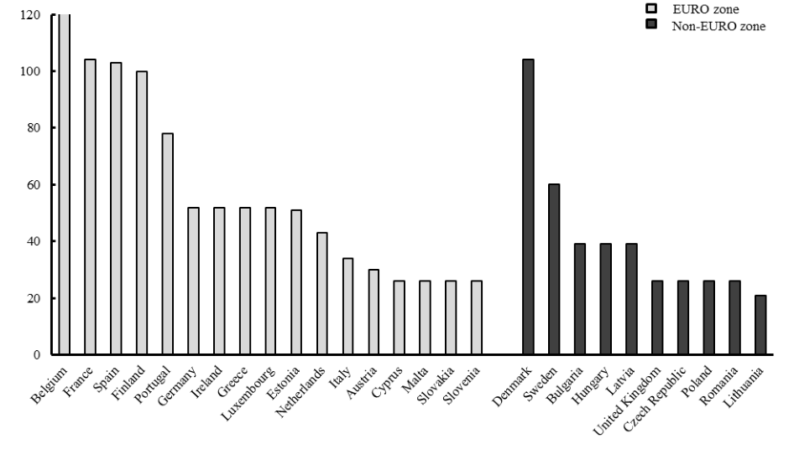
Duration of Unemployment Benefits (in weeks), 2010

Slide 29
Categories of Unemployment (Cont.)
Long term
2. Structural Unemployment- changes in the technology and foreign competition
A whole industry dies
A mismatch between necessary skills and skills of the labor force
A sign of innovative society
TE NAFTA
Back to school (re-training)
3. Cyclical Unemployment - follows the business cycle
Economic contractions
Difficult to predict when jobs would come back (all cycles are different)

Slide 30
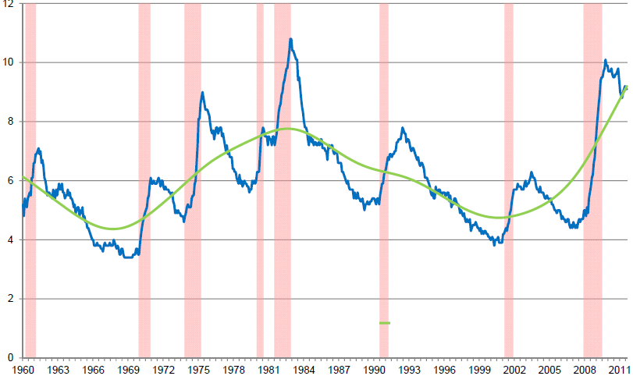
Business Cycle and Unemployment
TE The US Unemployment rate during 1948-2008
Ump. Rate
Source: Mankiw, 2012

Slide 31
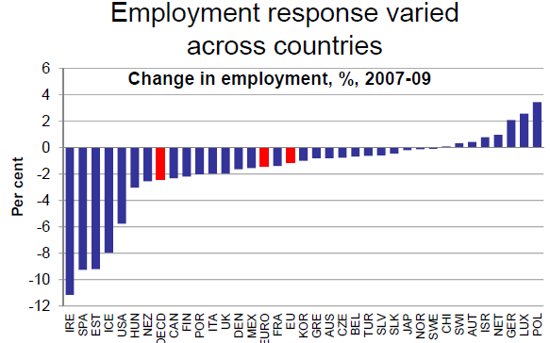
Recession of 2007-2009
Source: Pissarides, 2012

Slide 32
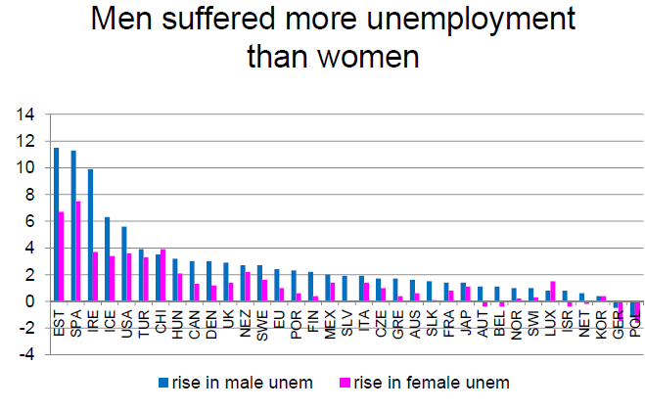
Recession of 2007-2009
Source: Pissarides, 2012

Slide 33
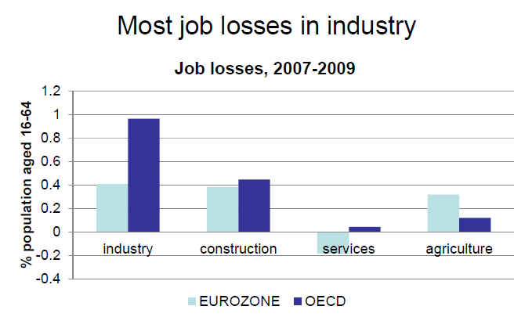
Recession of 2007-2009
Source: Pissarides, 2012

Slide 34
Natural Rate of Unemployment
Unemployment rate when the business cycle component is eliminated
Only frictional and structural unemployment
Always positive in dynamic economies, when the free movement of labor is allowed
=> Full employment => Potential GDP
Determinants
Demographics
Older labor force => Less frictions => Lower natural rate
Government unemployment insurance
More generous benefits => Higher natural rate
Wage rigidity: Minimum-wage laws
Efficiency wage

Slide 35
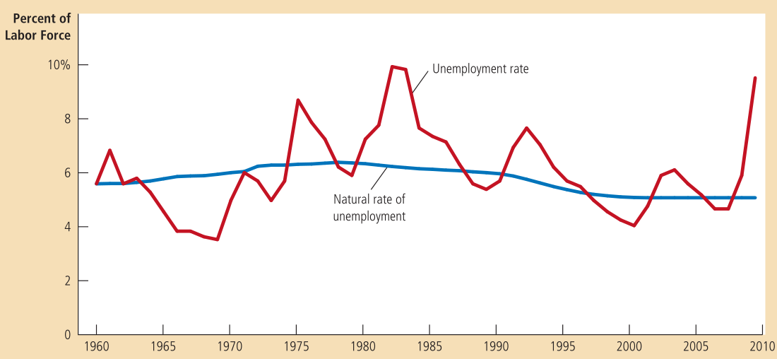
Natural Rate of Unemployment , the USA
5 %

Slide 36
Minimum Wage
Wage rigidity – the failure of wages to adjust to the equilibrium level
A legal minimum on wages set by the law
In the range of 30-50% of the average wage in manufacturing
Objective: Rising the income of working poor
Major criticism: Increases unemployment
Causes teenagers to drop out of school
Prevent low skilled workers from the participation in training programs

Slide 37
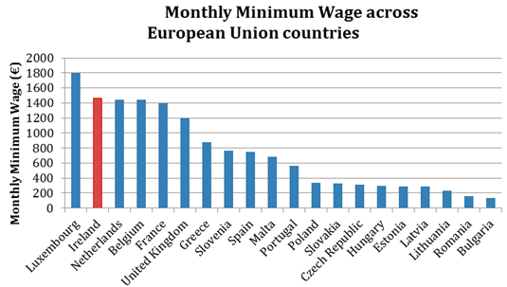
Gross minimum wages Euros per month, 2012
Source:

Slide 38
Labor Supply and Labor Demand
Aggregate supply: the sum of individuals’ labor supply
Extensive margin: Whether or not participate in the labor market?
Intensive margin: For participants, how many hours of labor to supply
Most variations in labor supply is due the extensive margin (new entries)
Two goods: Consumption and leisure
Wage is the opportunity cost of leisure
Reservation wage – the wage such that the agent participates in the labor market
At the reservation wage workers are indifferent b/w staying on the job or leaving
A famous supermodel once said that she would not get out of bed for less than $10 000 (presumably per day)
Labor Demand: maximization of profits/ minimization of costs

Slide 39
The Labor Market: Equilibrium
Hourly wage, W
Unemployment
Minimum wage
Labor hours , Q
N!B! Minimum wage results in the unemployment increase
Different markets for different skills types
The most affected are the least skilled whom the policy is intended to help

Slide 40
Increase in Minimum Wage
Assume the government raises the minimum wage.
What does this do to the natural rate of unemployment?
Do these effects arise by changing the amount of frictional
unemployment or by changing the amount of structural unemployment?

Slide 41
Unionization
Organization of workers in some industry that bargains with firms about wages and working conditions
The wages of union workers are determined by the bargaining between union leaders and firm management
Higher than equilibrium wages
Wage effect
Union status increases wages of workers by 10-20 %
Outsiders are hurt by low fewer job offerings

Slide 42
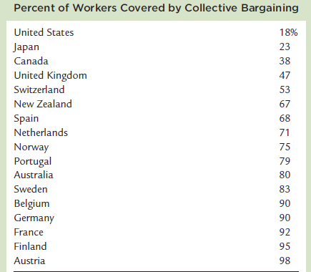
The Importance of Labor Unions
Source: Mankiw, 2009

Slide 43
The Role of Labor Unions (Cont.)
Unions in the US have become considerably weaker and less prevalent since the 1950s. What did this do to the natural rate of unemployment?
2. Did these effects arise by changing the amount of frictional unemployment or by changing the amount of structural unemployment?

Slide 44
Wage Distortion: Efficiency Wage
Improve workers productivity and effort
Reduce labor turn-over
Improves average quality of the firm’s work force
TE Ford Motor Company
In 1914 the company started paying workers $5 per day
“We wanted to pay these wages so that business would be on a lasting foundation… The payment of $5 per day was one of the finest costs cutting mover we ever made” Henry Ford

Slide 45
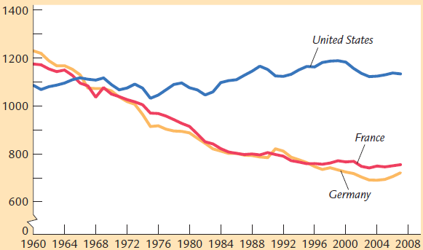
American vs. European Labor Markets
Annual hours worker per person
Source: Mankiw, 2009

Slide 46
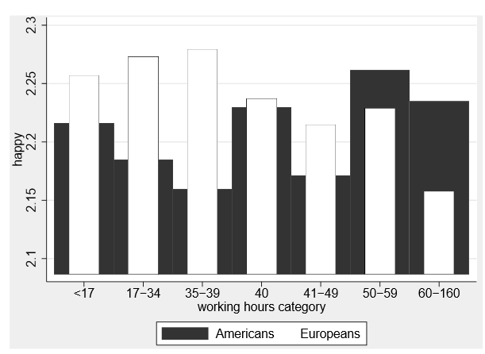
Happiness by Working Hours in the US and Europe
Source: Okulicz-Kozaryn, 2013

Slide 47
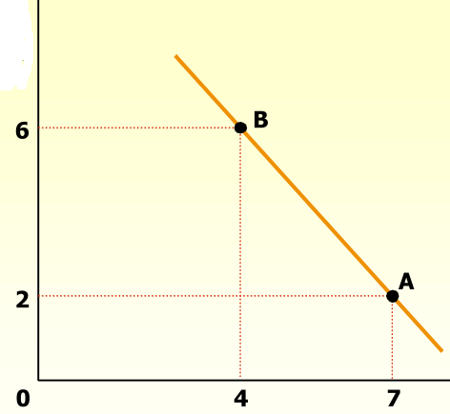
Inflation and Unemployment
A trade-off: in the short run, inflation and unemployment move in opposite directions
Empirical finding for the UK data 1861-1957
Expansionary policy => Lower unemployment & Higher inflation
Phillips curve
Fighting inflation with
contractionary monetary policy’
M^{S} => AD => Y => U
Inflation
rate (%)
Unemployment rate

Slide 48
Inflation Targeting
Monetary policy is tailored with a focus on inflation
Long-term goal for inflation (inflation target)
Target values: 2 % values for developed economies and 4 % for emerging
Price stability + Maximum employment
Why inflation target is not 0? => Benefits of inflation
Reduce probability of falling into deflation
Heating lower zero bound
Downward nominal rigidities in factor prices
Critique: Shifting focus from other macroeconomic goals

Slide 49
Benefits of Positive Inflation
“Greasing the wheels of the economy”
People dislike nominal wage cuts
If inflation is positive, real wages decline
People quite jobs rather than accept wage cuts => increase in unemployment
Keeping inflation positive allows to eliminate this type of unemployment
2. Some inflation can may monetary policy easier

