Slide 1
MACROECONOMICS I
Class 3. Explaining Economic Growth.
The Solow-Swan Model
March 7th, 2014

Slide 2
Announcement
Homework assignment #1 is now posted on the web
Deadline: March 21st, before the class (12:00)
Submission: One hard copy of answers from a group
N!B! NO late submissions will be accepted

Slide 3
The evolution of GDP per capita, 1960-2010
Log GDP
USA
UK
S. Korea
Botswana
Singapore
Guatemala
India
Nigeria

Slide 4
Solow-Swan Model of Economic Growth(1956)
What drives changes in GDP per capita in the long run?
Robert Solow (1956)
Economic environment (a set of assumptions)
A single composite good
Two factors of production: capital and labor
Two agents: firms and households
A closed economy

Slide 5
Solow-Swan Model: Supply Side
Production function (technology)
Maximum output for given inputs
Aggregate output
(GDP)
Capital
Labor
Factor Inputs
Production of movies

Slide 6
Solow-Swan Model: Returns to Scale
Output is a positive function of inputs
What would happen to GDP is both inputs increase twice?
Constant returns to scale (CRS)
If the quantity of both inputs doubles, the output also doubles
- Decreasing vs. Increasing returns to scale

Slide 7
Solow-Swan Model: Returns to Factor Inputs
What would happen to GDP if only one input increases?
Diminishing returns to factor inputs
For a fixed L, an increase in K would lead to smaller and smaller increase in Y
For a fixed K, an increase in L would lead to smaller and smaller increase in Y
Increasing returns to factor inputs

Slide 8
Solow-Swan Model: GDP Per Capita
Transforming the model to per capital terms
GDP per capita
Capital per worker
or Capital/Labor ratio
N!B! The level of capital per worker determines the level of output per worker

Slide 9
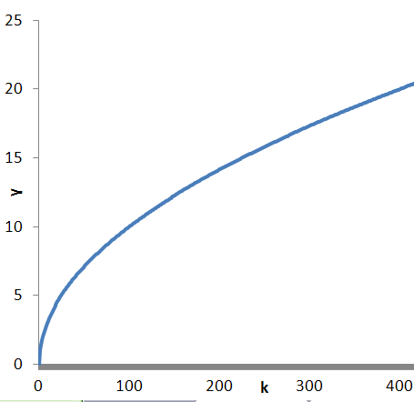

Solow-Swan Model: Diminishing Returns
Production function:
Implication: Countries with small capital stock (k) are more productive => grow faster
GDP per capita
Capital per worker

Slide 10
Solow-Swan Model: Diminishing Returns (Cont.)
Country | Average annual growth rate of GDP per capita
 | 1950-1960 | 1980-1990
Germany | 6.6 % | 1.9 %
Japan | 6.8 % | 3.4 %
France | 9.6 % | 2.8%
USA | 1.2 % | 2.3 %
Source: Blanchard et al (2010)

Slide 11

Solow-Swan Model: Demand Side
Consumption
Investment
A fixed fraction of HH income is saved
I=sY & C= (1-s)Y
Constant savings rate (s): s=30 %
Savings rate determines the allocation of income between consumption and investment

Slide 12
Solow-Swan Model: Demand Side (Cont.)
Transforming to per capita terms
I=sY & C= (1-s)Y
i = sf(k) & c = (1-s)f(k)
y =f(k) – GDP per capita
i =0.3y – Investment per capita
c =(1-0.3)y – Consumption per capita

Slide 13
Solow-Swan Model: Capital Accumulation
No population growth: L= const
GDP per capital will increase only due to increase in capital stock
Households’ savings are used as investment into capital accumulation (K)
- New capital
-Replacement of old capital
Capital depreciation: every year a fraction of capital δ breaks down and becomes useless

Slide 14
Solow-Swan Model: Capital Accumulation (Cont.)
Capital accumulation
k_{t+1}=sf(k)+(1-ẟ)k_{t}
Change in capital from year t to year t+1
k_{t+1} - k_{t} =s f(k)-ẟk_{t}
Δk – change in capital stock
If Δk >0 (capital stock increases) if sf(k)>ẟk_{t}
If Δk <0 (capital stock decreases) if sf(k)<ẟk_{t}

Slide 15
Solow-Swan Model: Graphical Representation
Output per capita
Investment
7
3

Slide 16
Solow Model: Steady-State (Cont.)
Steady-state: the long-run equilibrium of the economy
The amount of savings per worker is just sufficient to cover the depreciation of the capital stock per worker
Economy will remain in the steady state (unless additional channels of growth are introduced)
Economy which is not in the steady state will go there => convergence to the constant level of output per worker over time
Different economies have different steady state value of capital

Slide 17
Solow Model: Steady-State
Steady-state: investment and depreciation just balance

Slide 18
Solow Model: Steady-State Level of Capital per Worker
Convergence to steady state

Slide 19
Solow Model: Increase in Savings Rate
Savings rate increases from 30 % to 40 %
Economy moves to a new steady state => Higher capital and output per capita

Slide 20
Solow Model: Steady-State (Cont.)
Implications
Savings rate (s) has no effect on the long-run growth rate of GDP per capita
Increase in savings rate will lead to higher growth of output per capita only for some time, but not forever.
Saving rate is bounded by interval [0, 1]
Savings rate determines the level of GDP per capita in a long run

Slide 21
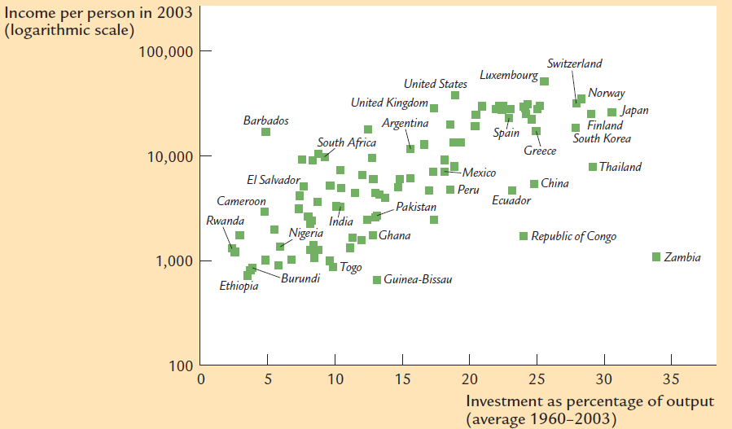
Solow Model: The Role of Savings
A nation that devotes a large fraction of its income to savings will have a higher steady-state capital stock and a high level of income
Source: Mankiw (2009)

Slide 22
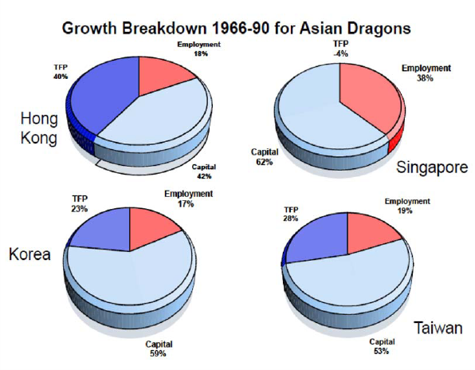

Slide 23
The Solow-Swan Model: Steady State
Steady state: the long-run equilibrium of the economy
  Savings are just sufficient to cover the depreciation of the capital stock
In the long run, capital per worker reaches its steady state for an exogenous s
Increase in s leads to higher capital per worker and higher output per capita
Output grows only during the transition to a new steady state (not sustainable)
Economy will remain in the steady state (no further growth)
Economy which is not in the steady state will go there => Convergence
  Government policy response?
N!B! Savings rate is a fraction of wage, thus is bounded by the interval [0, 1]

Slide 24
The Solow-Swan Model: Numerical Example
Production function
Production function in per capita terms
GDP per capita:
Savings rate:
Depreciation rate:
Initial stock of capital per worker:

Slide 25
The Solow-Swan Model: Numerical Example (Cont.)
Year | k | y | i | c | δk | Δk
1 | 4
2
…
Consumption: C = (1-s)Y
Consumption per capita C/Y = c
Steady state capital/labor ration:

Slide 26
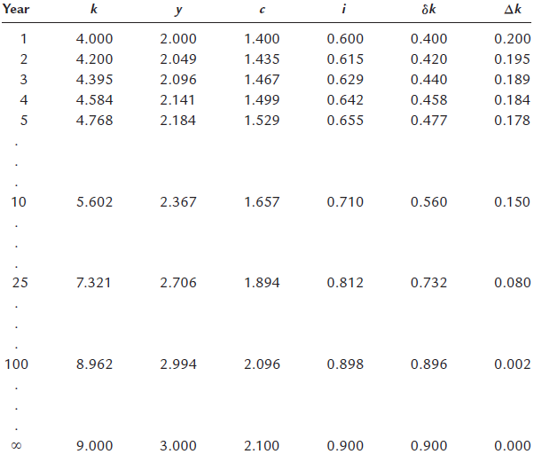

Slide 27
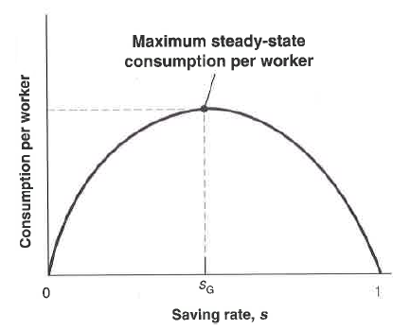
The Golden Rule Level of Capital
Increasing savings rate means less present consumption
What is the optimal savings rate?
N!B! Optimal savings rate maximizes consumption per capita

Slide 28
The Solow-Swan Model: Convergence to Steady State
N!B! Regardless of , if two economies have the same s, δ, L, they will reach the same steady state
The property of catching-up is known as convergence
If countries have the same steady state, poorest countries grow faster
Not much convergence worldwide
Different countries have different institutions and policies
Conditional convergence: comparison of countries with similar savings rates

Slide 29
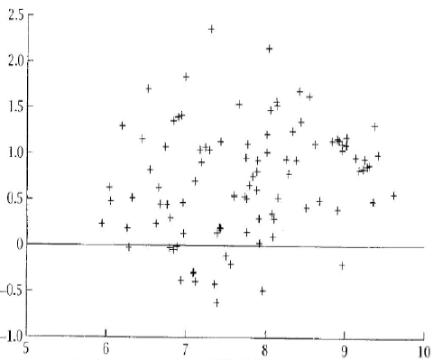
World Wide Convergence
Changes in Log income per capita in 1960 -1990
Log income per capita in 1960 (100=1996)

Slide 30
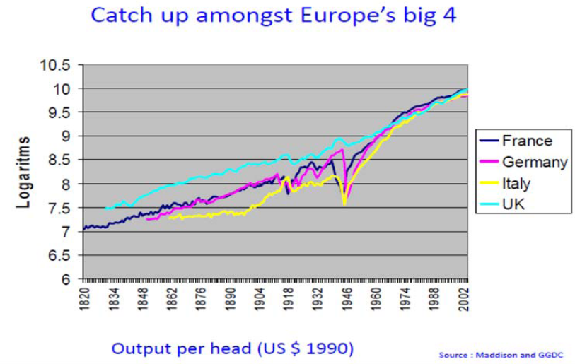

Slide 31

Next class: Solow-Swan Growth Model (Cont.)
N!B! Reading Assignment: Handout “Theories that don’t work”

