Slide 1
MACROECONOMICS I
Class 6. The Core: Financial Markets.
Monetary Policy
March 25th, 2014

Slide 3
Review
The short run: year-to-year changes in real GDP
A fundamental identity (closed economy)
Supply
Aggregate output
Demand
Aggregate expenditure
Total Output = Total Expenditure = Total Income
The goods’ market equilibrium:
Aggregate Output (Y) = Aggregate Expenditure (AE)

Slide 4
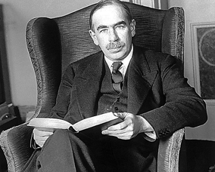
Review (Cont.)
John Maynard Keynes
The General Theory of Employment, Interest, and Money (1936)
The economy is driven by demand (in the short-run)
Prices in the short run are fixed
Insufficient spending is the key reason behind recessions
Active government interventions

Slide 5
Review: Equilibrium in the Goods’ Market
AE
Y*
Autonomous spending
45⁰
Y*
Y, output

Slide 6
Review: Fiscal Policy
GDP in the short-run
Which multiplier is bigger?
Fiscal policy
Government spending (G)
Total effect of the policy:
Taxes (T)
Total effect of the policy:

Slide 7
Example on Multipliers
TE Consider two countries:
Japan
The USA
1. What are the values of the government spending (G) and tax (T) multiplies in each countries?
2. In what country the fiscal policy will be more efficient

Slide 8
The Financial Markets: Introduction
Relaxing assumption about fixed investments (I)
Investment depends on two factors
Y – level of sales; i-nominal interest rate
Interest rate (i) is the price of money
What is money?
Funds that you can spend: Currency + Checking accounts
The most liquid asset: spend whenever you want

Slide 9
The Financial Markets: Introduction (Cont.)
The story
Not enough money in circulation (Money Supply)
Money is scarce => More expensive to borrow => Higher interest rate (i)
Excess of money in circulation
Money is abundant => Less expensive to borrow => Low interest rate (i)
Money supply => Interest rate => Output
The effect of financial markets on the goods’ markets

Slide 10
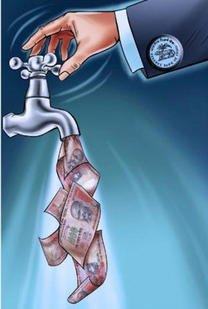
Money Supply (M^{S})
Who is in charge of the money supply?
A Nations’ Central Bank

Slide 11
Money Supply (Cont.)
Central Bank is a government agency
Stands at the center of the monetary and financial systems
First Central Banks
Bank of Sweden (1668); Bank of England (1694); Bank of France (1800)
The most important today
FED: The US Federal Reserve (1913). Consists of 12 Banks all over the US
ECB: European Central Bank (1998) – a common CB for the Eurozone
Central banks have a monopoly for printing national currency

Slide 12
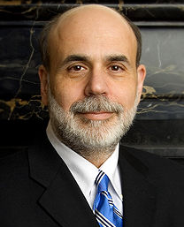
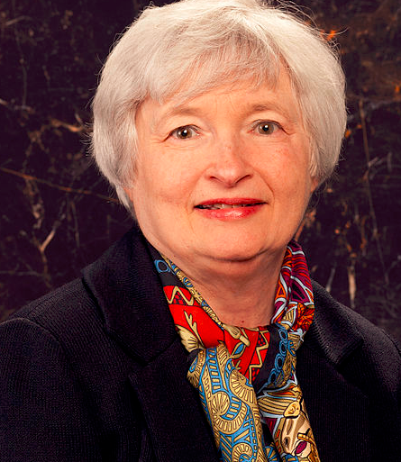
Money Supply (Cont.)
The US Federal Reserve Chairman
Ben Bernanke (since 2006-2014)
Janet Yellen (since Feb 2014)

Slide 13
The Central Banking System
Mission of a Central Bank:
Macroeconomic stability: low and stable inflation; stable growth of GDP and employment
Financial stability: preventing and mitigating financial panic or crises
Available tools:
Monetary policy – adjustment of the interest rate
Provision of liquidity – a “lender of the last resort”
Regulation and supervision of financial institutions

Slide 14
Changes in Money Supply
Three major tools
Reserve ratio: a share of funds that every bank must hold at the CB
Lower reserve ratio => More money to lend out => More money in circulation
2) Discount rate: Rate on the overnight loans
Lower discount rate => More borrowing from CD => More money lend out =>
More money in circulation
3) Open market operations (OMO): Purchase of governments securities
Government Bonds = Debt/Fixed-Income securities
A promise to pay a certain amount (face value) on a certain date and periodic interest payments
Free of credit risk: Trust in the government
Buying bond by CB => Increase in money supply => More money in circulation

Slide 15
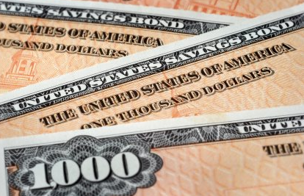
Demand for Money
The amount of money people want to hold (M^{D})
$ 20,000
Full liquidity
Yield NO interest
NO transaction costs
Less liquid
Yield positive interest
Transaction costs
Liquidity preferences: keep money or loan them to someone

Slide 16
Demand for Money (Cont.)
M^{D} will depends on:
Level of transactions (Y)
Bonds’ interest rate (i)
Where Y – nominal income; i is a nominal interest rate
Demand for money increases in proportion to nominal income
The lower the interest rate, the higher is the demand for money

Slide 17
Demand for Money: Graphical Representation
For a given level of nominal income Y
Interest rate, i
i₁
M^{D}
i₂
M₁
M₂
Money, M

Slide 18
Shifts in M^{D}
Increase in nominal income & fixed interest rate
Interest rate, i
i
M`^{D}
M^{D}
M
M`
Money, M
Increase in prices & fixed interest rate

Slide 19
The Equilibrium in Money Market
Interest rate, i
Determination of the equilibrium interest rate
M^{S}
i*
M^{D}
M*
Money, M
For a given level of nominal income Y

Slide 20
Comparative Statics
Increase in nominal income
Interest rate, i
Leads to an increase in i*
i`*
i*
M`^{D}
M^{D}
M*
Money, M
Same effect in the case of price change

Slide 21
Comparative Statics (Cont.)
Increase in money supply
Interest rate, i
Leads to a drop in i*
M^{S}
M`^{S}
i*
i`*
M^{D}
M*
M`*
Money, M
Monetary policy: Central banks affect interest rate by changing money supply

Slide 22
The Goods Market and the Role of Interest Rate
Drawing the link between the goods market and financial market
Linking element: Interest rate i
The goods’ market: Modifying equilibrium condition
As
N!B! Monetary policy affects aggregate output (GDP)

Slide 23
Monetary Policy and Aggregate Output
TE Assume CNB increases money supply by buying government bonds
Expansionary monetary policy: increase in the amount of money in circulation leads to an increase in investment and discourages savings which cause an increase in GDP

Slide 24
The Equilibrium
Interest rate, i
AE
M^{S}
Y*
i*
M^{D}
M*
Money, M
Y*
Y, output

