Slide 1
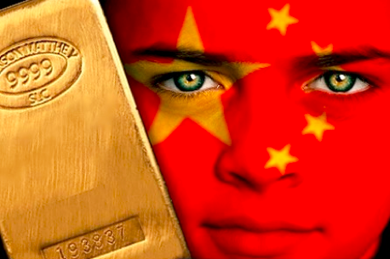
China
New world leader?

Slide 2
In the past few years China established a string of currency swaps with other nations to settle trade, bypassing the dollar completely.
The goal is to help internationalize the yuan by gradually growing its level of acceptance. It's working.
In March 2013, the Bank of England became the first primary central bank to allow currency swaps of the Yuan, ahead of states such as France and Switzerland who are in negotiations to do the same. All this, at a time when Yuan denominated bonds have increased 171 times worldwide since the credit crisis of 2008, and global trade in the Yuan has gone from 0% to 12% in just five years.
On Dec. 4, 2013, the Wall Street Journal reported that China's growing slice of the world's economic pie saw the yuan overtake the euro and yen in trade finance.
According to the Journal, "That made the yuan the second-most used currency in trade finance but still well behind the U.S. dollar, which backs 81% of trade finance." The yuan now accounts for 8.7%, but it's gaining quickly.
China's central bank has stated the yuan would become "basically convertible" by 2015.

Slide 3
New gold Yuan?
China's has been accumulating gold - a lot of gold.
China is the world's largest gold producer, and nearly all its production stays home.
Back in 2009 China announced its official gold holdings stood at 1,653 tons, or about 33.9 million ounces. There've been no updates since, but some think we could get news in 2014.
China's central bank stash now stands at 4,409 tons (est.). It could be even bigger than that.

Slide 4
New gold Yuan?
China, as the largest foreign holder of U.S. Treasurys, expressed its concerns and frustrations.
Zhang Bingnan, market analyst for China Central Television and vice president of the China Gold Association, had intriguing things to say at a financial conference last year. As a result of his studies on gold's place in the modern economy, he concluded it has an essential role in the current monetary system.
Shortly thereafter Tan Ya Ling, president of the China Foreign Exchange Investment Research Institute, spoke at a Beijing gold conference last May. She told delegates that gold is a currency - perhaps even the next world reserve currency - and therefore China has to dominate the world gold market.

Slide 5
New gold Yuan
gold-backed yuan would carry intrinsic value, something absent from every other currency today.
The world would quickly want the yuan, pushing up its value and rapidly spreading its ownership and acceptance.
True, a stronger yuan will make Chinese exports more expensive. But China's migrating toward a consumption economy, and a stronger yuan buys them more of the natural resources they desperately need.

Slide 6
Nothing last forever

Slide 7
The average life-cycle of a strictly fiat currency throughout history is just 30 years, with a ceiling period of around 42 years. As of 2013, the dollar has reached that threshold since it was adopted in its current form in 1971, and in those 42 years of global dominance

Slide 12
GDP PPP/capita (IMF 2010)
1. Qatar: $88,232
2. Luxembourg: $80,304
3. Singapore: $57,238
4. Norway: $52,238
5. Brunei: $47,200
6. US: $47,123
...
20. UK: $35,053
24. Japan: $33,828
93. China $7,518

Slide 13
China – less known facts
top 1 per cent of urban households own around 30-50 per cent of all liquid assets in the country.
Capital flight
top 1 per cent of urban households own around 30-50 per cent of all such liquid assets in the country.

