Slide 1
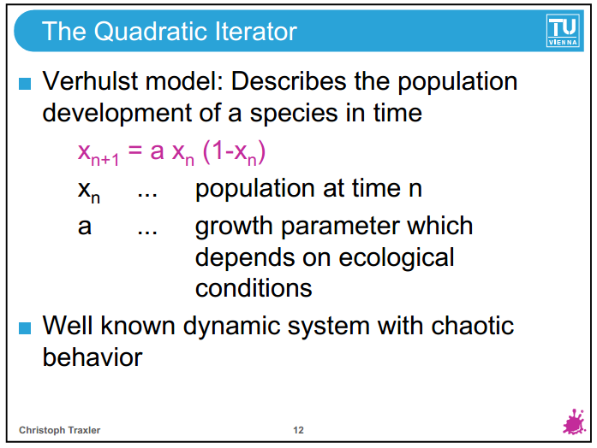
http://www.ibiblio.org/e-notes/MSet/Logistic.htm

Slide 2
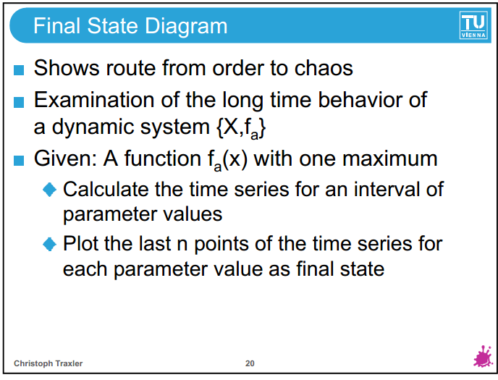

Slide 3
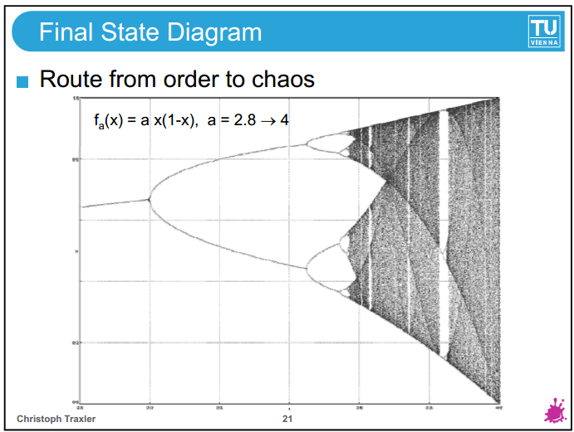

Slide 4
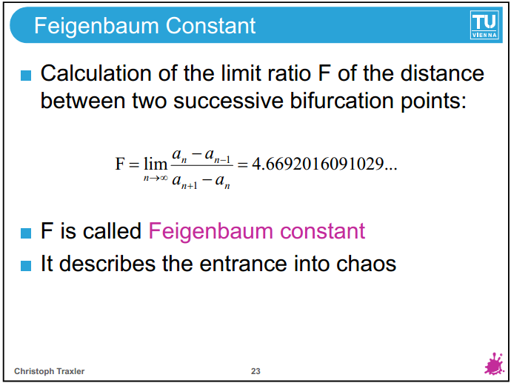

Slide 5
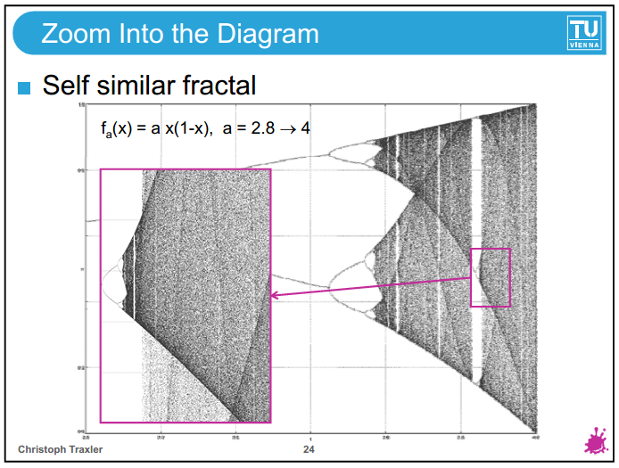

Slide 6
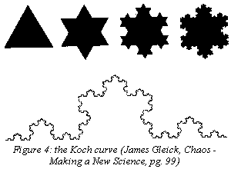
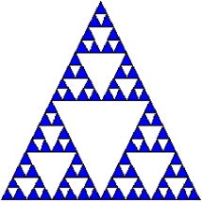

On to Fractals – Now let’s consider Scale
It’s all about scales and its invariance (not just space though – can also time
And self-organized similarity (scale invariance) a rather new term coined these days
- Another manifestation of Chaos theory in the form of scales

Slide 7
Types of Attractors
Point Attractors
Limit Cycles
Strange or Fractal Attractors

Slide 8
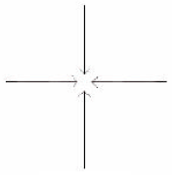
Point Attractors
Simplest form of attractor
Point at which a pendulum’s swing reverses
Theoretically comparable to an economic supply/demand balance or market equilibrium

Slide 9
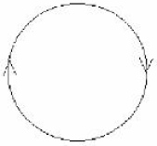
Limit Cycle Attractors
Friction and mechanical limitations are removed
Pendulum freely swings a full 360° indefinitely
This represents the market volatility around equilibrium or “market noise”

Slide 10
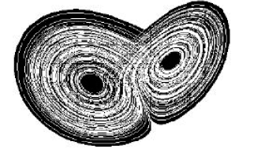
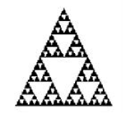
Chaotic or Fractal Attractors
Maps multiple pendulum swings of various magnitudes but never completing a full 360° circle
These random swings are always within a subset of the range of the Limit Cycle attractor called a “phase space”
Phase Space is comparable to the perimeter of the Sierpinski triangle
These attractors have fractal dimensions

Slide 11
The Human Heart
Healthy heart
Has slight variations in the time between one beat to the next.
Has a heart-rate that is a chaotic pattern that is self-similar.
Diseased heart
Doesn’t exhibit slight variations in time between each beat
Has a heart-rate that is steady, constant, and predictable or either extremely random
Interesting Fact:
This concept also applies to human walking. When humans walk with variation in their step they are normal. With the onset of a disease, such as Parkinson’s disease, the human stride is more constant.

Slide 12
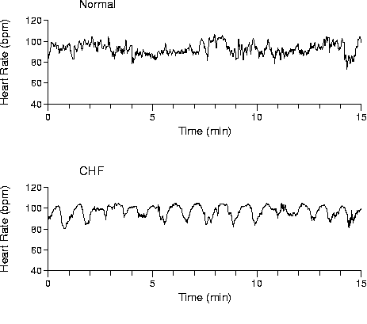
Evidence for chaotic healthy hearts
As you can see the top graph shows a normal healthy heart. The graph of the healthy heart has more complexity then the bottom graph. Complexity = healthy in many physiological aspects. The bottom time scale graph shows a heart with CHF (congestive heart failure). CHF is just one of the many diseases that causes the heart rate to lose it’s chaotic property. Click on the image for a further view of the normal heart-rate.
Picture from:http://www.physionet.org/tutorials/ndc/

Slide 13
Overview
Chaos Theory – What is it really?
Fractals – What is it really?
Relevance of Chaos Theory and Fractals to Management

Slide 14
Former conception of chaos
Chaos and order have long been viewed as antagonistic in the sciences
  Traditional notion of chaos – unorganized, disorderly, random etc.
Natural laws (Newton, Kepler, ...) represent the domain of order
Chaos was understood as a different state of nature where natural laws are not valid

Slide 15
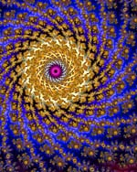
Examples of Chaos
Not everything can be observed or predicted perfectly or in a deterministic (very accurate) fashion:
Lightning
Weather Patterns
Earthquakes
Financial Markets
Social and Natural Systems
Governmental and Financial Institutions

Slide 16
Chaos Theory
But Chaos Theory has nothing do with the traditional notion per se
Not all that ‘chaos’ you see is due to chance, or random or caused by unknown factors
Uncertainties in various sources causes our observations and predictions to behave randomly.
But then Chaos Theory comes in and bridges the gap
  a mathematical approach to modeling patterns of non-linear, non-independent behaviors of dynamical systems. It is not, per se, a philosophical system or paradigm.

Slide 17
Properties of Non-Linear Systems
They do not follow the principle of superposition (linearity and homogeneity).
They may have multiple isolated equilibrium points.
They may exhibit properties such as limit-cycle, bifurcation, chaos.
Sensitivity to initial conditions – causing large divergence in the prediction. But this divergence is not infinite, it oscillates within bounds.
Discovered by Edward Lorenz in Weather Modeling

Slide 18
Contd.
Butterfly Effect: The flapping of a single butterfly's wing today produces a tiny change in the state of the atmosphere. Over a period of time, what the atmosphere actually does diverges from what it would have done. So, in a month's time, a tornado that would have devastated the Indonesian coast doesn't happen. Or maybe one that wasn't going to happen, does. (Ian Stewart, Does God Play Dice? The Mathematics of Chaos, pg. 141)
Or life itself – more chaotic. One tiny decision you take today (apparently tiny), you have no idea where it might take you in the long after an accumulation of the triggering effects.

Slide 19
Why is chaos theory important?
Organisations operate in turbulant and dynamic environments.
This means uncertainty, unease and feelings of powerlessness with people in and around organisations.
This is unfortunate as it often is on the outskirts of chaos that creativity flourishes.

Slide 20
Why is chaos theory important?
”Understanding chaos theory is important because of its significant implications for world systems design, organization design and administrative behaviour, and public policy analysis and implementation.” (Farazmand 2003:341)

Slide 21
Implicationess for organisational theory
Long-term planning is very difficult
compare weather forecasting
we cannot learn too much about the future by studying the past
strategic planning should work with possible scenarios
to focus on flexibility
Industries do not reach a stable equilibrium
changes in industry structures can be endogenous

Slide 22
Implicationess for organisational theory
Dramatic change can occur unexpectedly
managers might underesti­mate the potential for large changes in industry conditions or competitors' behavior
Small exogenous disturbances can lead to unexpectedly large changes
Short-term forecasts and predictions of patterns can be made
chaotic systems trace repetitive patterns
In a complex system the best strategies might achieve goals indirectly and even appear counter-intuitive.

Slide 23
Systems theory and chaos theory
”Systems theory is concerned with stability and equilibrium whereas chaos and transformation theories are characterized by chaotic changes that lead to order and vice versa.” (Farazmand 2003:351)

