Slide 1
MPV_COMA Communication and Managerial Skills Training
Seminar 1
Ing. Daria Borovko

Slide 2
Content
Introduction to the course
Basics of communication process (training)

Slide 3
I. Introduction to the course
Course objectives
to provide you with basic knowledge of effective communication in management and, by using training methods, to develop your communication and managerial skills

Slide 4
I. Introduction to the course
Requirements
Attendance at seminars (90%)
  (Maximum - missing one seminar)

Slide 5
I. Introduction to the course
Requirements
Elaboration of an assigned topic and its presentation at the seminar
  results of the thesis,
  student’s own topic (within the scope of the studied field), the aim of the presentation being either to convey information or to persuade (it is necessary to choose one of the aims).

Slide 6
I. Introduction to the course
Requirements
Test (minimum level of knowledge 60%)
  theoretical knowledge
  assessing practical communication skills (via practical examples, correcting wrong statements, etc.)
Assessment criteria:
  quantity and quality of theoretical knowledge, understanding the theory
  ability to apply gained knowledge
  extent of the development of relevant skills

Slide 7
Date | Type | Title | Lecturer/Instructor
21.2 | Exercise session | Communication process | Ing. Daria Borovko
28.2 | Lectures | Basic communication skills | PhDr. Martina Rašticová, Ph.D.
 |  | Assertiveness | PhDr. Martina Rašticová, Ph.D.
7.3 | Exercise sessions | Basic communication skills training | Ing. Daria Borovko
 |  | Basic communication skills training | Ing. Daria Borovko
14.3 | Lectures | Personality communication types | PhDr. Martina Rašticová, Ph.D.
 |  | Effective presentation | PhDr. Martina Rašticová, Ph.D.
21.3 | Exercise sessions | Basic communication skills training | Ing. Daria Borovko
 |  | Basic communication skills training | Ing. Daria Borovko
26.3 | Lecture | Communication: NLP (Neuro-linguistic programming) approach | Ghislaine Pellat
27.3 | Lecture | Negotiating | Ghislaine Pellat
28.3 | Exercise sessions | NLP approach | Ghislaine Pellat
 |  | Negotiating | Ghislaine Pellat
4.4 | Exercise sessions | Further communication skills training | Ing. Daria Borovko
 |  | Intercultural communication | Ing. Daria Borovko
11.4 | Exercise sessions | Presentations | Ing. Daria Borovko
 |  | Presentations | Ing. Daria Borovko
18.4 | Exercise sessions | Selection interview (recruitment) | Ing. Daria Borovko
 |  | Selection interview (recruitment) | Ing. Daria Borovko

Slide 8
Lectures of Ghislaine Pellat (S22)
  Wednesday 26.3: 16.20 – 18.45
  Thursday 27.3: 16.20 – 18.45
  16.20 – 17.55/ 17.10 – 18.45

Slide 9
II. Basics of communication process (training)
What is communication process?
Do you think quality of communication process is important? Why?
Exercise

Slide 10
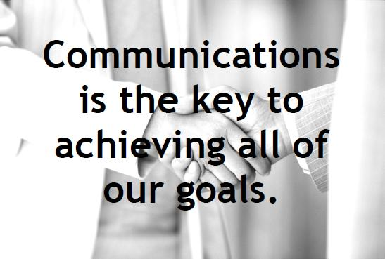
II. Basics of communication process (training)

