Slide 1
MPV_COMA Communication and Managerial Skills Training
Seminar 3
Ing. Daria Borovko

Slide 2
Contet
Non-verbal communication
  Body language
  Tone of voice
  Facial expressions
Assertiveness

Slide 3
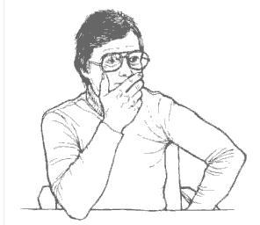
Non-verbal communication
Body language
Lying
Source: http://www.iwaha.com/ebook/index.php

Slide 4
Typical signs and signals that a person is lying
Eyes maintain little or no eye contact, or there may be rapid eye movements, with pupils constricted.
Hand or fingers are in front of his or her mouth when speaking.
His or her body is physically turned away from you, or there are unusual/un-natural body gestures.
His or her breathing rate increases.
Complexion changes such as in color; red in face or neck area.
Perspiration increases.
Voice changes such as change in pitch, stammering, throat clearing.
Source: http://www.mindtools.com/pages/article/Body_Language.htm

Slide 5
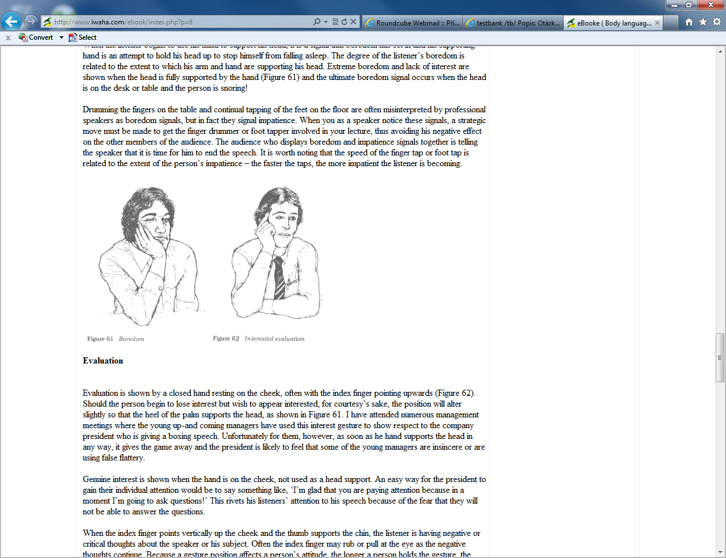
Non-verbal communication
Body language
Interested evaluation
Source: http://www.iwaha.com/ebook/index.php

Slide 6
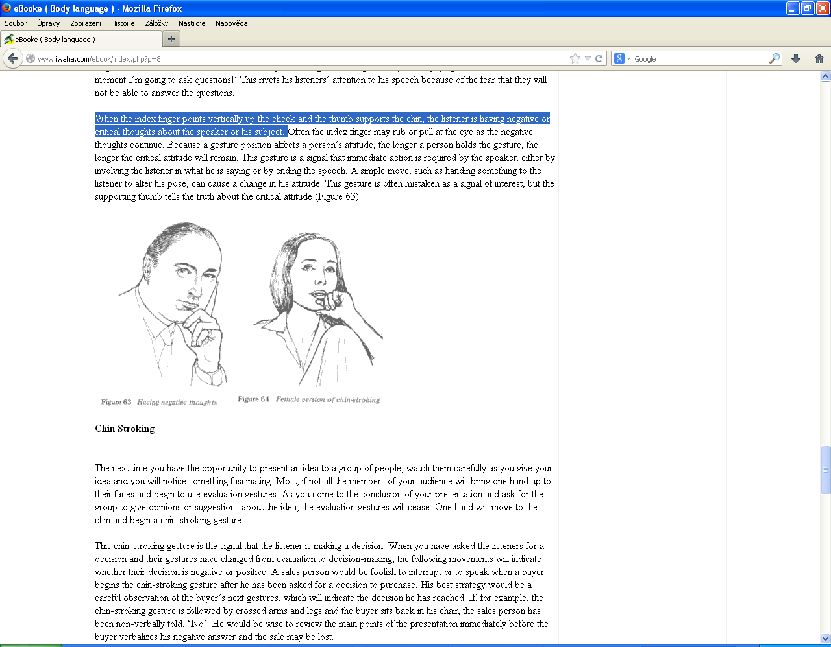
Non-verbal communication
Body language
Critical evaluation
Source: http://www.iwaha.com/ebook/index.php

Slide 7
Non-verbal communication
Body language
Boredom
Source: http://www.iwaha.com/ebook/index.php

Slide 8
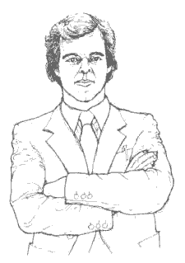
Non-verbal communication
Body language
Defensive/negative attitude
Source: http://www.iwaha.com/ebook/index.php

Slide 9
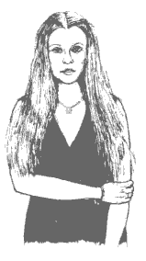
Non-verbal communication
Body language
Barrier/fearful
Source: http://www.iwaha.com/ebook/index.php

Slide 10
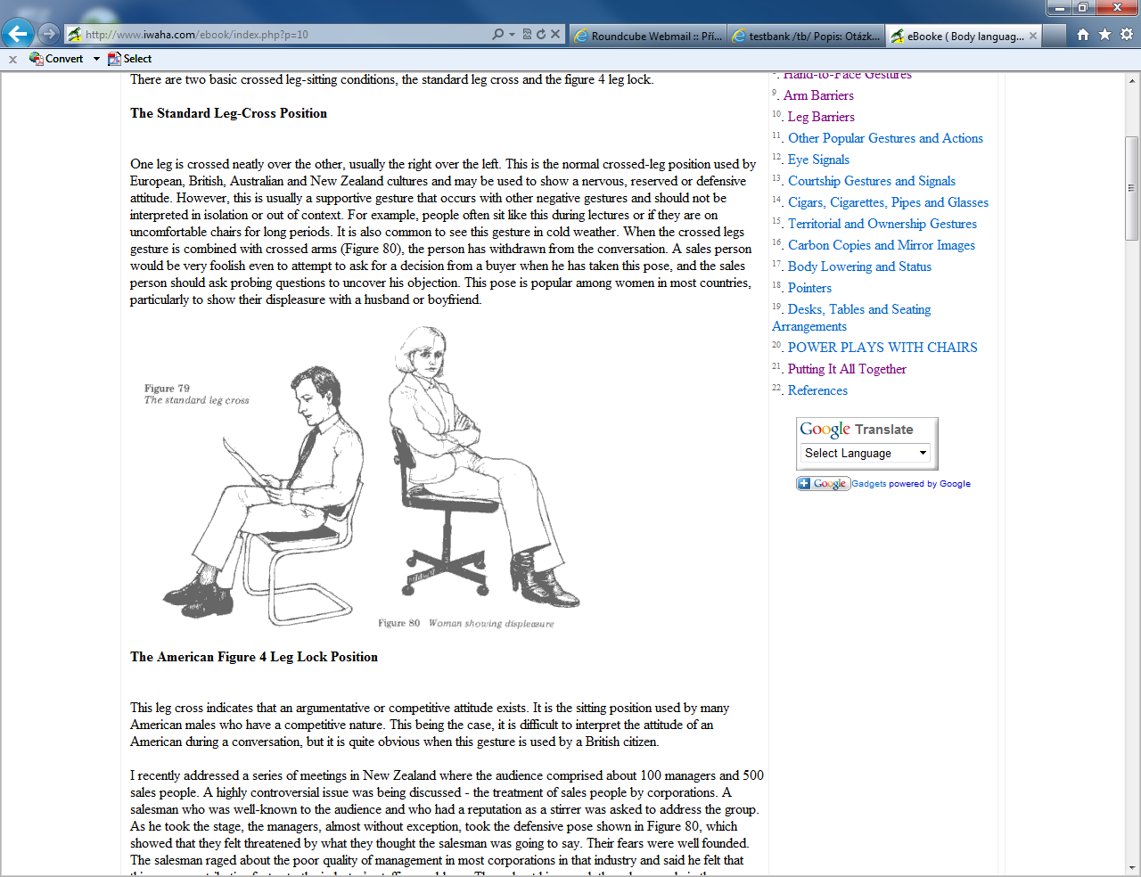
Non-verbal communication
Body language
Source: http://www.iwaha.com/ebook/index.php

Slide 11
Non-verbal communication
Body language
Open attitude?

Slide 12
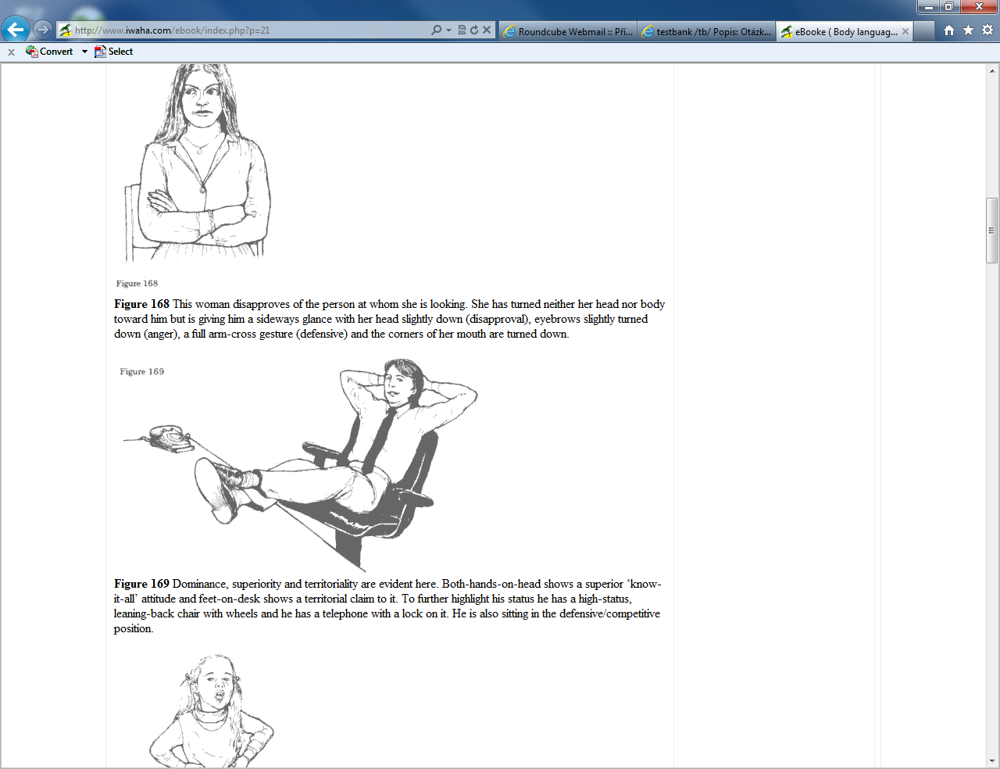
Non-verbal communication
Body language
Dominance/ superiority
Source: http://www.iwaha.com/ebook/index.php

Slide 13
Non-verbal communication
Body language
Powerlessness/weakness?

Slide 14
Non-verbal communication
Tone of voice
Exercise “We Have to Move Now!”

Slide 15
Non-verbal communication
Facial expressions
http://greatergood.berkeley.edu/ei_quiz

Slide 16
Non-verbal communication
Facial expressions
Embarrassment - the shame you feel when your inadequacy or guilt is made public
Contempt - a feeling of despisal/dislike for anything considered mean, vile, or worthless
Disgust - strong feelings of dislike
Compassion - a feeling of distress and pity for the suffering or misfortune of another, often including the desire to ease it
Amusement - the state of being amused, entertained, or pleased

Slide 17
Non-verbal communication
5 Body Language Mistakes People Make
https://www.youtube.com/watch?v=1n13RaVocjw

Slide 18
Non-verbal communication
Surprising Truths about Body Language
http://www.forbes.com/sites/nickmorgan/2012/10/25/7-surprising-truths-about-body-language/

Slide 19
Non-verbal communication
Surprising Truths about Body Language
Much of what the experts tell you about body language is wrong.
The face is a poor place to start reading body language.
But the face does sometimes give away our strongest feelings.
Body language signals intent, not specific meaning.
You’re much better at reading the body language of people you know than any expert.
To read body language accurately, don’t think about it.
You have 3 brains; 2 of them are good at reading body language.
Source: http://www.forbes.com/sites/nickmorgan/2012/10/25/7-surprising-truths-about-body-language/

Slide 20
Assertiveness
Assertive Communication Skills: Overview
http://www.youtube.com/watch?v=rxO7wjl4Vbo

Slide 21
Assertiveness
Assertive behavior: examples
Your partner recently spent too much money outside the budget.
  “You idiot, I can’t believe you bought all that crap. You always mess things up. You’re selfish.”
  “Oh well, it isn’t important.” (Or doesn’t bring the issue up at all)
  “I would like to know a good time we could talk about the budget. I am concerned.”

Slide 22
Assertiveness
Assertive behavior: examples
A colleague is going to be on the lunch break longer than should be asks to cover for her. You don’t like that she asked that from you:
    Oh, ok. Anyway, I think no one will be looking for you.

Slide 23
Assertiveness
Assertive behavior: examples
During meeting two your colleagues are gossiping while you are presenting a report:
  Silence. You two also need to know these information.

Slide 24
Assertiveness
Assertive behavior: examples
A friend repeatedly makes plans with you and then cancels at the last minute:
  "When we make plans and you change your mind at the last minute. You've done that two out of the last three times, I feel frustrated because it's too late to make plans with someone else. Besides, I start to think that you don't really want to be with me if you can find anything else to do. In the future, I'd like for you to tell me at least an hour in advance if you have to change plans. Would you do that?"

Slide 25
Assertiveness
Assertive behavior: examples
You are talking with your colleague on the phone for too long. You would like to finish the conversation:
  Listen, I need to end our talk. I have another incoming call.

Slide 26
Assertiveness
Assertive behavior: examples
Your subordinate asks for holiday on Thursday, because her brother is coming. But it is the end of quarter and you necessarily need her presence:
  I would really like to, but I can’t.

Slide 27
Assertiveness
Assertive behavior: examples
Your subordinate is hard working and you would like to praise him/her:
  …, you are working like a horse! What would we do without you!

Slide 28
Assertiveness
Assertive behavior: examples
Your boss is praising you for a good done job on a project:
It is still not perfect. There are still some things, that I could do better.

Slide 29
Assertiveness
Assertive behavior: examples
This is some real sloppy work, Johnson! You've really gone downhill since we've hired you!
  I agree that this is not my best work, but with more realistic time constraints and an adequate budget, we could have done much better.
What is the technique?

Slide 30
Assertiveness
Assertive behavior: examples
Colleague: I work really hard, but receive no appreciation or recognition whatsoever. Don’t you think I am being taken for granted?
You: I agree you have been working really hard! We couldn’t have completed that project without you.
Colleague: But no one appreciates my efforts.
You: I understand. No one likes feeling unappreciated.

Slide 31
Assertiveness
Assertive behavior: examples
One of your colleagues tells you that you never listen what you’ve been told:
  No, I listen.
  Assertive variant using fogging technique?

Slide 32
Assertiveness
Assertive behavior: examples
Friend: Can I borrow $20 from you?
You: I can’t lend you any money. I’ve run out.
Friend: I’ll pay you back as soon as I can. I need it desperately. You are my friend aren’t you?
You: I can’t lend you any money.
Friend: I would do the same for you. You won’t miss $20.
You: I am your friend but I can’t lend you any money. I’ve run out.
What is the technique?

Slide 33
Assertiveness
The art of saying ‘No’
The Art of Saying No http://www.youtube.com/watch?v=AqN9jcLA61s
How to say no: The Snowball Effect way to refuse the friendly way http://www.youtube.com/watch?v=dUtGVWHuChE

Slide 34
Thank you for your attention!

