Slide 1
CHAPTER 8
“Immigration is the sincerest form of flattery.”
-Jack Paar
“Imitation is the sincerest form of flattery.”
(Copying someone is flattering because it shows you want to be like that person)
Notes:
Give a brief overview of the presentation. Describe the major focus of the presentation and why it is important.
Introduce each of the major topics.
To provide a road map for the audience, you can repeat this Overview slide throughout the presentation, highlighting the particular topic you will discuss next.

Slide 2
Introduction
Labor mobility is the mechanism labor markets use to improve the allocation of workers to firms.

Slide 3
Geographic Labor Migration as an Investment in Human Capital
Mobility decisions are guided by comparing present value of lifetime earnings among alternative employment opportunities in different locations.

Slide 4
Geographic Labor Migration as an Investment in Human Capital
Improvements in economic opportunities available in a destination location increases the net gains to migration and raises the likelihood a worker moves.
Improvements in economic opportunities available in the current location decreases the net gains to migration and lowers the likelihood a worker moves.
An increase in migration costs lowers the net gains to migration, decreasing the probability a worker moves.

Slide 5
Geographic Labor Migration as
an Investment in Human Capital
A worker decides to move if the net gain from moving is positive.
Migration occurs when there is a good chance the worker will recoup his investment in the move.

Slide 6
Internal Migration in the U.S.
The probability of migration is sensitive to the income differential between the destination and original locations.
There is a positive correlation between improved employment conditions and the probability of migration.
There is a negative correlation between the probability of migration and distance.
  Distance is taken as a proxy for migration costs.

Slide 7
Internal Migration in the U.S.
There is a positive correlation between a worker’s educational attainment and the probability of migration.
Workers that have migrated are likely to return to the location of origin (return migration) and are more likely to migrate again (repeat migration).

Slide 8
Probability of Migrating across State Lines in 2005-2006, by Age and Educational Attainment

Slide 9
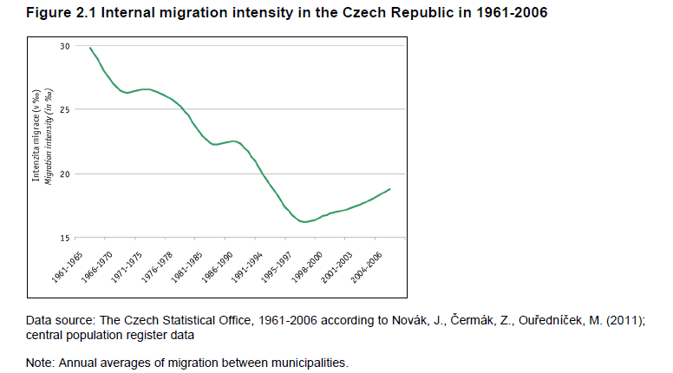

Slide 10
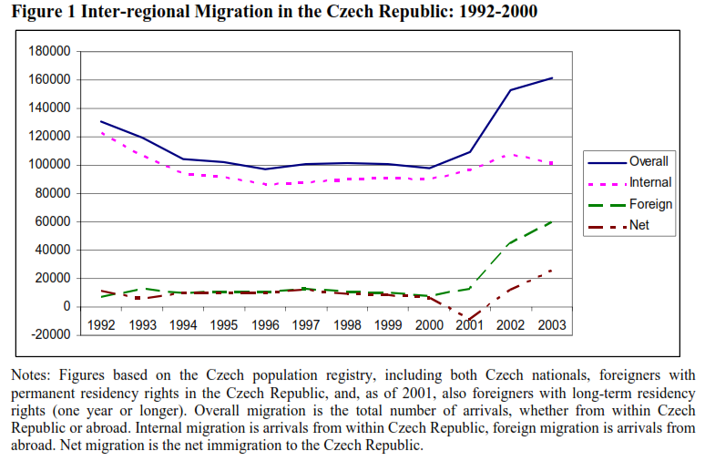
1% of Czech change residence
Source: Jan Fidrmuc (2005), Labor Mobility during Transition: Evidence from the Czech Republic

Slide 11
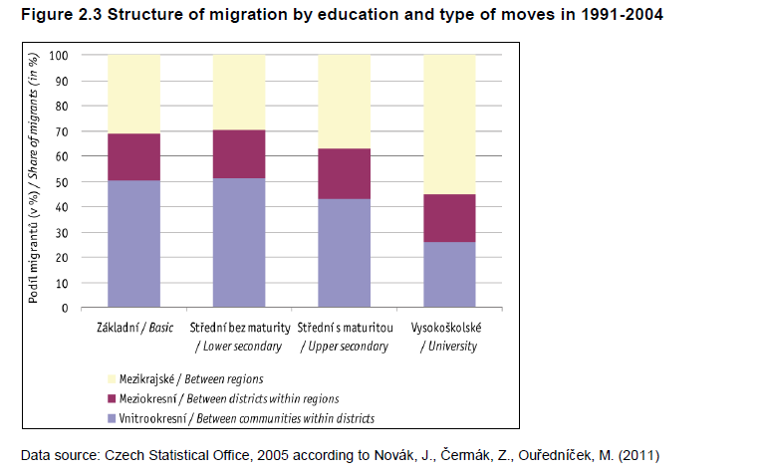

Slide 12
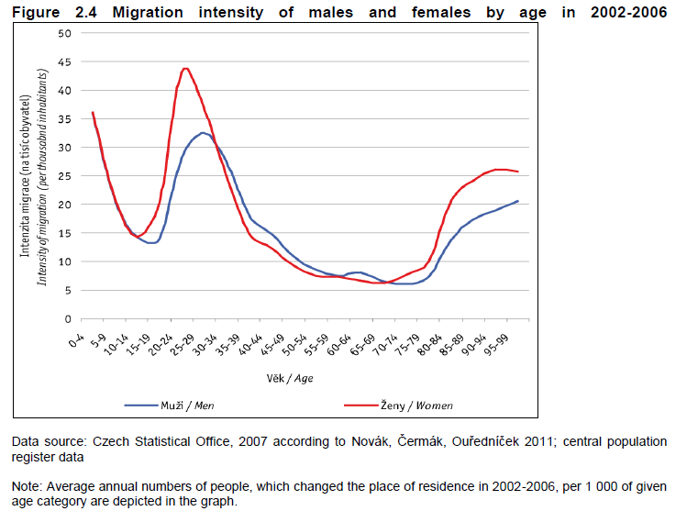

Slide 13
Family Migration
The family unit will move if the net gains to the family are positive.
The optimal choice for a member of the family may not be optimal for the family unit (and vice versa).
  Tied stayer: someone who sacrifices better income opportunities elsewhere because the partner is better off in the current location
  Tied mover: someone who moves with the partner even though his or her employment outlook is better in the current location.

Slide 14
Tied Movers and Tied Stayers
Private Gains to Husband (ΔPV_{H})
If the husband were single, he would migrate whenever ΔPV_{H} > 0 (A, B, and C). If the wife were single, she would migrate whenever ΔPV_{W} > 0 (C, D, and E). The family migrates when the sum of the private gains is positive (B, C, and D). In D, the husband would not move if he were single, but moves as part of the family, making him a tied mover. In E, the wife would move if she were single, but does not move as part of the family, making her a tied stayer.
B
Y
10,000
C
A
-10,000
10,000
Private Gains to Wife (ΔPV_{W})
D
F
-10,000
X
E
ΔPV_{H} + ΔPV_{W} = 0

Slide 15
Immigration in the United States
There has been a resurgence of immigration to the United States in recent decades.
The United States receives the largest immigrant flow in the world.
The mix of countries of origin has changed substantially over time.
  In the 1950s, 6% of immigrants came from Asia.
  Presently, 31% of immigrants come from Asia.

Slide 16
Legal Immigration to the U.S. by Decade, 1820-2010

Slide 17
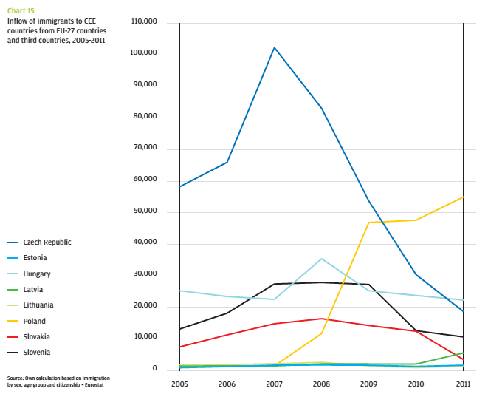
Source: CEED Institute 2014, Migration in the 21st century from the perspective of CEE countries – an opportunity or a threat?

Slide 18
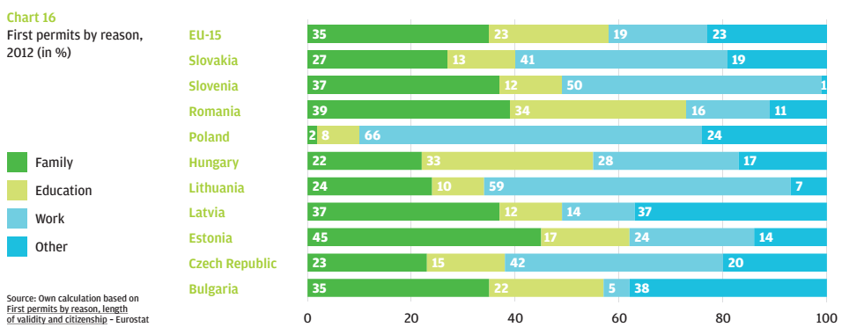
Most immigrants come to Czech Republic for work (42%) and family reasons (23%)
Source: CEED Institute 2014, Migration in the 21st century from the perspective of CEE countries – an opportunity or a threat?

Slide 19
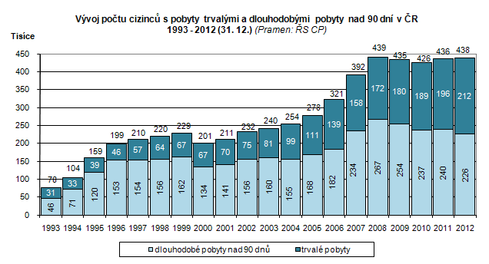
Podíl cizinců v populaci je přes 4 % od roku 2008.
Source: http://www.czso.cz/csu/cizinci.nsf/kapitola/ciz_pocet_cizincu
Notes:
http://www.czso.cz/csu/cizinci.nsf/kapitola/ciz_pocet_cizincu

Slide 20
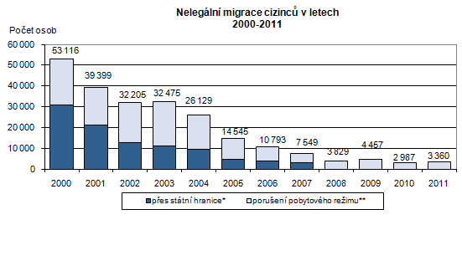
Undocumented immigration is small

Slide 21
60% of immigrants in the Czech Republic is of non-EU origin.
Pramen: Ředitelství služby cizinecké a pohraniční policie Ministerstva vnitra ČR
Source: CZSO
Note: Interestingly the relative size of dominant ethnic groups is approximately the same in both years but the ranking has changed. The pool of immigrants is very vivid and changing.

Slide 22
Immigrant Performance in the U.S. Labor Market
Immigrants who can adapt well and are successful in new jobs make a significant contribution to economic growth.
The economic impact of immigration depends on the skill composition of the immigrant flow.

Slide 23
The Age-Earnings Profiles of Immigrant and Native Men in the Cross Section

Slide 24
The Decision to Immigrate
Skills vary across country-of-origin (or source country) immigrant groups.
The general rule: Workers decide to immigrate if U.S. earnings exceed earnings in the source country.
  The decision ultimately depends on individual skills and the returns to those skills in the source and destination countries.

Slide 25
Cohort Effects and the Immigrant Age-Earnings Profile
The cross-sectional age-earnings profile erroneously suggests that immigrant earnings grow faster than those of natives.

Slide 26
The Wage Differential between Immigrants and Native Men at Time of Entry

Slide 27
Evolution of Wages for Specific Immigrant Cohorts over the Life Cycle

Slide 28
The Roy Model
The Roy model considers the skill composition of workers in the source country.
  Positive selection: immigrants who are very skilled do relatively well in the U.S.
  Negative selection: immigrants who are unskilled do relatively well in the U.S.
  The relative return to skills determines the skill composition of the immigrants from different source countries.

Slide 29
The Distribution of Skills in the Source Country
Frequency
Frequency
Negatively
-
-
Selected
Immigrant Flow
Selected
Positively
Positively
-
-
Immigrant Flow
Immigrant Flow
Skills
s
s
Skills
N
s
N
P
P
The distribution of skills in the source country gives the frequency of workers in each skill level. If immigrants have above-average skills, the immigrant flow is positively selected. If immigrants have below-average skills, the immigrant flow is negatively selected.

Slide 30
The Self-Selection of the Immigrant Flow
Dollars
Dollars
Positive Selection
U.S.
Source Country
Source Country
U.S.
Do Not Move
Move
Move
Do Not Move
s_{P}
Skills
s_{N}
Skills
(a) Positive selection
(b) Negative selection

Slide 31
Policy Application:
Economic Benefits of Migration
The immigrant surplus is a measure of the increase in national income that occurs as a result of immigration. (The surplus accrues to natives.)
Immigration raises national income by more than it costs to employ immigrants.

Slide 32
The Impact of a Decline in U.S. Incomes
Dollars
Dollars
U.S.
Source Country
U.S.
Source Country
s_{P}
′
Skills
s_{N}
s_{N}
Skills
(a) Positive selection
(b) Negative selection

Slide 33
Decline in U.S. Incomes
The previous graphs shows that when U.S. incomes decrease (shift down in the returns-to-skills curve):
  Fewer workers migrate to the U.S.
  The type of selection (positive vs. negative) doesn’t change.

Slide 34
Policy Application:
Labor Flows in Puerto Rico
The case study of Puerto Rico confirms an important insight of the Roy model: skills flow to where they receive their highest return.
  The rate of return to skills is much higher in Puerto Rico than in the United States, so the Roy model predicts that a relatively higher fraction of the least-educated Puerto Ricans would leave the island.
  As of 2000, nearly 45 percent of Puerto Rican-born working age men who lacked a high school diploma had moved to the United States. In contrast, only 30 percent of working age men with at least a college education had moved to the United States.

Slide 35
Earnings Mobility between 1st and 2nd Generations of Americans, 1970-2000

Slide 36
Job Turnover: Stylized Facts
Newly hired workers tend to leave their jobs within 24 months of being hired, while workers with more seniority rarely leave their jobs.
The rate of job loss is highest among the least educated workers

Slide 37
Job Turnover: Stylized Facts
There is a strong negative correlation between a worker’s age and the probability of job separation.
  This fits with the hypothesis that labor turnover can be an investment in human capital.
  Older workers have a smaller payoff period to recoup the costs associated with job search. Thus, they are less likely to search (or move).

Slide 38
The Job Match
Each particular pairing of a worker and employer has its own unique value.
Workers and firms might improve their situation by shopping for a better job match.
Efficient turnover is the mechanism by which workers and firms correct matching errors and obtain a better and more efficient allocation of resources.

Slide 39
Specific Training and Turnover
When a worker receives specific training, his productivity improves only at the current firm.
This implies there should be a negative correlation between the probability of job separation and job seniority.
  As age increases, the probability of job separation decreases.

Slide 40
Specific Training and the Probability of Job Separation
If a worker acquires specific training as he accumulates more seniority, the probability that the worker will separate from the job declines over time. The probability of job separation then exhibits negative state dependence; it is lower the longer the worker has been in a particular employment state.
Probability of separation
Seniority

Slide 41
Job Turnover and the
Age-Earnings Profile
Young people who quit often experience substantial increases in their wages.
Workers who are laid off often experience wage cuts.
A worker’s earnings depend on total labor market experience and seniority on the current job. (Workers experiencing a good job match will have low probabilities of job separation, and these workers will tend to have seniority on the job.)

Slide 42
Probability of Job Turnover over a 2-Year Period

Slide 43
Incidence of Long-Term Employment Relationships:1979-1996

Slide 44
The Rate of Job Loss in the United States, 1981-2001

Slide 45
Impact of Job Mobility on the Age-Earnings Profile
Wage
Stayers
The age-earnings profile of movers is discontinuous, shifting up when they quit and shifting down when they are laid off. Long job matches encourage firms and workers to invest in specific training, and steepen the age-earnings profile. As a result, stayers have a steeper age-earnings profile within any given job.
Movers
Quit
Quit
Layoff
t₁
t₂
t₃
Age

