Slide 1
Transformation in Hungary
Libor Žídek

Slide 2
Contents
Development during the communist regime
  Insight to long-run political development
  Economic situation
Political Development
Transformation period
  Economic reforms after 1990
  Currency problems
  Privatisation
4. Economic results
  Economic growth
  Structure of the economy
  Inflation
  Unemployment
  External relationship

Slide 3
Development DURING THE COMMUNIST REGIME
The first part

Slide 4
Insight to long-run political development
Aftermath of WWI
  fall of the Austria-Hungarian Empire -> loss of land and population for Hungary
  recreation of „large Hungary“ -> main aim of Hungarian diplomacy
  cooperation with fascist Germany
Soviet influence after WWII
  establishment of Soviet-style regime
  strong opposition to regime -> uprising (1956)
  “goulash socialism” in 1960s
Political relaxing
  creation of the apposition (middle of the 1980s)
  change of the constitution + new democratic Hungary (1989)

Slide 5
Economic situation I.
Centrally planned system (after WWII)
  Similar basis but less tough regime
  More evident differences after the reforms of 1968
New Economic Mechanism (1968)
  Certain decentralization of the decision-making process (from centre to companies)
  Increasing responsibility of firms (p, w, i)
Measures in external sector
  Permission of FDI (1980s)
  Unification of the exchange rate (1981)
  Trade in convertible currencies for enterprises
  Membership in IMF (1988)

Slide 6
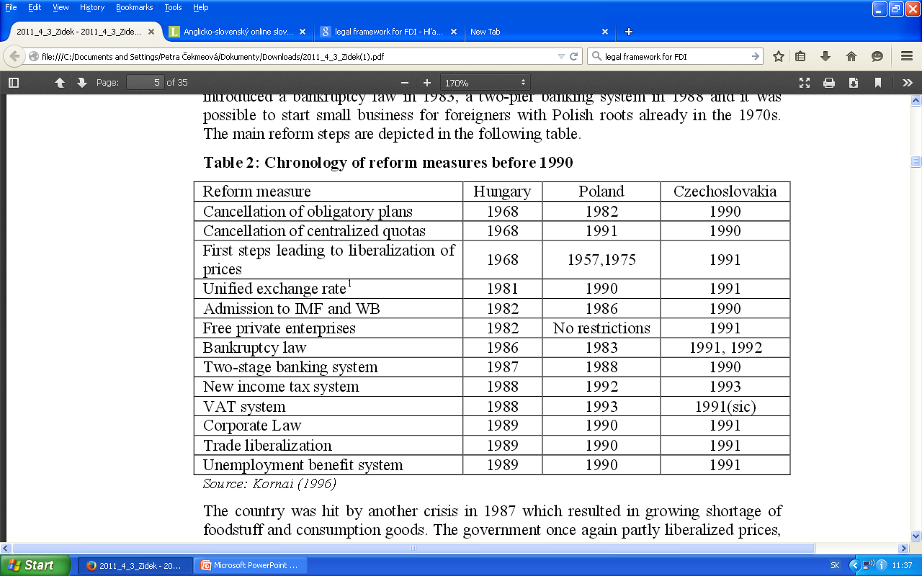
Table 1: Chronology of reform measures before 1990
Source: Kornai (1996)

Slide 7
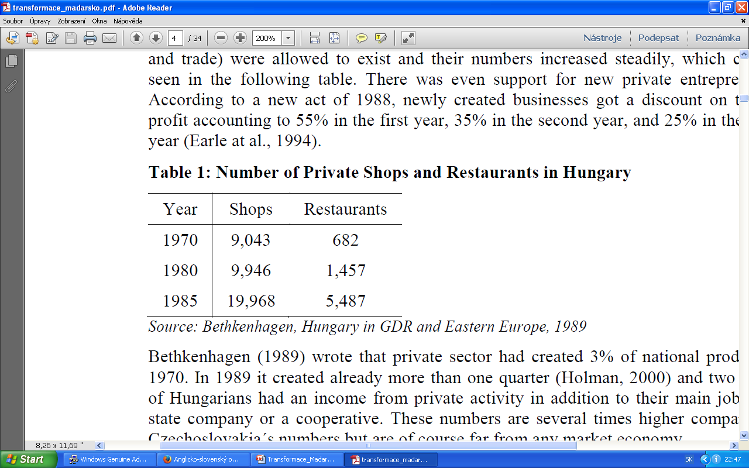
Economic situation II.
Other reforms in the 1980s
  continuous devaluations of the forint
  change in ownership structure - > support for new private enterpreneurs
  price and trade liberalization
Table 1: Number of Private Shops and Restaurants in Hungary
Ready for the shift to the market economy ???
Source: Bethkenhagen, Hungary in GDR and Eastern Europe, 1989

Slide 8
Economic situation III.
Well prepared at the level of formal insitution and microeconomy
BUT
Problems at the macroeconomic level
  Deficits of public finance and trade (goulash socialism)
  Large foreign debt (70% of GDP)
  Structure of the economy
  Declining trend of economic growth
  High inflation

Slide 9
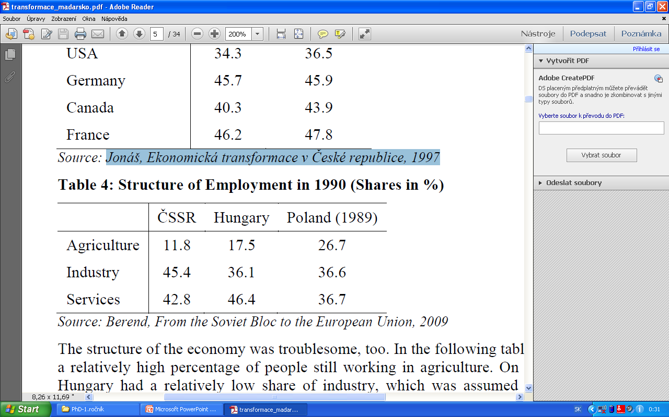
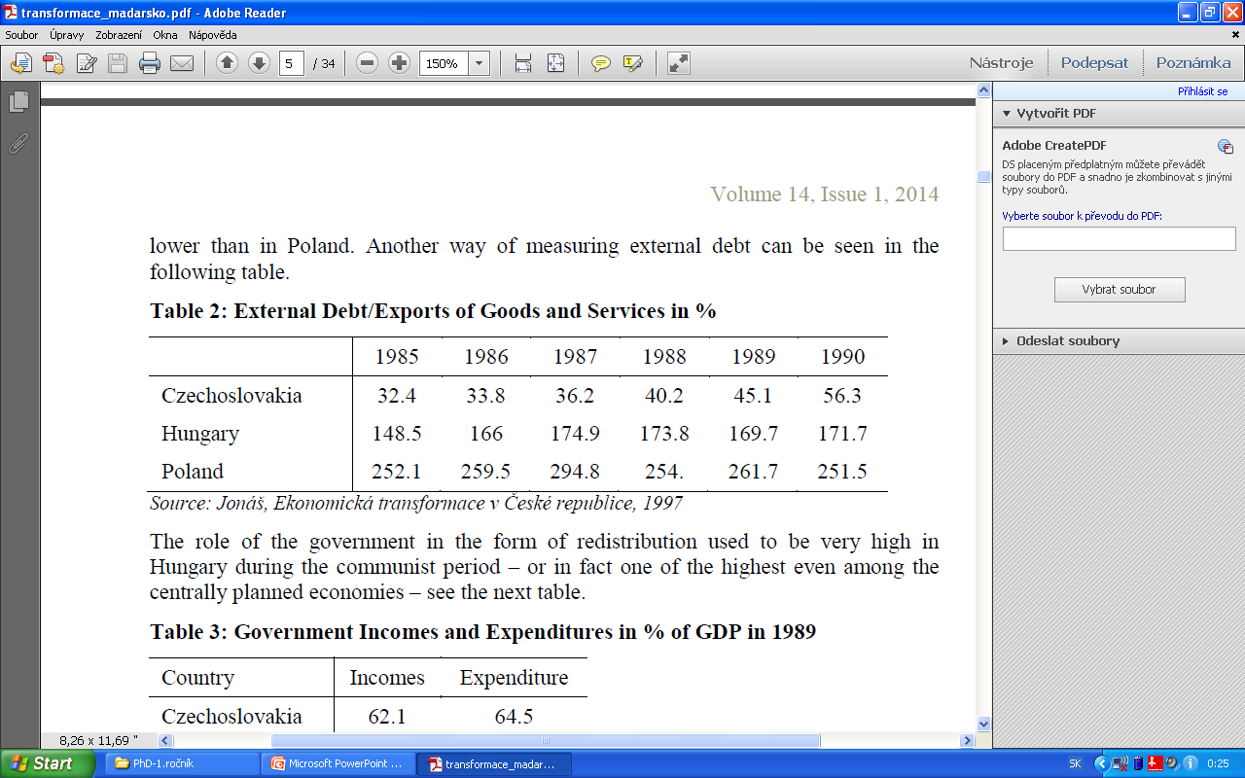
Table 3:Structure of Employment in 1990 (shares in %)
Source: Berend, From the Soviet Bloc to the European Union, 2009.
Table 2: External Debt/Exports of Goods and Services in %
Source: Jonáš, Ekonomická transformace v České republice, 1997.

Slide 10
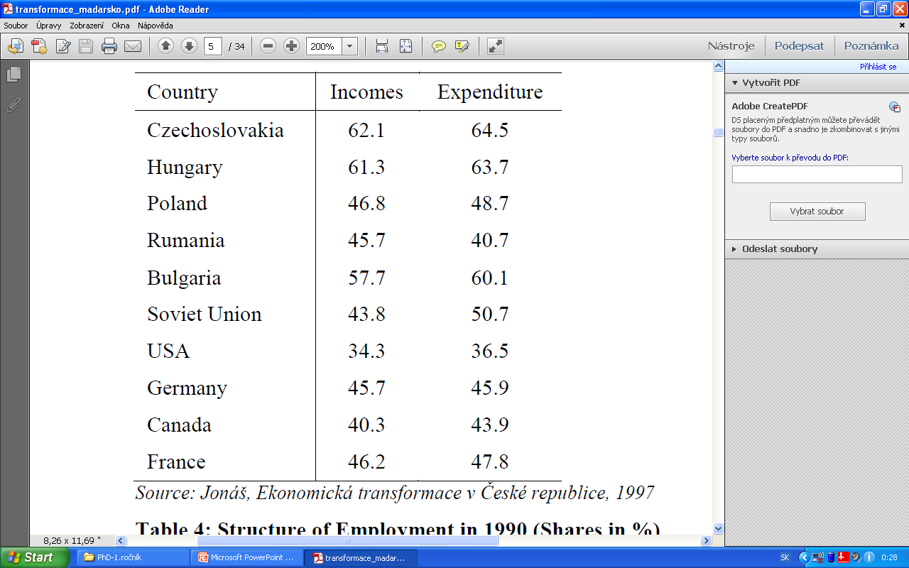
Table 3: Government Incomes and Expenditures in % of GDP in
Source: Jonáš, Ekonomická transformace v České republice, 1997.

Slide 11
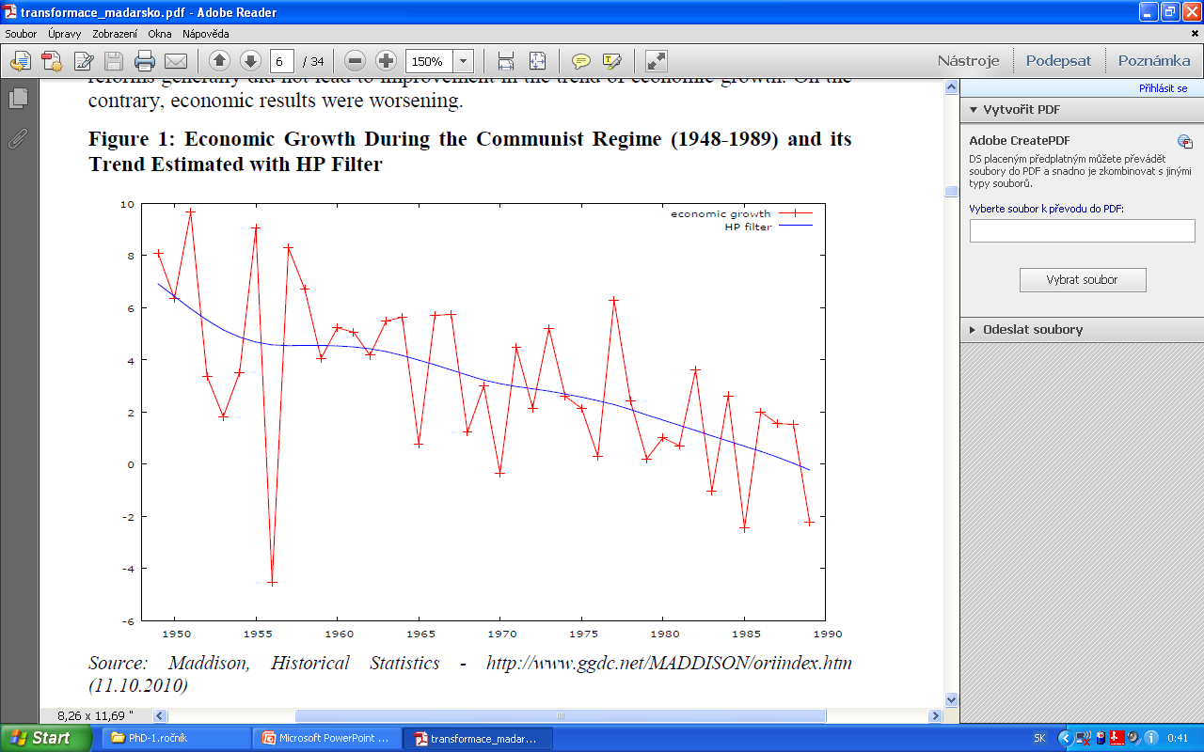
Chart 2: Economic Growth During the Communist Regime (1948-1989) and its Trend Estimated with HP Filter
Source: Maddison, Historical Statistics - http://www.ggdc.net/MADDISON/oriindex.htm ,(11.10.2010).

Slide 12
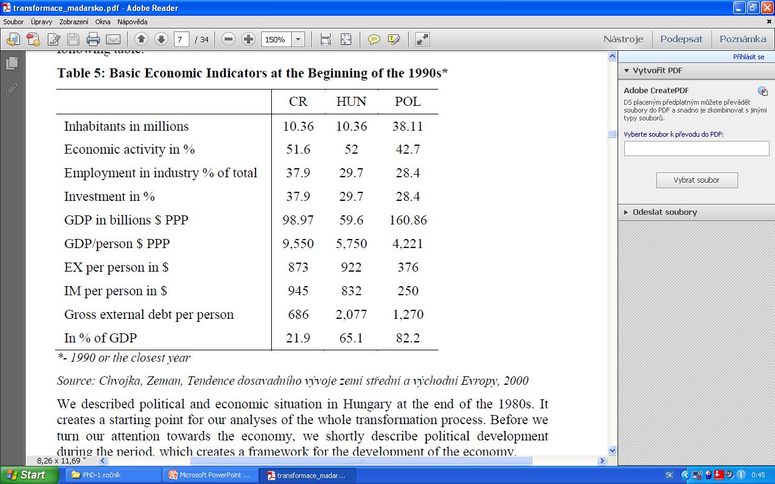
Chart 3: Basic Economic Indicators at the Beginning of the 1990s*
Source: Chvojka, Zeman, Tendence dosavadního vývoje zemí střední a východní Evropy, 2000

Slide 13
Contents
Development during the communist regime
  Insight to long-run political development
  Economic situation
Political Development
Transformation period
  Economic reforms after 1990
  Currency problems
  Privatisation
4. Economic results
  Economic growth
  Structure of the economy
  Inflation
  Unemployment
  External relationship

Slide 14
Political development
The second part

Slide 15
Political development
First post-communist government
  created in 1990 by Jozsef Antall
  stable position (60% in the parliament)
  successes – left of Soviet troops, association agreement with EC
Discussion about the role of previous communist elites and nomenclature
Elections in 1994
  winner: MSPZ (post-communist party) – social democracy
  tough economic measures
Elections in 1998
  shift to right-wing coalition (Fidesz)
  membership in NATO
Elections in 2002
  Fidesz as winner, but left-wing government
Democratic principles, membership in EU vs.
Dissatisfaction with transformation and life in general

Slide 16
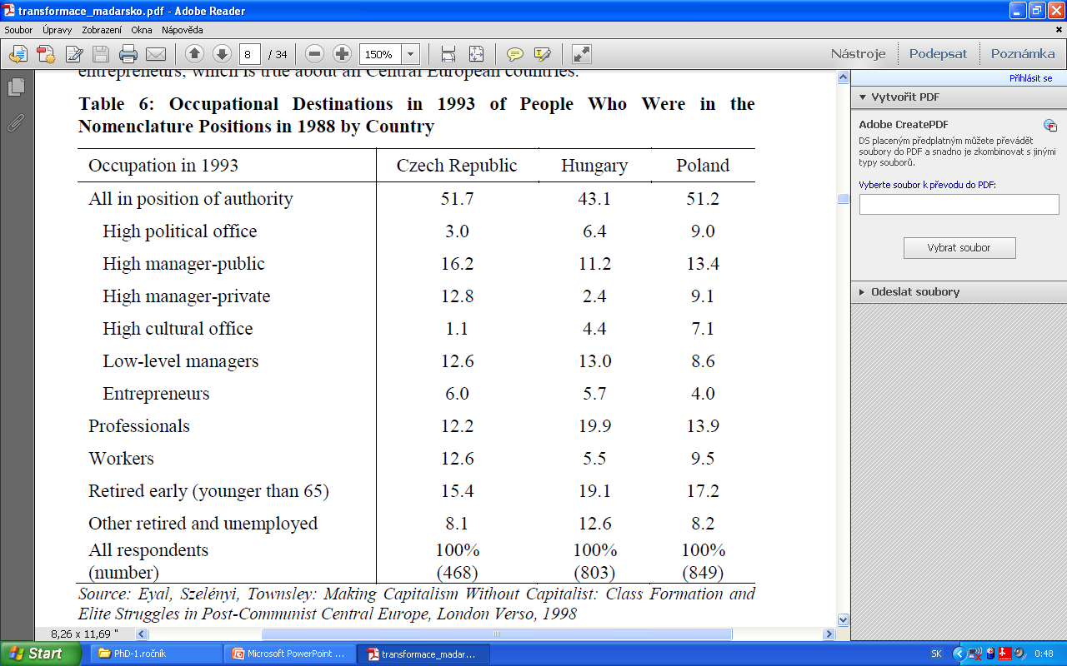
Chart 1: Occupational Destinations in 1993 of People Who Were in the Nomenclature Positions in 1988 by Country
Source: Eyal, Szelényi, Townsley: Making Capitalism Without Capitalist: Class Formation and Elite Struggles in Post-Communist Central Europe, London Verso, 1998

Slide 17
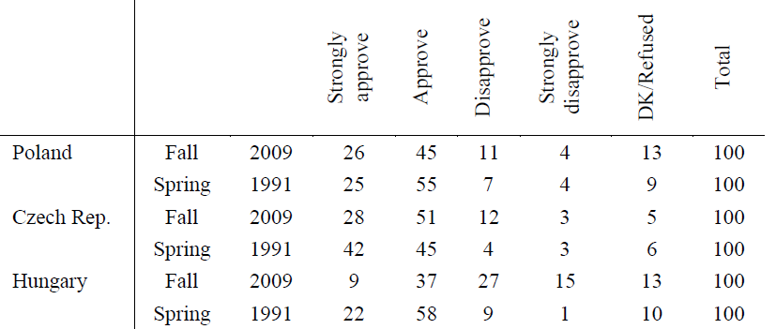
Table 7: Results of the Survey – A Comparison of Economic Situation in 2008 and 1991
„Thinking back to 1989/1991, do you approve of your country moving from having a state controlled economy to having a market economy?“
Source: The PEW: Global Attitudes project, www.pewglobal.org, published 2. 11. 2009, 15. 5. 2013

Slide 18
Contents
Development during the communist regime
  Insight to long-run political development
  Economic situation
Political Development
Transformation period
  Economic reforms after 1990
  Currency problems
  Privatisation
4. Economic results
  Economic growth
  Structure of the economy
  Inflation
  Unemployment
  External relationship

Slide 19
Transformation Period
The third part

Slide 20
Economic reforms – Gradualism I.
Specific feature
  reforms started by communist party before the fall of the regime
  Gradualist reforms - first half of the 1990s
  in contrast to radical reforms and shock therapy
  cosequence of previous steps + public opinion against radical change
  belief that slower reforms lead to similar result with lower cost
  with few exceptions (f.e. bankruptcy law)
Macroeconomic imbalances
  creditworthiness of the country
  inflation
  growing public deficit
Main tasks
of the government

Slide 21
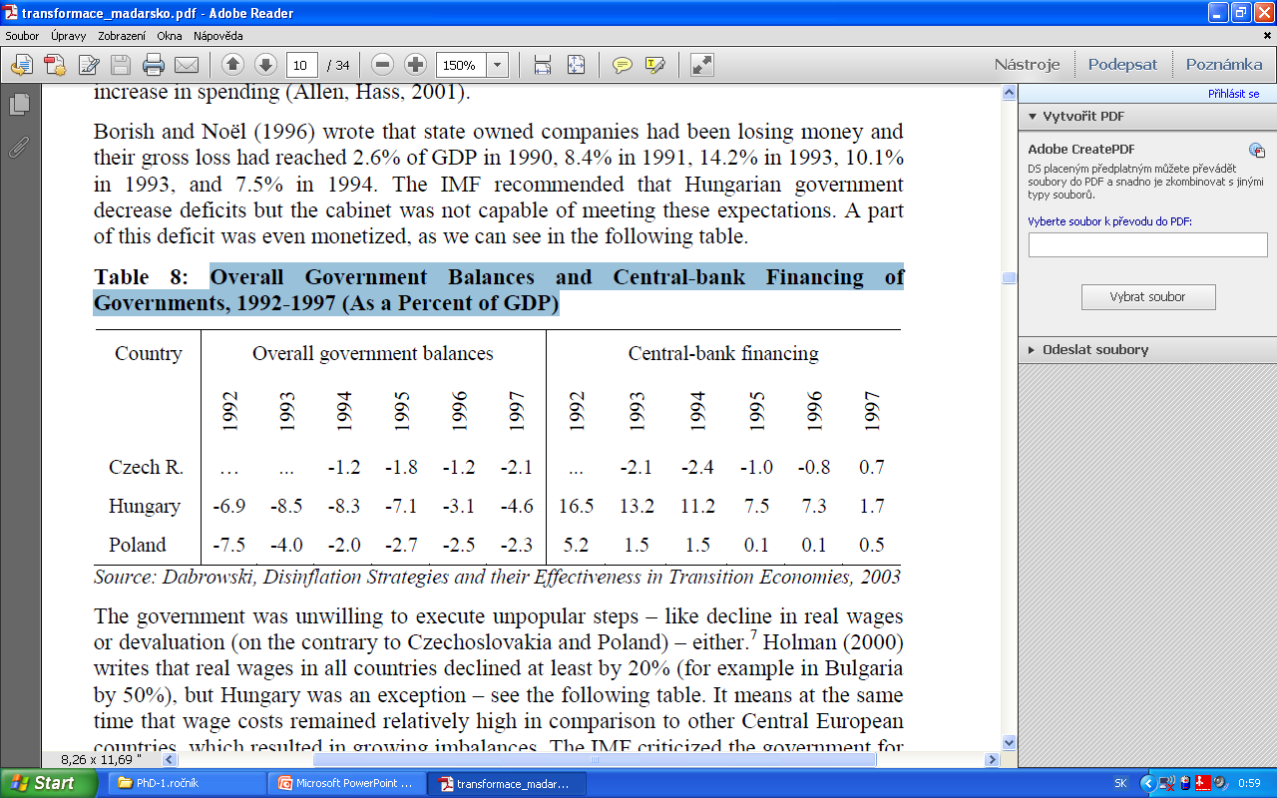
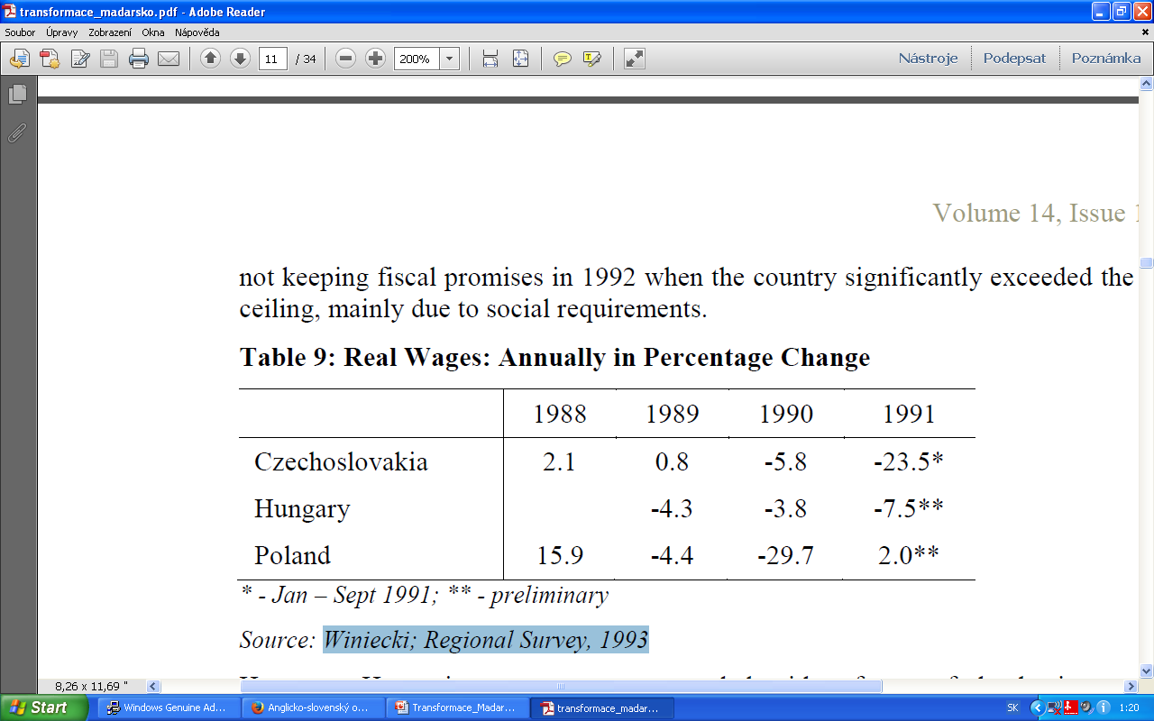
Table 3: Overall Government Balances and Central-bank Financing of Governments, 1992-1997 (% of GDP)
Jozsef Antall
Source: Dabrowski, Disinflation Strategies and their Effectiveness in Transition Economies, 2003
Table 3: Real Wages: Annually in Percentage Change
Source: Winiecki; Regional Survey, 1993

Slide 22
Economic reforms - Gradualism II.
Reforms of the business and the financial sectors
  improvement of the legal system
  privatization
  improvement of the antitrust policy
  bankruptcy law
Transformation recession
  relatively high U
  continuously higher inflation
  deficit of the current account
Inflow of foreign capital
Progress on the microeconomic level vs.
Unsolved macroeconomic problems

Slide 23
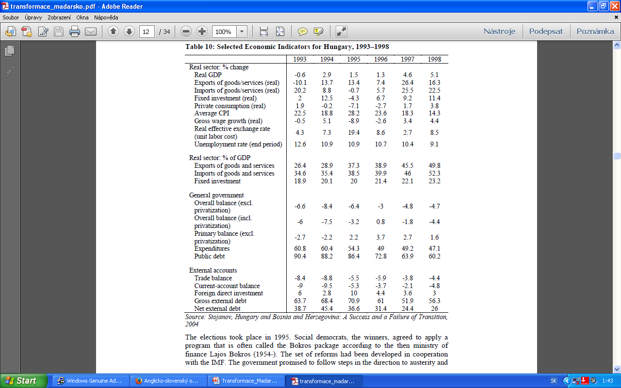
Table 10: Selected Economic Indicators for Hungary, 1993–1998
Source: Stojanov, Hungary and Bosnia and Herzegovina: A Success and a Failure of Transition, 2004

Slide 24
Economic reforms – Bokros Package I.
Reforms of social democrats (1995), supported by IMF
  Austerity for loans from IMF and EBRD
  Bokros – ministry of finance
Measures – Bokros Package
  Devaluation + shift to crawling peg
  Temporary import surchage and restrictions
  New jobs in public sector
  Tightening of social benefits
  Agreements on real wage reduction
  Privatization of state companies (FDI)
Consequences ???

Slide 25
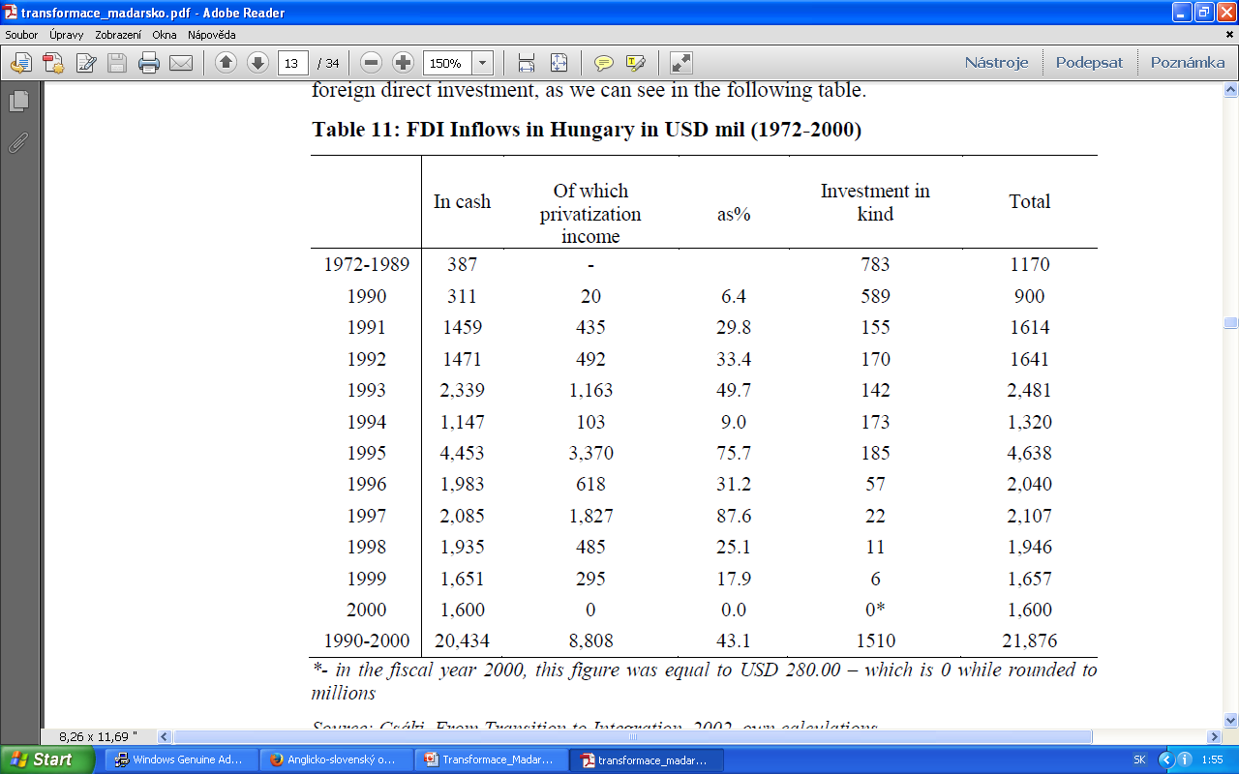
Table 11: FDI Inflows in Hungary in USD mil (1972-2000)
Source: Csáki, From Transition to Integration, 2002, own calculations

Slide 26
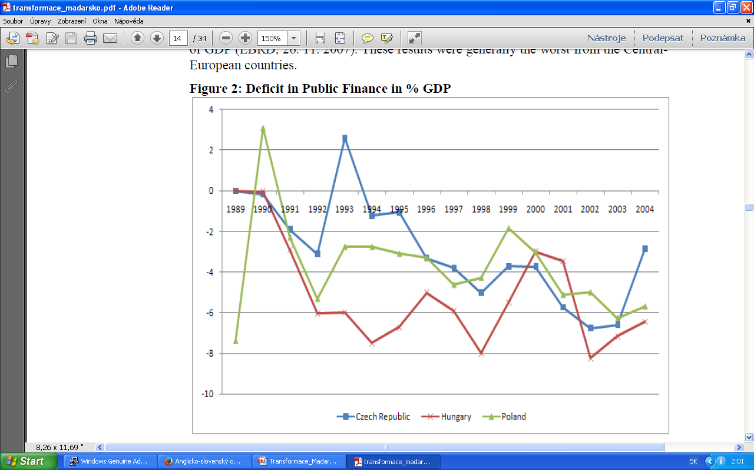
Figure 2: Deficit in Public Finance in % GDP
Source: EBRD: Selected economic indicators data, 26. 11. 2007.

Slide 27
Currency problems
Beginning of the 21st century – problems are back
  Notorious problems with fiscal dicipline
  Growing trade deficit
  Increasing wages -> declining competitiveness
Monetary policy – response to inflation pressures
  Monetary restriction
  Widening the flutuation band
  Inflation targeting (2001)
  Full convertibility of the forint + fixed central parity
  Interest rates as a sigle tool to hit targets
Loose fiscal policy
Massive interventions on the foreign exchange market
  Loss of the CB´s credibility, decline of confidence in the currency, inflation

Slide 28
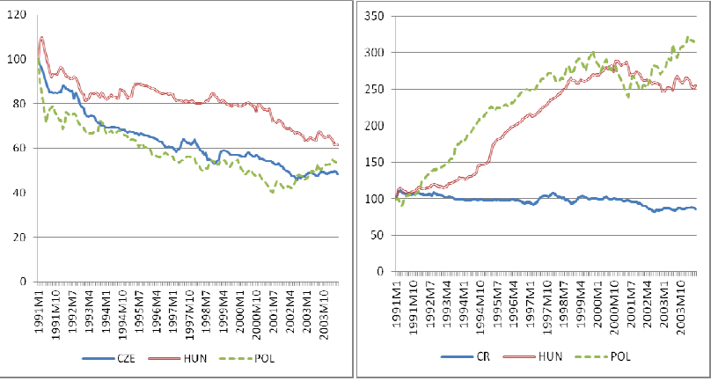
Figure 3: Nominal (left) and Real Exchange Rate (1991 = 100) in Hungary, Poland and the Czech Republic 1991-2004
Source: IMF, International financial statistics, http://elibrary-data.imf.org/

Slide 29
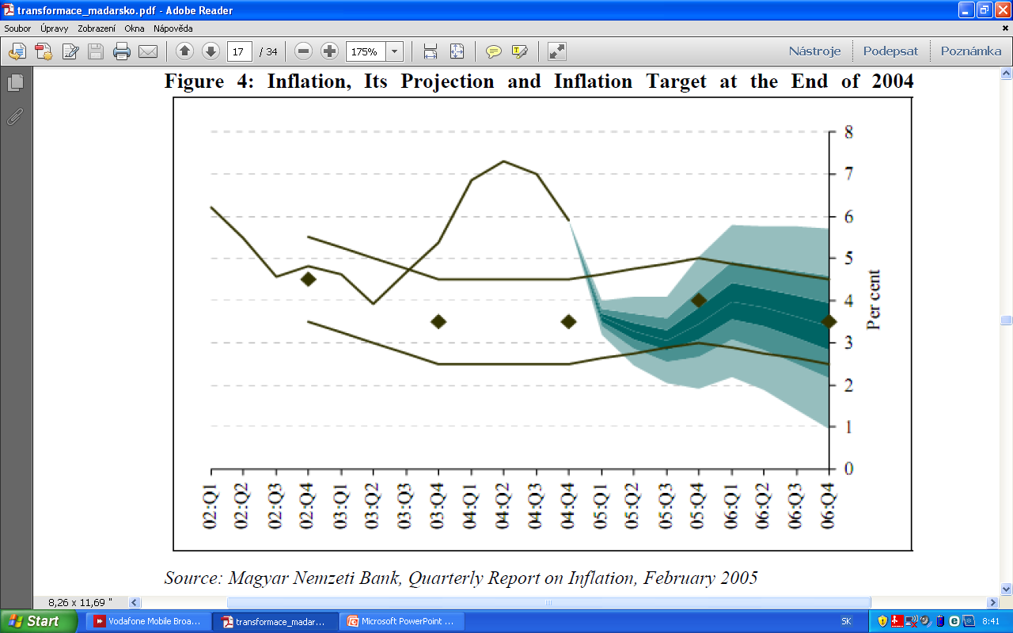
Figure 4: Inflation, Its Projection and Inflation Target at the End of 2004
Source: Magyar Nemzeti Bank, Quarterly Report on Inflation, February 2005

Slide 30
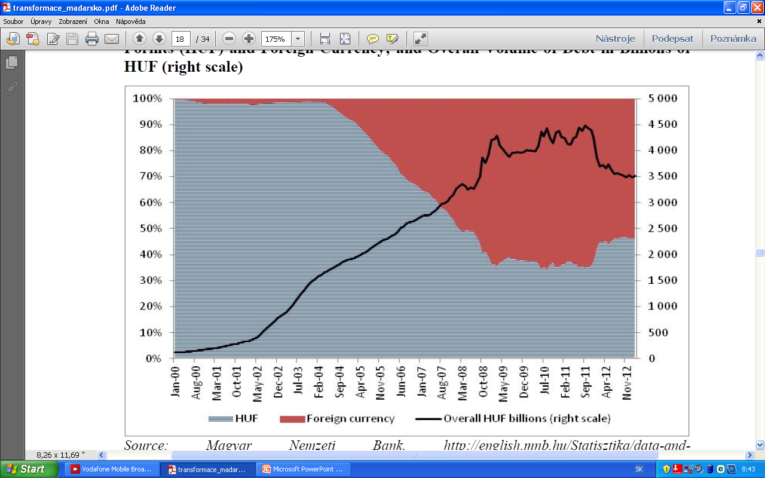
Figure 5: Household Indebtedness Over One Year Maturity. Share of Debt in Forints (HUF) and Foreign Currency; and Overall Volume of Debt in Billions of HUF (right scale)
Source: Magyar Nemzeti Bank, http://english.mnb.hu/Statisztika/data-and-information/mnben_statisztikai_idosorok, 15. 4. 2013

Slide 31
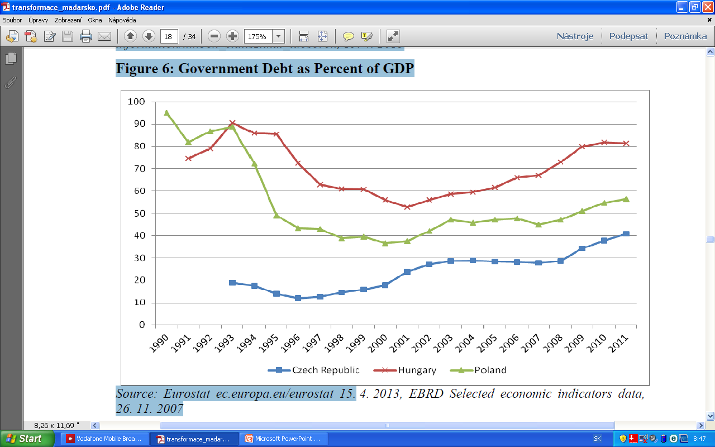
Figure 6: Government Debt as Percent of GDP
Source: Eurostat ec.europa.eu/eurostat 15. 4. 2013, EBRD Selected economic indicators data,26. 11. 2007

Slide 32
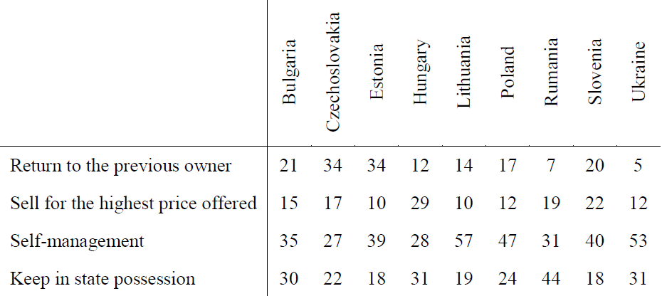
Privatisation
Table 12: Public Survey – How Would you Solve The Problem of Ownership
November 1990/August 1991
Source: Kende, Rovnostářské a etatistické dědictví ve střední a východní Evropě in Politická a ekonomická transformace v zemích střední a východní Evropy, 1993

Slide 33
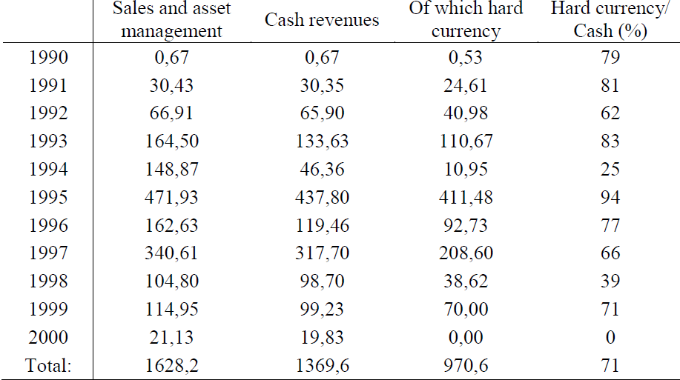
Table 14: Privatization Revenues of the State Privatization Companies, 1990-2000, HUF billion
Source: Csáki, From Transition to Integration, 2002

Slide 34
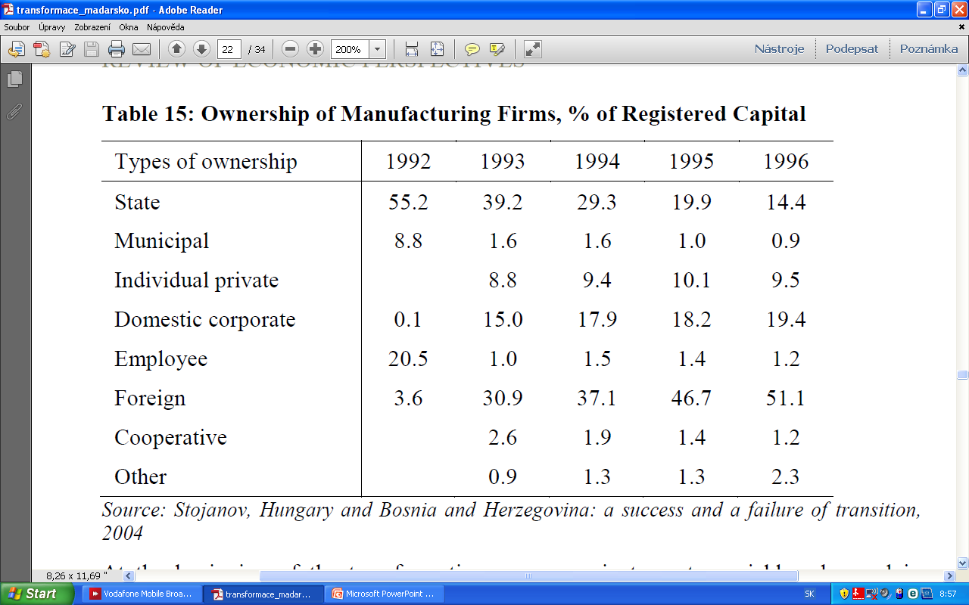
Table 15: Ownership of Manufacturing Firms, % of Registered Capital
Source: Csáki, From Transition to Integration, 2002

Slide 35
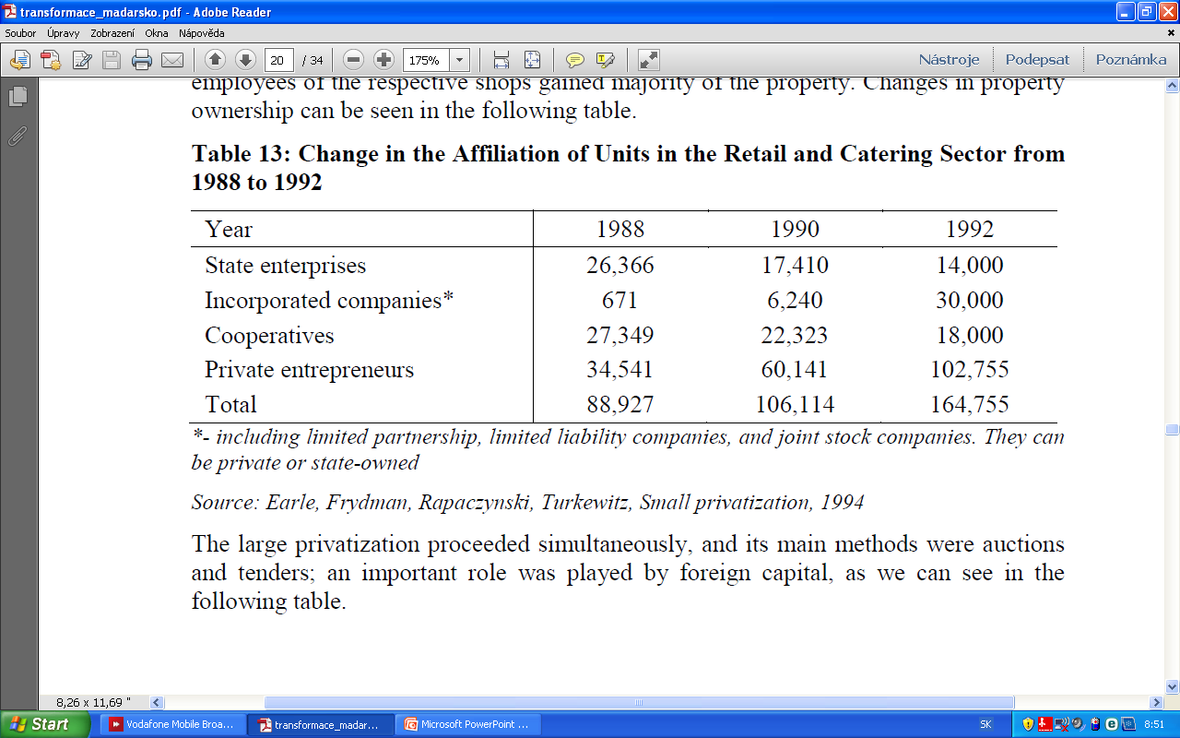
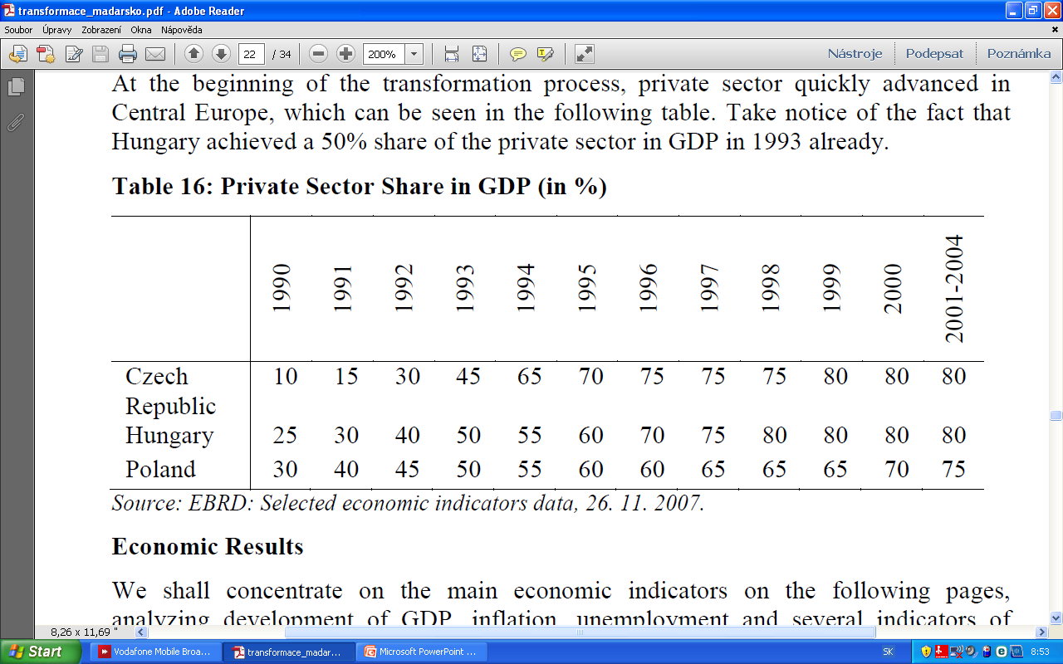
Table 11: Change in the Affiliation of Units in the Retail and Catering Sector from 1988 to 1992
Source: Earle, Frydman, Rapaczynski, Turkewitz, Small privatization, 1994
Table 12:Private Sector Share in GDP (in %)
Source: EBRD: Selected economic indicators data, 26. 11. 2007.

Slide 36
Contents
Development during the communist regime
  Insight to long-run political development
  Economic situation
Political Development
Transformation period
  Economic reforms after 1990
  Currency problems
  Privatisation
4. Economic results
  Economic growth
  Structure of the economy
  Inflation
  Unemployment
  External relationship

Slide 37
Economic results
The fourth part

Slide 38
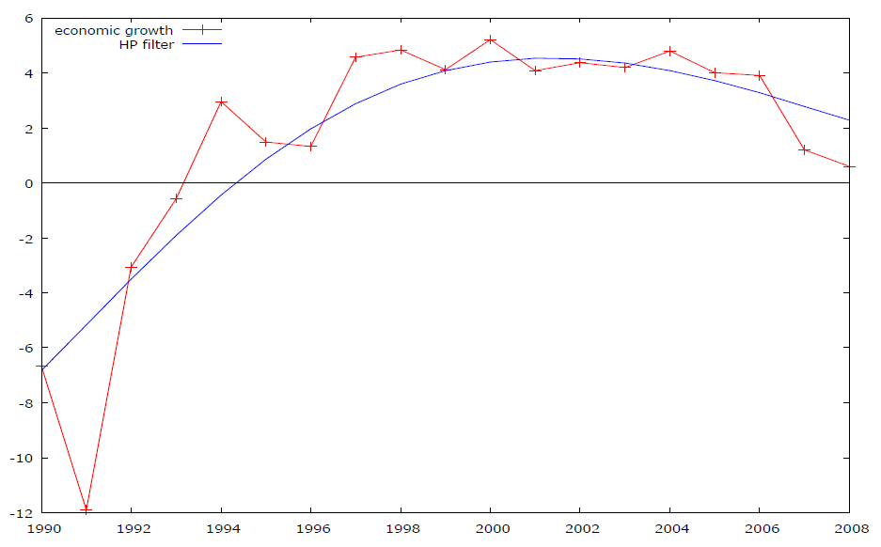
Chart X: Economic Growth After 1990 (in %) and Its Trend Estimated by HP Filter
Source: Maddison, Historical Statistics - http://www.ggdc.net/MADDISON/oriindex.htm, (11.10.2010)

Slide 39
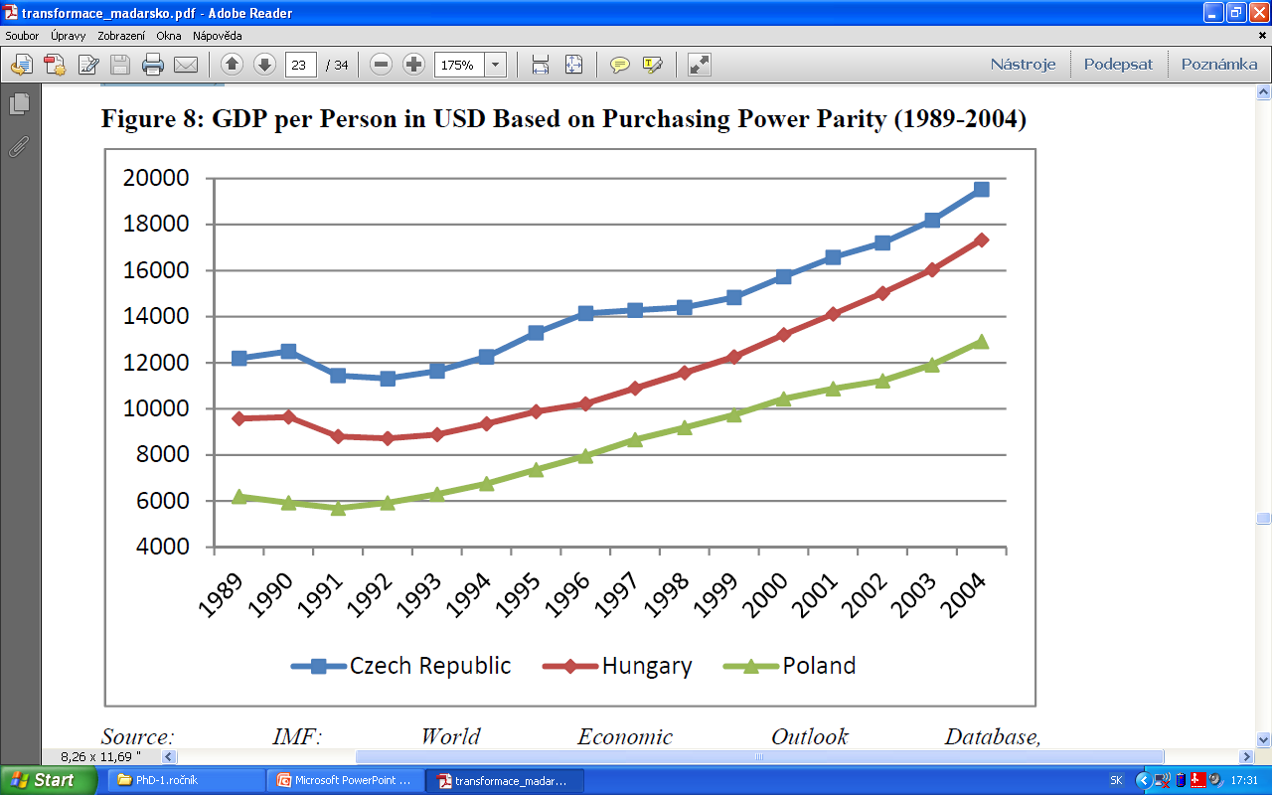
Figure 8: GDP per Person in USD Based on Purchasing Power Parity (1989-2004)
Source: IMF: World Economic Outlook Database, http://www.imf.org/external/pubs/ft/weo/2010/02/weodata/index.aspx (9. 10. 2010)

Slide 40
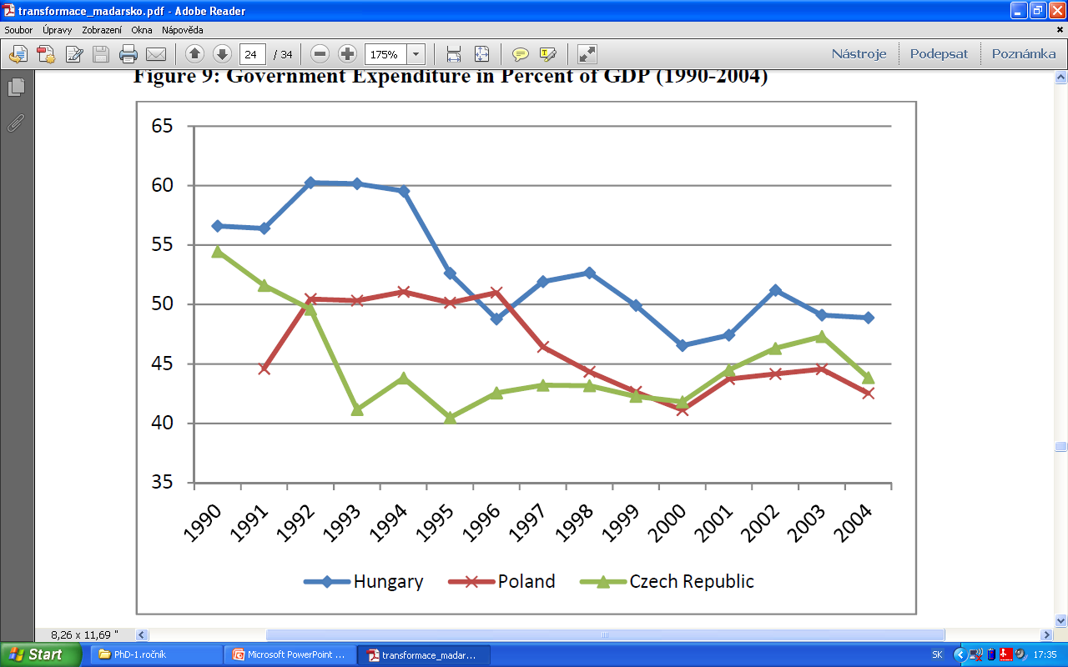
Figure 9: Government Expenditure in Percent of GDP (1990-2004)
Source: EBRD: Selected economic indicators data, 26. 11. 2007.

Slide 41
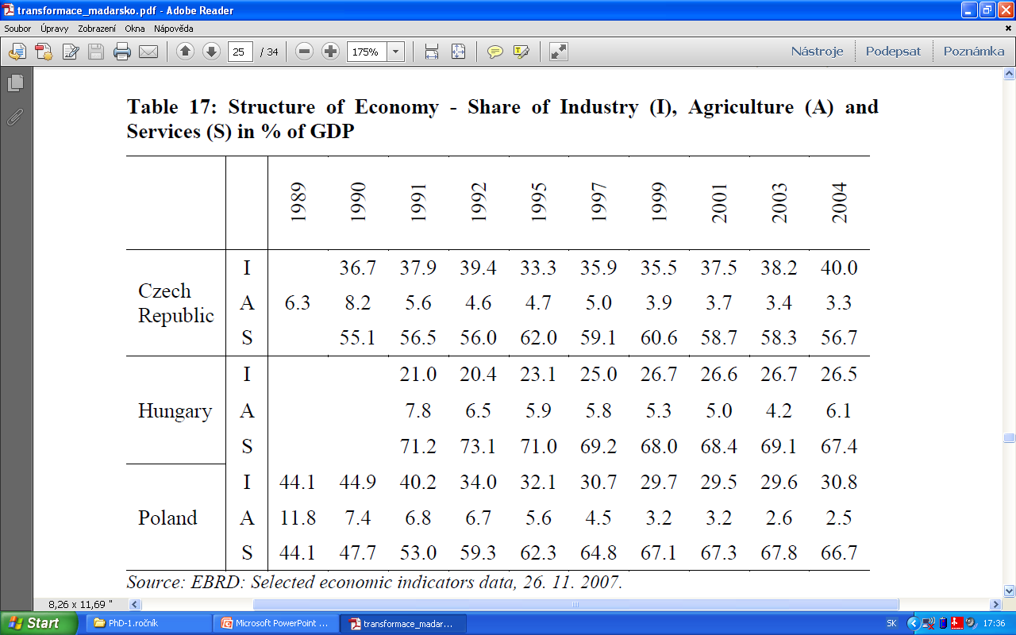
Table 17: Structure of Economy - Share of Industry (I), Agriculture (A) and Services (S) in % of GDP
Source: IMF: World Economic Outlook Database, http://www.imf.org/external/pubs/ft/weo/2010/02/weodata/index.aspx (9. 10. 2010)

Slide 42
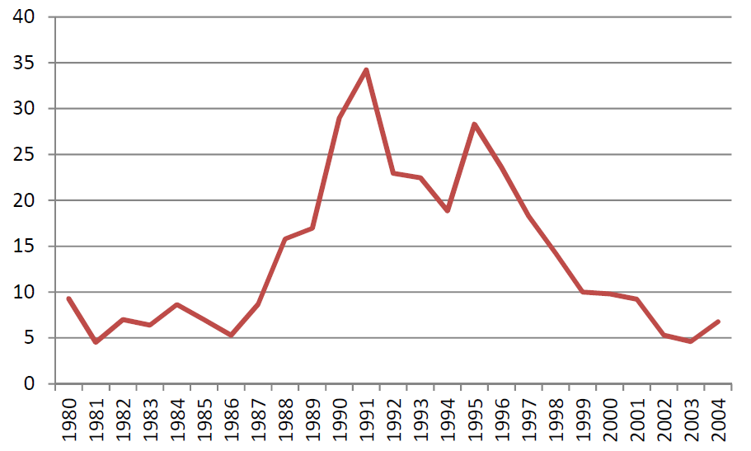
Figure 10: Inflation, Average Consumer Prices (Percentage Change) 1980-2004
Source: IMF: World Economic Outlook Database, http://www.imf.org/external/pubs/ft/weo/2010/02/weodata/index.aspx (9. 10. 2010)

Slide 43
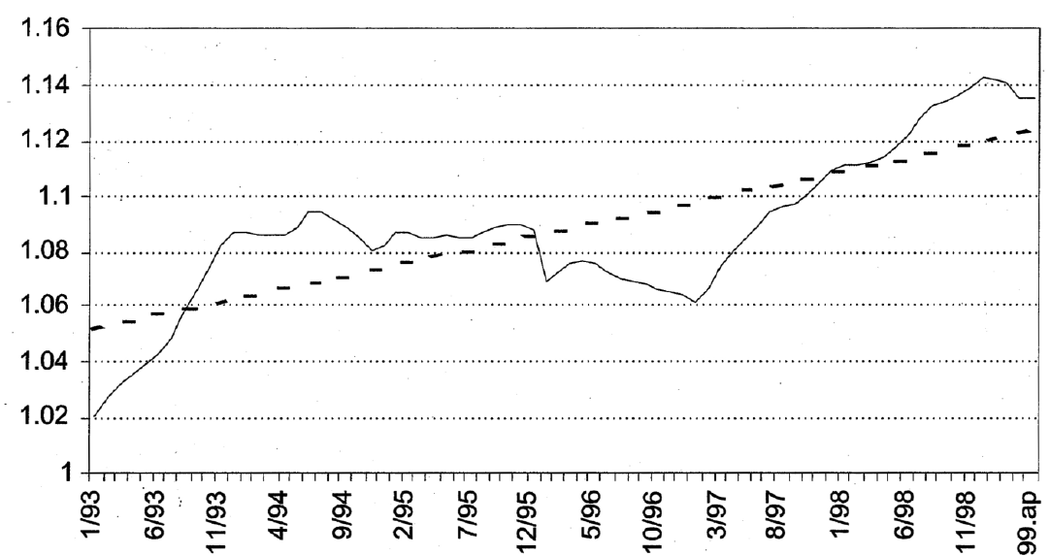
Figure 11: Non-tradable/Tradable Inflation in Hungary (1991=1)
Source: Halpern, Neményi, Fiscal Foundations of Convergence to the European Union, 2001.

Slide 44
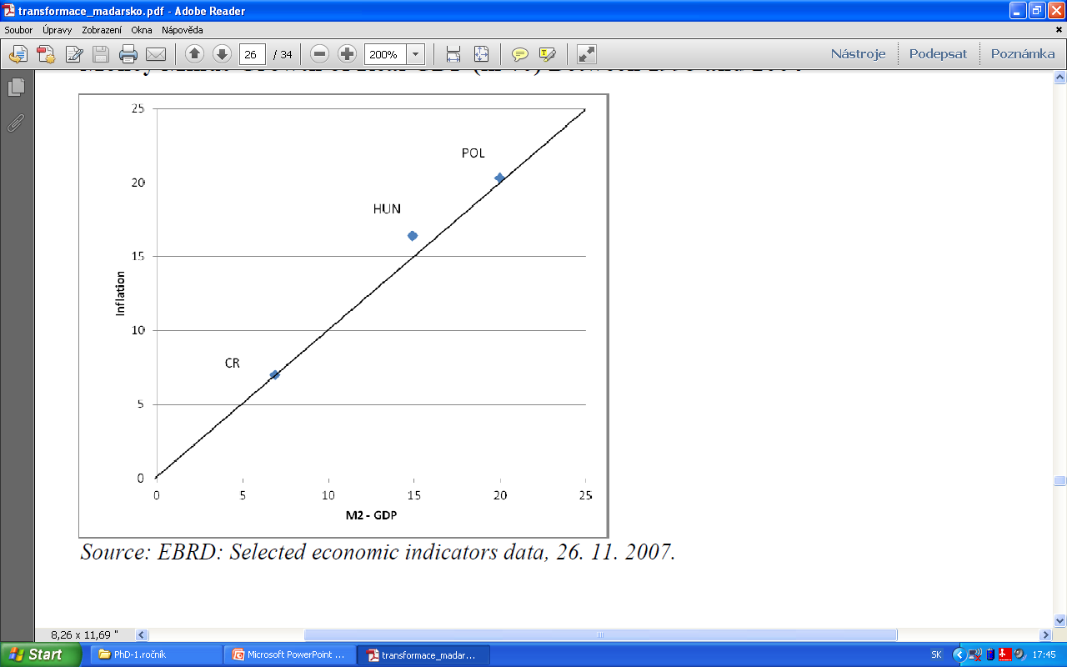
Figure 12: Inflation (Average Percentage Change of CPI) Growth of Broad Money Minus Growth of Real GDP (%)
Between 1993 and 2004
Source: EBRD: Selected economic indicators data, 26.11. 2007.

Slide 45
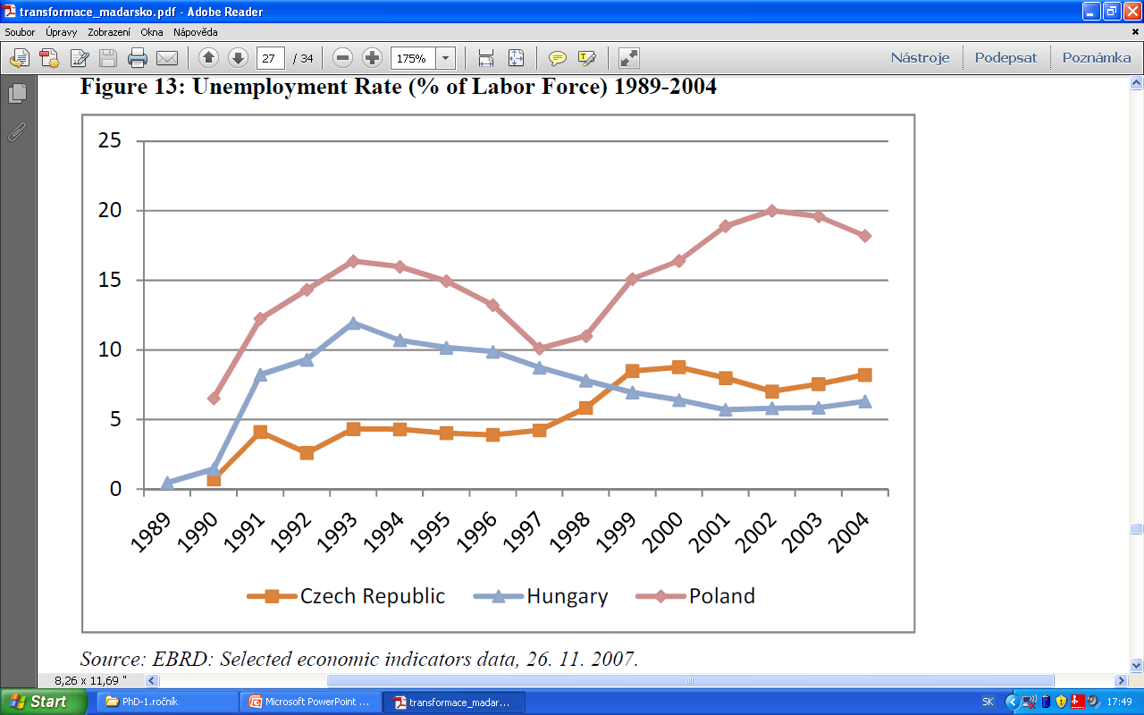
Figure 13: Unemployment Rate (% of Labor Force) 1989-2004
Source: EBRD: Selected economic indicators data, 26. 11. 2007.

Slide 46
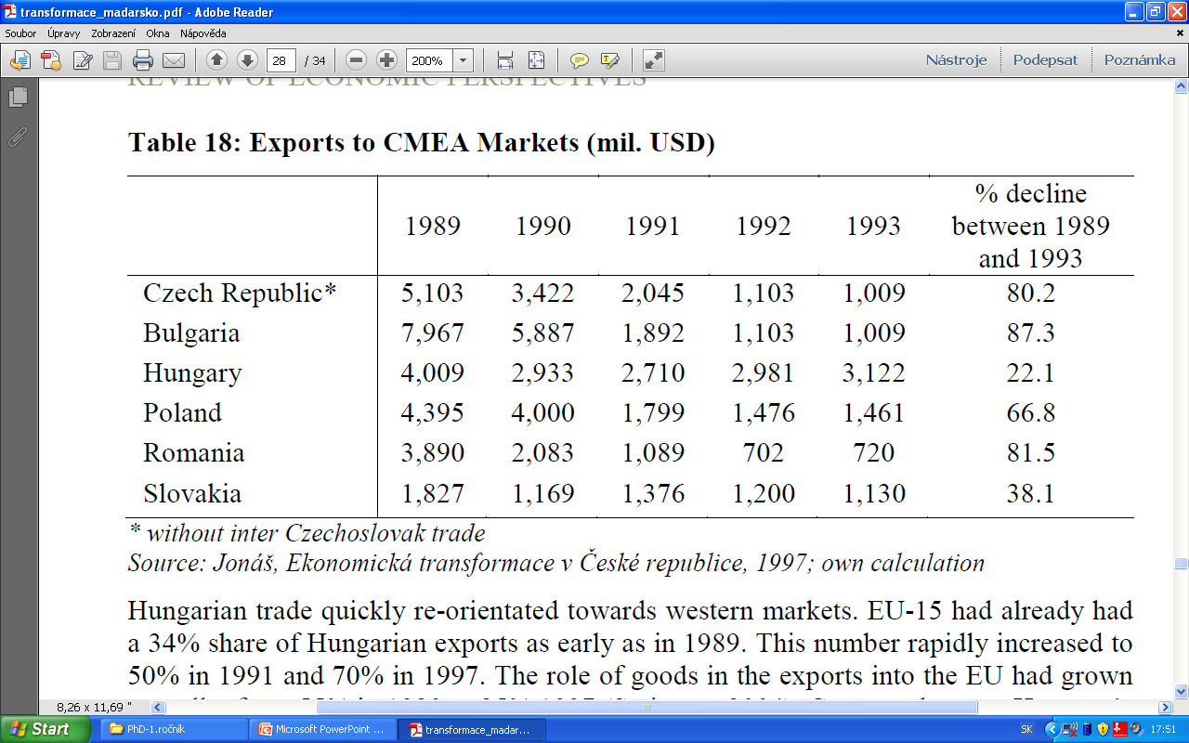
Table 18: Exports to CMEA Markets (mil. USD)
Source: Jonáš, Ekonomická transformace v České republice, 1997; own calculation

Slide 47
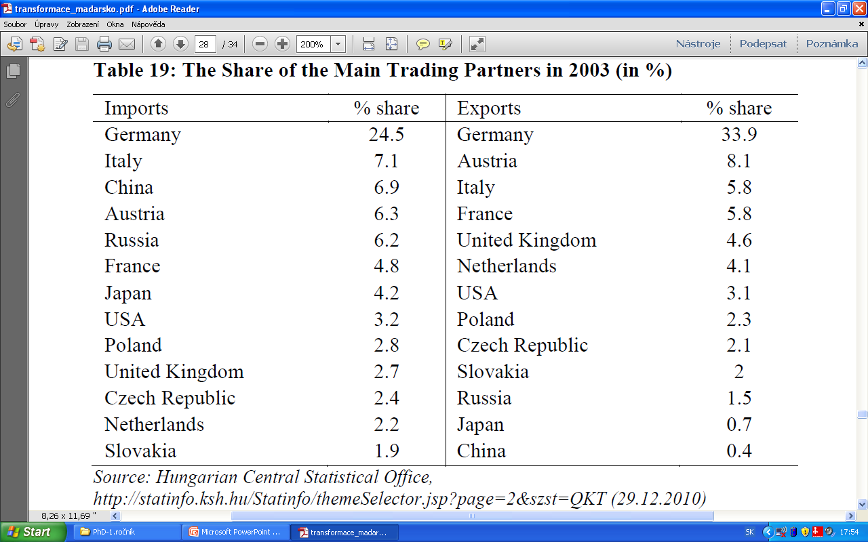
Table 19: The Share of the Main Trading Partners in 2003 (in %)
Source: Hungarian Central Statistical Office, http://statinfo.ksh.hu/Statinfo/themeSelector.jsp?page=2&szst=QKT (29.12.2010)

Slide 48
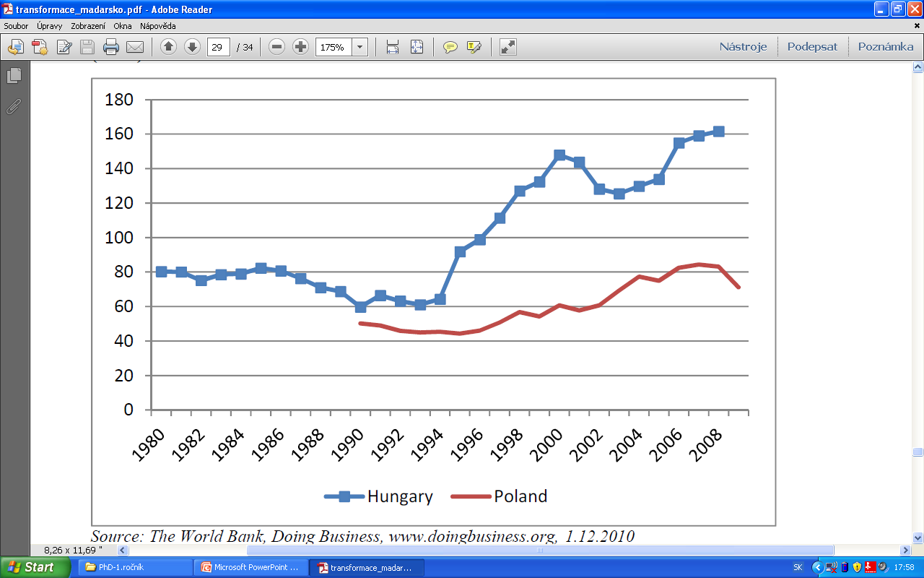
Figure 14: Exports and Imports as Percentage of GDP in Hungary and Poland (in %)
Source: The World Bank, Doing Business, www.doingbusiness.org, 1.12.2010

Slide 49
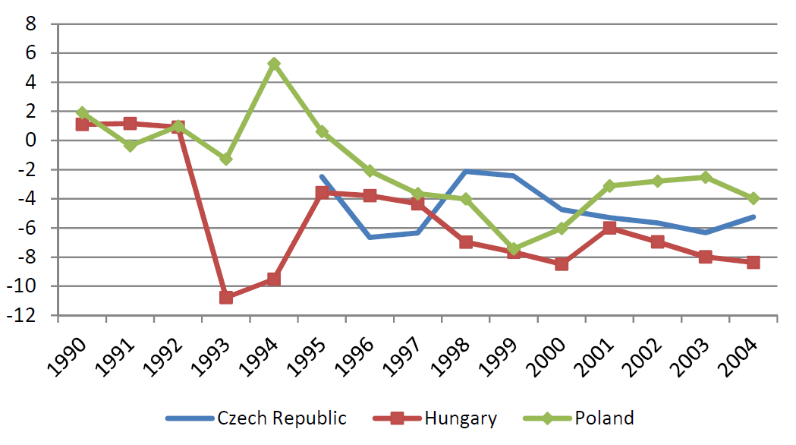
Figure 15: Current Account to GDP (%) 1990 – 2004
Source: IMF: World Economic Outlook Database, http://www.imf.org/external/pubs/ft/weo/2010/02/weodata/index.aspx (9. 10. 2010)

Slide 50
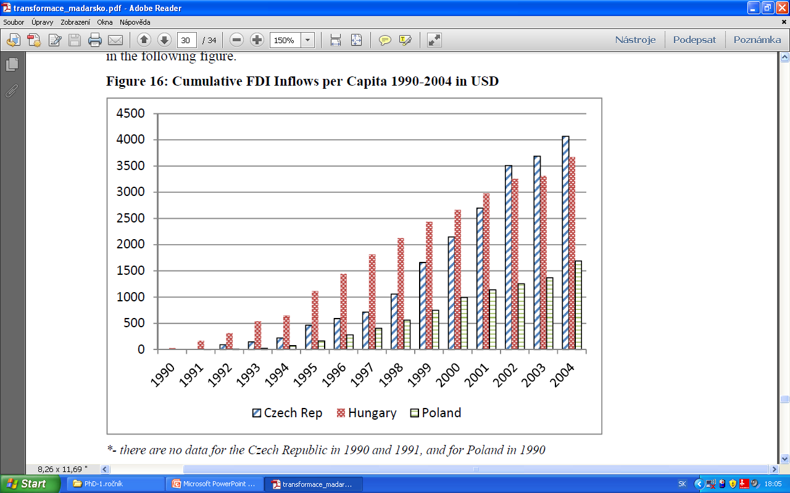
Figure 16: Cumulative FDI Inflows per Capita 1990-2004 in USD
Source: EBRD: Selected economic indicators data, 26. 11. 2007.

Slide 51
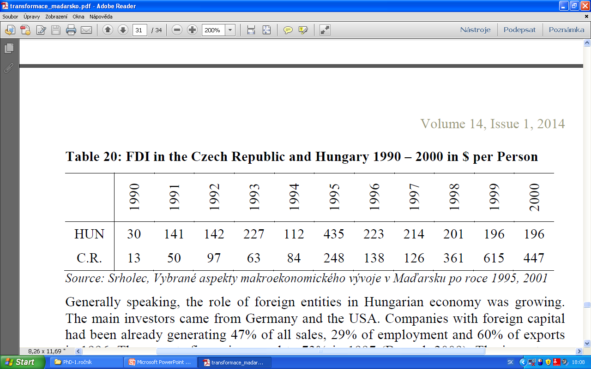
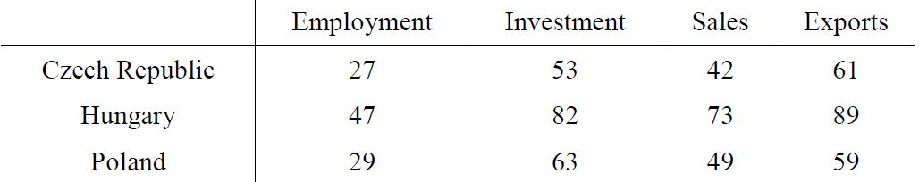
Table 20: FDI in the Czech Republic and Hungary 1990 – 2000 in $ per Person
Source: Srholec, Vybrané aspekty makroekonomického vývoje v Maďarsku po roce 1995, 2001.
Table 20: Share of Foreign Companies in Industrial Sector at the End of the 1990s
Source: Berend, From the Soviet Bloc to the European Union, 2009

Slide 52
Conclusions
Successful results
  change of overall economic framework and membership in EU
  almost duble increase of GDP p.c.
  establishment of positive growing trend
  catching up with developed countries
  rising competitiveness of Hungarian companies
Troubles
  transformation recession
  half-hearted economic reforms - > economic imbalances
  sources of future economic problems
  The main goals of transformation were achieved,
  but some mistakes still occured !

Slide 53
Thank you for attention !

