Slide 1
Transformation in Poland
Libor Žídek

Slide 2
Contents
Development during the communist regime
  Insight to long-run political development
  Economic situation
Political Development
Transformation period
  Economic reforms after 1990
  Privatisation
  Development in banking sector
4. Economic results
  Economic growth
  Structure of the economy
  Unemployment
  Inflation
  External relationships

Slide 3
Development DURING THE COMMUNIST REGIME
The first part

Slide 4
Insight to long-run political development
Poland – Russia relations before WWII
Member of the communist block after WWII
  prickly relations with Russia -> effect on attitude towards socialism
  problems with the regime + bad economic situation -> protests (1956, 1970)
  attempts for reforms -> Gomulka (1956), Gierek (1970)
  Jan Pavel II (1978)-> symbol of Polish opposition against the communist regime
  lack of freedoms + economic situation –> emmigration

Slide 5
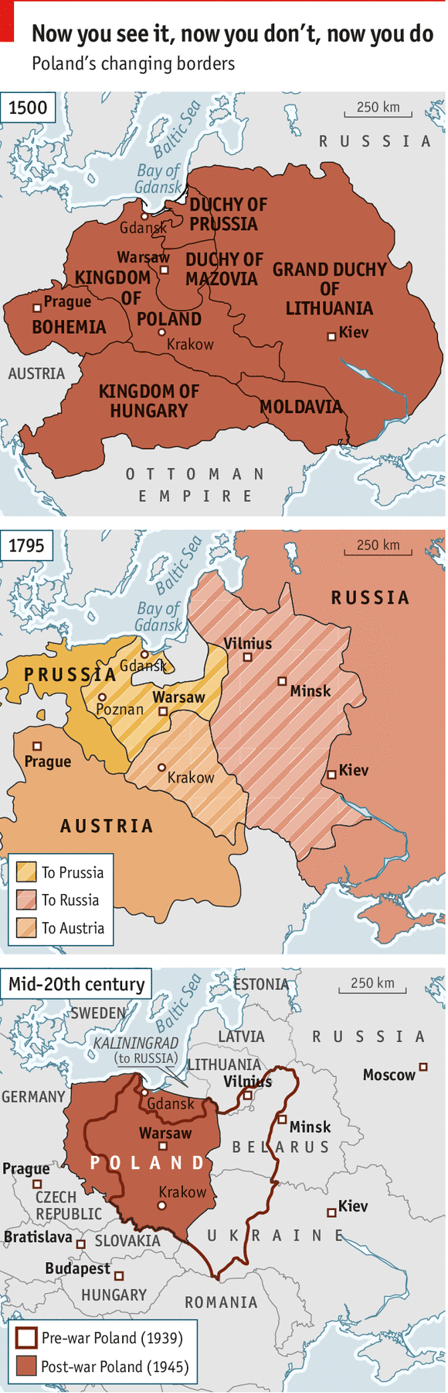
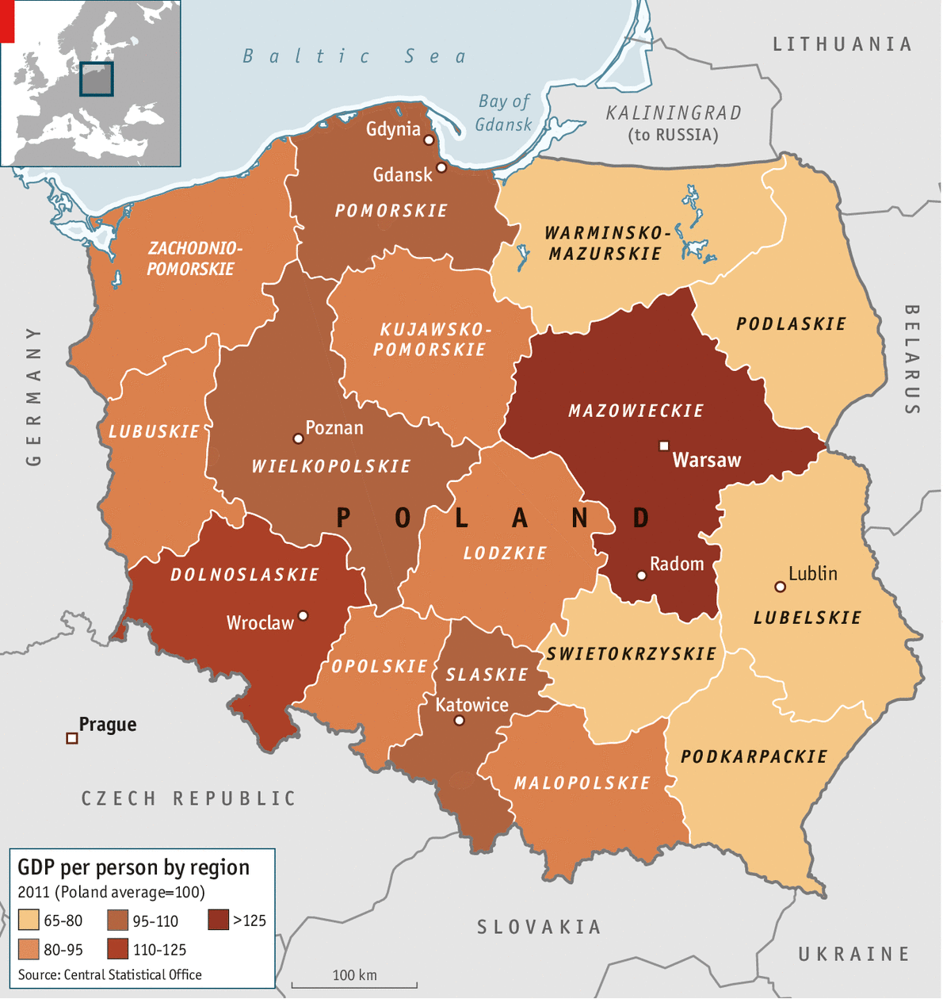

Slide 6
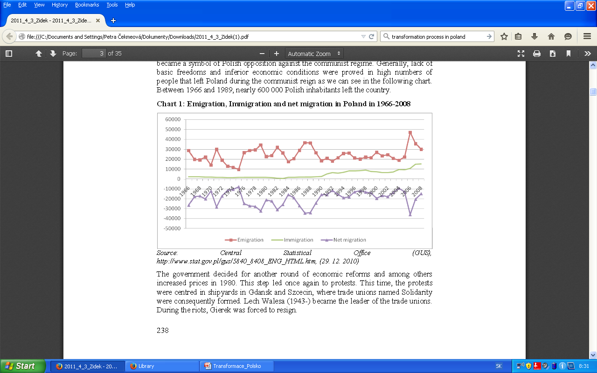
Chart 1: Emigration, Immigration and net migration in Poland in 1966-2008
Source: Central Statistical Pffice (GUS), http://www.stat.gov.pl/gus/5840_8408_ENG_HTML.htm, (29.12. 2010)

Slide 7
Economic situation I.
Centrally planned system
Backward economy with large portion of agriculture
Measures in 1960´s and 1970´s
  Membership in GATT since 1967
  Legal framework for FDI
Economic problems
  FDI -> overheating, inflationary pressures
  Borrowings from abroad -> foreign debt
  Impacts of global debt crisis (1980) -> GDP, government deficit, deficit of BoP, shortage of basic products, monetary excess
Riots, destabilization ...
... martial law and reforms as solutions?

Slide 8
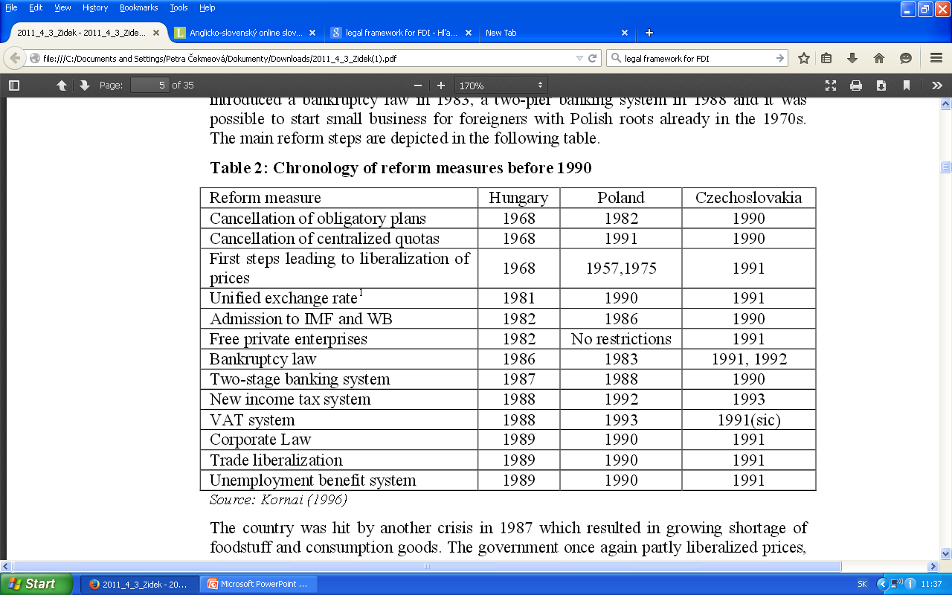
Table 1: Chronology of reform measures before 1990
Source: Kornai (1996)

Slide 9
Economic situation II.
No impovement ...
Another crisis (1987) - > shortage of consumer goods
Partial price liberalization -> hyperinflation
Chaotic economic policy and economic distortions
Problems with ...
Polish self-managed socialism
Overal ownership structure
Structure of the economy
Development of main indicators

Slide 10
Self-management socialism
Companies controlled by workers
  better functioning, motivated employees, improved overall efficiency
  self-governing (powerful) councils established in almost all companies
In reality negative impact on companies
  increasing wages -> inflation
  no rationalisation of production processes
  no improvement in motivation of employees

Slide 11
Structure of the economy
Public sector
  large portion of GDP
  f.e. state companies and cooperatives created 81.9% of GDP in 1988
Private sector
  smaller portion of GDP, mainly in agriculture
  growing share since the end of 1970s
  BUT larger than in Czechoslovakia
Large share of agriculture
  – sign of underdevelopment
Armament production
  obstacle to transformation
  relatively high portion of industrial production
  one of the biggest producer
  for Warsaw Pact countries and Soviet Union

Slide 12
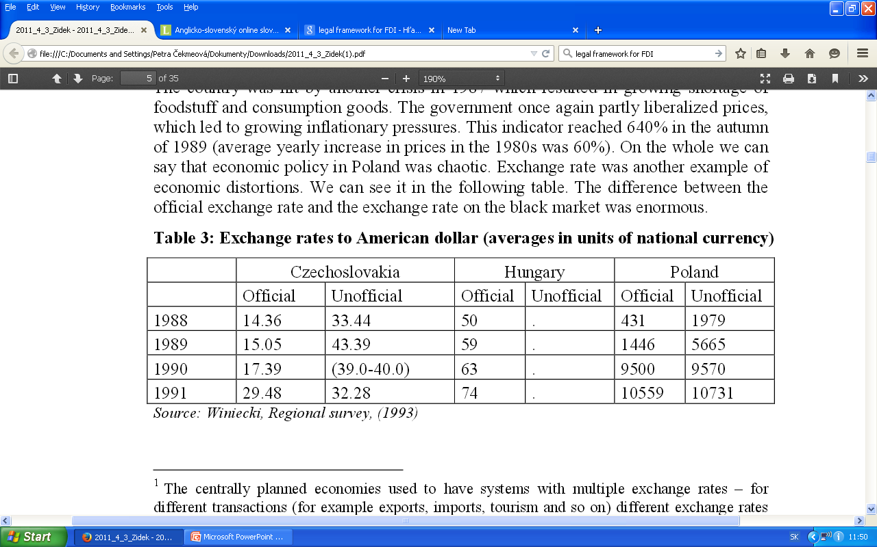
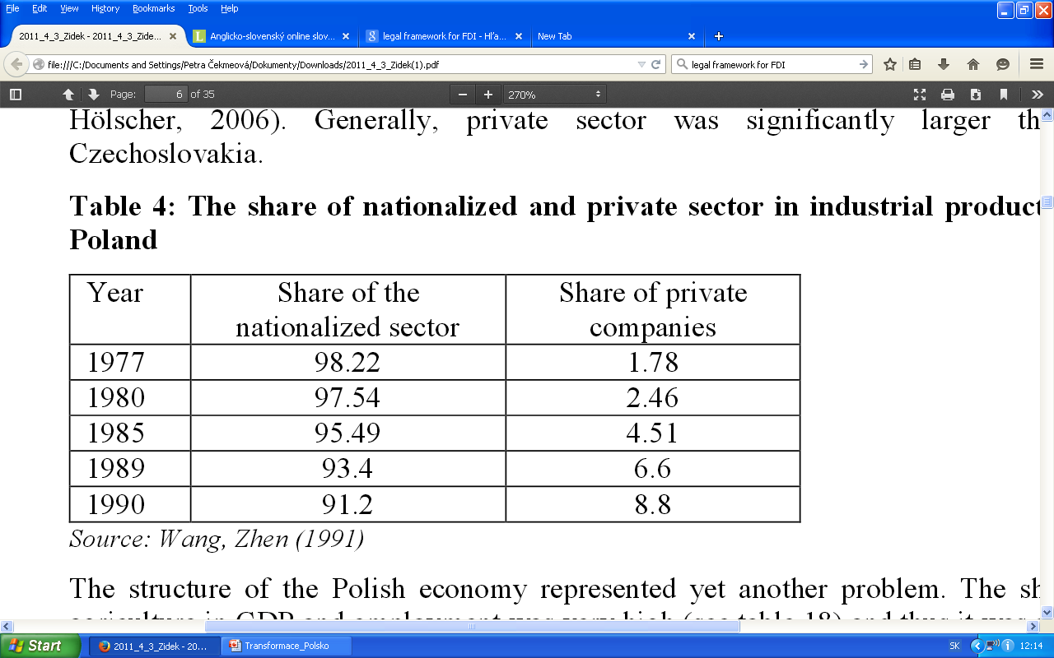
Table 2: Exchange rates to American dollar (averages in units of national currency)
Source: Winiecki, Regional survey, (1993).
Table 3: The share of nationalized and private sector in industrial production in Poland
Source: Wang, Zhen (1991)

Slide 13
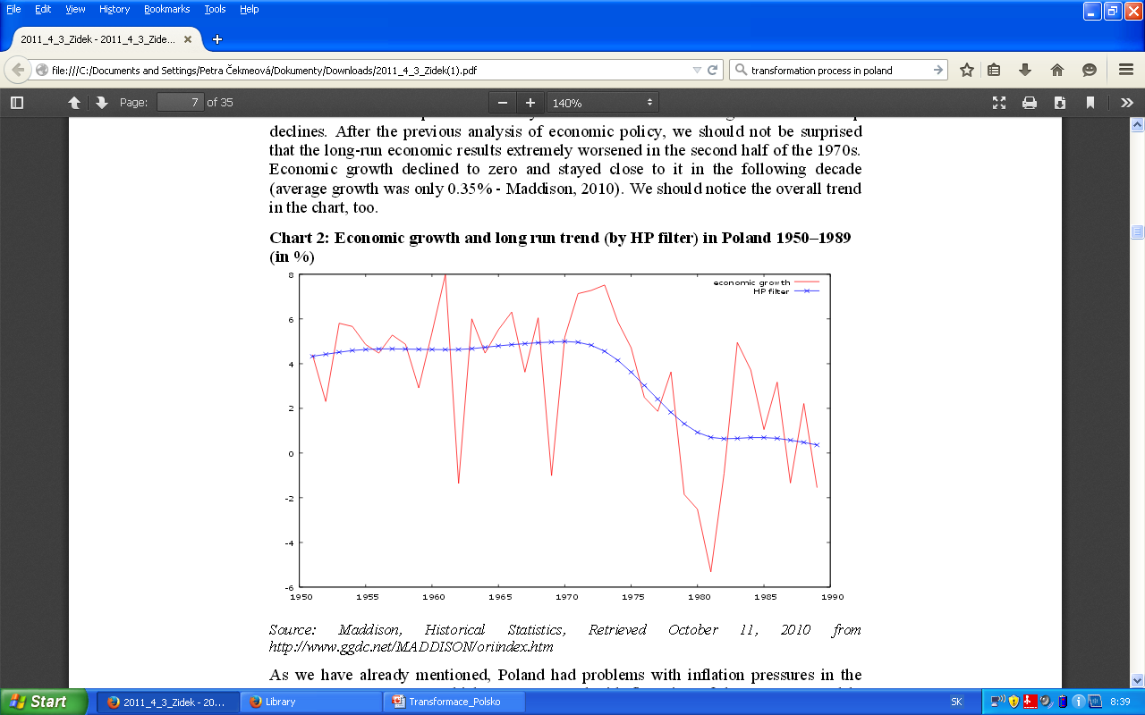
Chart 2: Economic growth and long run trend (by HP filter) in Poland 1950–1989 (in %)
Source: Maddison, Historical Statistics, Retrieved October 11, 2010 from http://www.ggdc.net/MADDISON/oriindex.htm

Slide 14
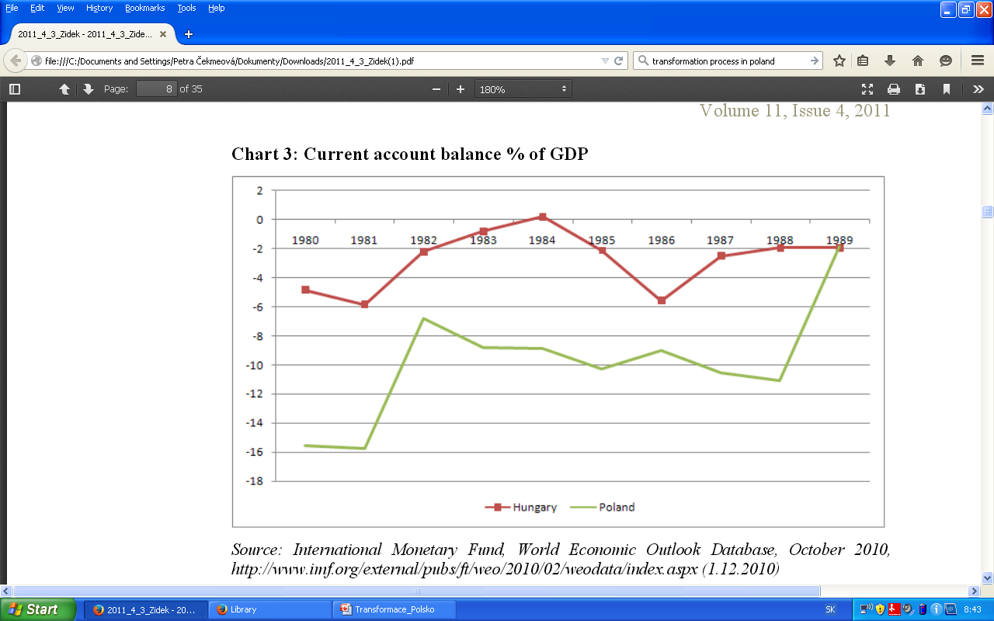
Chart 3: Current account balance % of GDP
Source: International Monetary Fund, World Economic Outlook Database, October 2010, http://www.imf.org/external/pubs/ft/weo/2010/02/weodata/index.aspx (1.12.2010)

Slide 15
Contents
Development during the communist regime
  Insight to long-run political development
  Economic situation
Political Development
Transformation period
  Economic reforms after 1990
  Privatisation
  Development in banking sector
4. Economic results
  Economic growth
  Structure of the economy
  Unemployment
  Inflation
  External relationships

Slide 16
Political Development
The second part

Slide 17
Political development I.
Pseudo-democratic system
  Consequence of negotiations with Solidarity
  First non-communist government in 1989 -> Solidarity (high support)
  Walesa – president (1989)
First free elections in 1991 –> 29 parties in the Parliament
  fragile political situation
  weak and changing coalition governments
  associate agreement with EC in 1991
  new constitution -> stronger position of president
  protests -> early elections

Slide 18
Political development II.
Elections in 1993 –> post-communist party (DLA) as winner
  slowdown of the transformation process
  emphasisi on social aspects
  leader of the party -> next president
Elections in 1997 -> right wing parties (SEA)
  40 political groups without uniform position
  membership in NATO (1999)
  unpopular steps -> collapse in 2000
Elections in 2001 -> left wing parties (DLA)
  coalition with the Polish People’s Party
  collapse in 2003
Membership in EU (2004)
Unstable political situation regardless of +/- economic situation

Slide 19
Contents
Development during the communist regime
  Insight to long-run political development
  Economic situation
Political Development
Transformation period
  Economic reforms after 1990
  Privatisation
  Development in banking sector
4. Economic results
  Economic growth
  Structure of the economy
  Unemployment
  Inflation
  External relationships

Slide 20
Transformation Period
The third part

Slide 21
Economic reforms after 1990 I.
„Big Bang“ reform (shock therapy)
  Consequence of catastrophic economic situation
Public opinion
  In favour of reforms
  No sense about the function of market economies
Balcerowicz plan (1990)
  Liberalization of markets and prices
  Inner convertibility of the zloty
  Restrictive monetary policy
  Devaluation + fixing of the zloty to the dollar
  Wage regulation
  Fiscal restrictions (limiting subvensions)
Jeffrey Sachs
  key economic adviser of the Polish government

Slide 22
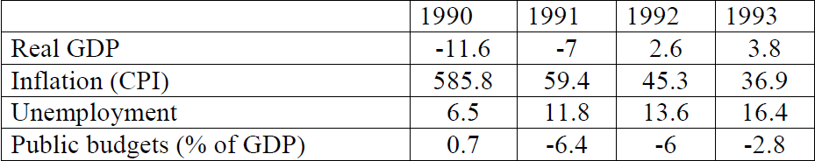
Economic reforms after 1990 II.
Transformation recession
Development in foreign sector
  Decline in trade with COMECOM
  Support from the West
    PHARE
    Remitting polish debts
    IMF (stabilization program and loans)
Devaluations of the zloty + fixed to a basket of 5 currencies + crawling pegg
Poor economic conditions still in 1993 -> Strategy for Poland
Table 4:Development of the main economic indicators in Poland 1990-1993
Source: Holman (2000)

Slide 23
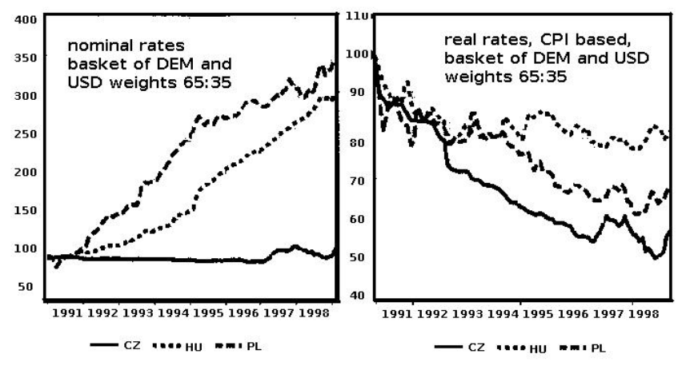
Chart 4: Nominal and real exchange rate in Central
Europe
Source: Frait, Kotlán (2000)

Slide 24
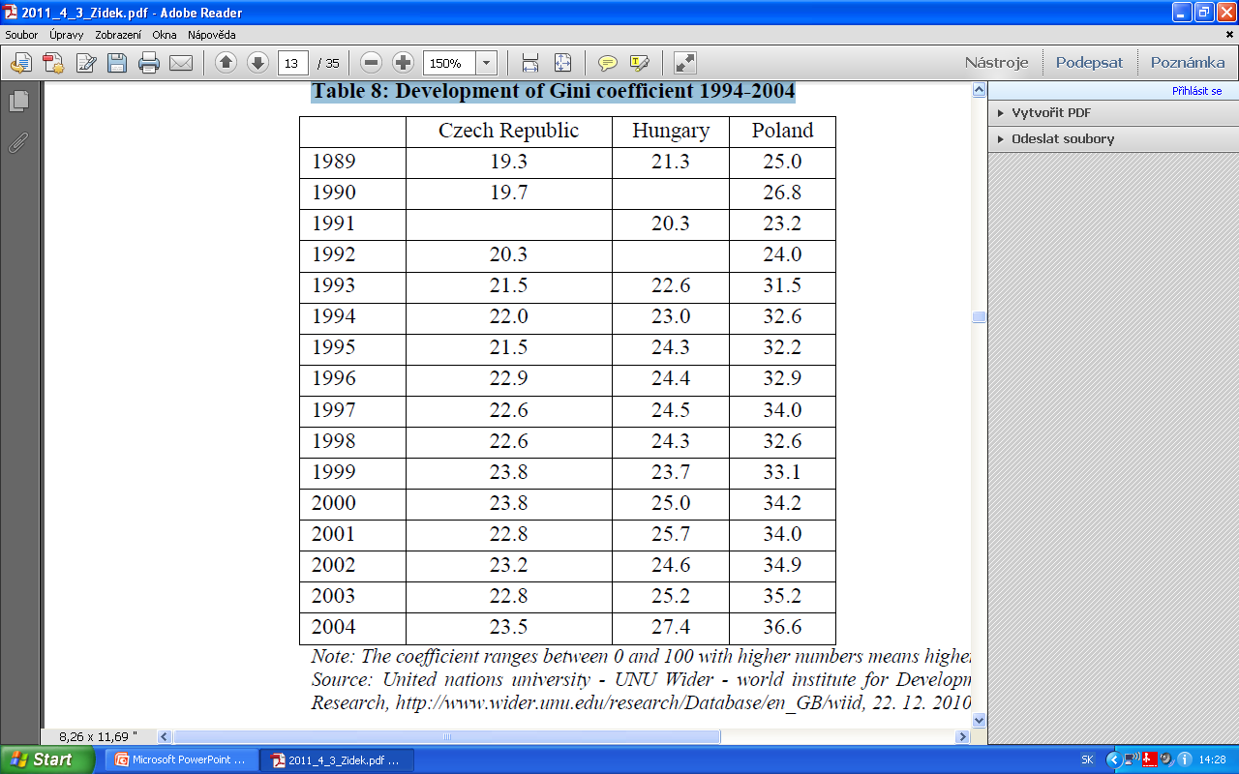
Table 5: Development of Gini coefficient 1994-2004
Source: United nations university - UNU Wider - world institute for Development Economics Research, http://www.wider.unu.edu/research/Database/en_GB/wiid, 22. 12. 2010

Slide 25
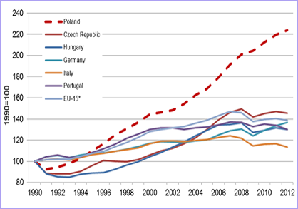
GDP per person 1990=100
Source:

Slide 26
Economic reforms after 1990 III.
Relatively high economic growth -> budget deficit under control
Monetary policy -> targeting money in circulation
Agreements with London and Paris creditors clubs (1994)
Re-denomination of the zloty (1995) -> 10 000 PLZ for 1 PLN
Liberalization of transactions on the financial account
  Massive inflow of foreign capital
  Appreciation and increase of foreign reserves to keep the exchange rate
  Periodic devaluation, wider fluctuation zone, basket of 2 currencies
Membership in OECD (1996)
Government vs. Public debt
Direct inflation targeting (1999)
Free floating since 2000

Slide 27
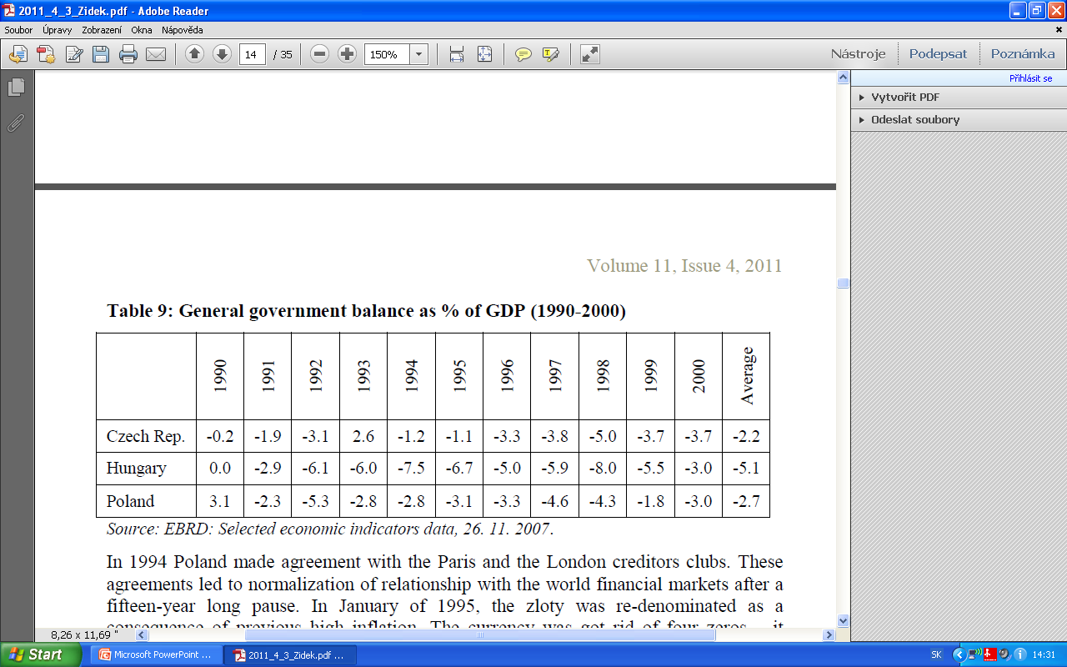
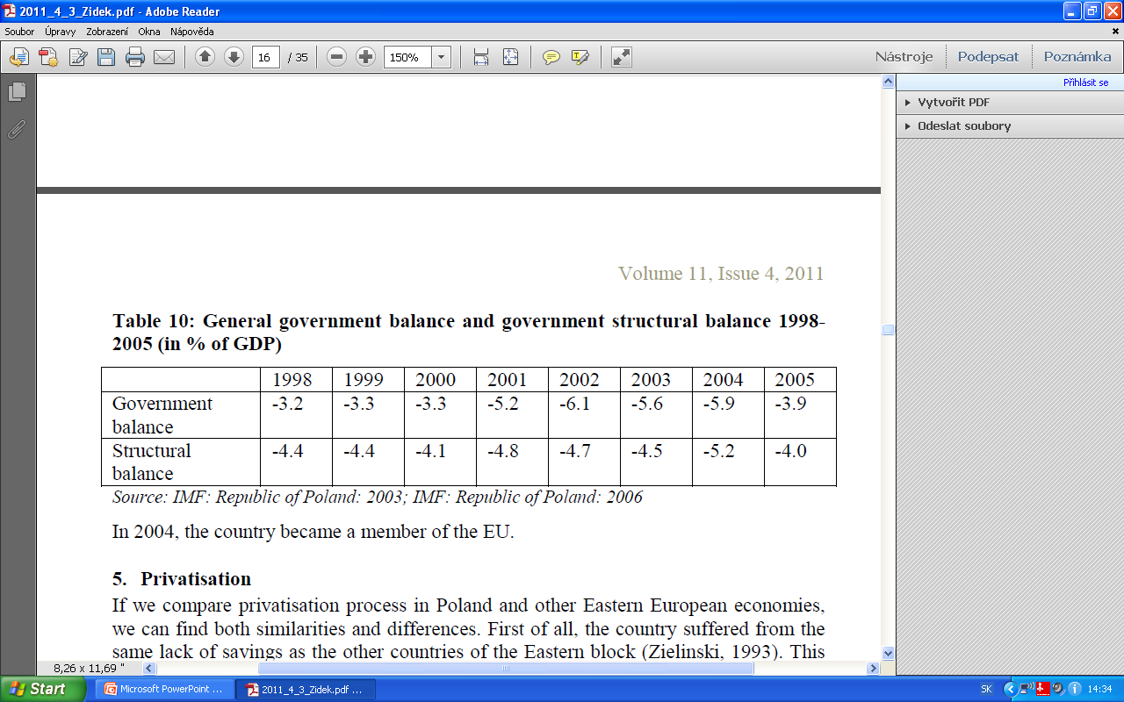
Table 9: General government balance as % of GDP (1990-2000)
Source: EBRD: Selected economic indicators data, 26. 11. 2007.
Table 9: General government balance as % of GDP (1990-2000)
Source: IMF: Republic of Poland: 2003; IMF: Republic of Poland: 2006

Slide 28
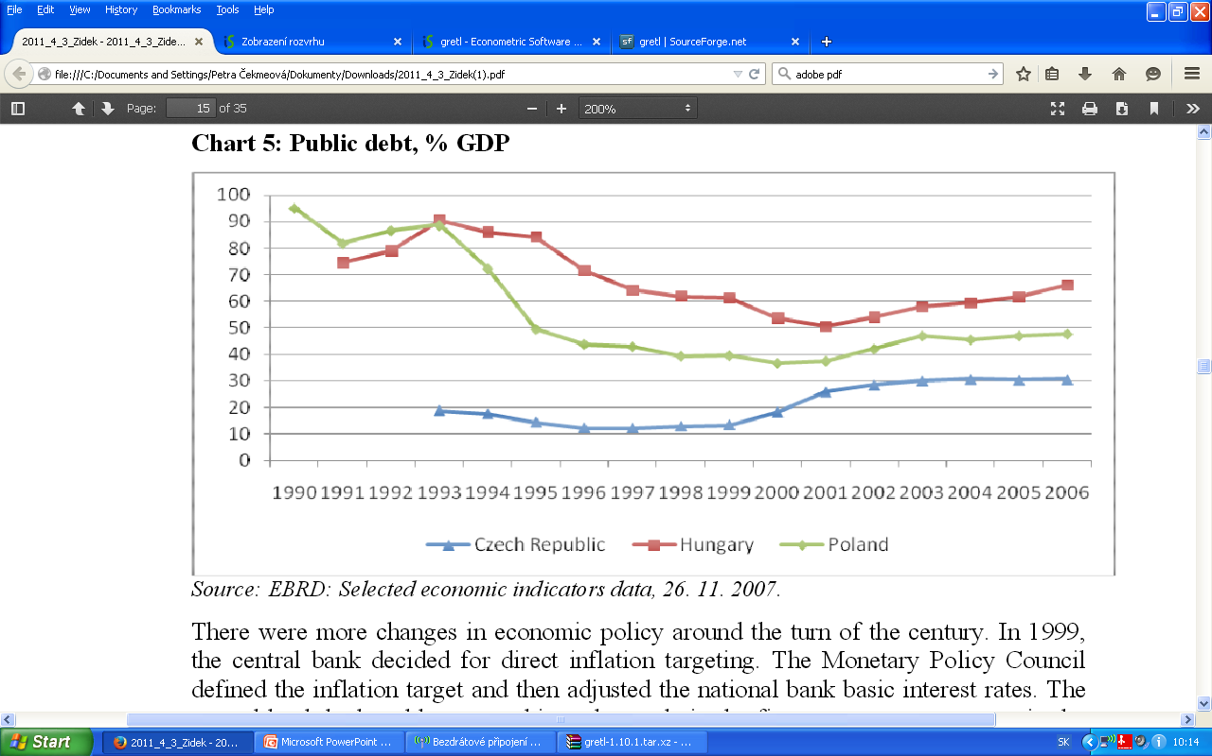
Chart 5: Public debt, % GDP
Source: EBRD: Selected economic indicators data, 26. 11. 2007.

Slide 29
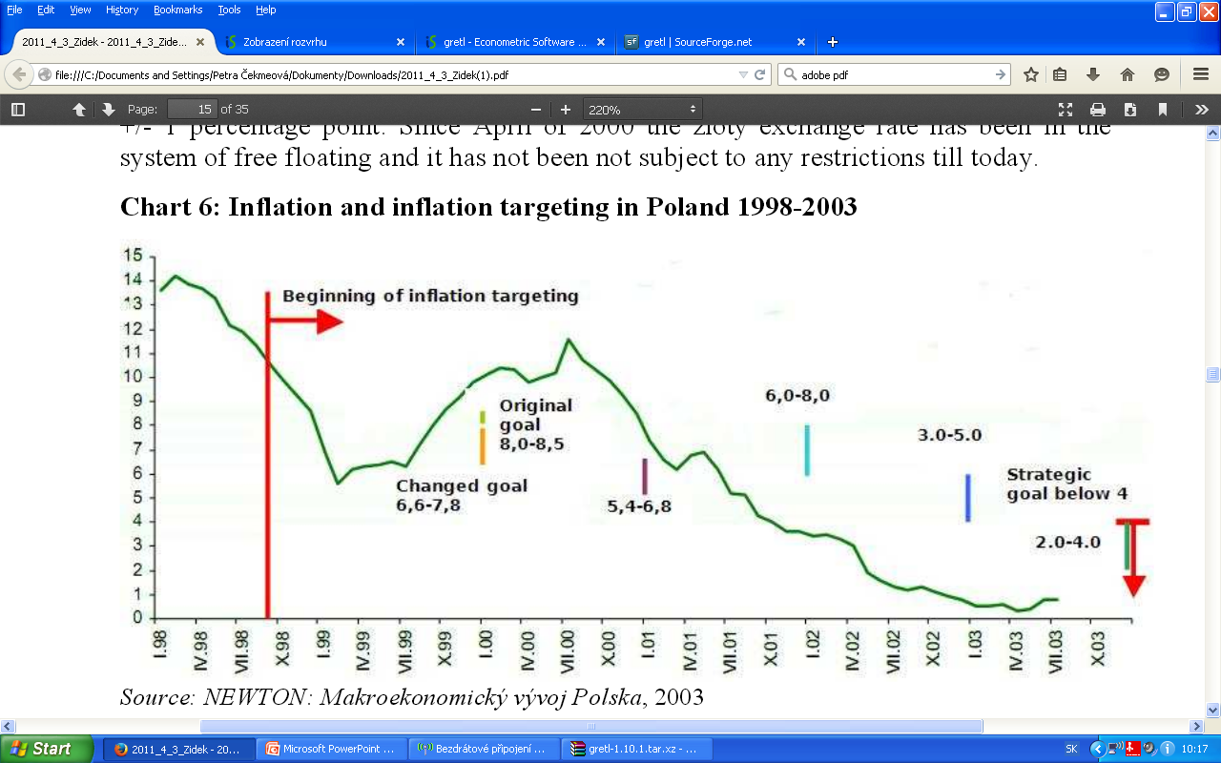
Chart 6: Inflation and inflation targeting in Poland 1998-2003
Source: NEWTON: Makroekonomický vývoj Polska, 2003

Slide 30
Privatisation
Lack of domestic savings but stronger position of employees and trade unions
„Spontaneous privatisation“ at the beggining
New forms of ownership change – commercialisation and liquidation
Voucher privatisation – specific features
Slow and postponed process

Slide 31
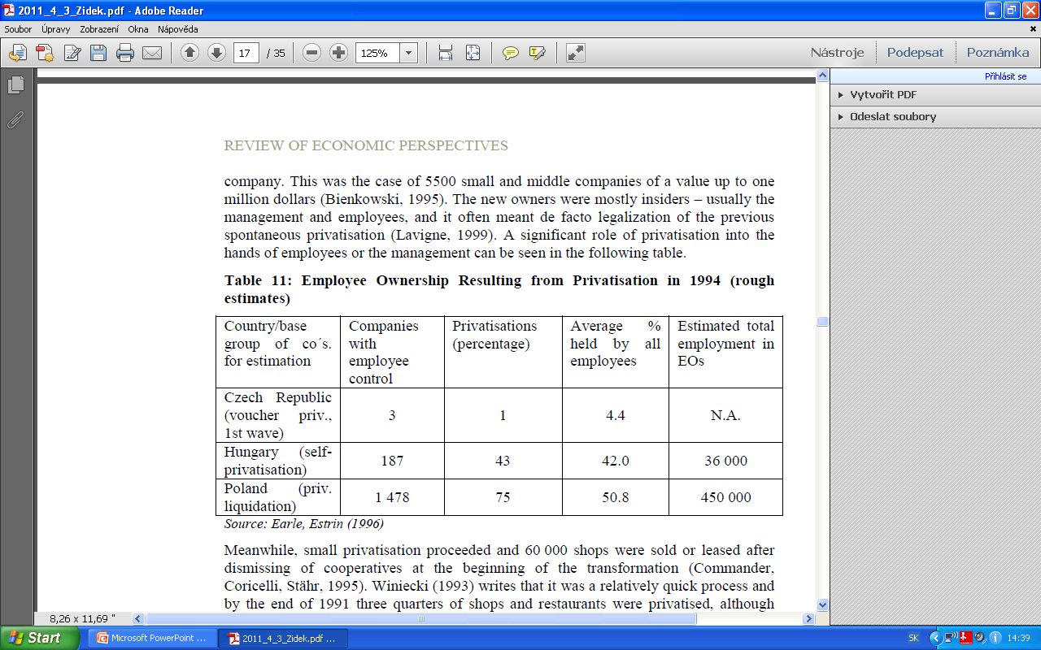
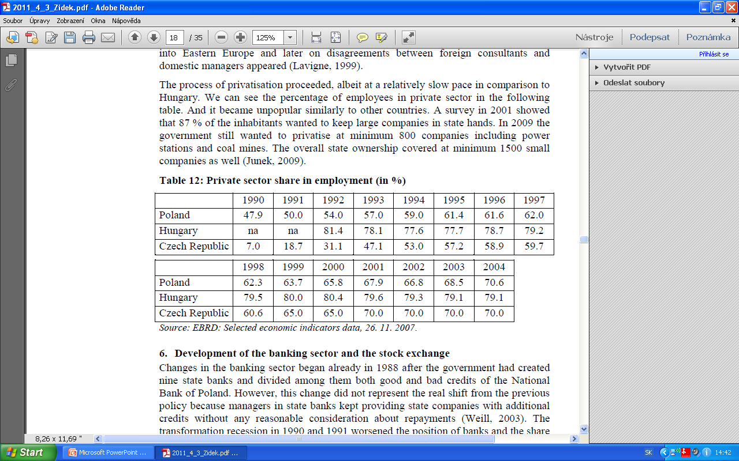
Table 11: Employee Ownership Resulting from Privatisation in 1994
Source: Earle, Estrin (1996)
Table 12:Private sector share in employment (in %)
Source: EBRD: Selected economic indicators data, 26. 11. 2007.

Slide 32
  Development in banking sector
The firt attempt for change in 1988 (creation of 9 state banks)
Impacts of transformation recession
  weak position of banks, share of classified credits
Enterprise and Bank Restructuring Program (1993)
  recapitalization, positive effect on banking sector
  relatively low cost on recovery
Privatisation of banks
  Slower than excepted, but share of foreign banks
Importance of state banks vs. limited role of commercial banks and exchange stock

Slide 33
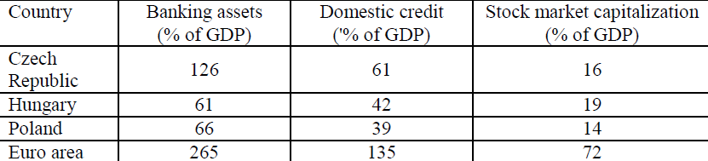
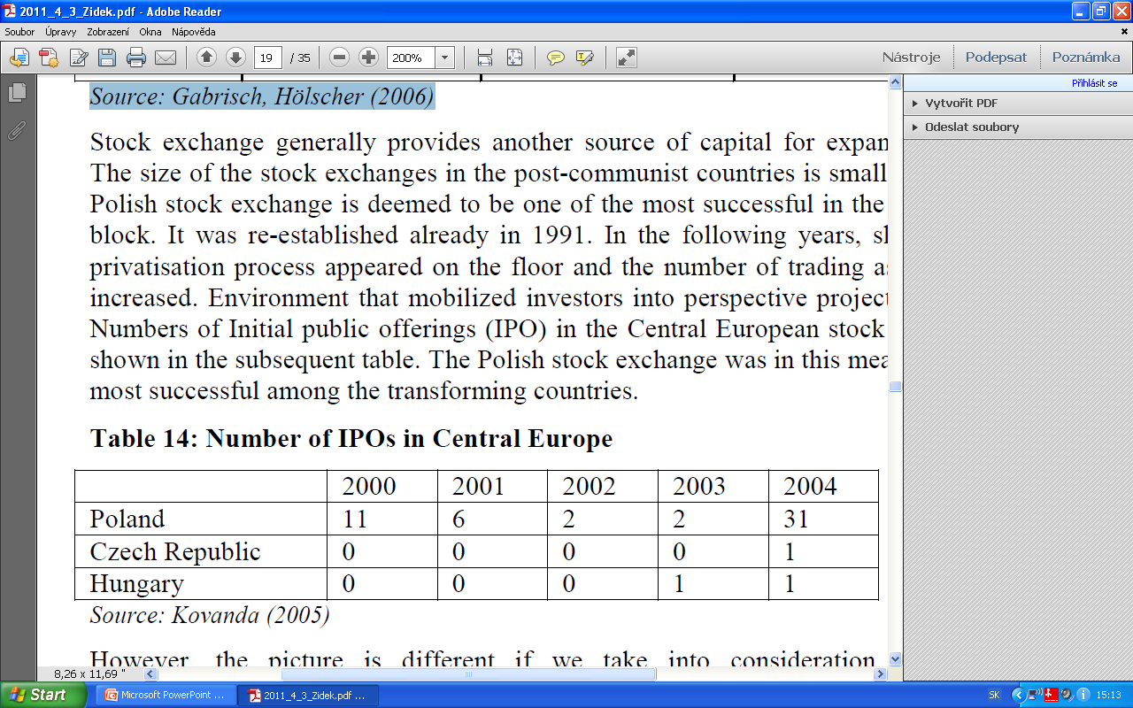
Table 13: Financial sectors in European countries in 2002
Source: Gabrisch, Hölscher (2006)
Table14: Number of IPOs in Central Europe
Source: Kovanda (2005)

Slide 34
Contents
Development during the communist regime
  Insight to long-run political development
  Economic situation
Political Development
Transformation period
  Economic reforms after 1990
  Privatisation
  Development in banking sector
4. Economic results
  Economic growth
  Structure of the economy
  Unemployment
  Inflation
  External relationships

Slide 35
Economic results
The fourth part

Slide 36
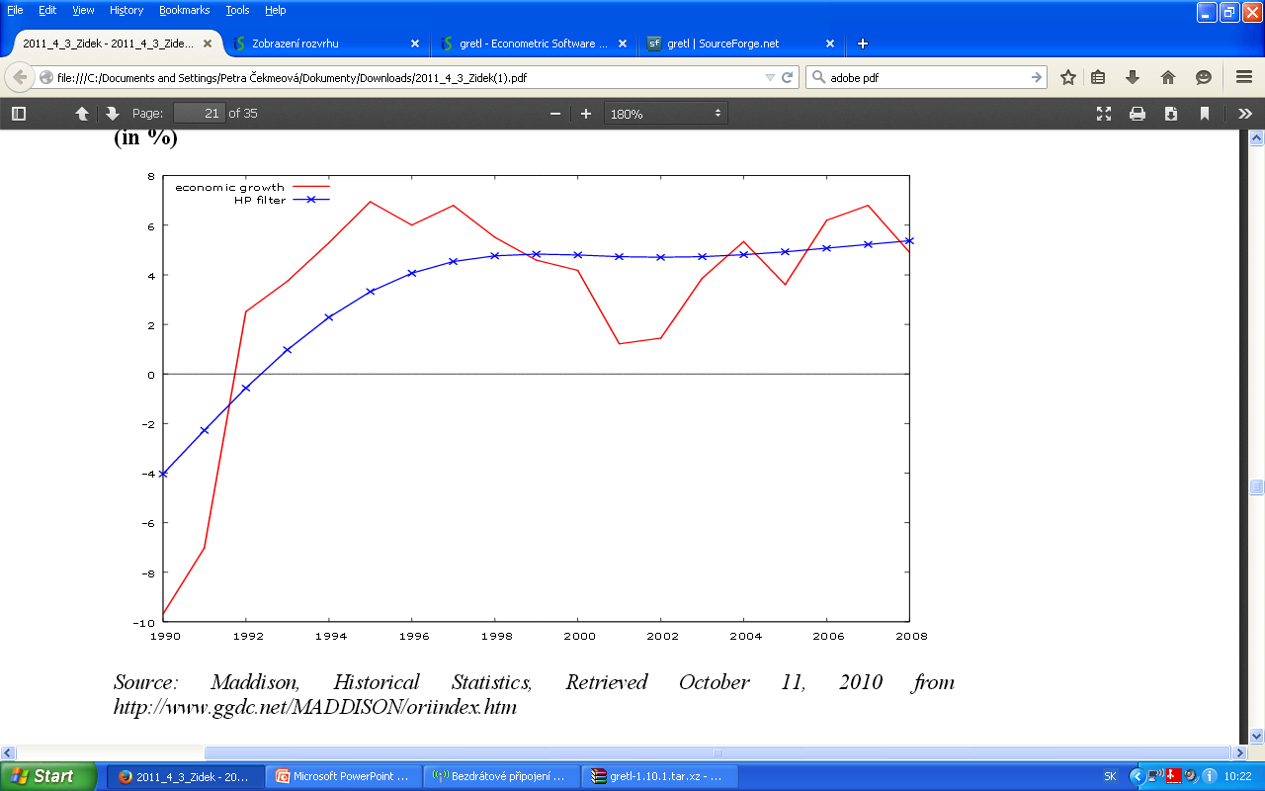
Chart 8: Economic growth and long run trend (by HP filter) in Poland 1990-2008 (in %)
Source: EBRD: Maddison, Historical Statistics, Retrieved October 11, 2010 from http://www.ggdc.net/MADDISON/oriindex.htm .

Slide 37
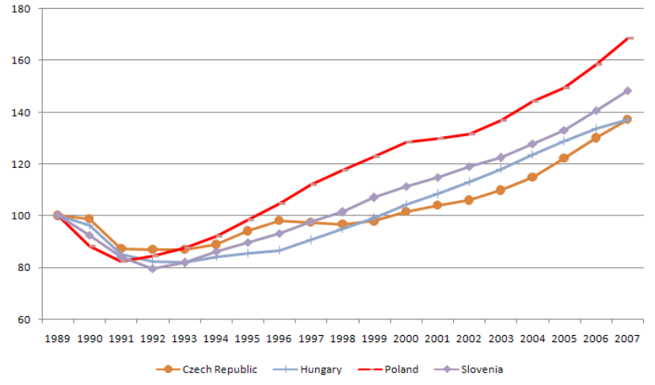
Chart 7: Cumulated GDP (1989=100)
EBRD: Selected economic indicators data, 26.11. 2007.

Slide 38
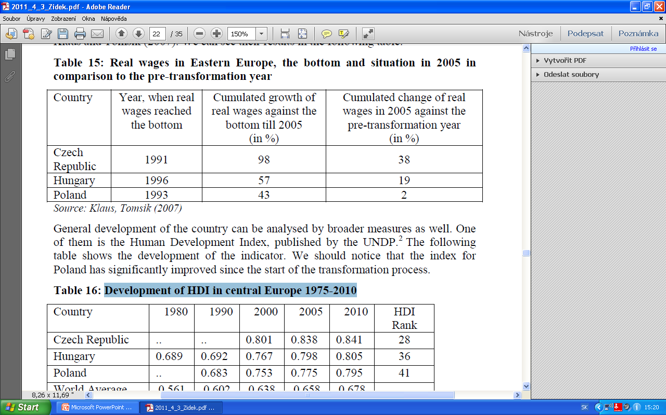
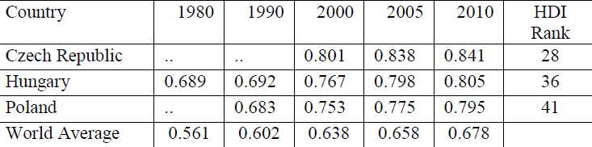
Table 15: Real wages in Eastern Europe, the bottom and situation in 2005 in comparison to the pre-transformation year
Source: Klaus, Tomsik (2007)
Table 16: Development of HDI in central Europe 1975-2010
Source: UNDP: International human development indicators Retrieved December 22, 2010 from
http://hdrstats.undp.org/en/indicators/49806.html

Slide 39
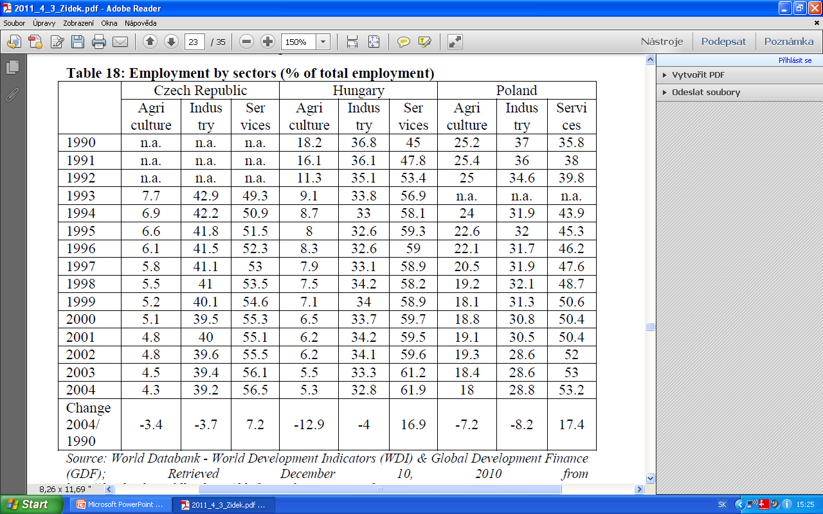
Table 18: Employment by sectors (% of total employment)
Source: World Databank - World Development Indicators (WDI) & Global Development Finance (GDF); Retrieved December 10, 2010 from http://databank.worldbank.org/ddp/home.do?Step=12&id=4&CNO=2

Slide 40
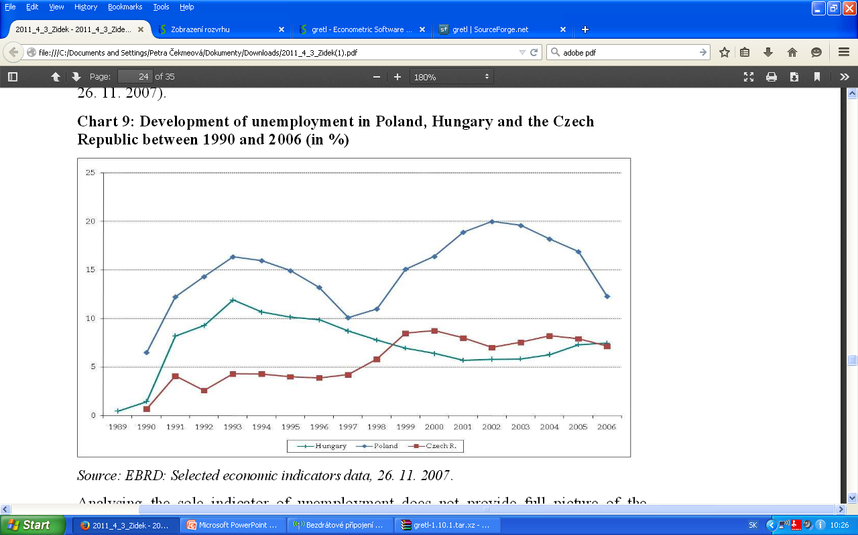
Chart 9: Development of unemployment in Poland, Hungary and the Czech Republic between 1990 and 2006 (in %)
Source: EBRD: Selected economic indicators data, 26. 11. 2007.

Slide 41
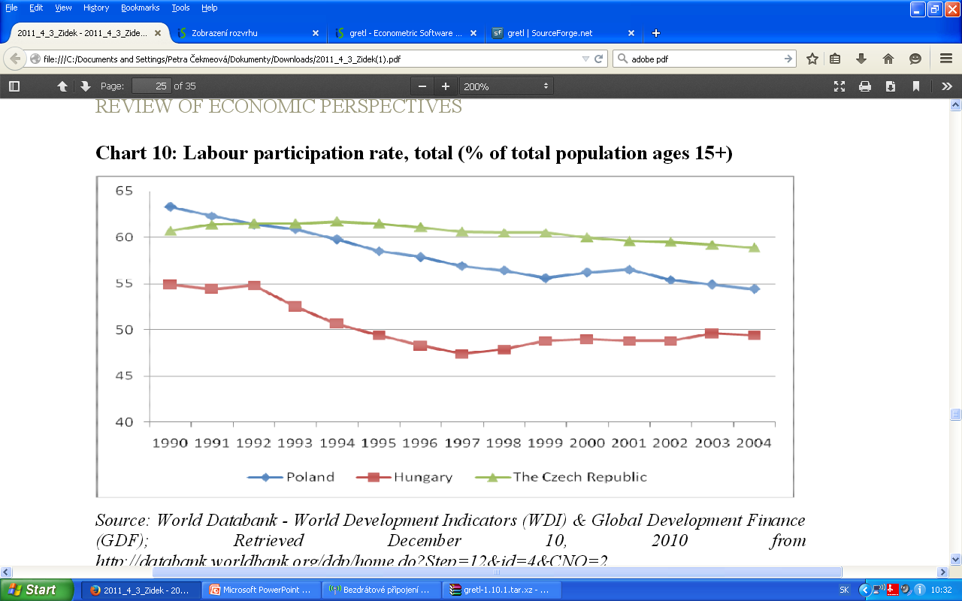
Chart 10: Labour participation rate, total (% of total population ages 15+)
Source: World Databank - World Development Indicators (WDI) & Global Development Finance (GDF); Retrieved December 10, 2010 from http://databank.worldbank.org/ddp/home.do?Step=12&id=4&CNO=2

Slide 42
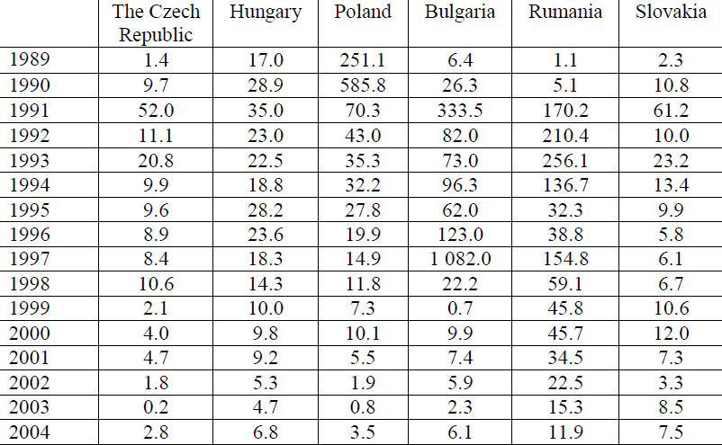
Table 19: Development of consumers prices annual average (%)
Source: EBRD: Selected economic indicators data, 26. 11. 2007.

Slide 43
Comparison of inflation in the CR, selected transition economies (1989 = 100)

Slide 44
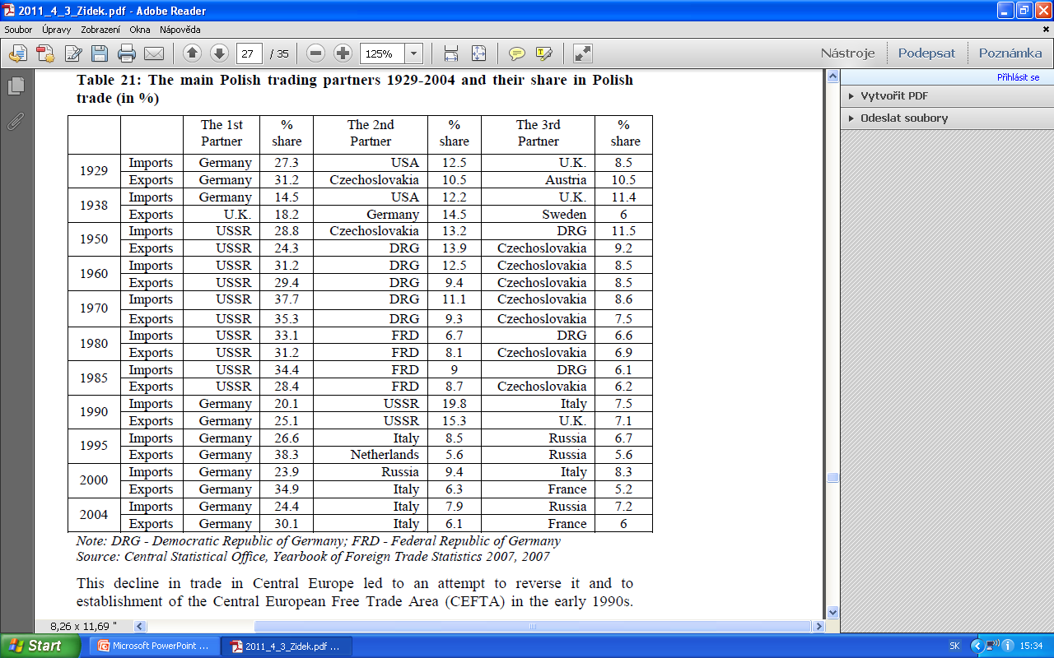
Table 21: The main Polish trading partners 1929-2004 and their share in Polish trade (in %)
Source: Central Statistical Office, Yearbook of Foreign Trade Statistics 2007, 2007.

Slide 45
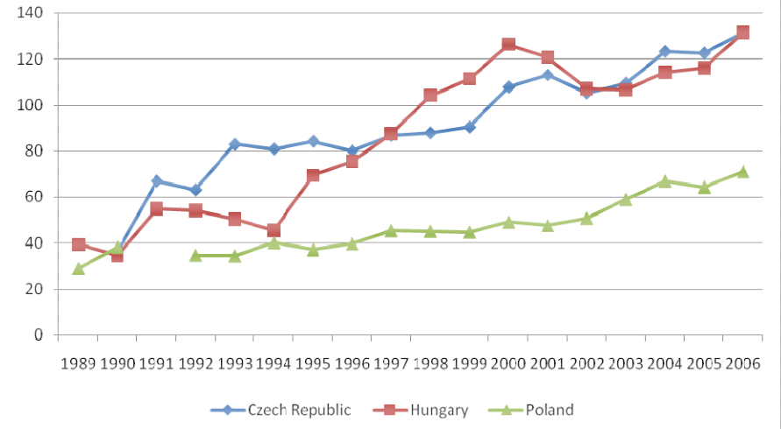
Chart 11: Trade openness (exports plus imports to GDP in %) in Poland, Hungary and the Czech Republic
Source: EBRD: Selected economic indicators data, 26. 11. 2007.

Slide 46
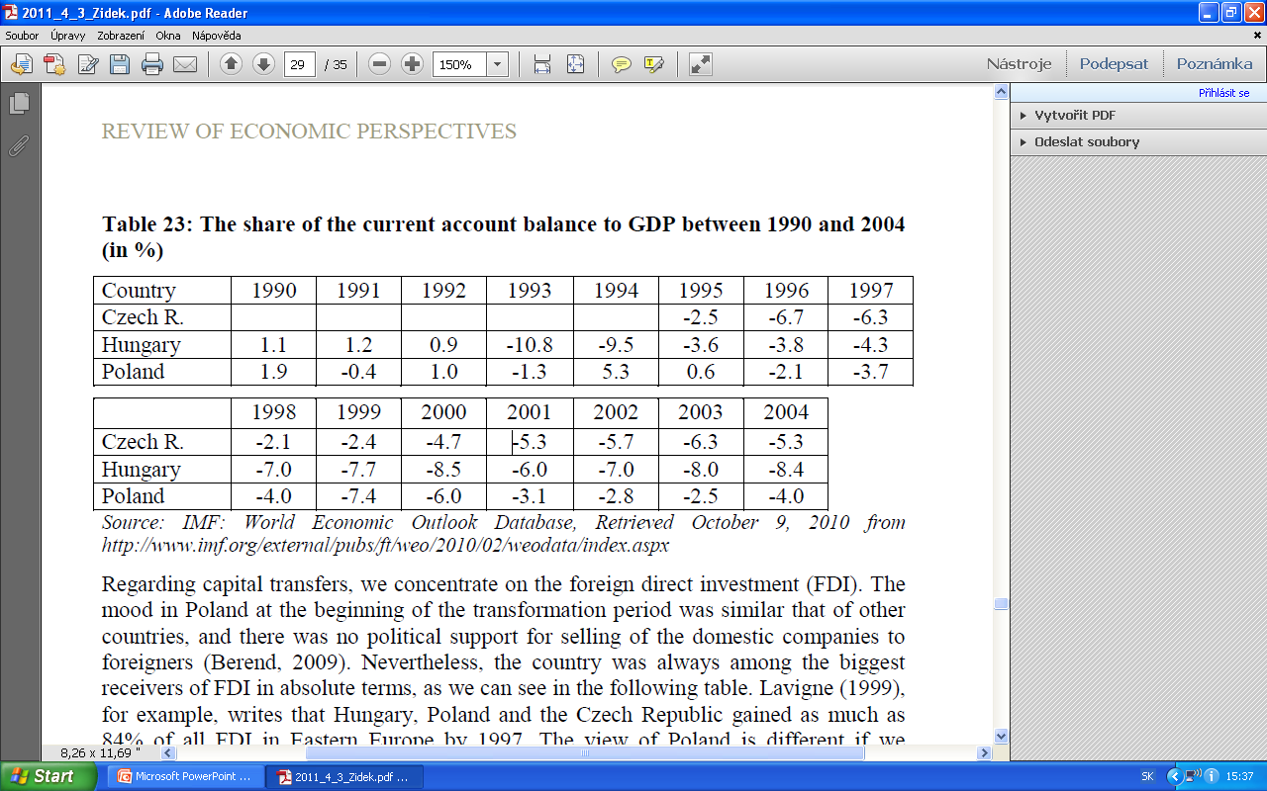
Table 23: The share of the current account balance to GDP between 1990 and 2004 (in %)
Source: IMF: World Economic Outlook Database, Retrieved October 9, 2010 from http://www.imf.org/external/pubs/ft/weo/2010/02/weodata/index.aspx

Slide 47
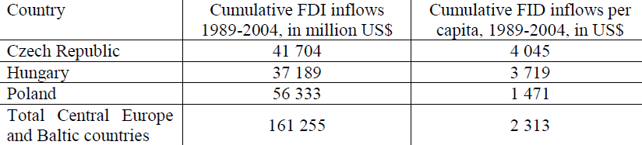
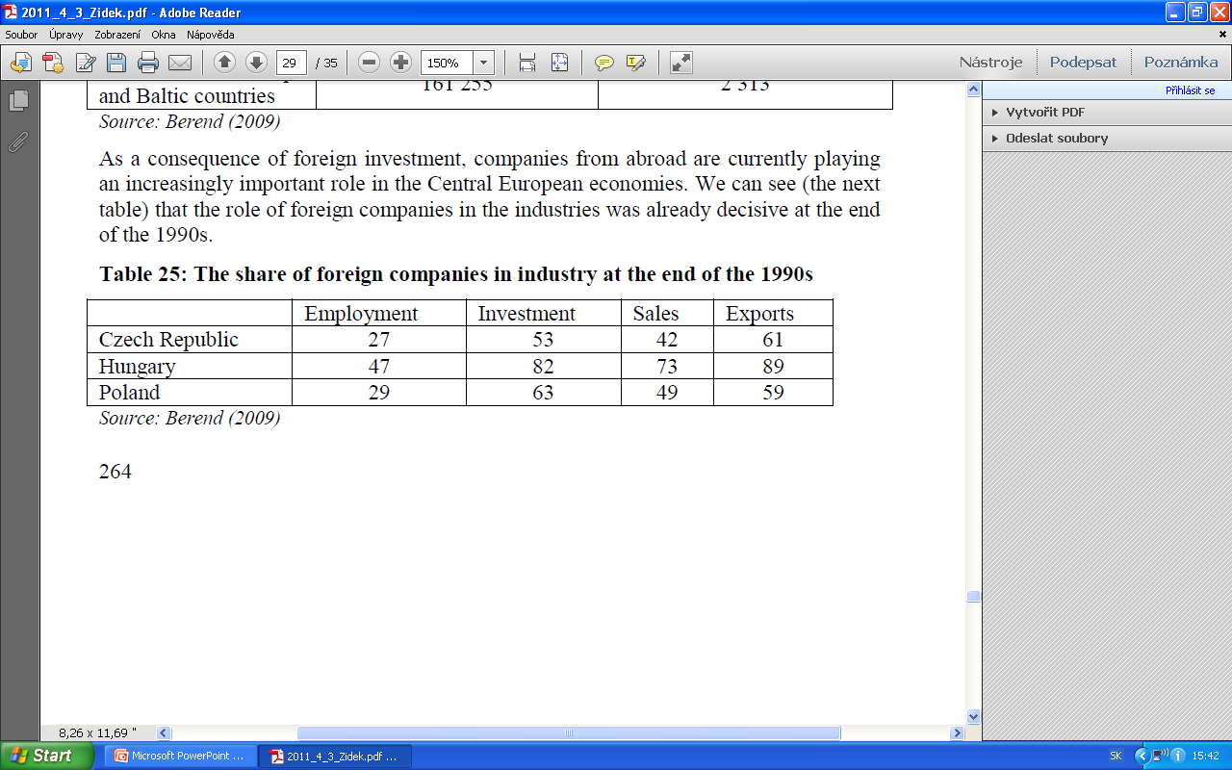
Table 24: Cumulative inflows of FDI in absolute terms and per capita in Eastern Europe 1989-2004
Source: Berend (2009)
Table 25: The share of foreign companies in industry at the end of the 1990s
Source: Berend (2009)

Slide 48
Conclusions
Dramatic changes in economic conditions through the analysed period
  Economic catastroph before the fall of communist regime
  Transformation recession and hyperinflation due to „shock therapy“
  Improvement of economic situation in medium-term
Outcomes
  Establishment of growing trend
  Catching up with developed countries
  ... the main goal of transformation was fulfilled !

Slide 49
Thank you for attention !

