Slide 1
Transformation in Slovenia

Slide 2
Contensts
Situation during CPE period
Political Development
Gradualism
Development of Economic Policy
Privatization
Banks
Main Economic Indicators
Conclusions

Slide 3
Functioning of the CPE model
Slovenia – 2 million - 8% of population but 20% of GDP and 29% of exports
huge differences among the JUG republics
  redistribution
after 1974 – republics highly independent
differences in the political regime … differences in the functioning of CPE
  more orientated towards West
  western consumption goods
  price flexibility – kind of … several waves of
  (very) high inflation

Slide 4
Functioning of the CPE model
  borrowing on international markets in the 1970s
  unable to pay debts at the begining of the 1980s
austerity program after 1982
  relaxed later on
1984 restrictions
another program 1988 – Markovic
  price liberalization, opening domestic market …
high inflation
  dolarization

Slide 5
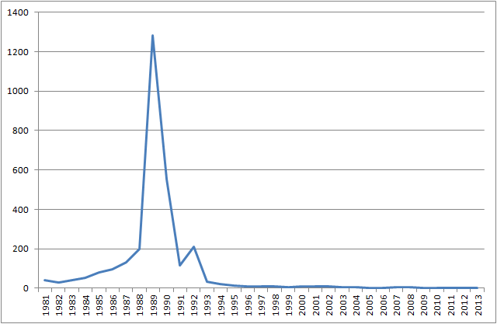
Inflation in Slovenia– Annual Consumer price index - CPI all items (change in %)

Slide 6
1990 reform program – stabilization
  devaluation + fix, convertibility on current account, bankruptcies, restrictions
  individual republics did not follow
  agaist each other
federal government not able implement
runs on banks, hyperinflation, lack of hard currencies
free elections
another program July 1991 – country already falling apart

Slide 7
Gross Domestic Product per capita in Yugoslavia in 1980 and 1989 (all figures in 1972 USD)

Slide 8
GDP per person in Austria and Yugoslavia in USD

Slide 9
microeconomic situation
self-management socialism
  high independence of companies
  workers councils
  companies „socially owned“ – not state not private
  demand for growth of wages
  soft budget constraint
relatively low level of private sector
  in industry
  high in agriculture

Slide 10
Share of import value (percent) 1986-96

Slide 11
Contensts
Situation during CPE period
Political Development
Gradualism
Development of Economic Policy
Privatization
Banks
Main Economic Indicators
Conclusions

Slide 12
Political development
1990 centrifugal tendencies
12/1990 referendum – 90% for independence
6/1991 declared independence
  YUG army attacked
  10 days
  postponing independence
1/1992 independence
till 1995 war in ex-Yugoslavia
1993 IMF, 1994 GATT, 1995 WTO, CEFTA 1996
2004 EU and NATO

Slide 13
Political development
1990 Communist party gave up its leading role
4/1990 elections for DEMOS – centre- right
  till 1992 toppled
12/1992 – Drnovšek – Liberal democratic party
  till 2002 when he became president
  Liberal democrats till 2004
2004 – Slovenian Democratic Party
  Janša – later on blamed for corruption
2008 – Social Democrats
  economic crisis strongly hit
after 2011 unstable political situation

Slide 14
Contensts
Situation during CPE period
Political Development
Gradualism
Development of Economic Policy
Privatization
Banks
Main Economic Indicators
Conclusions

Slide 15
Gradualism
proud of
definition problem
initial conditions
  price liberated
  trade liberated
  75% of trade with West! (95% trade/GDP)
  + followed strict monetary and fiscal
  shock therapy?
in their view – exchange rate was not fixed
  could hardly afford
in their view avoided avoided sharp decline in production ….?

Slide 16
Liberalization Index 1989 and 1997
Liberalization Index – a weighted average of three components: domestic market liberalization (weight 0.3), foreign trade liberalization (weight 0.3), enterprise privatization and banking reform (weight 0.4). Each component, and the average reported in the table, is scored in the range [0, 1].

Slide 17
Cumulative economic growth in Central Europe and Slovenia

Slide 18
Gradualism
in practice postponing of reforms
  especially privatization
relatively slow way of desinflation
reluctant attitude towards FDI
it seemed to be working for long time
till crisis 2008

Slide 19
Contensts
Situation during CPE period
Political Development
Gradualism
Development of Economic Policy
Privatization
Banks
Main Economic Indicators
Conclusions

Slide 20
Economic policy 1990-2
high inflation
end of 1990 own currency
1/1991 declared control above taxes
limit payments to federal budget
1990 stabilization program
  restructuring of banks and loosing companies, privatization
10/1991 – new currency
  floating
  depreciations
  1992 to managed floating
1991 CB as indepenent institution
+ decline in inflation
1991 new tax system
liberalization of labour market rules – just slightly
opening domestic market
decline in production

Slide 21
Economic policy 1993-6
slow but steady reforms
  1993 foreign trade law
  1994 bankcruptcy
  till 1994 most prices liberalized + current account convertibility
export boom
excellent fiscal policy
high level of redistribution
agreements with London and Paris clubs

Slide 22
Government deficit and share of government expenditure to GDP

Slide 23
Share of total output of branches by selected sectors and industries 1990-2000 (percent of contribution)

Slide 24
Economic policy 1997-2007
1996 asoc. treaty
  following way – similar to others
  pressure from the EU against restrictions … deregulation
only after 1998 allowed more FDI and inflow of capital
only after 1997 change in indexation of wages in public sector
changes in pension system
improving fiscal balance after 2004
  for accession to eurozone

Slide 25
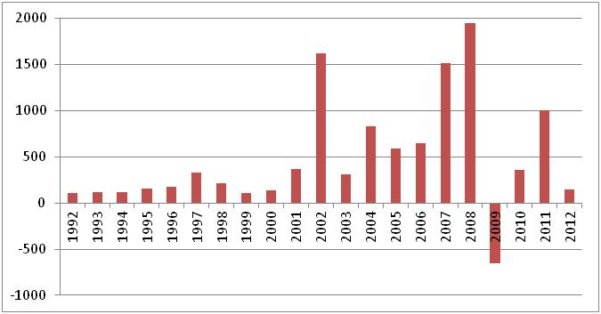
FDI inward (US Dollars at current prices and current exchange rates in millions)

Slide 26
General government debt (percent of GDP)

Slide 27
2002 removed restrictions on foreign capital
2004 EU
2004 tolar ERM II
2005 informal inflation targeting
only later on low inflation
2007 eurozone

Slide 28
Development of the exchange rate – Tolar per dollar and Euro (monthly average)

Slide 29
Economic policy 2008-2013
long lasting criticism of slow reforms – restructuring
  low level of FDI
  government intefering into companies
2008 slump
  outside demand
  banks
2008-9 fiscal parcels … deficits

Slide 30
Net flow of FDI (in millions of USD)

Slide 31
General government net lending/borrowing and its prognosis (in % of GDP)

Slide 32
Unit labour costs (index 2005=100)

Slide 33
2011 - plans for liberalization – public against

Slide 34
Contensts
Situation during CPE period
Political Development
Gradualism
Development of Economic Policy
Privatization
Banks
Main Economic Indicators
Conclusions

Slide 35
Cumulated privatisation revenues as a share of GDP

Slide 36
Large scale privatization index* 1989-2012

Slide 37
Public assets (% of GDP)

Slide 38
Contensts
Situation during CPE period
Political Development
Gradualism
Development of Economic Policy
Privatization
Banks
Main Economic Indicators
Conclusions

Slide 39
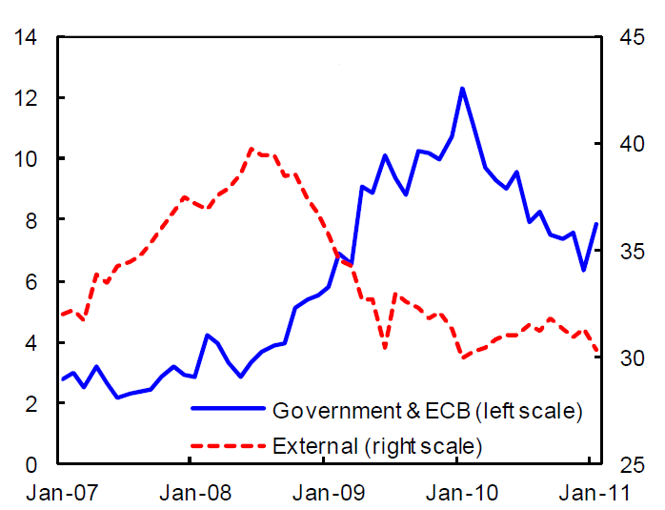
Bank Funding (Percent of total assets)

Slide 40
Non-performing loans (in % of total loans)

Slide 41
Non-performing Loans to Total Gross Loans (in %) in 2013 (or the latest)

Slide 42
Contensts
Situation during CPE period
Political Development
Gradualism
Development of Economic Policy
Privatization
Banks
Main Economic Indicators
Conclusions

Slide 43
Development of GDP in Slovenia (year to year change in percent)

Slide 44
GDP per person in central and eastern Europe (and Slovenia to EU average = 100)

Slide 45
Share of the sectors - value added (% of GDP)

Slide 46
Unemployment rate (in percent of labour force) and employment (1990=100) – right scale

Slide 47
Inflation (CPI) in Slovenia and the Czech Republic 1993-2013

Slide 48
Cumulative growth of price level among the transition countries

Slide 49
External trade of goods and services per GDP (in %)

Slide 50
Current account balance (percent of GDP)

Slide 51
Cumulative FDI inflows per capita, 1989-2004, in US$

Slide 52
Gini coefficients* of inequality of market and disposable incomes; Persons of working age (18-65 years-old), late 2000s

Slide 53
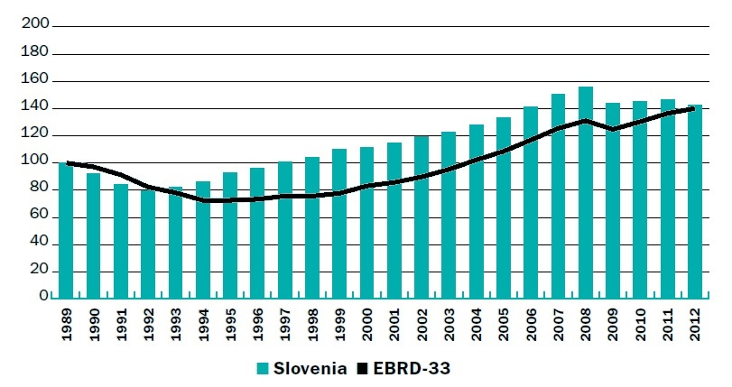
Real GDP (1989=100), Slovenia and EBRD 33

Slide 54
Contensts
Situation during CPE period
Political Development
Gradualism
Development of Economic Policy
Privatization
Banks
Main Economic Indicators
Conclusions

