Slide 1
Little´s law basics

Slide 2
Běžná situace, kterou je potřeba řešit
30 zákazníků/hodina – (max kapacita provozovny)
8 zákazníků čeká ve frontě (nárazník)
5 minut trvá doba obsluhy jednoho zákazníka
Potřeba odstranit všechny časy, které nepřinášejí hodnotu
8 zákazníků
čeká ve frontě
5 minut/obsluha 1 zákazníka

Slide 3
Otázky
Jak dlouho průměrně čeká zákazník ve frontě ?
Kolik průměrně lidí může být naráz obslouženo ?
Kolik zákazníků je v provozovně v jenom okamžiku (jak čekající, tak ti, které personál obsluhuje) ?
Jaká je průměrná doba „průstupu“ zákazníka provozovnou (čekání i obsluha)
Zjednodušující podmínka
„Vstupní tok“ (průměr) =„Výstupní tok“ (průměr)
Díky průměrování neuvažujeme fluktuace (viz hod mincí)

Slide 4
Klíčová měřítka (proměnné)
Lead Time =LT (jak dlouho trvá celý proces)
Inventory = WIP (kolik jednotek je v procesu= nedokončená výroba-Work In Progress)
Throughput Rate =T (počet zákazníků/jednotka času) – někdy Flow Time nebo Flow Rate
Cycle Time = čas/jednotka = počet minut /zákazník nebo počet hodin/výrobek = CT = (někdy se tomu říká TAKT TIME)
CT= 1/T=1/ FT, kde FT = Flow Time
Tyto měřítka jsou propojena Littlovým zákonem WIP=T x CT =T/FT
Příklad : T= 30 výrobků/hod, výroba jednoho výrobku trvá 0,5 hodiny (0,5 hod/výrobek=CT).
Otázka : kolik je WIP ?
Odpovědˇ : WIP =30*0,5=15 výrobků
WIP
T
Lead Time

Slide 5
Řešení
Proces | WIP | T (Zák/hod) | LT
Buffer | 8 | 30
Obsluha |  | 30 | 5
Celkem |  | 30
Proces | WIP | T (Zák/hod) | CT (min/Zák) | LT
Buffer | 8 | 30 | 0,5
Obsluha |  | 30 | 0,5 | 5
Celkem |  | 30 | 0,5
WIP =T x LT(třetí sloupec je kvůli jednotkám)
LT= WIP /T (třetí sloupec je kvůli jednotkám)
Proces | WIP | T (Zák/hod) | CT(min/Zák) | Lead Time
Buffer | 8 | 30 | 0,5
Obsluha | 2,5 | 30 | 0,5 | 5
Celkem | 10,5 | 30 | 0,5
Proces | WIP | T (Zák/hod) | CT (/min/Zák) | Lead Time
Buffer | 8 | 30 | 0,5 | 16
Obsluha | 2,5 | 30 | 0,5 | 5
Celkem | 10,5 | 30 | 0,5 | 21
Zadání (z předchozích snímků)
30 zákazníků/hodina – (max kapacita provozovny) = Throughput Rate = T
8 zákazníků čeká ve frontě (nárazník) = WIP
5 minut trvá doba obsluhy jednoho zákazníka = CT (Cycle Time)
2,5=TxLT=((30/60)*5)=(3*5)/6 , 10,5=8,0+2,5 a dále pak
LT=16=WIP/T=8/(3/6)= (8*6)/3=58/3=16 a 5=(2,5*(3/6))=2,5*6/3=15/3

Slide 6
Otázky
Jak dlouho průměrně čeká zákazník ve frontě ?
Odpověď =16
Kolik průměrně lidí může být naráz obslouženo ?
Odpověď = 2,5
Kolik zákazníků je v provozovně v jenom okamžiku (jak čekající tak ty, které personál obsluhuje) ?
Odpověď = 10,5
Jaká je průměrná doba „průstupu“ zákazníka provozovnou (čekání i obsluha) ?
Odpověď = 21 minut

Slide 7
Takt time (process capacity)= Cycle Time
Throughput Rate: kolik jednotek (výrobků) může linka vyrobit za určitý časový úsek
Takt Time : inverzní hodnota k Flow Time (což je jiný název pro T)
nebo také čas výroby jednoho ks výrobku na stroji – viz žluté Obdélníčky, který je úzkým místem bottleneck) – v našem případě stroj s časem 30, protože to trvá nejdéle !!!!
30 15 -> Takt Time = Cycle Time = 30 minut
Takt Time = celkový dostupný čas, který je k dispozici/ zákaznický požadavek
Příklad : Požadavek 100 výrobků, 1 směna denně, 8 hodin směna, 5 dní v týdnů
Dostupný čas : 1 x 8 x 5=40 hod a požadavek je 100 , takže TT=0,4 hod 40/100
=24 minut a Thoughput Rate = 1/Takt Time = 1/0,4 =2,5 výrobku/hod

Slide 8
Little´s law
Skorkovský ,KPH,ESF.MU
Based on resource : Factory Physics (Hopp and Spearman)

Slide 9
Little´s law - definition (formula)
Fundamental relationships among :
WIP (Work In Process)
Cycle Time (CT)
Throughput (T or sometimes TH)
Formula
Can be applied to :
Single machine station
Complex production line
Entire plant
WIP=TH x CT
Relationships among these variables will serve to se clearly precise (quantitative) description of behaviour of the single production line . It helps user to use a given scale to benchmark actual production systems

Slide 10
Definition of basic parameters
Throughput (Throughput rate, TH) : production per unit time that is sold (see TOC definition)
If TH is measured in cost dollars rather than in prices it is typically called :
Cost of good sold (COGS)
Upper limit of TH in production process is capacity
If you release more raw material above capacity of the line (machine), system become unstable –> WIP goes up !!

Slide 11
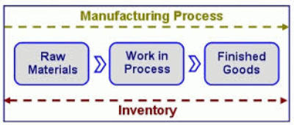
Definition of basic parameters
WIP (Work In Process) : inventory between start and end points of the product routing
WIP can be used as one parameter to calculate (measure) an efficiency
Efficiency can be defined as Turnover Ratio = TH/FGI for warehouses or TH/(FGI+WIP) for production plants where FGI=Finished goods inventory
WIP : inventory still in line
FGI : inventory waiting for dispatch (shipping)

Slide 12
Definition of basic parameters
CT (Cycle Time or so called Throughput Rate) : average time from release of the job of the beginning of the routing until it reaches an inventory point at the end of the routing or time that part spends as a WIP.
LT (Lead Time) : managerial constant used for planning of production
Service Level (especially for MTO lines, where plant have to satisfy orders with specific due dates) :
Service level P{Cycle time=<Lead Time}

Slide 13
Definition of basic parameters
Utilization U(x) = Arrival rate / Effective production rate
Where
Arrival Rate =r = amount of parts arriving to workstation per time unit
Effective production time is maximum average rate at which the workstation can process parts (considering effects of failures, setup times and so on)
Bottleneck rate (see TOC)
rb = rate (parts per unit time or jobs per unit time) of workstation having the highest long term utilization

Slide 14
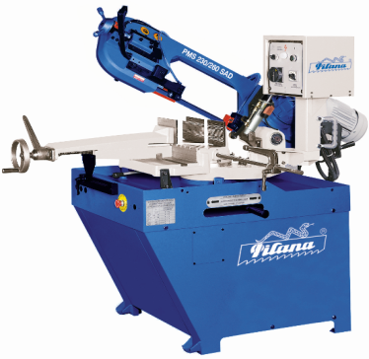
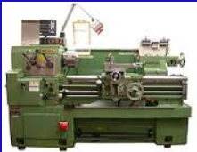
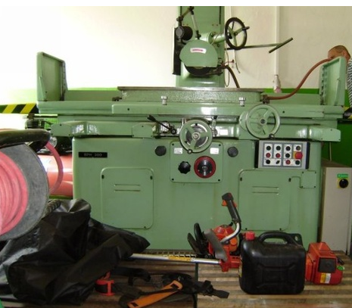
Definition of basic parameters
T₀ =Row process time of the line is the sum of the long –term average process time of each workstation in the line (single job entering empty line from staring point to the ending one)
7, 8, 9, 7, 6, 10
7,83
5,3, 4, 5, 6, 8
5,16
9, 8, 4, 5, 5, 6
6,1
19,16=7,83+5,16+6,1

Slide 15
Definition of basic parameters
Critical WIP (W₀) of the line is the WIP level for which a line with given values of rb (bottleneck rate) and T₀ achieves maximum throughput ( rb ) with minimum cycle time (which is in this case T₀ )
W₀ = rb xT₀

Slide 16
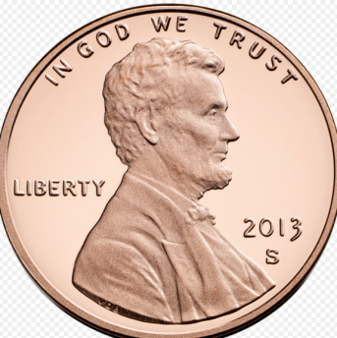
Use of defined parameters
Simple production line that makes giant one-cent pieces
It is as a model very with unrealistic assumption because process times are deterministic (no waiting times after every operation and no queue times before any other operation, 24 hours /day an unlimited market)→ balanced line
Any machine can be regarded as the bottleneck (one- half part per hour)
Head stamping
Tail stamping
Rimming
Deburring
2 h
2 h
2 h
2 h
rb = bottleneck rate (parts per unit time or jobs per unit time) of workstation having the highest long term utilization =0.5 penny per hour, which means 24 hour x 0.5=12 pennies /day
T₀ =Row process time of the line is the sum of the long –term average process time of each workstation in the line = 8 hours=2+2+2+2=8
Critical WIP (W₀) of the line is the WIP level for which a line with given values of rb and T₀ achieves maximum throughput ( rb ) with minimum cycle time (which is in this case T₀ ) = rb x T₀ = 0.5 x 8 = 4 pennies

Slide 17
Use of defined parameters
2 h
5 h
10 h
3 h
Tail stamping
Rimming
Deburring
Rimming
Head stamping
Tail stamping
Deburring
Rimming
1
2
Rimming
4
Rimming
Bottleneck= rb =0,4
It is neither the station that contains the slowest
machines nor the one with fewest machines !!!
Rimming
3
Station number | Number of machines | Process time (hours) | Station capacity (jobs per hour)
1 | 1 | 2 | 0.5=(1/2)*1
2 | 2 | 5 | 0.4=(1/5)*2
3 | 6 | 10 | 0.6=(1/10)*6
4 | 2 | 3 | 0.67=(1/3)*2
T₀ =Row process time of the line =2+5+10+3 =20 and
Critical WIP(W₀) =rb x T₀ = 0.4 x20 = 8 pennies <number of machines (11). This is because system is not balanced.
Not balanced line is the line where some stations are not fully utilized !!!

Slide 18
Best case performance I
WIP=1, Total cycle time= T ₀=8=CT,
Throughput=1/8=part/hour= rb/4=0,125,
Bottleneck rate = rb=0,5
WIP=2, Total cycle t ime= T ₀=8=CT
Throughput=WIP/CT=WIP/T ₀= 2/8=part/hour= rb/2=0,250, což je
50 % of rb where bottleneck rate = rb=0,5
t=0
t=2
time
time
t=4
t=6
WIP=3
WIP=4
t=1
Text on the next slide
t=2
t=4
t=6
WIP=3, Total cycle time= T ₀=8=CT,
Throughput=WIP/CT=WIP/T ₀= 3/8=part/hour
= 0,375, což je 75 % of rb where bottleneck rate = rb=0,5
t=8

Slide 19
Best case performance II
t=1
t=2
T₀ =Row process time of the line is the sum of the
long –term average process time of each workstation
in the line (single job entering empty line from staring point
to the ending one)
t=4
t=6
t=8
WIP=4
All stations stay busy all the time. Because no waiting so T ₀=8 h., rb=0,5 .
So minimum value of T ₀ an maximum value of rb (throughput) is achieved only if
WIP is set to critical value !
Critical WIP (W₀) of the line is the WIP level for which a line with given values of rb and T₀ achieves maximum throughput ( rb ) with minimum cycle time (which is in this case T₀ ) = rb x T₀ = 0.5 x 8 = 4 pennies

Slide 20
Best case performance III
Table 1.
Parameters : | 100 % rb=0,5
WIP | CT=T₀ | % T₀ | TH=Throughput | % rb
1 | 8 | 100 | 0,125 | 25
2 | 8 | 100 | 0,25 | 50
3 | 8 | 100 | 0,375 | 75
4 | 8 | 100 | 0,5 | 100
5 | 10 | 125 | 0,5 | 100
6 | 12 | 150 | 0,5 | 100
7 | 14 | 175 | 0,5 | 100
8 | 16 | 200 | 0,5 | 100
9 | 18 | 225 | 0,5 | 100
10 | 20 | 250 | 0,5 | 100
20 hours = 12 hours waiting before line and 8 hours processing
All machines remains busy so rb=0,5 (2 hours per processing one penny)
% T₀ =(CT/ T₀) *100, so e.g. 250=(20/8)*100
% rb =((WIP/ T₀)/0,5)*100, where rb=0,5

Slide 21
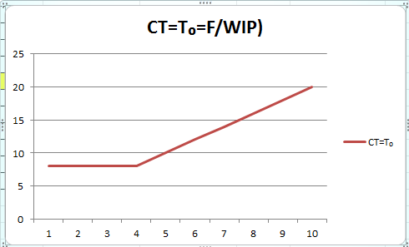
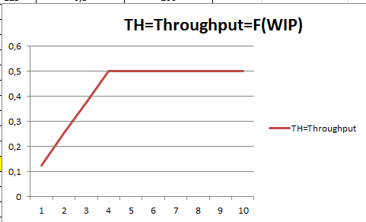
Best case performance IV

Slide 22
Conclusion
Close examination of Table 1 reveals fundamental relationship among WIP, CT and TH (throughput)
At every WIP level WIP is equal to the product of TH and CT (cycle time)
This relation is known as Little´s law.
WIP=TH * CT
Source : Factory Physiscs, Wallace J Hopp and Mark L. Spearman ; ISBN 13: 978-1-57766-739-1 or ISBN 10 :1-57766-739-5
http://www.factoryphysics.com/principle/littleslaw.htm

Slide 23
Example 1
Estimating Waiting Times: If are in a grocery queue behind 10 persons and estimate that the clerk is taking around 5 minutes/per customer, we can calculate that it will take us 50 minutes (10 persons x 5 minutes/person) to start service.
This is essentially Little's law. We take the number of persons in the queue (10) as the "inventory".
The inverse of the average time per customer (1/5 customers/minute) provides us the rate of service or the throughput.
Finally, we obtain the waiting time as equal to number of persons in the queue divided by the processing rate 10/(1/5) = 50 minutes).

Slide 24
Example 2
Planned Inventory Time: Suppose a product is scheduled so that we expect it to wait for 2 days in finished goods inventory before shipping to the customer. This two days is called planned inventory time and is sometimes used as protection against system variability to ensure high delivery service. Using Little's law the total amount of inventory in finished goods can be computed as :
FGI = throughput × planned inventory time

Slide 25
Youtube examples (6 minutes)
http://www.youtube.com/watch?v=VU8TUSnQ-vw
http://www.youtube.com/watch?v=rtGihR-bm-U

