Slide 1
Introduction to MS Dynamics NAV XVI. (CRM)
Ing.J.Skorkovský,CSc.
MASARYK UNIVERSITY BRNO, Czech Republic
Faculty of economics and business administration
Department of corporate economy

Slide 2
CRM – Customer Relationship Management
PROs
  It enables to keep track of all prospective customer (suspects and prospects)
  Improve sales and marketing service
  Company can promote the work it has done for its customers in order to approach prospects
CONs
  CRM software may not integrate well with other email and accounting systems
  Another disadvantage to a newly implemented CRM software is the learning curve.

Slide 3
CRM – Customer Relationship Management
Relationship management is a customer-oriented feature with service response based on customer input, one-to-one solutions to customers’ requirements, direct online communications with customer and customer service centers that help customers solve their issues.
Sales force automation
  Sales promotion analysis
    Advertising
    Personal selling
    Direct marketing
    Public relations
  automate tracking of a client’s account history
  Use of technology (ERP)
Opportunity Management

Slide 4
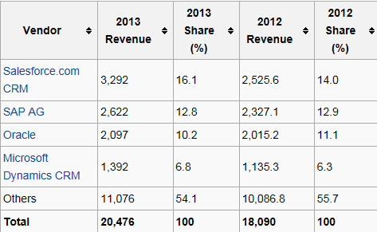

Market leaders
figures in millions of US dollars
Resource:

Slide 5

Vendor
Statistic :
Costs/Revenue
Only Czech course
BPH_PIS 1| 2 !!!!
Customer Entries
Customer
Interaction
Log
Entries
Contact
Card
Salesperson
To-Do
Card
Profile (parameters)
(To-Do)
Assigned
activities
Statistics:
Interactions, Stages,
Chances, Values,..
ABC (Pareto)
analysis
Opportunity
Activity
(code)
Sales Cycle
Stage
Partial Activities
Meeting /Telephone call
Interaction Log
Entries
Stage number
Activity

Slide 6
ERP-CRM
Only Czech course
BPH_PIS1| 2 !!!!
20000
70%
Meeting
Task1
Task22
Task p
Opportunity
ERP n
CRM
Customer
Card
QUOTE
ERP 2
ERP 1
Products
Task p+1
Task p+2
Task q
Opportunity
Financial
estimation
Success estimation
in %
Interactions

Slide 7
Contact cards
Contact card- company
Contact card- person
Contact Character– profiles, technologies,..
Interactions
Business Opportunities (estimated close date and value, probability,.. )
Sales Cycles
Customer Card creation from Contact card
Quotes

Slide 8
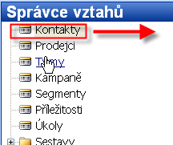
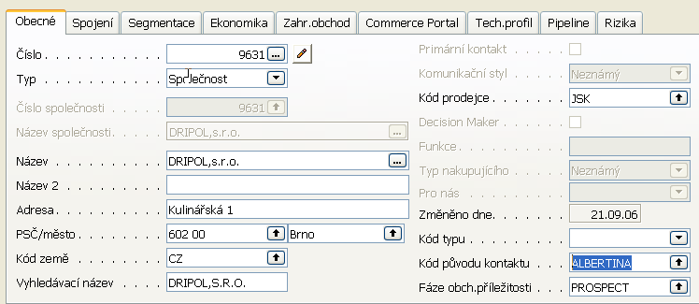
Karta kontaktu- společnost (hlavička karty) I
Kontakty typu
osoba
Jirka Sirka
Jitka Plytká
Jakub Holub

Slide 9
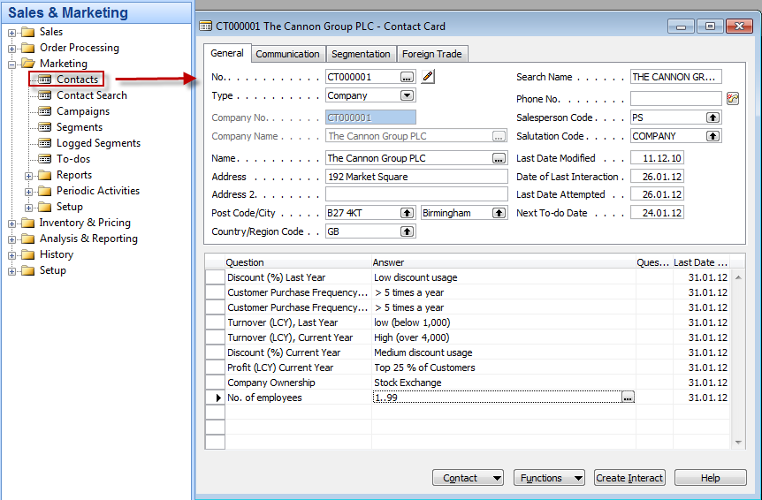
Contact Card

Slide 10
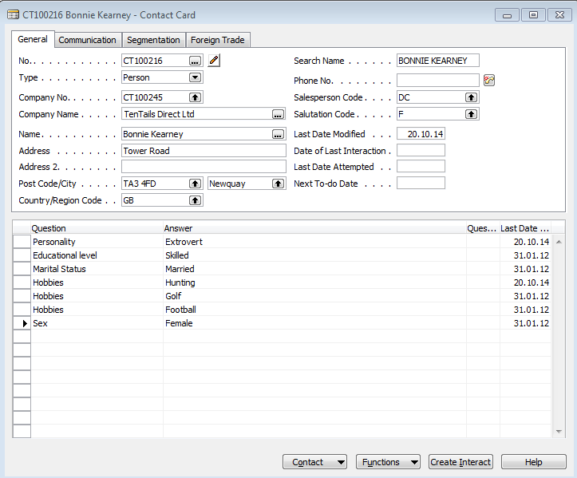
Contact Card- Person
Profile

Slide 11
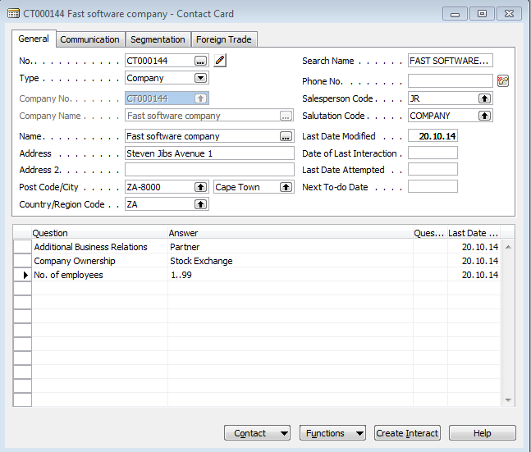
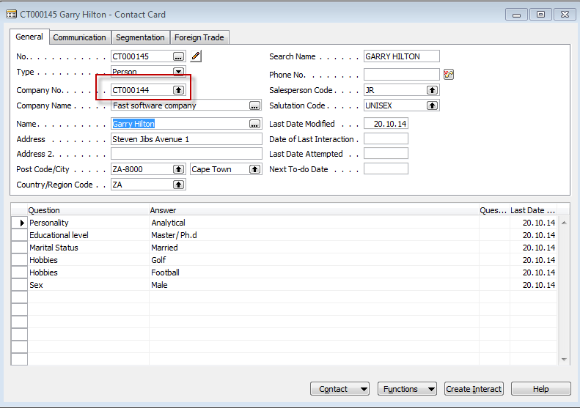
Contact Card- Company-person new

Slide 12
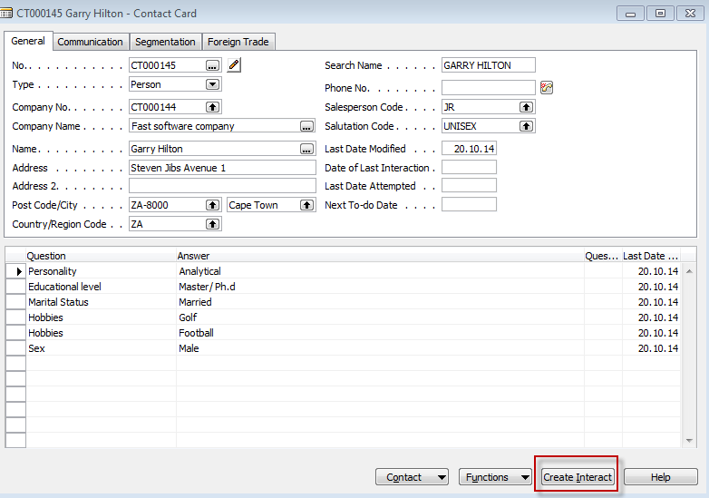
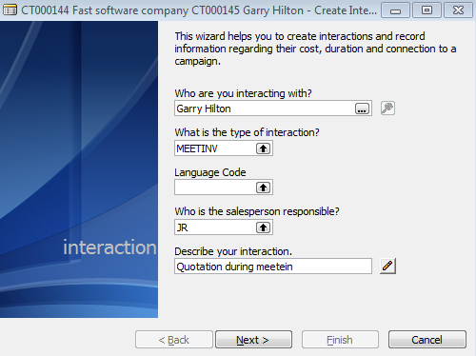
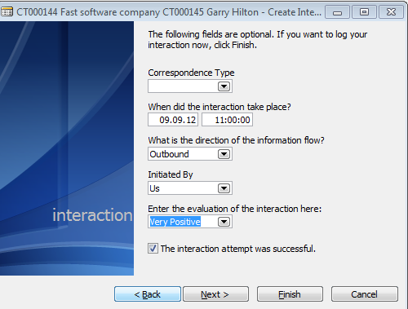
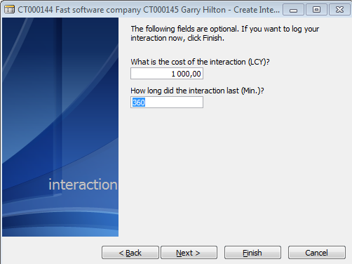
New interaction

Slide 13
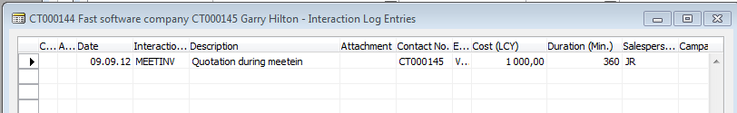
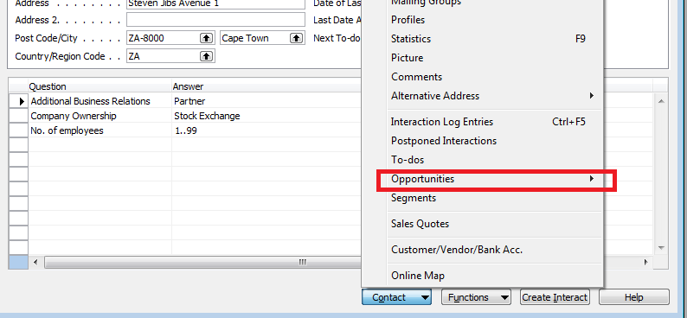
New interaction
Interaction entry
Create new opportunity

Slide 14
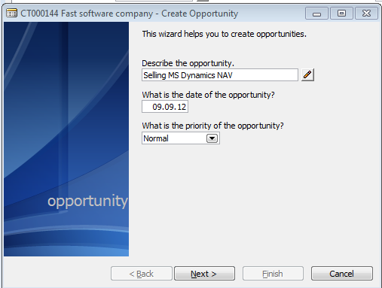
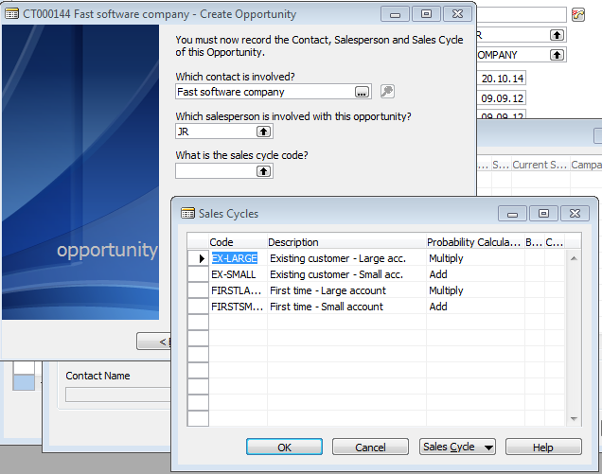
New oportunity

Slide 15
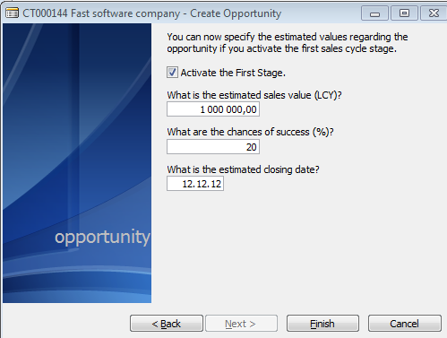
New oportunity

Slide 16
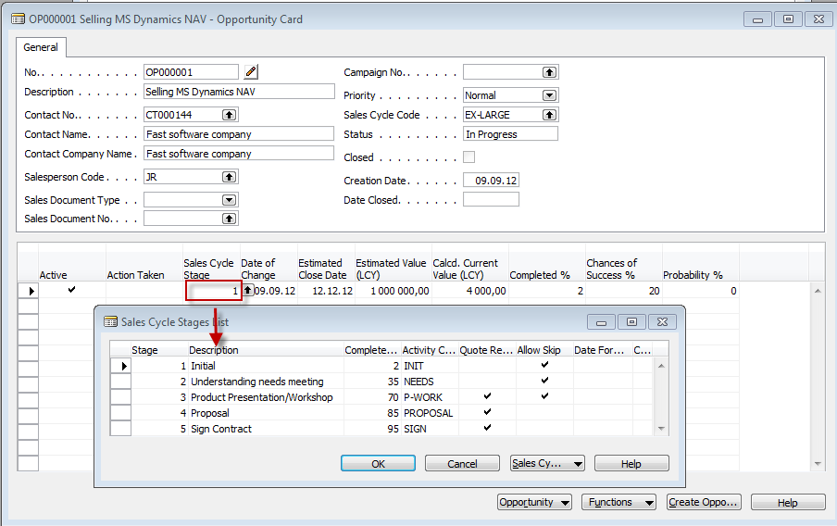
New oportunity
From here you can create various To-Dos and and change Sales Cycle stages

Slide 17
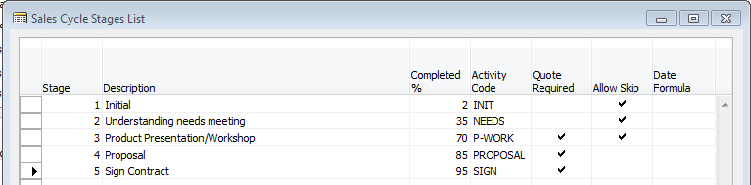
Sales Cycle Stages

Slide 18
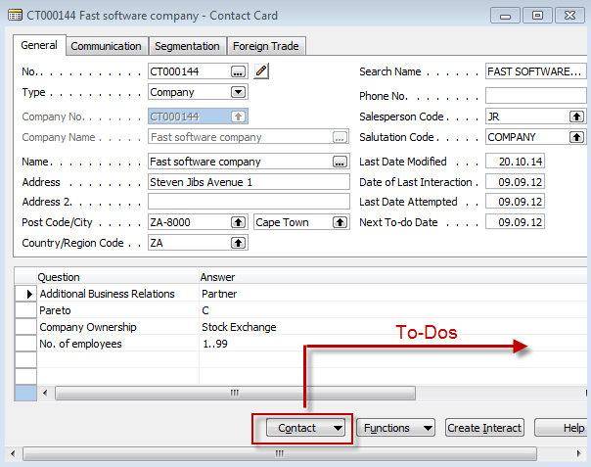

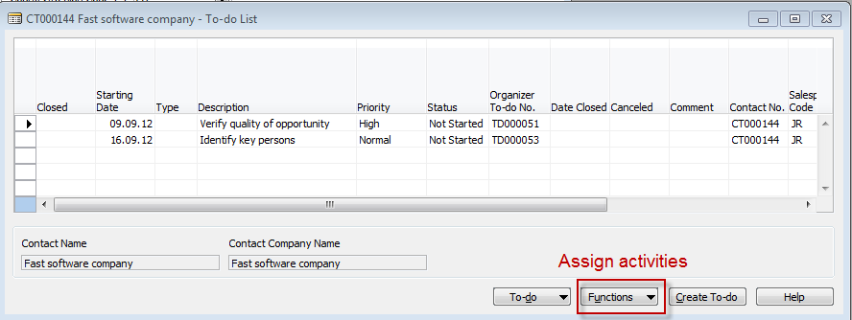
Contact card->To-Dos->Activities
Only Czech course
BPH_PIS1|2 !!!!

Slide 19
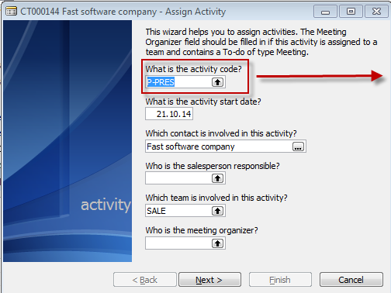
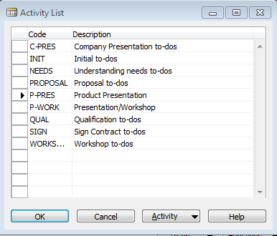
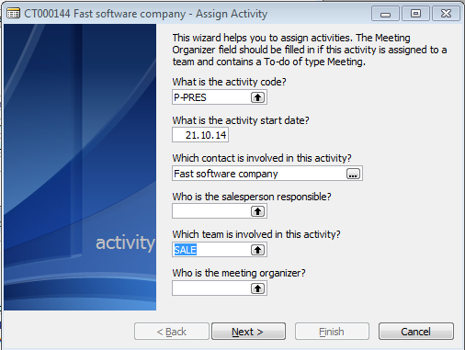
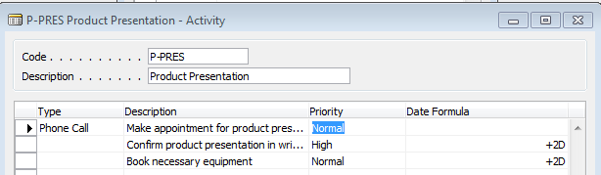
Contact card->To-Dos->Activities
Only Czech course
BPH_PIS1|2 !!!!

Slide 20
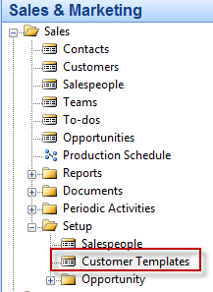
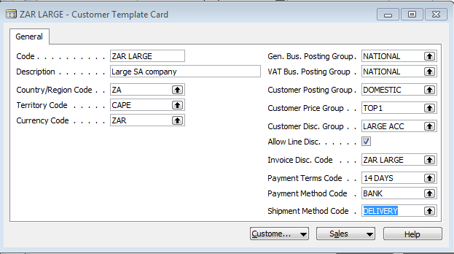
How to create a new customer from contact card
Only Czech course
BPH_PIS1| 2 !!!!
Enter data either by writing
or by use Look-up (F6)

Slide 21
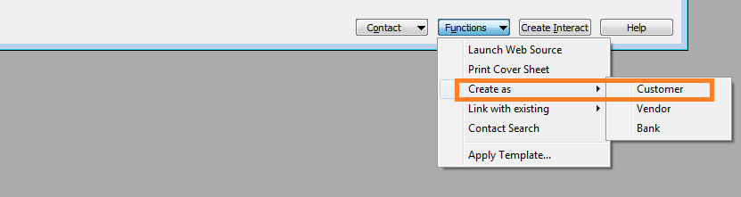
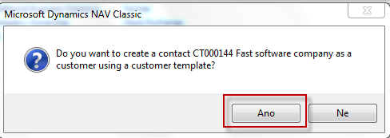
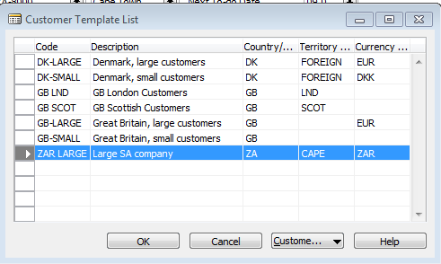
How to create a new customer from contact card
Only Czech course
BPH_PIS 1| 2 !!!!
Bottom of the contact card

Slide 22
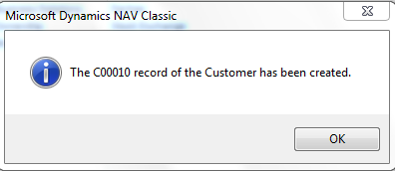
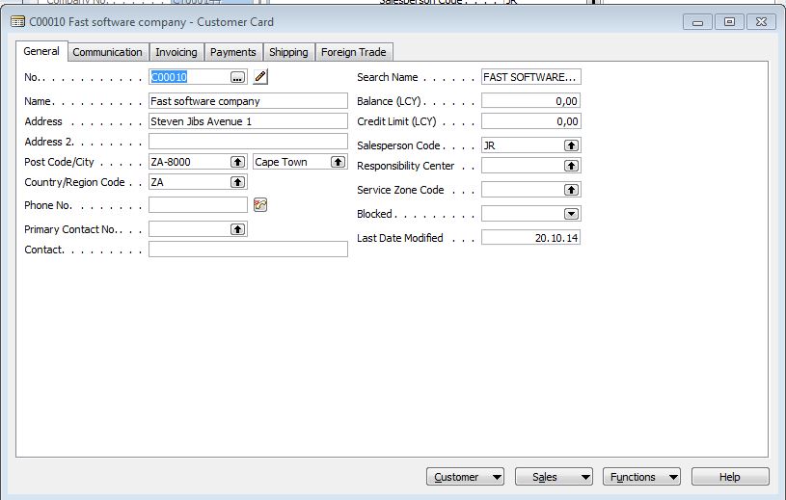

How to create a new customer from contact card
Only Czech course
BPH_PIS2| 1 !!!!

Slide 23
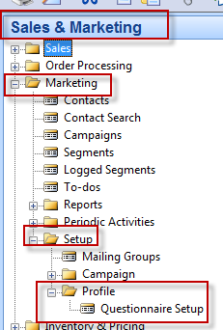
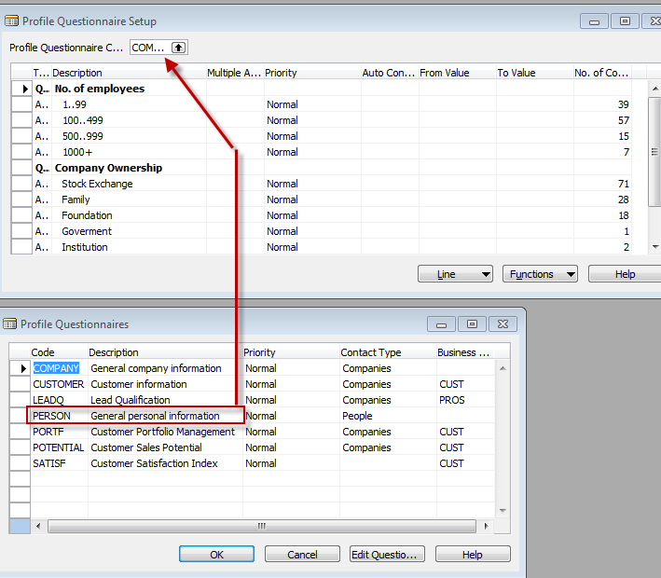

Personal profile creation

Slide 24
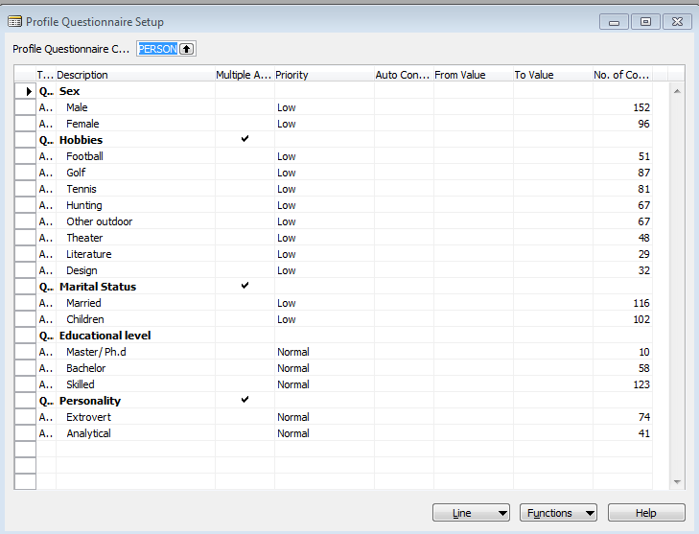
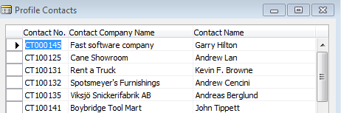
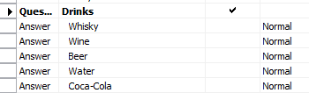
Personal profile creation
Add a new question

Slide 25
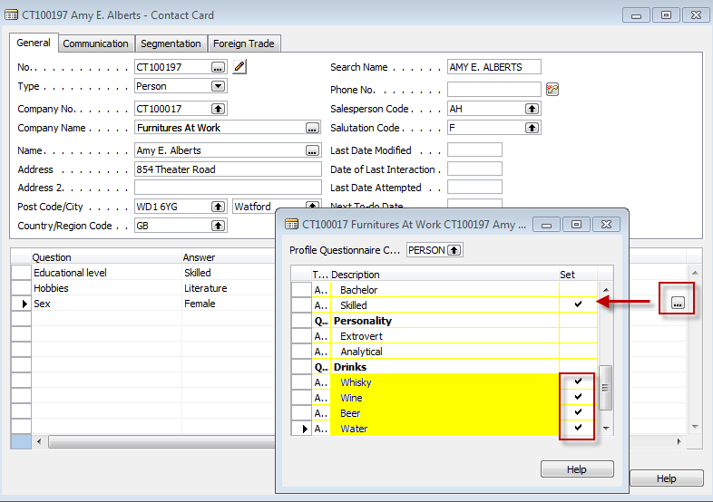
Personal profile creation

Slide 26
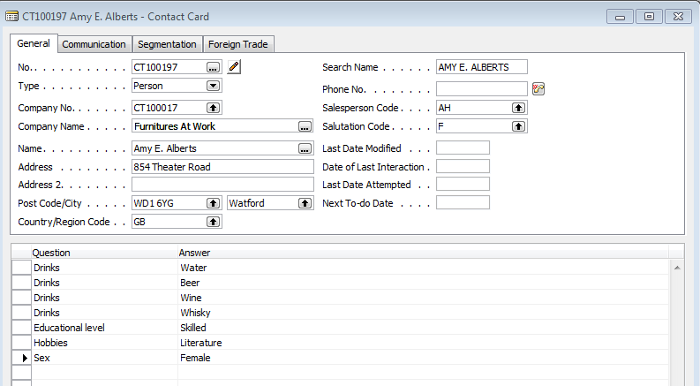
Personal profile creation

Slide 27
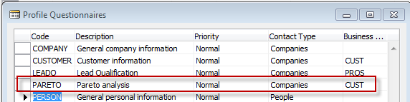
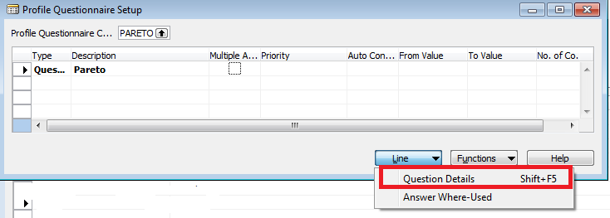
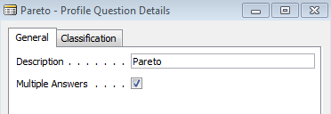
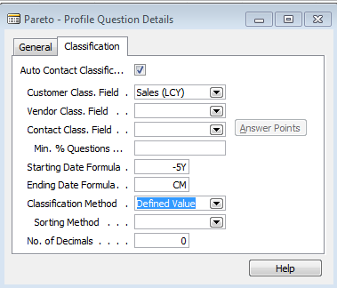

Pareto analysis based on company profile
Only Czech course
BPH_PIS 1|2 !!!!
Add new line
Add Question details

Slide 28
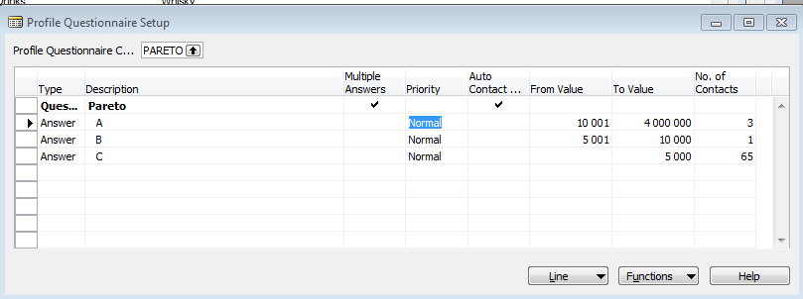
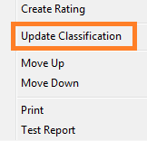
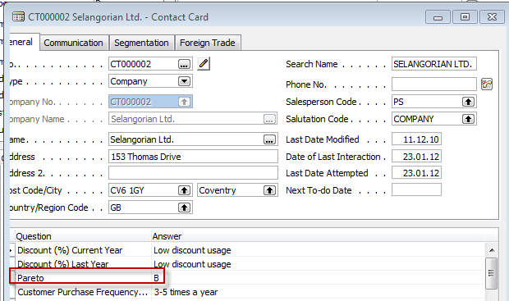
Pareto analysis based on company profile
Only Czech course
BPH_PIS 1|2 !!!!

Slide 29
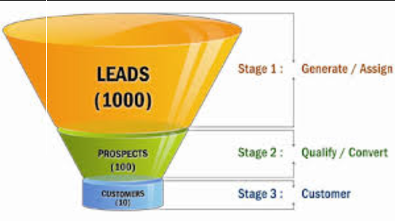
End of the section XVI.

