Slide 1
South African project
Masaryk University
Faculty of Economics and Administration,
Department of Business Administration
Ing.J.Skorkovský,CSc.

Slide 2
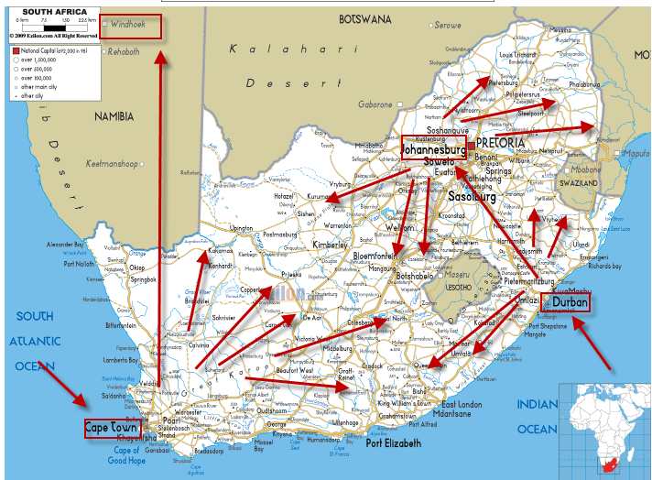
Wholesale-paper-warehouse management-ERP

Slide 3
Basic business specification
100 000 Tones per Year
Carbonless papers
Cast coated papers and Board
Coated papers
House brands
Office papers
5000 locations in HQ and 40 000 M2 warehousing space
50000 customers
90 vehicles
FEC trading (Forward Exchange Contracts)
Hundreds of employees
Heterogeneous IT system with every day synchronization of data in HQ and subsidiaries
High volume-low margin type of business
Products

Slide 4
Basic requirement
One database only (MS SQL)
Modern IT technology ensuring :
Fast access to data providing on-line information any time
Easy upgrades
Mobile technologies (BAR code readers,..)
Quick response to business partner requirements
Multidimensional analytic tool->reporting to support decision making process
Efficient warehousing (inbound and outbound oprations)
On-line reporting (warehouse status, accounting, cost control,…..)

Slide 5
Isolated Data Islands
Marketing
& Sales
Islands
Accounting
Island
Marketing
Management
Production
Island
Customer
Orders
Accounting
Sales Representatives
Customers
Banks
Replenishment planning - Vendors
Island of
Deliveries
Quality
Management
Island
Quality Management
Inventory -warehousing
5

Slide 6
One Solution One Database All Microsoft
Management
Marketing
Warehouse
(pickers and pullers
Customer
support
Internal Sales
(paper shop)
Reporting
One Company
Database
Accounting
Sales Representatives
Customers
Credit limits, rebates, consignment stock
FEC, transport,..
Purchase-Vendors
Shareholders
Planning

Slide 7
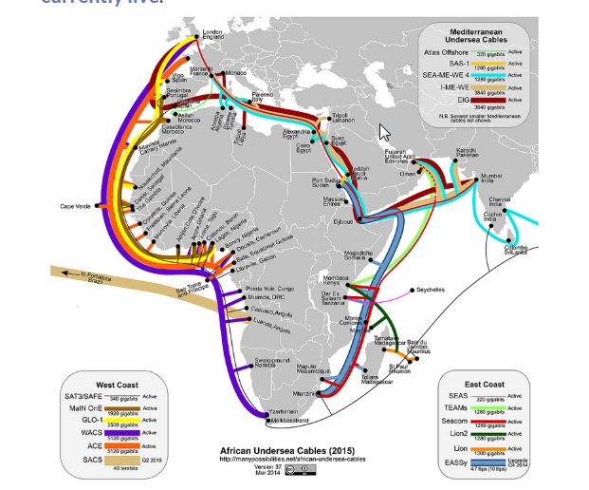
Communications limits (band width, stable connection…)

Slide 8
Efficient warehousing –(only a few examples)
Receipt bins (area where lorries are unloaded)
Put-away to bins (racks) based on zones definition
Capacities of the bins (racks) – (weight, size)
Cross docking (from inbound are directly to outbound area)
Transfer between location (HQ and subsidiaries)
Picking slips (from rack to shipment area)
Shipments area (bins, cages)
Transport planning
Credit limits and overdue payment check
Invoices, Credit memos,….
Claim management

Slide 9
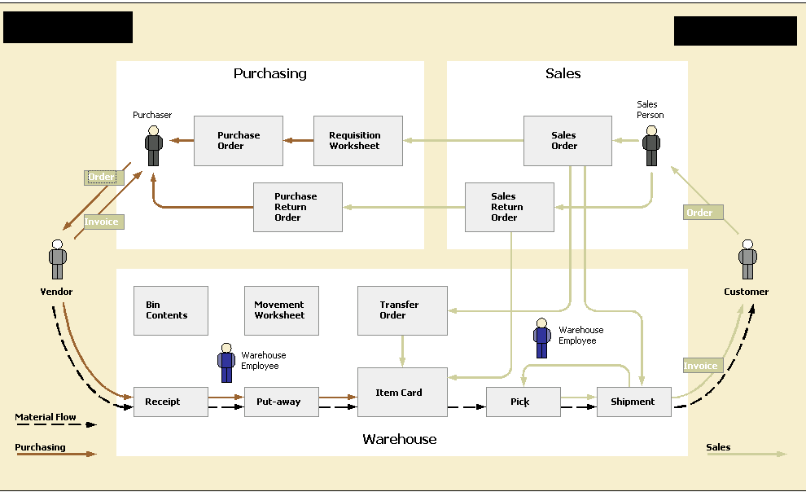
Warehousing

Slide 10
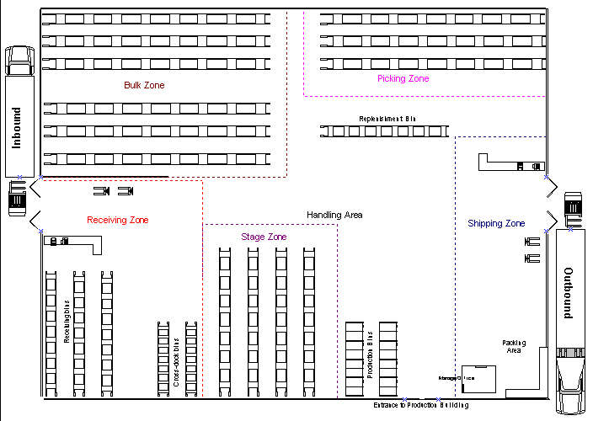
Warehousing

Slide 11
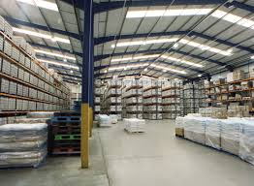

Slide 12
Design (S=Sheets, R=Reels, G=Graphics, C=Cutting, G=Guillotine)
= palette
B0 bin in receiving bin
S zone
G zone
R zone
C zone
6
5
G1
4
2 (3) palettes in each bin
3
G2
2
1
Broken Bulk
rack
Adjustment bin
EST WEST bins in – shipment area (cages)

Slide 13
Project management
Budget <->Quote and contract
Planning of resources and task control
Planning tools – see following slides
Reporting
Change management
Project Risks
Consignment stock
CPM,PERT,CCPM – will be mentioned later

Slide 14
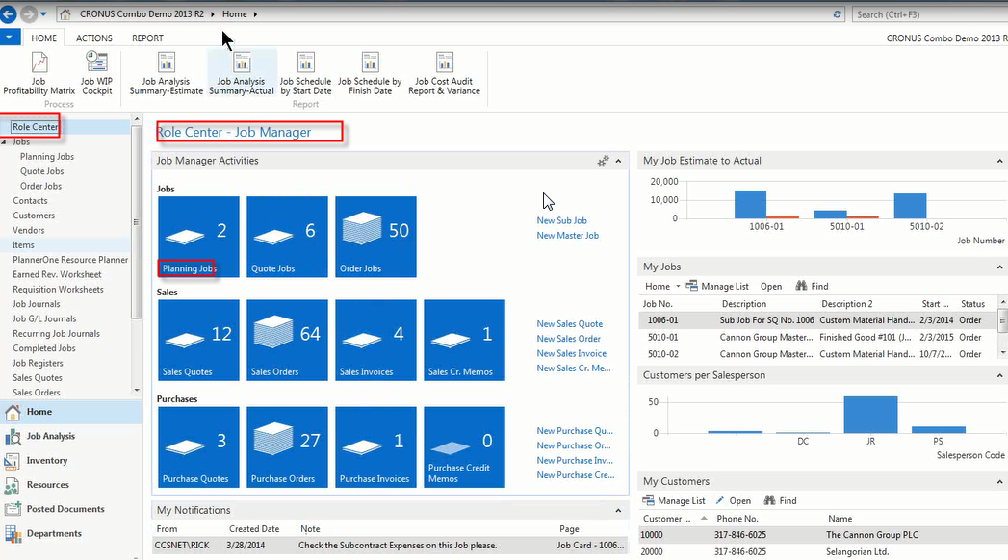
Resource planner tool

Slide 15
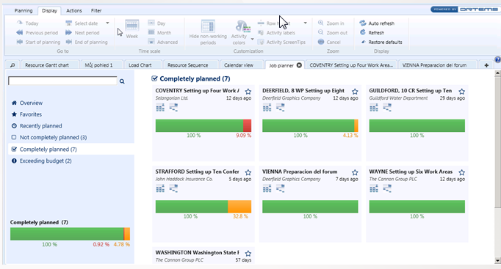
Resource planner tool

Slide 16
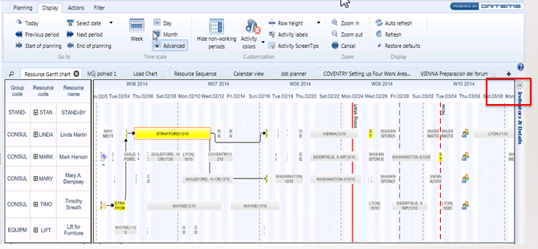
Resource planner tool

Slide 17
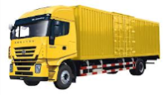
Consignment stock (benefits)
= palette
Requests
Customer
Wholesaler
Transfer
Customer
Remaining
stock
Partial invoice after 1 month
(one palette)
Wholesaler
Partial invoice after 2 months
(one palette)
Final invoice after 3 months

Slide 18
Forward Exchange Contract' A special type of foreign currency transaction. Forward contracts are agreements between two parties to exchange two designated currencies at a specific time in the future. These contracts always take place on a date after the date that the spot contract settles, and are used to protect the buyer from fluctuations in currency prices.
Opened from Purchase order (MS Dynamics NAV 2013)

Slide 19
Training
Materials
Key users
Trainig planning
Examination
Change management

Slide 20
Project Management I.
Data transfer
Setup of the system
Tests
Evaluation
Change management
Sharp start
Closing project

Slide 21
Project Management II.
Capacities of the teams unbalanced
Underestimation
Language barriers (especially understanding)
Budget excess (reasons will be explained)
Quantity of locations
Low margin
….…

Slide 22
Implementation
Data transfer
Setup of the system
Role Tailored Clients- profiles, Approvals
Tests
Evaluation
Change management
Sharp start (Namibia and SA)
Closing project
Next stages

