Slide 1
Kepner-Tregoe Methodology
Skorkovský
Department of business economy
Feveloped by Charles H. Kepner and Benjamin B. Tregoe in the 1960s.

Slide 2
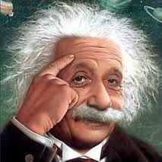
The formulation of a problem is far more essential than its solution which may be merely a matter of mathematical or experimental skill”
- Albert Einstein

Slide 3

Apollo 13 – Houston, Houston, do you read me ? We have a big problem….!
The Apollo 13 team is famous for bringing back the astronauts stranded in space by solving difficult and complex problems. The teams solving the problems has used the Kepner-Tregoe (KT) methodology !

Slide 4
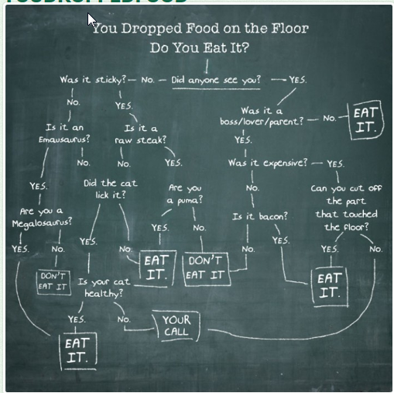
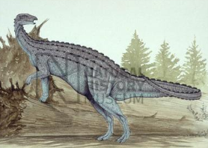
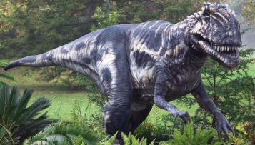
Decision Analysis –serious one
Sticky- lepkavý
Lick – olíznout

Slide 5
What is it K-T methodology ?
Kepner Tregoe is used for decision making (one of many possible methods )
It is a structured methodology for gathering information and prioritizing and evaluating it.
It is very detailed and complex method applicable in many areas, which
is much broader than just idea selection.
It is called also a root cause analysis and decision-making method.
It is a step-by-step approach for systematically solving problems, making decisions, and analyzing potential risks.

Slide 6
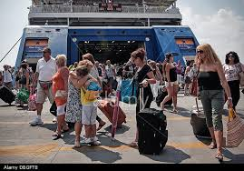
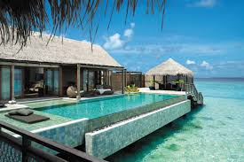
Make decision (A choice between two or more alternatives)
Identify what is being decided (e.g. how many rooms I have to order if I am owner of the travel agency)–see next slide (in this case K-T method is not considered)

Slide 7
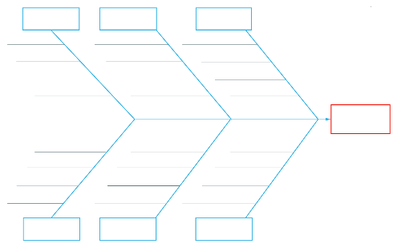
CRT-Ishikawa
12
3
1
2
4
3
7
OR
4
7
2
12
CRT
2
6
1
6
1
Root problem
3
4
Requirement
Prerequisite
 | 1 | 2 | 3 | 4 | 6 | 7
John | 8 | 7 | 4 | 3 | 5 | 6
Caroline | 9 | 5 | 7 | 8 | 5 | 6
Mean | 8,5 | 6 | 5,5 | 5,5 | 5 | 6
P1
Alternative 1
R1
1
EC
Conflict
1
= Nature (see, forest, mountains, jungle, river,..)
R2
P2
Alternative 2
2
= Hotel type
Root problem contrary
3
= Amenities (pool, golf course, wellness,.. )
4
= Period (spring, summer, fall, winter).
Alternative means how to solve problem and what kind of pay-off you will get

Slide 8
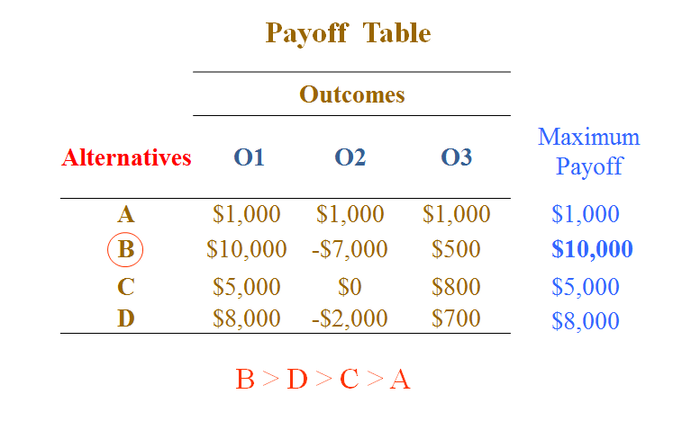
One possible solution Decision making methods without probabilities (MaxiMax and MaxiMin) – 1st slide-explanantion
  MaxiMax is the rule for the optimist. A slogan for MaxiMax might be "best of the best" - a decision maker considers the best possible outcome for each course of action, and chooses the course of action that corresponds to the best of the best possible outcomes

Slide 9
MaxiMin Payoff
Select the alternative which results in the maximum of minimum payoffs; a pessimistic criterion
Payoff Table
 | Outcomes
Alternatives | O1 | O2 | O3
A | $1,000 | $1,000 | $1,000
B | $10,000 | -$7,000 | $500
C | $5,000 | $0 | $800
D | $8,000 | -$2,000 | $700
Minimum Payoff
$1,000
-$7,000
$0
-$2,000
A > C > D > B

Slide 10
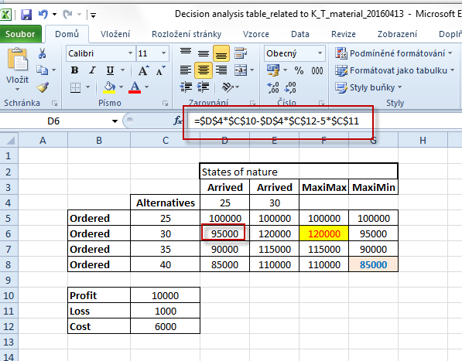
Decision making without probability
Hotel industry simple example (placed ordered-> alternatives and how many
of them will really arrive)

Slide 11
Make decision (A choice between two or more alternatives-Kepner-Tregoe approach)
Identify what is being decided
Establish and classify objectives (main ones, minor ones,..)
Separate the objectives into must (must to have) and want (nice to have) categories (we have to assign importance factors from 1-10, where 10 is the most important want objective) and assign criterion rating (weights)
Generate the alternatives (we can do it that way or we can take another way as well)
Evaluate the alternatives by scoring the wants against the main objective – see next slides
Review adverse (harmful) consequences of your corrective steps (risk evaluation, risk assessment)
Make the best possible choice what to do

Slide 12
Access situation (situation appraisal)
Identify concerns (problems) by listing them
Separate the level of concern (importance, magnitude, level of influence)
Set the priority level to measure seriousness of impacts (influence), urgency and growth potential
Decide what action to take next (step by step approach)
Plan for who is involved, what they will be doing, where they will be involved, when it happened and the extent of involvement (magnitude)

Slide 13

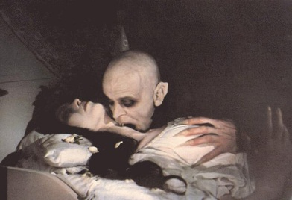
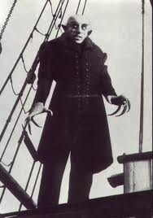
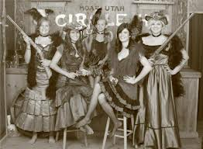

WHO WHAT WHEN WHERE EXTENT

Slide 14
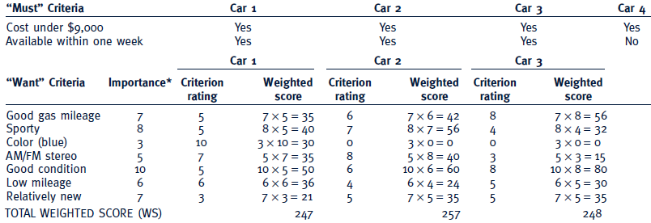
Criteria rating
See similar example on the next slide
Importance can be understood as a Satisfaction score,
meaning desirable but not essential.
Criteria rating is related to want criteria and every car property

Slide 15
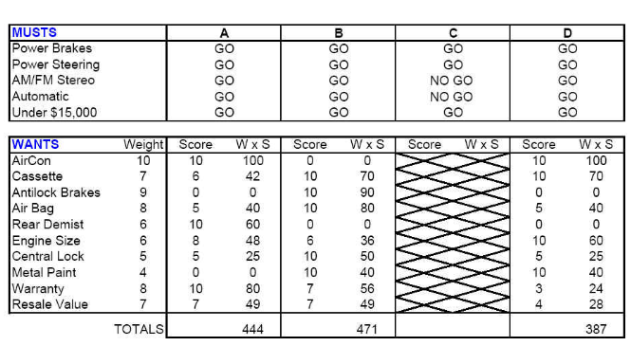
Which car to buy ?
Criterion rating
Importance score, meaning
desirable but not essential.
go to slide 34 and back

Slide 16
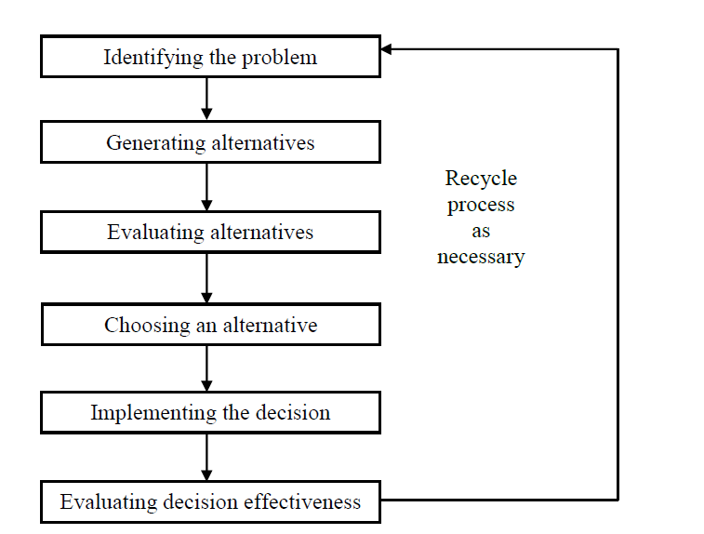
See the Upcoming (approaching, next to come) and Potential Opportunity=Solution=řešení)
List the potential alternatives A{a1, a2 ,..,aN}
Consider the possible(suitable)solution (e.g. the second one)
Take the action to address the likely cause/solution
Prepare actions to enhance(vylepšit) likely (possible) effects
feedback

Slide 17
Uncover and handle problems
(problem analysis)
State the problem (definition and description of the problem)
Specify the problem by asking what is and what is not
Develop possible causes of the problem (similar to CRT)
Test and verify possible causes
Determine the most probable cause (root cause)
Verify any assumptions
Try the best possible solution and monitor what will be a situation after applied correctives step

Slide 18
Description
WHERE
and WHERE NOT
WHERE
and WHERE NOT
Priority
(urgency)
Priority
(urgency)
Description
Description
Problem 1
Problem N
Causes
Situation
Causes
Situation
What
WhereWhenExtent
What
WhereWhenExtent
Big
problems
Solution (corrective action) 1
Solution (corrective action) 1
Solution (corrective action) X
Solution (corrective action) Y
Problem 1´
Problem N´
Smaller
problems

Slide 19
Decomposition, priorities and causes
Sub-problem 1
Priority1
Problem 1
Sub-problem N
Priority N
Problem 1
Sub-problem 1
Cause 1
Problem 2
Sub-problem N
Cause N
Problem 2

Slide 20
Example of problem manifestation (decrease of performance)
Change
Performance
Planned performance
Unfavourable deviation
  What do we see, hear, feel,
  taste, or smell that tells us
  there is a deviation?
Real performance
Time
Change
Final effect of the = PROBLEM (e.g. server crashed)
  Then we have to ask : What, Where, When, and to what Extent –Size (how much, how many)?

Slide 21
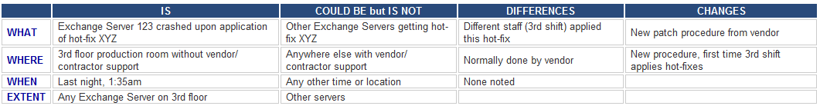
Server crashed !!!! (home study !!!)
Server crashed (this is a very poor problem definition)
The e-mail system crashed after the 3rd shift support engineer applied hot-fix XYZ to Exchange Server 123 (better definition of the problem)
History (and best practice) says that the root cause of the problem is probably due to some recent change. WHAT, WHERE, WHEN and EXTENT will be shown on next slides

Slide 22
Test the Most Probable Cause
(home study !!!)
Clarifying problem Analysis (example)
We have to ask (where Qi =QUESTION i) :
Question IS IS NOT
What (identify) Q1 Q2
Where (locate) Q3 Q4
When (timing) Q5 Q6
Extent (magnitude) Q7 Q8
See next slides

Slide 23
Problem Analysis - What
Is
Is Not
What specific object(s) has the deviation?
What is the specific deviation?
What similar object(s) could have the deviation, but does not? (It did not happen)
What other deviations could be reasonably observed, but are not? (It did not happen)
Example for Is :
1. What specific object IS related to the defect?
Inventory Valuation Objects in database A
2. What specifically is the defect (deviation)?
Inventory Adjustment does not work
1-> see setup of the database and see differences
2->see algorithm used for calculation and parameters used.
You can see , that in production calculation it dose not work
Example for Is Not :
1. What specific object IS NOT related to the defect?
Inventory Valuation Objects in database B
2. What specifically is not the defect (deviation)?
1 -> Setup has another parameters On
2-> Algorithm is used also for production where not error
occurs

Slide 24
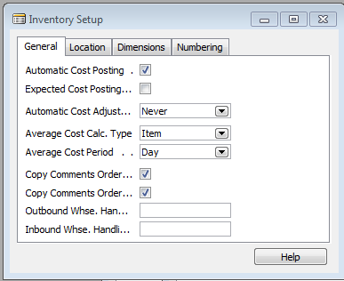
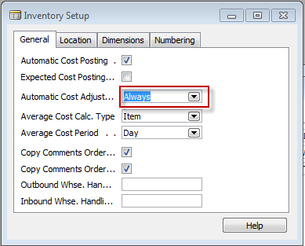
See two MS Dynamics Setup screens
(related to the problem specified recently)

Slide 25


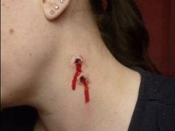


Problem Analysis - What
Is
Is Not
What specific object(s) has the deviation?
What is the specific deviation? - bites on the neck
What similar object(s) could have the deviation, but does not? (It did not happen)
What is the specific deviation? but does not? (It did not happen) – bites, anemia
Example for Is :
1. Nice young girl´s neck and strange
look of anemic person
Girl with garlic in her hands
No bites
Zaftig
Example of Is Not :

Slide 26
Another example for What IS and What IS NOT
Example I.
Customer X and Customer Y both use product B but only to customer X was sent the wrong product so the object IS Customer X , but IS NOT Customer Y
Example II.
IS girl visited Dracula lower castle without a bunch of garlic, but IS NOT not the one having bunch of garlic and visiting Špiberk castle in Brno

Slide 27
Problem Analysis - Where
Is
Is Not
Where is the object when the deviation is observed? (geographically)
Where is the deviation on the object?
Where else could the object be when the deviation is observed, but is not?
Where else could the deviation be located on the object, but is not?
Example for Is :
Old castle in the mountains (Romania)
Where IS : Romanian Carpathian mountains
where it is very easy to meet a lot of vampires
there
Example for Is Not
1. Brno castle Špilberk
Where IS NOT possible to meet vampires
(only lovers and children and seniors)

Slide 28
Problem Analysis - When
Is
Is Not
When was the deviation observed first (clock and calendar time)?
When since that time has the deviation been observed?
When, in the object’s history or life cycle, was the deviation observed first?
When else could the deviation have been observed first, but was not?
When since that time could the deviation have been observed, but was not?
When else, in the object’s history or life cycle, could the deviation have been observed first, but was not?
See example next slide

Slide 29
Example for When and IS and IS NOT
Customer X and Customer Y both use product B but only customer X was sent the wrong product if Salesman Tony was on holiday in this time and Salesman Mustafa was in charge, so the object IS Salesman Mustafa , but IS NOT Salesman Tony

Slide 30
Problem Analysis - Extent
Is
Is Not
How many objects have the deviation?
What is the size of a single deviation?
How many deviations are on each object?
What is the trend?
  Occurrences?
  Size?
How many objects could have the deviation, but don’t?
What other size could a deviation be, but isn’t?
How many deviations could there be on each object, but are not?
What could be the trend, but isn’t?
  Occurrences?
  Size?

Slide 31
Problem Analysis
Confirm True Cause
What can be done to verify any assumptions made?
How can this cause be observed at work?
How can we demonstrate the cause-and-effect relationship (e.g. Current Reality Tree or Ishikawa Fishbone Diagram)?
When corrective action is taken, how will results be checked?

Slide 32
Let’s Look At Some Problems!

Slide 33
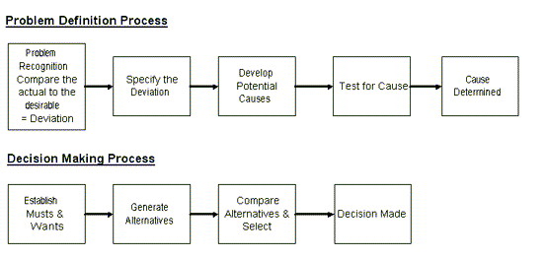
Systematic Problem Solving and Decision making Overview

Slide 34
Planning the Next Steps
Problem Analysis
    Do we have a deviation?
    Is the cause unknown?
    Is it important to know the cause to take effective action?
If the answer is YES to ALL three, than you have a big problem, Huston !!!

Slide 35
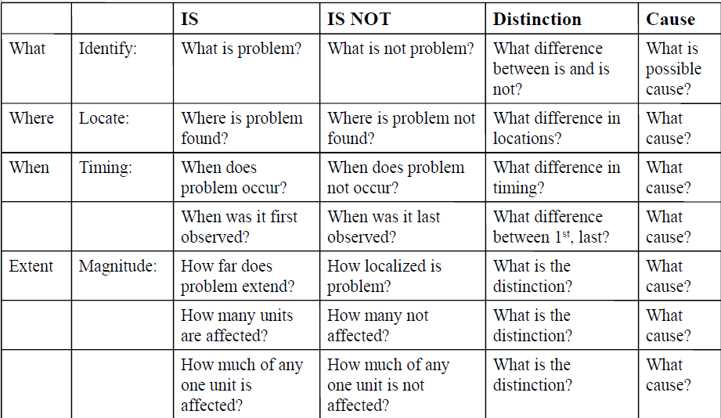
Problem analysis table template
(Home study)

Slide 36
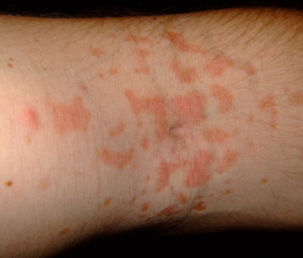
Problem description (example)
On a new model of airplane, flight attendants develop rash on arms, hands, face (only those places). It only occurs on flights over water.
Usually disappears after 24 hours. No problems on old planes over those routes.
Does not affect all attendants on these flights, but same
number of attendants get it on each flight. Those who get rash have no other ill effects.
No measurable chemicals, etc., in cabin air.
Rash arm ->

Slide 37
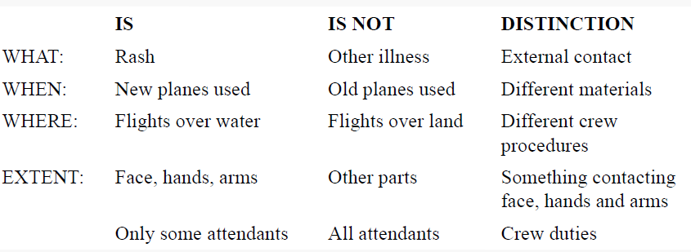
Problem analysis real table
Distinction=Difference

Slide 38

Results ????

Slide 39
Tree of the casual relationships I –example
Decline of revenue due to :
Lower merchantability of the items
    New competitors
    Change of the customer preferences
    Poor (not sufficient) quality of the item
  Restriction of capacity production
    Downtime due to machine failure, obsolete machinery, irregular maintenance
  Change of the legislation (change of the health rules)
See tree

Slide 40
Revenue decline
Decline of
demand
Lower production
    Change of the
    customer preferences
Decrease of production capacity
New competitors
Lower quality
Machinery downtimes
…
…
Change of the health rule
…
    Machinery is liable
    to breakdowns
…

Slide 41
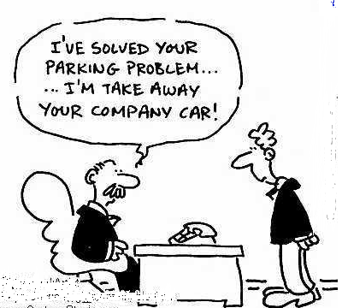
Let’s Look At Some Problems again!

Slide 42
Decision making process
Problem definition
Requirements identification
Goal establishment
Evaluation criteria development
Select decision –making tool
Apply tool (K &T, Pros-Cons,…)
Check

Slide 43
Step 1 and Step 2
Step 1 Problem: Pick a replacement vehicle for the motor pool fleet
The definition of the problem dictates the requirements. As the vehicle is for a motor pool, the requirements will differ from those for a family car, for example.
Step 2 Requirements:
1. Vehicle shall be made in U. S. A.
2. Vehicle shall seat at least four adults, but no more than six adults
3. Vehicle shall cost no more than $28,000
4. Vehicle shall be new and the current model year

Slide 44
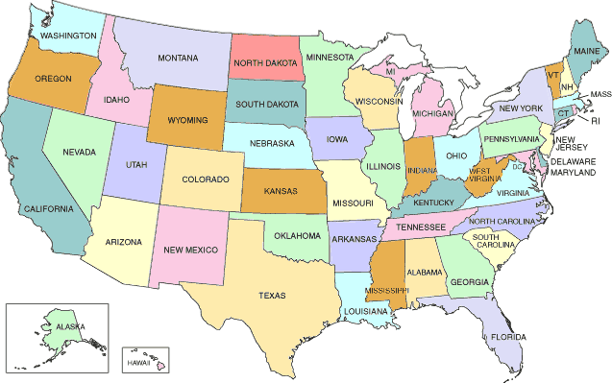
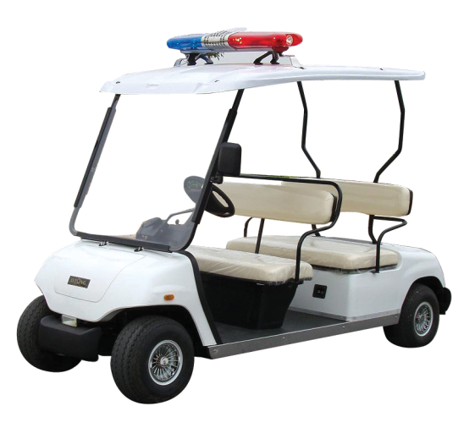
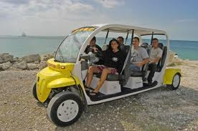

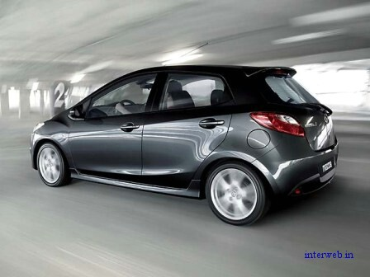
Min
Max 28000 USD
Max
New car
(current model)

Slide 45
Step 3 and Step 4
Step 3 Goals:
· Maximize passenger comfort
· Maximize passenger safety
· Maximize fuel-efficiency
· Maximize reliability of the car
· Minimize investment cost
Step 4 Alternatives:
There are many alternatives but the requirements eliminate the consideration of a number of them:
Requirement 1 eliminates the products not manufactured in the USA
Requirement 2 eliminates vans, buses, and sports cars (Ferrari no !!!!)
Requirement 3 eliminates high-end luxury cars
Requirement 4 eliminates used vehicles

Slide 46
Step 5
Step 5 Criteria:
“Maximize comfort” will be based on the combined rear seat leg and shoulder room. (Note: front seat passenger leg and shoulder room was found to be too nearly the same to discriminate among the alternatives.) 5
“Maximize safety” will be based on the total number of stars awarded by the National Highway Traffic Safety Administration for head-on and side impact. 10
“Maximize fuel efficiency” will be based on the EPA fuel consumption for city driving. 7
“Maximize reliability” will be based on the reliability rating given each vehicle by a consumer product testing company. 9
“Minimize Cost” will be based on the purchase price. 10
Weighted criteria vector C(5,10,7,9,10) are values assigned by decision makers !!!!

Slide 47
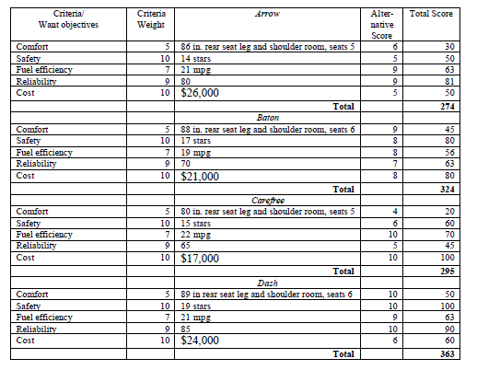
Kepner-Tregoe table
(for 4 cars : Arrow, Baton, Carefree and Dash)

Slide 48
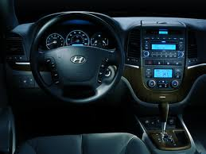
Last step – Validation (check)
Last Step Validate Solution:
The totals of the weighted scores show that the Dash most nearly meets the wants/goals (or put another way, has the most “benefits”). Dash meets all the requirements and solves the problem !!!
Go back to slide 9

Slide 49
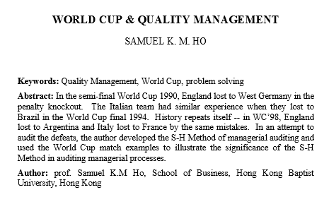
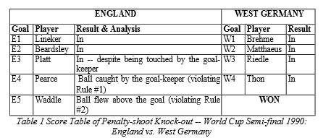

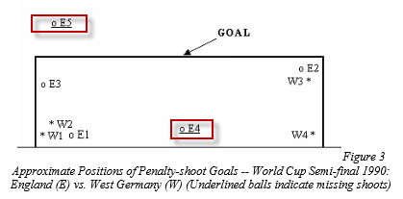


Slide 50
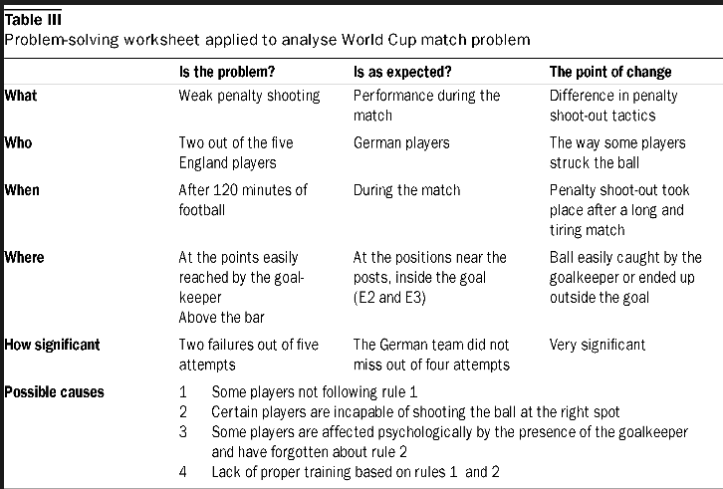
Example of analysis- use of questions

Slide 51
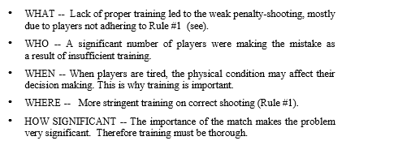

Slide 52

Thanks for Your attention

