Slide 1
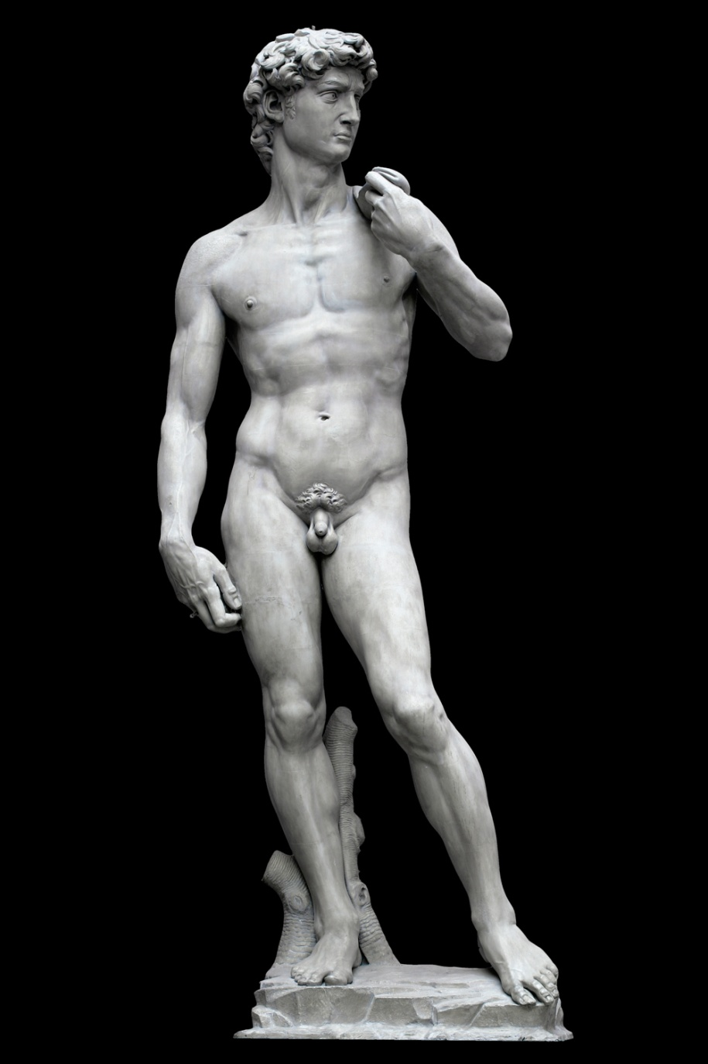
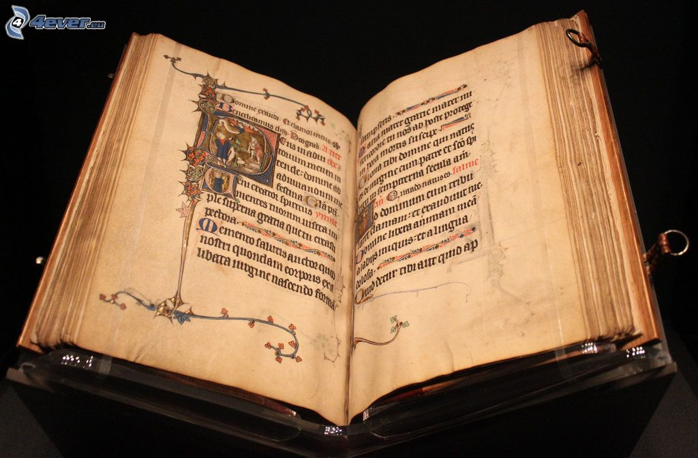
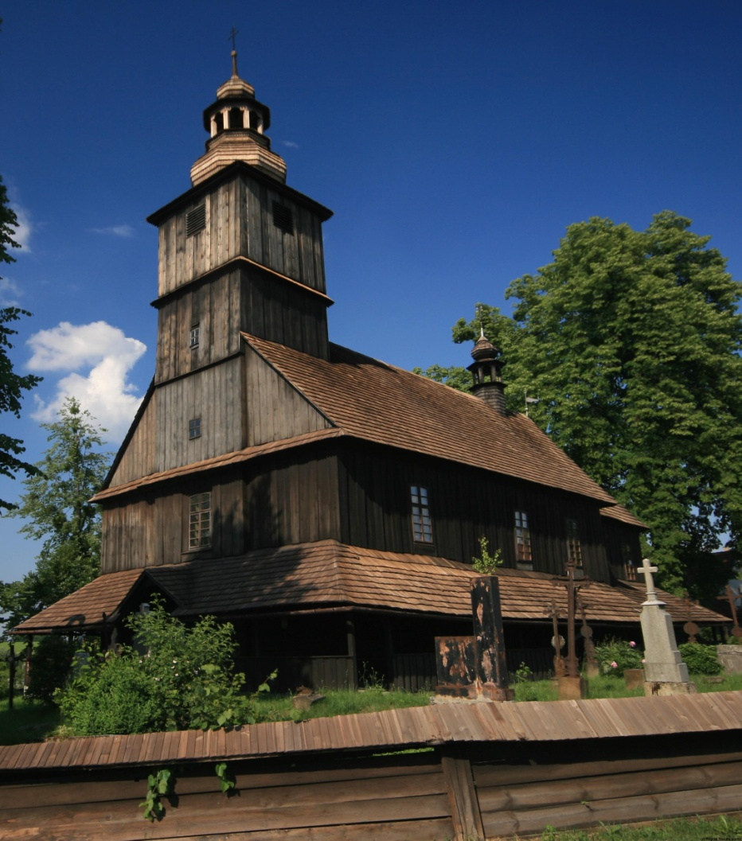
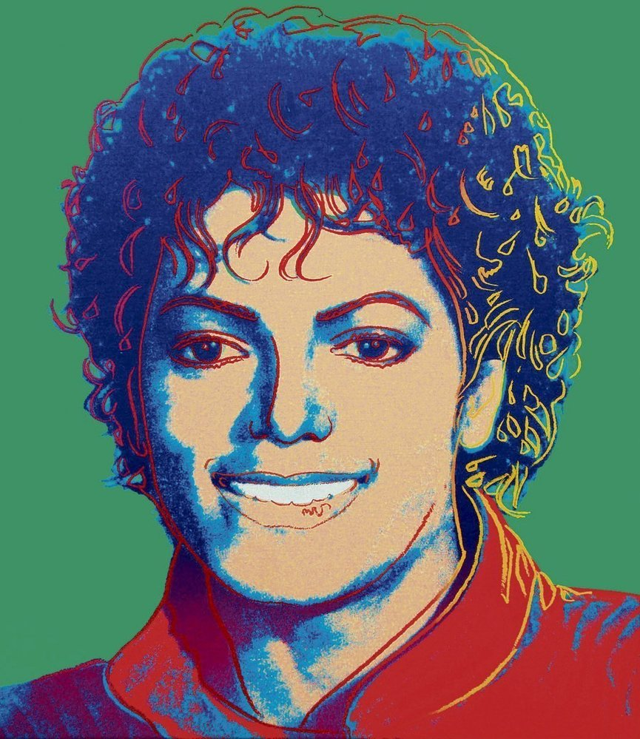
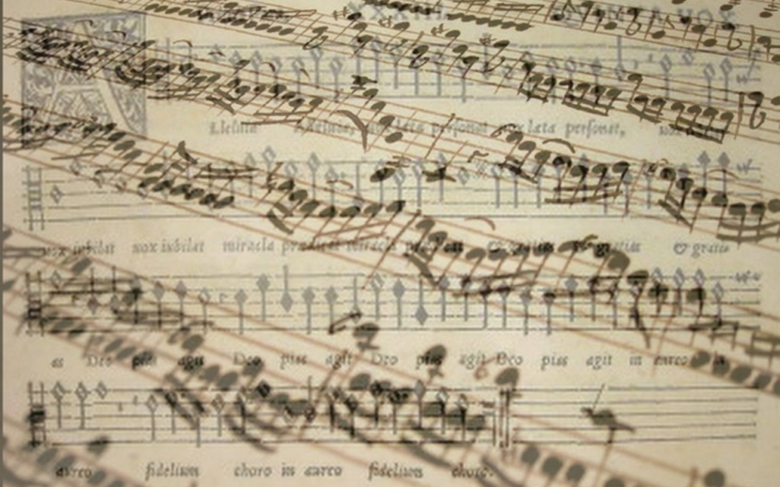
Culture and Mass Media Economy

Slide 2
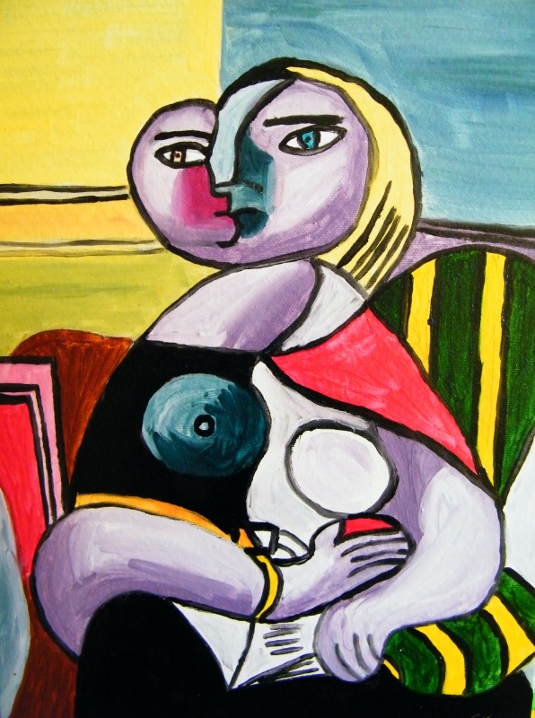
DEFINING CULTURE CULTURAL POLICY

Slide 3
Content
Definition of culture
Definition of cultural economics
Economic characteristics of cultural goods
Cultural policy
Cultural policy in the Czech Republic

Slide 4
Definitions
What is culture?
What is art?
Difference?
Group discussion

Slide 5
I. DEFINITION OF CULTURE

Slide 6
Definition of culture
Definition – long time discussions about this topic
An international debate centered in UNESCO (United Nations Educational, Scientific, and Cultural Organization) since 1960s
Term cultural heritage

Slide 7
Definition of culture (cont.)
Narrow definition – specific cultural goods and services
Wide definition – all, what make people different from other animals

Slide 8
Definition of culture (cont.)
the arts and other manifestations of human intellectual achievement regarded collectively (Oxford dictionary)

Slide 9
High culture vs. low culture
High culture = visual and performing arts, heritage
Low culture = cultural/creative industries, mainstream

Slide 10
Definition of arts
the expression or application of human creative skill and imagination, typically in a visual form such as painting or sculpture, producing works to be appreciated primarily for their beauty or emotional power (Oxford dictionary)

Slide 11
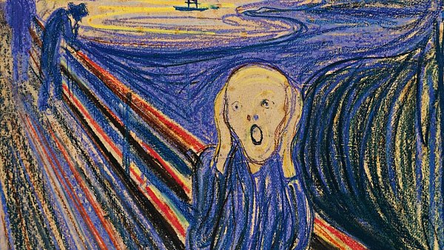
II. DEFINITION OF CULTURAL ECONOMICS

Slide 12
Cultural Economics
“Economics of the arts” vs. “Cultural economics”
“Economics of the arts” more specific and narrow than the subject matter included in cultural economics
“Cultural economics” covers the creative and performing arts and heritage, as well as the cultural industries.

Slide 13
Cultural economics (cont.)
Cultural economics is the application of economics to the production, distribution and consumption of all cultural goods and services.

Slide 14
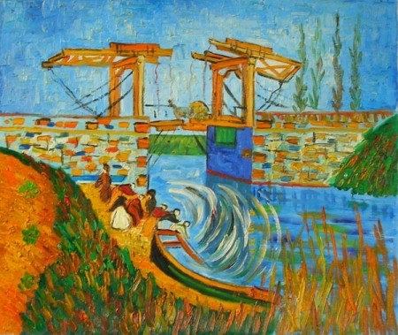
III. CULTURAL GOODS AND SERVICES

Slide 15
Cultural goods and services
Name cultural goods and services you know.
Group discussion

Slide 16
Cultural goods and services (cont.)
Ballet
Opera
Orchestras
Heritage
Museums
Publishing
Cinema
Television
Broadcasting
Music
Visual arts(architecture, design, crafts, etc.)
Festivals
…

Slide 17
Cultural goods and services
Contain creative or artistic element
Tangible (goods) vs. Intangible (services)
Examples?
Immovable vs. Movable
Examples?
Durable vs. Exist in particular time span
Examples?
Final (supplied to consumers) vs. Intermediate (involved in production of other cultural products or non-cultural output)
Examples?

Slide 18
Cultural goods and services (cont.)
Have cultural goods any common elements with all other goods and services?

Slide 19
Cultural goods and services (cont.)
Yes
Their production utilizes resources of land, labour and capital and other inputs, particularly human ingenuity.
These resources may have other uses, so have an opportunity cost and a price.
No
They are not all sold on the market, though many are, as are the labour services of artists and other creative workers.
Some are supplied by the government and may be provided free of charge, being financed out of taxes.

Slide 20
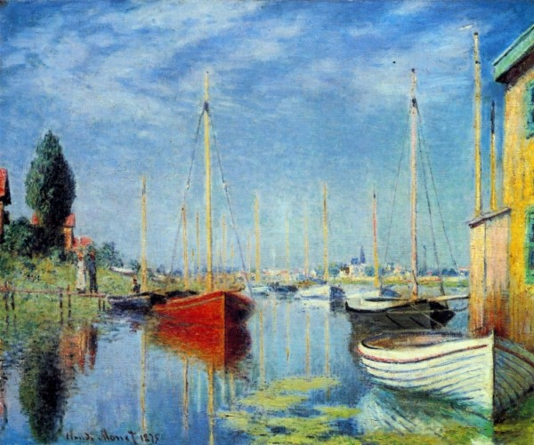
IV. CULTURAL POLICY

Slide 21
Cultural policy
Priorities of the state regarding culture, general idea of the government’s role in culture
Production and supply side

Slide 22
Cultural policy (cont.)
Before – concerned only “high culture”
Now – broadened out, includes also cultural industries, crafts, etc.

Slide 23
Cultural policy (cont.)
Cultural policy (cont.)
The EU:
Supranational (authoritative governance institutions and policy-making activities above member states)
Intergovernment prespective (bargaining processes among member states)
Confederal consociational perspective (protect own vital interests by consensus and achieve a certain unity of goals and solve common issues)
National (financing):
Central,
Regional
local government

Slide 24
Cultural policy (cont.)
Ownership and cultural policy:
State-owned – owned and/or managed by civil servants (in some countries), revenues and costs absorbed by local authority (heritage)
Publicly owned organizations – mimic market forces (shops in museums)
Private organizations – controlled by financial (subsidy) and legal means (including restrictions, prescriptions)

Slide 25
Hillman-Chartrand model
Facilitator – Tax reduces for donators (USA)
Patron – Art Councils (UK)
Architect – Ministry of culture (CZ, France)
Engineer of the arts – State is owner and decisionmaker (China)

Slide 26
Cultural policy (cont.)
Economic dimensions of cultural policy:
Intervention in cultural markets
Depends upon financial incentives and regulatory measures

Slide 27
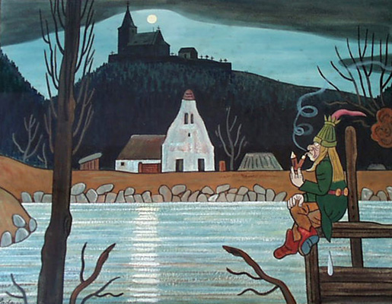
V. CULTURAL POLICY IN THE CZECH REPUBLIC

Slide 28
Cultural policy in the Czech Republic
Till 1989
State monopoly in culture
Political and ideological importance of culture
No motivation for efficient functioning of state organizations
After 1989
Decrease in efficiency and collapsing of some cultural institutions due to inability to adapt to new economic situation
Increased prices and lack of resources on maintenance and reconstruction
Result – denationalization, privatization, transformation and dissolving of cultural organizations and spontaneous development of new infrastructure

Slide 29
Cultural policy in the Czech Republic (cont.)
Cultural Policy 2009-2014:
“the Czech Republic wants to become a cultural crossroad, it wants to utilize its natural position in a free, open and creative way in the creation of its own culture, in the preservation of cultural heritage and its application in every realm of social life.” (Czech Ministry of culture, 2009)

Slide 30
Cultural policy in the Czech Republic (cont.)
Tasks of the state:
to create optimal relations between culture and other realms of life of society,
develop creative opportunities in the economy, research and education, motivate donors,
provide sufficient resources to strengthen the competitiveness of the state in a global environment.

Slide 31
Cultural policy in the Czech Republic (cont.)
Objectives:
Use the benefits of the arts and cultural heritage and associated creativity to increase competitive strength in other areas and activities,
Emphasize the role of culture in individual professional and personal development of citizens,
Provide direct and indirect support to maintain existing cultural values and create new values as well,
Create a transparent and non-discriminating environment for cultural activities

Slide 32
Cultural policy in the Czech Republic (cont.)
Actual cultural policy 2015-2020
Document: Plan for implementation cultural policy 2015-2020
Support of culture identity
Support of culture diversification
Support of multicultural dialogue

Slide 33
Cultural policy
Cultural policy in your country?

Slide 34
Sources:
Presentation made by Daria Kuchařová
A handbook of cultural economics. Edited by Ruth Towse. Cheltenham: Edward Elgar, 2003.
Simona Škarabelová et al. Ekonomika kultury a masmédií. Brno: Masaryk University, 2007
Michelle Reeves. Measuring the economic and social impact of the arts: a review. London: Arts Council of Egland, 2002
National Cultural Policy Czech Republic 2009-2014. Ministry of Culture, Prague, 2009

Slide 35
THANK YOU FOR ATTENTION!

Slide 36
Short paintings Quiz
Who is author of these paintings?

Slide 43
Results
Pablo Picaso
Edvard Munch
Vincent Van Gogh
Claude Monet
Josef Lada
Andy Warhol

