Slide 1
Marketing for Cultural Organisations
Ing.Vojtěch Müllner

Slide 2
Outline of lecture
Work with artickle
Understand the core and role of marketing
Yes minister-The Middle Class Rip
Understand the role of “interests groups“
Presentation
Definition of term Marketing
Challenges for cultural organizatons
Instruments of marketing
Customers

Slide 3
Work with article

Slide 4
Work with article
Answer following questions
What is the situation today in cultural organizations?
What is the core of the changes?
What are the main differences in funding of cultural organizations in time?
What is marketing?
What does the term mean?
What for do we need it?
What does the term include?
What is the difference between marketing in cultural organizations and in business organizations?

Slide 5
Yes minister-The Middle Class Rip

Slide 6
Yes minister-The Middle Class Rip
Jim Hacker- is the Minister for Administrative Affairs
Sir Humphrey- serves as Permanent Secretary under his Minister, Jim Hacker at the Department of Administrative Affairs
Bernard Woolley- is Jim Hacker's Principal Private Secretary. His loyalties are often split between his Minister and his Civil Service boss, Sir Humphrey

Slide 7
Yes minister-The Middle Class Rip
When the Minister (Jim Hacker) is approached by a group of local constituents seeking government funding for their nearly bankrupt local football club, he suggests that they sell the local museum to private interests and use the proceeds for their sports team. Sir Humphrey - a patron of the arts and an avid opera-goer - is aghast at the prospect of taking funds from the arts and transferring it to sports. He and his fellow permanent secretaries come up with an ideal solution - make Jim Hacker the Minister responsible for the arts.

Slide 8
Yes minister-The Middle Class Rip
Answer following questions:
For which group of people culture and art primary is?
Why want Sir Humphrey suppoart culture?
Define the main interests group in the movie
Focus on:
Interests groups
Reasons why we should suppoart culture

Slide 9
Yes minister-The Middle Class Rip

Slide 10
Term marketing

Slide 11
Term marketing
Marketing – “the process of planning and executing the conception, pricing, promotion, and distribution of ideas, goods and services to create exchanges that satisfy individual and organizational goals” (Bennet, 1995)
◦ Negative view in cultural organizations
◦ But, both sides (individual and organiuzational goals)

Slide 12
Challenges for cultural organizations

Slide 13
Reality in culture sector
Art can no longer be treated as having sacred right for public support
Culture organizations can no longer assume that they know what consumer wants
Consumers living in multimedia and cross-cultural environment want more combinations of art forms and delivery methods
Cultural events must provide multiple benefits to meet consumer needs, while fitting in their time and budget constraints
Current generation doesn’t view high art as inherently more valuable than pop culture that shapes their lives

Slide 14
Challenges no.1
Answer to societal changes
More stressful life than a genaration ago
Less energy for leisure activities
World has become smaller
Cheaper traveling
Development of comunication technology
New technology has enabled people to experience music and visual arts from around the world
Tv broadcasting
Internet and streaming services

Slide 15
How to deal with challenges
Let the challenges be and follow your own way
Conservative point of view
Accept the challenges
Actual point of view
Use instrument of marketing (creat a Marketing Plan)

Slide 16
Instruments of marketing

Slide 17
Examples of Instruments
Marketing plan
Marketing mix
The 4Ps of Marketing Mix
The 7Ps of Marketing Mix

Slide 18
Marketing plan
Statement of Organisational Mission
Each organization is established for the purpose of achieve main goal
Without goal we cannot find the best way for our organization
Environmental Analysis
(e.g. purchasing power of population, location of action, demographic factors, etc.)
Competitor Analysis
„We need to know our enemies“
Understanding Buyer Motivation
Why are the customers interested in our product?
Segmentation
What are the group of our customers?
What are the main specification of these groups?

Slide 19
Marketing plan (cont.)
Research Plan
Product Analysis
What are the benefits of our product?
What are the weak part of our product?
SWOT analysis
Distribution Analysis
How deliver product to customers?
Pricing Options
Comes from our price policy
Promotional Plan

Slide 20
Marketing mix

Slide 21
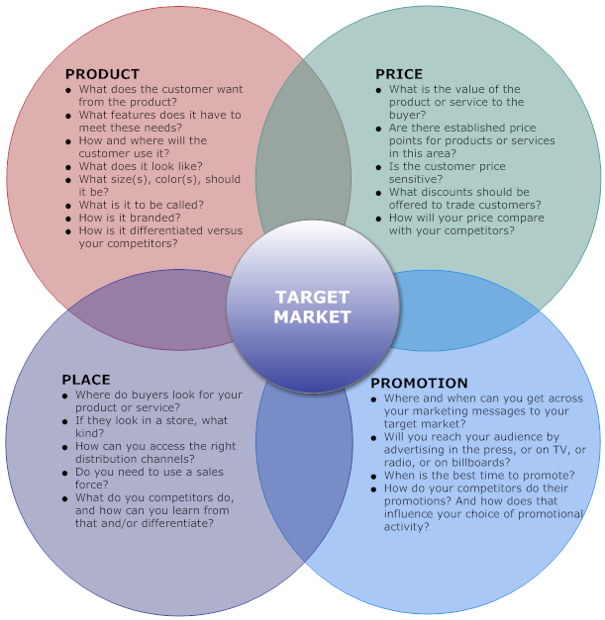
4 Ps of Marketing Mix

Slide 22
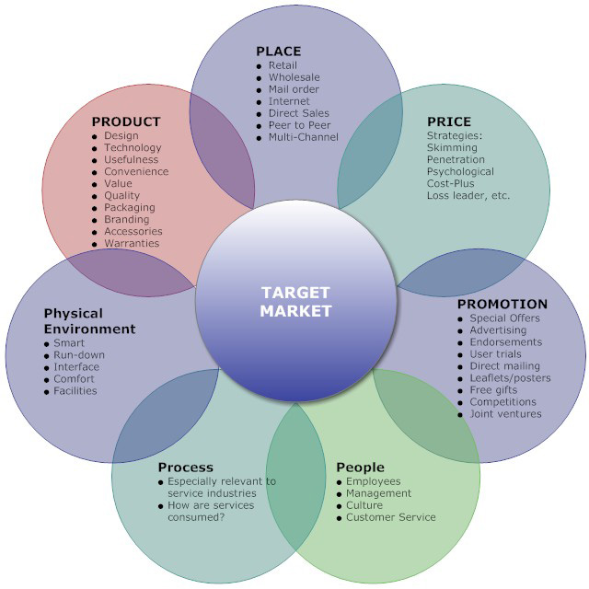
7 Ps of Marketing Mix

Slide 23
Customers of cultural organizations

Slide 24
Customers
What type of customers do we have in business branch?
Group discussion…

Slide 25
Customers in business branch
Ready-to-Buy Customers
Often have a sense of urgency (actual need)
Repeat Customer
Most loyal customer
They are our customers as long as we continue to satisfy their needs
They represent no more than 20 percent of our customer base, but make up more than 50 percent of our sales

Slide 26
Customers in business branch (cont.)
Impulse Buying Customers
Customers who make purchasing decisions based upon a whim or a great sales presentation usually are not in a position of needing anything in particular
Sale or Discount Customers
Sale or discount customers always shop for the best deals available on the items they want to purchase
Potential Customers
Usually in no hurry to make a purchase
They need attention of seller

Slide 27
Customers
What type of customers do we have in culture branch?

Slide 28
Customers
In business branch and in cultural branch are the same types of customers
Group of Ready-to-Buy Customers
must be impressed by our product
Loyal group of customers/Repeat Customer
They visit theatre/cinema/museum periodically
Group of Impulse Buying Customers
Follow the trends and feelings
Group of Sale or Discount Customers
Follow the best offer
Potential Customers
All of the people

Slide 29
Costumers motivations

Slide 30
Costumers motivations
Social Ritual
For the traditional high art audience, attendence may be an affirmation of their social values
Self-improvement
„Culture is mirror of our behavior“
Symbol of social status
Higher class are more interested of culture
Need of catharsis
Satiation through culture

Slide 31
Visitors of cultural organizations -research

Slide 32
Visitors of cultural organizations -research

Slide 33
Visitors of cultural organizations -research

Slide 34
Relationship between customers needs and marketing

Slide 35
Relationship between customers needs and marketing

Slide 36
Source
Marketing for Cultural Organisations. 2nd edition. Bonita M Kolb, 2005
A handbook of cultural economics. Edited by Ruth Towse. Cheltenham: Edward Elgar, 2003.
SVOBODA F., Kultura 2013
Yes Minister: http://www.imdb.com/title/tt0751820/plotsummary?ref_=tt_ov_pl
Website
www.marketingmix.co.uk/
www.smartdraw.com/marketing-mix/examples/marketing-mix-4ps/
www,smallbusiness.chron.com/five-types-customer-segmentation-10566.html

Slide 37
Thank you for attention

