Slide 1
PUBLIC SUPPORT OF THE CULTURE
Jana rozmarinová

Slide 2
Requirements
requirements
To visit permanent exhibition in Moravian gallery
“La traviata”
sightseeing tour in the center of Brno on 3th May
seminar work + presentation
written exam

Slide 3
Revision
Definition of culture
Definition of cultural economics
Economic characteristics of cultural goods
Cultural policy
Cultural policy in the Czech Republic

Slide 4
Content
Public support
Yes or no?
Levels of public support
Forms of public support
+ a bit about private funding

Slide 5
Two aspects of public support
POSITIVE – analyses extent of support by Government
NORMATIVE –whether to support

Slide 6
Where the support is not needed?
Film is generally considered self sufficient /profitable culture
Theaters in the Czech Republic sufficient partly (28%)
Galleries, museums and monuments - self-sufficient in an average of 18.2%

Slide 7
Government support of the arts in ten countries, 1994, direct spending in dollars per capita
Finland | 112
Germany | 90
Sweden | 65
France | 57
Netherlands | 48
Canada | 44
United Kingdom | 26
Australia | 24
Ireland | 9
United States | 6

Slide 8
Public support
Public support
Direct
Indirect – tax deductions, the higher the tax rate, the higher the willingess to give to the arts
The difference between the two types of support?
Where the decisions about size of support and its recipients is taken?

Slide 9
Public support of culture
Should government support the culture?
Arguments & Counter-arguments
Group discussion
Hint: Market failure (info asymmetries, non-competitive markets, externalities, public goods)

Slide 10
Should government support the arts?
Arguments: Market failures on DEMAND SIDE
External benefits of production and consumption
Public good features (non-excludability, no rivalry in consumption)
Non-market demand (national identity, prestige, social cohesion)
Merit goods
Irrationality of customers
Lack of information – consumers badly informed about supply
Income distribution

Slide 11
Should government support the arts?
Arguments: Market failures on SUPPLY SIDE
Imperfect competition (monopolistic features)
Productivity lag (BAUMOL´S DISEASE)
Income distribution (of artists)

Slide 12
Baumol´s cost disease
Phenomenon discrabed by Bauml and Bowen in th 1960s
Rise of salaries of musicians without productivity changes
Rise of wages in automobile factory X in opera

Slide 13
Baumol´s cost disease
Hypothetical illustration of productivity lag
 | 1990 | 2000 | Chang in %
Automobile industry
Output in automobile i. per work hour | 20 | 24 | +20
Wage per hour | 10 | 12 | +20
Symphony orchestra
Output measured by admissions per work hour | 2 | 2 | 0
Wage per hour | 10 | 12 | +20

Slide 14
Should government support the arts?
Counter-arguments:
External effects is small or non -existent
Income distribution is even worsen after the support
still supports high-income population, as they are primary consumers
Deviate from preferences of the population (own taste, re-election)

Slide 15
Sources for supporting culture
Public support
Direct
Indirect
Funding from private sources - finance may come from private sources –
sponsorship, donations of money, goods and volunteer labour can be significant sources of support.

Slide 16
Amount of public support
EU countries 0,7% of GDP, 1% of budget
Considerable support
But tiny compared to other sectors
State (CZ – 0,5% budget)
Local (Prague 5% of budget)

Slide 17
Forms of public support
Direct vs. Indirect
Historically – direct (after WW2)
Now – diversity of various sources
Direct and indirect sources of funding?
Group discussion

Slide 18
We can make the general observation:
The balance of public and private financing varies a lot between different countries:
The proportion of private finance of culture is greater in the USA, Japan and the UK than in other European countries, Canada and Australia.
Differs between countries is the role of non-profit organizations and their relative importance in the cultural sector
There are the private for profit organizations that are financed from private capital and from sales revenues:
Such as the cultural industries and Brodway and West End theatre

Slide 19
Culture budget – proportion of governmant spending
Even in countries that spend relatively large amounts on public provision or subsidy of culture, the cultural budget is only a small proportion of government spending, often less than one per cent of the government budget.

Slide 20
Funding of culture
State organizations - State-owned organizations, but still may receive funds from private sources (gifts, volunteering)
Non-profit organizations - Role and relative importance is typically lower in continental Europe than elsewhere
Private for profit organizations - are financed from private capital and from sales revenues (Broadway)

Slide 21
The main resources for supporting culture
Direct |  | Indirect resources
Subsidies from public budgets | Not from public budget
Subsidies | taxes | Social contributions
Subsidies with a contribution | fees | Tax reduces for donators
 | money from sales revenues | Tax reduces for donees
 | foundations and foundations funds
 | other founds (state fund for czech cinematography)
 | Communal obligations
 | Donations and sponsorship
 | Lottery and punts
 | Flag days = public collections

Slide 22
We can make the general observation:
The balance of public and private financing varies a lot between different countries:
By and large, the proportion of private finance of culture is greater in the USA, Japan and the UK than in other European countries, Canada and Australia.
Differs between countries is the role of non-profit organizations and their relative importance in the cultural sector:
That is typically lower in continental Europe than elsewhere.
There are the private for profit organizations that are financed from private capital and from sales revenues:
Such as the cultural industries and Brodway and West End theatre

Slide 23
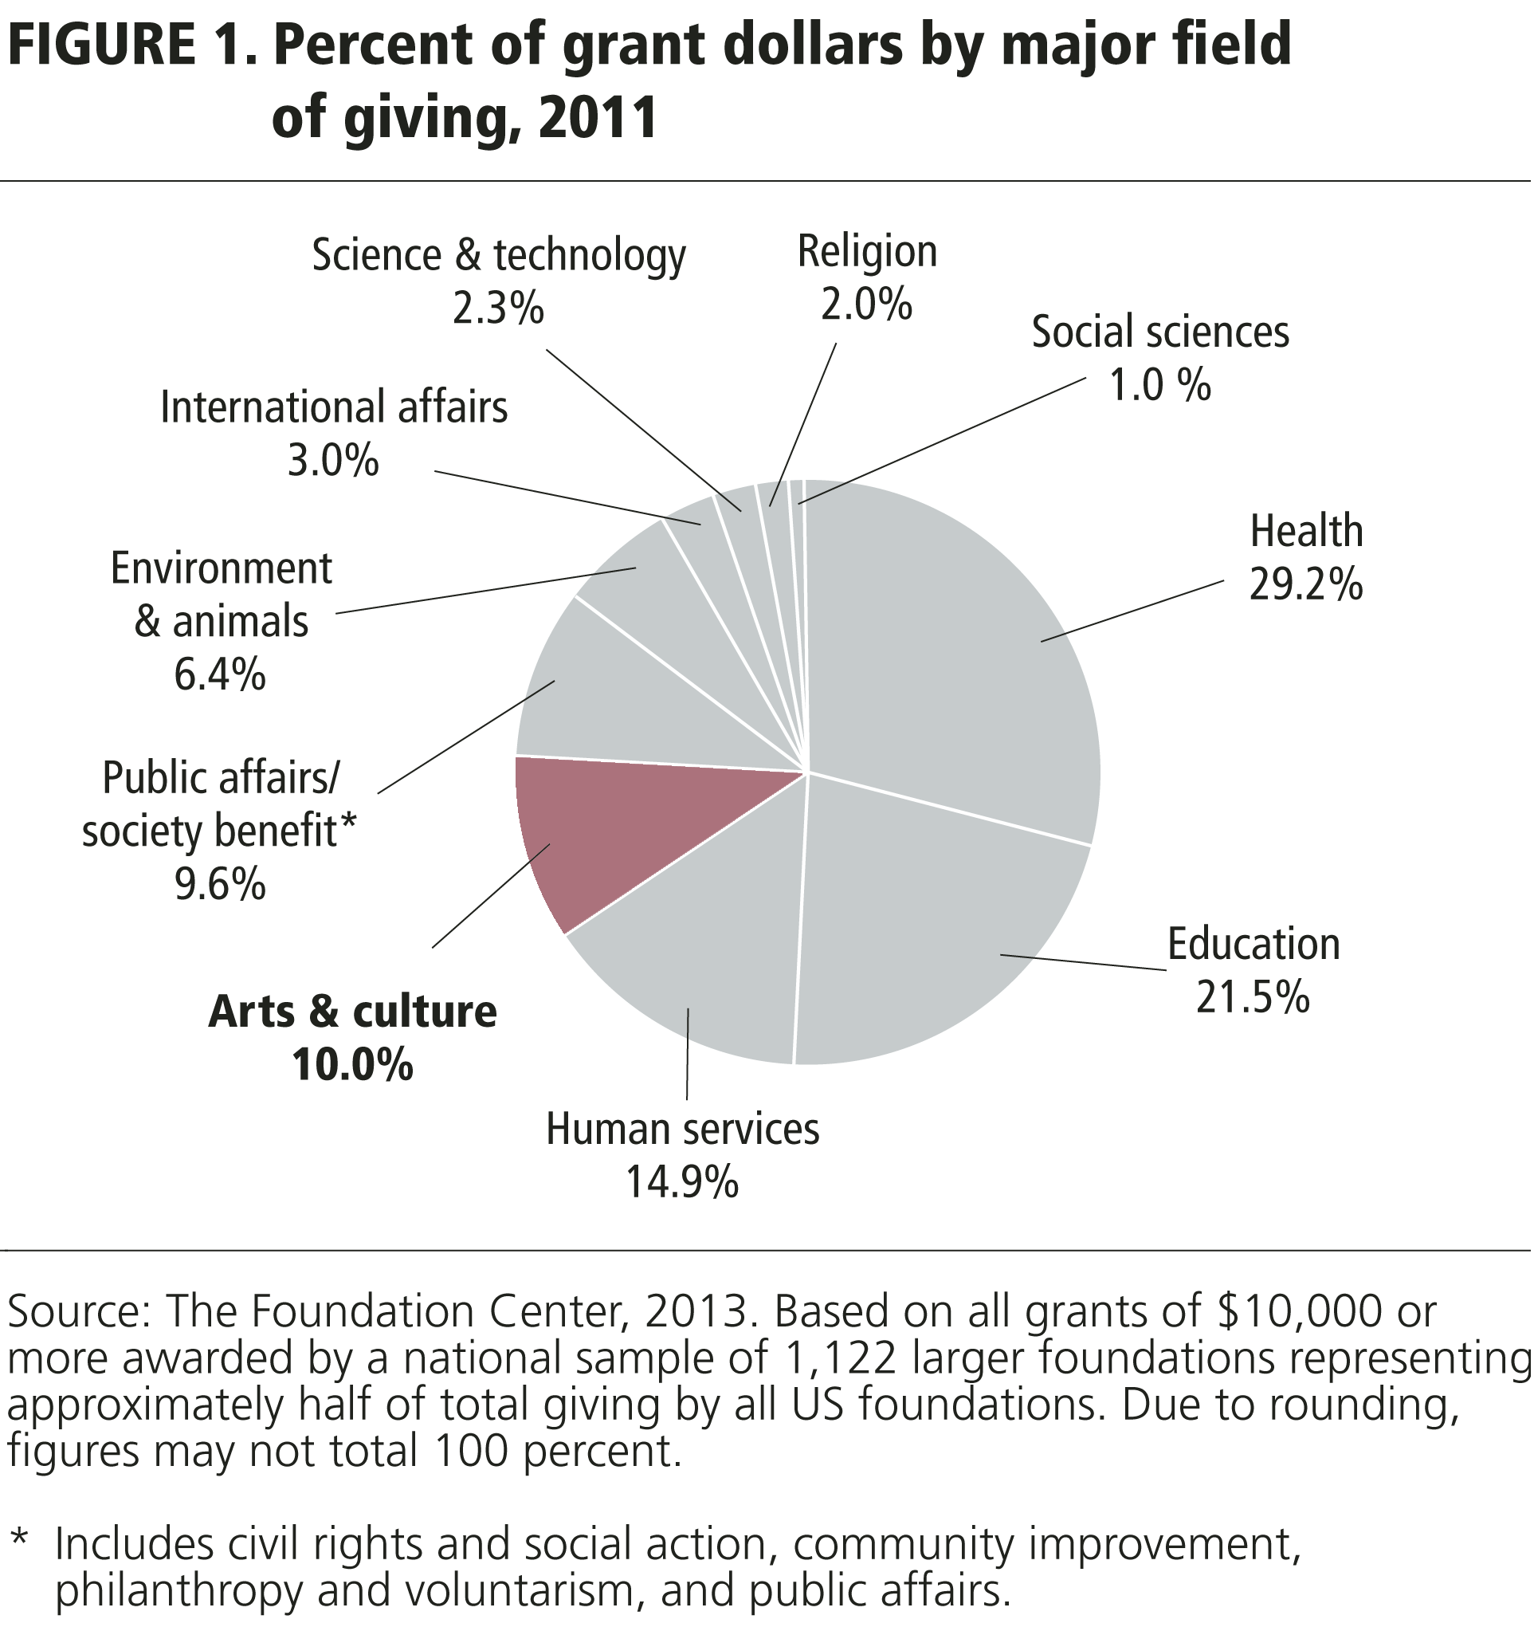

Slide 24
Presentation made by Daria Kuchařová
A handbook of cultural economics. Edited by Ruth Towse. Cheltenham: Edward Elgar, 2003.
Simona Škarabelová et al. Ekonomika kultury a masmédií. Brno: Masaryk University, 2007
Michelle Reeves. Measuring the economic and social impact of the arts: a review. London: Arts Council of England, 2002
National Cultural Policy Czech Republic 2009-2014. Ministry of Culture, Prague, 2009

