Slide 1
Decision-Making Under Certainty
IEBE

Slide 2
We‘ll start with...
… a test!

Slide 3
“Under Certainty”
There is no doubt as to which outcome will result from a given act
“If I do X, Y happens“
Risk: “If I do X, there is 50% probability Y happens“
Uncertainty: „If I do X, Y may happen. Or maybe not.“

Slide 4
Preferences
What is a preference?
“a greater liking for one alternative over another“
Being able to say “I like bananas more than apples”
A is preferred to B OR I am indifferent between A and B

Slide 5
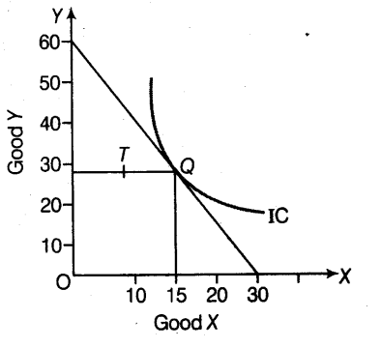
Preferences

Slide 6
Rational preferences
Complete
Transitive
Violations?
Utility
u(apple) > u(orange)
u(apple) > u(10 Kč)

Slide 7
Rational choice
the action chosen by a decision-maker is at least as good, according to his/her preferences, as every other available action

Slide 8
Preferences
Inherent?
Constructed?
“In experiments, people are unable to estimate "fair" prices accurately and are strongly influenced by the unconscious and irrational.” (W. Poundstone)

Slide 9
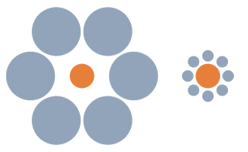

Slide 10
Rational = consistent

Slide 11
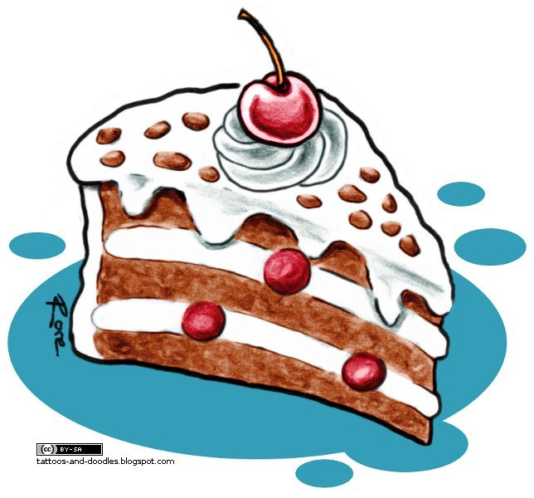
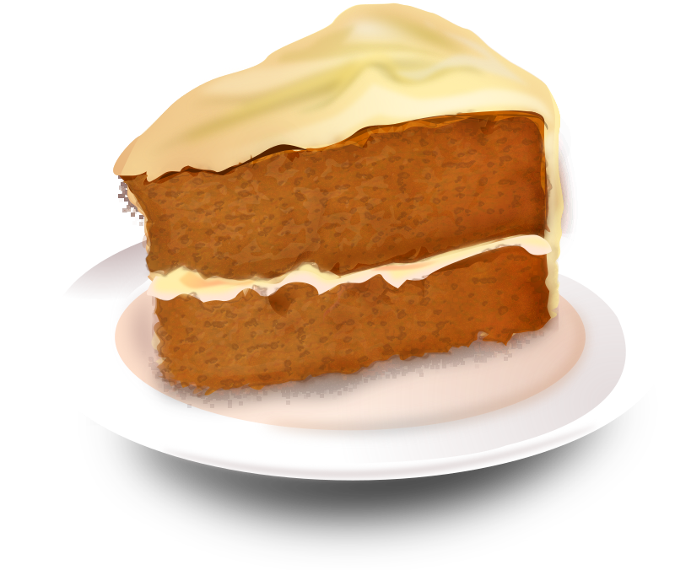
Rational?

Slide 12
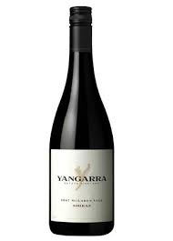
Rational?
Wine bottles:
100 - 120
120 - 140
160 - 180
180 - 200
200 - 220
220 - 240
240 - 260
100 - 260

Slide 13
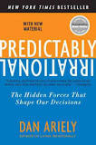
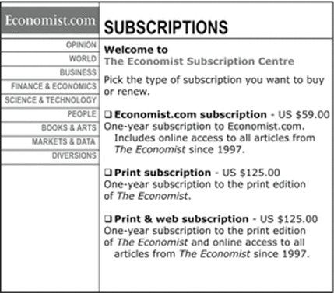

Slide 14
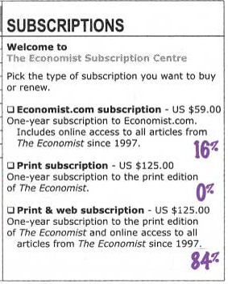
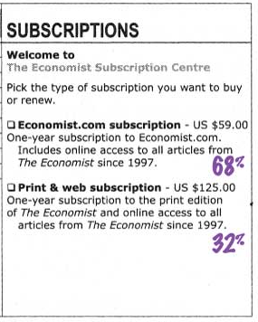

Slide 15
Decoy effect
Consumers tend to have a specific change in preference between two options when also presented with a third option that is asymmetrically dominated.
An option is asymmetrically dominated when it is inferior in all respects to one option; but, in comparison to the other option, it is inferior in some respects and superior in others.

Slide 16
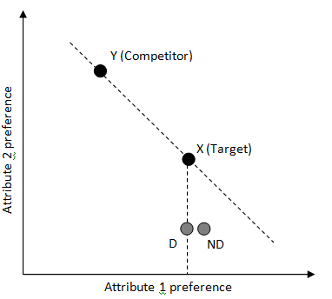
Decoy effect

Slide 17
Decoy effect

Slide 18
Decoy effect
Works with people too- you can make yourself more attractive by hanging around the right people

Slide 19
Compromise effect
Items can gain market share when new options are added to the market when they become the compromise or middle option in the choice set.

Slide 20
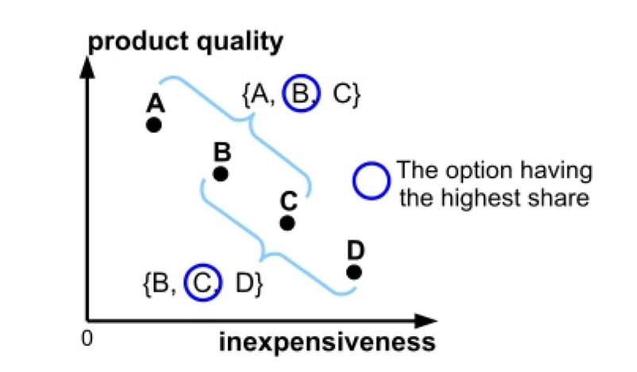
Compromise effect

Slide 21
Compromise effect

Slide 22
Compromise effect

Slide 23
Context dependent preferences

Slide 24
Cheerleader effect
Hierarchical Encoding Makes Individuals in a Group Seem More Attractive (Psychological Science)

Slide 25
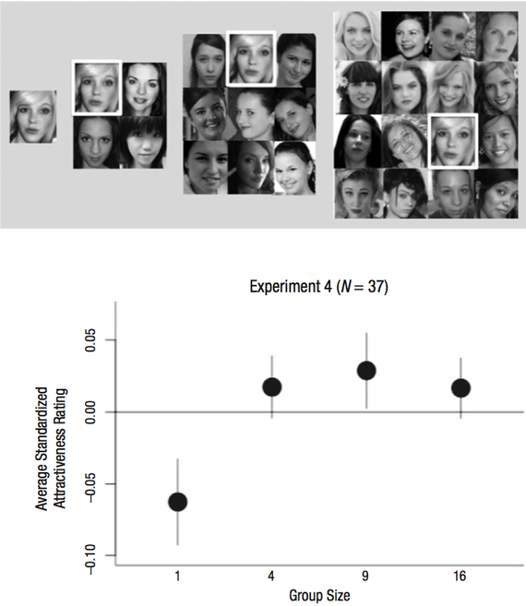

Slide 26
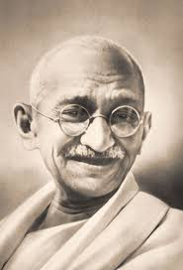
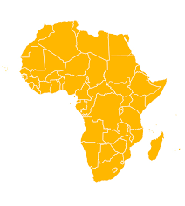
Anchoring effect
Human tendency to rely too heavily on the first piece of information offered (the "anchor") when making decisions
78 y.o. 3,776 m 28%

Slide 27
Anchoring effect

Slide 28
Anchoring effect

Slide 29
Framing
cognitive bias, in which people react to a particular choice in different ways depending on how it is presented

Slide 30
Framing

Slide 31
Framing
Pizza
149.- free delivery
89.- delivery 60.-
Free pizza! (delivery 149.-)

Slide 32
Framing

Slide 33
Endowment effect
People ascribe more value to things merely because they own them.
People often demand much more to sell an object than they would be willing to pay to buy it.
Loss aversion: people dislike losses more than they like gains of the same size

Slide 34
Endowment effect
WTA/WTP [$]

Slide 35
Endowment effect
You call to cancel your phone subscription
“If you stay with us, we give you 100 free calls”
“We have just credited your account with 100 calls”

Slide 36
Endowment effect

Slide 37
Preference construction WTA/WTP
Tom Sawyer effect

Slide 38
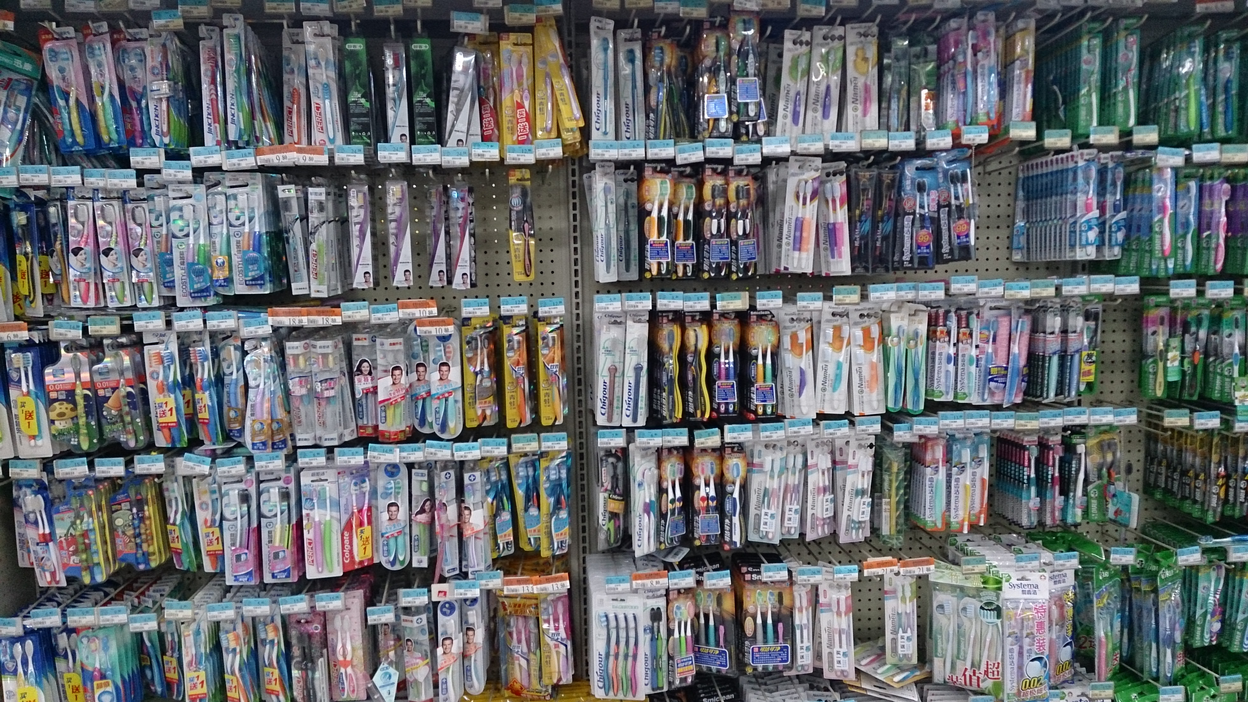

Slide 39
Choice paralysis
With increased size of the choice set it becomes more difficult to pick the best option – or to choose at all.
Cognitive overload
Regret aversion (FOMO)

Slide 40
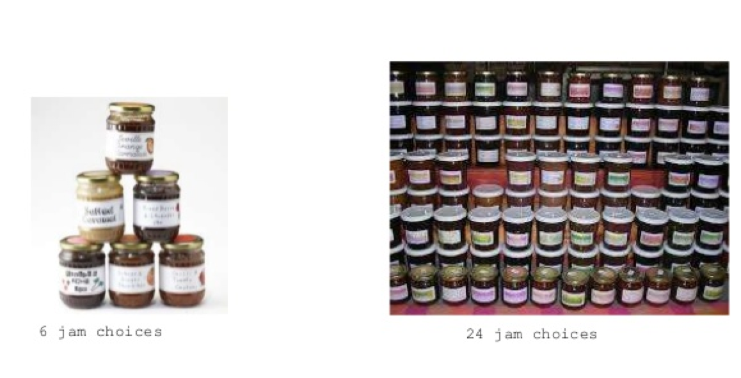
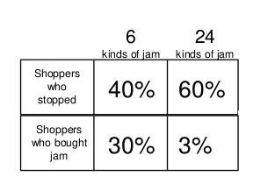
Choice paralysis

Slide 41
Paradox of Choice
Consumer satisfaction?

Slide 42
Nudging, marketing research problems, manipulating by businesses

Slide 43
For the seminar next week
Read one paper, write 1-2 pages about it.
Think of few examples of your own irrationality, or somebody else’s.

