Slide 1
Decision Making under
Uncertainty and Risk
Miloš Fišar

Slide 2
Structure of the lecture
Decision-making and Theory
  Decision Theory vs. Game Theory
  Decision Theory
  Rational Choice Theory
  Behavioral Decision Theory (BDT)
Risk or Uncertainty
  Decision Making Under Uncertainty
  Expected Utility Theorem
  Lottery
  Decision Making Under Risk
  Risk Aversion
Application in Experimental Economics

Slide 3
Decision-making and Theory
What for do or why we need a theory of decision-making?
Economics, psychology, sociology and other science fields are looking forward to identify issues relevant to any decision made by a human being.
All theories aim to explain parameters of an optimal choice.
We may sum up many theories under a term Theory of Choice (or Decision Theory)

Slide 4
Decision Theory vs. Game Theory
There is other theory, that deals with decision making – Game Theory.
Game Theory is concerned with interaction between agents (individuals) and how decisions influences the other agent.
Decision Theory focuses on the choices of individual agents only.
Want to know more about Game Theory?
BINMORE, K. Game theory: a very short introduction. Oxford: Oxford University Press, c2007. ISBN 978-0-19-921846-2.

Slide 5
Decision Theory
Normative
  To identify the best decision to make for an ideal fully rational decision maker.
Positive
  To describe observed behaviors with assumption that the agents behave according to some rule.
Traditional Decision Theory does not take into account other influences on the decision but only theoretical predictions and assumptions ➔ Behavioral Decision Theory

Slide 6
Rational Choice Theory (RCT)
Based on methodological individualism
  Neo-classical economics accepts individual preferences as given.
The rational agent bases his/her action on all available information, probabilities and cost/benefits
In microeconomics models (as well as in experimental models) we assume that individuals are rational agents.
Want to know more about Rational Choice Theory in 60 seconds?
The Open University YouTube Channel: Rational Choice Theory - 60 Second Adventures in Economics. https://youtu.be/JaKMimJPxyA

Slide 7
Behavioral Decision Theory (BDT)
Humans tend no to make only rational decisions and therefore RCT might fail to explain real-world behavior.
BDT extends the traditional RCT by
  beliefs,
  values,
  framing,
  under or overweighting of probabilities/costs/benefits
  and other aspects that influence the decision making

Slide 8
Risk or Uncertainty
What is a difference between Risk and Uncertainty?
prof. Frank H. Knight:
  Uncertainty = randomness with unknowable probability
  Risk = randomness with knowable probability

Slide 9
Decision Making Under Uncertainty
is a disciplined, methodical approach to decision-making, with probabilistic analysis and logical reasoning.
Key stone of the decision theory and modern economics.
Closely connected to Expected Utility Theorem.

Slide 10
Expected Utility Theorem
by professors John Von Neumann and Oskar Morgenstern
It is a theory of how people should make decisions.
The individual decision is an act when average utilities of each possible outcome are weighted according to its probability.

Slide 11
EUT - Example
I want to go for a walk. there is always a question: to take the umbrella or leave it at home? What are the outcomes?

Slide 12
EUT - Example
I want to go for a walk. there is always a question: to take the umbrella or leave it at home? What are the outcomes? |  | states
 |  | it rains | it does not rain
Acts | take umbrella
 | leave umbrella

Slide 13
EUT - Example
What is my Expected Utility (EU)? When it’s more likely to rain (P=0.6). |  | states
 |  | it rains | it does not rain
Acts | take umbrella | carry it, dry | carry it, dry
 | leave umbrella | free, wet | free, dry

Slide 14
EUT - Example
What is my Expected Utility (EU)? When it’s more likely to rain (P=0.6) |  | states
 |  | it rains (P=0.6) | it does not rain (P=0.4)
Acts | take umbrella | carry it, dry U=5 | carry it, dry U=5
 | leave umbrella | free, wet U=0 | free, dry U=10
${EU}_{take}= P_{rain}∗U_{take, rain}+P_{no rain}∗U_{take, no rain}=0.6∗5+0.4∗5=5$
${EU}_{leave}= P_{rain}∗U_{leave, rain}+P_{no rain}∗U_{leave, no rain}=0.6∗0+0.4∗10=4$

Slide 15
EUT – Newcom‘s Paradox
Two boxes, A and B, stand before you. You know that A contains $1,000 for sure, while B contains either $1,000,000 or nothing, though you don’t know which.
You have a choice between taking both boxes or just box B, where you may keep whatever you find in the box or boxes that you take.
Content of box B depends on what a certain man predicted (beforehand) you would do. If he predicted that you would take just box B, he has left the million dollars in it, but if he predicted that you would take both boxes (or do anything else), he has left box B empty. He is very good in predictions and is almost never wrong.
What should you do?

Slide 16
EUT – Newcom‘s Paradox
 |  | states
 |  | $1,000,000 (predicted B) | nothing (predicted A+B)
Acts | box B | $1,000,000 | $0
 | A+B | $1,001,000 | $1,000

Slide 17
Lottery
In the EUT it is a discrete distribution of probability over a known, finite set of outcomes.
In theory individuals rank lotteries according to their rational preferences and follow the preference axioms.
Microeconomics – the Preference Axioms
Completeness: people have preferences over all lotteries, and can rank them all
Transitivity: if g is preferred (or indifferent) to g', and g' is preferred (or indifferent) to g", then g is preferred (or indifferent) to g"
Continuity: any gamble in G, there exists some probability such that the decision-maker is indifferent between the "best" and the "worst" outcome
Monotonicity: a gamble which assigns a higher probability to a preferred outcome will be preferred to one which assigns a lower probability to a preferred outcome
Substitution: If a decision-maker is indifferent between two possible outcomes, then they will be indifferent between two lotteries which offer them with equal probabilities, if the lotteries are identical in every other way, i.e., the outcomes can be substituted.

Slide 18
Risk
What is risk?
  an unwanted event which may or may not occur.
  the cause of an unwanted event which may or may not occur.
  the probability of an unwanted event which may or may not occur.
  the statistical expectation value of an unwanted event which may or may not occur.
  the fact that a decision is made under conditions of known probabilities (“decision under risk” as opposed to “decision under uncertainty”)

Slide 19
Decision Making Under Risk
Any entrepreneur, investor, policy maker or you make decisions under risk.
Modern economic theory provides several models of risk taking and measures risk.
Michael Rothschild and Joseph Stiglitz:
  if we move probability mass from the center to the tails of a probability distribution, while keeping its mean unchanged, then we increase the risk associated with the distribution. A measure based on this principle (mean preserving spread) can be constructed that has more attractive mathematical properties than those of the older standard deviation measure.
  In other words: a person is risk-averse if he/she prefers a certain outcome to a risky outcome with the same expected utility

Slide 20
Risk Aversion
We can measure the degree of risk preferences.
A person's degree of risk aversion can be measured as her willingness to pay (or to accept a lower expected utility) in order to avoid a risk.
  By theory (Arrow-Pratt measure):
    Provided that an agent's utility function u(x) is twice continuously differentiable, her risk aversion at any point x can be measured as −u′′(x)/u′(x). Hence, a person with the utility function u₁ is more risk averse at a point x than one with utility function u₂ if and only if −u′′₁(x)/u′₁(x) > −u′′₂(x)/u′₂(x)
We can define 3 types of individuals by their risk attitudes:
  risk-loving
  risk-neutral
  risk-averse

Slide 21
Risk Aversion - example
A coin toss gamble.
$10 heads, and $20 tails
Expected Value of the gamble is:
$EV= P_{heads}∗U_{head}+P_{tail}∗U_{tail}=0.5∗\$10+0.5∗\$20=\$15$
The Example and all calculation from:
http://www.econport.org/econport/request?page=man_ru_basics4

Slide 22
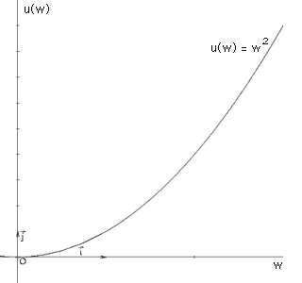

Risk-loving
If a person's utility of the expected value of a gamble is less than their expected utility from the gamble itself, they are said to be risk-loving
Truly risk-loving person should be willing to stake all their assets on a role of dice.
Convex Bernoulli utility function captures risk/loving behavior.
$EU= P_{heads}∗{(U}_{head})^{2}+P_{tail}∗{(U}_{tail})^{2} =0.5∗\${10}^{2}+0.5∗\${20}^{2}=\$250$
$$u\left(EV\right)={EV}^{2}={\$15}^{2}=\$225$$

Slide 23
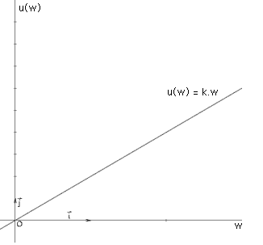

Risk-neutral
If a person's utility of the expected value of a gamble is exactly equal to their expected utility from the gamble itself, they are said to be risk-neutral.
Most financial institutions behave in a risk-neutral manner while investing.
Linear Bernoulli utility function captures risk-neutral behavior.
$EU= P_{heads}∗{k∗U}_{head}+P_{tail}∗{k∗U}_{tail} =0.5∗2∗\$10+0.5∗2∗\$20=\$30$
$$u\left(EV\right)=2∗EV=\$15∗2=\$30$$

Slide 24
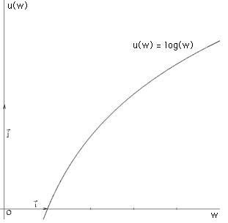

Risk-averse
If a person's utility of the expected value of a gamble is greater than their expected utility from the gamble itself, they are said to be risk-averse.
Truly risk-loving person should be willing to stake all their assets on a role of dice.
Concave Bernoulli utility function captures risk-averse behavior.
$EU= P_{heads}∗{log⁡(U}_{head})+P_{tail}∗{log⁡(U}_{tail}) =0.5∗log⁡(\$10)+0.5∗log⁡(\$20)=\$1.15$
$$u\left(EV\right)=log⁡(EV)=log⁡(\$15)=\$1.176$$

Slide 25
Application in Experimental Economics
The experiments focus on decision making an therefore the knowledge of decision making theory is necessary.
To design the experiment you need to model the situation beforehand and by the experiment to verify or disconfirm.
Many existing theoretical models assume that the rational agent is a risk neutral → Risk Elicitation in the experiment.

Slide 26
Assignment for seminar
Take a look on a paper
  Holt, Charles A., and Susan K. Laury. "Risk aversion and incentive effects." American Economic Review 92.5 (2002) (http://www.nber.org/~rosenbla/econ311-04/syllabus/holtlaury.pdf)
And collect data…

Slide 27
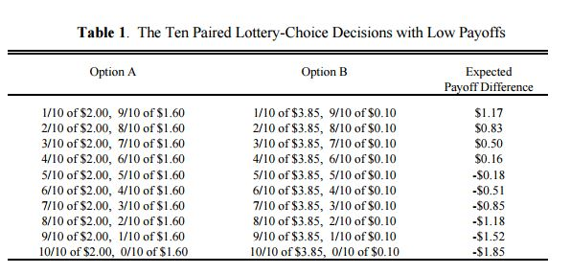
Assignment for seminar

Slide 28
Decision making table for assignment
 | 1 | 2 | 3 | 4 | 5 | 6 | 7 | 8 | 9 | 10
10% of 40 Kč, 90% of 32 Kč |  |  |  |  |  |  |  |  |  |  | 10% of 77 Kč, 90% of 2 Kč
20% of 40 Kč, 80% of 32 Kč |  |  |  |  |  |  |  |  |  |  | 20% of 77 Kč, 80% of 2 Kč
30% of 40 Kč, 70% of 32 Kč |  |  |  |  |  |  |  |  |  |  | 30% of 77 Kč, 70% of 2 Kč
40% of 40 Kč, 60% of 32 Kč |  |  |  |  |  |  |  |  |  |  | 40% of 77 Kč, 60% of 2 Kč
50% of 40 Kč, 50% of 32 Kč |  |  |  |  |  |  |  |  |  |  | 50% of 77 Kč, 50% of 2 Kč
60% of 40 Kč, 40% of 32 Kč |  |  |  |  |  |  |  |  |  |  | 60% of 77 Kč, 40% of 2 Kč
70% of 40 Kč, 30% of 32 Kč |  |  |  |  |  |  |  |  |  |  | 70% of 77 Kč, 30% of 2 Kč
80% of 40 Kč, 20% of 32 Kč |  |  |  |  |  |  |  |  |  |  | 80% of 77 Kč, 20% of 2 Kč
90% of 40 Kč, 10% of 32 Kč |  |  |  |  |  |  |  |  |  |  | 90% of 77 Kč, 10% of 2 Kč
100% of 40 Kč, 0% of 32 Kč |  |  |  |  |  |  |  |  |  |  | 100% of 77 Kč, 0% of 2 Kč

Slide 29
Assignment for seminar - requirements
At least 5 subjects
Classify their risk preferences
Add demographic information about the subjects (gender is mandatory, other are up to you)
Submit it as a Word and Excel with data

Slide 30
Literature
Johnatan Levin: Choice under Uncertainity (http://web.stanford.edu/~jdlevin/Econ%20202/Uncertainty.pdf)
VON NEUMANN, John; MORGENSTERN, Oskar. Theory of games and economic behavior. Princeton university press, 2007.
Newcomb’s Paradox: http://barang.sg/index.php?view=newcomb

