Slide 1
ALTRUISM and RECIPROCITY
Miloš Fišar

Slide 2
What is ALTRUISM?
Merriam-Webster dictionary
unselfish regard for or devotion to the welfare of others
behavior by an animal that is not beneficial to or may be harmful to itself but that benefits others of its species
Cambridge English Dictionary:
willingness to do things that ​bring ​advantages to ​others, ​even if it ​results in ​disadvantage for yourself
origin
from French altruisme,
from Italian altrui 'somebody else',
from Latin alteri huic 'to this other'.
In 19th century philosopher Auguste Comte begin to use altruism as antonym to egoism

Slide 3
How to measure altruism?
Can you measure altruism when you see it?
Self-Report Altruism Scale
ex-post or ex-ante measurement for altruism
20 (14 in adopted version) questions
answers 1=Never/Once/More than once/Often/5=Very often
measures
what subjects really did
what would they do
Rushton, J. Philippe, Roland D. Chrisjohn, and G. Cynthia Fekken. "The altruistic personality and the self-report altruism scale." Personality and individual differences 2.4 (1981): 293-302.

Slide 4
Altruism in experiments
Prisoner‘s Dilemma
Public Goods
Dictator Game
Trust Game

Slide 5
Prisoners’ Dilemma I
One of the standard game theory problems
Two gangsters (Pablo and Frank) have committed a crime and have been caught.
They are being held in separate cells so that they cannot communicate with each other.
They are both offered a deal by the police and have to decide what to do independently.

Slide 6
Prisoners’ Dilemma II
If one gangster confesses and the other denies taking part in the crime, first goes free and second gangster goes to prison for ten years.
If you both gangsters confess they will serve six years each.
If you both gangsters deny taking part in the crime, both both go to prison for six months.

Slide 7
Prisoners’ Dilemma III
 |  | PABLO
 |  | CONFESS | DENY
FRANK | CONFESS
 | DENY

Slide 8
Prisoners’ Dilemma III
 |  | PABLO
 |  | CONFESS | DENY
FRANK | CONFESS | 6 ; 6 | 0 ; 10
 | DENY | 10 ; 0 | 0.5 ; 0.5

Slide 9
Prisoners’ Dilemma III
 |  | PABLO
 |  | CONFESS | DENY
FRANK | CONFESS | 6 ; 6 | 0 ; 10
 | DENY | 10 ; 0 | 0.5 ; 0.5

Slide 10
Prisoners’ Dilemma III
Cooperation
is the key to success in the game (Kelly and Stahelski, 1970; Roth and Murningam, 1978; and other)
But it might be triggered by altruism but probably reputation is more important (Kreps, et al., 1982)
Andreoni and Miller (1993) found that 20% of subjects have to be altruistic to support equilibria findings

Slide 11
Public Goods Game
You learned about PGG two weeks ago
To sum up, a game where players either contribute to private and public account.
Dominant strategy is giving zero.
Results show, that average giving is significantly above zero (Isaac and Walker, 1988; Isaac, Walker and Williams, 1994; Andreoni, 1988; Andreoni and Carson, 2008; Palfrey and Prisbrey, 1996)

Slide 12
Public Goods Game II
Any error or variance in data could be viewed as altruism (Ladyard, 1995)
Experiments shown that:
Warm-glow dominates altruism (Palfrey and Prisbey, 1997)
Altruism dominates warm-glow (Goerree, Holt and Laury, 2002)
Both warm-glow and altruism are evident in PGG (Bolton and Katok, 1998; Eckel, Grossman and Johnston, 2005)

Slide 13
Ultimatum and Dictator Game (from 2nd week)
Ultimatum Game
Dictator Game
Two players (proposer and responder) bargain over a division of a given sum of money.
proposer: makes an offer how to split the sum
responder: accepts or rejects
if accepted they split the money
if rejected neither gets anything
unique subgame perfect equilibrium the proposer suggests the responder the smallest amount possible and the responder accepts
Two players (dictator and recipient) bargain over a division of a given sum of money.
dictator: splits the sum
recipient: is informed of endowment left by the dictator
unique subgame perfect equilibrium: the dictator takes it all

Slide 14
Dictator Game
Proposers choose a fair deal (Guth, Schmittberger and Schwarze, 1982) but is it altruism?
Answered by Forsythe, et al. (1994) by removing 2nd stage of the game: in average 25% of the endowment was shared
Andreoni and Miller (2002) investigated altruism by gender
men are more likely to maximize total payments to both subjects
women are more likely to equalize payments to both
⇨ men are more altruistic when giving is cheap and women when it is expensive

Slide 15
Do you trust each other?
Let‘s play a game!

Slide 16
Trust Game
2 players
Both receive same endowment (e.g. 100 Kč)
Player 1 (Bob) is told that he may send some amount of his money (x) to a second player (Tom)
Bob is also informed that whatever he sends will be tripled by the experimenter.
Tom is then told to make a similar choice – give some amount of the now-tripled money back (y) to Bob

Slide 17
Trust Game II
Bob
Doesn’t trust
Bob: 100 Kč
Tom: 100 Kč
Trusts
Tom
Defects
Bob: 100 Kč – x
Tom: 100 Kč + 3y
Cooperates
Bob: 100 Kč – x + y
Tom: 100 Kč + (3x – y)

Slide 18
Trust Game II
Bob
Doesn’t trust
Bob: 100 Kč
Tom: 100 Kč
Trusts
Tom
Defects
Bob: (0 – 100 Kč)
Tom: (100 – 400 Kč)
Cooperates
Bob: (0 – 300 Kč)
Tom: (100 – 400 Kč)

Slide 19
Trust Game III
x = 0 is subgame perfect equilibria for sender (Bob)
y = 0 is a dominant strategy for receiver (Tom)
y is often slightly below average x (Berg, Dickhaut, McCabe, 1995)
60% of senders and 42 receivers is motivated by altruism (Cox, 2004)
reciprocity is clearly present in Trust Game (Charness and Haruvy, 2002; Gneezy, Guth and Verboven, 2000)

Slide 20
Where does the altruism come from?
Culture (Roth et al., 1991; Henrich et al., 2001)
Psychological development and socialization (Harbaugh and Krause, 2000)
Our brain (Tankersley, Stowe and Huettel, 2007)

Slide 22
What is RECIPROCITY?
Merriam-Webster dictionary
a situation or relationship in which two people or groups agree to do something similar for each other, to allow each other to have the same rights, etc. : a reciprocal arrangement or relationship
Cambridge English Dictionary:
behavior in which two ​people or ​groups of ​people give each other ​help and ​advantages
origin
from Latin reciproc(us) mening returning.

Slide 23
Reciprocity
It is also a social rule that says that we should repay
It differs from altruism in a manner that a response is expected
You may find reciprocity in Hammurabi’s code (about 1750 BC) → eye for eye
Strong method to make someone follow a rule → e.g. law, wage are reciprocal

Slide 24
Positive vs Negative Reciprocity
Positive
a motivation to adopt a generous action that benefits someone else, at one’s own material cost, because that person’s intentional behavior was perceived to be beneficial to oneself.
Negative
a motivation to adopt an action that harms someone else, at one’s own material cost, because that person’s intentional behavior was perceived to be harmful to oneself

Slide 25
Reciprocity in Experiments
PGG
Dictator Game
Trust Game
Other

Slide 26
Reciprocity in experiments
It is confirmed that direct positive reciprocity is frequent in experiments (Diekmann, 2004)
40-66% of subjects display non-selfish behavior (Fehr and Gaachter, 2000)
Negative reciprocity is measured by means of a moonlighting game (Abbink et al., 2000) where one player can take money from other, who can punish in return

Slide 27
Moonlighting Game
2 players
Both endowed with 12 tokens
At the 1st stage player A can take money (up to 6) from or pass money to player B
At the 2nd stage player B can pass money (up to 18) to A or punish (take up to 6) player A.

Slide 28
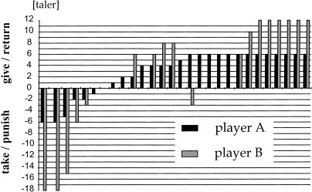
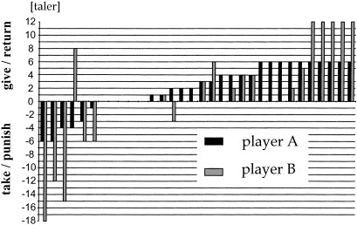
Moonlighting Game

Slide 29
Moonlighting Game
Results:
retribution (punishment for breaking the contract) is more compelling than reciprocity because the hostile actions are punished more often than friendly actions rewarded (Abbink et al., 2000)
first players are not afraid of negative reciprocity (Cox et al., 2002)

Slide 30
Bribery Game
Essential characteristic of corruption is reciprocity
Both negative and positive
2 (Abbink et al., 2002) or 3 player game (Alatas et al., 2009)
1st player “FIRM” may offer a bribe
2nd player “OFFICIAL” either rejects or accepts it
3rd player “CITIZEN” may punish

Slide 31
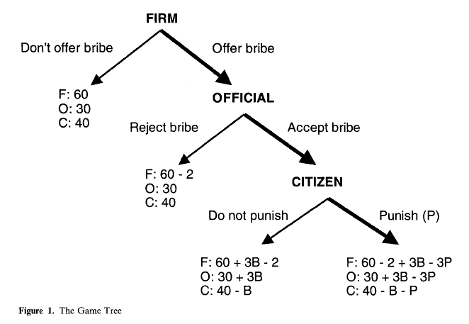
Bribery Game

Slide 32
Bribery
Women are less likely to offer bribes and more likely to punish corruption but it varies across countries. Variation might be explained by different roles of women (Alatas et al., 2009)
Reciprocity and trust may lead to stable exchange of benefits (corruption) even when own payoffs are not maximized (Abbink et al., 2002)

Slide 33
Thank you for your attention

