Slide 1
Free Ride
What is Free ride?
Who are Free riders?

Slide 2
Agenda
Introduction
Explaining who is free rider and examples
Video
Experience
Rules
Hypotheses
Results
Observation
Questions

Slide 3
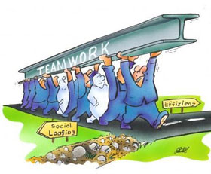
Free rider
A person who chooses to receive the benefits of a "public good" or a "positive externality" without contributing to paying the costs of producing those benefits.

Slide 5
The term free rider was first used in economic theory of public goods, but similar concepts have been applied in to other contexts, including collective bargaining, antitrust law, psychology, and political science
The concepts that individuals could receive the benefits from group activity without bearing their proportional share of the costs was a central theme and is commonly referred as free riding or the free rider problem

Slide 6
What is the Problem???
In economics, the free rider problem occurs when those who benefit from resources, goods, or services do not pay for them, which results in an under-provision of those goods or services.
QUESTION ???
how to limit free riding and its negative effects in these situations???

Slide 7
The free rider problem may occur when property rights are not clearly defined and imposed.
Public goods are characterized by the inability to exclude nonpayers.
The free rider problem is common among public goods.

Slide 8
These are goods that have two characteristics:
non-excludability —
non-paying
non-rivalry
consumers cannot be prevented from using it
when you consume the good, it does not reduce the amount available to others.
THE POTENTIAL FOR FREE RIDING EXISTS WHEN PEOPLE ARE ASKED TO VOLUNTARILY PAY FOR A PUBLIC GOOD

Slide 9
Common example
a free rider problem is defense spending. No one person can be excluded from being defended by a state's military forces, and thus free riders may refuse or avoid paying for being defended, even though they are still as well guarded as those who contribute to the state's efforts.

Slide 10
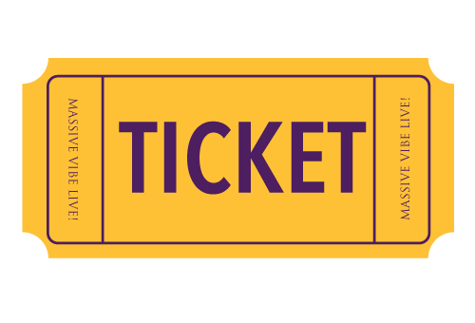
Other example
A person using public transport without a valid ticket is benefited which carries this service, at the same time not bear the cost for its maintenance…
A person uses that other users pay, so it can also use… but without the cost of their own…
it is difficult to exclude a person from consumption - anyone can take the public transport

Slide 11
Video
http://www.investopedia.com/video/play/free-rider-problem/

Slide 12
Let’s play a game… Rules
In Andreoni’s experience :
5 players with 50 tokens each who contribute to common or private account.
- Private account : 1 for 1
- Common account : for 1, all receive 0.5
The group's total payoff is maximized when everyone contributes all of their tokens to the public pool (1 vs 2.5)
Those who do not contribute are called free riders.

Slide 13
Let’s play a game… HypothesEs
No significant evidence on free riding in single-shot games
In repeated games, decay of provision of the public good toward free riding level with each repetition
Often approximation of free riding after subjects trials, although exact free riding is seldom realized

Slide 14
Let’s play a game… HypothesEs
Partner / Stranger
Restart
How do they should react ?

Slide 15
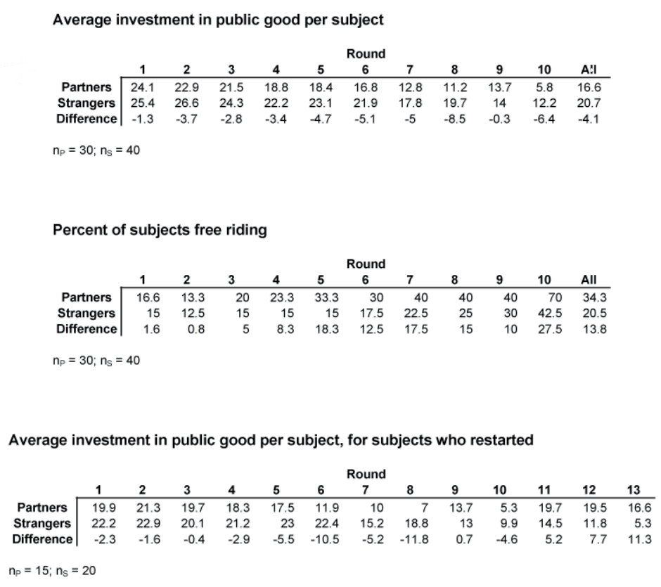
Let’s play a game… Results

Slide 16
Let’s play a game… Observations
Observation 1 : Contributions by Partners are significantly smaller than contributions by Strangers in all 10 rounds and the difference grows as the last round approaches.
Observation 2 : In all 10 rounds the percent of free riding Partners is greater than the percent of free riding Strangers. The difference is greatest in the last round and is statistically significant.
Observation 3 : The contributions by Partners are smaller in round 10, but are still above the free riding level.

Slide 17
Let’s play a game… Observations
Observation 4 : The contributions by Strangers are greater that contributions by Partners in the last round.
Observation 5 : Strangers appear to be only temporarily affected by the restart.
Observation 6 : Partners return to high contributions after the restart. The restart also seems to have a lasting effect on this group. On the other hand, the Strangers were not affected as strongly and treated the restart as a continuation of the repeated single-shot game.

Slide 18
Let’s play a game… interpretation /explanation
Based on observations 1-6 :
both rational strategic play and learning hypotheses are contradicted in this study. Andreoni suggests that perhaps the hypotheses do not focus on the right kind of learning. It is possible that subjects have learned the single-shot dominant strategy, but have not learned the backward induction necessary to understand the equilibrium.
Also an understanding of the single-shot equilibria does not necessarily reveal an understanding of the repeated-game structure. The results also suggest that one might want to consider an alternative to monetary payoff maximizing model, for example subjects getting non-monetary pleasure from cooperative outcomes or investing being consistent with social norms about participation in social dilemmas. Decay in this case might represent the groups' struggles to establish a norm

Slide 19
Question 1
What is the definition of free-rider ?
1- A person who takes place in the game without changing groups and who can play strategically or not.
2- A person who chooses to receive the benefits of a "public good" or a "positive externality" without contributing to paying the costs of producing those benefits.
3- A person who is randomly reassigned by the computer after each repetition.
4- A person who likes off-piste skiing.

Slide 20
Question 1
What is the definition of free-rider ?
1- A person who takes place in the game without changing groups and who can play strategically or not. Partner
2- A person who chooses to receive the benefits of a "public good" or a "positive externality" without contributing to paying the costs of producing those benefits.
Free-rider
3- A person who is randomly reassigned by the computer after each repetition. Stranger
4- A person who likes off-piste skiing. Also true but irrelevant here

Slide 21
Question 2
What is the Nash Equilibrium ?
1- It is an economic state where resources are allocated in the most efficient manner. Pareto efficiency is obtained when a distribution strategy exists where one party's situation cannot be improved without making another party's situation worse.
2- is a concept of game theory where the optimal outcome of a game is one where no player has an incentive to deviate from his or her chosen strategy after considering an opponent's choice.
3- is a situation in game theory in which one person’s gain is equivalent to another’s loss, so the net change in wealth or benefit is zero.
4- It is the fact when Nash is able to stand without falling.

Slide 22
Question 2
What is the Nash Equilibrium ?
1- It is an economic state where resources are allocated in the most efficient manner. Pareto efficiency is obtained when a distribution strategy exists where one party's situation cannot be improved without making another party's situation worse. Pareto efficiency
2- It is a concept of game theory where the optimal outcome of a game is one where no player has an incentive to deviate from his or her chosen strategy after considering an opponent's choice. Nash Equilibrium
3- It is a situation in game theory in which one person’s gain is equivalent to another’s loss, so the net change in wealth or benefit is zero. Zero-Sum Game
4- It is the fact when Nash is able to stand without falling. Nothing worth to mention it

Slide 23
Thanks for your attention

