Slide 1
Chapter 18 (7)
Fixed Exchange Rates and
Foreign Exchange Intervention

Slide 2
Preview
Balance sheets of central banks
Intervention in the foreign exchange markets and the money supply
How the central bank fixes the exchange rate
Monetary and fiscal policies under fixed exchange rates
Financial market crises and capital flight
Types of fixed exchange rates: reserve currency and gold standard systems

Slide 3
Introduction
Many countries try to fix or “peg” their exchange rate to a currency or group of currencies by intervening in the foreign exchange markets.
Many with a flexible or “floating” exchange rate in fact practice a managed floating exchange rate.
  The central bank “manages” the exchange rate from time to time by buying and selling currency and assets, especially in periods of exchange rate volatility.
How do central banks intervene in the foreign exchange markets?

Slide 4
Central Bank Intervention and the Money Supply
To study the effects of central bank intervention in the foreign exchange markets, first construct a simplified balance sheet for the central bank.
  This records the assets and liabilities of a central bank.
  Balance sheets use double-entry bookkeeping: each transaction enters the balance sheet twice.

Slide 5
Central Bank’s Balance Sheet
Assets
  Foreign government bonds (official international reserves)
  Gold (official international reserves)
  Domestic government bonds
  Loans to domestic banks (called discount loans in US)
Liabilities
  Deposits of domestic banks
  Currency in circulation (previously central banks had to give up gold when citizens brought currency to exchange)

Slide 6
Central Bank’s Balance Sheet (cont.)
Assets = Liabilities + Net Worth
  If we assume that net worth is constant, then
    An increase in assets leads to an equal increase in liabilities.
    A decrease in assets leads to an equal decrease in liabilities.
Changes in the central bank’s balance sheet lead to changes in currency in circulation or changes in deposits of banks, which lead to changes in the money supply.
  If their deposits at the central bank increase, banks are typically able to use these additional funds to lend to customers, so that the amount of money in circulation increases.

Slide 7
Assets, Liabilities, and the Money Supply
A purchase of any asset by the central bank will be paid for with currency or a check written from the central bank,
  both of which are denominated in domestic currency, and
  both of which increase the supply of money in circulation.
  The transaction leads to equal increases of assets and liabilities.
When the central bank buys domestic bonds or foreign bonds, the domestic money supply increases.

Slide 8
Assets, Liabilities, and the Money Supply (cont.)
A sale of any asset by the central bank will be paid for with currency or a check written to the central bank,
  both of which are denominated in domestic currency.
  The central bank puts the currency into its vault or reduces the amount of deposits of banks,
  causing the supply of money in circulation to shrink.
  The transaction leads to equal decreases of assets
  and liabilities.
When the central bank sells domestic bonds or foreign bonds, the domestic money supply decreases.

Slide 9
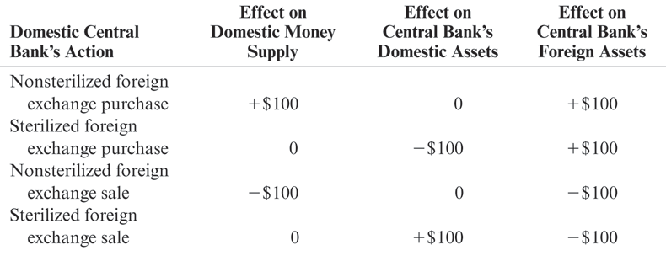
Table 18-1: Effects of a $100 Foreign Exchange Intervention: Summary

Slide 10
Foreign Exchange Markets
Central banks trade foreign government bonds in the foreign exchange markets.
  Foreign currency deposits and foreign government bonds are often substitutes: both are fairly liquid assets denominated in foreign currency.
  Quantities of both foreign currency deposits and foreign government bonds that are bought and sold influence the exchange rate.

Slide 11
Sterilization
Because buying and selling of foreign bonds in the foreign exchange markets affects the domestic money supply, a central bank may want to offset this effect.
This offsetting effect is called sterilization.
If the central bank sells foreign bonds
in the foreign exchange markets, it can buy domestic government bonds in bond markets—hoping to leave the amount of money in circulation unchanged.

Slide 12
Fixed Exchange Rates
To fix the exchange rate, a central bank influences the quantities supplied and demanded of currency by trading domestic and foreign assets, so that the exchange rate (the price of foreign currency in terms of domestic currency) stays constant.
Foreign exchange markets are in equilibrium when
        R = R* + (E^{e} – E)/E
When the exchange rate is fixed at some level E⁰ and the market expects it to stay fixed at that level, then
        R = R*

Slide 13
Fixed Exchange Rates (cont.)
To fix the exchange rate, the central bank must trade foreign and domestic assets in the foreign exchange market until R = R*.
Alternatively, we can say that it adjusts the quantity of monetary assets in the money market until the domestic interest rate equals the foreign interest rate, given the level of average prices and real output:
M^{s}/P = L(R*, Y)

Slide 14
Fixed Exchange Rates (cont.)
Suppose that the central bank has fixed the exchange rate at E⁰ but the level of output rises, raising the demand of real monetary assets.
This is predicted to put upward pressure on interest rates and the value of the domestic currency.
How should the central bank respond if it wants to fix exchange rates?

Slide 15
Fixed Exchange Rates (cont.)
The central bank should buy foreign assets in the foreign exchange markets,
  thereby increasing the domestic money supply,
  thereby reducing interest rates in the short run.
  Alternatively, by demanding (buying) assets denominated in foreign currency and by supplying (selling) domestic currency, the price/value of foreign currency is increased and the price/value of domestic currency is decreased.

Slide 16
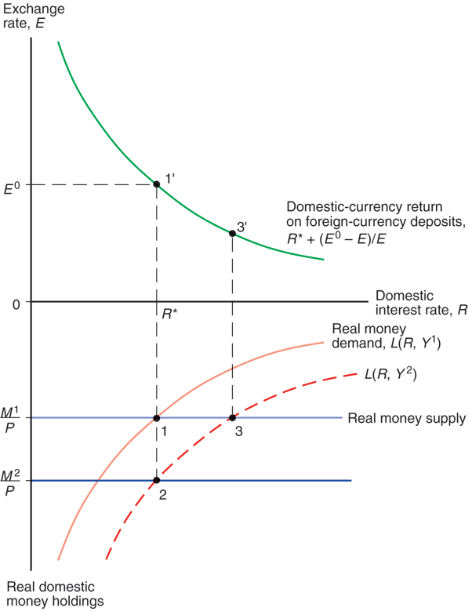
Fig. 18-1:
Asset Market Equilibrium with a Fixed Exchange Rate, E⁰

Slide 17
Monetary Policy and Fixed Exchange Rates
When the central bank buys and sells foreign assets to keep the exchange rate fixed and to maintain domestic interest rates equal to foreign interest rates, it is not able to adjust domestic interest rates to attain other goals.
  In particular, monetary policy is ineffective in influencing output and employment.

Slide 18
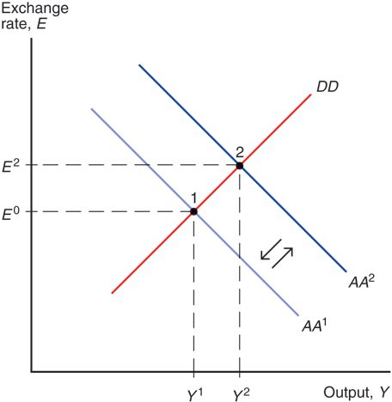
Fig. 18-2: Monetary Expansion Is Ineffective under a Fixed Exchange Rate

Slide 19
Fiscal Policy and Fixed Exchange Rates in the Short Run
Temporary changes in fiscal policy are more effective in influencing output and employment in the short run:
  The rise in aggregate demand and output due to expansionary fiscal policy raises demand for real monetary assets, putting upward pressure on interest rates and on the value of the domestic currency.
  To prevent an appreciation of the domestic currency, the central bank must buy foreign assets, thereby increasing the money supply and decreasing interest rates.

Slide 20
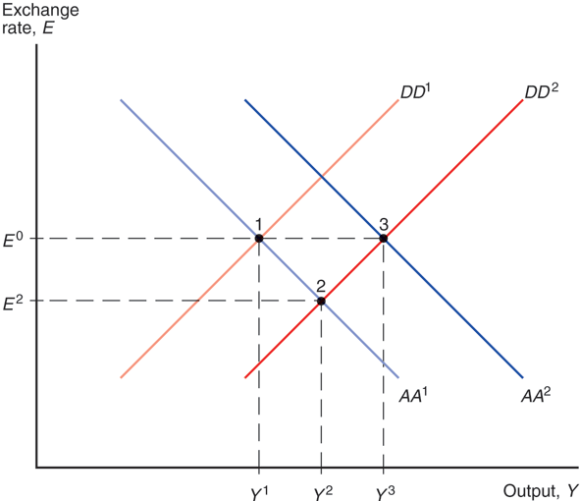
Fig. 18-3: Fiscal Expansion under a Fixed Exchange Rate

Slide 21
Fiscal Policy and Fixed Exchange Rates in the Long Run
When the exchange rate is fixed, there is no real appreciation of the value of domestic products in the short run.
But when output is above its potential level, wages and prices tend to rise in the long run.
A rising price level makes domestic products more expensive: a real appreciation (EP*/P falls).
  Aggregate demand and output decrease as prices rise:
  DD curve shifts left.
  Prices tend to rise until employment, aggregate demand, and output fall to their normal (potential or natural) levels.

Slide 22
Fiscal Policy and Fixed Exchange Rates in the Long Run (cont.)
Prices are predicted to change proportionally to the change in the money supply when the central bank intervenes in the foreign exchange markets.
  AA curve shifts down (left) as prices rise.
  Nominal exchange rates will be constant (as long as the fixed exchange rate is maintained), but the real exchange rate will be lower (a real appreciation).

Slide 23
Devaluation and Revaluation
Depreciation and appreciation refer to changes in the value of a currency due to market changes.
Devaluation and revaluation refer to changes in a fixed exchange rate caused by the central bank.
  With devaluation, a unit of domestic currency is made less valuable, so that more units must be exchanged for 1 unit of foreign currency.
  With revaluation, a unit of domestic currency is made more valuable, so that fewer units need to be exchanged for 1 unit of foreign currency.

Slide 24
Devaluation
For devaluation to occur, the central bank buys foreign assets, so that domestic monetary assets increase and domestic interest rates fall, causing a fall in the rate return on domestic currency deposits.
  Domestic products become less expensive relative to foreign products, so aggregate demand and output increase.
  Official international reserve assets (foreign bonds) increase.

Slide 25
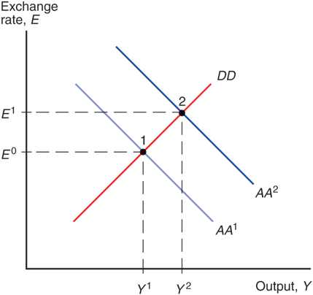
Fig. 18-4: Effect of a Currency Devaluation

Slide 26
Financial Crises and Capital Flight
When a central bank does not have enough official international reserve assets to maintain a fixed exchange rate, a balance of payments crisis results.
  To sustain a fixed exchange rate, the central bank must have enough foreign assets to sell in order to satisfy the demand of them at the fixed exchange rate.

Slide 27
Financial Crises and Capital Flight (cont.)
Investors may expect that the domestic currency will be devalued, causing them to want foreign assets instead of domestic assets, whose value is expected to fall soon.
This expectation or fear only makes the balance of payments crisis worse:
  Investors rush to change their domestic assets into foreign assets, depleting the stock of official international reserve assets more quickly.

Slide 28
Financial Crises and Capital Flight (cont.)
As a result, financial capital is quickly moved from domestic assets to foreign assets: capital flight.
  The domestic economy has a shortage of financial capital
  for investment and has low aggregate demand.
To avoid this outcome, domestic assets must offer high interest rates to entice investors to hold them.
  The central bank can push interest rates higher by reducing the money supply (by selling foreign and domestic assets).
As a result, the domestic economy may face high interest rates, a reduced money supply, low aggregate demand, low output, and low employment.

Slide 29
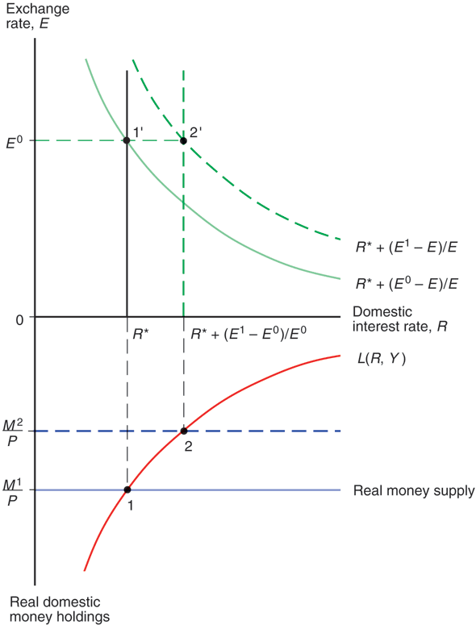
Fig. 18-5: Capital Flight, the Money Supply, and the Interest Rate

Slide 30
Financial Crises and Capital Flight (cont.)
Expectations of a balance of payments crisis only worsen the crisis and hasten devaluation.
  What causes expectations to change?
    Expectations about the central bank’s ability and willingness to maintain the fixed exchange rate.
    Expectations about the economy: shrinking demand of domestic products relative to foreign products means that the domestic currency should become less valuable.
In fact, expectations of devaluation can cause a devaluation: a self-fulfilling crisis.

Slide 31
Financial Crises and Capital Flight (cont.)
What happens if the central bank runs out of official international reserve assets (foreign assets)?
It must devalue the domestic currency so that it takes more domestic currency (assets) to exchange for 1 unit of foreign currency (asset).
  This will allow the central bank to replenish its foreign assets by buying them back at a devalued rate,
  increasing the money supply,
  reducing interest rates,
  reducing the value of domestic products,
  increasing aggregate demand, output, and employment over time.

Slide 32
Financial Crises and Capital Flight (cont.)
In a balance of payments crisis,
  the central bank may buy domestic bonds and sell domestic currency (to increase the money supply) to prevent high interest rates, but this only depreciates the domestic currency more.
  the central bank generally cannot satisfy the goals of low domestic interest rates (relative to foreign interest rates) and fixed exchange rates simultaneously.

Slide 33
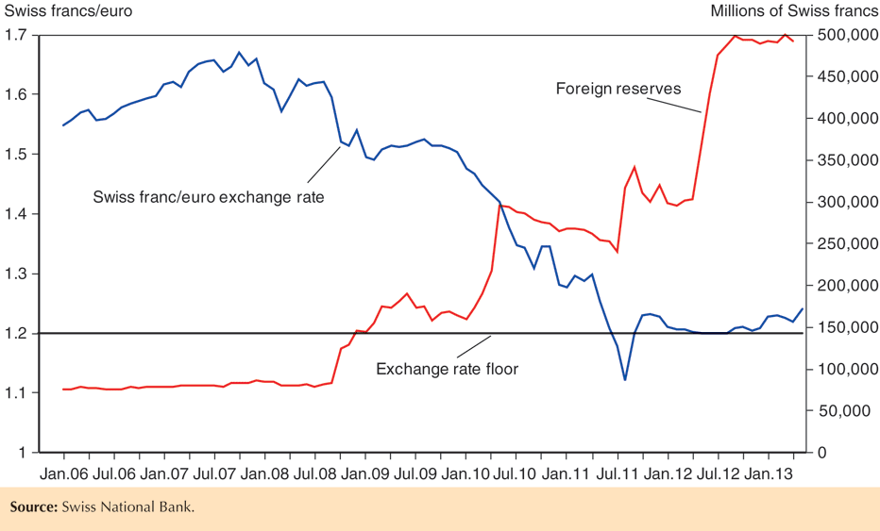
Fig. 18-6: The Swiss Franc’s Exchange Rate against the Euro and Swiss Foreign Exchange Reserves, 2006–2013

Slide 34
Interest Rate Differentials
For many countries, the expected rates of return are not the same: R > R*+(E^{e} –E)/E . Why?
Default risk:
The risk that the country’s borrowers will default on their loan repayments. Lenders therefore require a higher interest rate to compensate for this risk.
Exchange rate risk:
If there is a risk that a country’s currency will depreciate or be devalued, then domestic borrowers must pay a higher interest rate to compensate foreign lenders.

Slide 35
Interest Rate Differentials (cont.)
Because of these risks, domestic assets and foreign assets are not treated the same.
  Previously, we assumed that foreign and domestic currency deposits were perfect substitutes: deposits everywhere were treated as the same type of investment, because risk and liquidity of the assets were assumed to be the same.
  In general, foreign and domestic assets may differ in the amount of risk that they carry: they may be imperfect substitutes.
  Investors consider these risks, as well as rates of return on the assets, when deciding whether to invest.

Slide 36
Interest Rate Differentials (cont.)
A difference in the risk of domestic and foreign assets is one reason why expected rates of return are not equal across countries:
R = R*+(E^{e} –E)/E + ρ
where ρ is called a risk premium, an additional amount needed to compensate investors for investing in risky domestic assets.
The risk could be caused by default risk or exchange rate risk.

Slide 37
The Rescue Package: Reducing ρ
The U.S. & IMF set up a $50 billion fund to guarantee the value of loans made to Mexico’s government,
  reducing default risk,
  and reducing exchange rate risk, since foreign loans could act as official international reserves to stabilize the exchange rate if necessary.
After a recession in 1995, the economy began to recover.
  Mexican goods were relatively inexpensive, allowing production to increase.
  Increased demand of Mexican products relative to demand of foreign products stabilized the value of the peso and reduced exchange rate risk.

Slide 38
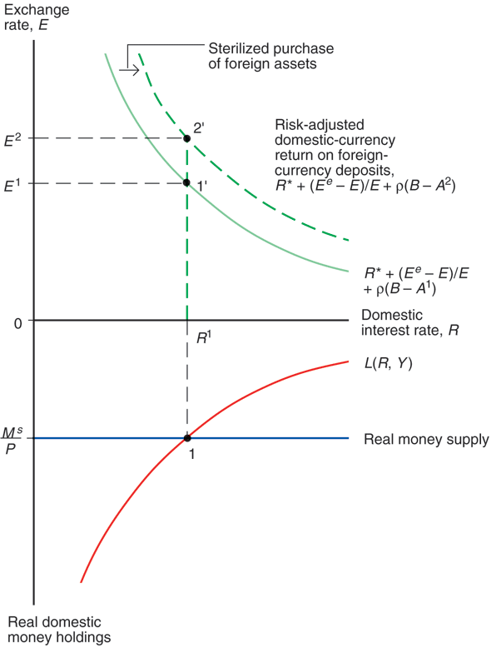
Fig. 18-7: Effect of a Sterilized Central Bank Purchase of Foreign Assets under Imperfect Asset Substitutability

Slide 39
Types of Fixed Exchange Rate Systems
Reserve currency system: one currency acts as official international reserves.
  The U.S. dollar was the currency that acted as official international reserves from under the fixed exchange rate system from 1944 to 1973.
  All countries except the U.S. held U.S. dollars as the means to make official international payments.
Gold standard: gold acts as official international reserves that all countries use to make official international payments.

Slide 40
Reserve Currency System
From 1944 to 1973, central banks throughout the world fixed the value of their currencies relative to the U.S. dollar by buying or selling domestic assets in exchange for dollar denominated assets.
Arbitrage ensured that exchange rates between any two currencies remained fixed.
  Suppose Bank of Japan fixed the exchange rate at 360¥/US$1 and the Bank of France fixed the exchange rate at 5Ffr/US$1.
  The yen/franc rate was (360¥/US$1)/(5Ffr/US$1) = 72¥/1Ffr.
  If not, then currency traders could make an easy profit by buying currency where it was cheap and selling it where it was expensive.

Slide 41
Reserve Currency System (cont.)
Because most countries maintained fixed exchange rates by trading dollar-denominated (foreign) assets, they had ineffective monetary policies.
The Federal Reserve, however, did not have to intervene in foreign exchange markets, so it could conduct monetary policy to influence aggregate demand, output, and employment.
  The U.S. was in a special position because it was able to use monetary policy as it wished.

Slide 42
Reserve Currency System (cont.)
In fact, the monetary policy of the U.S. influenced the economies of other countries.
Suppose that the U.S. increased its money supply.
  This would lower U.S. interest rates, putting downward pressure on the value of the U.S. dollar.
  If other central banks maintained their fixed exchange rates, they would have needed to buy dollar-denominated (foreign) assets, increasing their money supplies.
  In effect, the monetary policies of other countries had to follow that of the U.S., which was not always optimal for their levels of output and employment.

Slide 43
Gold Standard
Under the gold standard from 1870 to 1914 and after 1918 for some countries, each central bank fixed the value of its currency relative to a quantity of gold (in ounces or grams) by trading domestic assets in exchange for gold.
  For example, if the price of gold was fixed at $35 per ounce by the Federal Reserve while the price of gold was fixed at £14.58 per ounce by the Bank of England, then the $/£ exchange rate must have been fixed at $2.40 per pound.
  Why?

Slide 44
Gold Standard (cont.)
The gold standard did not give the monetary policy of the U.S. or any other country a privileged role.
If one country lost official international reserves (gold) so that its money supply decreased, then another country gained them so that its money supply increased.
The gold standard also acted as an automatic restraint on increasing money supplies too quickly, preventing inflationary monetary policies.

Slide 45
Gold Standard (cont.)
But restraints on monetary policy restrained central banks from increasing the money supply to increase aggregate demand, output, and employment.
And the price of gold relative to other goods and services varied, depending on the supply and demand of gold.
  A new supply of gold made gold abundant (cheap), and prices of other goods and services rose because the currency price of gold was fixed.
  Strong demand for gold jewelry made gold scarce (expensive), and prices of other goods and services fell because the currency price of gold was fixed.

Slide 46
Gold Standard (cont.)
A reinstated gold standard would require new discoveries of gold to increase the money supply as economies and populations grow.
A reinstated gold standard may give Russia, South Africa, the U.S., or other gold producers inordinate influence on international financial and macroeconomic conditions.

Slide 47
Gold Exchange Standard
The gold exchange standard: a system of official international reserves in both a group of currencies (with fixed prices of gold) and gold itself.
  Allows more flexibility in the growth of international reserves, depending on macroeconomic conditions, because the amount of currencies held as reserves could change.
  Does not constrain economies as much to the supply and demand of gold.
  The fixed exchange rate system from 1944 to 1973 used gold, and so operated more like a gold exchange standard than a currency reserve system.

Slide 48
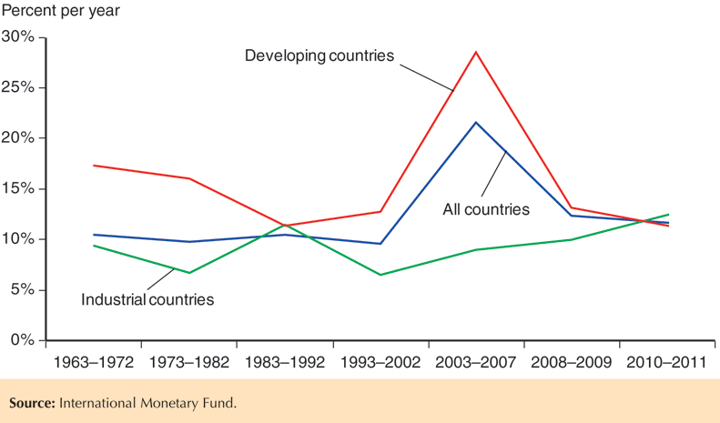
Fig. 18-8: Growth Rates of International Reserves

Slide 49
Gold and Silver Standard
Bimetallic standard: the value of currency is based on both silver and gold.
The U.S. used a bimetallic standard from 1837 to 1861.
Banks coined specified amounts of gold or silver into the national currency unit.
  371.25 grains of silver or 23.22 grains of gold could be turned into a silver or a gold dollar.
  So gold was worth 371.25/23.22 = 16 times as much
  as silver.
  See http://www.micheloud.com/FXM/MH/index.htm for a fun description of the bimetallic standard, the gold standard after 1873, and the Wizard of Oz!

Slide 50
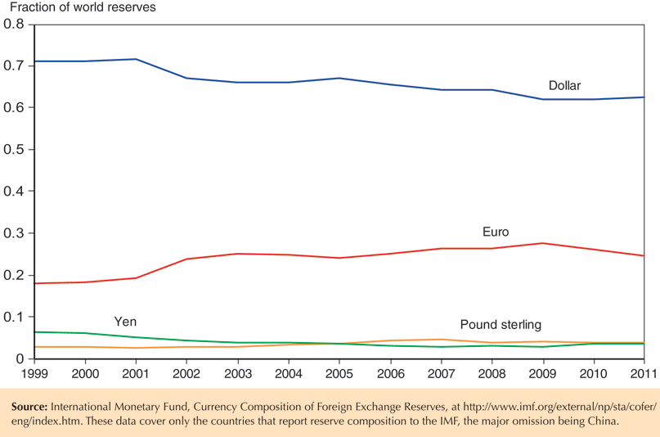
Fig. 18-9: Currency Composition of Global Reserve Holdings

Slide 51
Summary
Changes in a central bank’s balance sheet lead to changes in the domestic money supply.
  Buying domestic or foreign assets increases the domestic money supply.
  Selling domestic or foreign assets decreases the domestic money supply.
When markets expect exchange rates to be fixed, domestic and foreign assets have equal expected returns if they are treated as perfect substitutes.

Slide 52
Summary (cont.)
Monetary policy is ineffective in influencing output or employment under fixed exchange rates.
Temporary fiscal policy is more effective in influencing output and employment under fixed exchange rates, compared to under flexible exchange rates.

Slide 53
Summary (cont.)
A balance of payments crisis occurs when a central bank does not have enough official international reserves to maintain a fixed exchange rate.
Capital flight can occur if investors expect a devaluation, which may occur if they expect that a central bank can no longer maintain a fixed exchange rate: self-fulfilling crises can occur.
Domestic and foreign assets may not be perfect substitutes due to differences in default risk or due to exchange rate risk.

Slide 54
Summary (cont.)
Under a reserve currency system, all central banks but the one that controls the supply of the reserve currency trade the reserve currency to maintain fixed exchange rates.
Under a gold standard, all central banks trade gold to maintain fixed exchange rates.

Slide 55
Chapter 18 (7)
Appendix 1: Equilibrium in the Foreign Exchange Market with Imperfect Asset Substitutability

Slide 56
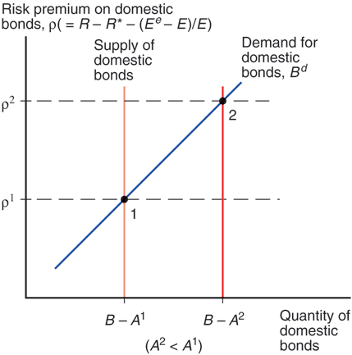
Fig. 18A1-1: The Domestic Bond Supply and the Foreign Exchange Risk Premium under Imperfect Asset Substitutability

Slide 57
Chapter 18 (7)
Appendix 2: The Timing of Balance of Payments Crises

Slide 58
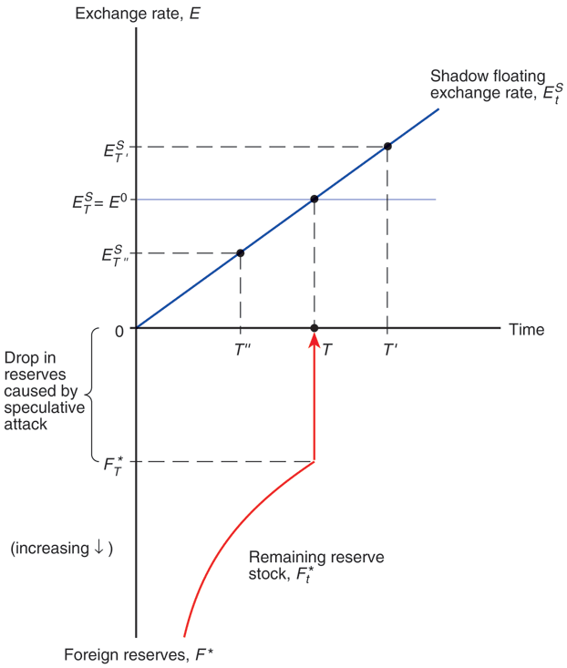
Fig. 18A2-1: How the Timing of a Balance of Payments Crisis Is Determined

