Slide 1
Chapter 9
The Instruments of Trade Policy

Slide 2
Preview
Partial equilibrium analysis of tariffs in a single industry: supply, demand, and trade
Costs and benefits of tariffs
Export subsidies
Import quotas
Voluntary export restraints
Local content requirements

Slide 3
Types of Tariffs
A tariff is a tax levied when a good is imported.
A specific tariff is levied as a fixed charge for each unit of imported goods.
For example, $3 per barrel of oil.
An ad valorem tariff is levied as a fraction of the value of imported goods.
For example, 25% tariff on the value of imported trucks.

Slide 4
Supply, Demand, and Trade in a Single Industry
Consider how a tariff affects a single market, say that of wheat.
Suppose that in the absence of trade the price of wheat is higher in Home than it is in Foreign.
With trade, wheat will be shipped from Foreign to Home until the price difference is eliminated.

Slide 5
Supply, Demand, and Trade in a Single Industry (cont.)
An import demand curve is the difference between the quantity that Home consumers demand minus the quantity that Home producers supply, at each price.
The Home import demand curve
MD = D – S
intercepts the price axis at P_{A} and is downward sloping:
As price increases, the quantity of imports demanded declines.

Slide 6
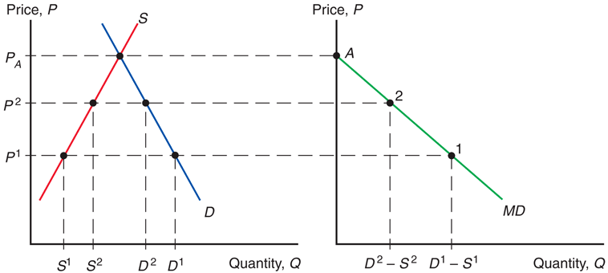
Fig. 9-1: Deriving Home’s Import Demand Curve

Slide 7
Supply, Demand, and Trade in a Single Industry (cont.)
An export supply curve is the difference between the quantity that Foreign producers supply minus the quantity that Foreign consumers demand, at each price.
The Foreign export supply curve
XS* = S* – D*
intersects the price axis at P_{A}* and is upward sloping:
As price increases, the quantity of exports supplied rises.

Slide 8
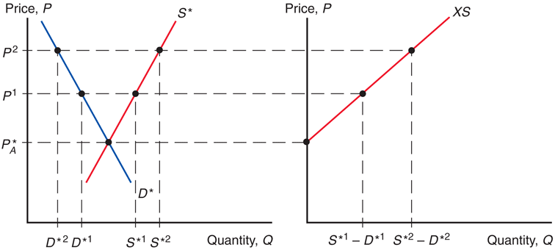
Fig. 9-2: Deriving Foreign’s Export Supply Curve

Slide 9
Supply, Demand, and Trade in a Single Industry (cont.)
In equilibrium,
import demand = export supply,
home demand – home supply
= foreign supply – foreign demand,
home demand + foreign demand
= home supply + foreign supply,
world demand = world supply.

Slide 10
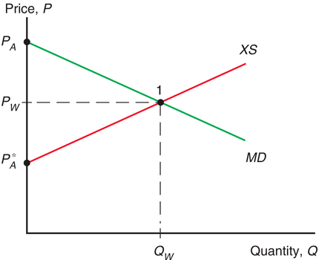
Fig. 9-3: World Equilibrium

Slide 11
Effects of a Tariff
A tariff acts like a transportation cost, making sellers unwilling to ship goods unless the Home price exceeds the Foreign price by the amount of the tariff:
P_{T} – t = P_{T}*
A tariff makes the price rise in the Home market and fall in the Foreign market.

Slide 12
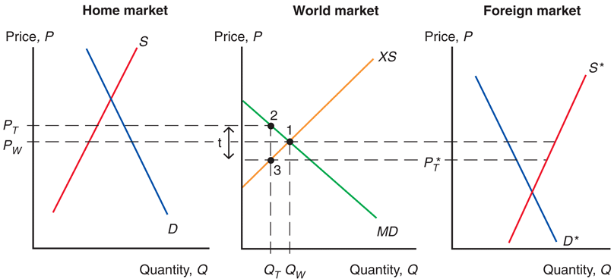
Fig. 9-4: Effects of a Tariff

Slide 13
Effects of a Tariff (cont.)
Because the price in the Home market rises from P_{W} under free trade to P_{T} with the tariff,
Home producers supply more and Home consumers demand less, so
the quantity of imports falls from Q_{W} under free trade to Q_{T} with the tariff.

Slide 14
Effects of a Tariff (cont.)
Because the price in the Foreign market falls from P_{W} under free trade to P_{T}* with the tariff,
Foreign producers supply less, and Foreign consumers demand more, so
the quantity of exports falls from Q_{W} to Q_{T} .

Slide 15
Effects of a Tariff (cont.)
The quantity of Home imports demanded equals the quantity of Foreign exports supplied when
P_{T} – P_{T}* = t
The increase in the price in Home can be less than the amount of the tariff.
Part of the effect of the tariff causes the Foreign export price to decline.
But this effect is sometimes very small.

Slide 16
Effects of a Tariff in a Small Country
When a country is “small,” it has no effect on the foreign (world) price because its demand is an insignificant part of world demand for the good.
The foreign price does not fall, but remains at P_{w} .
The price in the home market rises by the full amount of the tariff, to P_{T} = P_{w} + t .

Slide 17
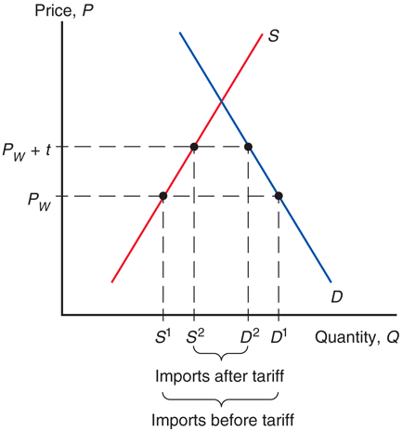
Fig. 9-5: A Tariff in a Small Country

Slide 18
Measuring the Amount of Protection
The effective rate of protection measures how much protection a tariff (or other trade policy) provides.
It represents the change in value that firms in an industry add to the production process when trade policy changes, which depends on the change in prices the trade policy causes.
Effective rates of protection often differ from tariff rates because tariffs affect sectors other than the protected sector, causing indirect effects on the prices and value added for the protected sector.

Slide 19
Measuring the Amount of Protection (cont.)
For example, suppose that automobiles sell in world markets for $8,000, and they are made from factors of production worth $6,000.
The value added of the production process is $8,000 – $6,000.
Suppose that a country puts a 25% tariff on imported autos so that home auto assembly firms can now charge up to $10,000 instead of $8,000.

Slide 20
Measuring the Amount of Protection (cont.)
The effective rate of protection for home auto assembly firms is the change in value added:
($4,000 – $2,000)/$2,000 = 100%
In this case, the effective rate of protection is greater than the tariff rate.

Slide 21
Costs and Benefits of Tariffs
A tariff raises the price of a good in the importing country, so it hurts consumers and benefits producers there.
In addition, the government gains tariff revenue.
How to measure these costs and benefits?
Use the concepts of consumer surplus and producer surplus.

Slide 22
Measuring the Costs and Benefits of Tariffs
A tariff raises the price in the importing country:
consumer surplus decreases (consumers worse off)
producer surplus increases (producers better off).
the government collects tariff revenue equal to the tariff rate times the quantity of imports with the tariff.
t Q_{T} = (P_{T} –P_{T}* ) (D₂ – S₂)
Change in welfare due to the tariff is e – (b + d).

Slide 23
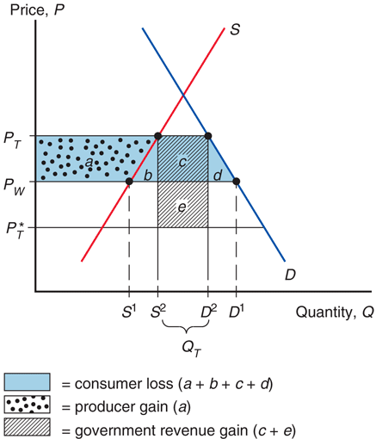
Fig. 9-9: Costs and Benefits of a Tariff for the Importing Country

Slide 24
Measuring the Costs and Benefits of Tariffs (cont.)
For a “large” country, whose imports and exports affect world prices, the welfare effect of a tariff is ambiguous.
The triangles b and d represent the efficiency loss.
The tariff distorts production and consumption decisions: producers produce too much and consumers consume too little.
The rectangle e represents the terms of trade gain.
The tariff lowers the Foreign price, allowing Home to buy its imports cheaper.

Slide 25
Measuring the Costs and Benefits of Tariffs (cont.)
Part of government revenue (rectangle e) represents the terms of trade gain, and part (rectangle c) represents some of the loss in consumer surplus.
The government gains at the expense of consumers and foreigners.
If the terms of trade gain exceed the efficiency loss, then national welfare will increase under a tariff, at the expense of foreign countries.
However, foreign countries are apt to retaliate.

Slide 26
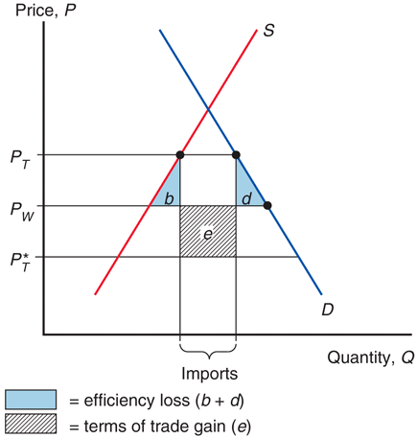
Fig. 9-10: Net Welfare Effects of a Tariff

Slide 27
Measuring the Costs and Benefits of Tariffs (cont.)
Tariffs can lead trading partners to retaliate with their own tariffs, thus hurting exporters in the country that first adopted the tariff.
Tariffs can be hard to remove and large tariffs may induce producers to engage in wasteful activities to avoid paying tariffs.
Ford and Subaru install (then later remove) seats in vans and pickups trucks to avoid U.S. tariff on imports of light commercial trucks.

Slide 28
Export Subsidy
An export subsidy can also be specific or ad valorem:
A specific subsidy is a payment per unit exported.
An ad valorem subsidy is a payment as a proportion of the value exported.
An export subsidy raises the price in the exporting country, decreasing its consumer surplus (consumers worse off) and increasing its producer surplus (producers better off).

Slide 29
Export Subsidy (cont.)
Also, government revenue falls due to paying s X_{S}* for the export subsidy.
An export subsidy lowers the price paid in importing countries P_{S}* = P_{S} – s.
In contrast to a tariff, an export subsidy worsens the terms of trade by lowering the price of exports in world markets.

Slide 30
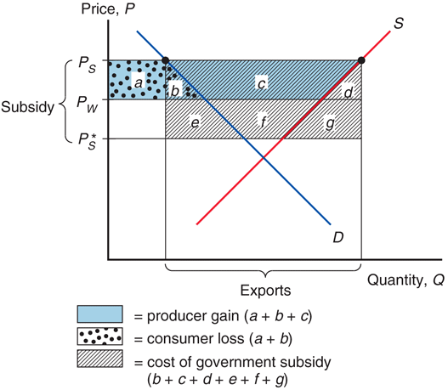
Fig. 9-11: Effects of an Export Subsidy

Slide 31
Export Subsidy (cont.)
An export subsidy damages national welfare.
The triangles b and d represent the efficiency loss.
The export subsidy distorts production and consumption decisions: producers produce too much and consumers consume too little compared to the market outcome.
The area b + c + d + f + g represents the cost of the subsidy paid by the government.
The terms of trade decrease, because the price of exports falls.

Slide 32
Export Subsidy in Europe
The European Union’s Common Agricultural Policy sets high prices for agricultural products and subsidizes exports to dispose of excess output.
Subsidized exports reduce world prices of agricultural products.
The cost of this policy for European taxpayers is almost $30 billion more than its benefits (in 2007). Subsidy payments are about 22% of the value of farm output.
The EU has proposed that farmers receive direct payments independent of the amount of production to help lower EU prices and reduce production.

Slide 33
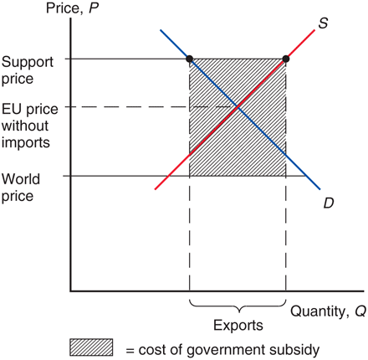
Fig. 9-12: Europe’s Common Agricultural Policy

Slide 34
Import Quota
An import quota is a restriction on the quantity of a good that may be imported.
This restriction is usually enforced by issuing licenses or quota rights.
A binding import quota will push up the price of the import because the quantity demanded will exceed the quantity supplied by Home producers and from imports.

Slide 35
Import Quota (cont.)
When a quota instead of a tariff is used to restrict imports, the government receives no revenue.
Instead, the revenue from selling imports at high prices goes to quota license holders.
These extra revenues are called quota rents.

Slide 36
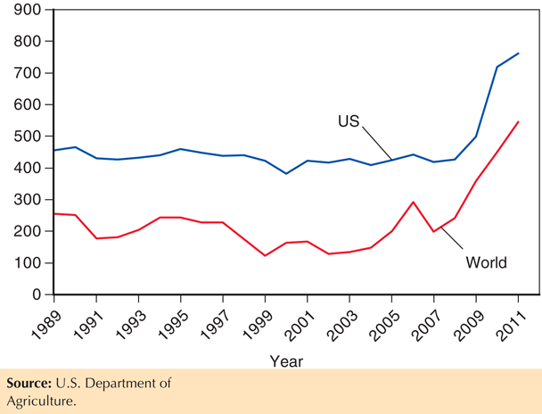
Fig. 9-13: U.S. and World Raw Sugar Prices in $ per ton, 1989–2011

Slide 37
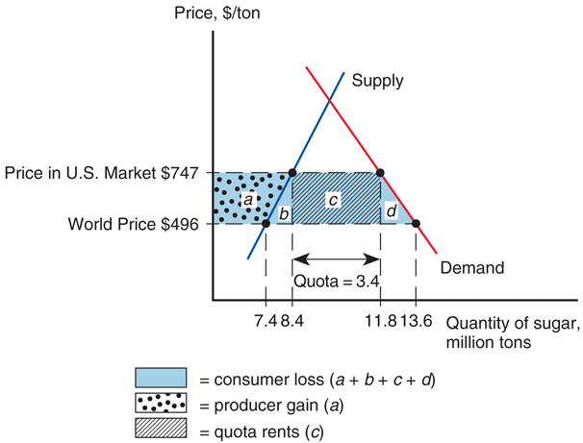
Fig. 9-14: Effects of the U.S. Import Quota on Sugar

Slide 38
Voluntary Export Restraint
A voluntary export restraint works like an import quota, except that the quota is imposed by the exporting country rather than the importing country.
These restraints are usually requested by the importing country.
The profits or rents from this policy are earned by foreign governments or foreign producers.
Foreigners sell a restricted quantity at an increased price.

Slide 39
Local Content Requirement
A local content requirement is a regulation that requires a specified fraction of a final good to be produced domestically.
It may be specified in value terms, by requiring that some minimum share of the value of a good represent home value added, or in physical units.

Slide 40
Local Content Requirement (cont.)
From the viewpoint of domestic producers of inputs, a local content requirement provides protection in the same way that an import quota would.
From the viewpoint of firms that must buy home inputs, however, the requirement does not place a strict limit on imports, but allows firms to import more if they also use more home parts.

Slide 41
Local Content Requirement (cont.)
Local content requirement provides neither government revenue (as a tariff would) nor quota rents.
Instead, the difference between the prices of home goods and imports is averaged into the price of the final good and is passed on to consumers.

Slide 42
Local Content Requirement (cont.)
Any public work project funded by the American Recovery and Re-Investment Act of 2009 (ARRA) must use U.S. iron, steel, and manufactured goods (unless foreign bid more than 25% lower).
The Bay Bridge linking San Francisco and Oakland did not use ARRA funding because some key components would have been 23% ($400 million) more expensive.
Delays due to having to show that some items are unavailable from U.S. sources.
Has triggered protectionist clauses that shut U.S. firms out of opportunities abroad.

Slide 43
Other Trade Policies
Export credit subsidies
A subsidized loan to exporters
U.S. Export-Import Bank subsidizes loans to U.S. exporters.
Government procurement
Government agencies are obligated to purchase from home suppliers, even when they charge higher prices (or have inferior quality) compared to foreign suppliers.
Bureaucratic regulations (red tape)
Safety, health, quality, or customs regulations can act as a form of protection and trade restriction.

Slide 44
The Effects of Trade Policy
For each trade policy, the price rises in the Home country adopting the policy.
Home producers supply more and gain.
Home consumers demand less and lose.
The world price falls when Home is a “large” country that affects world prices.
Tariffs generate government revenue; export subsidies drain it; import quotas do not affect government revenue.
All these trade policies create production and consumption distortions.

Slide 45
Table 9-1: Effects of Alternative Trade Policies

Slide 46
Summary
A tariff increases the home price and the quantity supplied and reduces the quantity demanded and the quantity traded; also decreases the world price when the country is “large.”
A quota does the same; an export subsidy does the same.
Tariffs generate government revenue; export subsidies drain it; import quotas are revenue neutral.

Slide 47
Summary (cont.)
The welfare effect of a tariff, quota, or export subsidy can be measured by
efficiency loss from consumption and production distortions.
terms of trade gain or loss.
With import quotas, voluntary export restraints, and local content requirements, the government of the importing country receives no revenue.
With voluntary export restraints and occasionally import quotas, quota rents go to foreigners.

Slide 48
Chapter 10
The Political Economy of Trade Policy

Slide 49
Preview
The cases for free trade
The cases against free trade
Political models of trade policy
International negotiations of trade policy and the World Trade Organization

Slide 50
The Cases for Free Trade
The first case for free trade is the argument that producers and consumers allocate resources most efficiently when governments do not distort market prices through trade policy.
National welfare of a small country is highest with free trade.
With restricted trade, consumers pay higher prices and consume too little while firms produce too much.

Slide 51
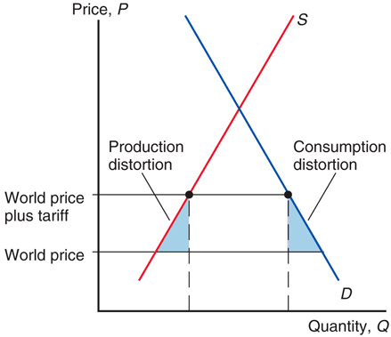
Fig. 10-1: The Efficiency Case for Free Trade

Slide 52
The Cases for Free Trade (cont.)
However, because tariff rates are already low for most countries, the estimated benefits of moving to free trade are only a small fraction of national income for most countries.
For the world as a whole, protection costs less than 1 percent of GDP.
The gains from free trade are somewhat smaller for advanced economies such as the United States and Europe and somewhat larger for poorer developing countries.

Slide 53
Table 10-1: Benefits of a Move to Worldwide Free Trade (percent of GDP)

Slide 54
The Cases for Free Trade (cont.)
Free trade allows firms or industry to take advantage of economies of scale.
Protected markets limit gains from external economies of scale by inhibiting the concentration of industries:
Too many firms to enter the protected industry.
The scale of production of each firm becomes inefficient.

Slide 55
The Cases for Free Trade (cont.)
Free trade provides competition and opportunities for innovation (dynamic benefits).
By providing entrepreneurs with an incentive to seek new ways to export or compete with imports, free trade offers more opportunities for learning and innovation.
Free trade avoids the loss of resources through rent seeking.
Spend time and other resources seeking quota rights and the profit that they will earn.

Slide 56
The Cases for Free Trade (cont.)
The political argument for free trade says that free trade is the best feasible political policy, even though there may be better policies in principle.
Any policy that deviates from free trade would be quickly manipulated by political groups, leading to decreased national welfare.

Slide 57
The Cases against Free Trade
For a “large” country, a tariff lowers the price of imports in world markets and generates a terms of trade gain.
This benefit may exceed the losses caused by distortions in production and consumption.
A small tariff will lead to an increase in national welfare for a large country.
But at some tariff rate, the national welfare will begin to decrease as the economic efficiency loss exceeds the terms of trade gain.

Slide 58
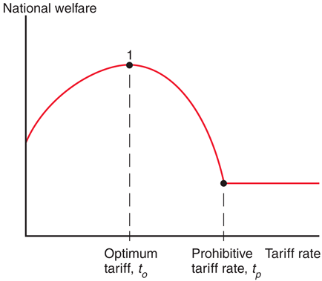
Fig. 10-2: The Optimum Tariff

Slide 59
The Cases against Free Trade (cont.)
A tariff rate that completely prohibits imports leaves a country worse off, but tariff rate t_{O} may exist that maximizes national welfare: an optimum tariff.

Slide 60
The Cases against Free Trade (cont.)
An export tax (a negative export subsidy) that completely prohibits exports leaves a country worse off, but an export tax rate may exist that maximizes national welfare through the terms of trade.
An export subsidy lowers the terms of trade for a large country; an export tax raises the terms of trade for a large country.
An export tax may raise the price of exports in the world market, increasing the terms of trade.

Slide 61
Counter-Argument
For some countries like the U.S., an import tariff and/or export tax could improve national welfare at the expense of other countries.
But this argument ignores the likelihood that other countries may retaliate against large countries by enacting their own trade restrictions.

Slide 62
The Cases against Free Trade (cont.)
A second argument against free trade is that domestic market failures may exist that cause free trade to be a suboptimal policy.
The economic efficiency loss calculations using consumer and producer surplus assume that markets function well.

Slide 63
The Cases against Free Trade (cont.)
Types of market failures include
Persistently high underemployment of workers
surpluses that are not eliminated in the market for labor because wages do not adjust
Persistently high underutilization of structures, equipment, and other forms of capital
surpluses that are not eliminated in the market for capital because prices do not adjust
Property rights not well defined or well enforced

Slide 64
The Cases against Free Trade (cont.)
Types of market failures include
technological benefits for society discovered through private production, but from which private firms cannot fully profit
environmental costs for society caused by private production, but for which private firms do not fully pay
sellers that are not well informed about the (opportunity) cost of production or buyers that are not well informed about value from consumption

Slide 65
The Cases against Free Trade (cont.)
Economists calculate the marginal social benefit to represent the additional benefit to society from private production.
With a market failure, marginal social benefit is not accurately measured by the producer surplus of private firms, so that economic efficiency loss calculations are misleading.
It’s possible that when a tariff increases domestic production, the benefit to domestic society will increase due to a market failure.

Slide 66
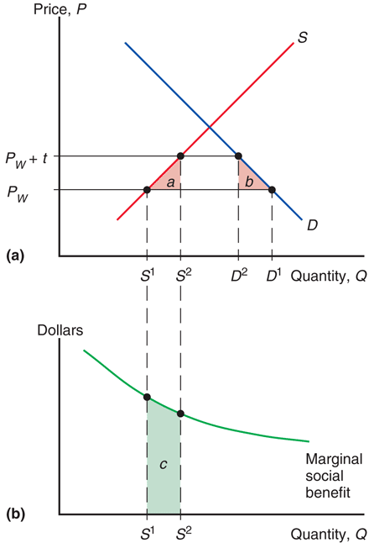
Fig. 10-3: The Domestic Market Failure Argument for a Tariff

Slide 67
The Cases against Free Trade (cont.)
The domestic market failure argument against free trade is an example of a more general argument called the theory of the second best.
Government intervention that distorts market incentives in one market may increase national welfare by offsetting the consequences of market failures elsewhere.
If the best policy, fixing the market failures, is not feasible, then government intervention in another market may be the “second-best” way of fixing the problem.

Slide 68
Counter-Arguments
Economists supporting free trade counter-argue that domestic market failures should be corrected by a “first-best” policy: a domestic policy aimed directly at the source of the problem.
If persistently high underemployment of labor is a problem, then the cost of labor or production of labor-intensive products could be subsidized by the government.
This policy could avoid economic efficiency losses due to a tariff.

Slide 69
Counter-Arguments (cont.)
Unclear when and to what degree a market failure exists in the real world.
Government policies to address market failures are likely to be manipulated by politically powerful groups.
Due to distorting the incentives of producers and consumers, trade policy may have unintended consequences that make a situation worse, not better.

Slide 70
Political Models of Trade Policy
How is trade policy determined?
Models of governments maximizing political success rather than national welfare:
Median voter theorem
Collective action
A model that combines aspects of collective action and the median voter theorem

Slide 71
Median Voter
The median voter theorem predicts that democratic political parties pick their policies to court the voter in the middle of the ideological spectrum (i.e., the median voter).
Suppose the level of a tariff rate is the policy issue.
Line up all the voters according to the tariff rate they prefer, starting with those who favor the lowest rate.

Slide 72
Median Voter (cont.)
Assumptions of the model:
There are two competing political parties.
The objective of each party is to get elected by majority vote.
What policies will the parties promise to follow?
Both parties will offer the same tariff policy to court the median voter (the voter in the middle of the spectrum) in order to capture the most votes.

Slide 73
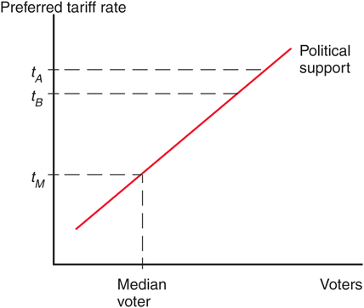
Fig. 10-4: Political Competition

Slide 74
Median Voter (cont.)
Thus, the median voter theorem implies that a two-party democracy should enact trade policy based on how many voters it pleases.
A policy that inflicts large losses on a few people (import-competing producers) but benefits a large number of people (consumers) should be chosen.
But trade policy doesn’t follow this prediction.

Slide 75
Collective Action
Political activity is often described as a collective action problem:
While consumers as a group have an incentive to advocate free trade, each individual consumer has no incentive because his benefit is not large compared to the cost and time required to advocate free trade.
Policies that impose large losses for society as a whole but small losses on each individual may therefore not face strong opposition.

Slide 76
Collective Action (cont.)
However, for groups who suffer large losses from free trade (for example, unemployment), each individual in that group has a strong incentive to advocate the policy he desires.
In this case, the cost and time required to advocate restricted trade is small compared to the cost of unemployment.

Slide 77
A Model of Trade Policy
While politicians may win elections partly because they advocate popular policies as implied by the median voter theorem, they also require funds to run campaigns.
These funds may especially come from groups who do not have a collective action problem and are willing to advocate a special interest policy.
Models of trade restrictions try to measure the trade-off between the reduction in welfare of constituents as a whole and the increase in campaign contributions from special interests.

Slide 78
Which Industries Are Protected?
Agriculture: In the U.S., Europe, and Japan, farmers make up a small fraction of the electorate but receive generous subsidies and trade protection.
Examples: European Union’s Common Agricultural Policy, Japan’s 1000% tariff on imported rice, America’s sugar quota.

Slide 79
Which Industries Are Protected? (cont.)
Clothing: textiles (fabrication of cloth) and apparel (assembly of cloth into clothing).
Until 2005, quota licenses granted to textile and apparel exporters were specified in the Multi-Fiber Agreement between the United States and many other nations.
Phase-out of MFA drastically reduced the costs of U.S. protection, from 14.1b in 2002 (11.8b from textiles and apparel) to 2.6b estimate for 2015 (only 0.5b from textiles and apparel).

Slide 80
Table 10-2: Welfare Costs of U.S. Protection ($ billion)

Slide 81
International Negotiations of Trade Policy
After rising sharply at the beginning of the 1930s, the average U.S. tariff rate has decreased substantially from the mid-1930s to 1998.
Since 1944, much of the reduction in tariffs and other trade restrictions has come about through international negotiations.
The General Agreement of Tariffs and Trade was begun in 1947 as a provisional international agreement and was replaced by a more formal international institution called the World Trade Organization in 1995.

Slide 82
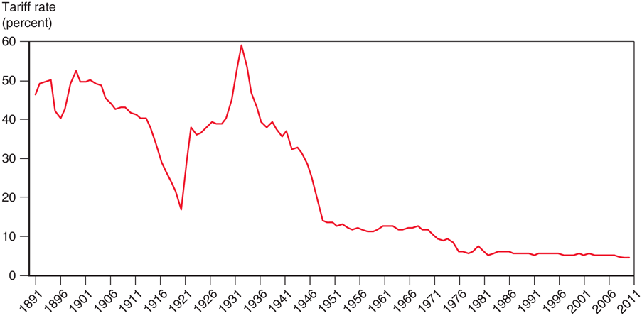
Fig. 10-5: The U.S. Tariff Rate

Slide 83
International Negotiations of Trade Policy (cont.)
Multilateral negotiations mobilize exporters to support free trade if they believe export markets will expand.
This support would be lacking in a unilateral push for free trade. The multilateral approach counteracts the support for restricted trade by import-competing groups.

Slide 84
International Negotiations of Trade Policy (cont.)
Multilateral negotiations also help avoid a trade war between countries, where each country enacts trade restrictions.
A trade war could result if each country has an incentive to adopt protection, regardless of what other countries do.
All countries could enact trade restrictions, even if it is in the interest of all countries to have free trade.
Countries need an agreement that prevents a trade war or eliminates the protection from one.

Slide 85
Table 10-3: The Problem of Trade Warfare

Slide 86
International Negotiations of Trade Policy (cont.)
In this example, each country acting individually would be better off with protection (20 > 10), but both would be better off if both chose free trade than if both choose protection (10 > –5).
If Japan and the U.S. can establish a binding agreement to maintain free trade, both can avoid the temptation of protection and both can be made better off.
Or if the damage has already been done, both countries can agree to return to free trade.

Slide 87
International Trade Agreements: A Brief History
In 1930, the United States passed a remarkably irresponsible tariff law, the Smoot-Hawley Act.
Tariff rates rose steeply and U.S. trade fell sharply.
Initial attempts to reduce tariff rates were undertaken through bilateral trade negotiations:
U.S. offered to lower tariffs on some imports if another country would lower its tariffs on some U.S. exports.
Bilateral negotiations, however, do not take full advantage of international coordination.
Benefits can “spill over” to countries that have not made any concessions.

Slide 88
World Trade Organization
In 1947, a group of 23 countries began trade negotiations under a provisional set of rules that became known as the General Agreement on Tariffs and Trade, or GATT.
In 1995, the World Trade Organization, or WTO, was established as a formal organization for implementing multilateral trade negotiations (and policing them).

Slide 89
World Trade Organization (cont.)
WTO negotiations address trade restrictions in at least 3 ways:
Reducing tariff rates through multilateral negotiations.
Binding tariff rates: a tariff is “bound” by having the imposing country agree not to raise it in the future.

Slide 90
World Trade Organization (cont.)
Eliminating nontariff barriers: quotas and export subsidies are changed to tariffs because the costs of tariff protection are more apparent and easier to negotiate.
Subsidies for agricultural exports are an exception.
Exceptions are also allowed for “market disruptions” caused by a surge in imports.

Slide 91
World Trade Organization (cont.)
The World Trade Organization is based on a number of agreements:
General Agreement on Tariffs and Trade: covers trade in goods.
General Agreement on Tariffs and Services: covers trade in services (ex., insurance, consulting, legal services, banking).
Agreement on Trade-Related Aspects of Intellectual Property: covers international property rights (ex., patents and copyrights).

Slide 92
World Trade Organization (cont.)
The dispute settlement procedure: a formal procedure where countries in a trade dispute can bring their case to a panel of WTO experts to rule upon.
The panel decides whether member counties are breaking their agreements.
A country that refuses to adhere to the panel’s decision may be punished by the WTO allowing other countries to impose trade restrictions on its exports.

Slide 93
World Trade Organization (cont.)
The GATT multilateral negotiations in the Uruguay Round, ratified in 1994:
agreed that all quantitative restrictions (ex., quotas) on trade in textiles and clothing as previously specified in the Multi-Fiber Agreement were to be eliminated by 2005.
Quotas on imports from China had to be temporarily reimposed due to surge in Chinese clothing exports when MFA expired.

Slide 94
World Trade Organization (cont.)
In 2001, a new round of negotiations was started in Doha, Qatar, but these negotiations have not yet produced an agreement.
Most of the remaining forms of protection are in agriculture, textiles, and clothing—industries that are politically well organized.

Slide 95
Table 10-4: Percentage Distribution of Potential Gains from Free Trade

Slide 96
Do Agricultural Subsidies in Rich Countries Hurt Poor Countries?
We learned in Chapter 9 that subsidies lower the world price of products.
Since importing countries benefit from cheaper food, why would poor countries want rich countries to remove their agricultural subsidies?
Subsidies harm farmers in poor countries who compete with farmers in rich countries.

Slide 97
Table 10-5: Percentage Gains in Income under Two Doha Scenarios

Slide 98
Preferential Trading Agreements
Preferential trading agreements are trade agreements between countries in which they lower tariffs for each other but not for the rest of the world.
Under the WTO, such discriminatory trade policies are generally not allowed:
Each country in the WTO promises that all countries will pay tariffs no higher than the nation that pays the lowest: called the “most favored nation” (MFN) principle.
An exception is allowed only if the lowest tariff rate is set at zero.

Slide 99
Preferential Trading Agreements (cont.)
There are two types of preferential trading agreements in which tariff rates are set at or near zero:
A free trade area: an agreement that allows free trade among members, but each member can have its own trade policy towards non-member countries.
An example is the North America Free Trade Agreement (NAFTA).

Slide 100
Preferential Trading Agreements (cont.)
A customs union: an agreement that allows free trade among members and requires a common external trade policy towards non-member countries.
An example is the European Union.

Slide 101
Preferential Trading Agreements (cont.)
Are preferential trading agreements necessarily good for national welfare?
No, it is possible that national welfare decreases under a preferential trading agreement.
How? Rather than gaining tariff revenue from inexpensive imports from world markets, a country may import expensive products from member countries but not gain any tariff revenue.

Slide 102
Preferential Trading Agreements (cont.)
Preferential trading agreements increase national welfare when new trade is created, but not when existing trade from the outside world is diverted to trade with member countries.
Trade creation
occurs when high-cost domestic production is replaced by low-cost imports from other members.
Trade diversion
occurs when low-cost imports from nonmembers are diverted to high-cost imports from member nations.

Slide 103
Summary
The cases for free trade are that freer trade
allows consumers and producers to allocate their resources freely and efficiently, without price distortions.
may allow for economies of scale.
increases competition and innovation.
The cases against free trade are that trade restrictions may allow
terms of trade gains.
a government to address a market failure when better policies are not feasible.

Slide 104
Summary (cont.)
Models of trade policy choice consider the incentives politicians face given their desire to be reelected, and the tendency for groups that gain from protection to be better organized than consumers who lose.
Agricultural and clothing industries are the most protected industries in many countries.

Slide 105
Summary (cont.)
Multilateral negotiations of free trade may mobilize domestic political support for free trade, as well as make countries agree not to engage in a trade war.
The WTO and its predecessor have reduced tariffs substantially in the last 50 years, and the WTO has a dispute settlement procedure for trade disputes.
A preferential trading agreement is beneficial for a country if it creates new trade but is harmful if it diverts existing trade to higher-cost alternatives.

