Slide 1
Chapter 11
Trade Policy in Developing Countries

Slide 2
Preview
Import-substituting industrialization
Trade liberalization since 1985
Trade and growth: takeoff in Asia

Slide 3
Introduction
Which countries are “developing countries”?
The term “developing countries” does not have a precise definition, but it is a name given to many low- and middle-income countries.

Slide 4
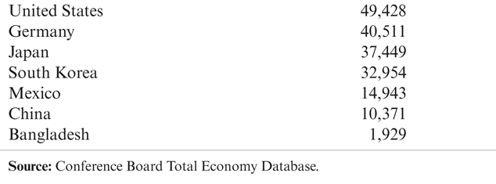
Table 11-1: Gross Domestic Product Per Capita, 2009 (dollars)

Slide 5
Import-Substituting Industrialization
Import-substituting industrialization was a trade policy adopted by many low- and middle-income countries before the 1980s.
The policy aimed to encourage domestic industries by limiting competing imports.

Slide 6
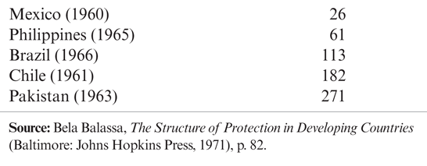
Table 11-2: Effective Protection of Manufacturing in Some Developing Countries (percent)

Slide 7
Import-Substituting Industrialization (cont.)
The principal justification of this policy was/is the infant industry argument:
Countries may have a potential comparative advantage in some industries, but these industries cannot initially compete with well-established industries in other countries.
To allow these industries to establish themselves, governments should temporarily support them until they have grown strong enough to compete internationally.

Slide 8
Problems with the Infant Industry Argument
It may be wasteful to support industries now that will have a comparative advantage in the future.
With protection, infant industries may never “grow up” or become competitive.
There is no justification for government intervention unless there is a market failure that prevents the private sector from investing in the infant industry.

Slide 9
Infant Industries and Market Failures
Two arguments for how market failures prevent infant industries from becoming competitive:
Imperfect financial asset markets
Because of poorly working financial laws and markets (and more generally, a lack of property rights), firms cannot or do not save and borrow to invest sufficiently in their production processes.
If creating better functioning markets and enforcing laws is not feasible, then high tariffs would be a second-best policy to increase profits in new industries, leading to more rapid growth.

Slide 10
Infant Industries and Market Failures (cont.)
The problem of appropriability
Firms may not be able to privately appropriate the benefits of their investment in new industries because those benefits are public goods.
The knowledge created when starting an industry may not be appropriable (may be a public good) because of a lack of property rights.
If establishing a system of property rights is not feasible, then high tariffs would be a second-best policy to encourage growth in new industries.

Slide 11
Import-Substituting Industrialization (cont.)
Import-substituting industrialization in Latin American countries worked to encourage manufacturing industries in the 1950s and 1960s.
But economic development, not encouraging manufacturing, was the ultimate goal of the policy.
Did import-substituting industrialization promote economic development?
No, countries adopting these policies grew more slowly than others.

Slide 12
Import-Substituting Industrialization (cont.)
It appeared that the infant industry argument was not as valid as some had initially believed.
New industries did not become competitive despite or because of trade restrictions.
Import-substitution industrialization involved costs and promoted wasteful use of resources:
It involved complex, time-consuming regulations.
It set high tariff rates for consumers, including firms that needed to buy imported inputs for their products.
It promoted inefficiently small industries.

Slide 13
Trade Liberalization
Some low- and middle-income countries that had relatively free trade had higher average economic growth than those that followed import substitution.
By the mid-1980s, many governments had lost faith in import substitution and began to liberalize trade.
Dramatic fall in tariff rates in India and Brazil, and less drastic reductions in many other developing countries.

Slide 14
Trade Liberalization (cont.)
Trade liberalization in developing countries occurred along with a dramatic increase in the volume of trade.
The share of trade in GDP has tripled over 1970–1998, with most of the growth happening after 1985.
The share of manufactured goods in developing-country exports surged, coming to dominate the exports of the biggest developing economies.
A number of developing countries have achieved extraordinary growth while becoming more, not less, open to trade.

Slide 15
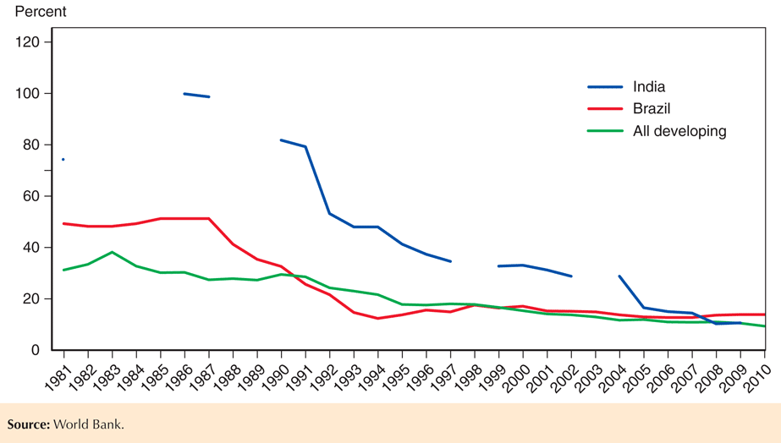
Fig. 11-1: Tariff Rates in Developing Countries

Slide 16
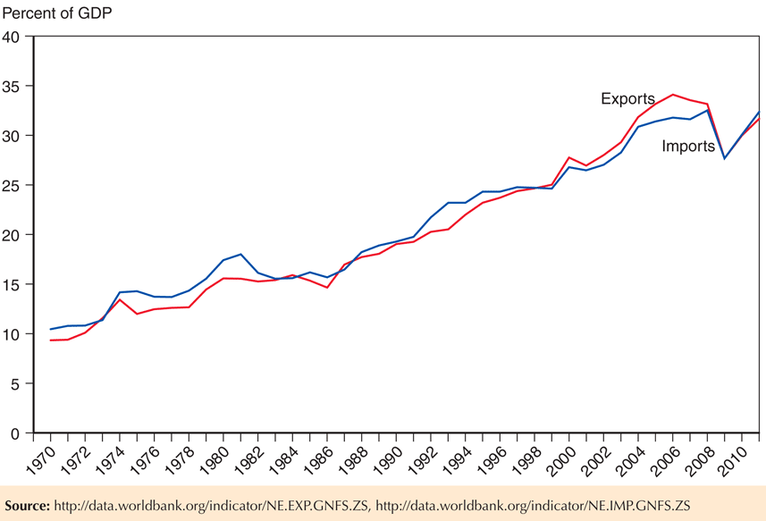
Fig. 11-2: The Growth of Developing-Country Trade

Slide 17
Trade Liberalization (cont.)
Has trade liberalization promoted development? The evidence is mixed.
Growth rates in Brazil and other Latin American countries have been slower since trade liberalization than they were during import-substituting industrialization.
But unstable macroeconomic policies and financial crises contributed to slower growth since the 1980s.

Slide 18
Trade Liberalization (cont.)
Other countries like India have grown rapidly since liberalizing trade in the 1980s, but it is unclear to what degree liberalized trade contributed to growth.
Some economists also argue that trade liberalization has contributed to income inequality, as the Heckscher-Ohlin model predicts.

Slide 19
Trade and Growth: Takeoff in Asia
Instead of import substitution, several countries in East Asia adopted trade policies that promoted exports in targeted industries.
Japan, Hong Kong, Taiwan, South Korea, Singapore, Malaysia, Thailand, Indonesia, and China have experienced rapid growth in various export sectors and rapid economic growth in general.

Slide 20
Trade and Growth: Takeoff in Asia (cont.)
These high-performance Asian economies generated a high volume of exports and imports relative to total production.
Their policy reforms were followed by a large increase in openness, as measured by their share of exports in GDP.
So it is possible to develop through export-oriented growth.
However, Latin American nations such as Mexico and Brazil, which also sharply liberalized trade and shifted toward exports, did not see comparable economic takeoffs.
These Latin American results suggest that other factors must have played a crucial role in the Asian miracle.

Slide 21
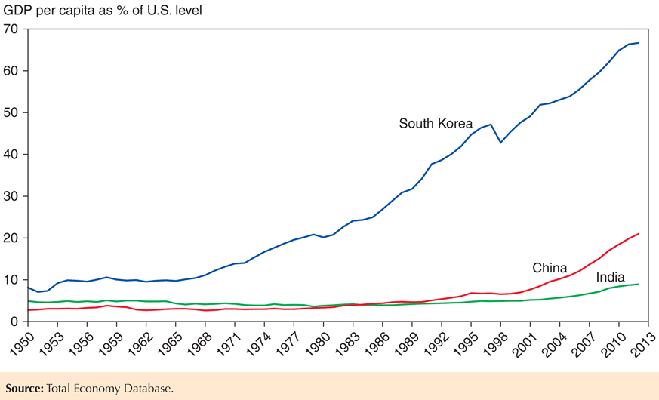
Fig. 11-3: The Asian Takeoff

Slide 22
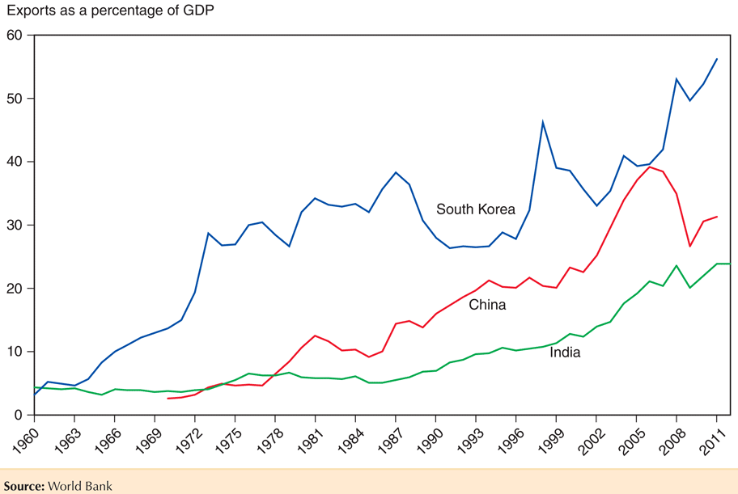
Fig. 11-4: Asia’s Surging Trade

Slide 23
Trade and Growth: Takeoff in Asia (cont.)
It’s unclear if the high volume of exports and imports caused rapid economic growth or was merely correlated with rapid economic growth.
High saving and investment rates could have led to both rapid economic growth in general and rapid economic growth in export sectors.
Rapid growth in education led to high literacy and numeracy rates important for a productive labor force.
These nations also undertook other economic reforms.

Slide 24
Summary
Import-substituting industrialization aimed to promote economic growth by restricting imports that competed with domestic products in low- and middle-income countries.
The infant industry argument says that new industries need temporary trade protection due to market failures:
imperfect asset markets that restrict saving, borrowing, and investment in production processes
problems of appropriating gains from private investment in production processes

Slide 25
Summary (cont.)
Import-substituting industrialization was tried in the 1950s and 1960s but by the mid-1980s it was abandoned for trade liberalization.
The effect of liberalized trade on national welfare is still being debated.
Trade helped growth in some sectors, but saying that trade caused higher overall economic growth has attracted some skepticism.
Some argue that trade has caused increased income inequality.

Slide 26
Summary (cont.)
Several East Asian economies adopted export- oriented instead of import-substituting industrialization.
High export and import volumes and relatively low trade restrictions were characteristics of this policy.
It’s unclear to what degree this policy contributed to overall economic growth, especially since other countries have not had similar successes.

Slide 27
Chapter 12
Controversies in Trade Policy

Slide 28
Preview
Arguments for “activist” trade policies
Externality or appropriability problem
Strategic trade policy with imperfect competition
Arguments concerning trade and people
Trade and low-wage labor
Trade and the environment
Trade and culture

Slide 29
Arguments for an Activist Trade Policy
An activist trade policy usually means government policies that actively support export industries through subsidies.
Arguments for activist trade policies use an assumption that import-substituting industrialization (Econ/Trade Chapter 11) and the cases against free trade (Econ/Trade Chapter 10) used: market failure.
Externalities or an appropriability problem
Imperfect competition that results in revenues that exceed all (opportunity) costs: “excess” profits.

Slide 30
Technology and Externalities
Firms that invest in new technology generally create knowledge that other firms can use without paying for it: an appropriability problem.
By investing in new technology, firms are creating an extra benefit for society that is easily used by others.
An appropriability problem is an example of an externality: benefits or costs that accrue to parties other than the one that generates it.
An externality implies that the marginal social benefit of investment is not represented by producer surplus.

Slide 31
Technology and Externalities (cont.)
Governments may want to actively encourage investment in technology when externalities in new technologies create a high marginal social benefit.
Should the U.S. government subsidize high- technology industries?

Slide 32
Technology and Externalities (cont.)
When considering whether a government should subsidize high-technology industries, consider:
The ability of governments to subsidize the right activity.
Much activity by high technology firms has nothing to do with generating knowledge: subsidizing equipment purchases or non-technical workers generally does not create new technology.
Knowledge and innovation are created in industries that are not usually classified as high tech.

Slide 33
Technology and Externalities (cont.)
2. Instead of subsidizing specific industries, the U.S. subsidizes research and development through the tax code.
Research and development expenses can be deducted from corporate taxable income.
3. The economic importance of externalities.
It is difficult to determine the quantitative importance that externalities have on the economy.
Therefore, it is difficult to say how much to subsidize activities that create externalities.
4. Externalities may occur across countries as well.
No individual country has an incentive to subsidize industries if all countries could take advantage of the externalities generated in a country.

Slide 34
Technology and Externalities (cont.)
Some argue that the United States should have a deliberate policy of promoting high-technology industries and helping them compete against foreign rivals.
Fear in the 1980s that Japan’s dominance of the semiconductor memory market would translate into a broader dominance of computers and related technologies proved to be unfounded.

Slide 35
Technology and Externalities (cont.)
More recently, the decline in U.S. employment in the information, communication, and technology (ICT) industries, which are at the heart of the information technology revolution, and large U.S. trade deficits in ICT goods have renewed fears.

Slide 36
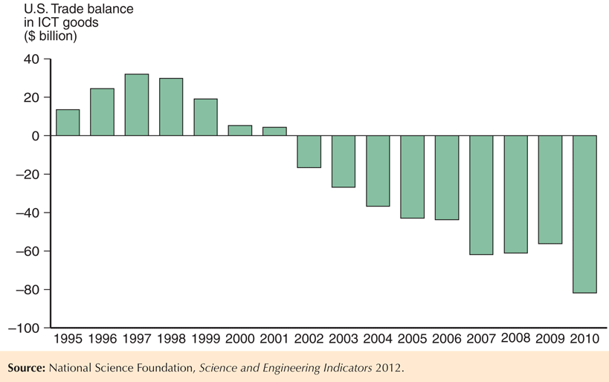
Fig. 12-1: The U.S. Trade Balance in Information Goods

Slide 37
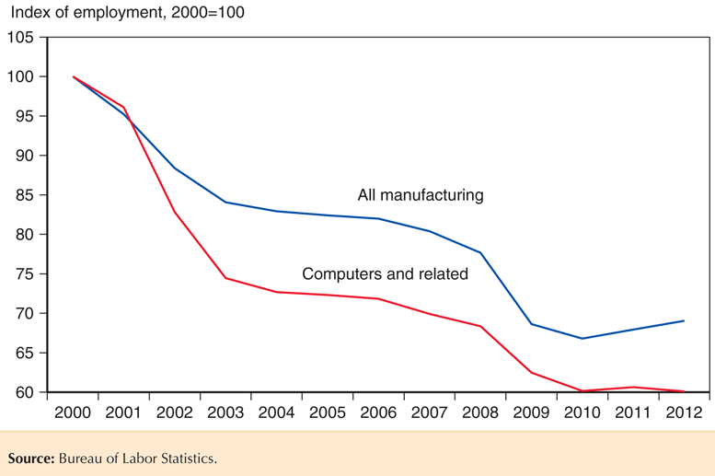
Fig. 12-2: U.S. Manufacturing Employment

Slide 38
Imperfect Competition and Strategic Trade Policy
Imperfectly competitive industries are typically dominated by a few firms that generate monopoly profits or excess profits.
Excess profits are revenues that exceed all opportunity costs: profits higher than what equally risky investments elsewhere in the economy earn.
In an imperfectly competitive industry, government subsidies can shift excess profits from a foreign firm to a domestic firm.

Slide 39
Imperfect Competition and Strategic Trade Policy (cont.)
Example (called the Brander-Spencer analysis):
Two firms (Boeing and Airbus) compete in the international market but are located in two different countries (U.S. and EU).
Both firms manufacture airplanes, but each firm’s profits depends on the actions of the other.
Each firm decides to produce or not depending on profit levels.

Slide 40
Table 12-1: Two-Firm Competition

Slide 41
Imperfect Competition and Strategic Trade Policy (cont.)
The predicted outcome depends on which firms invest/produce first.
If Boeing produces first, then Airbus will not find it profitable to produce.
If Airbus produces first, then Boeing will not find it profitable to produce.
But a subsidy by the European Union can alter the outcome by making it profitable for Airbus to produce regardless of Boeing’s action.

Slide 42
Table 12-2: Effects of a Subsidy to Airbus

Slide 43
Imperfect Competition and Strategic Trade Policy (cont.)
If Boeing expects that the European Union will subsidize Airbus, Boeing will be deterred from entering the industry.
Thus, the subsidy of 25 will generate profits of 125 for Airbus.
The subsidy raises profits more than the amount of the subsidy itself due to its deterrent effect on foreign competition.

Slide 44
Imperfect Competition and Strategic Trade Policy (cont.)
A government policy to give a domestic firm a strategic advantage in production is called a strategic trade policy.

Slide 45
Imperfect Competition and Strategic Trade Policy (cont.)
Criticisms of this analysis include:
Practical use of strategic trade policy requires more information about firms than is likely available.
The predictions from the simple example differ if the numbers are slightly different.
What if governments or economists are not exactly right when predicting the profits of firms?
For example, what if Boeing has a better technology that only it can recognize, so that even if Airbus produces, Boeing still finds it profitable to produce?

Slide 46
Imperfect Competition and Strategic Trade Policy (cont.)
Foreign retaliation also could result:
If the European Union subsidizes Airbus, the U.S. could subsidize Boeing, which would deter neither firm from producing, start a trade war, and waste taxpayer funds.
Strategic trade policy, like any trade policy, could be manipulated by politically powerful groups.

Slide 47
Trade and Low-Wage Labor
Manufactured exports from low- and middle- income countries have been increasing.
Compared to rich-country standards, workers who produce these goods are paid low wages and may work under poor conditions.
Some have opposed free trade for this reason.

Slide 48
Trade and Low-Wage Labor (cont.)
One example of this situation is the maquiladora sector: Mexican firms that produce for export to the U.S.
Opponents of the North American Free Trade Agreement have argued that it is now easier for employers to replace high-wage workers in the U.S. with low-wage workers in Mexico.

Slide 49
Trade and Low-Wage Labor (cont.)
The above claim can be true, but we cannot conclude that trade hurts workers.
A Ricardian model predicts that while wages in Mexico should remain lower than those in the U.S. due to low productivity in Mexico, they will rise relative to their pretrade level.
A Heckscher-Ohlin model does predict that unskilled workers in the U.S. will lose from NAFTA, but it also predicts that unskilled workers in Mexico will gain.

Slide 50
Trade and Low-Wage Labor (cont.)
Despite the low wages earned by workers in Mexico, both theories predict that those workers are better off with trade than they would be if trade had not taken place.
Evidence consistent with these predictions would show that wages in maquiladoras have risen relative to wages in other Mexican sectors.
One could also compare working conditions in maquiladoras with the working conditions in other Mexican sectors, rather than with those in the U.S.

Slide 51
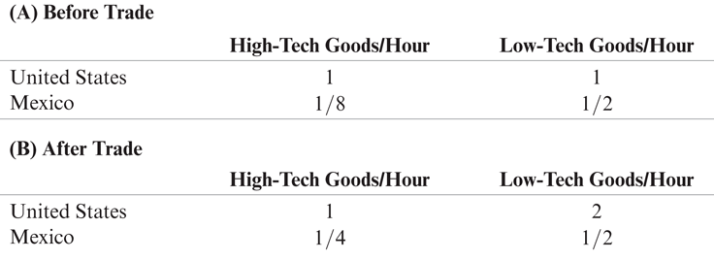
Table 12-3: Real Wages

Slide 52
Trade and Low-Wage Labor (cont.)
Some labor activists want to include labor standards in trade negotiations.
However, labor standards imposed by foreign countries are opposed by governments of low- and middle-income countries.
International standards could be used as a protectionist policy or a basis for lawsuits when domestic producers did not meet them.
Standards set by high-income countries would be expensive for low- and middle-income producers.

Slide 53
Trade and Low-Wage Labor (cont.)
A policy that could be agreeable for governments of low- and middle-income countries is a system that monitors wages and working conditions and makes this information available to consumers.
Products could be certified as made with acceptable wage rates and working conditions.
But this policy would have a limited effect, since a large majority of workers in low- and middle-income countries do not work in the export sector.

Slide 54
Trade and the Environment
Compared to rich-country standards, environmental standards in low- and middle- income countries are lax.
Some have opposed free trade for this reason.
But we cannot conclude that trade hurts the environment, since consumption and production in the absence of trade have degraded the environment.

Slide 55
Trade and the Environment (cont.)
Some environmental activists want to include environmental standards in trade negotiations.
However, environmental standards imposed by foreign countries are opposed by governments of low- and middle-income countries.
International standards could be used as a protectionist policy or a basis for lawsuits when domestic producers did not meet them.
Standards set by high-income countries would be expensive for low- and middle-income producers.

Slide 56
Trade and the Environment (cont.)
As poor countries grow richer, possibly partly due to trade, they produce more and can consume more, leading to more environmental degradation.
But as countries grow richer, they want to pay for more stringent environment protection.
Both of these ideas are represented as an environmental Kuznets curve:
an inverted “U-shaped” relationship between environmental degradation and income per person

Slide 57
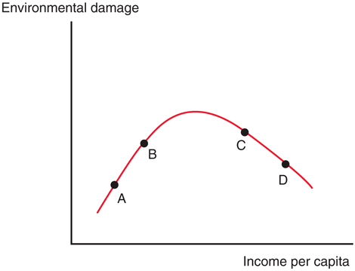
Fig. 12-3: The Environmental Kuznets Curve

Slide 58
Trade and the Environment (cont.)
Because rich countries usually have strict environmental regulations and poor countries do not, environmentally hazardous activities may be moved to poor countries.
A pollution haven is a place where an economic activity that is subject to strict environmental controls in some countries is moved to (sold to) other countries with less strict regulation.
Yet, there is evidence that pollution havens are insignificant relative to the pollution that occurs without international trade.

Slide 59
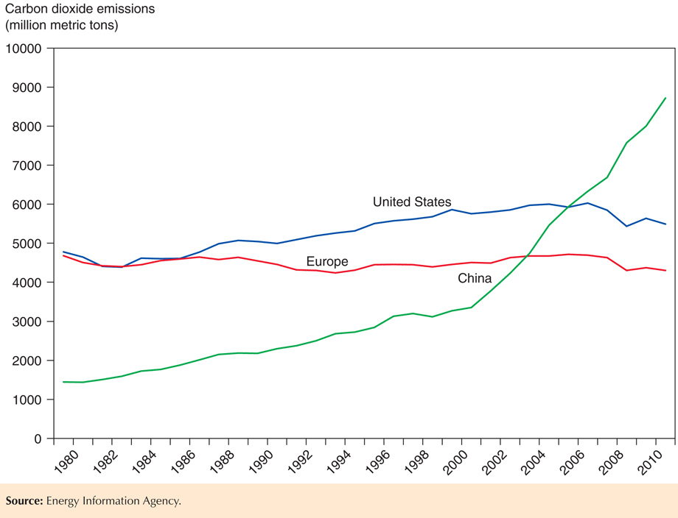
Fig. 12-4: Carbon Dioxide Emissions

Slide 60
Trade and the Environment (cont.)
Pollution in some countries may cause a negative externality for other countries.
For example, production in China could cause air pollution in Korea (or on the West Coast of the U.S.).
To the degree that pollution causes negative externalities for other countries, they should want to include it in international negotiations.
Emissions of carbon dioxide is an example of pollution that causes a negative externality and that has been included in international negotiations.

Slide 61
Trade and Culture
Some activists believe that trade destroys culture in other countries.
This belief neglects the principle that we should allow people to define their culture through the choices that they make, not through standards set by others.
Also, any economic change, not just trade, leads to changes in everyday life.

Slide 62
Summary
One argument for an activist trade policy is that investment in high-technology industries produces externalities for the economy.
But it is hard to identify which activities produce externalities and if so, to what degree they do.
A second argument for an activist trade policy is that governments can give domestic firms a strategic advantage in industries with excess profits.
But it is unclear if such a policy would succeed at giving a firm a strategic advantage or if it would be worthwhile.

Slide 63
Summary (cont.)
Some have opposed free trade because of the fact that workers in low- and middle-income countries earn lower wages and have worse working conditions than workers in high-income countries.
But workers in low- and middle-income countries are predicted to have lower wages due to lower productivity, yet still have higher wages compared to their situation without trade.

Slide 64
Summary (cont.)
Some have proposed that trade negotiations should involve labor, environmental, or “cultural” standards, but these standards are generally opposed by governments of low- and middle- income countries.

