Slide 1
Chapter 15 (4)
Money, Interest Rates, and Exchange Rates

Slide 2
Preview
What is money?
Control of the supply of money
The willingness to hold monetary assets
A model of real monetary assets and interest rates
A model of real monetary assets, interest rates, and exchange rates
Long-run effects of changes in money on prices, interest rates, and exchange rates

Slide 3
What Is Money?
Money is an asset that is widely used as a means of payment.
Different groups of assets may be classified as money.
Money can be defined narrowly or broadly.
Currency in circulation, checking deposits, and debit card accounts form a narrow definition of money.
Deposits of currency are excluded from this narrow definition, although they may act as a substitute for money in a broader definition.

Slide 4
What Is Money? (cont.)
Money is a liquid asset: it can be easily used to pay for goods and services or to repay debt without substantial transaction costs.
But monetary or liquid assets earn little or no interest.
Illiquid assets require substantial transaction costs in terms of time, effort, or fees to convert them to funds for payment.
But they generally earn a higher interest rate or rate of return than monetary assets.

Slide 5
What Is Money? (cont.)
Let’s group assets into monetary assets (or liquid assets) and nonmonetary assets (or illiquid assets).
The demarcation between the two is arbitrary,
but currency in circulation, checking deposits, debit card accounts, savings deposits, and time deposits are generally more liquid than bonds, loans, deposits of currency in the foreign exchange markets, stocks, real estate, and other assets.

Slide 6
Money Supply
The central bank substantially controls the quantity of money that circulates in an economy, the money supply.
In the U.S., the central banking system is the Federal Reserve System.
The Federal Reserve System directly regulates the amount of currency in circulation.
It indirectly influences the amount of checking deposits, debit card accounts, and other monetary assets.

Slide 7
Money Demand
Money demand represents the amount of monetary assets that people are willing to hold (instead of illiquid assets).
What influences willingness to hold monetary assets?
We consider individual demand of money and aggregate demand of money.

Slide 8
What Influences Demand of Money for Individuals and Institutions?
Interest rates/expected rates of return on monetary assets relative to the expected rates of returns on non-monetary assets.
Risk: the risk of holding monetary assets principally comes from unexpected inflation, which reduces the purchasing power of money.
But many other assets have this risk too, so this risk is not very important in defining the demand of monetary assets versus nonmonetary assets.
Liquidity: A need for greater liquidity occurs when the price of transactions increases or the quantity of goods bought in transactions increases.

Slide 9
What Influences Aggregate Demand of Money?
Interest rates/expected rates of return: monetary assets pay little or no interest, so the interest rate on non-monetary assets like bonds, loans, and deposits is the opportunity cost of holding monetary assets.
A higher interest rate means a higher opportunity cost of holding monetary assets → lower demand of money.
Prices: the prices of goods and services bought in transactions will influence the willingness to hold money to conduct those transactions.
A higher level of average prices means a greater need for liquidity to buy the same amount of goods and services → higher demand of money.

Slide 10
What Influences Aggregate Demand of Money? (cont.)
Income: greater income implies more goods and services can be bought, so that more money is needed to conduct transactions.
A higher real national income (GNP) means more goods and services are being produced and bought in transactions, increasing the need for liquidity → higher demand of money.

Slide 11
A Model of Aggregate Money Demand
The aggregate demand of money can be expressed as:
M^{d} = P x L(R,Y)
where:
P is the price level
Y is real national income
R is a measure of interest rates on nonmonetary assets
L(R,Y) is the aggregate demand of real monetary assets
Alternatively:
M^{d}/P = L(R,Y)
Aggregate demand of real monetary assets is a function of national income and interest rates.

Slide 12
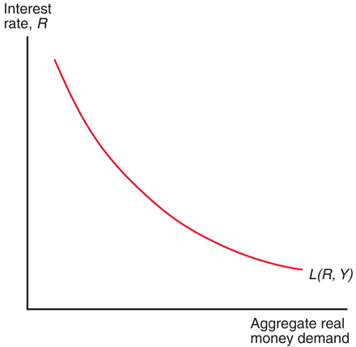
Fig. 15-1: Aggregate Real Money Demand and the Interest Rate

Slide 13
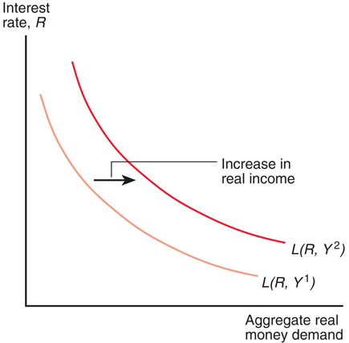
Fig. 15-2: Effect on the Aggregate Real Money Demand Schedule of a Rise in Real Income

Slide 14
A Model of the Money Market
The money market is where monetary or liquid assets, which are loosely called “money,” are lent and borrowed.
Monetary assets in the money market generally have low interest rates compared to interest rates on bonds, loans, and deposits of currency in the foreign exchange markets.
Domestic interest rates directly affect rates of return on domestic currency deposits in the foreign exchange markets.

Slide 15
A Model of the Money Market (cont.)
When no shortages (excess demand) or surpluses (excess supply) of monetary assets exist, the model achieves an equilibrium:
M^{s} = M^{d}
Alternatively, when the quantity of real monetary assets supplied matches the quantity of real monetary assets demanded, the model achieves an equilibrium:
M^{s}/P = L(R,Y)

Slide 16
A Model of the Money Market (cont.)
When there is an excess supply of monetary assets, there is an excess demand for interest- bearing assets like bonds, loans, and deposits.
People with an excess supply of monetary assets are willing to offer or accept interest-bearing assets (by giving up their money) at lower interest rates.
Others are more willing to hold additional monetary assets as interest rates (the opportunity cost of holding monetary assets) fall.

Slide 17
A Model of the Money Market (cont.)
When there is an excess demand of monetary assets, there is an excess supply of interest- bearing assets like bonds, loans, and deposits.
People who desire monetary assets but do not have access to them are willing to sell nonmonetary assets in return for the monetary assets that they desire.
Those with monetary assets are more willing to give them up in return for interest-bearing assets as interest rates (the opportunity cost of holding money) rise.

Slide 18
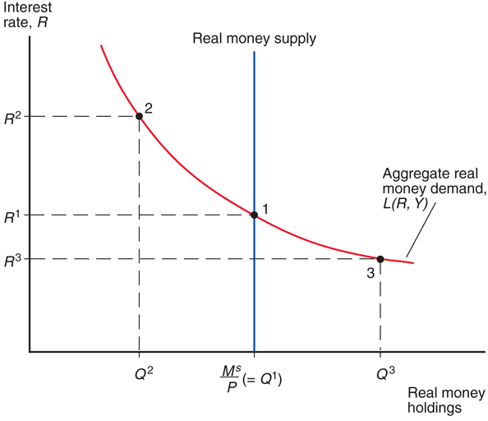
Fig. 15-3: Determination of the Equilibrium Interest Rate

Slide 19
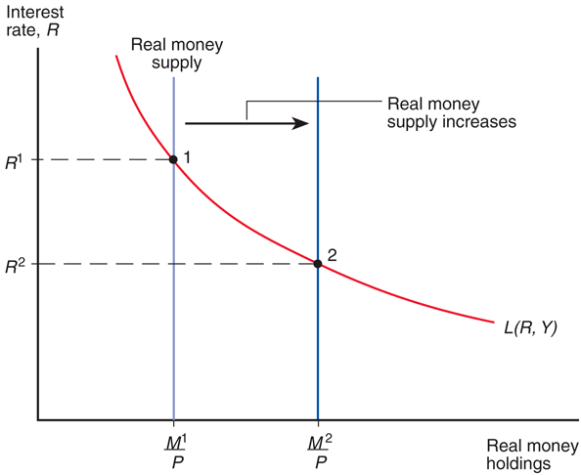
Fig. 15-4: Effect of an Increase in the Money Supply on the Interest Rate

Slide 20
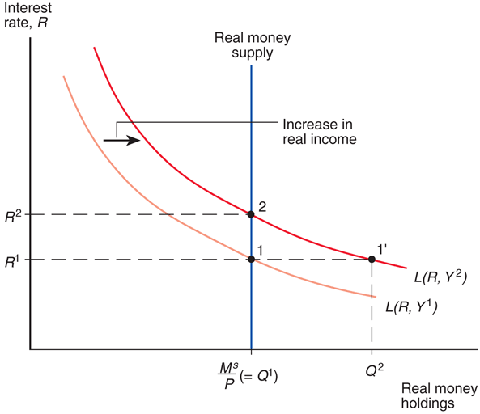
Fig. 15-5: Effect on the Interest Rate of a Rise in Real Income

Slide 21
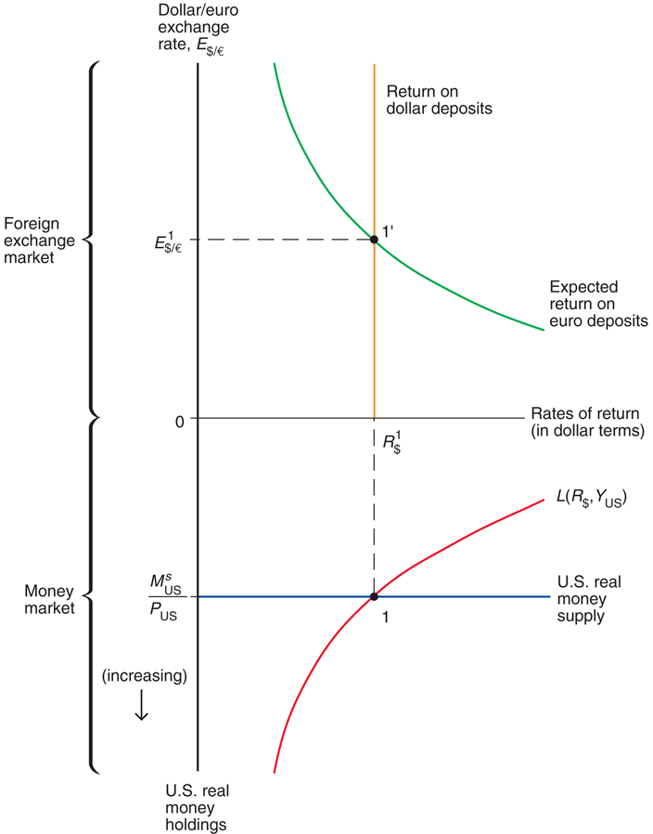
Fig. 15-6: Simultaneous Equilibrium in the U.S. Money Market and the Foreign Exchange Market

Slide 22
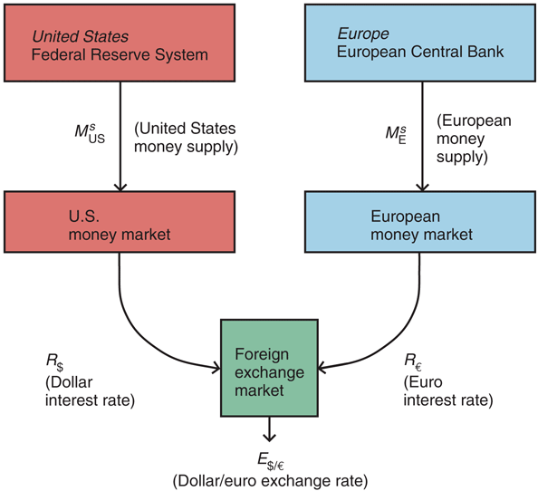
Fig. 15-7: Money Market/Exchange Rate Linkages

Slide 23
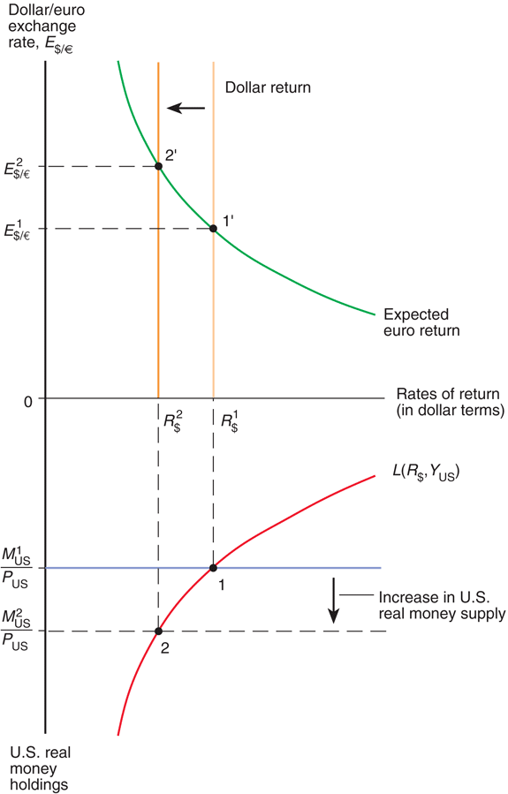
Fig. 15-8: Effect on the Dollar/Euro Exchange Rate and Dollar Interest Rate of an Increase in the U.S. Money Supply

Slide 24
Changes in the Domestic Money Supply
An increase in a country’s money supply causes interest rates to fall, rates of return on domestic currency deposits to fall, and the domestic currency to depreciate.
A decrease in a country’s money supply causes interest rates to rise, rates of return on domestic currency deposits to rise, and the domestic currency to appreciate.

Slide 25
Changes in the Foreign Money Supply
How would a change in the supply of euros affect the U.S. money market and foreign exchange markets?
An increase in the supply of euros causes a depreciation of the euro (an appreciation of the dollar).
A decrease in the supply of euros causes an appreciation of the euro (a depreciation of the dollar).

Slide 26
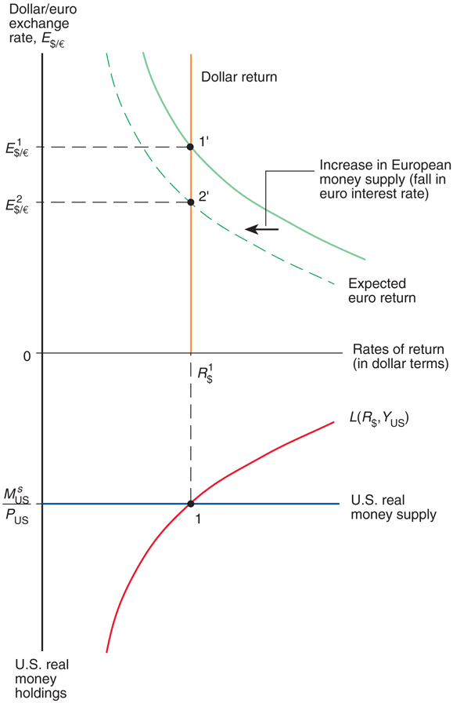
Fig. 15-9: Effect of an Increase in the European Money Supply on the Dollar/Euro Exchange Rate

Slide 27
Changes in the Foreign Money Supply (cont.)
The increase in the supply of euros reduces interest rates in the EU, reducing the expected rate of return on euro deposits.
This reduction in the expected rate of return on euro deposits causes the euro to depreciate.
We predict no change in the U.S. money market due to the change in the supply of euros.

Slide 28
Long Run and Short Run
In the short run, prices do not have sufficient time to adjust to market conditions.
The analysis heretofore has been a short-run analysis.
In the long run, prices of factors of production and of output have sufficient time to adjust to market conditions.
Wages adjust to the demand and supply of labor.
Real output and income are determined by the amount of workers and other factors of production—by the economy’s productive capacity—not by the quantity of money supplied.
(Real) interest rates depend on the supply of saved funds and the demand of saved funds.

Slide 29
Long Run and Short Run (cont.)
In the long run, the quantity of money supplied is predicted not to influence the amount of output, (real) interest rates, and the aggregate demand of real monetary assets L(R,Y).
However, the quantity of money supplied is predicted to make the level of average prices adjust proportionally in the long run.
The equilibrium condition M^{s}/P = L(R,Y) shows that P is predicted to adjust proportionally when M^{s} adjusts, because L(R,Y) does not change.

Slide 30
Long Run and Short Run (cont.)
In the long run, there is a direct relationship between the inflation rate and changes in the money supply.
M^{s} = P x L(R,Y)
P = M^{s}/L(R,Y)
ΔP/P = ΔM^{s}/M^{s} – ΔL/L
The inflation rate is predicted to equal the growth rate in money supply minus the growth rate in money demand.

Slide 31
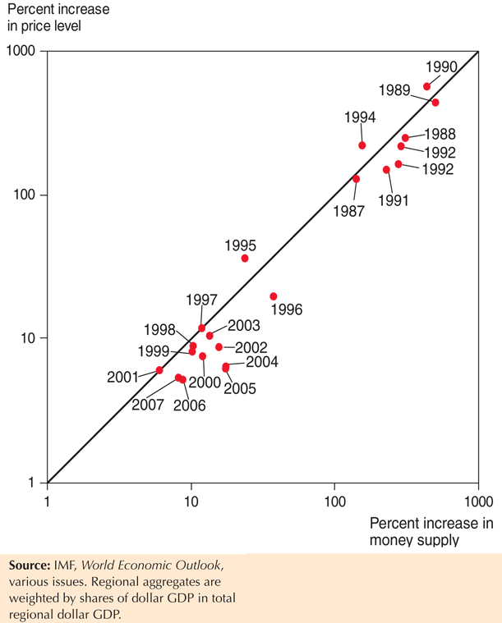
Fig. 15-10: Average Money Growth and Inflation in Western Hemisphere Developing Countries, by Year, 1987–2007

Slide 32
Money and Prices in the Long Run
How does a change in the money supply cause prices of output and inputs to change?
Excess demand of goods and services: a higher quantity of money supplied implies that people have more funds available to pay for goods and services.
To meet high demand, producers hire more workers, creating a strong demand of labor services, or make existing employees work harder.
Wages rise to attract more workers or to compensate workers for overtime.
Prices of output will eventually rise to compensate for higher costs.

Slide 33
Money and Prices in the Long Run (cont.)
Alternatively, for a fixed amount of output and inputs, producers can charge higher prices and still sell all of their output due to the high demand.
Inflationary expectations:
If workers expect future prices to rise due to an expected money supply increase, they will want to be compensated.
And if producers expect the same, they are more willing to raise wages.
Producers will be able to match higher costs if they expect to raise prices.
Result: expectations about inflation caused by an expected increase in the money supply causes actual inflation.

Slide 34
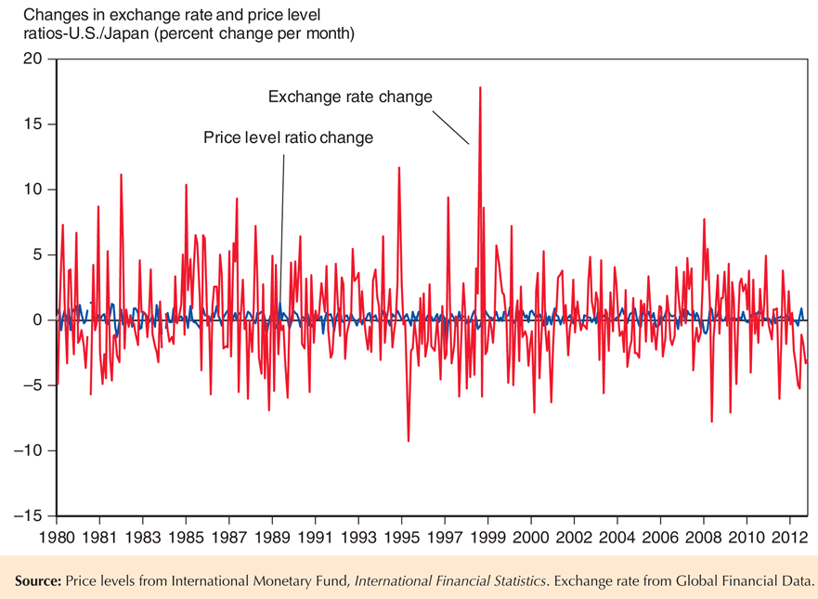
Fig. 15-11: Month-to-Month Variability of the Dollar/Yen Exchange Rate and of the U.S./Japan Price Level Ratio, 1980–2013

Slide 35
Money, Prices, Exchange Rates, and Expectations
When we consider price changes in the long run, inflationary expectations will have an effect in foreign exchange markets.
Suppose that expectations about inflation change as people change their minds, but actual adjustment of prices occurs afterwards.

Slide 36
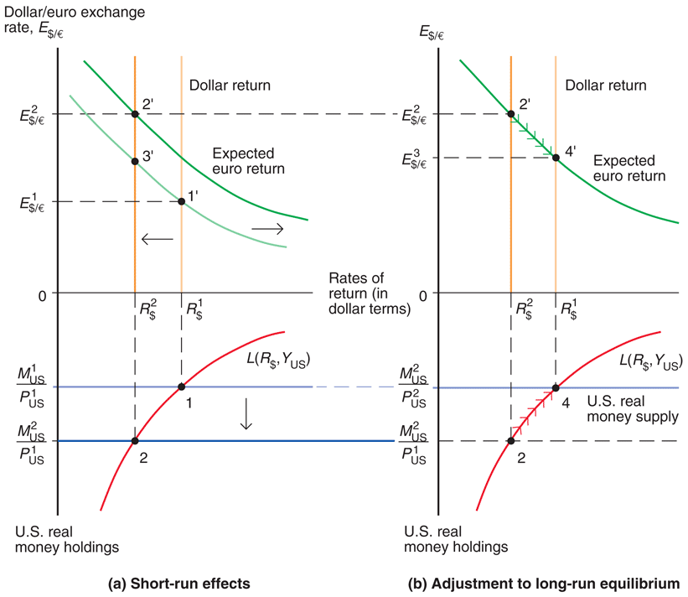
Fig. 15-12: Short-Run and Long-Run Effects of an Increase in the U.S. Money Supply (Given Real Output, Y)

Slide 37
Money, Prices, and Exchange Rates in the Long Run
A permanent increase in a country’s money supply causes a proportional long-run depreciation of its currency.
However, the dynamics of the model predict a large depreciation first and a smaller subsequent appreciation.
A permanent decrease in a country’s money supply causes a proportional long-run appreciation of its currency.
However, the dynamics of the model predict a large appreciation first and a smaller subsequent depreciation.

Slide 38
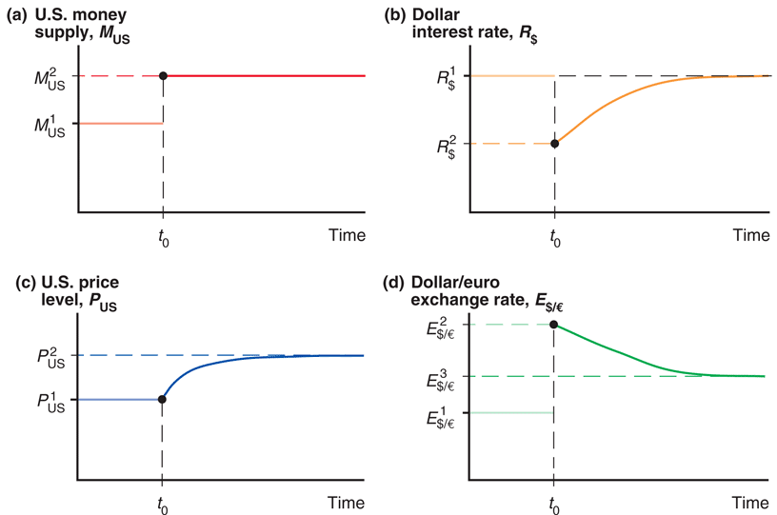
Fig. 15-13: Time Paths of U.S. Economic Variables after a Permanent Increase in the U.S. Money Supply

Slide 39
Exchange Rate Overshooting
The exchange rate is said to overshoot when its immediate response to a change is greater than its long-run response.
Overshooting is predicted to occur when monetary policy has an immediate effect on interest rates, but not on prices and (expected) inflation.
Overshooting helps explain why exchange rates are so volatile.

Slide 40
Summary
Money demand for individuals and institutions is primarily determined by interest rates and the need for liquidity, the latter of which is influenced by prices and income.
Aggregate money demand is primarily determined by interest rates, the level of average prices, and national income.
Aggregate demand of real monetary assets depends negatively on the interest rate and positively on real national income.

Slide 41
Summary (cont.)
When the money market is in equilibrium, there are no surpluses or shortages of monetary assets: the quantity of real monetary assets supplied matches the quantity of real monetary assets demanded.
Short-run scenario: changes in the money supply affect domestic interest rates, as well as the exchange rate. An increase in the domestic money supply
lowers domestic interest rates,
thus lowering the rate of return on deposits of domestic currency,
thus causing the domestic currency to depreciate.

Slide 42
Summary (cont.)
Long-run scenario: changes in the quantity of money supplied are matched by a proportional change in prices, and do not affect real income and real interest rates. An increase in the money supply
causes expectations about inflation to adjust,
thus causing the domestic currency to depreciate further,
and causes prices to adjust proportionally in the long run,
thus causing interest rates to return to their long-run values,
and causes a proportional long-run depreciation in the domestic currency.

Slide 43
Summary (cont.)
6. Interest rates adjust immediately to changes in monetary policy, but prices and (expected) inflation may adjust only in the long run, which results in overshooting of the exchange rate.
Overshooting occurs when the immediate response of the exchange rate due to a change is greater than its long-run response.
Overshooting helps explain why exchange rates are so volatile.

