Slide 1
Chapter 16 (5)
Price Levels and the Exchange Rate in the Long Run

Slide 2
Preview
Law of one price
Purchasing power parity
Long-run model of exchange rates: monetary approach
Relationship between interest rates and inflation: Fisher effect
Shortcomings of purchasing power parity
Long-run model of exchange rates: real exchange rate approach
Real interest rates

Slide 3
The Behavior of Exchange Rates
What models can predict how exchange rates behave?
In last chapter we developed a short-run model and a long-run model that used movements in the money supply.
In this chapter, we develop 2 more models, building on the long-run approach from last chapter.
Long run means a sufficient amount of time for prices of all goods and services to adjust to market conditions so that their markets and the money market are in equilibrium.
Because prices are allowed to change, they will influence interest rates and exchange rates in the long-run models.

Slide 4
The Behavior of Exchange Rates (cont.)
The long-run models are not intended to be completely realistic descriptions about how exchange rates behave, but ways of representing how market participants may form expectations about future exchange rates and how exchange rates tend to move over long periods.

Slide 5
Law of One Price
The law of one price simply says that the same good in different competitive markets must sell for the same price, when transportation costs and barriers between those markets are not important.
Why? Suppose the price of pizza at one restaurant is $20, while the price of the same pizza at an identical restaurant across the street is $40.
What do you predict will happen? Many people will buy the $20 pizza, few will buy the $40 one.

Slide 6
Law of One Price (cont.)
Due to the price difference, entrepreneurs would have an incentive to buy pizza at the cheap location and sell it at the expensive location for an easy profit.
Due to strong demand and decreased supply, the price of the $20 pizza would tend to increase.
Due to weak demand and increased supply, the price of the $40 pizza would tend to decrease.
People would have an incentive to adjust their behavior and prices would tend to adjust until one price is achieved across markets (across restaurants).

Slide 7
Law of One Price (cont.)
Consider a pizza restaurant in Seattle and one across the border in Vancouver.
The law of one price says that the price of the same pizza (using a common currency to measure the price) in the two cities must be the same if markets are competitive and transportation costs and barriers between markets are not important.
P^{pizza}_{US} = (E_{US$/C$}) x (P^{pizza}_{Canada})
P^{pizza}_{US} = price of pizza in Seattle
P^{pizza}_{Canada} = price of pizza in Vancouver
E_{US$/C$} = U.S. dollar/Canadian dollar exchange rate

Slide 8
Purchasing Power Parity
Purchasing power parity is the application of the law of one price across countries for all goods and services, or for representative groups (“baskets”) of goods and services.
P_{US} = (E_{US$/C$}) x (P_{Canada})
P_{US} = level of average prices in the U.S.
P_{Canada} = level of average prices in Canada
E_{US$/C$} = U.S. dollar/Canadian dollar exchange rate

Slide 9
Purchasing Power Parity (cont.)
Purchasing power parity (PPP) implies that the exchange rate is determined by levels of average prices
E_{US$/C$} = P_{US}/P_{Canada}
If the price level in the U.S. is US$200 per basket, while the price level in Canada is C$400 per basket, PPP implies that the C$/US$ exchange rate should be C$400/US$200 = C$2/US$1.
Predicts that people in all countries have the same purchasing power with their currencies: 2 Canadian dollars buy the same amount of goods as 1 U.S. dollar, since prices in Canada are twice as high.

Slide 10
Purchasing Power Parity (cont.)
Purchasing power parity (PPP) comes in 2 forms:
Absolute PPP: purchasing power parity that has already been discussed. Exchange rates equal the level of relative average prices across countries.
E$/€ = P_{US}/P_{EU}
Relative PPP: changes in exchange rates equal changes in prices (inflation) between two periods:
(E_{$/€,t} – E_{$/€, t –1})/E_{$/€, t –1} = π_{US, t} – π_{EU, t}
where π_{t} = inflation rate from period t –1 to t

Slide 11
Monetary Approach to Exchange Rates
Monetary approach to the exchange rate: uses monetary factors to predict how exchange rates adjust in the long run, based on the absolute version of PPP.
It predicts that levels of average prices across countries adjust so that the quantity of real monetary assets supplied will equal the quantity of real monetary assets demanded:
P_{US} = M^{s}_{US}/L (R$, Y_{US})
P_{EU} = M^{s}_{EU}/L (R€, Y_{EU})

Slide 12
Monetary Approach to Exchange Rates (cont.)
To the degree that PPP holds and to the degree that prices adjust to equate the quantity of real monetary assets supplied with the quantity of real monetary assets demanded, we have the following prediction:
The exchange rate is determined in the long run by prices, which are determined by the relative supply and demand of real monetary assets in money markets across countries.

Slide 13
Monetary Approach to Exchange Rates (cont.)
Predictions about changes in
Money supply: a permanent rise in the domestic money supply
causes a proportional increase in the domestic price level,
thus causing a proportional depreciation in the domestic currency (through PPP).
This is same prediction as long-run model without PPP.
Interest rates: a rise in domestic interest rates
lowers the demand of real monetary assets,
and is associated with a rise in domestic prices,
thus causing a proportional depreciation of the domestic currency (through PPP).

Slide 14
Monetary Approach to Exchange Rates (cont.)
Output level: a rise in the domestic level of production and income (output)
raises domestic demand of real monetary assets,
and is associated with a decreasing level of average domestic prices (for a fixed quantity of money supplied),
thus causing a proportional appreciation of the domestic currency (through PPP).
All 3 changes affect money supply or money demand, and cause prices to adjust so that the quantity of real monetary assets supplied matches the quantity of real monetary assets demanded, and cause exchange rates to adjust according to PPP.

Slide 15
Monetary Approach to Exchange Rates (cont.)
A change in the money supply results in a change in the level of average prices.
A change in the growth rate of the money supply results in a change in the growth rate of prices (inflation).
A constant growth rate in the money supply results in a persistent growth rate in prices (persistent inflation) at the same constant rate, when other factors are constant.
Inflation does not affect the productive capacity of the economy and real income from production in the long run.
Inflation, however, does affect nominal interest rates. How?

Slide 16
The Fisher Effect
The Fisher effect (named affect Irving Fisher) describes the relationship between nominal interest rates and inflation.
Derive the Fisher effect from the interest parity condition: R$ – R€ = (E^{e}$/€ – E$/€)/E$/€
If financial markets expect (relative) PPP to hold, then expected exchange rate changes will equal expected inflation between countries: (E^{e}$/€ – E$/€)/E$/€ = π^{e}_{US} – π^{e}_{EU}
Therefore, R$ – R€ = π^{e}_{US} – π^{e}_{EU}
The Fisher effect: a rise in the domestic inflation rate causes an equal rise in the interest rate on deposits of domestic currency in the long run, when other factors remain constant.

Slide 17
Monetary Approach to Exchange Rates
Suppose that the U.S. central bank unexpectedly increases the growth rate of the money supply at time t₀.
Suppose also that the inflation rate is π in the US before t₀ and π + Δπ after this time, but that the European inflation rate remains at 0%.
According to the Fisher effect, the interest rate in the U.S. will adjust to the higher inflation rate.

Slide 18
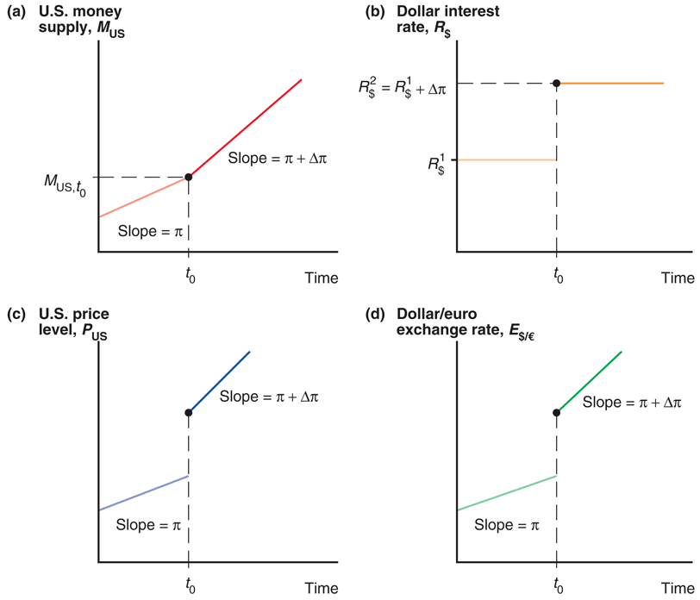
Fig. 16-1: Long-Run Time Paths of U.S. Economic Variables After a Permanent Increase in the Growth Rate of the U.S. Money Supply

Slide 19
Fig. 16-1: Long-Run Time Paths of U.S. Economic Variables After a Permanent Increase in the Growth Rate of the U.S. Money Supply (cont.)

Slide 20
Monetary Approach to Exchange Rates (cont.)
The increase in nominal interest rates decreases the demand of real monetary assets.
In order for the money market to maintain equilibrium in the long run, prices must jump so that
P_{US} = M^{s}_{US}/L (R$, Y_{US})
In order to maintain PPP, the exchange rate must jump (the dollar must depreciate) so that
E$/€ = P_{US}/P_{EU}
Thereafter, the money supply and prices are predicted to grow at rate π + Δπ and the domestic currency is predicted to depreciate at the same rate.

Slide 21
The Role of Inflation and Expectations
In the long-run model without PPP:
Changes in money supply lead to changes in the level of average prices.
No inflation is predict to occur in the long run, but only during the transition to the long-run equilibrium.
During the transition, inflation causes the nominal interest rate to increase to its long-run value.
Expectations of higher domestic inflation cause the expected return on foreign currency deposits to increase, making the domestic currency depreciate before the transition period.

Slide 22
The Role of Inflation and Expectations (cont.)
In the monetary approach (with PPP), the rate of inflation increases permanently when the growth rate of the money supply increases permanently.
With persistent domestic inflation (above foreign inflation), the monetary approach also predicts an increase in the domestic nominal interest rate.
Expectations of higher domestic inflation cause the expected purchasing power of domestic currency to decrease relative to the expected purchasing power of foreign currency, thereby making the domestic currency depreciate.

Slide 23
The Role of Inflation and Expectations (cont.)
In the long-run model without PPP, the level of average prices does not immediately adjust even if expectations of inflation adjust,
causing the exchange rate to overshoot (causing the domestic currency to depreciate more than) its long-run value.
In the monetary approach (with PPP), the level of average prices adjusts with expectations of inflation,
causing the domestic currency to depreciate, but with no overshooting.

Slide 24
Shortcomings of PPP
There is little empirical support for absolute purchasing power parity.
The prices of identical commodity baskets, when converted to a single currency, differ substantially across countries.
Relative PPP is more consistent with data, but it also performs poorly to predict exchange rates.

Slide 25
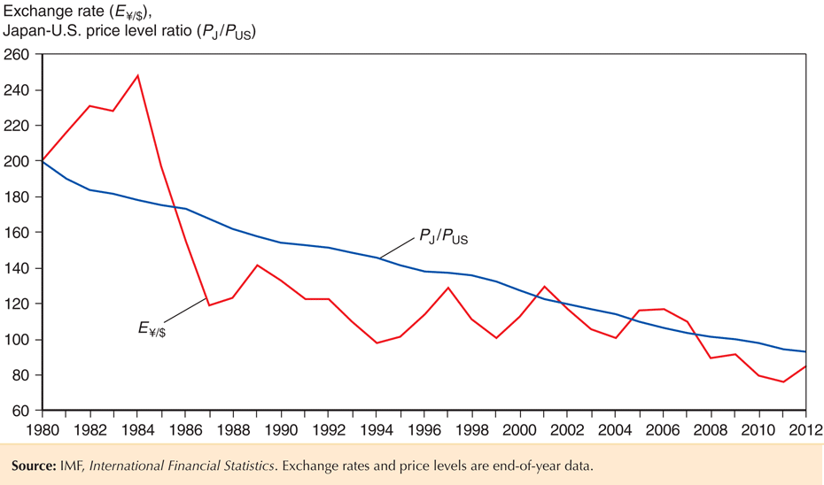
Fig. 16-2: The Yen/Dollar Exchange Rate and Relative Japan-U.S. Price Levels, 1980–2012

Slide 26
Shortcomings of PPP (cont.)
Reasons why PPP may not be accurate: the law of one price may not hold because of
Trade barriers and nontradable products
Imperfect competition
Differences in measures of average prices for baskets of goods and services

Slide 27
Shortcomings of PPP (cont.)
Trade barriers and nontradable products
Transport costs and governmental trade restrictions make trade expensive and in some cases create nontradable goods or services.
Services are often not tradable: services are generally offered within a limited geographic region (for example, haircuts).
The greater the transport costs, the greater the range over which the exchange rate can deviate from its PPP value.
One price need not hold in two markets.

Slide 28
Shortcomings of PPP (cont.)
Imperfect competition may result in price discrimination: “pricing to market.”
A firm sells the same product for different prices in different markets to maximize profits, based on expectations about what consumers are willing to pay.
One price need not hold in two markets.

Slide 29
Shortcomings of PPP (cont.)
Differences in the measure of average prices for goods and services
levels of average prices differ across countries because of differences in how representative groups (“baskets”) of goods and services are measured.
Because measures of groups of goods and services are different, the measure of their average prices need not be the same.
One price need not hold in two markets.

Slide 30
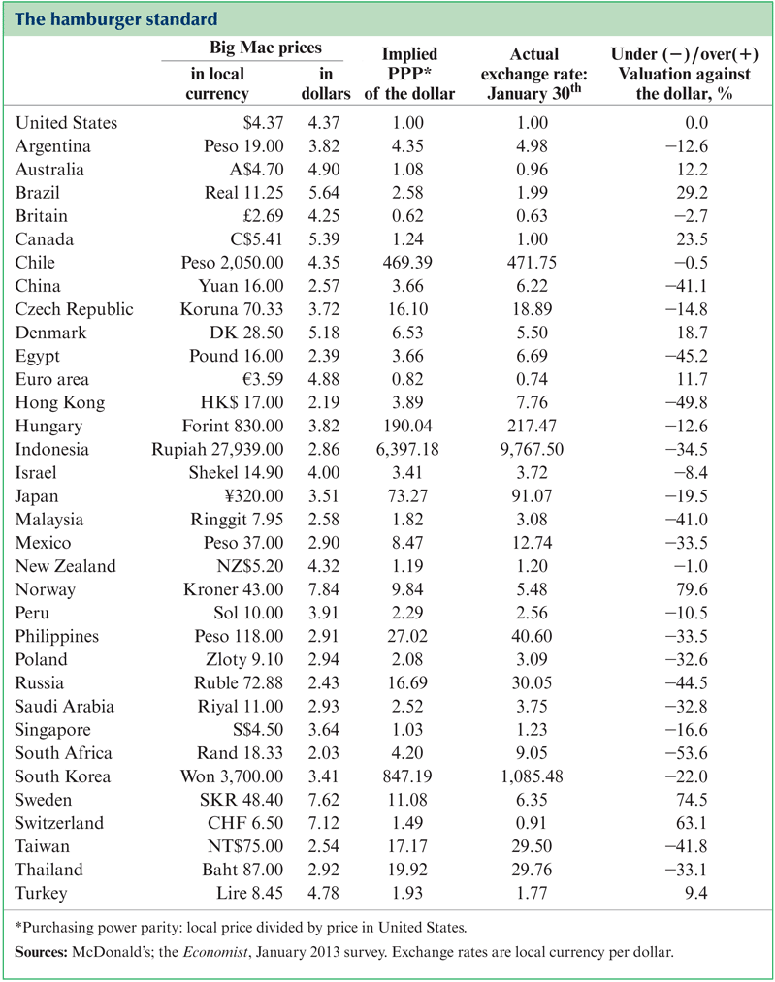
Law of One Price for Hamburgers?

Slide 31
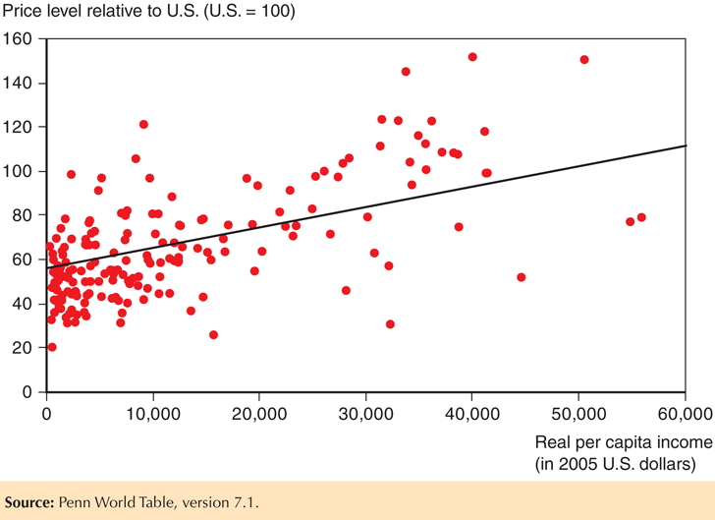
Fig. 16-3: Price Levels and Real Incomes, 2010

Slide 32
The Real Exchange Rate Approach to Exchange Rates
Because of the shortcomings of PPP, economists have tried to generalize the monetary approach to PPP to make a better theory.
The real exchange rate is the rate of exchange for goods and services across countries.
In other words, it is the relative value/price/cost of goods and services across countries.
For example, it is the dollar price of a European group of goods and services relative to the dollar price of an American group of goods and services:
q_{US/EU} = (E$/€ x P_{EU})/P_{US}

Slide 33
The Real Exchange Rate Approach to Exchange Rates (cont.)
q_{US/EU} = (E$/€ x P_{EU})/P_{US}
If the EU basket costs €100, the U.S. basket costs $120, and the nominal exchange rate is $1.20 per euro, then the real exchange rate is 1 U.S. basket per 1 EU basket.
A real depreciation of the value of U.S. products means a fall in a dollar’s purchasing power of EU products relative to a dollar’s purchasing power of U.S. products.
This implies that U.S. goods become less expensive and less valuable relative to EU goods.
This implies that the value of U.S. goods relative to value of EU goods falls.

Slide 34
The Real Exchange Rate Approach to Exchange Rates (cont.)
q_{US/EU} = (E$/€ x P_{EU})/P_{US}
A real appreciation of the value of U.S. products means a rise in a dollar’s purchasing power of EU products relative to a dollar’s purchasing power of U.S. products.
This implies that U.S. goods become more expensive and more valuable relative to EU goods.
This implies that the value of U.S. goods relative to value of EU goods rises.

Slide 35
The Real Exchange Rate Approach to Exchange Rates (cont.)
According to PPP, exchange rates are determined by relative average prices:
E$/€ = P_{US}/P_{EU}
According to the more general real exchange rate approach, exchange rates may also be influenced by the real exchange rate:
E$/€ = q_{US/EU} x P_{US}/P_{EU}
What influences the real exchange rate?

Slide 36
The Real Exchange Rate Approach to Exchange Rates (cont.)
A change in relative demand of U.S. products
An increase in relative demand of U.S. products causes the value (price) of U.S. goods relative to the value (price) of foreign goods to rise.
A real appreciation of the value of U.S. goods: P_{US} rises relative to E$/€ x P_{EU}
The real appreciation of the value of U.S. goods makes U.S. exports more expensive and imports into the U.S. less expensive (thereby reducing the relative quantity demanded of U.S. products).
A decrease in relative demand of U.S. products causes a real depreciation of the value of U.S. goods.

Slide 37
The Real Exchange Rate Approach to Exchange Rates (cont.)
A change in relative supply of U.S. products
An increase in relative supply of U.S. products (caused by an increase in U.S. productivity) causes the price/cost of U.S. goods relative to the price/cost of foreign goods to fall.
A real depreciation of the value of U.S. goods: P_{US} falls relative to E$/€ x P_{EU}
The real depreciation of the value of U.S. goods makes U.S. exports less expensive and imports into the U.S. more expensive (thereby increasing relative quantity demanded to match increased relative quantity supplied).
A decrease in relative supply of U.S. products causes a real appreciation of the value of U.S. goods.

Slide 38
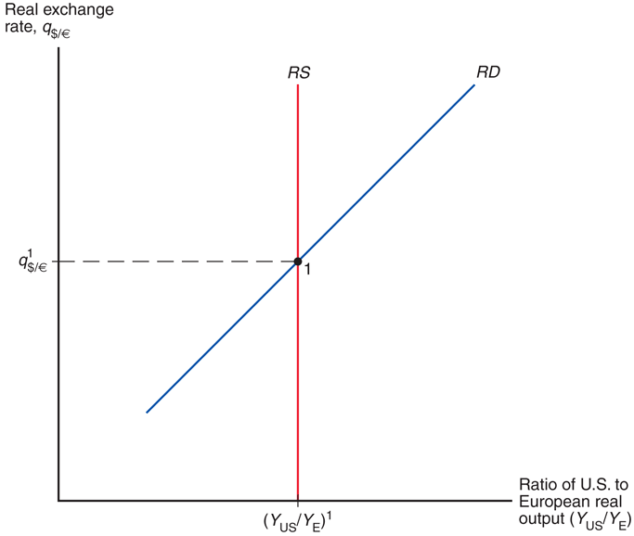
Fig. 16-4: Determination of the Long-Run Real Exchange Rate
Notes:
Suppose the supply of long run output in the US economy is equal to Y¹_{US} and the supply of long run output in the EU is equal to Y¹_{EU}. In the long run, these two quantities depend on the productive capacity of the respective economy--on factors of production like labor, physical capital, technology, natural resources, and so on. They do not depend on the real exchange rate. That is, they do not depend on the nominal exchange rate, nor the price levels in either economy. Thus, the relative supply of US products, (Y_{US}/Y_{EU}⁾¹, is also independent of the real exchange rate. We represent this independence by drawing a vertical line in the graph.

Slide 39
The Real Exchange Rate Approach to Exchange Rates
The real exchange rate is a more general approach to explain exchange rates. Both monetary factors and real factors influence nominal exchange rates:
1a. Increases in monetary levels lead to temporary inflation and changes in expectations about inflation.
1b. Increases in monetary growth rates lead to persistent inflation and changes in expectations about inflation.
2a. Increases in relative demand of domestic products lead to a real appreciation.
2b. Increases in relative supply of domestic products lead to a real depreciation.

Slide 40
The Real Exchange Rate Approach to Exchange Rates (cont.)
What are the effects on the nominal exchange rate?
E$/€ = q_{US/EU} x P_{US}/P_{EU}
When only monetary factors change and PPP holds, we have the same predictions as before.
No changes in the real exchange rate occurs.
When factors influencing real output change, the real exchange rate changes.
With an increase in relative demand of domestic products, the real exchange rate adjusts to determine nominal exchange rates.
With an increase in relative supply of domestic products, the situation is more complex.

Slide 41
The Real Exchange Rate Approach to Exchange Rates (cont.)
With an increase in the relative supply of domestic products, the real exchange rate adjusts to make the price/cost of domestic goods depreciate, but the relative amount of domestic output also increases.
This second effect increases the demand of real monetary assets in the domestic economy:
P_{US} = M^{s}_{US}/L (R$, Y_{US})
Thus the level of average domestic prices is predicted to decrease relative to the level of average foreign prices.
The effect on the nominal exchange rate is ambiguous:
E$/€ = q_{US/EU} x P_{US}/P_{EU}
?

Slide 42
The Real Exchange Rate Approach to Exchange Rates (cont.)
When economic changes are influenced only by monetary factors, and when the assumptions of PPP hold, nominal exchange rates are determined by PPP.
When economic changes are caused by factors that affect real output, exchange rates are not determined by PPP only, but are also influenced by the real exchange rate.

Slide 43
Interest Rate Differences
A more general equation of differences in nominal interest rates across countries can be derived from
(q^{e}_{US/EU} – q_{US/EU})/q_{US/EU} = [(E^{e}$/€ – E$/€)/E$/€] – (π^{e}_{US} – π^{e}_{EU})
R$ – R€ = (E^{e}$/€ – E$/€)/E$/€
R$ – R€ = (q^{e}_{US/EU} – q_{US/EU})/q_{US/EU} + (π^{e}_{US} – π^{e}_{EU})
The difference in nominal interest rates across two countries is now the sum of
the expected rate of depreciation in the value of domestic goods relative to foreign goods, and
the difference in expected inflation rates between the domestic economy and the foreign economy.

Slide 44
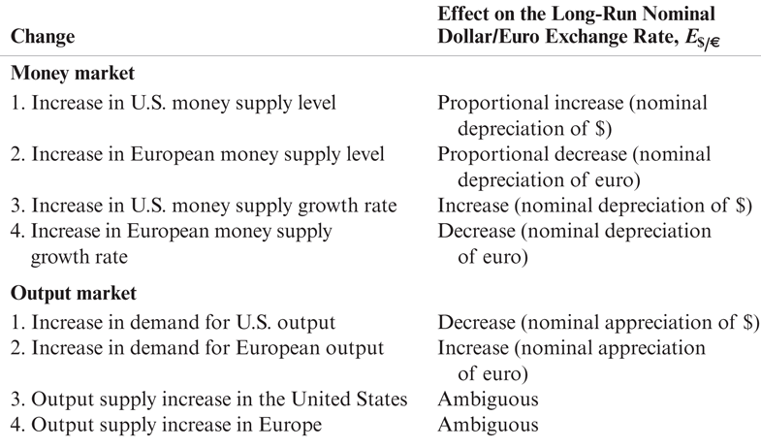
Table 16-1: Effects of Money Market and Output Market Changes on the Long-Run Nominal Dollar/Euro Exchange Rate, E$/€

Slide 45
Real Interest Rates
Real interest rates are inflation-adjusted interest rates:
r^{e} = R – π^{e}
where π^{e} represents the expected inflation rate and R represents a measure of nominal interest rates.
Real interest rates are measured in terms of real output:
the quantity of goods and services that savers can purchase when their assets pay interest
the quantity of goods and services that borrowers cannot purchase when they must pay interest on their loans
What are the predicted differences in real interest rates across countries?

Slide 46
Real Interest Rates (cont.)
Real interest rate differentials are derived from
r^{e}_{US} – r^{e}_{EU} = (R$ – π^{e}_{US}) – (R€ – π^{e}_{EU})
R$ – R€ = (q^{e}_{US/EU} – q_{US/EU})/q_{US/EU} + (π^{e}_{US} – π^{e}_{EU})
r^{e}_{US} – r^{e}_{EU} = (q^{e}_{US/EU} – q_{US/EU})/q_{US/EU}
The last equation is called real interest parity.
It says that differences in real interest rates (in terms of goods and services that are earned or forgone when lending or borrowing) between countries are equal to the expected change in the value/price/cost of goods and services between countries.

Slide 47
Summary
The law of one price says that the same good in different competitive markets must sell for the same price, when transportation costs and barriers between markets are not important.
Purchasing power parity applies the law of one price for all goods and services among all countries.
Absolute PPP says that currencies of two countries have the same purchasing power.
Relative PPP says that changes in the nominal exchange rate between two countries equals the difference in the inflation rates between the two countries.

Slide 48
Summary (cont.)
The monetary approach to exchange rates uses PPP and the supply and demand of real monetary assets.
Changes in the growth rate of the money supply influence inflation and exchange rates.
Expectations about inflation influence the exchange rate.
The Fisher effect shows that differences in nominal interest rates are equal to differences in inflation rates.
Empirical support for PPP is weak.
Trade barriers, nontradable products, imperfect competition and differences in price measures may cause the empirical shortcomings of PPP.

Slide 49
Summary (cont.)
The real exchange rate approach to exchange rates generalizes the monetary approach.
It defines the real exchange rate as the value/price/cost of domestic products relative to foreign products.
It predicts that changes in relative demand and relative supply of products influence real and nominal exchange rates.
Interest rate differences are explained by a more general concept: expected changes in the value of domestic products relative to the value of foreign products plus the difference of inflation rates between the domestic and foreign economies.

Slide 50
Summary (cont.)
Real interest rates are inflation-adjusted interest rates, and show how much purchasing power savers gain and borrowers give up.
Real interest parity shows that differences in real interest rates between countries equal expected changes in the real value of goods and services between countries.

Slide 51
Chapter 16 (5)
Appendix: the Fisher Effect, the Interest Rate, and the Exchange Rate under the Flexible-Price Monetary Approach

Slide 52
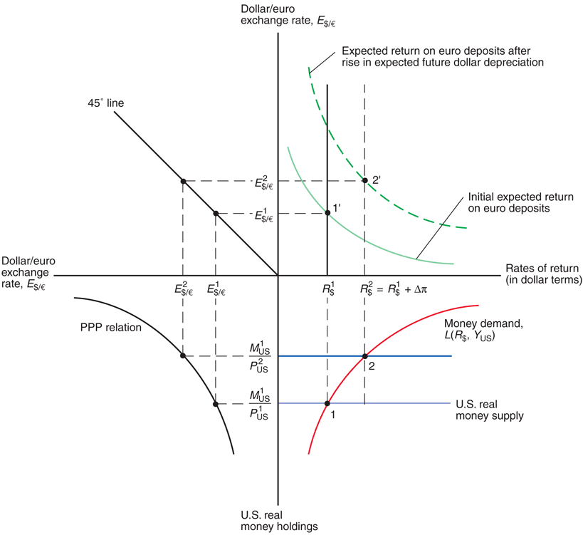
Fig. 16A-1: How a Rise in U.S. Monetary Growth Affects Dollar Interest Rates and the Dollar/Euro Exchange Rate When Goods Prices Are Flexible

