Slide 1
Stock Valuation and Risk

Slide 2
Chapter Objectives
explain methods of valuing stocks
explain how to determine the required rate of return on stocks
identify the factors that affect stock prices
explain how to measure the risk of stocks

Slide 3
Stock Valuation Methods
The Price-Earnings (PE) Method applies the mean price-earnings (PE) ratio based on expected earnings of all traded competitors to the firm’s expected earnings for the next year
Valuation = Expected earnings per share x Mean industry PE ratio
Assumes future earnings are an important determinant of a firm’s value
Assumes that the growth in earnings in future years will be similar to that of the industry

Slide 4
Stock Valuation Methods
Price-Earnings Method (cont.)
Reasons for Different Valuations
Investors may use different forecasts for the firm’s earnings or the mean industry earnings over the next year
Investors disagree on the proper measure of earnings.
Limitations of the PE Method –
May result in an inaccurate valuation of a firm if errors are made in forecasting the firm’s future earnings or in choosing the industry composite used to derive the PE ratio.

Slide 5
Dividend Discount Model
where t = period
D _{t} = dividend in period t
k = discount rate

Slide 6
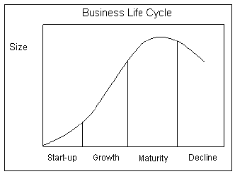
Business Life Cycle and Dividend Policy

Slide 7
Stock Valuation Methods
Dividend Discount Model (cont.)
Relationship with PE Ratio for Valuing
Limitations of the Dividend Discount Model
Errors can be made in determining the dividend to be paid, the growth rate, and the required rate of return
Errors are more pronounced for firms that retain most of their earnings.

Slide 8
Stock Valuation Methods
Free Cash Flow Model
For firms that do not pay dividends:
estimate the free cash flows that will result from operations.
FCFF (discount factor WACC) – value of the firm
FCFE (discount factor k – required rate of return/ costs of equity capital) – value of the eqiuty capital
Limitations - difficulty of obtaining an accurate estimate of free cash flow per period.

Slide 9
Free Cash Flow to the Firm
FCFF = CFO + [Int x (1-tax rate)] – FCInv Where: CFO = Cash Flow from Operations Int = Interest Expense FCInv = Fixed Capital Investment (total capital expenditures)

Slide 10
Free Cash Flow to the Firm (for firm's that follow IFRS)
FCFF = NI + NCC + [Int x (1-tax rate)] – FCInv – WCInv Where: NI = Net Income NCC = Non-cash Charges (depreciation and amortization) Int = Interest Expense FCInv = Fixed Capital Investment (total capital expenditures) WCInv = Working Capital Investments (Change in Net working Capital)

Slide 11
Free Cash Flow to Equity
FCFE = FCFF - [Int x (1-tax rate)] + Net Borrowing
FCFE = Net Income - Net Capital Expenditure - Change in Net Working Capital + New Debt - Debt Repayment

Slide 12
Required Rate of Return on Stocks
Capital Asset Pricing Model
Sometimes used to estimate the required rate of return for any firm with publicly traded stock.
The only important risk of a firm is systematic risk.
Suggests that the return of a stock (Rj) is influenced by the prevailing risk-free rate (Rf), the market return (Rm), and the beta (Bj): Rj = Rf + Bj(Rm – Rf) where Bj is measured as the covariance between Rj and Rm, which reflects the asset’s sensitivity to general stock market movements.

Slide 13
Required Rate of Return on Stocks
Capital Asset Pricing Model (Cont.)
Estimating the Market Risk Premium
The yield on newly issued Treasury bonds is commonly used as a proxy for the risk-free rate.
The term, (Rm – Rf), is the market risk premium: the return of the market in excess of the risk-free rate.
Historical data for 30 or more years can be used to determine the average market risk premium over time.
Estimating the Firm’s Beta - typically measured by applying regression analysis to determine the sensitivity of the asset’s return to the market return based on monthly or quarterly data.

Slide 14
Country Risk Premium

Slide 15
Firm’s Beta

Slide 16
Equity Risk Premium

Slide 17
Required Rate of Return on Stocks
Capital Asset Pricing Model (Cont.)
Application of the CAPM
Given the risk-free rate as well as estimates of the firm’s beta and the market risk premium, it is possible to estimate the required rate of return from investing in the firm’s stock.
At any given time, the required rates of return estimated by the CAPM will vary across stocks because of differences in their risk premiums, which are due to differences in their systematic risk (as measured by beta).

Slide 18
Factors that Affect Stock Prices
Economic Factors
Impact of Economic Growth (Exhibit 11.1)
An increase in economic growth is expected to increase the demand for products and services produced by firms and thereby increase a firm’s cash flows and valuation.
Impact of Interest Rates
Given a choice of risk-free Treasury securities or stocks, investors should purchase stocks only if they are appropriately priced to reflect a sufficiently high expected return above the risk-free rate.
Interest rates commonly rise in response to an increase in economic growth.

Slide 19
Exhibit 11.1 Stock Market Trend Based on the S&P 500 Index

Slide 20
Factors that Affect Stock Prices
Market-Related Factors
Investor Sentiment
Represents the general mood of investors in the stock market.
January Effect
Portfolio managers prefer investing in riskier, small stocks at the beginning of the year and then shifting to larger, more stable companies near the end of the year in order to lock in their gains.
This tendency places upward pressure on small stocks in January each year

Slide 21
Factors that Affect Stock Prices
Firm-Specific Factors
Change in Dividend Policy
An increase in dividends may reflect the firm’s expectation that it can more easily afford to pay dividends.
Earnings Surprises
When a firm’s announced earnings are higher than expected, some investors raise their estimates of the firm’s future cash flows and hence revalue its stock upward.

Slide 22
Factors that Affect Stock Prices
Firm-Specific Factors (Cont.)
Acquisitions
The expected acquisition of a firm typically results in an increased demand for the target’s stock, which raises its price.
Expectations
Attempting to anticipate new policies so that they can make their move in the market before other investors.

Slide 23
Factors that Affect Stock Prices
Integration of Factors Affecting Stock Prices
Whenever indicators signal the expectation of higher interest rates, there is upward pressure on the required return by investors and downward pressure on a firm’s value. (Exhibit 11.2)

Slide 24
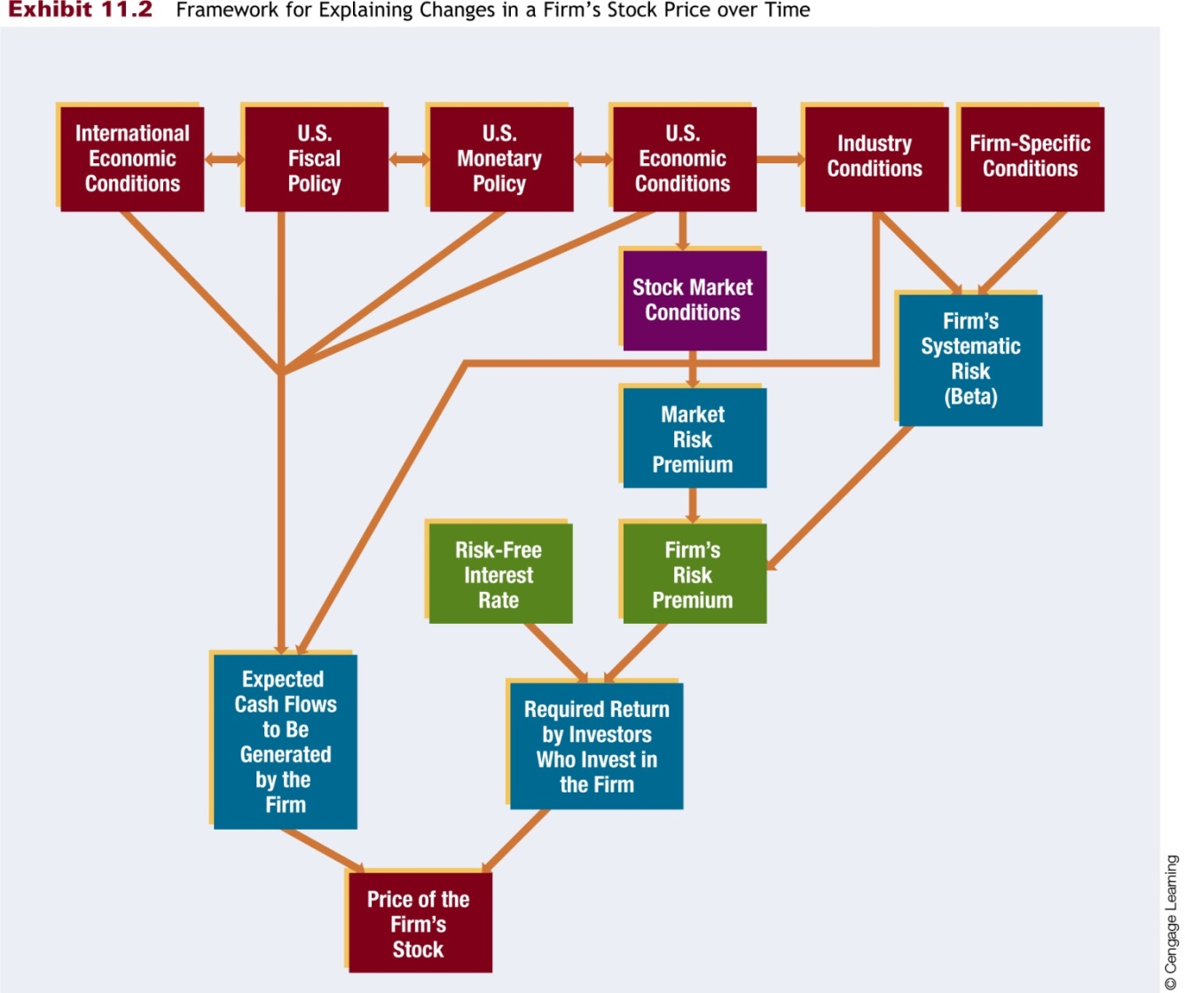
Exhibit 11.2 Framework for Explaining Changes in a Firm’s Stock Price over Time

Slide 25
Stock Risk
The return from investing in stock over a particular period is measured as
The risk of a stock can be measured by using its price volatility, its beta, and the value-at-risk method.

Slide 26
Stock Risk
Volatility of a Stock or total risk serves as a measure of risk because it may indicate the degree of uncertainty surrounding the stock’s future returns.
Using Standard Deviation to forecast Stock Price Volatility
Using the historical method: a historical period is used to derive a stock’s standard deviation of returns, and that estimate is then used as the forecast over the future.
Using Implied Volatility to Forecast Stock Price Volatility
Derive a stock’s implied standard deviation from a stock option pricing model.

Slide 27
Stock Risk
Volatility of a Stock (cont.)
Forecasting Stock Price Volatility of the Stock Market
Monitor the volatility index (VIX) derived from stock options on the S&P 500 stock at a given point in time.
The VIX measures investors’ expectation of the stock market volatility over the next 30 days. (Exhibit 11.3)

Slide 28
Exhibit 11.3 Implied Volatility Index for U.S. Stocks over Time

Slide 29
Stock Risk
Volatility of a Stock (Cont.)
Volatility of a Stock Portfolio - The portfolio’s volatility can be measured by the standard deviation:

Slide 30
Stock Risk
Beta of a Stock - measures the sensitivity of its returns to market (Exhibit 11.4)
Beta of a Stock Portfolio can be measured as the weighted average of the betas of stocks that make up the portfolio
High-beta stocks are expected to be relatively volatile because they are more sensitive to market returns over time. Likewise, low-beta stocks are expected to be less volatile because they are less responsive to market returns.

Slide 31
Stock Risk
Value at Risk
Estimates the largest expected loss to a particular investment position for a specified confidence level.
Is intended to warn investors about the potential maximum loss that could occur
Is commonly used to estimate the risk of a portfolio
Monte Carlo Simulation
Riskmetrics JP Morgan
(confidence level: 95% (99%), time frame: 1 day, loss amount (or percentage) )

Slide 32
Risk-Adjusted Stock Performance
Sharpe Index
The reward-to-variability ratio, or Sharpe Index, measures risk-adjusted returns when total variability is the most appropriate measure of risk.
This index measures the excess return above the risk-free rate per unit of risk.

Slide 33
Risk-Adjusted Stock Performance
Treynor Index
The Treynor Index measures risk-adjusted returns when beta is the most appropriate measure of risk.

Slide 34
Thank you for your attention

