Slide 1
Options Market

Slide 2
Chapter Objectives
provide a background on options
explain why stock option premiums vary
explain how stock options are used to speculate
explain how stock options are used to hedge

Slide 3
Background on Options
Call Option: right to buy underlying financial instrument at exercise price (or strike price) within a specified period of time.
    In the money when market price > exercise price
    At the money when market price = exercise price
    Out of the money when market price < exercise price
Put Option: right to sell underlying financial instrument at exercise price (or strike price) within a specified period of time.
    In the money when market price < exercise price
    At the money when market price = exercise price
    Out of the money when market price > exercise price

Slide 4
Background on Options
Comparison of Options and Futures
  To obtain an option, a premium must be paid in addition to the price of the financial instrument.
  The owner of an option can choose to let the option expire on the expiration date without exercising it.

Slide 5
Markets Used to Trade Options
The Chicago Board Options Exchange (CBOE), created in 1973, is the most important exchange for trading options.
As the popularity of stock options increased, various stock exchanges began to list options.
Listing Requirements - One key requirement is a minimum trading volume of the underlying stock.
Role of the Options Clearing Corporation - serves as a guarantor on option contracts traded in the United States.
Regulation of Options Trading – SEC and others.

Slide 6
Background on Options
How Option Trades Are Executed
  Computer technology allows investors to have trades executed electronically.
  Market-makers can execute stock option transactions for customers.
Types of Orders
  An investor can use either a market order or a limit order for an option transaction.
  Online Trading - Option contracts can also be purchased or sold online.

Slide 7
Background on Options
Stock Option Quotations (Exhibit 14.1)
Institutional Use of Options
Although options positions are sometimes taken by financial institutions for speculative purposes, they are more commonly used for hedging. (Exhibit 14.2)

Slide 8
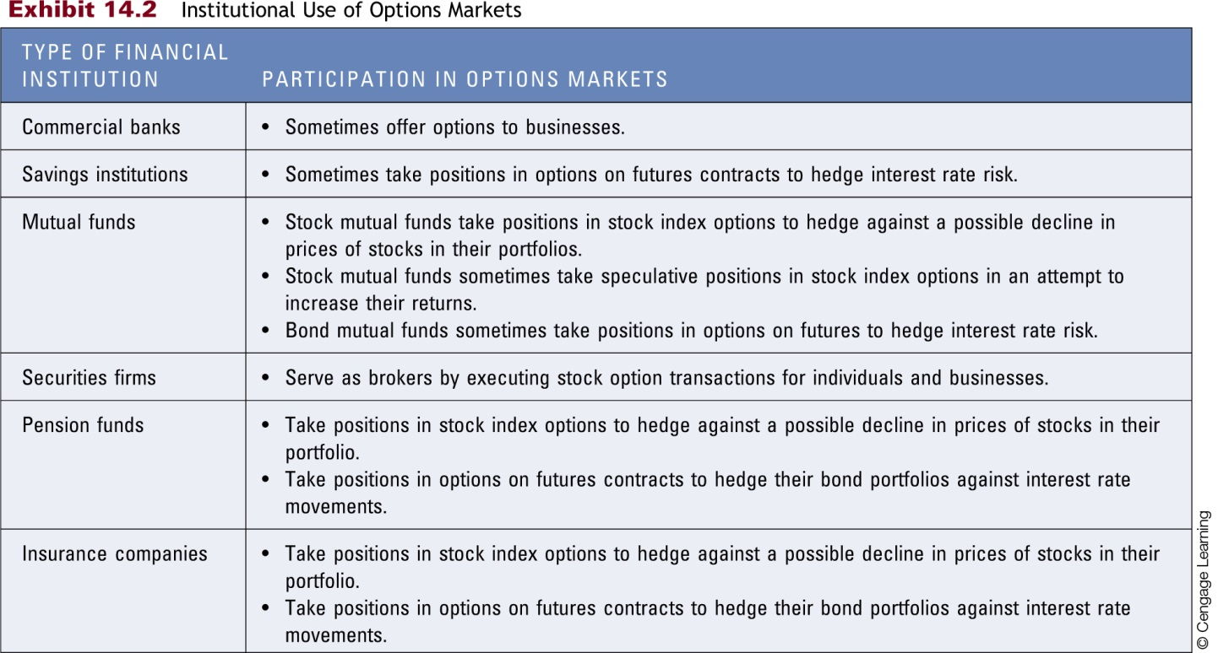

Slide 9
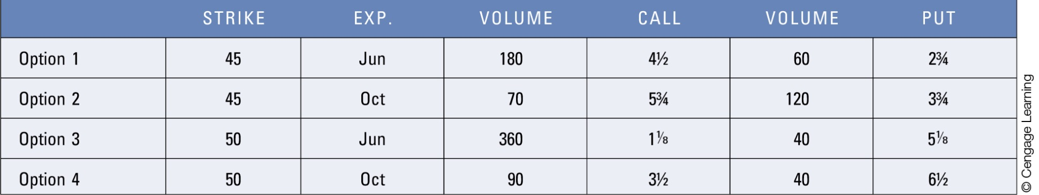
Viperon Company Stock Option Quotations

Slide 10
Determinants of Call Option Premiums
Influence of the Market Price - The higher the existing market price of the underlying financial instrument relative to the exercise price, the higher the call option premium, other things being equal. (Exhibit 14.3)
Influence of the Stock’s Volatility - The greater the volatility of the underlying stock, the higher the call option premium, other things being equal.
Influence of the Call Option’s Time to Maturity - The longer the call option’s time to maturity, the higher the call option premium, other things being equal (Exhibit 14.4)

Slide 11
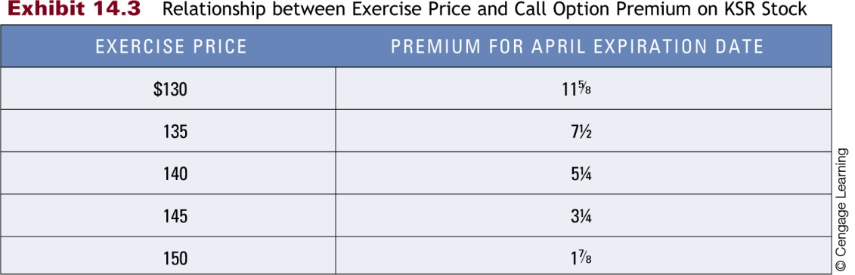
14.3 Relationship between Exercise Price and Call Option Premium on KSR Stock

Slide 12
Viperon Company Stock Option Quotations

Slide 13
Determinants of Put Option Premiums
Influence of the Market Price - The higher the existing market price of the underlying stock relative to the exercise price, the lower the put option premium, other things being equal. (Exhibit 14.5)
Influence of the Stock’s Volatility - The greater the volatility of the underlying stock, the higher the put option premium, other things being equal.
Influence of the Put Option’s Time to Maturity - The longer the time to maturity, the higher the put option premium, other things being equal (Exhibit 14.6)

Slide 14
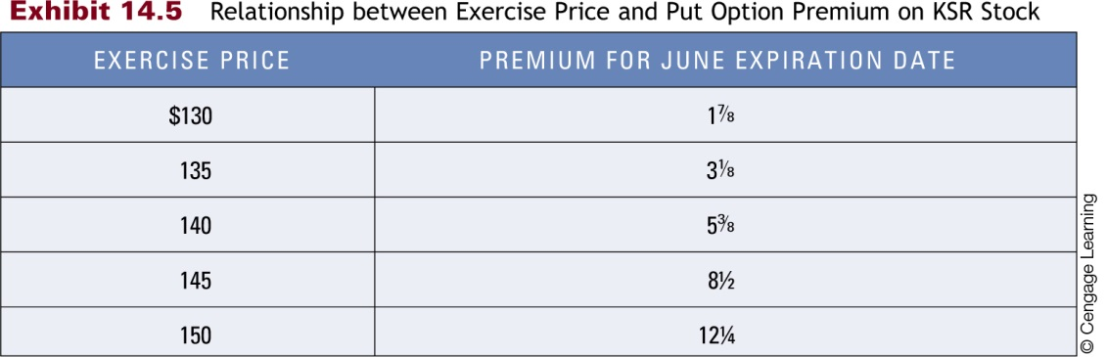
Relationship between Exercise Price and Put Option Premium on KSR Stock

Slide 15
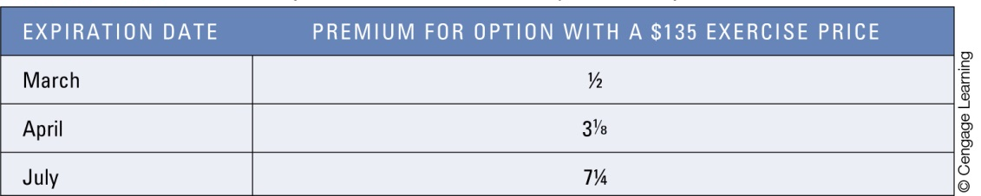
Relationship between Time to Maturity and Put Option Premium on KSR Stock

Slide 16
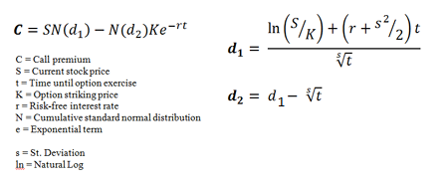
How Option Pricing Can Be Used to Derive a Stock’s Volatility
  Some investors assess a specific stock’s risk by using the option-pricing formula to estimate the stock’s anticipated volatility.
  By using the prevailing option premium and values for the other factors in the option-pricing formula, the implied volatility or implied standard deviation can be estimated.

Slide 17
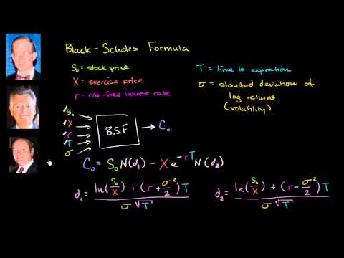
Black-Scholes Model for option pricing

Slide 18
Explaining Changes in Option Premiums
  Economic conditions and market conditions can cause abrupt changes in the stock price or in the anticipated volatility of the stock price over the time until option expirations, leading to changes in the stock option’s premium. (Exhibit 14.7)
  Indicators Monitored by Participants in the Options Market Traders of options tend to monitor economic indicators because economic conditions affect cash flows of firms and thus can affect expected stock valuations and stock option premiums

Slide 19
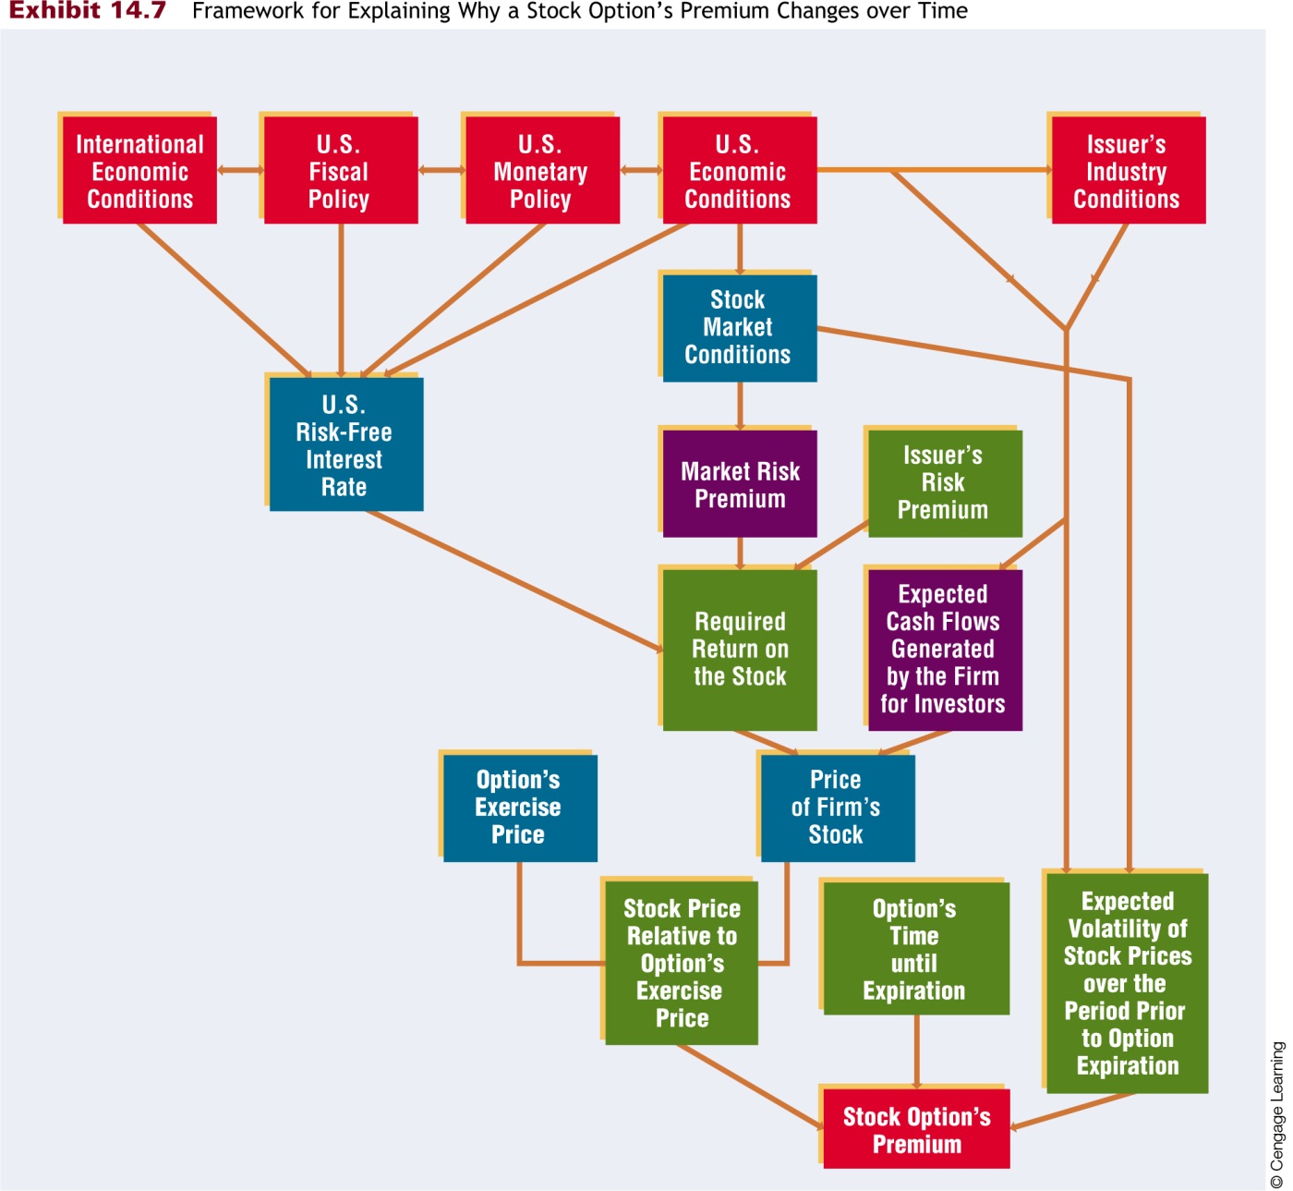
Framework for Explaining Why a Stock Option’s Premium Changes over Time

Slide 20
Speculating with Stock Options
Speculating with Call Options
  Call options can be used to speculate on the expectation of an increase in the price of the underlying stock.
  See Exhibits 14.8 – 14.11.
Speculating with Put Options
  Put options can be used to speculate on the expectation of a decrease in the price of the underlying stock.
  See Exhibits 14.12.

Slide 21
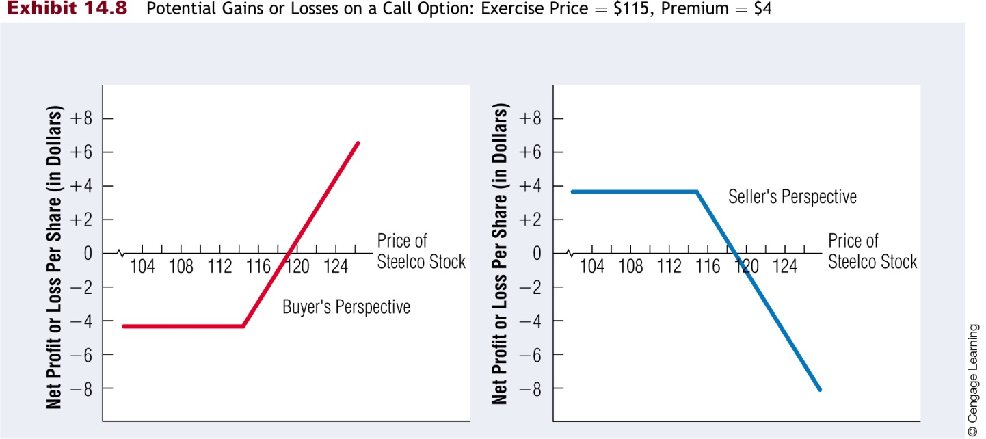
Potential Gains or Losses on a Call Option: Exercise Price = $115, Premium = $4

Slide 22
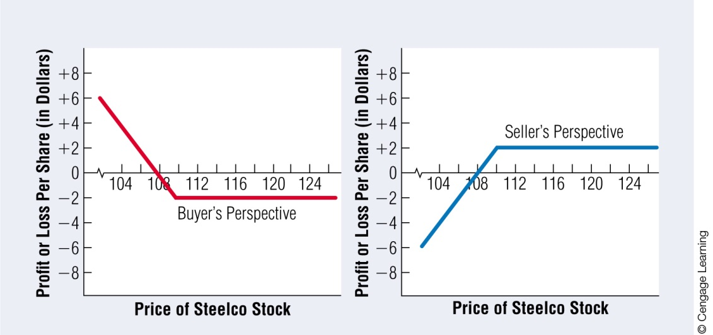
Potential Gains or Losses on a Put Option: Exercise Price = $110, Premium = $2

Slide 23
Option versus Stock Investments
Purchasing call option
  Bullish strategy
  Profit when stock prices are increase
Writing call option
  Bearish strategy
  Profit when stock prices are decrease
Purchasing put option
  Bearish strategy
  Writing put option
Bullish strategy
  Because option values depend on the price of the underlying stock, purchase of options may be viewed as a substitute to direct purchase or sale of a stock

Slide 24
Option versus Stock Investments
Investment Strategy Investment
Equity only Buy stock @ 100 100 shares $10,000
Options only Buy calls @ 10 1000 options $10,000
Call +T- bills Buy calls @ 10 100 options $1,000
Buy T-bills @ 3% $9,000
Yield

Slide 25
Option versus Stock Investments
IBM Stock Price
$95 $105 $115
All Stock $9,500 $10,500 $11,500
All Options $0 $5,000 $15,000
Call + T-bills $9,270 $9,770 $10,770

Slide 26
IBM Stock Price
$95 $105 $115
All Stock -5.0% 5.0% 15%
All Options -100% -50% 50%
Call + T- bills -7.3% -2.3% 7.7%

Slide 27
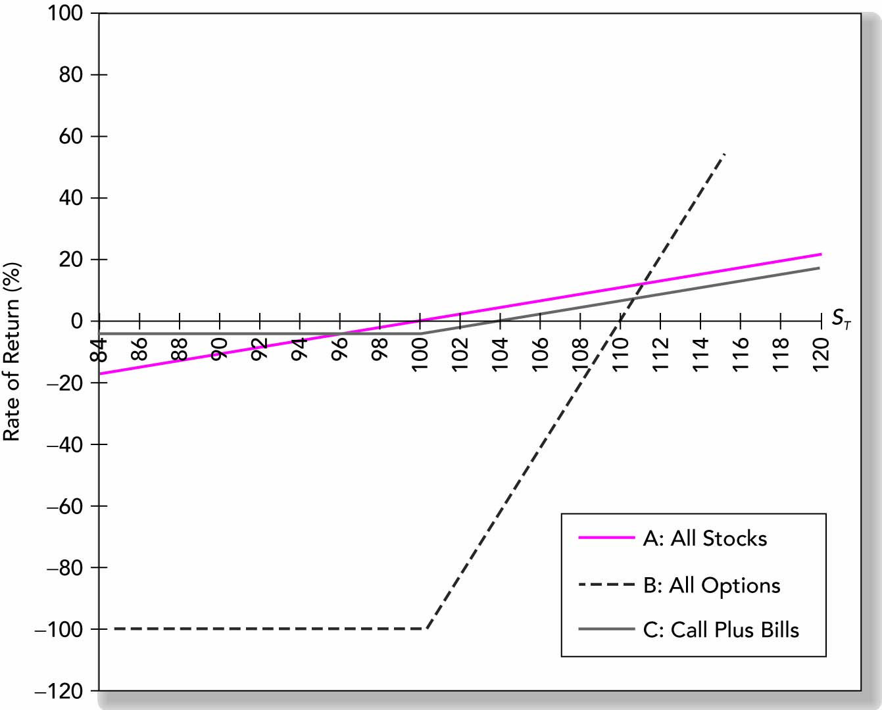
Rate of Return to Three Strategies

Slide 28
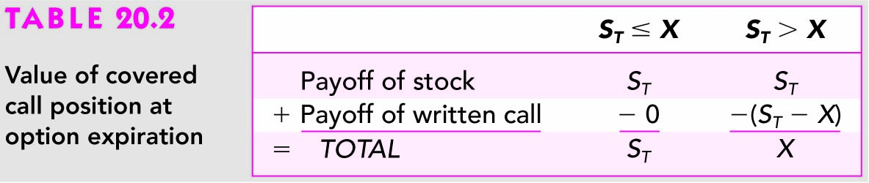
Hedging – Covered Call
The purchase of a share of stock with a simultaneous sale of a call on the stock
  The call is covered because the potential obligation to deliver the stock is covered by the stock held in the portfolio

Slide 29
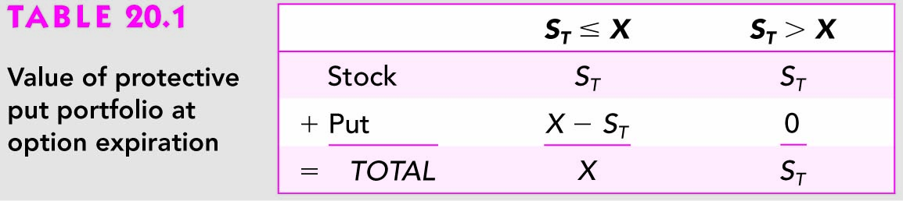
Hedging - Protective Put
Investing in a stock but with unwillingness to bear potential losses beyond some given level
  Investing in stock with purchasing a put option on stock

Slide 30
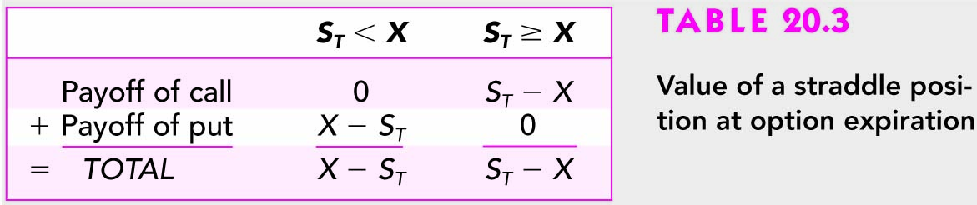
Hedging - Straddle
A long straddle buying both a call and a put on a stock with the same exercise price
For investors who expect move a lot in price but are not certain about direction of the move
The worst scenario for straddle is no movement in the stock price

