Slide 1
Dell internationalization
1984 to 2004
Ivan Mitringa
Lukas Stecak 03/03/2014

Slide 2
Agenda
Introduction
Dell Evolution
Stopford Model

Slide 3
Career Triangle – Ivan Mitringa, FCCA, CIA, CTP
Compliance/Accounting
Corporate (Planning/Reporting)
DELL
1
University of Economics - Masters
Finance/Business Leader
DELL /ANYWHERE 5Y
OUTSIDE DELL
Sales (Segment)
People Management
2
ACCA – Association of Chartered Certified Accountants
International Assignment
Global Operations/
WW Procurement
Financial Services
3
CIA – Certified Internal Auditor
4
CTP– Certified Treasury
Professional
Individual Contributor/Leadership– Senior Level
BU Accounting Sr. Manager
DELL 1Y
Country Accounting Sr. Manager
DELL 6M
4
Competitive Analytics (US)
DELL 1Y
IT Finance
FP&A (US)
DELL 1Y
CER Channel Controller
DELL 2Y
9Y
Reporting Manager
DELL 1.5Y
HSB FP&A Controller
DELL 2Y
2
3
Individual Contributor – Junior Level
Audit Assistant
Delloite & Touche 1Y
Financial Controller
UPC 1Y
Reporting Analyst
DELL 0.6Y
2.6Y
1

Slide 4
Dell evolution

Slide 5
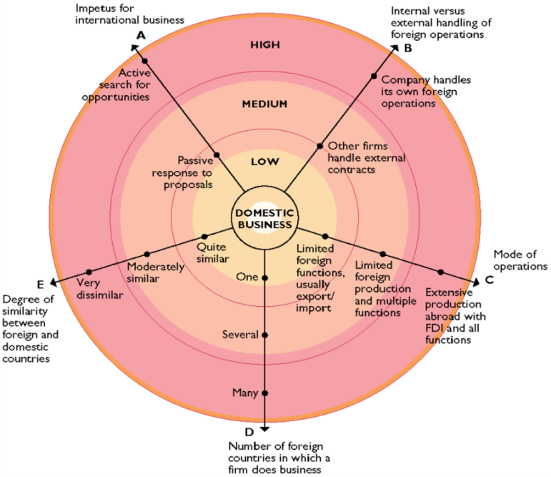
Pattern of International expansion
Daniels & Radebaugh’s model:
organization’s extent of globalization
Patterns of international expansion:
Passive to active expansion
External to internal handling of operations
Deepening mode of commitment
Geographical diversification

Slide 6

Birth and Childhood (1983-1987)
1983-Dorm room business
1984-Dell Computer Corporation
Dell Direct model
Production only in USA
Penetrating US market
1985- revenue growth from $6M to $70M
Support services introduced
Notes:
Competition – IBM, Apple, Japanese manufacturers
Competitive Advantage
Building a brand – 15% discount

Slide 7
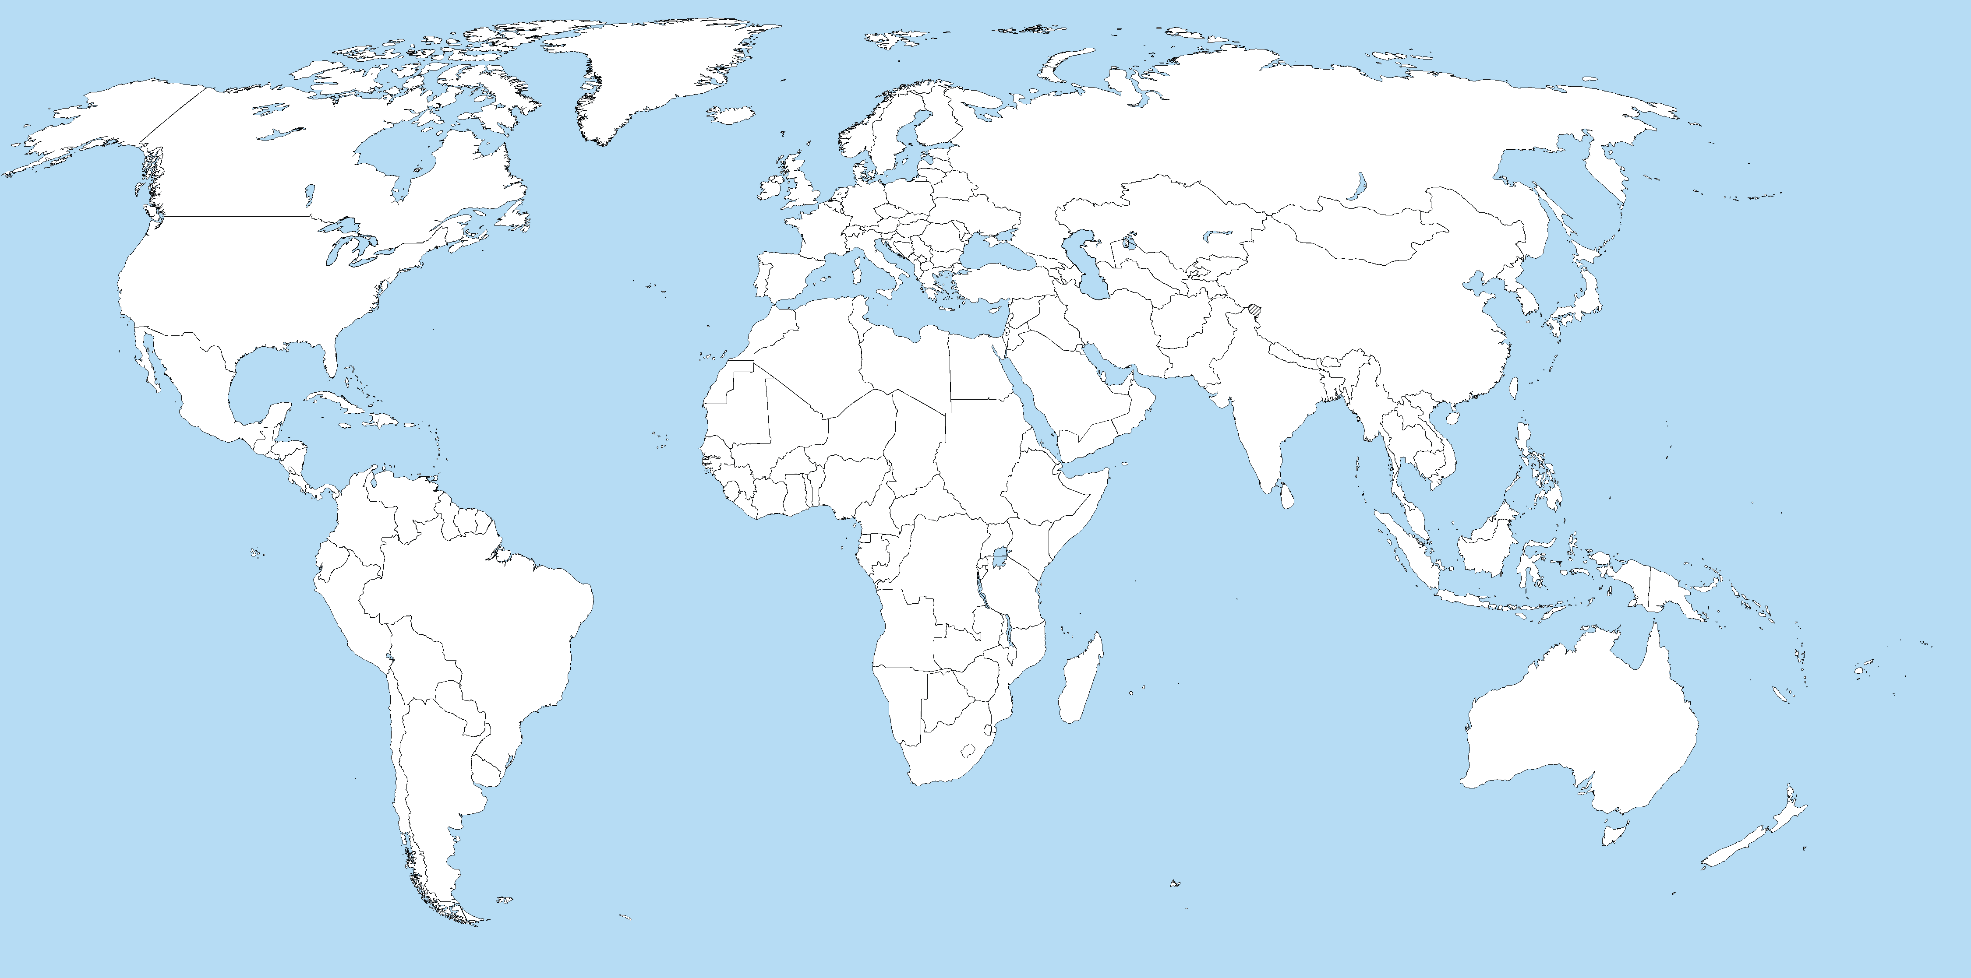
Start of international expansion (1987-1991)
Legend:
HQ/Subsidiary
Manufacture
1990
1987
1990
1988
1990
Canada
MFG in Limerick, Ireland
Regional HQ United Kingdom
Norway
1990
Sweden
Finland
1988
West Germany
1990
1984
Poland
HQ in Austin, Texas
1990
Czechoslovakia
MFG in Austin, Texas
Mexico
Spain
France
Belgium & Luxembourg
Netherlands
1990
1990
1990
1990
1990

Slide 8
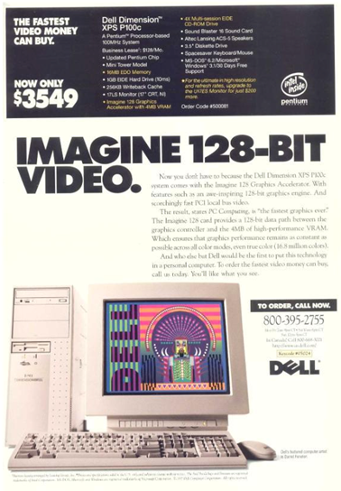
PC’s in the Mid 1990’s…

Slide 9
Start of international expansion (1987-1991)
Challenges of internationalization:
FX Issue
Logistics
Geopolitics situation
Competition
Language
Customer behavior
Notes:
FX issues
Competition – followers as Gateway 2000 more aggressive in pricing (15-30% lower price)
Geopolitics – The Fall of Berlin wall 1990 – new markets
Improvement of logistics – Limerick factory

Slide 10
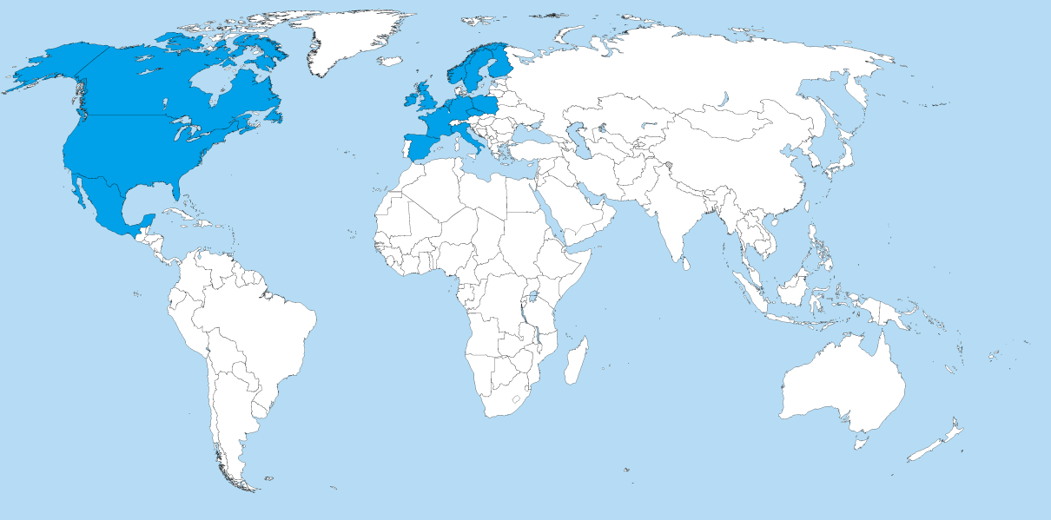
Puberty (1991-1995)
1990
1987
1992
1992
1992
Legend: excuses
HQ/Subsidiary
Manufacture
MFG in Limerick, Ireland
Regional HQ United Kingdom
Denmark
Regional HQ Hong Kong
Regional HQ JAPAN
1993
1984
Taiwan
World HQ in Austin, Texas
1993
MFG in Austin, Texas
Malaysia
Switzerland
Singapore
Australia
1991
1992
1992

Slide 11
Puberty (1991-1995)
1991 - Dell entered the retail channel
  CompUSA
  Staples
  Best Buy
  PC World, etc.
Reducing suppliers
1992- First steps in Asia-Pacific-Japan (APJ)
1994- Dell quit the retail channel and focus only on Direct model
Notes:
Reaction to customers who preferred a face-to-face, physical access sales process -> Growing sales but with minimum profit ->cash issues ->
First operating loss in 1993
Indirect model didn’t work very well with Dell’s operating model and spartan approach
Mid 1994 – Dell pulled out of the retail market
1992 launching business in APJ (export).
Established competitors
different customer expectations ( in APJ they like to feel and touch products)
-> low revenue ($20M)

Slide 12
Puberty (1991-1995)
Indirect model
External sales force, marketing
Lack of contact with end user
Easier coverage of new / minor markets (sales force, customer preferences, market restrictions etc.)
No need to have too diverse product portfolio
Ability to provide a solution or consultancy
Customer can see or touch product
Supply chain management
Risk that reseller will not know the product portfolio well
Risk that reseller will prefer to sell competitor’s products (on shelf placement etc.
Need to share margin

Slide 13
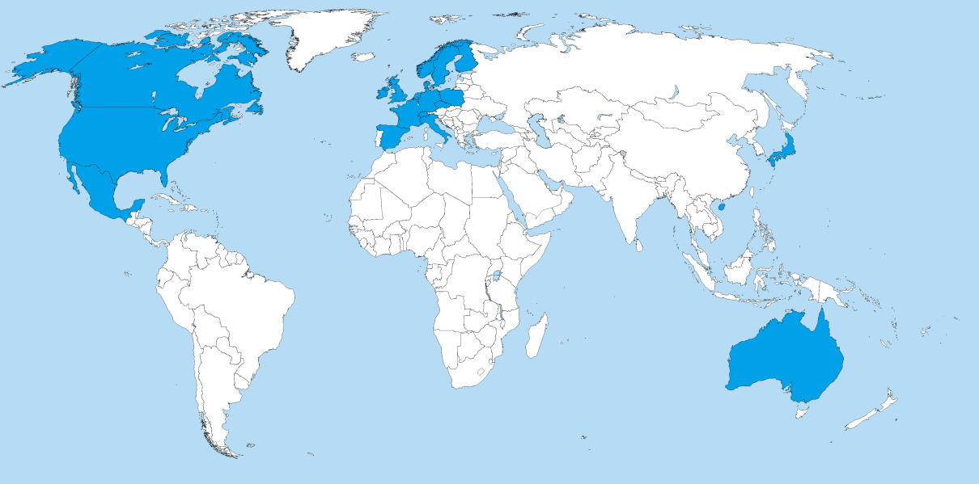
Internet era and exceptional growth (1995-2000)
1999
1990
1998
Legend: excuses
HQ/Subsidiary
Manufacture
MFG in Nashville and Lebanon, Tennessee
MFG in Limerick, Ireland
MFG in Xiamen, China
1996
MFG in Penang, Malaysia
1984
HQ in Austin, Texas
MFG in Austin, Texas
1999
MFG in Eldorado do Sul, Brazil

Slide 14
Internet era and exceptional growth (1995-2000)
1995 – Dell.com
1994 – 1999 – Sales grew at annual rate 49.5% from $3.5B
to $25B
Establishing factories around the world
Decrease of direct cost
by 15%
Growth in Asia-Pacific-Japan and Latin America

Slide 15
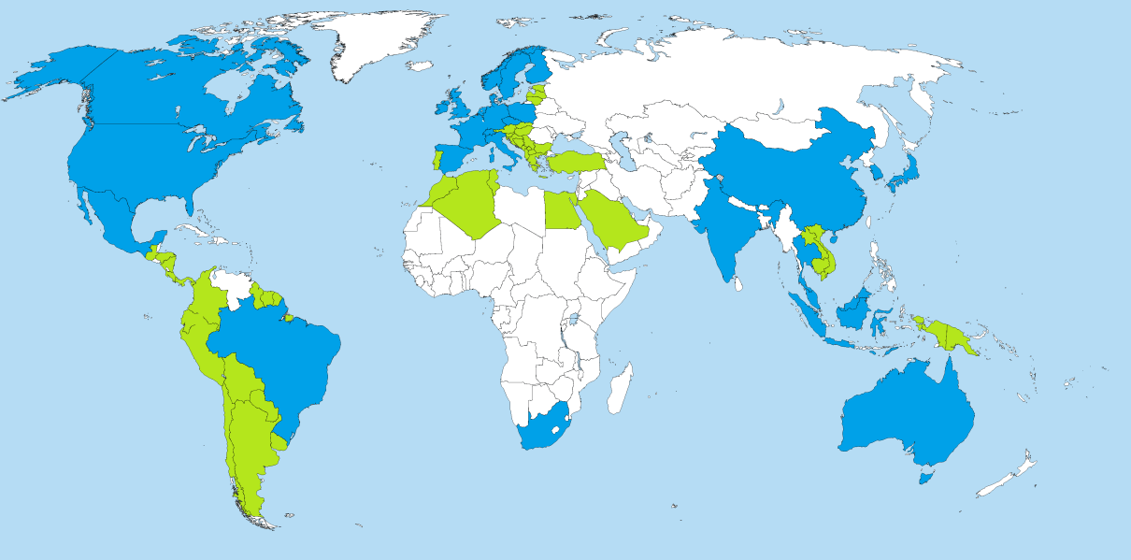
True Global Company (2000-2004)
1999
1990
1998
Legend: excuses
HQ/Subsidiary
Manufacture
MFG in Nashville and Lebanon, Tennessee
MFG in Limerick, Ireland
MFG in Xiamen, China
1996
MFG in Penang, Malaysia
1984
HQ in Austin, Texas
MFG in Austin, Texas
1999
MFG in Eldorado do Sul, Brazil

Slide 16
True Global Company (2000-2004)
2000- Community engagement : Michael and Susan Dell Foundation
2000 – Environment issues – recycling program
2001- Market decrease but…
2003 & 2004 – no.1 in market share of computer vendors
2004 – Michael Dell Stepped down as CEO
Direct model as successful Global strategy

Slide 17
Stopford Model

Slide 18
CIT and Dell
Joint-venture
Licensing
Services
2000 CIT
Affiliated company
2011
Dell financial services
Export
Dell Direct model

Slide 19
Thank You

Slide 20

Dell approach – Global commercial channel
Registered Partners
Entry program for most partners
Preferred Partners
Assigned account manager
Premier Partners
Highest level of support from Dell
Grants access to Dell’s partner portal and customer support
Access to trainings and certifications
Better return and payment conditions
Requires Dell certifications and minimal revenue threshold
Requires two or more Dell certifications and higher revenue threshold than Preferred
Level of cooperation

Slide 21
How does Michael Dell describe the Dell evolution?
http://www.youtube.com/watch?v=N3VOR31Hrn4

Slide 22
Dell’s commitment to customers
http://www.youtube.com/watch?v=-5-3t4RAaio

Slide 23
Creating global business units

Slide 24

Dell organization based on the customer
Large Enterprise
Large business
Public
Healthcare
Small & Medium
Medium business
Consumer
Consumers
WW presence
Small non-segmented countries
Government
Schools
Small business
World-wide view
Dell strategic business units (SBU’s) aligned to customer segments

Slide 25
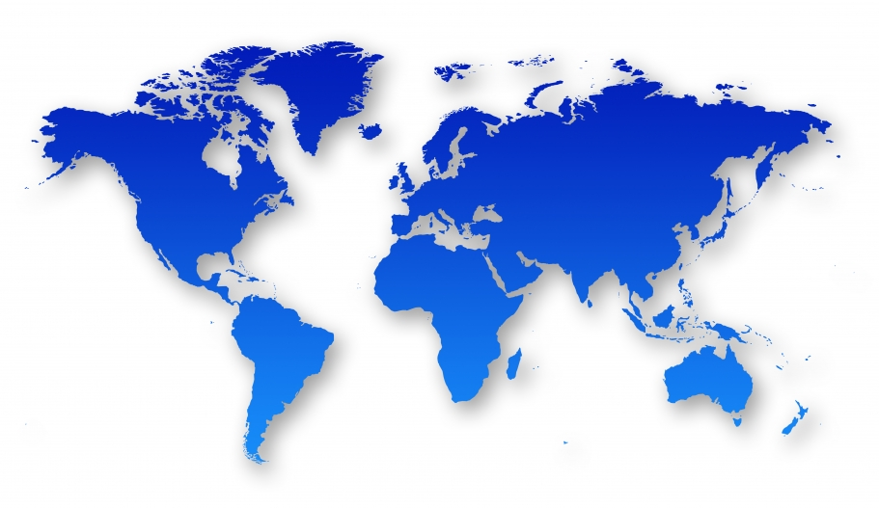
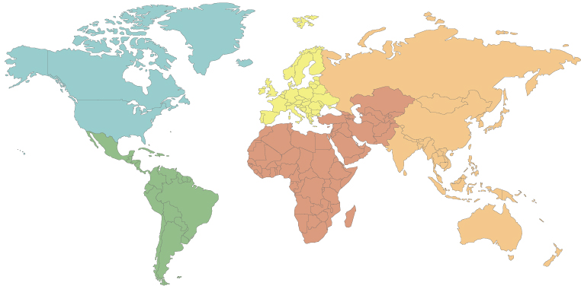
Regional structure to global SBUs
“We have laid the foundation for the transition from a global business that's run regionally to businesses that are really globally organized.”
Michael Dell ¹⁾
Before
Regional business structure
After
Global business structure
High reporting complexity
Complex Internal Tree
Lower complexity
Simplified hierarchy
¹⁾ http://www.itexaminer.com/dell-implements-restructuring-plan.aspx

Slide 26
Dell organization based on customers
Consumer
SMB
Large Enterprise
Public
End User Computing Solutions
Overlay solution groups to drive strategy
Enterprise Solutions
Services
Corporate/Shared (Supporting Functions)
Dell strategic business units (SBU’s) aligned to customer segments

Slide 27
Financial reporting changes to reflect strategy
Mobility
ESG
Enterprise Solution Group
Software
Dell Software
Services
Dell Services
EUC
End-user computing
Desktops
Notebooks
3rd party SW
Client-related SVC & products
Servers
Networking
Storage
Related peripherals products
Support & Deployment
Infrastructure & Cloud
Security
Applications & Business process
Systems management
Security and business intelligence SW
Support functions
http://en.community.dell.com/dell-blogs/dell-shares/b/dell-shares/archive/2013/01/10/financial-reporting-change-product-and-service-based-p-amp-l.aspx

Slide 28
Dell reflecting current IT trends

Slide 29
Major IT trends
Consumer
Ubiquitous computing
Enterprise
Mobility
Always On connectivity
Anywhere Anytime mobility
Increasing IT Complexity
Cloud Computing
Large Data Analytics
Rise of Smartphones, Tablets, Ultra-books and Cloud Services
Rapidly increasing storage requirements, services instead of in-house solutions
Global industry trends
BRIC country IT market growth
Consumerization of IT – change of traditional work/life patterns

