Slide 1
Qualitative methods evaluation in PS

Slide 2
    Analytical methods for public projects (types)
Quantitative methods
  One-criteria
  Multi-criteria
Managerial methods
  Empirical methods
  Qualitative methods
    SWOT analysis, causal analysis

Slide 3
    Qualitative methods for evaluation
    To determine mutual relationships between gained data
    Is used to identify and explain causal relationships and potential benefits
    Analyse difficult to quantify phenomena and processes
    Identify mutual connections
    Provide explanation of causal relationships

Slide 4
Causal models
Measure impacts of many factors of different projects or programs
E.g. Simultation models, microeconomics models or statistical models
Models are used to evaluate impacts of differente projects / programs / policy
Risks presence => potential risk of misleading results

Slide 5
„circle“ problem = project / program / policy and its consequences / effects
influence of external factors and their share on consequences
Example:
Infrastructure development (eg. highway network) around cities and its impact on cities in the locality which are influenced
=> Economic development of influenced cities (compare to others) ???
Solution could be detailed descripiton of the project with help of various suitable methods (case study, interviews, document etc.)

Slide 6
Non-causal methods
eg. participants observation, interviews, case study, preference identification etc.
political dimension problem in decision-making process within application on projects / programs / policy in public sector
primary vs secondary data

Slide 7
SWOT analysis
Analysis of strength (S) and weak (W) sides, opportunities (O) and threats (T)
Aim: to get subject / service / product from A to B (positioning)
How to do?
  Identify S and W
  Assess O and T (inside and outside)
Use in public sector (city development, projects and grants etc.)
Pragmaticism empirism

Slide 8
Disadvantage and limits of SWOT analysis
Wrong use or execution of the method
  Speed of execution
  Depth of execution
  Wrong interpretation (causal analysis)
  Wrong positioning in the matrix
Use of analysis for already decided goals (bias)
Limits of brainstorming
Organization goals vs community goals
Width of the working group

Slide 9
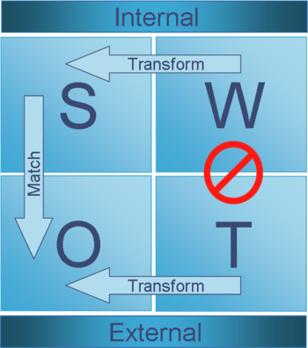
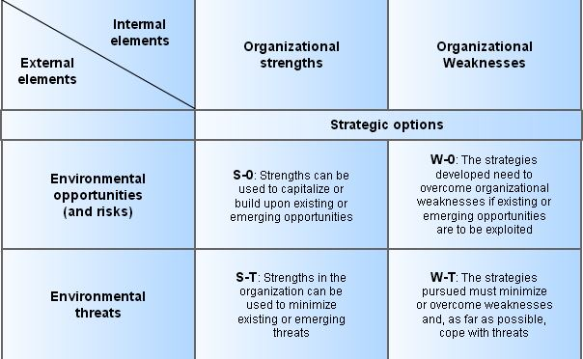
SWOT analysis

Slide 10
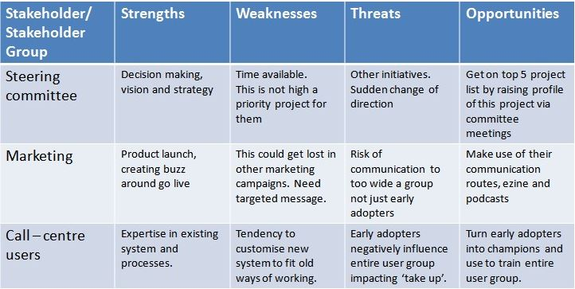
SWOT analysis (processing)

Slide 11
SWOT for more complex projects / subjects
SWOT
SWOT1
SWOT2
SWOT3
SWOT4

Slide 12
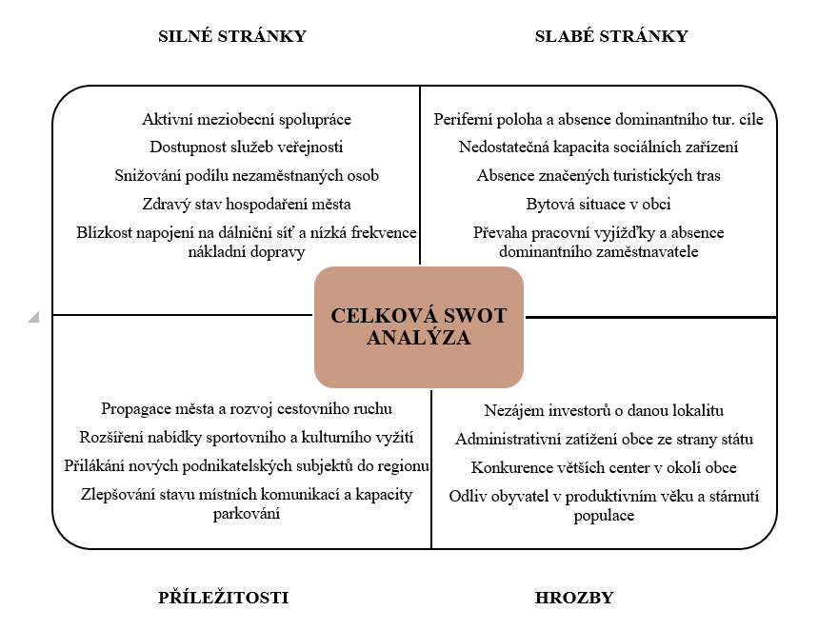
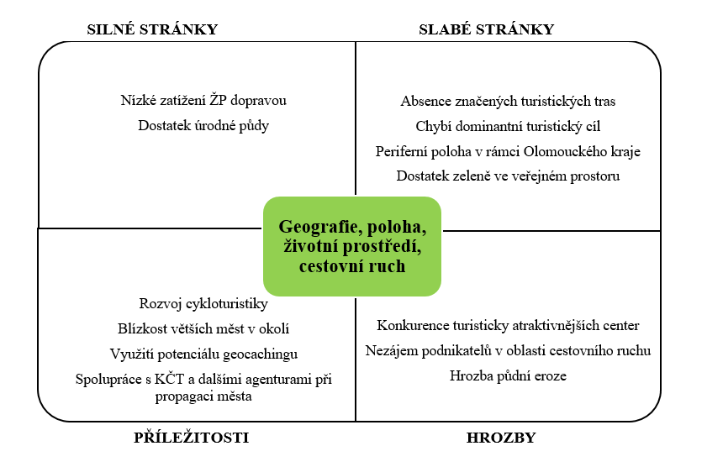
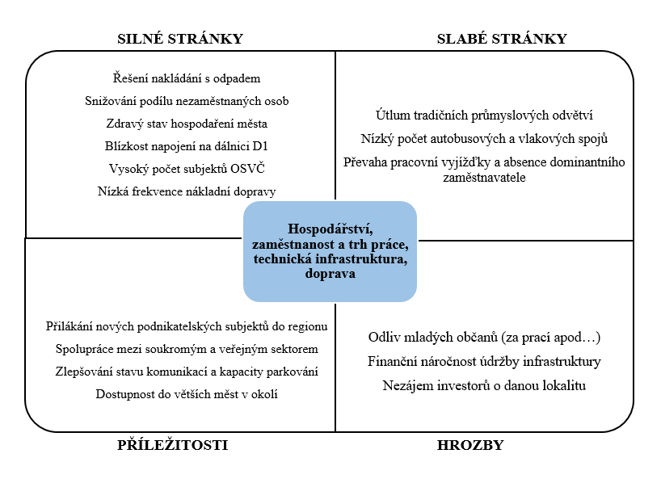
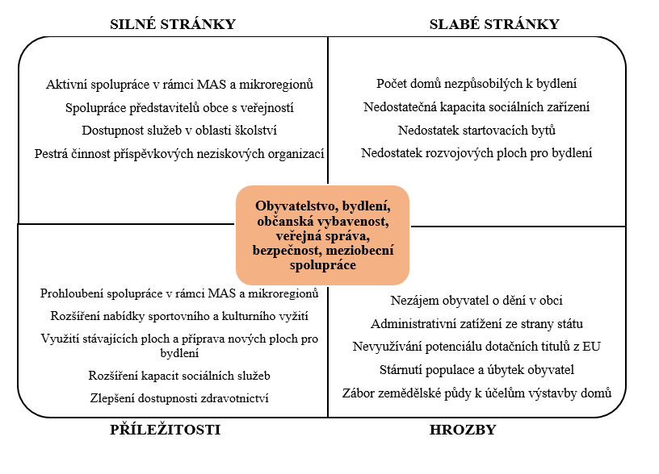
CS: SWOT analysis for city Němčice nad Hanou

Slide 13
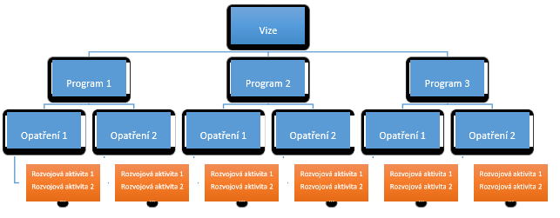
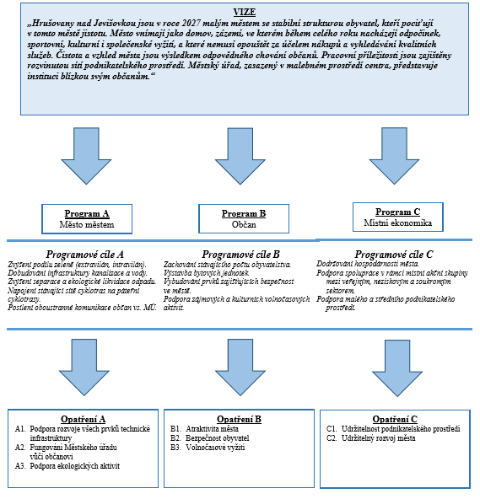
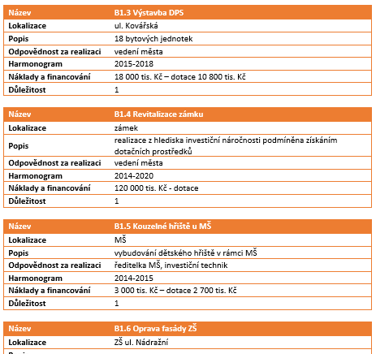
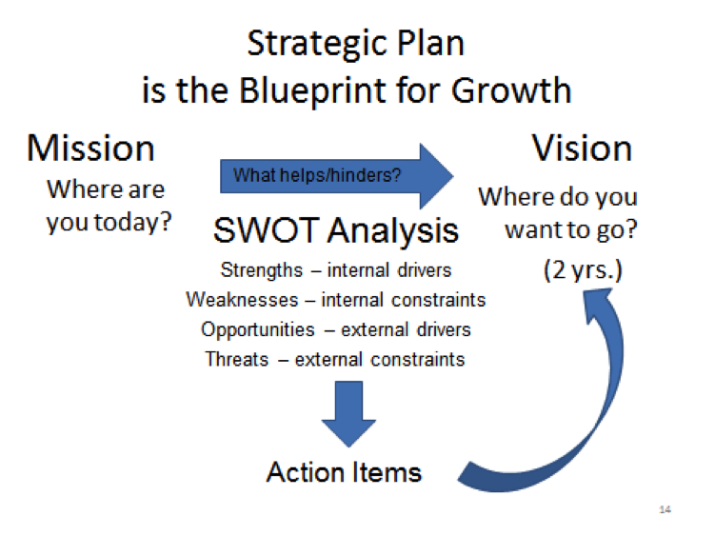

Slide 14
Focus groups vs roundtable
Focus groups
Time: app. 60-90 minutes
Small groups of people interested in the issue (around 7 people)
Together discussing about previously chosen issue / topic
Advantage: lower time consumption
Advantage: developing debate / discussion and potential space for generating of new opinions and views
Roundtable
Time: 90 minutes +
Large group with potential of representativeness (see rules for representativeness)
Multidisciplinarity and more topics
Advantage: connection and confrontation of municipal council (mayor) with residents
Advantage: potentially higher objectivity => findings objectivisation

Slide 15
Further methods
Case study
For more detalied description and analysis of the project
Collecting data (qualitative, quantitative)
Critical analysis, implementation analysis or analysis of project impacts
See structure and form
Interview
To find out specific type of information or gain more complex view
Type: free, semi-structured and structured
Suitable selection of the sample and interviewer experience
Questionnaire survey
Segmentation of the sample (representativeness??).
See rules for questionnaire preparation
Closed questions vs vs open vs semi-open question
Test (structure, answers, calibration)
Data coding for further processing

Slide 16
Helpful tips
If secondary data are not available, it is necessary to collect primary data (expensive, time-demanding etc…)
Not everybody is interested in full use of evaluation or asessment – sensitive issues and areas (politicians, public officers, etc..)
  Fear of different outcomes
  Fear of criticism or feedback
Therefore it is important to consult with them definition of the problems (why the program is applied) and also the plan of evaluation / asessment
  Because they are providing information and data
  Because they can help with interpretation of results and realization of recommendations
  Beacuse if they become active adversaries, they can sabotage the project or its evaluation or asessment

Slide 17
Causal analysis
Approach: searching and exploring of connections between two or more phenomena / processes
Goal: Get deeper into essence of phenomena / processes observed
Goal: Get through to causal connections
Cause = existence of phenomena (A) is resulting (consequence) into existence of different phenomena (B)
Disadvantage
  Sensible to the level of awareness and subjective approach of individual investigators

Slide 18
Causal analysis
Deductive type
  We know consequences => We dont know their causes (revealing)
Induktive type
  We know their causes => We dont know consequences (revealing)
Tools:
Kepner method
Causal chain
Tree of causal relations
Ishikawa
Diagram of causes and consequences
Causal diagnosis
Analysis of the force field
Pareto analysis
Causal layers

Slide 19
Causal chain
Causal deduction
Assumption (1 cause => 1 consequence)
Example:
High price of the service
Low demand
Low volume of the production of this service
Reduced utilization of production factors
Unused production capacity (expensive production)
Alternatively can be used for the tree of causal realations (assumption: 1 consequence has more causes)

Slide 20
Thank for your attention ☺

