Slide 1
Interaction Strategies
Jan Řezáč
04/04/2016

Slide 2
Lesson outline
Teamwork
Personality communication types
Appraisal interview
Notes:
2
Personal opening
Opening statement: take 30 seconds to think of the last times you had to present something. How was it? how did it go? What would you do better?
Then slide questions
extra questions:
Why

Slide 3

I Teamwork

Slide 4
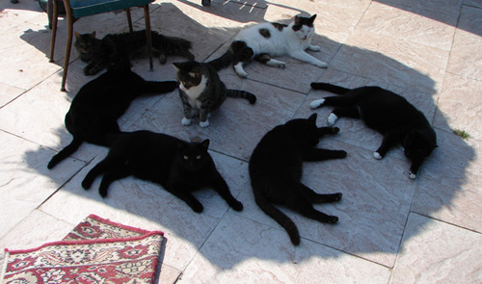
Teamwork
Humans are social creatures, build to work with others
Every time you are in group with someone, you start liking the person more
Whole is more, than sum of its parts

Slide 5
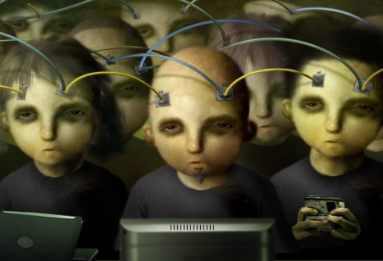
Groupthink
It is very easy for groups to make a wrong decision
Examples of faulty thinking of teams are called Groupthink
Groupthink was researched after the decision of J.F. Kennedy to invade Cuba

Slide 6
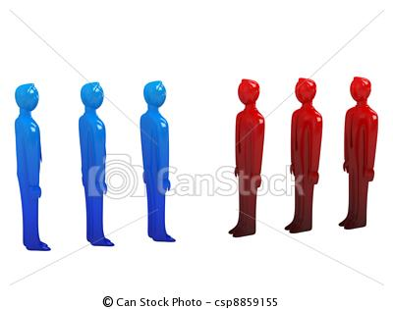

Group polarization
An example of groupthink
People in groups reach more extreme decision, than a single person would choose
Examples are groups of teenagers, that do things they would not do alone

Slide 7
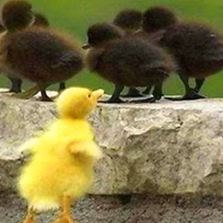
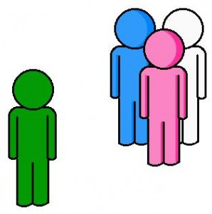
Outgroup homogenity effect
Example of groupthink
Tendency to believe, that members of other group are all the same
Can make negotiation more difficult

Slide 8
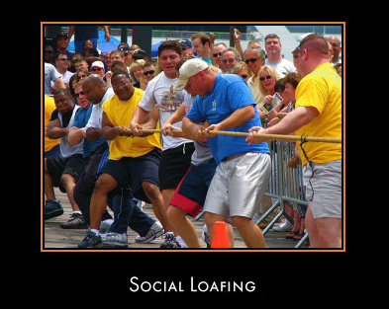
Social laziness
Imagine an easily measurable task to do, such as pulling a rope
Then single person pulls with higher force (80Nm), than if this person is in group with other people (5 people - 300Nm)
The ways to fight social laziness include motivating everyone to a goal, and by giving everyone his own part on the task

Slide 9
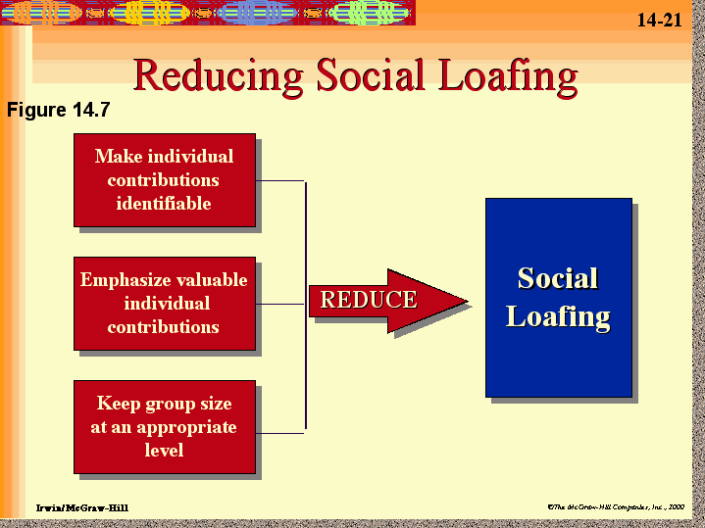
How to deal with social laziness
The ways to fight social laziness include motivating everyone to a goal, and by giving everyone his own part on the task

Slide 10
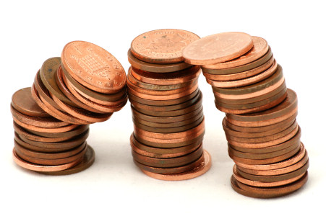
Game
Common cents (15 pennies)
There are 20 pennies on the table
You can take 1, 2 or 3 pennies of the table at once. Than plays the other team
Goal – to take the last penny

Slide 11
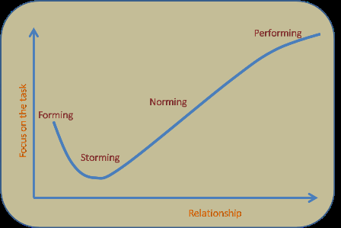
Stages of groups
Groups follow very similar patterns of forming
Forming, storming and norming come before performing stage (where Team does most of work)
And finally, transforming stage, where roles are reassessed.

Slide 12
II Personality types

Slide 13
David Kantor´s Four-Player Model
Move
Bystand
Follow
Oppose

Slide 14
Potential Impact of the Four Player Model
Without movers, there is no direction
Without followers, there is no implementation
Without opposers, there is no correction
Without bystanders, there is no perspective

Slide 15
ROLES of the Four Player Model
Movers are not necessarily leaders
Followers are not weak
Opposers are not devil’s advocates
Bystanders can be called “Big Picture Synthesizers and Team Paraphrasers”

Slide 16
Stuck Groups
Individuals get locked into a single form of action
Opposers are punished by the group, or they dominate
There are no strong Movers, or no one ever Follows a move
The Bystander is disabled
Individuals attach double messages to their moves
The team is unable to reach closure and produce results
Lack of capability or flexibility to engage in all four action behaviors

Slide 17
Personality communication types
Dominance
Dictator Performer
Hostility Affiliation
Bureaucrat Socialite
Submissivenes

Slide 18
III Performance appraisal interview

Slide 19
Performance appraisal
 a method by which the job performance of an
employee is documented and evaluated.

Slide 20
Performance appraisal - Benefits
 Facilitation of communication,
 Enhancement of employee focus through promoting trust,
 Goal setting and desired performance reinforcement,
 Performance improvement,
 Determination of training needs.

Slide 21
How performance appraisal interview should not look like?
 https://www.youtube.com/watch?v=09b
p 4Muh8

Slide 22
Preparation. Manager
Choose neutral territory,
Let employee confirm date, time, place and content,
Give employee at least 1 week for preparation,
Prepare a comprehensive overview of employee’s performance,
Facts, concrete evidence.

Slide 23
Preparation. Manager
Pay attention:
Goals, stated during previous appraisal interview,
Real successes and failures and their consequences,
Conditions of successes and failures,
Any changes in job description,
Relationship with other employees,
Personal development and self-education.
Use forms provided by company

Slide 24
Preparation. Employee
 Do prepare!!!
 Use form from previous appraisal

Slide 25
Appraisal process
 Open and relaxed atmosphere
 Mutual respect
 Goal is to gain agreement, it is not the situation where manager commands and employee obeys
 Engage employee in discussion

Slide 26
Appraisal process. Manager
DO
Prepare
Listen and ask questions
Concentrate on performance, not personality
Be concrete regarding successes and failures
Gain commitment regarding goals and further actions
DON’T
Press your ideas
Be destructive

Slide 27
After appraisal. Manager
 Control improvement,
 Observe for problems.

Slide 28
How to do Effective
Performance Appraisals
 https://www.youtube.com/watch?v=E34Z t1cEpFA

Slide 29
Biggest Mistakes Bosses Make In Performance Reviews
 Too vague,
 Everything’s perfect – until it’s not and you’re fired,
 Recency effect,
 No preparation,
 No recognition,
 Not being truthful with employees about their
performance,
 No follow-up,
 No discussion around the report’s career ambitions.

Slide 30
Sources
http://info.worldbank.org/etools/docs/library/200854/section06/06g1Section_6_Slides_Four_Player_Model_for_Conversations_sept1.pps
The Family, Politics, and Social Theory (RLE Social Theory), D.H.J. Morgan - 2014

Slide 31
Sources. Performance
appraisal
 The appraisal interview. Training programme / Melrose Film Productions Ltd., 1988
 Ten Biggest Mistakes Bosses Make In Performance Reviews http://www.forbes.com/sites/ericjackson/2012/01/09/ten- reasons-performance-reviews-are-done-terribly/

