Slide 1



Business Projects
Seminar Slides
Masaryk University is the Accredited Training Organisation responsible for this course material
PRINCE2® is a Registered Trade Mark of AXELOS Limited
The Swirl Logo is a Trademark of AXELOS Limited
Referencing for materials taken from the official PRINCE2 Manual is done via the statement:
Based on AXELOS PRINCE2 material. Reproduced under licence from AXELOS Limited.
Direct quotes from the PRINCE2 Manual are cited using Harvard Style in-text referencing. The reference list is included on the last slide of this presentation.

Slide 2
Seminar 5
Controlling a Stage
Managing Product Delivery
Logs and Registers Exercise

Slide 3
Controlling a stage
The purpose of the Controlling a Stage process is to assign work to be done, monitor such work, deal with issues, report progress to the Project Board, and take corrective actions to ensure that the stage remains within tolerance.
(Axelos, 2009, p. 149)

Slide 4
Corporate / programme
Project authorization notification
Project Board request for advice
Corporate advice and decisions
Project Mandate
Initiation notification
Closure
notification
Direction
(DP) Directing a Project
Authorize Initiation
Authorize Project
Authorize Stage or Exception Plan
Give ad hoc direction
Authorize Closure
(SU) Starting up a Project
Request approval: Next Stage or Exception Plan
Premature Closure
End Stage Report & Next Stage Plan or Exception Plan
Exception Plan request
Closure Recommendation
Approved Initiation Stage Plan
PID & Benefit Review Plan
Stage authorization or Exception Plan approval
Project Board advice
Authority to initiate a project
Request to deliver a project
Authority to deliver a project
Exception raised
Request for advice
Request to initiate a project
Project Brief & Plan
Approved PID
Highlight Reports
Management
(SB) Managing a Stage Boundary
(CP) Closing a Project
Stage boundary approaching
Project end approaching
(CS) Controlling a Stage
(IP) Initiating a Project
Authority to deliver a Work Package
Checkpoint Reports
Completed Work Package
Pre-Project
Initiation Stage
Work Package
Delivery
Legend
Communication
Management Product
(MP) Managing Product Delivery
Process

Slide 5
Controlling a Stage Objectives
The process objectives are to ensure:
A product based focus is maintained and that scope creep does occur
Risks and issues are dealt with in accordance with the management strategies
The stage’s agreed products are delivered within the stated standards, in accordance with the plan and are fit for purpose
The products are delivered within the allocated tolerances

Slide 6
Triggers and Outputs
Triggered by a:
  Stage plan authorization or Exception Plan approval
  Project Board advice
  Receipt of a Checkpoint Report or completed Work Package
  New issue
Outputs and their Purpose:
  Raised Exception
  Request for advice
  Highlight Reports
  Authority to deliver a Work Package

Slide 7
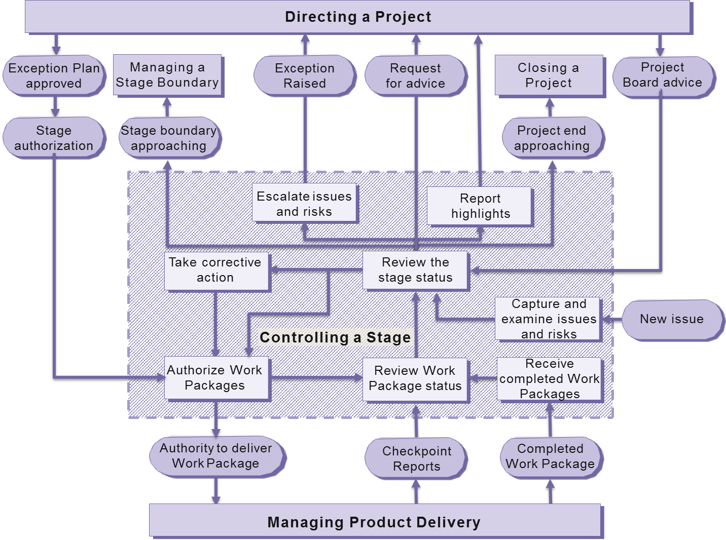
Overview, Perfect World
6
5
3
2
1
2
4
(Figure 15.1 Managing Successful Projects with PRINCE2® 2009 edition).

Slide 8
Managing product delivery
The purpose of the Managing Product Delivery process is to control the link between the Project Manager and the Team Manager(s), by placing formal requirements on accepting, executing and delivering project work. (Axelos, 2009, p. 185)

Slide 9
Managing Product Delivery Objectives
The process objectives are to ensure:
Agreement regarding the products to be created and the work required is obtained before work begins
Work is authorized prior to commencing
All people involved with the products to be produced understand the plan in terms of expected cost, time, or effort
Products are delivered within the tolerances specified and expectations are met
Progress reporting is agreed and the information is provided to Project Management to ensure a proper level of control and management

Slide 10
Triggers and Outputs
Triggered by a:
  Authority to deliver a Work Package
Outputs:
  Checkpoint Reports
  Completed Work Package
  Issues and Risks

Slide 11
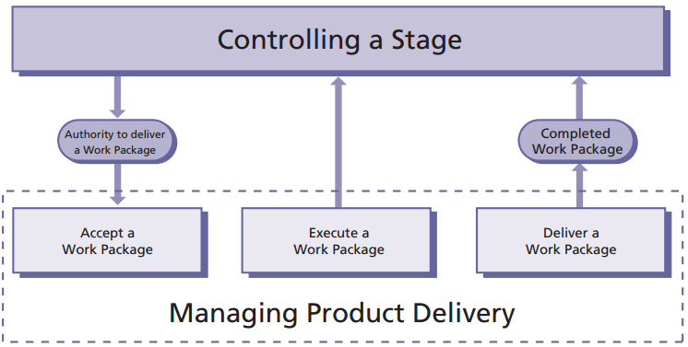
Overview
1
2
3
(Figure 16.1 Managing Successful Projects with PRINCE2® 2009 edition).

Slide 12
Overview, Perfect World
6
5
3
2
1
2
4
(Figure 15.1 Managing Successful Projects with PRINCE2® 2009 edition).

Slide 13
Overview, Perfect World
6
5
3
2
1
2
4
(Figure 15.1 Managing Successful Projects with PRINCE2® 2009 edition).

Slide 14
Overview
1
2
3
(Figure 16.1 Managing Successful Projects with PRINCE2® 2009 edition).

Slide 15
Overview, Perfect World
6
5
3
2
1
2
4
(Figure 15.1 Managing Successful Projects with PRINCE2® 2009 edition).

Slide 16
Overview, Not So Perfect World
(Figure 15.1 Managing Successful Projects with PRINCE2® 2009 edition).

Slide 17
Exercise 5. Logs and Registers
This exercise contains additional scenario information. In your assigned teams and using the information in this exercise and the Project Brief, determine the correct course of action and complete the entries in the appropriate log or register. The scenario items are in chronological order. Please address them as such. Your group has 40 minutes to complete this task.

Slide 18
Logs and Registers
The goal is to better understand the daily use of the PRINCE2 Logs and Registers.
Using the scenario update, create the appropriate entries in the Logs and Registers provided.
The event listed in the scenario update are provided in chronological order and must be addressed sequentially.
Time: 40 minutes.

Slide 19
Exercise 5 Results

Slide 20
Sequential Entries – 1-1
Two entries are required in the Risk Register
The Risk Register and Risk Grid should be updated with information gathered at the meeting for the two risks.

Slide 21
Updated Risk Register, Entry 1

Slide 22
Updated Risk Register, Entry 2

Slide 23
Updated Risk Grid

Slide 24
Sequential Entries – 1-2
The Risk Register and Risk Grid should be updated with information gathered at the meeting.
An entry should be made in the Project Manager’s Daily Log recording that the meeting took place and the Risk Register updated. A point to follow-up with the risk owner in the future may be helpful.
There is no entry in the Issue Log as these are not new issues. These items should have been transferred from the Project Brief to the Risk Register when it was first established.

Slide 25
Daily Log Entry

Slide 26
Sequential Entries - 2
At the moment, this issue should be dealt with informally. An entry should be made in the Daily Log and a meeting set up to talk to Zdeňka.

Slide 27
Daily Log Entry

Slide 28
Sequential Entries - 3
Update the Daily log to reflect your meeting.
There is a new issue which affects baselined management products. It must be dealt with formally as a “Request for Change”. A entry in the Issue Register is required.
Issues being dealt with formally require an Issue Report.
In many projects, approval of changes to baselined management products such as this do not require Board approval. Instead, the Project Board delegates its change authority to the Project Manager.

Slide 29
Update the Daily Log

Slide 30
Issue Register Entry

Slide 31
Sequential Entries - 4
Make an entry in the Daily Log.
Analyse the situation, gather information.
No entry in the Issue Register yet, we may be able to address this informally.
No entry in the Risk Register as this may not be a risk.

Slide 32
Daily Log Entry

Slide 33
Sequential Entries - 5
This is a negative risk to the project.
Make an entry in the Risk Register and the Risk Grid.
The risk falls outside the risk tolerance for the project. This can be seen on the grid.
Risk tolerance is exceeded and an issue needs to be raised along with an exception report.
Current stage is on hold pending a decision from the Project Board.
Make an entry in the Daily log.

Slide 34
Risk Register Entry

Slide 35
Risk Grid Entry

Slide 36
Issue Register Entry

Slide 37
Homework
Read pages 167 to 202 of Managing Successful Projects and Appendices:
  A.3, Checkpoint Report
  A.5, Configuration Item Records
  A.7, Daily Log
  A.9, End Stage Report
  A.10, Exception Report
  A.11, Highlight Report
  A.12, Issue Register
  A.13, Issue Report
  A.14, Lessons Log
  A.23, Quality Register
  A.25, Risk Register
  A.26, Work Package

