Slide 1
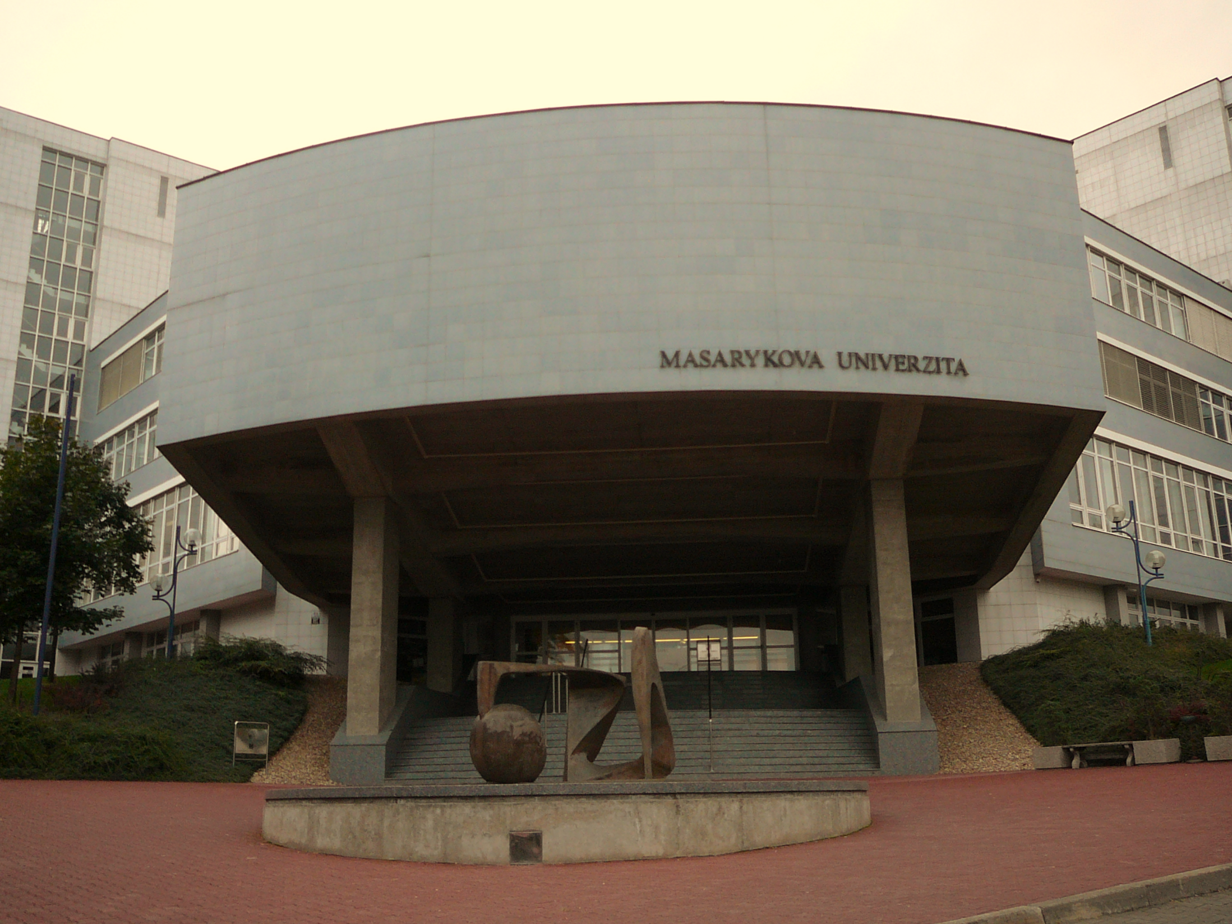
Business Projects Seminar Slides
Masaryk University is the Accredited Training Organisation responsible for this course material
PRINCE2® is a Registered Trade Mark of AXELOS Limited The Swirl Logo is a Trademark of AXELOS Limited
Referencing for materials taken from the official PRINCE2 Manual is done via the statement: Based on AXELOS PRINCE2 material. Reproduced under licence from AXELOS Limited.
Direct quotes from the PRINCE2 Manual are cited using Harvard Style in-text referencing. The reference list is included on the last slide of this presentation.

Slide 2
Seminar 7
Closing a Project

Slide 3
Closing a project
The purpose of the Closing a Project process is to provide a fixed point at which acceptance for the project product is confirmed, and to recognize that the objectives set out in the Project Initiation Documentation or the approved changes to the objectives have been achieved or that the project has nothing more to contribute. (Axelos, 2009, p. 205)

Slide 4
Closing a project Objectives
The objectives of the Closing a Project process are to:
Verify user acceptance of the project’s products and ensure that the host site is able to support the products when the project is disbanded
Review the performance of the project against its baselines
Assess any benefits that have already been realized, update the forecast of the remaining benefits, and plan for a review of those unrealized benefits
Ensure that provision has been made to address all open issues and risks, with follow-on action recommendations. (Axelos, 2009, p. 205)

Slide 5
Triggers and Outputs
Triggered by a:
Premature closure request
Project end approaching
Outputs:
Draft project closure notification
Closure recommendation
End Project Report

Slide 6
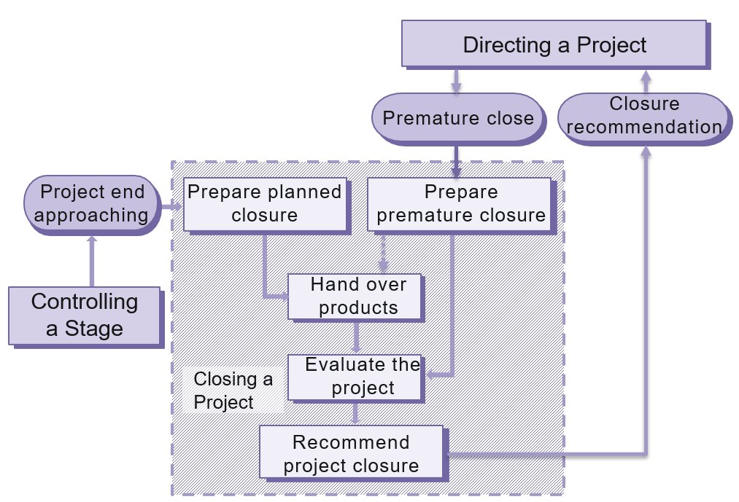
Overview
5
1
2
3
4
(Ref: Figure 17.1 Managing Successful Projects with PRINCE2® 2009 edition).

Slide 7
Exercise 5 Results
Premature Closure

Slide 8
Step 1
Step 1: ST 7 Prepare Premature Closure
# | Action | Description of Action
1. | AS 11 Update the Issue Register. | See Issue Register attached.
2. | AS 6 Update the Project Plan. | Enter the actuals to date.
3. | AS 1 Request a Product Status Report from Project Support. | Verify the status of the products produced to date.
4. | AS 14 Seek approval from the Board to inform Corporate that all project resources will be released early. | See interoffice memo 1.
Daily Log: 1st Entry: DLE 3, 2nd Entry: DLE 10
Issue Register: 1st Entry: IRE 3, 2nd Entry: IRE 8
Step 1, Action 4 Memo: RE 4, PR 23, PR 16, PR 12

Slide 9
Step 2
Step 2: ST 9 Hand Over Products
# | Action | Description of Action
1. | AS 12 Transfer ownership of the completed documents. | Configuration Management to change access rights from the project team to Věra Violetová. See interoffice memo 2.
2. | AS 5 Update the Configuration Item Records. | The records should be changed to reflect that the products have been delivered to the users.
Daily Log: 1st Entry: DLE 12, 2nd Entry: DLE 8
Step 2, Action 1 Memo: RE 8, PR 7

Slide 10
Step 3
Step 3: ST 4 Evaluate the Project
# | Action | Description of Action
1. | AS 13 Prepare the End Project Report. | See interoffice memo 3 and End Project Report.
2. | AS 10 Prepare a Lessons Report section in the End Project Report. | See End Project Report.
Daily Log: 1st Entry: DLE 6, 2nd Entry: DLE 11
Quality Register: Review the register while generating the End Project Report: Step 3 , Action 1
Lessons Log: Log is reviewed for lessons that should be highlighted to corporate or programme management. They are summarized in the Lessons Report section of the End Project Report.
Step 3, Action 1 Memo: RE 1, PR 20, PR 11
End Project Report: PR 13, PR 22, PR 17, PR 15, PR 14, PR 5

Slide 11
Step 4
 | Step 4: ST 8 Recommend Project Closure
# | Action | Description of Action
1. | AS 9 Close the Issue Register and place it under Configuration Control. | See Issue Register, step 4, attached.
2. | AS 15 Close the Risk Register and place it under Configuration Control. | See Risk Register, attached.
3. | AS 17 Close the Quality Register and place it under Configuration Control. | See Quality Register, attached.
4. | AS 8 Close the Lessons Log and place it under Configuration Control. | See Lessons Log, attached.
5. | AS 16 Prepare and send the Draft Project Closure Notification to the Board for review. | See Memo 4 and Drafted Project Closure Notification.
6. | AS 4 Close the Daily Log and place it under Configuration Control. | See Daily Log Register, step 4, attached.

Slide 12
Step 4, continued
Daily Log: 1st Entry: DLE7, 2nd Entry: DLE 5, 3rd Entry: DLE 15
Issue Register: 1st Entry: IRE 9, 2nd Entry: IRE 12
Risk Register: Close the register and have it placed under configuration control with access rights set to read only.
Quality Register: Close the register and have it placed under configuration control with access rights set to read only: Step 4 , Action 3.
Lessons Log: close the register and have it placed under configuration control with access rights set to read only.
Step 4, Action 5 Memo: RE 7, PR 1, PR 9, PR 3, PR 18
Draft Closure Notification: PR 21, PR 10, PR 19

Slide 13
Normal Closure
The same basic process as premature closure.
Major difference is the trigger and possibly handover of products.

Slide 14
Overview
5
1
1
2
3
4
(Ref: Figure 17.1 Managing Successful Projects with PRINCE2® 2009 edition).

Slide 15
Homework
Review project closure in the book.
Review Appendix E, pages 287 to 294 in the PRINCE2 book

