Slide 1
Reforms in the Public Sector
Spring 2017
Labor market discrimination
Martin Guzi
martin.guzi@econ.muni.cz

Slide 2
Gary Becker (1957) – The economics of discrimination
Definition of labor market discrimination is based on the
unequal treatment of equally qualified workers.
In general discrimination is difficult to prove.

Slide 3
Wage differentials
Different people earn different wages
Explaining why different people earn different wages is a classic question in labor economics
Typically, we can only explain about 30 or 40 percent of observed wage variation on the basis of observable characteristics of workers and firms
We call the differences in the wages earned by people with different characteristics wage differentials
Many factors that might generate wage differentials

Slide 4
Measuring discrimination
Suppose that we have two groups of workers, say, male and female. The average male wage is given by , while the average female wage is given by .
One possible definition of discrimination is given by the difference in mean wages, or:

Slide 5
A more appropriate definition of labor market discrimination compares the wages of equally skilled workers. Suppose that only one variable, schooling (which we denote by s), affects earnings. The earnings functions for each of the two groups can then be written as:
Male earnings function:
Female earnings function:
The coefficient tell us by how much a man’s earnings increase if he
gets one more year of schooling, while the coefficient gives the same statistic for a woman.
The regression model implies that the raw wage differential can be written as:

Slide 6
The Oaxaca Decomposition
We can rewrite the raw wage differential as:
Differential due to discrimination
Differential due to difference in skills
The second term in the equation arises because the two groups differ in their skills. The first term in the equation arises because of this differential
treatment of men and women which is typically defined as discrimination.
→ The raw wage differential can be decomposed into a portion due to differences in characteristics (explained) between the two groups, and a portion that remains unexplained.

Slide 7
The average woman has S_{F} years of schooling and earns W_{F} dollars. The average man has S_{M} years of schooling and earns W_{M} dollars. Part of the
wage differential arises
because men have more
schooling than women. If the
average woman was paid as if
she were a man, she would
earn W_{F} * dollars. A measure of
discrimination is then given by
(W_{F} * − W_{F} ).
Dollars
Men’s Earnings Function
Women’s Earnings Function
α_{M}
α_{F}
Schooling

Slide 8
Easy math
Suppose years of schooling, s, is the only variable that affects earnings. The equations for the weekly salaries of male and female workers are given by
On average, men have 14 years of schooling and women 12.
  A) What is the male-female wage differential in the labor market?
  B) Using the Oaxaca decomposition, calculate how much of this wage differential is due to discrimination?

Slide 9
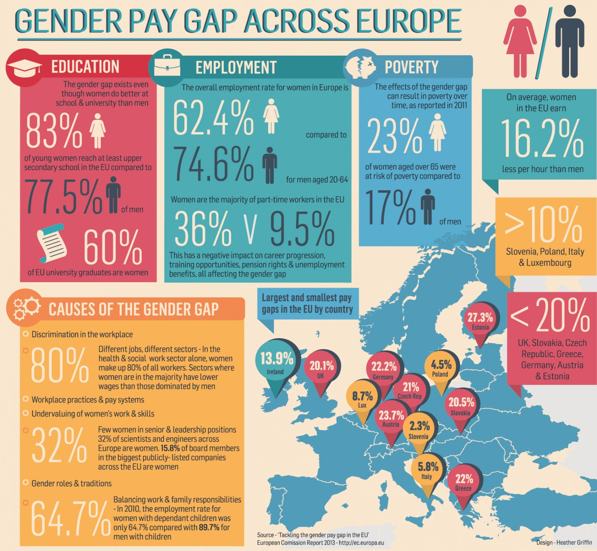

Slide 10
Theories of discrimination
Taste discrimination: individuals prefer certain individuals to others.
Statistical discrimination: agents make decisions about individuals based on their attributes and those of their group.

Slide 11
Employer discrimination
Employer discrimination occurs when employers have preferences for hiring certain “types” of workers (assume two types of workers A and B).
Prejudiced employer incurs a psychic cost d > 0 that raises the cost of hiring a worker from minority group B to (w_{B} + d) and will hire B workers only if w_{A} ≥ w_{B} + d.
B workers are employed by the least prejudiced firms; A and B workers will be segregated into different firms.
If discriminating tastes are widespread and there are many B workers seeking employment, some B workers will have to find jobs at discriminating firms (at the lower wage).
A wage differential w_{A} ≥ w_{B} will arise only if the fraction of discriminating employers is sufficiently large

Slide 12
Customer discrimination
Customers have discriminatory preferences
Prejudiced consumers in group M get less utility if they purchase from a group F member than from a group M member.
They act as if the price was p(1+d_{C})
i.e. They are willing to pay M higher price than p to avoid buying from F.
The effect of such discrimination on wages is eliminated if
F workers can serve only F customers and unprejudiced M customers, or if F workers are employed in occupations without consumer contact.

Slide 13
Discrimination at the group level.
Employers want to hire the “best person for the job,” but this can be a difficult thing to assess on the basis of interviews, resumes.
Instead, the employer can observe things that may be correlated with productivity
  Education, experience, references, etc.
Employers might have low demand for particular “types” of workers because being that type might be associated with low productivity on average
Statistical discrimination is often used and tolerated. Why?
Notes:
http://en.wikipedia.org/wiki/Statistical_discrimination_%28economics%29

Slide 14
The cost of discrimination
Discriminating against an individual based on the perceived characteristics of his or her group is illegal in many cases.
Discrimination should not survive in the face of market forces because non-discriminating employers should out-perform discriminating employers because they are willing to hire the cheaper but equally productive inputs.
Non-discriminating employers should expand and discriminating ones contract, until discriminatory wage differentials are eliminated all firms earn zero profits

Slide 15
Policy responses
Discrimination raises problems of inequity and inefficiency.
Many countries have responded to these perceived inequities by enacting equality promoting legislation.
European Union (EU) laws clearly prohibit discrimination in employment based on race or ethnicity, gender, age, disability, and religion or beliefs.
Color-blind treatment
Quotas (reversed discrimination)

Slide 16
We all have subconscious biases. Studies have shown that personal information, such as a name, can trigger these subconscious biases about ethnic origin, immigrant status and gender, for example, and prevent employers from objectively seeing the rest of what’s in the application.

Slide 17
Testing for discrimination
Identifying discriminatory practices is not an easy task.
Correspondence testing can be used to test for hiring discrimination based on race or ethnicity, gender, age, sexual orientation.
The method involves sending matched pairs of identical job applications to employers posting jobs—the only difference being a characteristic that signals membership to a group.
Correspondence studies than compare call-back rates for fictitious applications.

Slide 18
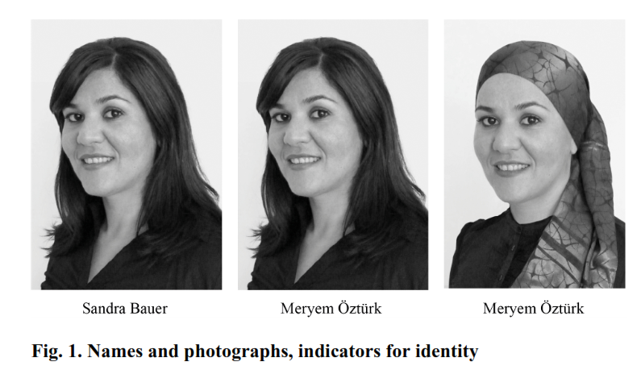
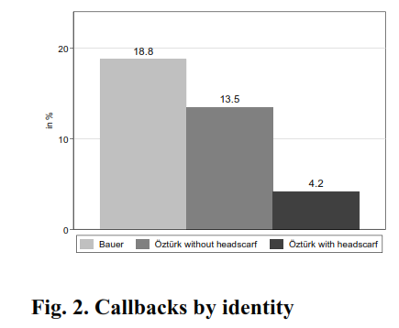
Everything else equal, a female with a Turkish name who wears a headscarf has to send 4.5 times as many applications (and even 7.6 times as many for higher-ranking jobs) as an applicant with a German name and no headscarf to receive the same number of callbacks for an interview
Source: Discrimination against Female Migrants Wearing Headscarves
by Doris Weichselbaumer, 2016
Notes:
http://newsroom.iza.org/en/2016/09/20/discrimination-against-female-migrants-wearing-a-headscarf/

Slide 19


Testing Discrimination against Workers with Visible Tattoos: Experimental Evidence from Germany
Daviti Jibuti (2017)
15 % of the population (14-44) in Germany have tattoo.
Fictitious resumes are sent to online job postings. Candidates have identical characteristics, but some applicants have a visible tattoo on the presented picture
Visible tattooed candidates have, on average, 12 % less chance of getting callback.

Slide 20
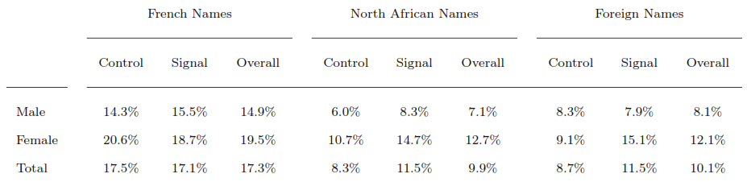
Statistical reasoning behind unequal treatment
Applicants aged 23, single, from South Paris, work experience <2 years
Signal is the language ability (e.g. teacher, writer, reading club)
Sent 3204 resumes to 504 job postings (accounting jobs, assistant)
Experiment conducted between Sep 2011 and Feb 2012 in Paris
Callback rates:

Slide 21
Applications with French names always elicit far more callbacks (17%) than non-French ones (10%).
North African (9.9%) and Foreign applicants (10.1%) are equally treated
Females are considerably more successful than males
The effect of the signal improves rates for non-French applicants but no effect on French (stronger effect for females)
Employer discrimination towards men may be primarily taste based (job), while women may suffer from statistical discrimination
Language ability potentially signals assimilation.
Discrimination is greater in the city of Paris than in the suburbs.
Discrimination disappears for recruiters with non-European name which points to Homophilous discrimination (preference for similar individuals)
Edo, Anthony, Nicolas Jacquemet, and Constantine Yannelis. "Language Skills and Homophilous Hiring Discrimination: Evidence from Gender-and Racially-Differentiated Applications." (2013).

Slide 22
Does publicly available information on Facebook matters for hiring?
For half applications pictures were pasted into the resumes, and other half with unique Facebook profile with name and picture
1056 job openings in Belgium
Results: candidates with the most beneficial FB picture obtain approximately 39% more job invitations relative to candidates with the least beneficial picture.
Baert, Stijn. "Do They Find You on Facebook? Facebook Profile Picture and Hiring Chances." (2015).

Slide 23




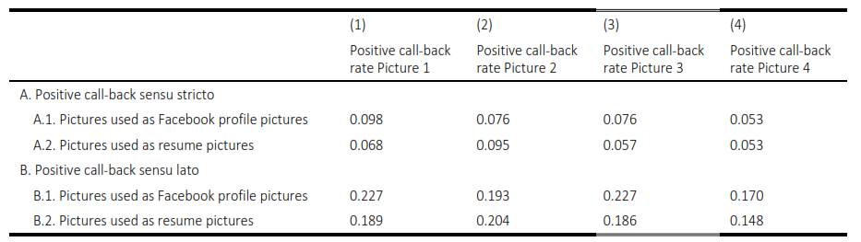
Positive call‐back sensu stricto means the applicant was invited for an interview concerning the posted job.
Positive call‐back sensu lato also includes the request to contact the recruiter to provide more information.

Slide 24
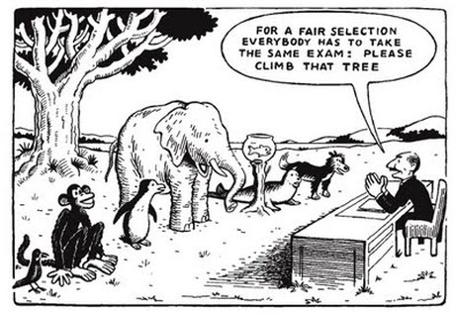

Slide 25
The hiring process and discrimination.
Discrimination is more frequent at the hiring level than the compensation plan
Discrimination appears to be strongest when employers decide about invitations to interviews

Slide 26
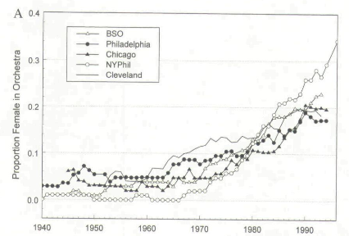
Notes:
Goldin, Claudia, and Cecilia Rouse. Orchestrating impartiality: The impact of" blind" auditions on female musicians. No. w5903. National bureau of economic research, 1997.

Slide 27
Study: The impact of blind auditions on female musicians
Symphony orchestra has 95-105 musicians
Types of jobs are identical and turnover is low
(only few female-dominant instruments: harp)
Before 1970s the US finest orchestras had less than 10% of women.
Most renewed conductors claimed: female musicians are not the equal of male musicians.
The audition procedures began to change in 70s.
The blind hiring procedure could eliminate the possibility of discrimination.
Goldin, Claudia, and Cecilia Rouse. Orchestrating impartiality: The impact of" blind" auditions on female musicians. No. w5903. National bureau of economic research, 1997.
Notes:
Goldin, Claudia, and Cecilia Rouse. Orchestrating impartiality: The impact of" blind" auditions on female musicians. No. w5903. National bureau of economic research, 1997.
Zubin Mehta, conductor of the Los Angeles Symphony from 1964 to 1978 and of the
New York Philharmonic from 1978 to 1990, is credited with saying, "I just don't think women
should be in an orchestra."' Many European orchestras had, and some continue to have, stated
poUcies not to hire women.

Slide 28
Anonymous job applications in Europe
In 2010 Germany’s Anti-Discrimination Agency, an advisory body, sponsored a voluntary scheme to get businesses to try it.
In France a law passed in 2006 made the anonymising of applicants’ CVs compulsory for firms of over 50 employees.
In the UK, big employers in the public and private sectors—including the civil service, HSBC and Deloitte—have agreed to start recruiting on a “name-blind” basis in Britain.
“IF YOU’VE got the grades, the skills and the determination, this government will ensure you can succeed” (David Cameron, 2015)

Slide 29
Anonymous job applications
Achieve better outcome with less information
In most cases, anonymous job applications lead to the desired effect of increasing the interview invitation probabilities of disadvantaged groups.
An attractive policy instrument to combat hiring discrimination in public sector.
Anonymous hiring can reduce discrimination if discrimination is present beforehand.
Notes:
It should be in the employers’ own interest to hire the most productive workers.

Slide 30
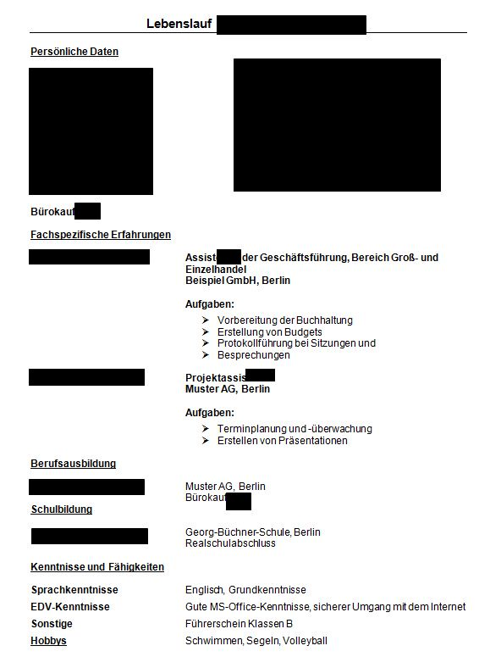
Anonymous application from German experiment
Notes:
German anonymous application

Slide 31
Employers that have online applications or that use a particular type of software could hide certain information—such as name, age or gender—during the initial screening stage.
Employers that use traditional paper or e-mail applications could simply instruct the applicants to submit two versions of their resume—one anonymous, one conventional—or to put their personal information on the last page.

Slide 32
Not all information can be removed
Recruiters may have used other indicators, such as knowledge of Arabic, to identify race. In places fraught with religious tension, such as Northern Ireland, the name of a school can reveal a candidate’s faith, while a few years missing on a CV may suggest maternity leave, and thus that the candidate is female.
When documents are not effectively anonymous then the result is worst than a normal application

Slide 33
Self-perceived objectivity
A sense of personal objectivity gives rise to an
‘I think it, therefore it’s true’ mindset, which increases people’s confidence in the validity of stereotypic beliefs, thoughts, and intuitions they have, and therefore increases their likelihood of acting on them.
When people feel objective, their hiring judgments should be relatively more influenced by stereotypic beliefs and thoughts.
Decision-makers who endorse stereotypic beliefs.

Slide 34
When the anonymous (blind) job hiring process is least efficient?
In public sector
In a small company
When a soccer player is hired
When a violinist for orchestra is hired

Slide 35
In what situation anonymous job application cannot be used?
“jobs in the worlds of sports, arts, and
letters, since in such creative,
highly skilled, and very competitive labor markets discrimination is limited.“
If diversity of workers leads to innovations and larger productivity, the company may not want to use anonymous hiring procedure

