Slide 1
Reforms in the Public Sector Spring 2017
Economics of incentives
Martin Guzi martin.guzi@econ.muni.cz

Slide 2
The idea is that a little science might help the government to collect taxes, distribute benefit payments, help people to find jobs, get en education or save for retirement.

Slide 3
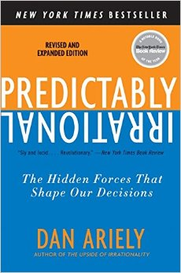
Predictably irrational
People are not only irrational on occasion but they tend to be irrational in consistent and predictable ways.
Act against your own self-interest
Fear losses more than you like profits
Tend to be little lazy
Government should account for these tendencies
People more likely do things that are easier to do.

Slide 4
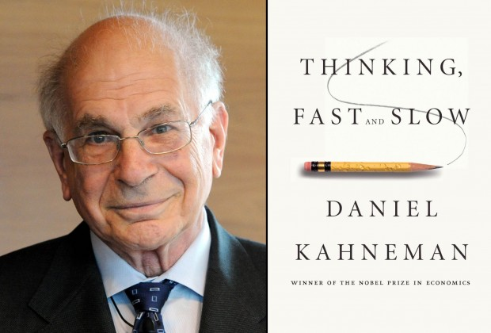
Behavior economics
Instead of making assumptions about human behavior, behavioral economics relies heavily on scientific experiments to determine how people behave in different situations
Daniel Kahneman - Nobel Prize 2002, book Thinking, Fast and Slow
A gas station gives a special 5-cent-per-gallon discount for paying cash. Another station with the same prices indicates that they charge a 5-cent-per-gallon surcharge to customers who pay by credit card.

Slide 5
The effects of framing on decisions
Imagine you are a physician working in an Asian village, and 600 people have come down with a life-threatening disease. Two possible treatments exist. If you choose treatment A, you will save exactly 200 people. If you choose treatment B, there is a one-third chance that you will save all 600 people, and a two-thirds chance you will save no one. Which treatment do you choose, A or B?
Kahneman and Tversky found that the majority of respondents (72 percent) chose treatment A, which saves exactly 200 people
Amos Tversky and Daniel Kahneman, “The Framing of Decisions and the Psychology of Choice,” Science 211(4481) (1981): 453–458.
Notes:
Amos Tversky and Daniel Kahneman, “The
Framing of Decisions and the Psychology of Choice,” Science
211(4481) (1981): 453–458.

Slide 6
The effects of framing on decisions
You are a physician working in an Asian village, and 600 people have come down with a life- threatening disease. Two possible treatments exist. If you choose treatment C, exactly 400 people will die. If you choose treatment D, there is a one-third chance that no one will die, and a two-thirds chance that everyone will die. Which treatment do you choose, C or D?
In this case, they found that the majority of respondents (78 percent) chose treatment D, which offers a one-third chance that no one will die.
Amos Tversky and Daniel Kahneman, “The Framing of Decisions and the Psychology of Choice,” Science 211(4481) (1981): 453–458.
Notes:
Amos Tversky and Daniel Kahneman, “The
Framing of Decisions and the Psychology of Choice,” Science
211(4481) (1981): 453–458.

Slide 7
Risk aversion and framing of questions
Assessment of risk is often an outcome of subjective evaluation
According to Tversky and Kahneman people evaluate gains and losses differently. Thus while treatments A and C are quantitatively identical, treatment A is framed as a gain (i.e., you save 200 people) while treatment C is framed as a loss (i.e., 400 people die).
People are more likely to take risks when it comes to losses than gains (people prefer a “sure thing” when it comes to a potential gain but are willing to take a chance if it involves avoiding a loss).

Slide 8
How old was Cristoforo Colombo? (each student replies one of two questions)
1) Was Christopher Columbus, the voyager who discovered America, older than 34 years when he died? How old was he when he died?
2) Was Christopher Columbus, the voyager who discovered America, older than 83 years when he died? How old was he when he died?
Students’ average guess to age questions was 43 and 62.
People put more weight on the last information they see.
Note: Colombo was born in 1451 and died in 1506.

Slide 9
Nudge (the design of a choice environment)
In 2008 Richard Thaler and Cass Sunstein introduced a behavioral strategy to public policy makers called nudge.
By changing people’s choice environment, citizens can be gently nudged into acting in ways that are more beneficial to not only themselves but also to others.
Nudge essentially assumes that individuals are ‘imperfect’ and need assistance in making the right decisions.
idea of nudging shows it is possible to steer people towards better decisions by presenting choices in different ways and without forbidding any options.
Notes:
Book
Nudge: Improving Decisions about Health, Wealth, and Happiness and
Simpler: The Future of Government by Richard Thaler and Cass Sunstein

Slide 10
Nudge units: a new tool in the policy toolbox
Search for scientifically grounded and empirically validated behavior innovations:
UK 2010 – the Nudge unit (first in the world)
US 2015 – Social and Behavior Science Team to use insights from behavioral science research to serve American people
Denmark, Germany, Australia, Singapore….
2014 Behavioral Exchange conference in Australia
Notes:
2014 Behavioural Exchange conference
http://ussc.edu.au/events/past/Behavioural-Exchange

Slide 11
Nudge – the critics
Individuals are regarded as ‘incapable’
Nudge is manipulative - the form of ‘subliminal mind-control’.
Performing behavior experiments on public (without knowing it)
Is the government competent to determine the directions in which we should be nudged?

Slide 12
Effects of ‘nudge’ are (so far) harmless, rather marginal and relatively short-lived.
Nudges (soft-touch interventions) are better than other strategies such as mandates, taxes or bans.
Attractive to government because nudges can achieve real improvements at very little cost.

Slide 13
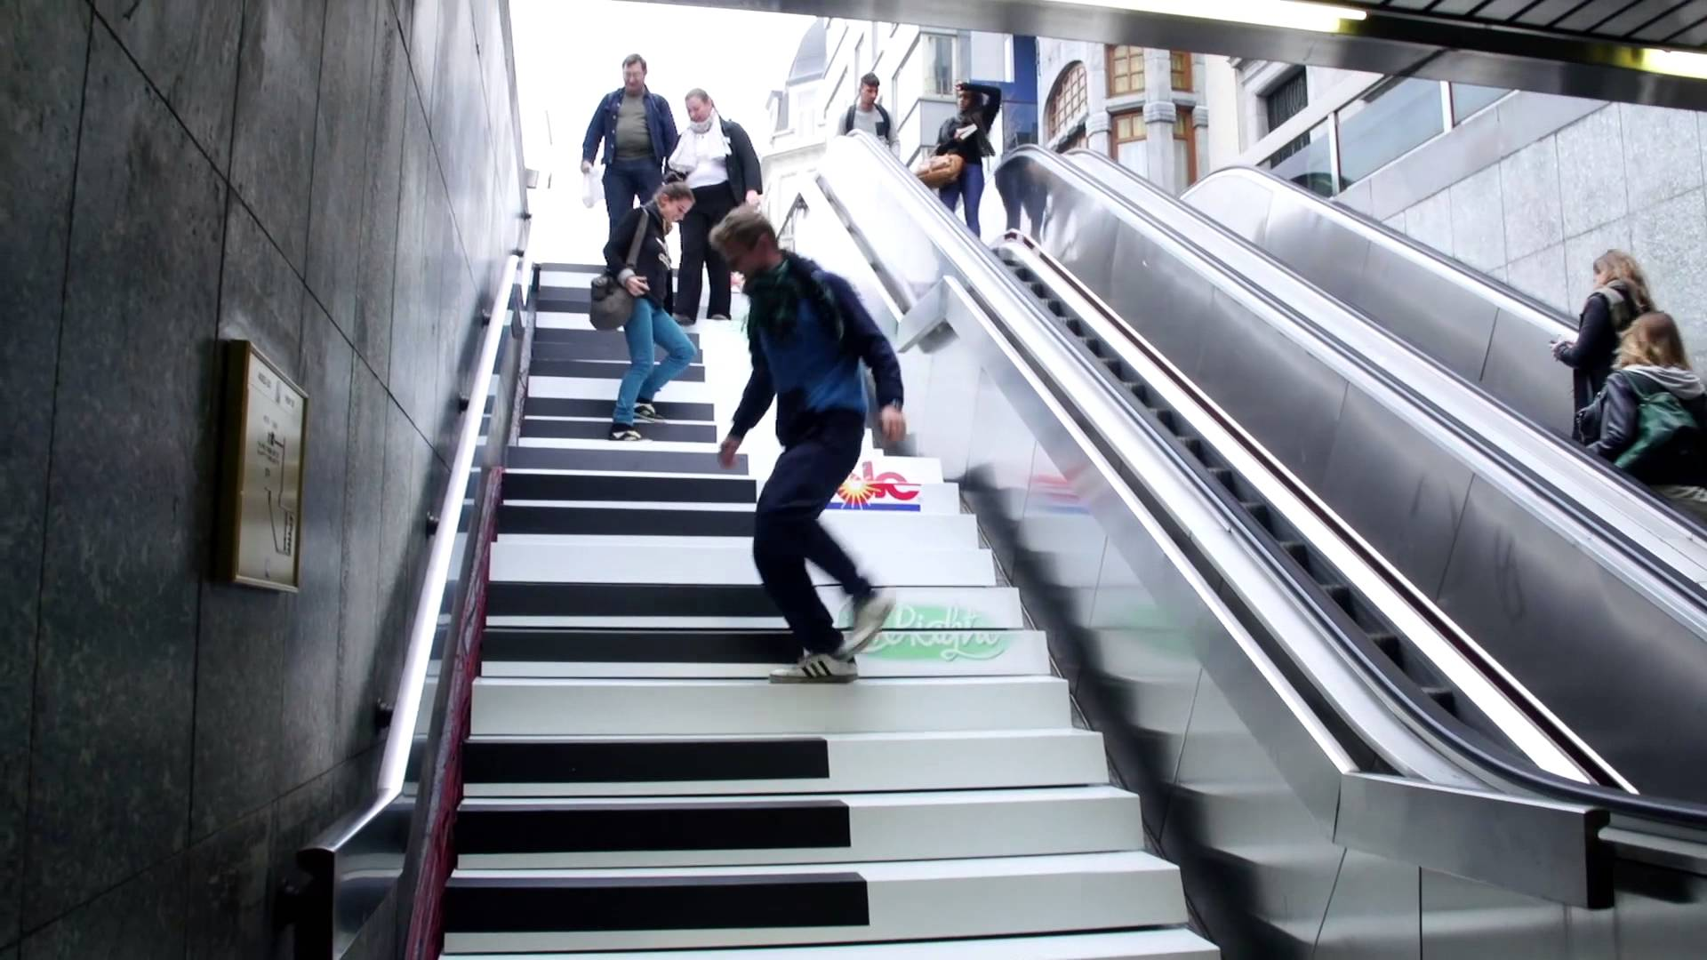
Piano stairs
https://www.youtube.com/watch?v=2lXh2n0aPyw

Slide 14
Default rules often have a large effect on social outcomes.
People tend to pick the default option in a range of choices
Role of inertia in decision making
Default may lead to greater participation in public programs
Examples where opt-out is necessary:
Automatic enrollment to pension plans
Organ donation

Slide 15
Personalized default rules
As technology evolves, it should be increasingly possible to produce personalized defaults, based on people’s own choices and situations (in oppose to mass default rules).
E.g. pension plan for high/low income workers
What Works Network for governments
Alternative is to avoid any default rule and to require active choices. Active choosing increases the likelihood that people will end up with their preferred outcomes.

Slide 16
Simplification
Significant benefits might be obtained merely by simplifying and easing people’s choices.
Complexity may reduce compliance
For some public programs, take-up rates are relatively low even though the cost of participation is small.
Simplify the application process (simpler and shorter forms).
Having more choices is not better (enrollment may decline).

Slide 17
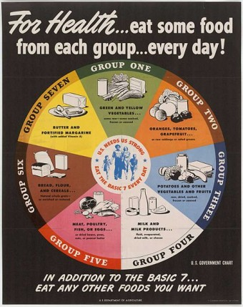
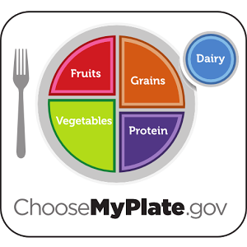
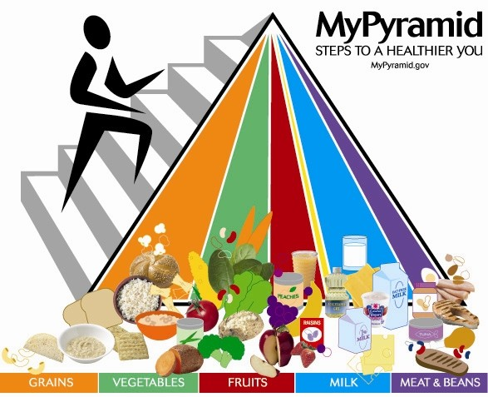
Plate, not pyramid. (straightforward guidance)
1943 1992 2010
By Cass Sunstein

Slide 18
Procrastination
Some people procrastinate or neglect to take steps that impose small short-term costs but that promise large long-term gains.
Some people make choices that have short-term net benefits but long-term net costs …. but fail to make choices that have short-term net costs but long- term net benefits.
Examples:
delay enrolling in a retirement plan, starting to exercise, seeing a doctor, ceasing to smoke, or adopt cost-saving technology
Solution: automatic enrollment, information on benefits/risks

Slide 19
Social influences
Individual behavior is influenced by the perceived behavior of other people.
People care about their reputations (social punishment)
Social norms can help create a phenomenon of compliance without enforcement (e.g. indoor smoking)
Social influences lead people to cooperate with one another, on the assumption that others are cooperating.
Example: If people learn that they are using more energy than similarly situated others, their energy use may decline—saving money while also reducing pollution.

Slide 20
How to ask for a donation?
“DEAR WIKIPEDIA READERS: To protect our independence, we’ll never run ads. We take no government funds. We survive on donations averaging about €10. Now is the time we ask. If everyone reading this right now gave €2, our fundraiser would be done within an hour. We’re a small non-profit with costs of a top 5 website: servers, staff and programs. Wikipedia is something special. It is a library or a public park where we can all go to think and learn. If Wikipedia is useful to you, take one minute to keep it online and ad-free another year. Thank you.”
Notes:
http://www.mindworx.net/en/the-first-pitch-ever-wikipedia

Slide 21
Principle of reciprocity
People have the urge to reciprocate a gift or a service provided to them.
Original: Now is the time we ask.
Reframed: For 13 years Wikipedia has been helping you in your quest for knowledge. Now, we ask you for help.
Notes:
http://www.mindworx.net/en/the-first-pitch-ever-wikipedia

Slide 22
Social norm
People follow the lead of others. If many people do something, it makes it trustworthy and right to do.
Original: We survive on donations averaging about 10 Euro.
Reframed: Already X hundred thousand people like you decided to become donors this year. We survive on their donations averaging about 10 Euro (where of course X is the real number).

Slide 23
Loss aversion
Information framed as possible loss has more impact than information framed as possible gain.
Original: If Wikipedia is useful to you, take one minute to keep it online and ad-free another year. Thank you.
Rephrased: If Wikipedia is useful to you, take one minute and help not losing it for another year. Thank you.
Source: Thinking, Fast and Slow (Daniel Kahneman, 2013)

Slide 24
Changed banner:
For 13 years Wikipedia has been helping you in your quest for knowledge. Now, we ask you for help. Please become a donor and join the X hundred thousand people like you who donated this year. If we don’t want to lose ad-free Wikipedia we need to raise 58 million $. We have already raised 67% of the money! Together we can do it! Please help. Thank you.
http://www.mindworx.net/en/the-first-pitch-ever-wikipedia

Slide 25
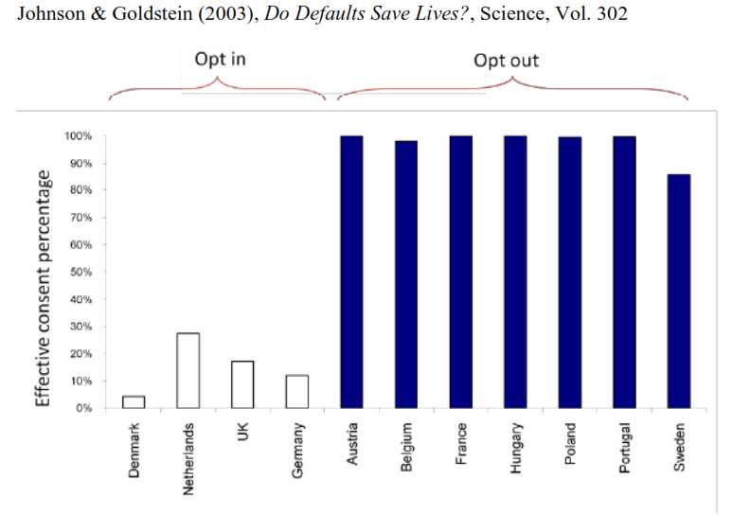
Default choices increase organ donation

Slide 26
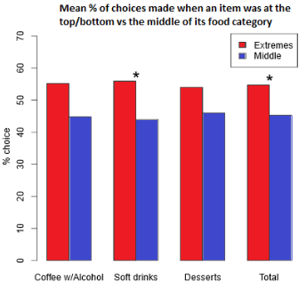
The position of food on a restaurant menu
Items placed at the beginning or end of the menu were up to twice as popular as when the same items were placed in the centre of the menu.
Dayan & Hillel (2011), Nudge to nobesity II: Menu positions influence food orders,
Judgment and Decision Making

Slide 27
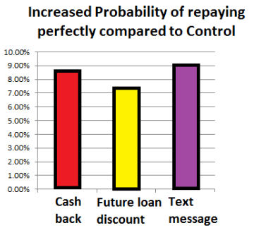
Incentives for loan repayment (Uganda)
Treatments:
a cash reward (25%) upon completing payments on time
a 25% interest rate reduction on the next loan taken from the bank
SMS reminders every month three days before the payments are due.
The mall businesses in developing countries suffer from lack of financial management
Cadena & Schoar (2011), Remembering to Pay: Reminders vs.Financial Incentives for Loan Payments, NBER Working Paper

Slide 28
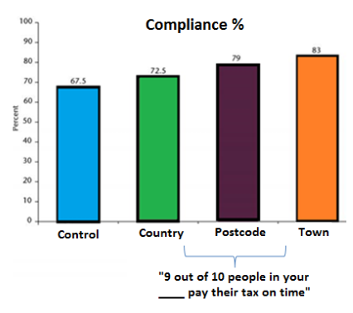
Tax compliance with social normative letters
The control group received standard tax letters reminding the recipients to pay the amount they owed in arrears. The treatment groups received the same letters but with an added social normative message in the form “9 out of 10 people in your ___ pay their tax on time”. The results indicated that all these treatments were effective at encouraging compliance.
In Swiss experiment tax payers received messages “Paying your taxes is the right thing to do”. Essentially no effect on tax compliance behavior.
Behavioural Insights Team 2010-11

