Slide 1
Education Policy

Slide 2
Sources
The Education System of the Czech Republic
http://www.msmt.cz/areas-of-work/skolstvi-v-cr/educational-system
Short version:
http://www.msmt.cz/file/27043/download/

Slide 3
Historical milestones for Czech Education
1348 – Charles IV established a university in Prague – first institution of higher education north of the Alps
1592 – John Amos Comenius – often considered the founder of modern education – was born in Moravia
1774 – Empress Maria Theresa introduced mandatory primary education in the Habsburg Monarchy

Slide 4
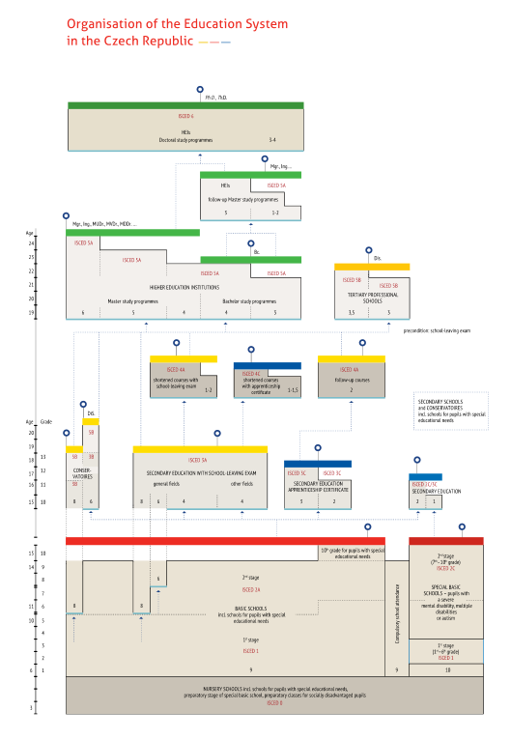
Source: The Education System in the Czech Republic

Slide 5
Key Facts about Education in the Czech Republic
Compulsory education
for all children at the age from 6 to 15 years
in 2010 the number of children of compulsory school age was 834 000, i.e. 7 % of population
the official language of instruction is Czech
only the Polish minority has its own school teaching in Polish

Slide 6
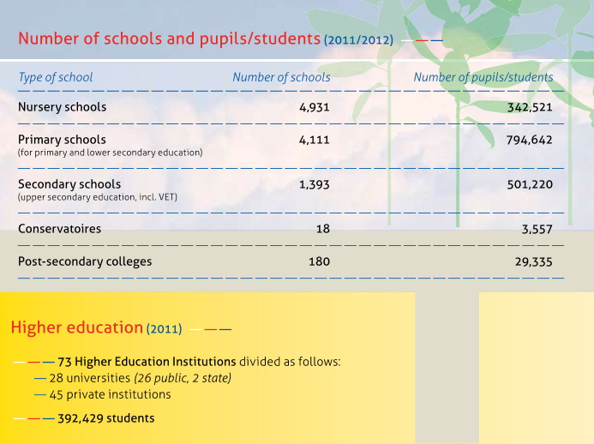
Source: The Education System in the Czech Republic

Slide 7
Structure and Responsibilities within the System of Education
The Ministry of Education, Youth and Sports
– is primarily responsible for the conception, state and development of the education system;
- content of education, state financing policy in education, school register, training of teachers
The municipalities are responsible for ensuring conditions for the compulsory attendance, thus they establish and administer basic schools. Usually, they are also organizing bodies of nursery schools which are not compulsory.

Slide 8
Legislation
Two main:
Education Act on Pre-primary, Basic, Secondary and Tertiary Professional Education (No. 472/2011)
The Higher Education Act (No. 111/1998)
Others (e.g. – The act on Providing Subsidies to Private Schools and Pre-school and School Establishments etc.)

Slide 9
Advisory and consultative bodies in education area
Council of Economic and Social Agreement (tripartite: government, employers – unions)
The Czech School Inspectorate
The National Institute of Education
The Centre for Evaluation of Educational Achievements
The National Institute for Further Education
Centre for Higher Education Studies

Slide 10
Education Policy of the Czech Republic
Framework Educational Programmes
Bologna process (European higher education area) - European Credit Transfer and Accumulation System (ECTS)
Strategy of Lifelong Learning
National qualification framework

Slide 11
Ongoing reforms
Improving the quality and availability of pre-school education (nursery school) - why, what and how?
Systematic improvements in the quality of education and reform of education system (basic and secondary schools) – why, what and how?
Higher education reform – discussion about fees, standards, curricula

Slide 12
Main Problems
demographic situation x number of schools
private x state schools (fees)
curricula (theory x practice)
„state“ school graduating exam
quality in education

