Slide 1
Reforms in the Public Sector
(Week 1)
Introduction
Eduard Bakoš
bakos@econ.muni.cz

Slide 2
Course outline
Interactive syllabi
https://is.muni.cz/auth/el/1456/jaro2017/BPV_TRPS/index.qwarp
The materials will be continuously updated! - Follow regularly!

Slide 3
Evaluation
CONDITIONS | FINAL MARKS (APPROXIMATELY)
lecture activity evaluation (see Notebooks) - up to 20 points every lecture seminar work (paper) - up to 20 points (max. 10 points for the presentation and max. 10 points for the content) final test (17. 5. 2017) - up to 40 points final essay (17. 5. 2017) - up to 20 points | A more than 61 points B 56 - 60 points C 51 - 55 points D 46 - 50 points E 40 - 45 points F less than 40 points

Slide 4
Czech Republic - Historic overview
1918: Czechoslovakia is established with diverse conditions among its regions
(Slovakia being the less-developed part with predominantly agrarian population, low urbanization, education and literacy)
1948 – 1989: The rule of communists
1989: Velvet Revolution
1993: The break-up of Czechoslovakia
1999: Joining NATO
2004: Joining the European Union
Notes:
Following the defeat of the Austro-Hungarian Empire in the First World War, the Czechs and Slovaks declared independence in 1918 and Czechoslovakia was established as a sovereign country. During the 1920s and 1930s, Czechoslovakia ranked among the ten most developed countries in the world.
The two parts of the newly established state differed in a number of aspects, including the degree of industrialization, urbanization, education and literacy (Slovakia being the less-developed part) and religiosity (Slovakia being the more conservative and religious part). Within pre-war and post-war Czechoslovakia the two parts converged in many aspects, whether as a consequence of deliberate policies or as a by-product of mingling populations and coexistence under one roof. Carpathian Ruthenia was the eastern-most part of Czechoslovakia that ceased to be part of Czechoslovakia as a consequence of World War II.
After the Velvet Revolution deep economic, social and political reforms were implemented, leading to democratization and economic liberalization in Czechoslovakia. On January 1, 1993, the Velvet Divorce resulted in two successor states of Czechoslovakia – the Czech Republic and Slovakia.

Slide 5
Reforms in the Public Sector
Public Administration Reform
Public Finance Reform

Slide 6
References (European Union)
Maastricht Treaty
- SGP - Stability and Growth Pact (Resolution) including corrective rules and amendment
Lisbon Treaty
Pix Pack, Two Pack
Treaty on Stability, Coordination and Governance (Fiscal Compact)
SGP Review
etc.

Slide 7
References (European Union)
Country Specific Recommendations
Commission Recommendation
Council Recommendation
Country Report (each year)
National Reform Programme
Convergence Programme (countries without euro)
Stability Programme (countries with euro)

Slide 8
References (international)
Recommendations and Reports of international organizations
International Monetary Fund (IMF)
Fiscal Issues at the IMF
Worldbank
The Organisation for Economic Co-operation and Development (OECD)
North Atlantic Treaty Organization (NATO) – specially for defence
etc. (G8, G20, WTO, UN, ….)

Slide 9
General Reasons for Reforms
demographic changes (population structure)
increasing budget amounts
permanent imbalance ( public deficit and debt)
Value for money approach
(economy, efficiency, effectiveness and equity)
public control of public finance
changes in the management of public sector (e-governance, quality management system etc.)
global economic crisis

Slide 10
Specific Reasons
economic crisis in 70s (recession) – oil crisis
post-communist transformation (25 years)
membership in European Union (adaptation of EU rules – standards, law etc. )
international migration
economic development of each specific country (Greece, Spain, Germany, Great Britain etc.)

Slide 11
Factors that influence reforms
Internal (specific conditions in the country – e.g. economic performance, culture, tradition, public policy and politics etc.) – the country can change
External (general conditions - geographical location, international relations etc.) – the country can hardly change

Slide 12
A comprehensive approach to reform (1)
policy reform in some sectors – health care, pension system, budgeting – what, why and how – try to think about goals, reasons and ways
technological aspects in some sectors – development of IT technologies, budgeting system, software etc.
institutional – formal and informal relations in some area including formal organizations

Slide 13
A comprehensive approach to reform (2)
government reform
tax reform
reform of the social system (including pensions and social benefits)
reform of the health care
reform of budgetary policy

Slide 14

Theory
Capitalism x Socialism
Many different theories:
classical economics (liberal)
Keynesian economics
Marxian school of economics
Austrian school
…..
What is the role of the state?
What is the role of the individual?

Slide 15
Reality - praxis
no one view
many ways
economic policy (e.g. fiscal and monetary)
methods (e.g. cost-benefit analysis, cost-effectiveness etc.)
financial instruments (public budget, regional and local budgets, subsidies, expenditure, tax)

Slide 16
Many examples in the world
Recommendations of IMF and World Bank
Recommendations of EU
Specific examples of past reforms in selected countries like New Zealand, Chile, Japan

Slide 17
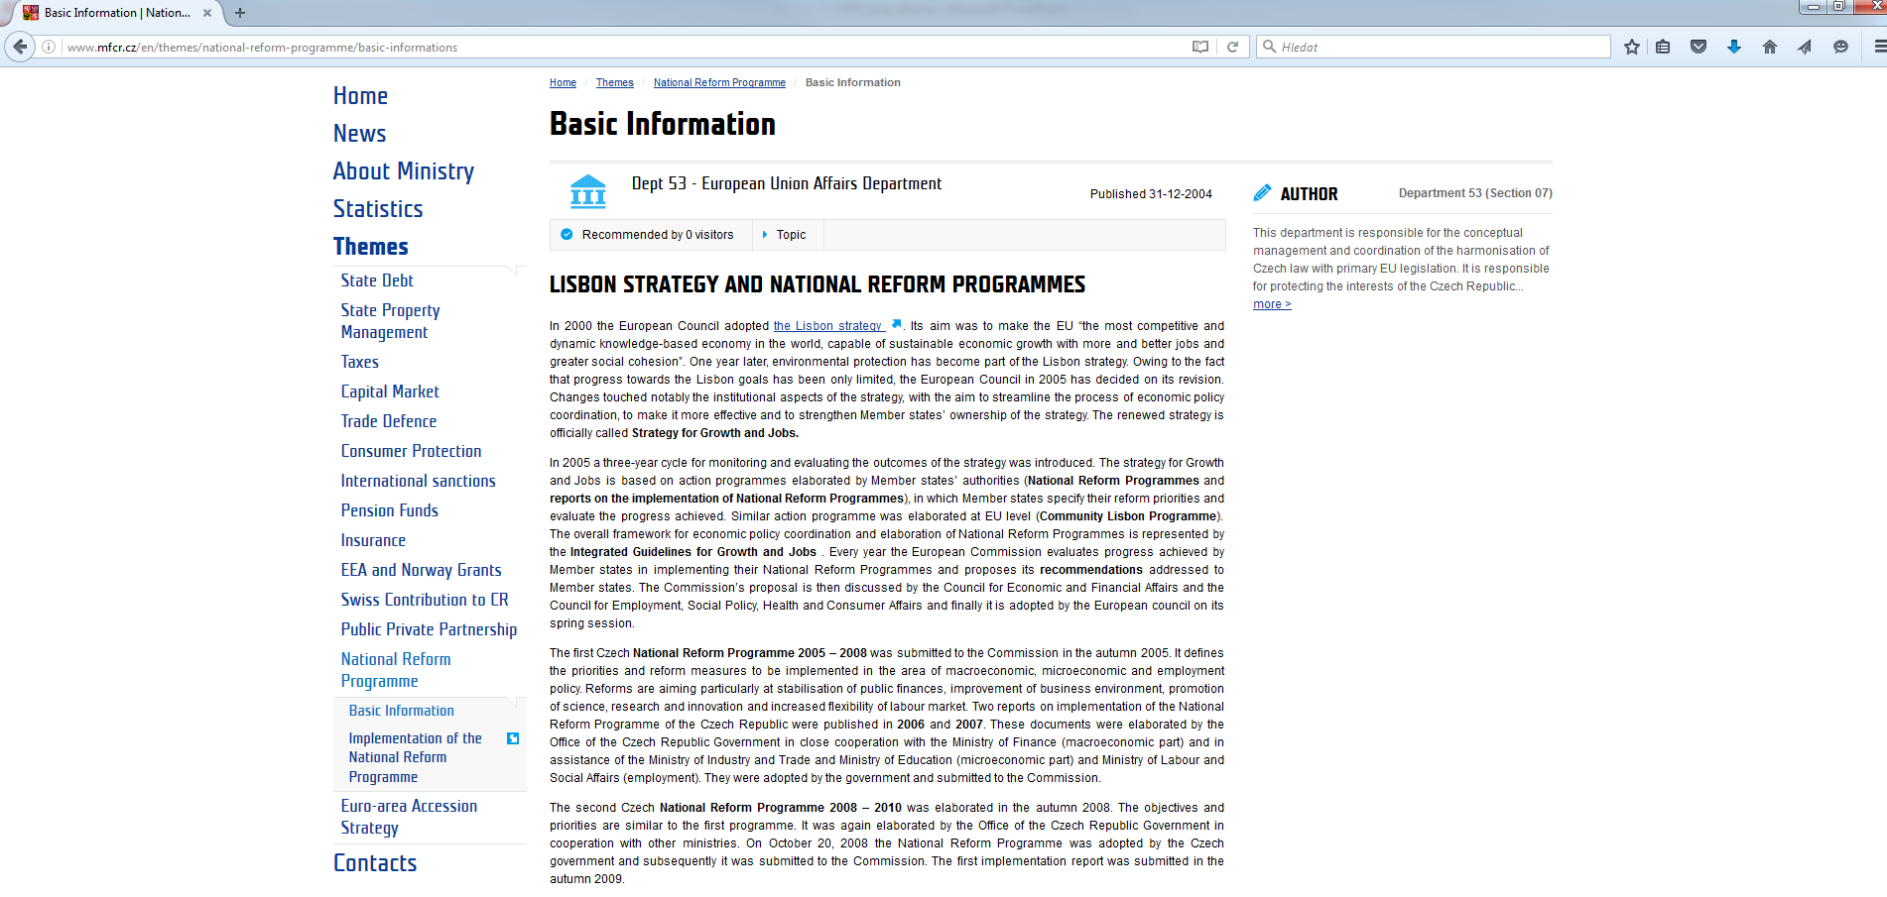
Public Finance Reform – country example of Czech Republic

Slide 18
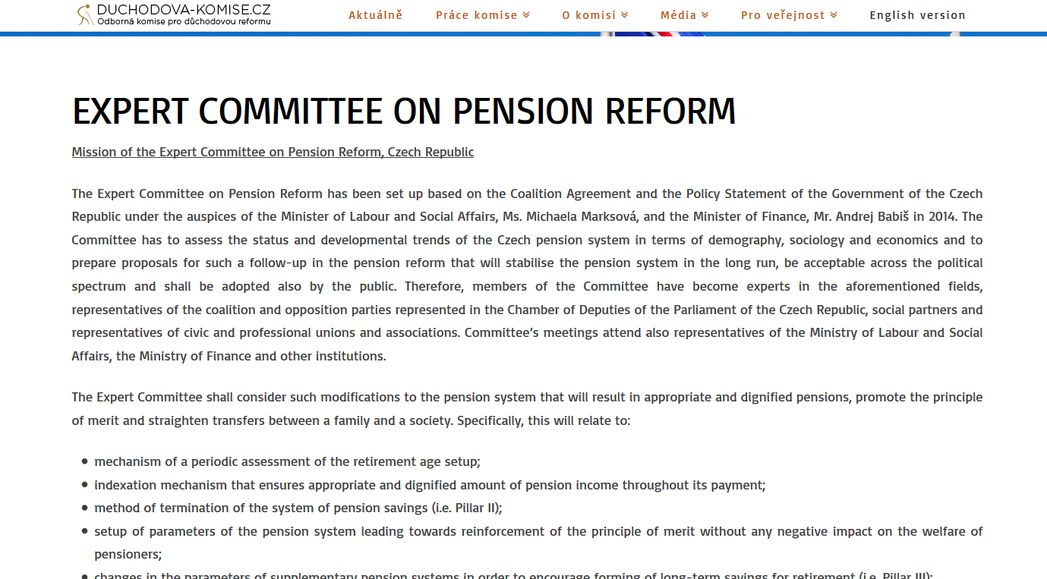
Public Finance Reform – area example - Pension Reform

