Slide 1
Balanced Scorecard
Ing.J.Skorkovský,CSc.
and various listed resources
Department of Corporate Economy

Slide 2

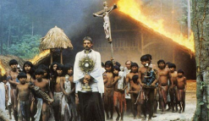



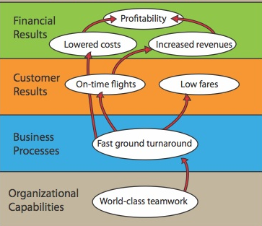
Balanced Scorecard and continuum of value (1st part)
Balanced Scorecard is a step in the continuum describing value
and how the value is created
Mission – why we exist
Values – what is important to us
Vision – what we want to be
Strategy – our game plan
Strategy map – translate to strategy
Balanced scorecard – measure and focus
See next show

Slide 3
Balanced Scorecard and continuum of value (2nd part)
Balanced Scorecard is a step in the continuum describing value
and how the value is created
Target – what WE need to do (plan, project, budget, …)
Personal Objectives – what I need to do
Strategic Outcomes
Satisfied Shareholders
Delighted Customers
Efficient and Effective Processes
Motivated and Prepared Workforce

Slide 4




Definition
BS developed by Robert Kaplan and David Norton
BS examines a firm´s performance in four critical areas
Finances – how should we look to our shareholders ?
Customers – how should we look to our customer ?
Processes – at which business processes must we excel ?
Learning and Growing – how will we sustain our ability to change and improve ?
Resource : Operation Management, Quality and Competitiveness in Global Environment, Russel &Taylor

Slide 5
Basic strategy map (two lower BS levels)
Processes
Production and Services
Lower cost of production
Continuous improvement (Kaizen)
Reduced cycle time (see Little´s law)
Shorter production lead times
Working capital efficiency (fin. leverage)
MRP,MRP_II
Advanced Planning and Scheduling
Good Resource Planning
Perfect way of cost calculation (actual-expected)
Application of Theory of Constraints
SCM-Supply Chain Management
Lower cost of transport
Better way of replenishment
Better delivery performance
Supplier Relationship
Lower cost of ownership
JIT delivery
TQM – High quality supply
Risk Management
Financial risks
Cash flow management
Operational risk
Technological risk
Human capital Organizational Capital Information Capital
Excellent training
of resources
Efficient and flexible
structures and reporting
system, teamwork, culture
Analytic applications
BI, transaction processing
applications=ERP, ..)
Resource : Operation Management, Quality and Competitiveness in Global Environment, Russel &Taylor (not the red ones)

Slide 6
Basic strategy map (two upper BS levels)
Shareholder value
Productivity Strategy
Growth Strategy
Finance
Become industry cost leader (Gartner Magic Quadrant Matrix)
Maximize use of existing assets
Improve cost management
Strategy
Increase value of customer account
Stars and Milk Caws segments of Boston Matrix
Stable product portfolio
New resources generation (higher market share )
R&D related to current product portfolio
Competitive prices Low cost of supply Perfect Quality Deliveries in time
Processes – at which business processes must we excel (see previous slide) ?
Resource : Operation Management, Quality and Competitiveness in Global Environment, Russel &Taylor (not the red ones)

Slide 7
Balanced Scorcard worksheet
(50+80)/2
Explanations : FTL-full truck load, LTL- less than truck load , SPC=statistical process control, EDI=electronic data interchange, Cycle time=time/unit=(e.g.7 min/1 customer request)
Resource : Operation Management, Quality and Competitiveness in Global Environment, Russel &Taylor

Slide 8
Some units (home study)
Will be presented later in sections such as :
  Little´s law (LT=WIP*CT=WIP/Throughput)
  Theory of Constraint…
Cycle Time (CT)– time to complete task (time/unit)
Takt Time (TT) – rhythm in which we have to produce in order to satisfy customer demand (demand is 240 toaster ovens and we can produce these in 480 minutes ->TT= 480/240=2
Lead Time (LT) – Number of minutes, hours, or days that must be allowed for the completion of an operation or process, or must elapse before a desired action takes place –see next slide
Comment : CT<>LT !!

Slide 9
Lead time
The lead time is the time and not the effort. You may have a lead time of 100 days and only have to work 1 hour to fix the bug. Sometime you start working on the bug. The cycle time is the time from the start of the work until the bugfix is live.
Priority of the task
is set
Cycle time
Lead time (fix)
Request
(bug reported)
Start work
Bug solved

Slide 10
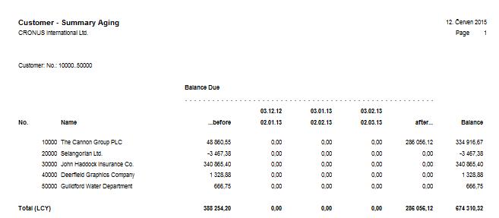
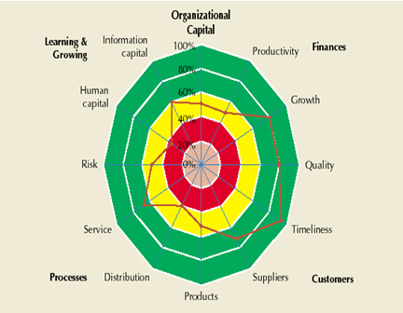
ERP outputs and BS
Report generated from
ERP MS Dynamics NAV
Financial way of
reporting
BS way of reporting
(Radar Chart)
Based on KPI estimation in % out
analysed company is excellent,
but on the other hand,
collecting money, credit limit
and overdue management
is falling behind
Resource : Operation Management, Quality and Competitiveness in Global Environment, Russel &Taylor (only radar chart)

Slide 11
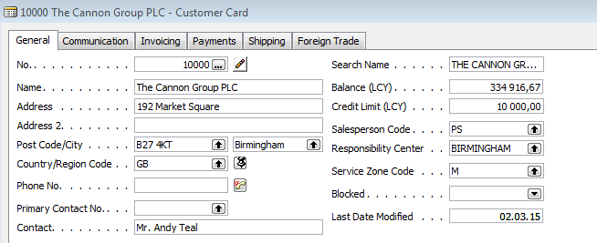
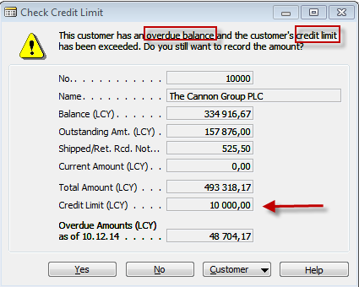
ERP forms related to customer aging report

Slide 12
BS and OM
Finances – how should we look to our shareholders ?
Processes – at which business processes must we excel ?
Customers – how should we look to our customer ?
Learning and Growing – how will we sustain our ability to change and improve ?
Project management
Theory of constraints
Production
Linear programming
Total quality
management
Product postitioning
Business Intelligence
Workflow
Critical chain
Drum –buffer-rope
MRP-MRP-II,JIT,APS
Cutting, blending
Pareto, ishikawa
Boston Matrix
Gartner QM
Decision
making
CONWIP
Logistics
Yield management
Kepner-Tregoe
EOQ, ABC
Hurviwtz
Little´s law
Prospect theory

Slide 13
Strategické iniciativy
(dolní dvě BSC vrstvy mají zde definovaný Cíl-Měření-Záměr-Akční program)
Spokojení akcionáři
Růst prodeje
Růst marží
Akční
program
Poskytnutá hodnota
Lepší vztahy
Cíl
Měření
Záměr
Udržet si
zákazníky
Poměr WIN/LOST
Akční
prodeje
Poměr WIN/LOST
Zvětšit podíl
na trhu
Obrat prodejního kanálu
Podpora
image
Noví klienti
o 100 % - 2 roky
(zvýšení)
Přišli poprvé
Nepříjemné překvapení
Počet problémů
o 50 % - 2 roky
(snížení)
Program
cíleného
marketingu
Marketingové
dovednosti
% dovedností
% zákazníků s OK
daty
Do 100% -rok
Do 80 % -2 roky
Školení
Nový SW
Marketingové dovednosti
Zákaznická databáze

Slide 14
Test 1
What is the main goal of a company?
A) Obtain the highest profit
B) Find solutions that will be in the best interests of stakeholders
C) Produce as many products as possible
D) A and C
E) None of the above
Notes:
B)

Slide 15
Test 2
Which of the following is Operations Management Technology not concerned with?
A)Product & Service Technology
B)Process Technology
C) Globalization technology
D)Information Technology
E)All of the above
Notes:
C)

Slide 16
Test 3
Which of the following would be considered an input when converting inputs into outputs during the transformation process?
A) Land
B) Capital
C) Raw Materials
D) Facilities
E) All of the above
Notes:
E)

Slide 17
Test 4
Which of the following is not a key element of supply chain management ?
A)Purchasing
B) Suppliers
C) Location
D) Logistics
E) Managers decision
Notes:
E)

Slide 18
Strategy Map-The Simple Model of Value Creation
Strategy
Financial perspective
If we succeed, how will we look
to our shareholders ?
Customer perspective
To achieve our vision,
how must we look to our
customers?
Internal perspective
To satisfy our customer, which
processes
must we excel at ?
Learning and growth perspective
To achieve our vision,
how must our organization learn
and improve ?
Resource : Strategy Maps, Kaplan and Norton

Slide 19
Strategická mapa (BSC)- velmi zjednodušené schéma
Spokojení
majitelé
Finance
Vyšší tržní podíl
Zisk
Zákazník
Konkurenční
výhoda
Spokojený
zákazník
Dodávka služeb
Výnosy
Procesy
Zdroj
Školení PZ
Testy
Vyškolený zdroj
Náklady
Růst
nízká míra úspěšnosti
Parametry výběru zdroje
Vyhledávání zdrojů
profil
zdroje
míra shody
SZ a PZ
Potřeba unikátních zdrojů-znalostí
Náklady na zdroje
IQ
kreativita
flexibilita
TOC
CONWIP
Workflow

Slide 20
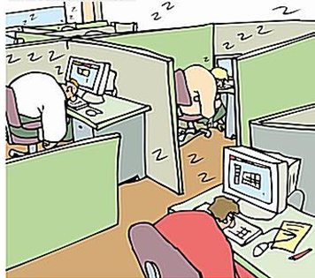
Zvýšení produktivity pomocí zrušení přestávek na kávu
Časté představy i velice kvalifikovaných manažerů o úsporách nákladů.

Slide 21
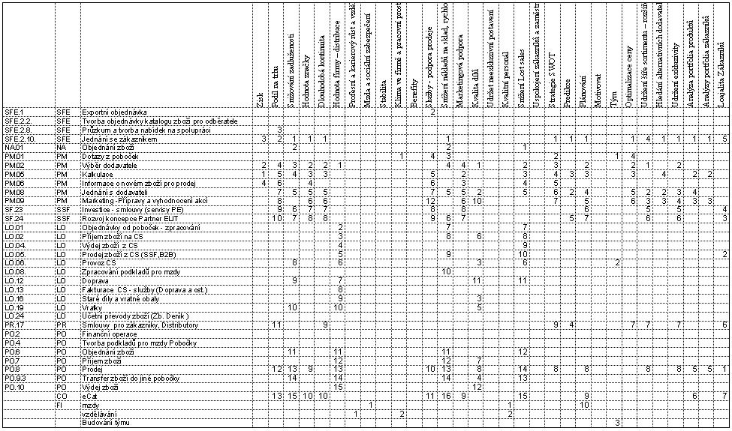
Tabulka jako podklad pro konstrukci grafu

Slide 22

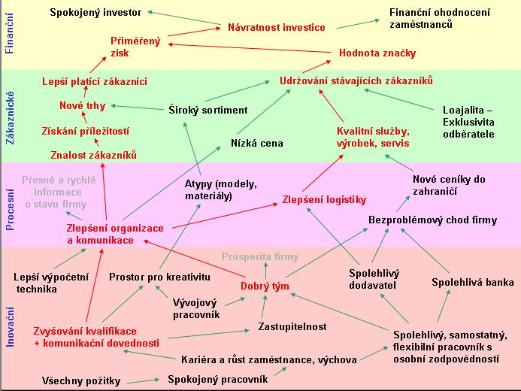
Výsledný graf po aplikaci JSS

Slide 23
Literatura
Robert Kaplan, David Norton : Balanced Scorecard – strategický systém měření výkonnosti podniku

