Slide 1
Masaryk University
Faculty od Economics and Administration
LEADERSHIP
Prepared by:
Angel TERRERO
Bachir OUDDANE
Supervised by:
Ing: Johannes Gollner
Academic Season : 2016/2017

Slide 2
Content Leadership: * Introduction * Definition * Difference between Leadership and Management * Dimensions * Tasks of the Leader * Relationship between the leadership style and the organizational performance * Leadership styles * Leadership Development Tools and Processes .

Slide 3
Definition of Leadership: « … Leadership is a process by which a person influences others to accomplish an objective and directs the organization in a way that makes it more cohesive and coherent.”1
“It is the practice of mobilizing people to face difficult challenges and to thrive.” - Lussier

Slide 4
Difference between Leadership and Management : Leadership and management are related phenomena but they are not the same. It is important to realize that not all individuals in management positions are necessarily leaders. and leadership is not necessarily tied to a position of authority. While only those in management positions are expected to be managers, leadership can and needs to be exercised by each of us wherever we may be. In other words, even though an individual does not hold a management position, she can still be a leader on a clinical unit, in an institution, in her community, or in the profession as a whole.

Slide 5
DIMENSIONS OF LEADERSHIP : Integrity: Leading through honesty and acceptance of personal responsibility . Self-Renewal: Flexible, responsive leadership that makes good use of experience . Fortitude: Acting with courage and confidence in the face of challenge. Perceiving: Looking beyond current details to the big picture . Judgment: Knowing what needs to be done and accurately anticipating consequences. Performing: Getting results by overcoming barriers to effectiveness .

Slide 6
Boldness: An uncompromising approach that involves facing problems head-on . Team Building: Accomplishing results through others by getting them to work together Collaboration: Sharing rewards and responsibility with others in the group Inspiring: Energizing, motivating, and encouraging others to pursue leader defined goals Serving: Taking cues from followers and providing assistance that others can’t get on their own

Slide 7
Tasks of the Leader: ■Envisioning goals: pointing the group in a new direction or asserting a vision. ■ Affirming values: reminding the group members of the norms and expectations they share. ■ Motivating: promoting positive attitudes. ■ Managing: keeping the system functioning and the group moving toward realizing the vision. ■ Achieving a workable unity: managing the conflict that inevitably accompanies change and growth.

Slide 8
■ Explaining: teaching followers and helping them understand why they are being asked to do certain things. ■ Serving as a symbol: acting in ways that convey the values of the group and its goals. ■ Representing the group: speaking on behalf of the group. ■ Renewing: bringing members of the group to new levels

Slide 9
Leadership styles: Based on research carried out at the University of Michigan, Rensis Likert identified four different styles: * exploitative/authoritative : the leader has little trust or confidence in his subordinates, manages by issuing orders and uses fear and punishment as motivators. * benevolent/authoritative : the leader has some trust in his workers but treats them in a condescending and paternalistic manner

Slide 10
* consultative : the leader shows trust and confidence towards subordinates, seeks their opinions and ideas, but retains decision making power
* participative : the leader trusts his subordinates completely, seeks and acts on their ideas and involves them in setting goals

Slide 11
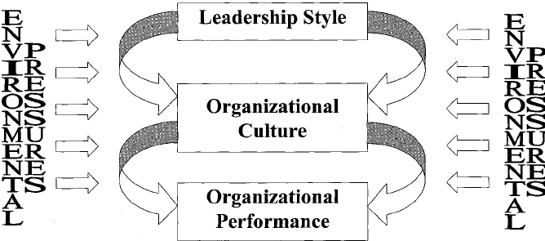
Relationship between the leadership style and the organizational performance :
Transactional Leader
Transformational Leader
Bernard Bass 1985
Andrew Brown 1992

Slide 12
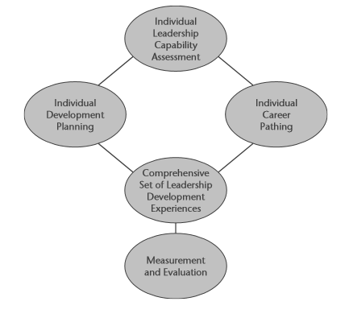
Leadership Development Tools and Processes : Best practice organizations use the next model , to guide their design and implementation of their work in this phase.

Slide 13
- Individual leadership capability assessment: This assessment is the process of evaluation and assessment of individual leaders ’ capabilities to meet the current and future needs of the organization. - Individual development planning: This aligns the individual’ s development activities and learning with capabilities the organization has determined he or she will require for success as a leader currently and in the future.

Slide 14
- Individual career pathing: This process provides a map deﬁning the expectations to be met by an individual in order to move up in the organization. Career pathing identiﬁes speciﬁc job assignments and projects that can provide the individual with the sequential steps of experience, skill, and capability building needed to attain speciﬁc career goals. - Comprehensive set of leadership development experiences: development system needs to provide ﬂexibility of choice through a range of learning experiences designed to meet the needs of a variety of users of the system based on their current competency level and their level of experience as a leader. That range of activities needs .

Slide 15
Measurement and evaluation: A well - functioning leadership development system contains measurement and evaluation of key elements. This measurement and evaluation are normally focused on changes in leadership behavior resulting from the leadership development system . However, measurement and evaluation also need to include elements of organizational performance considered indicative of critical elements of leadership by the executive sponsors of the leadership development system.

Slide 16
The Theory of leadership behavior
One contribution of behavioral research is that it resulted in a paradigm shift towards the contingency leadership theory. Situational leadership models do not match the use of the same leadership style in all scenarios, but prescribe the use of the same leadership style of behavior that best suits the situation.
University of Michigan
A second contribution of the behavioral theory of leadership was the recognition that organizations need both leadership, production oriented and people.
And A third contribution related to leadership behavior theory supports leadership. The manager does not need to perform production functions. Thus, highly productive leaders can be successful if They have co-leaders who exercise the functions oriented to the people, and vice versa.
Ohio University

Slide 17
Motivation and its process
Motivation is anything that influences behavior in search of a certain outcome, it is a search for personal benefit. Through the process of motivation people move from need to motivation, to behavior and consequence, to satisfaction or dissatisfaction.

Slide 18
The process of Motivation.
The theory of the hierarchy of needs states that employees are Motivated by five levels of need: physiological, Security, belonging, esteem and self-realization.
The two-factor theory proposes that employees are driven By motivators (higher level needs) rather than by factors of Maintenance (lower level requirements).
The theory of acquired needs proposes that employees are Motivated by their need for achievement, power and affiliation.
Theories of content of the Motivation focus on explaining And predict behavior Based on the motivation of the Needs of employees.
The theory of equity postulates that employees are motivated when their Perceived contributions equal results.
The theory of expectations states that employees are motivated When they can do the job, that they will be rewarded and that Rewards for doing well are worth the effort.
The goal setting theory proposes that attainable goals Motivate employees.
The Theories of the Motivation Process Focus on understanding how Employees choose behaviors that Meet their needs.
Theory of Reinforcement proposes that behavior can be explained, predicted, and controlled through the consequences of behavior.
Types of Reinforcement:
Positive
Evasion
Extinction
Punishment

